Slide 1
Exploring where food comes from
Claire Theobald, Education Services Manager (primary)

Slide 2
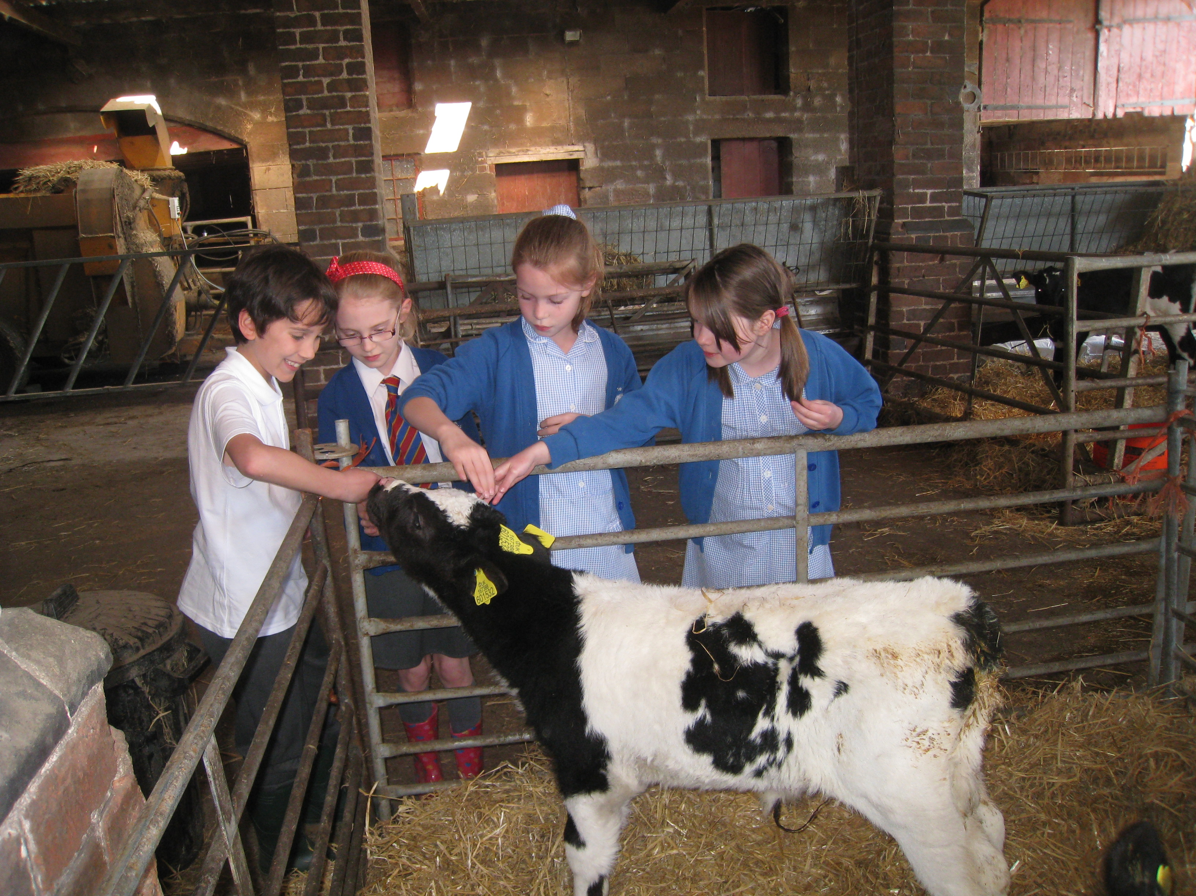
This session will cover:
How food commodities can be used as ‘hooks’ for food lessons to explore where food comes from.
Seasonal ingredients and food choice, including using seasonal ingredients in food preparation and cooking activities.
Aspects of sustainability including reducing food waste, using leftovers and composting.
Exploring food from different cultures, their origin and use in dishes.
Links to Food – a fact of life resources.

Slide 3
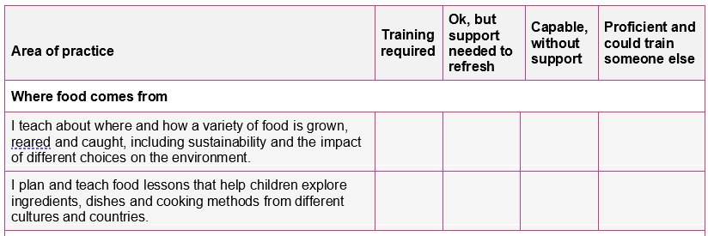
Your audit (completed with registration)
Where food comes from

Slide 4
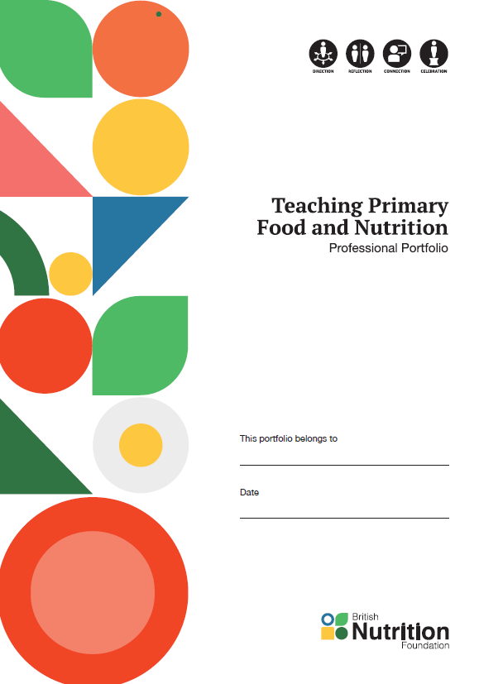
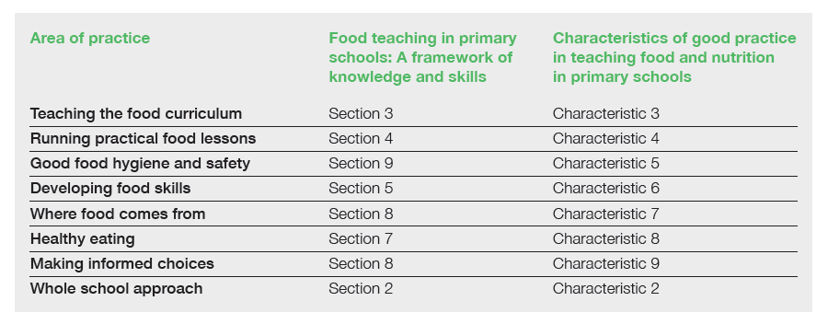
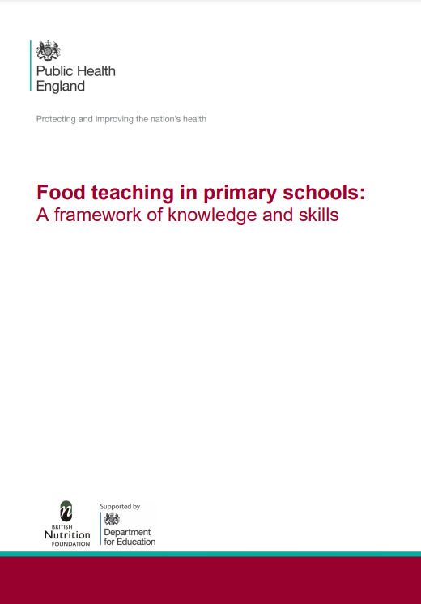

Where food comes from
Supporting documents
TPFN booklet, page 5

Slide 5
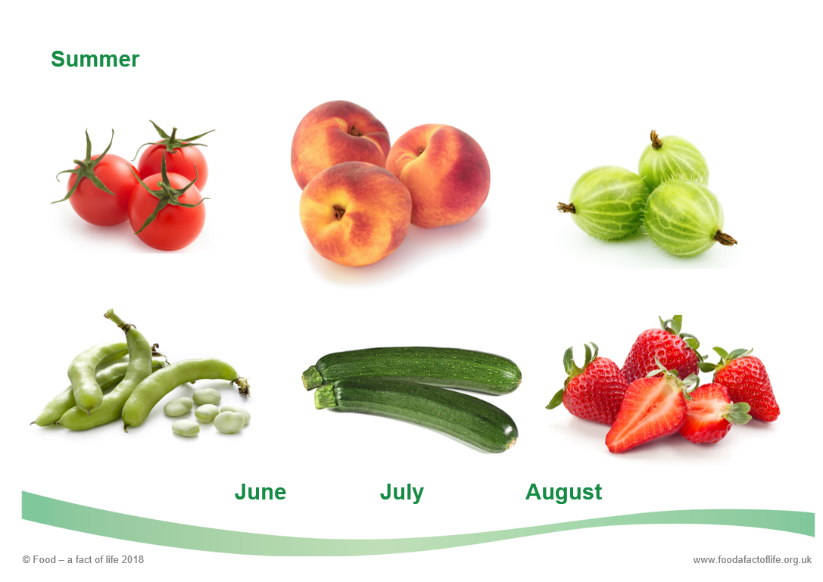
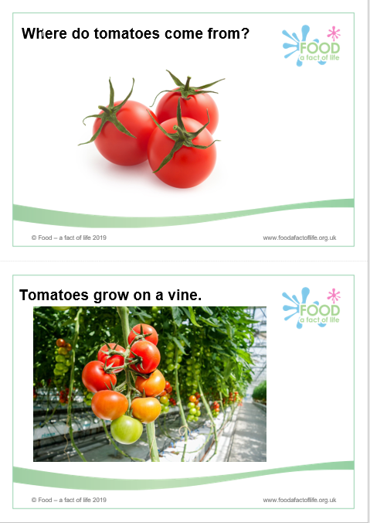
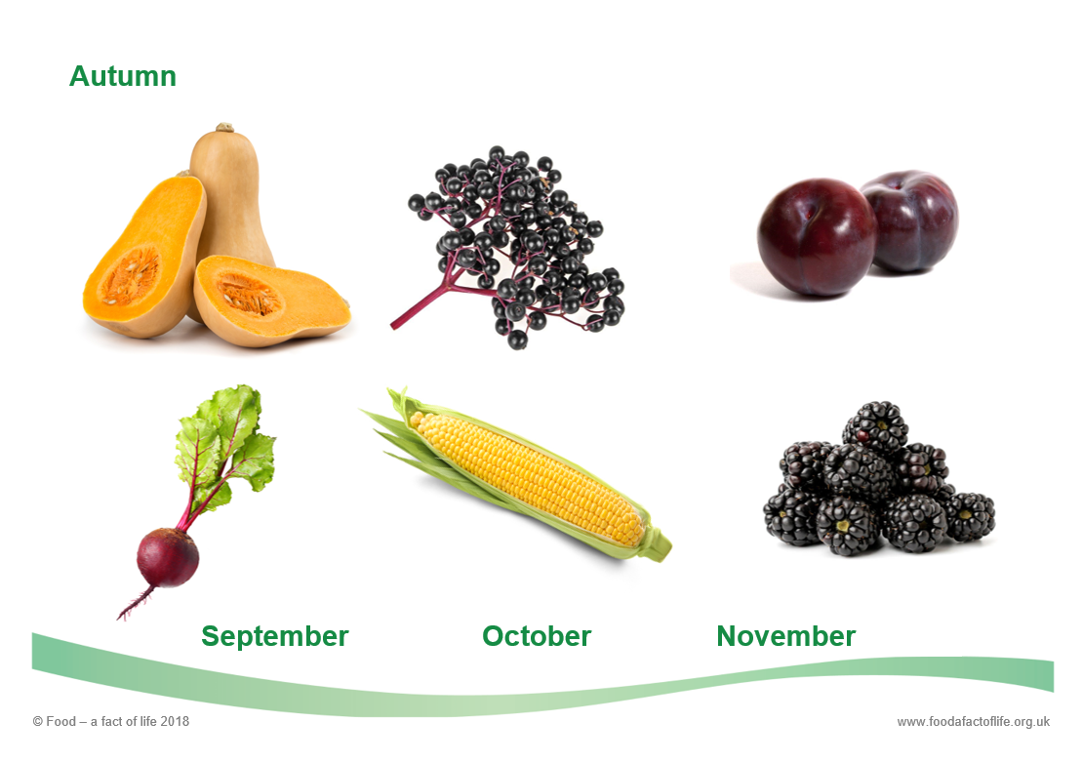
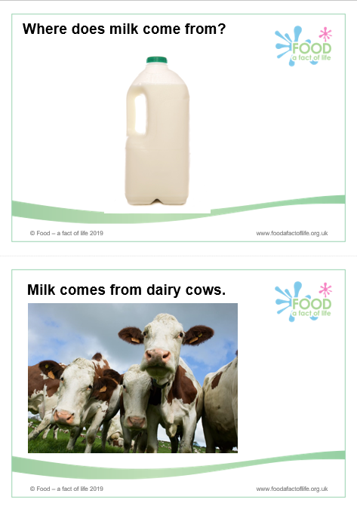
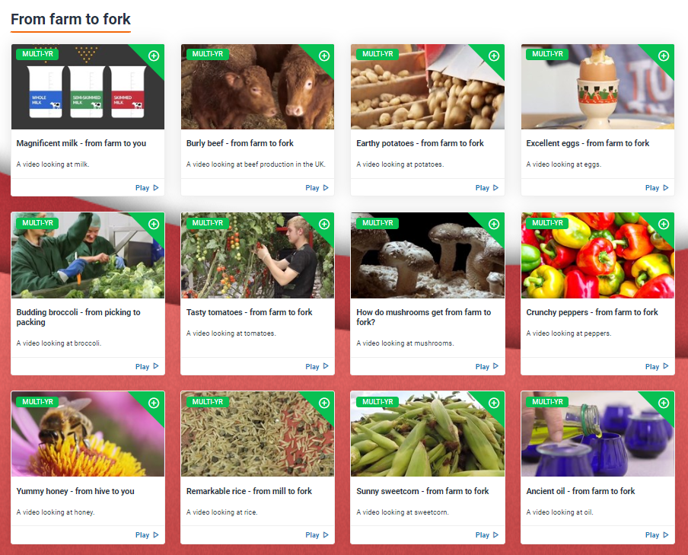
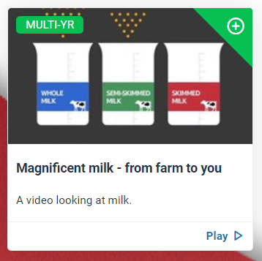
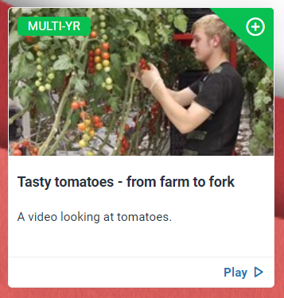
Where to look on Food – a fact of life
Season cards
Where food comes from cards
Where food comes from areas - progressive lessons and resources.
For ages:
3-5
5-7
7-11
Food commodities areas –
stand alone activities and resources built around different commodities.
For ages:
3-5
5-7
7-11
Farm to fork videos

Slide 6
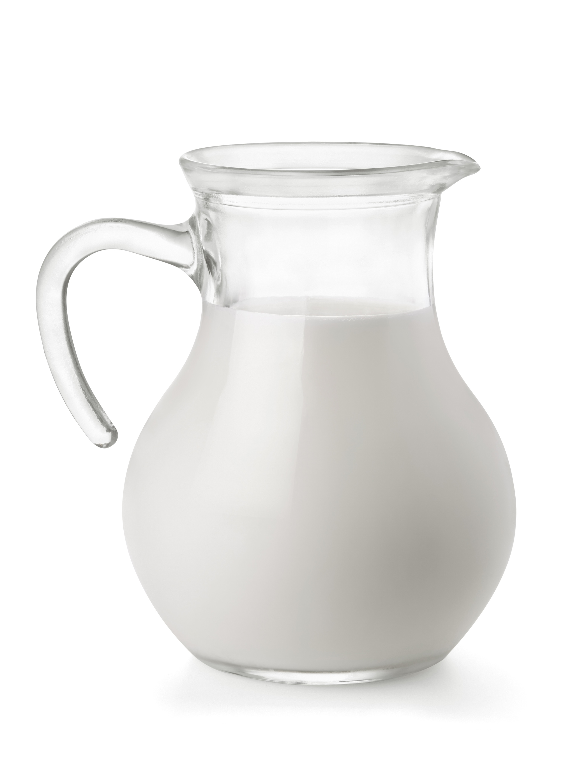
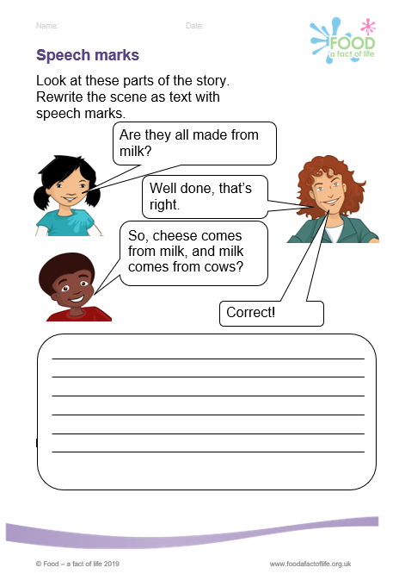
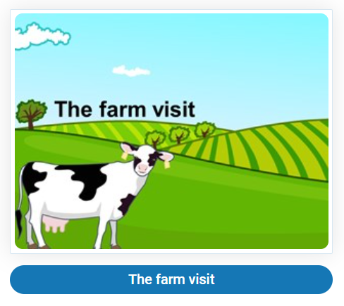
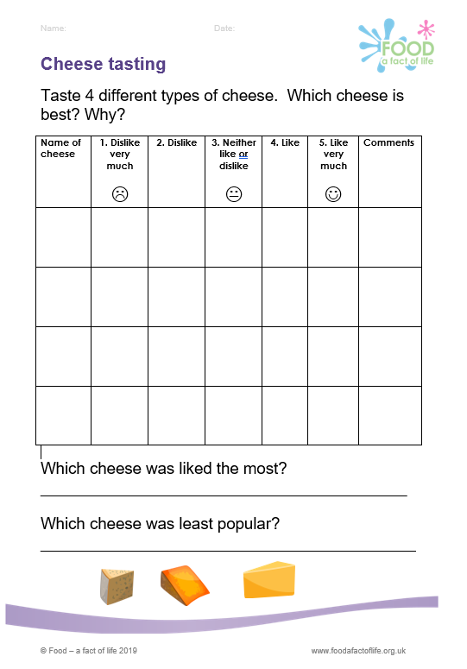
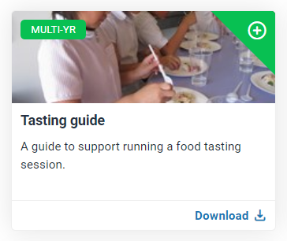
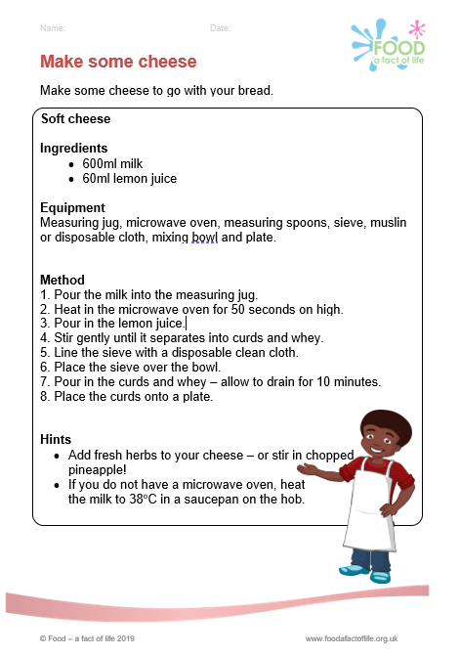
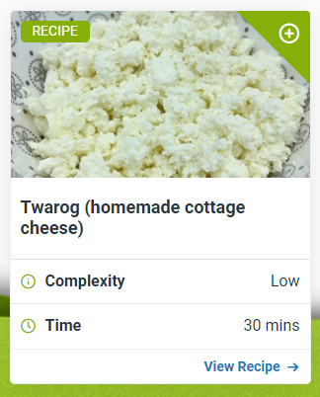
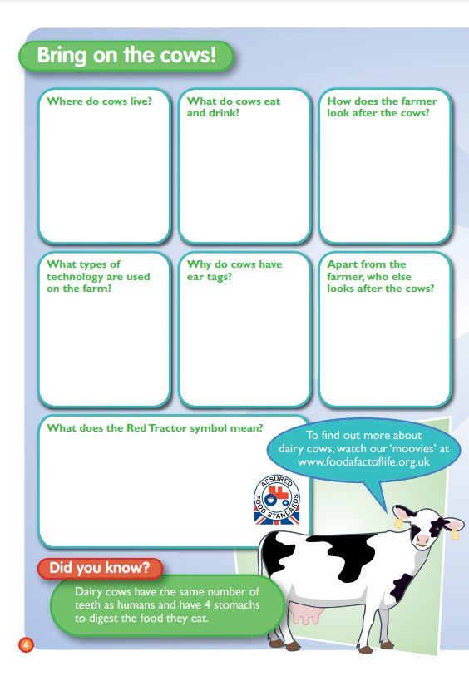
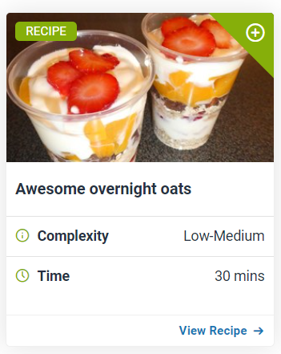
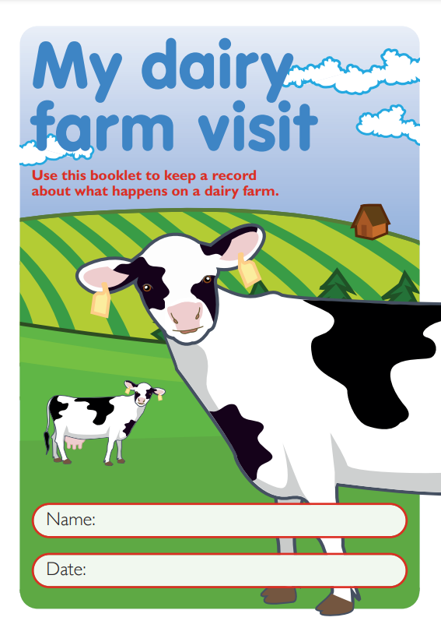
Using food commodities as a hook
Taste cheese
(or alternatives)
Explore where milk comes from and what it can be used to make!
Dairy
Make your own cheese
Milk video
(From grass to glass!))
The farm visit
(Story and literacy and numeracy resources.)
Visit a dairy farm
(and complete the booklet)
Try recipes that use dairy, e.g. yogurt
Global cuisine recipes

Slide 7
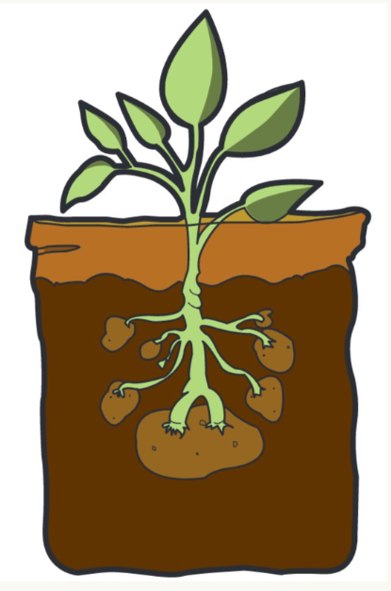
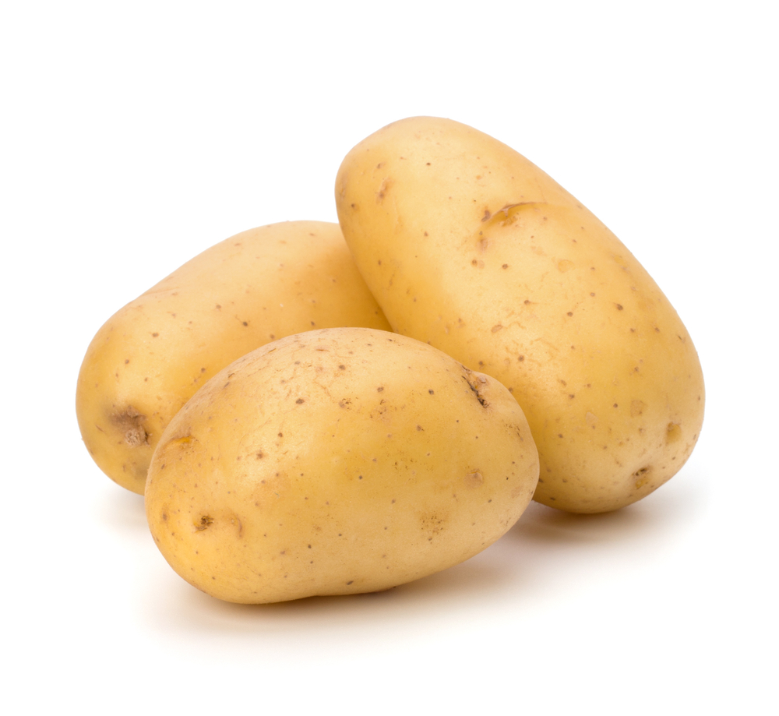
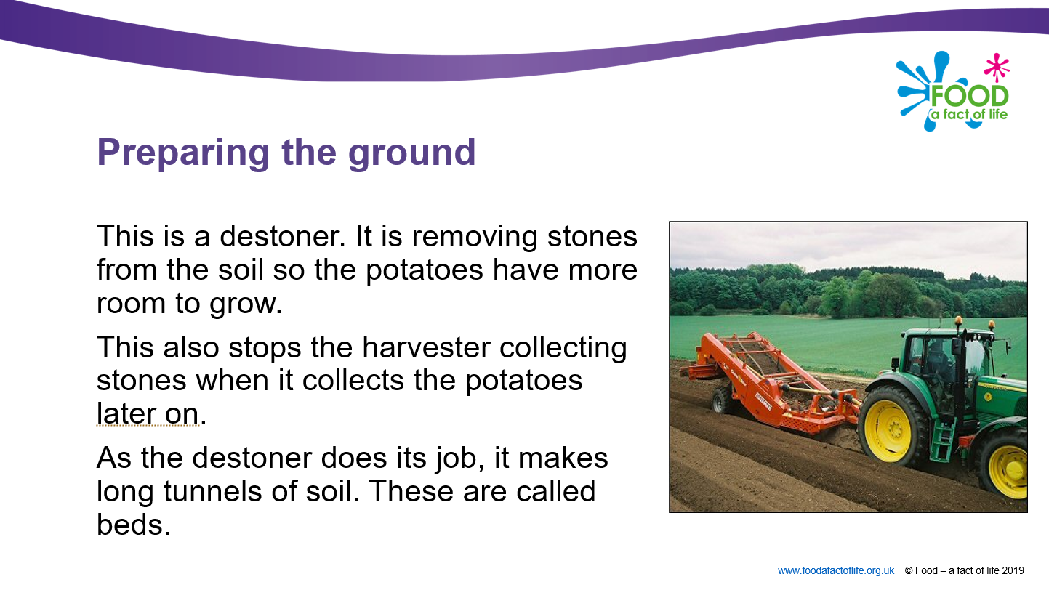
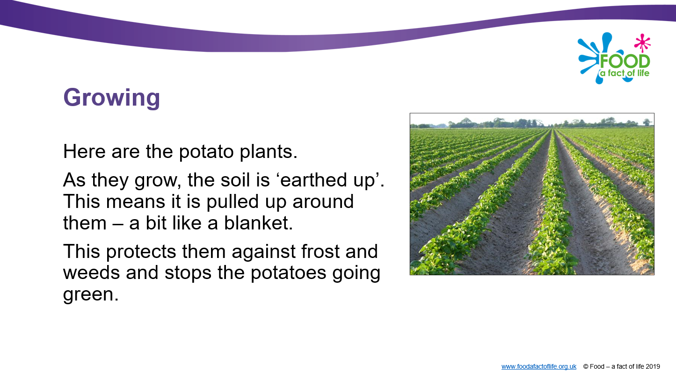
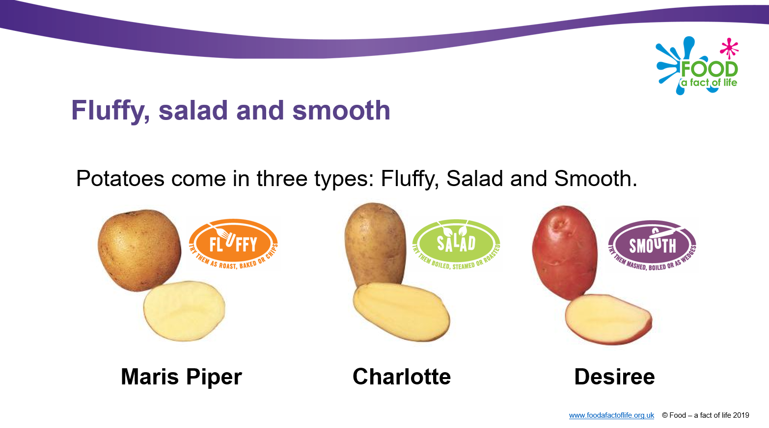
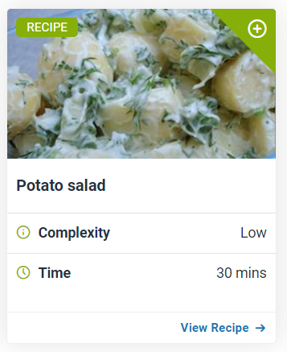
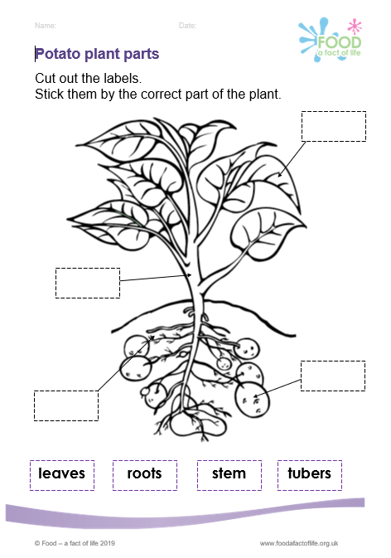
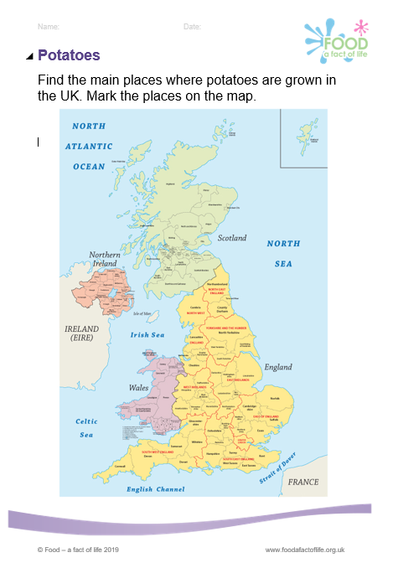
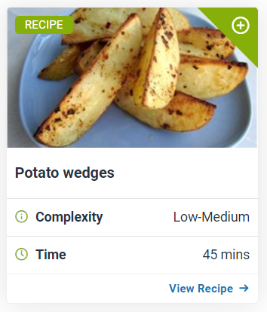
Using food commodities as a hook
Grow your own! A chance to look at potatoes as a plant (science) and explore seasonality.
Grow Your Own Potatoes
(FREE growing kits, information and a competition!)
Potatoes
Where do potatoes comes from?
Explore types of potatoes and those best for different dishes.
Food commodities areas (potatoes): 5-7 and 7-11
Recipes
(Search by commodities,
e.g. Potatoes’.)

Slide 8
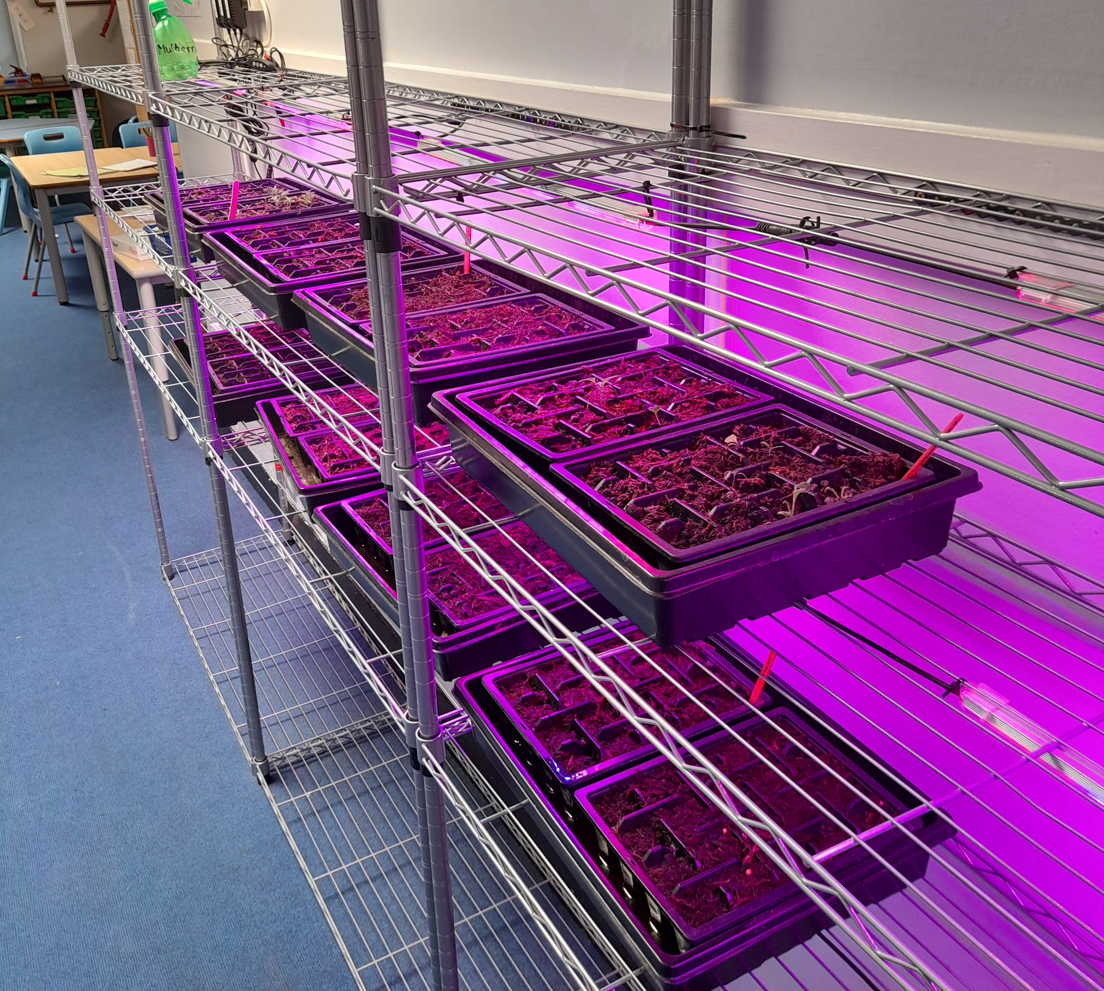
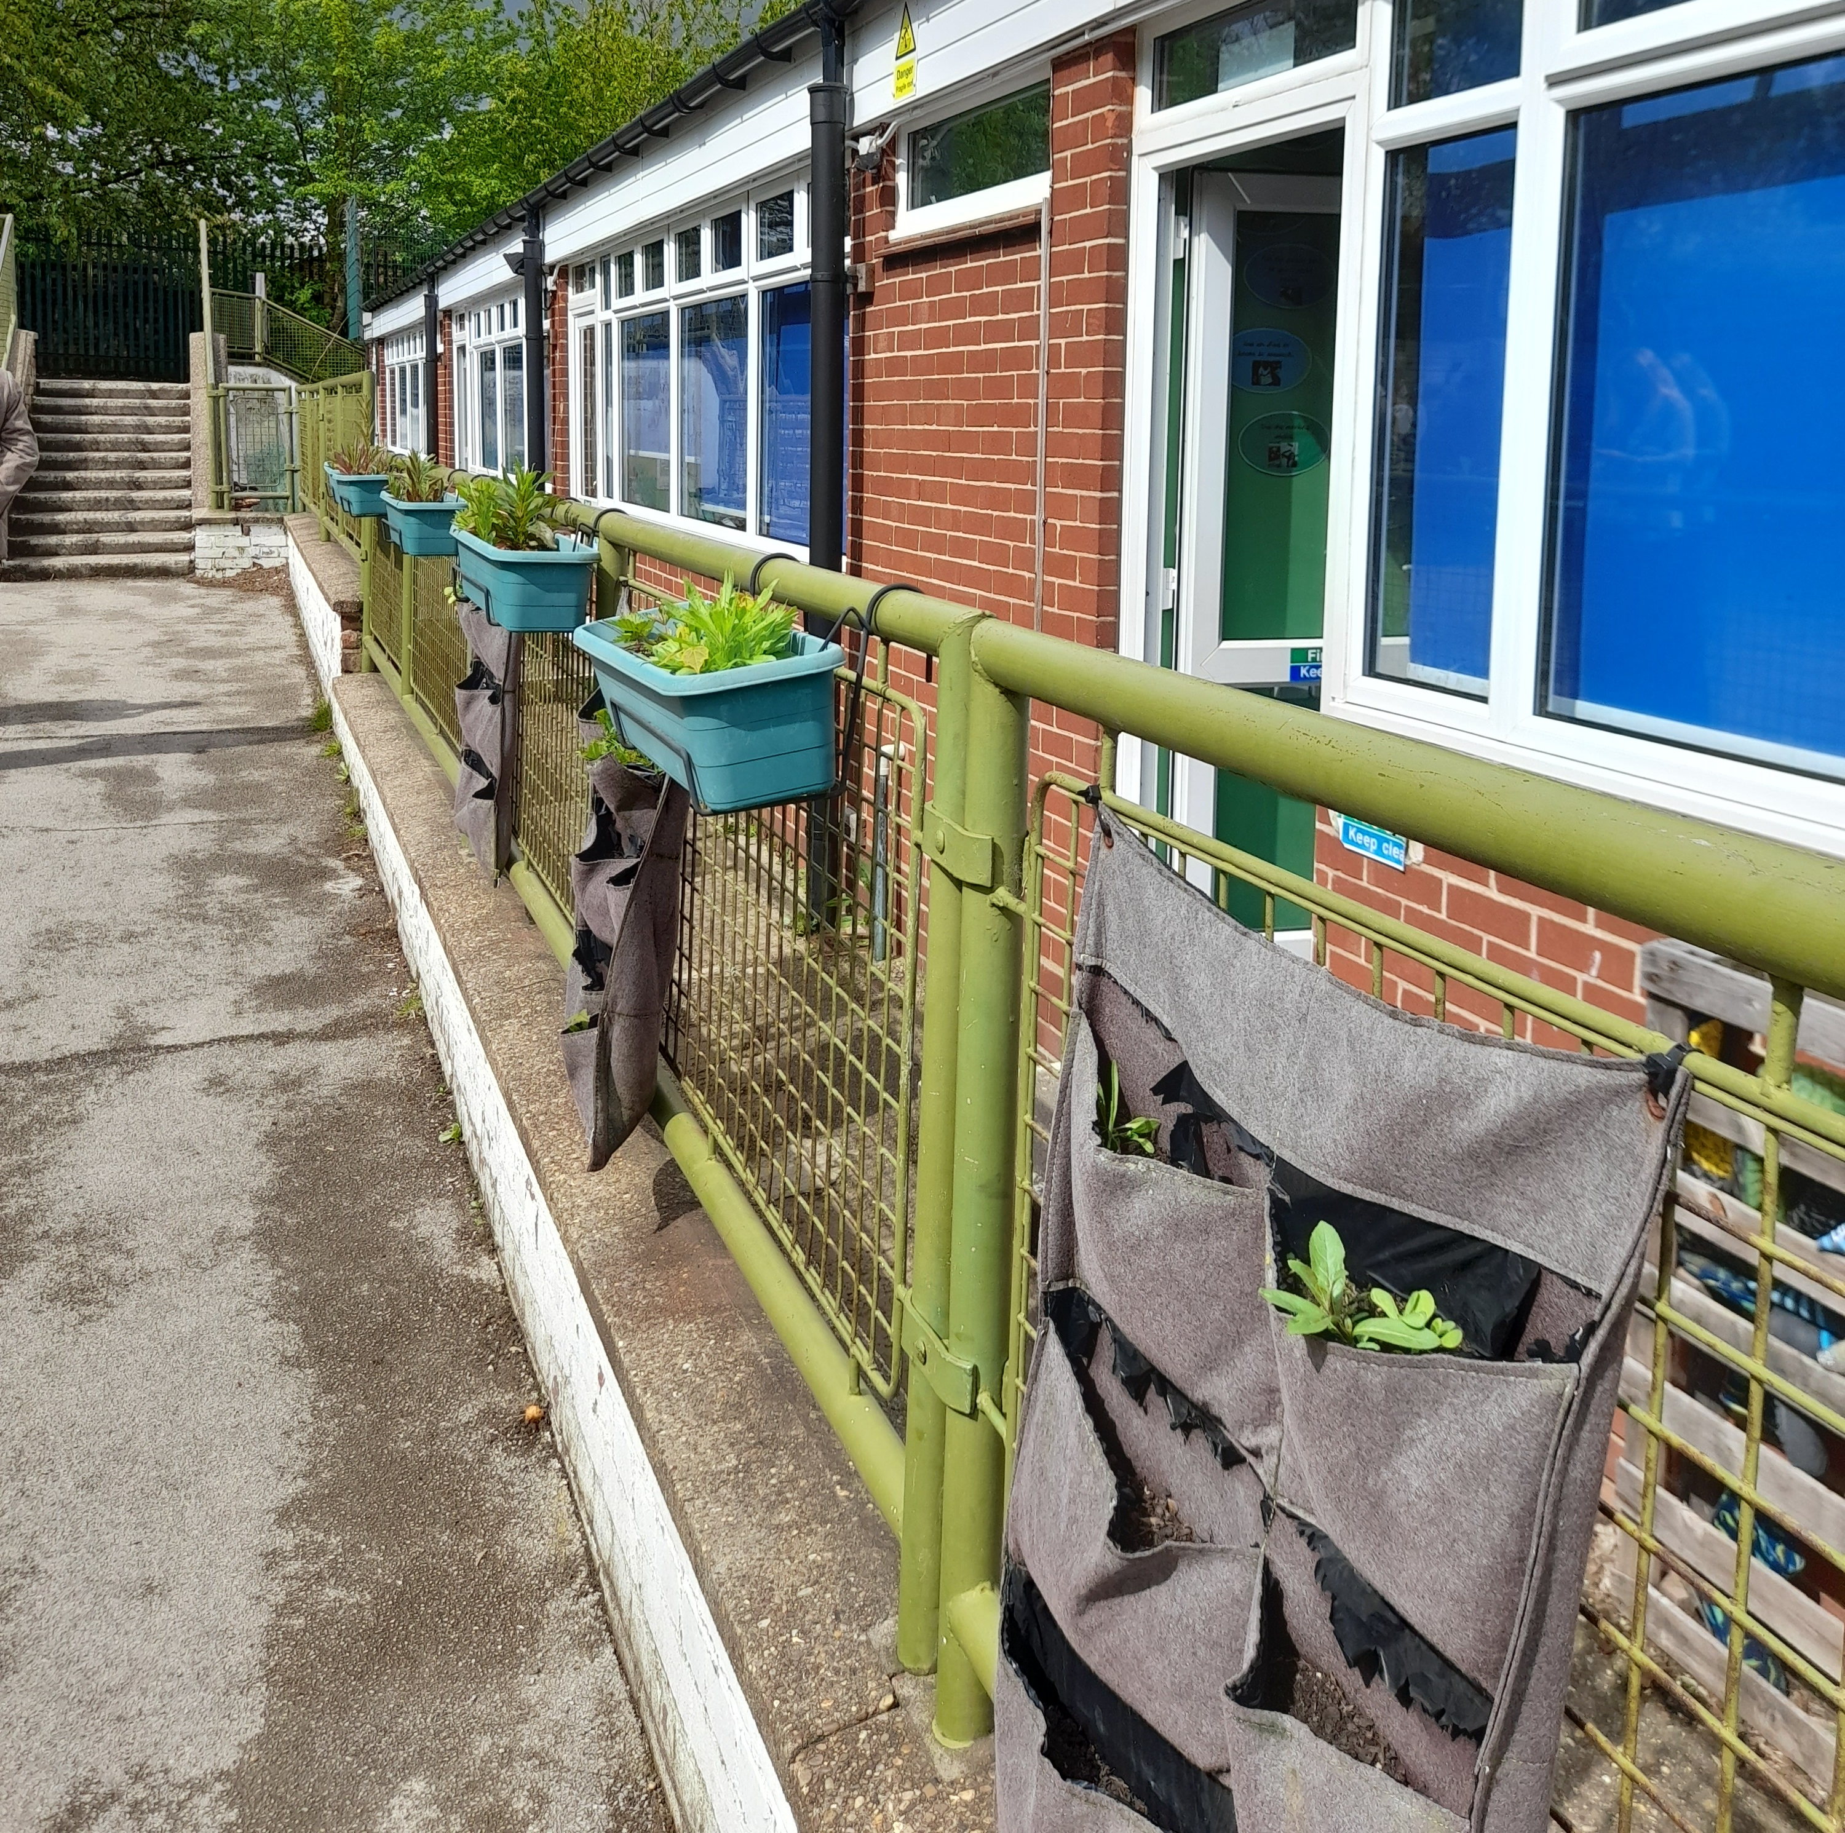
What you could grow at school
Inspiration from Washingborough Academy.
Micro greens
Lettuce

Slide 9
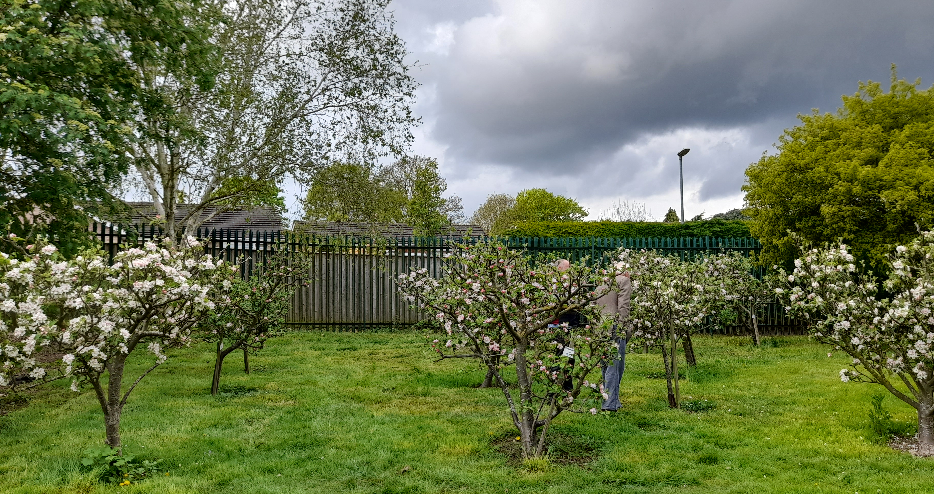
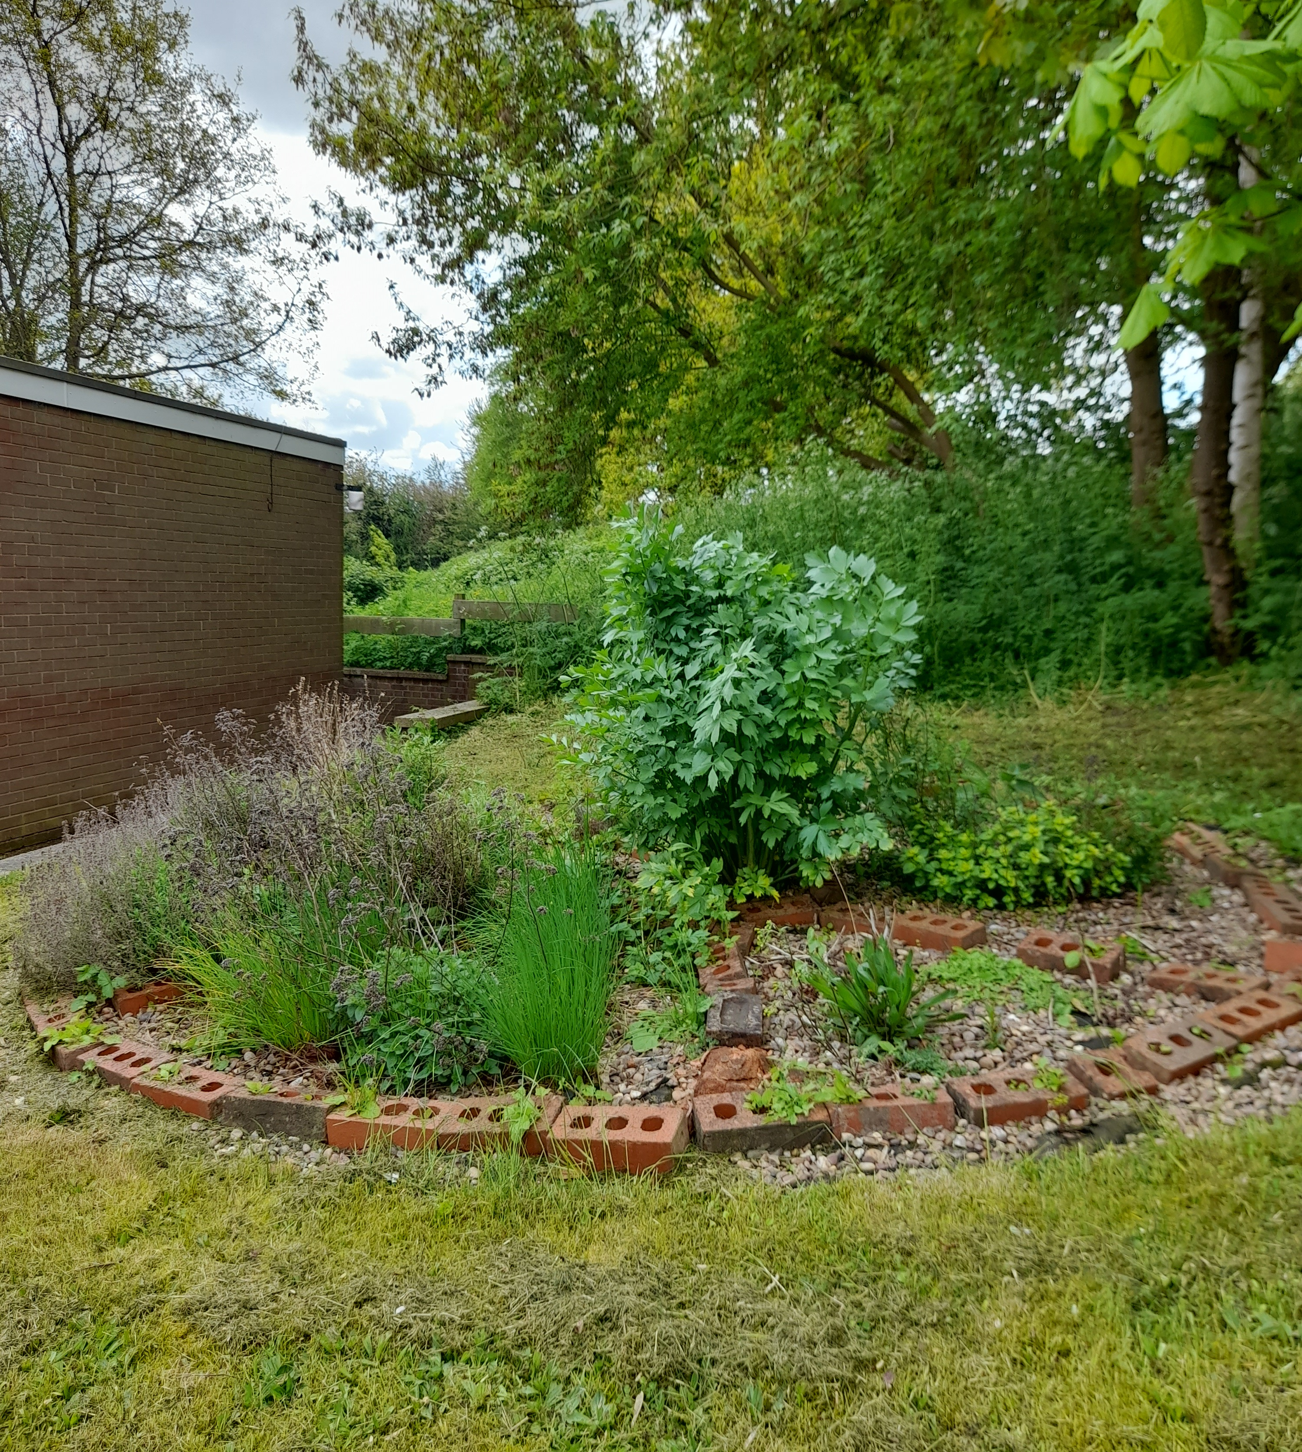
What you could grow at school
Inspiration from Washingborough Academy.
Apple trees
Herb wheel

Slide 10
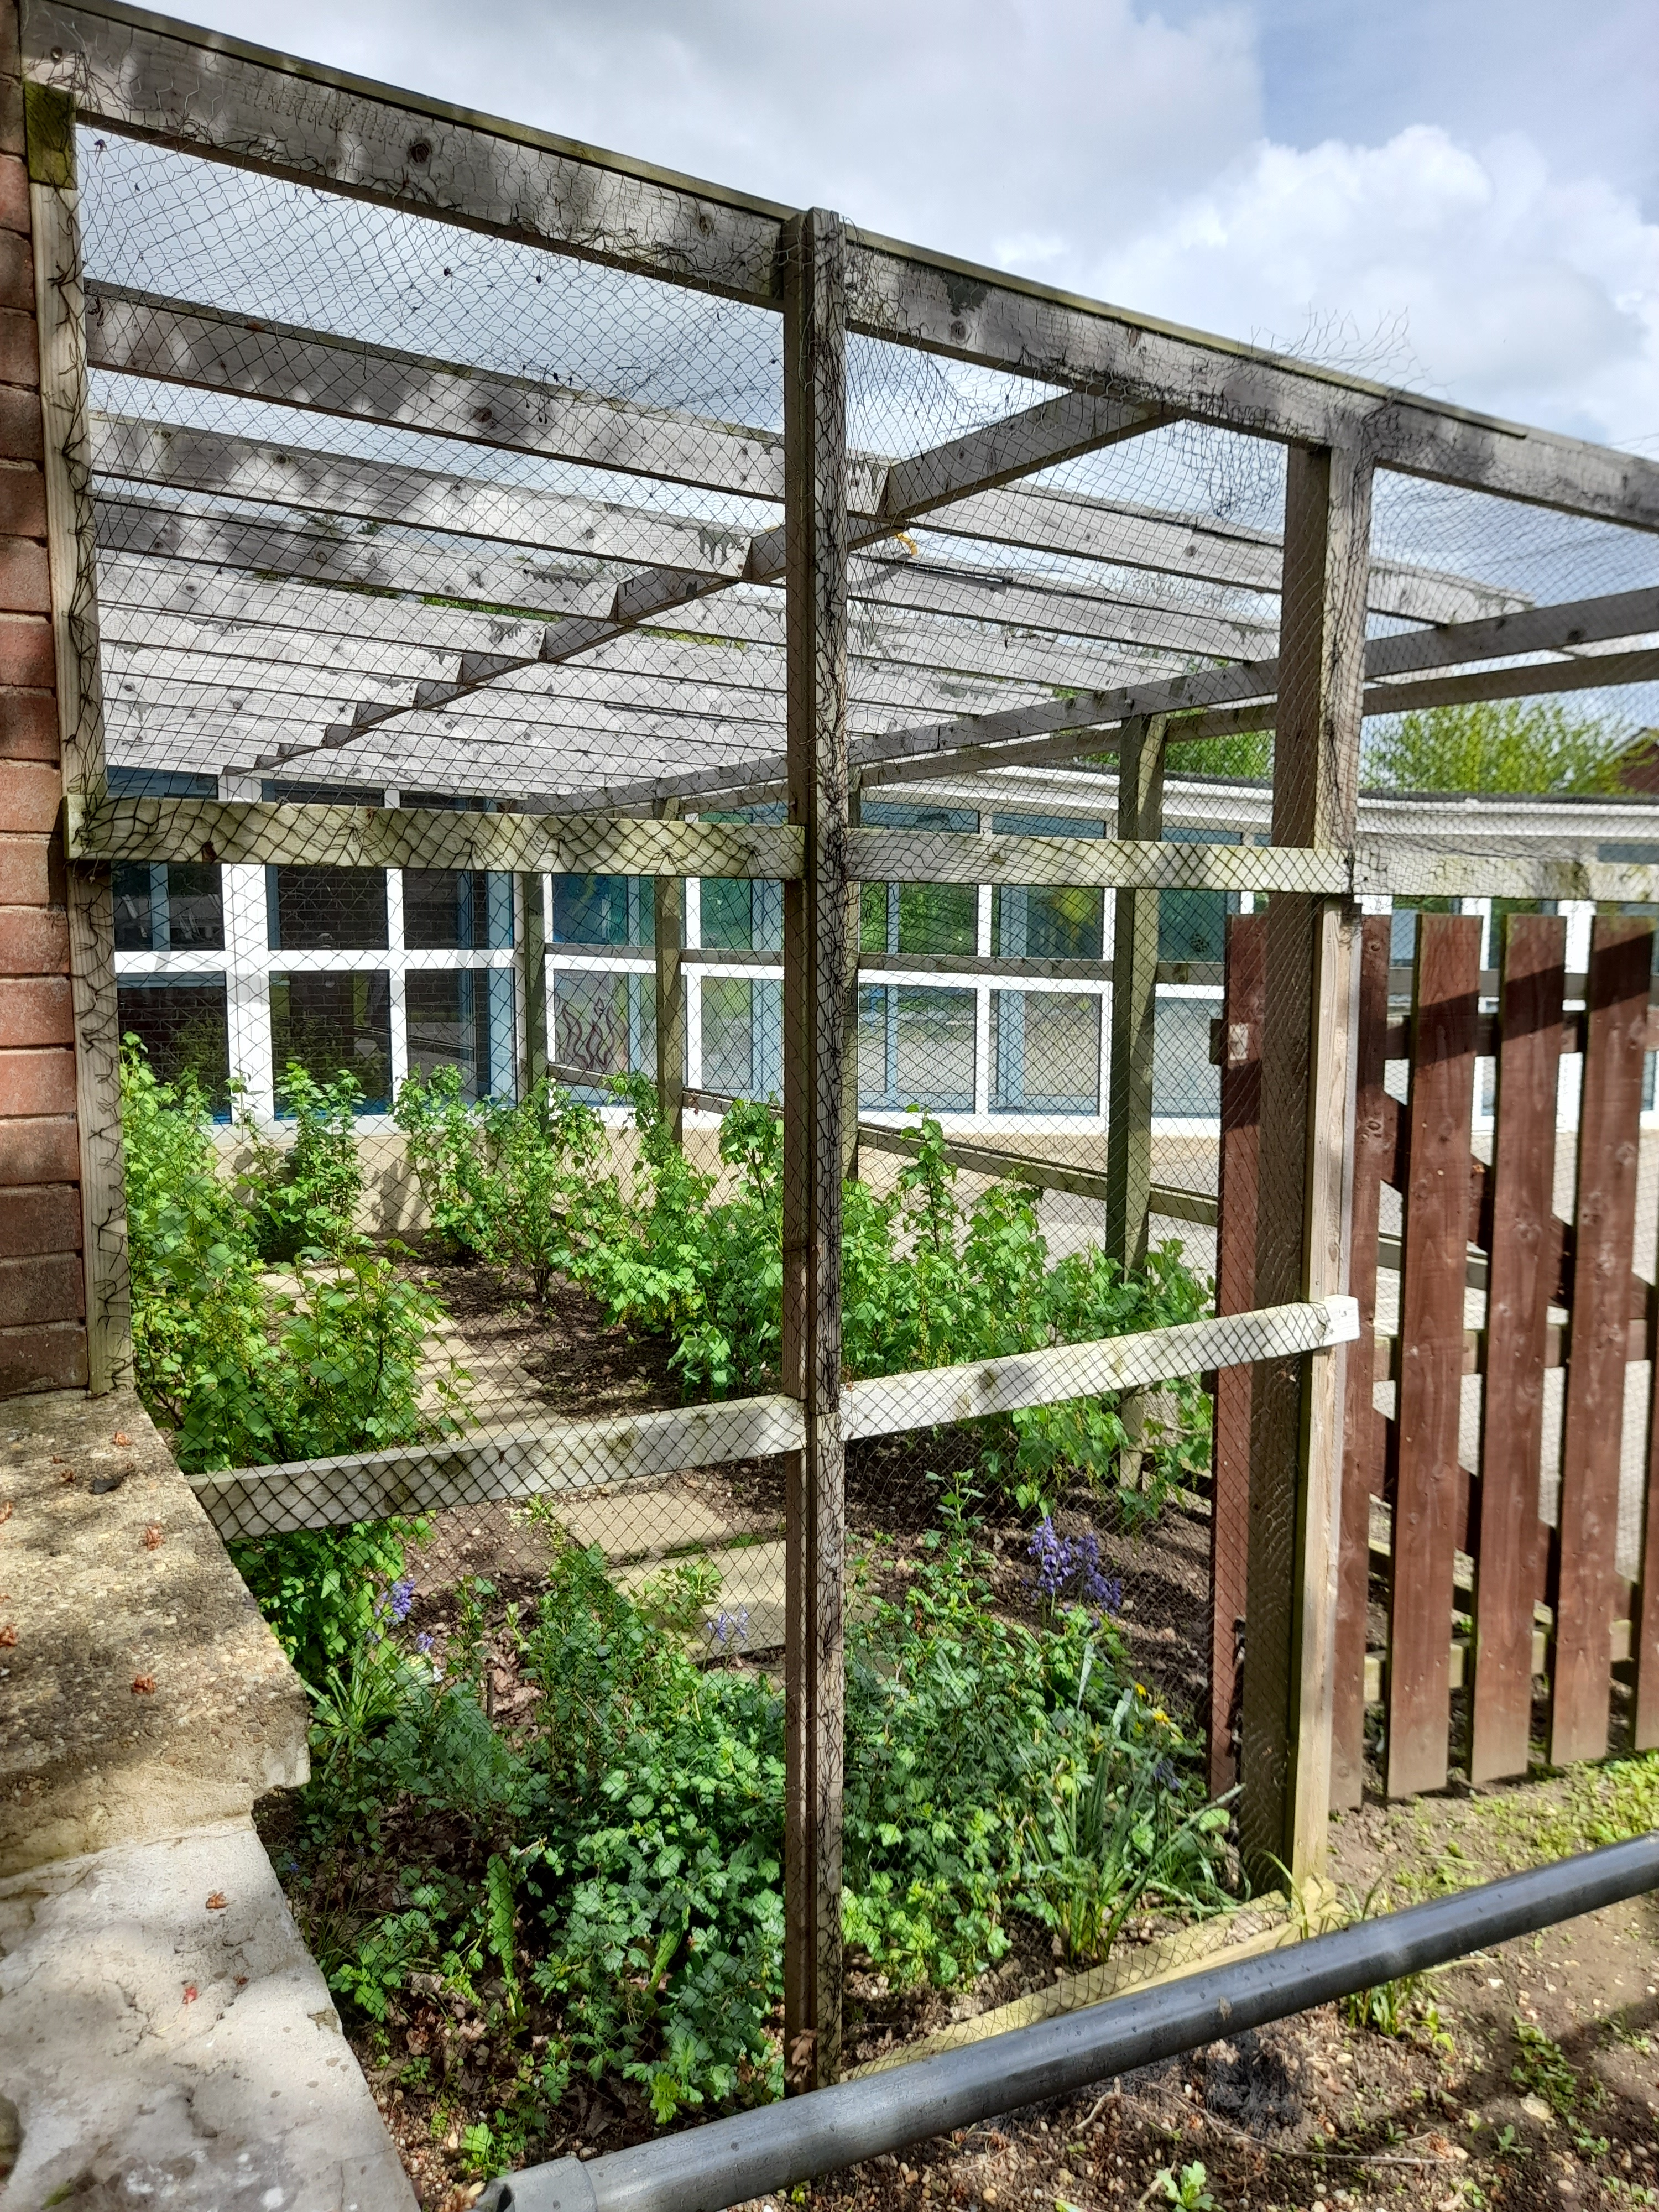
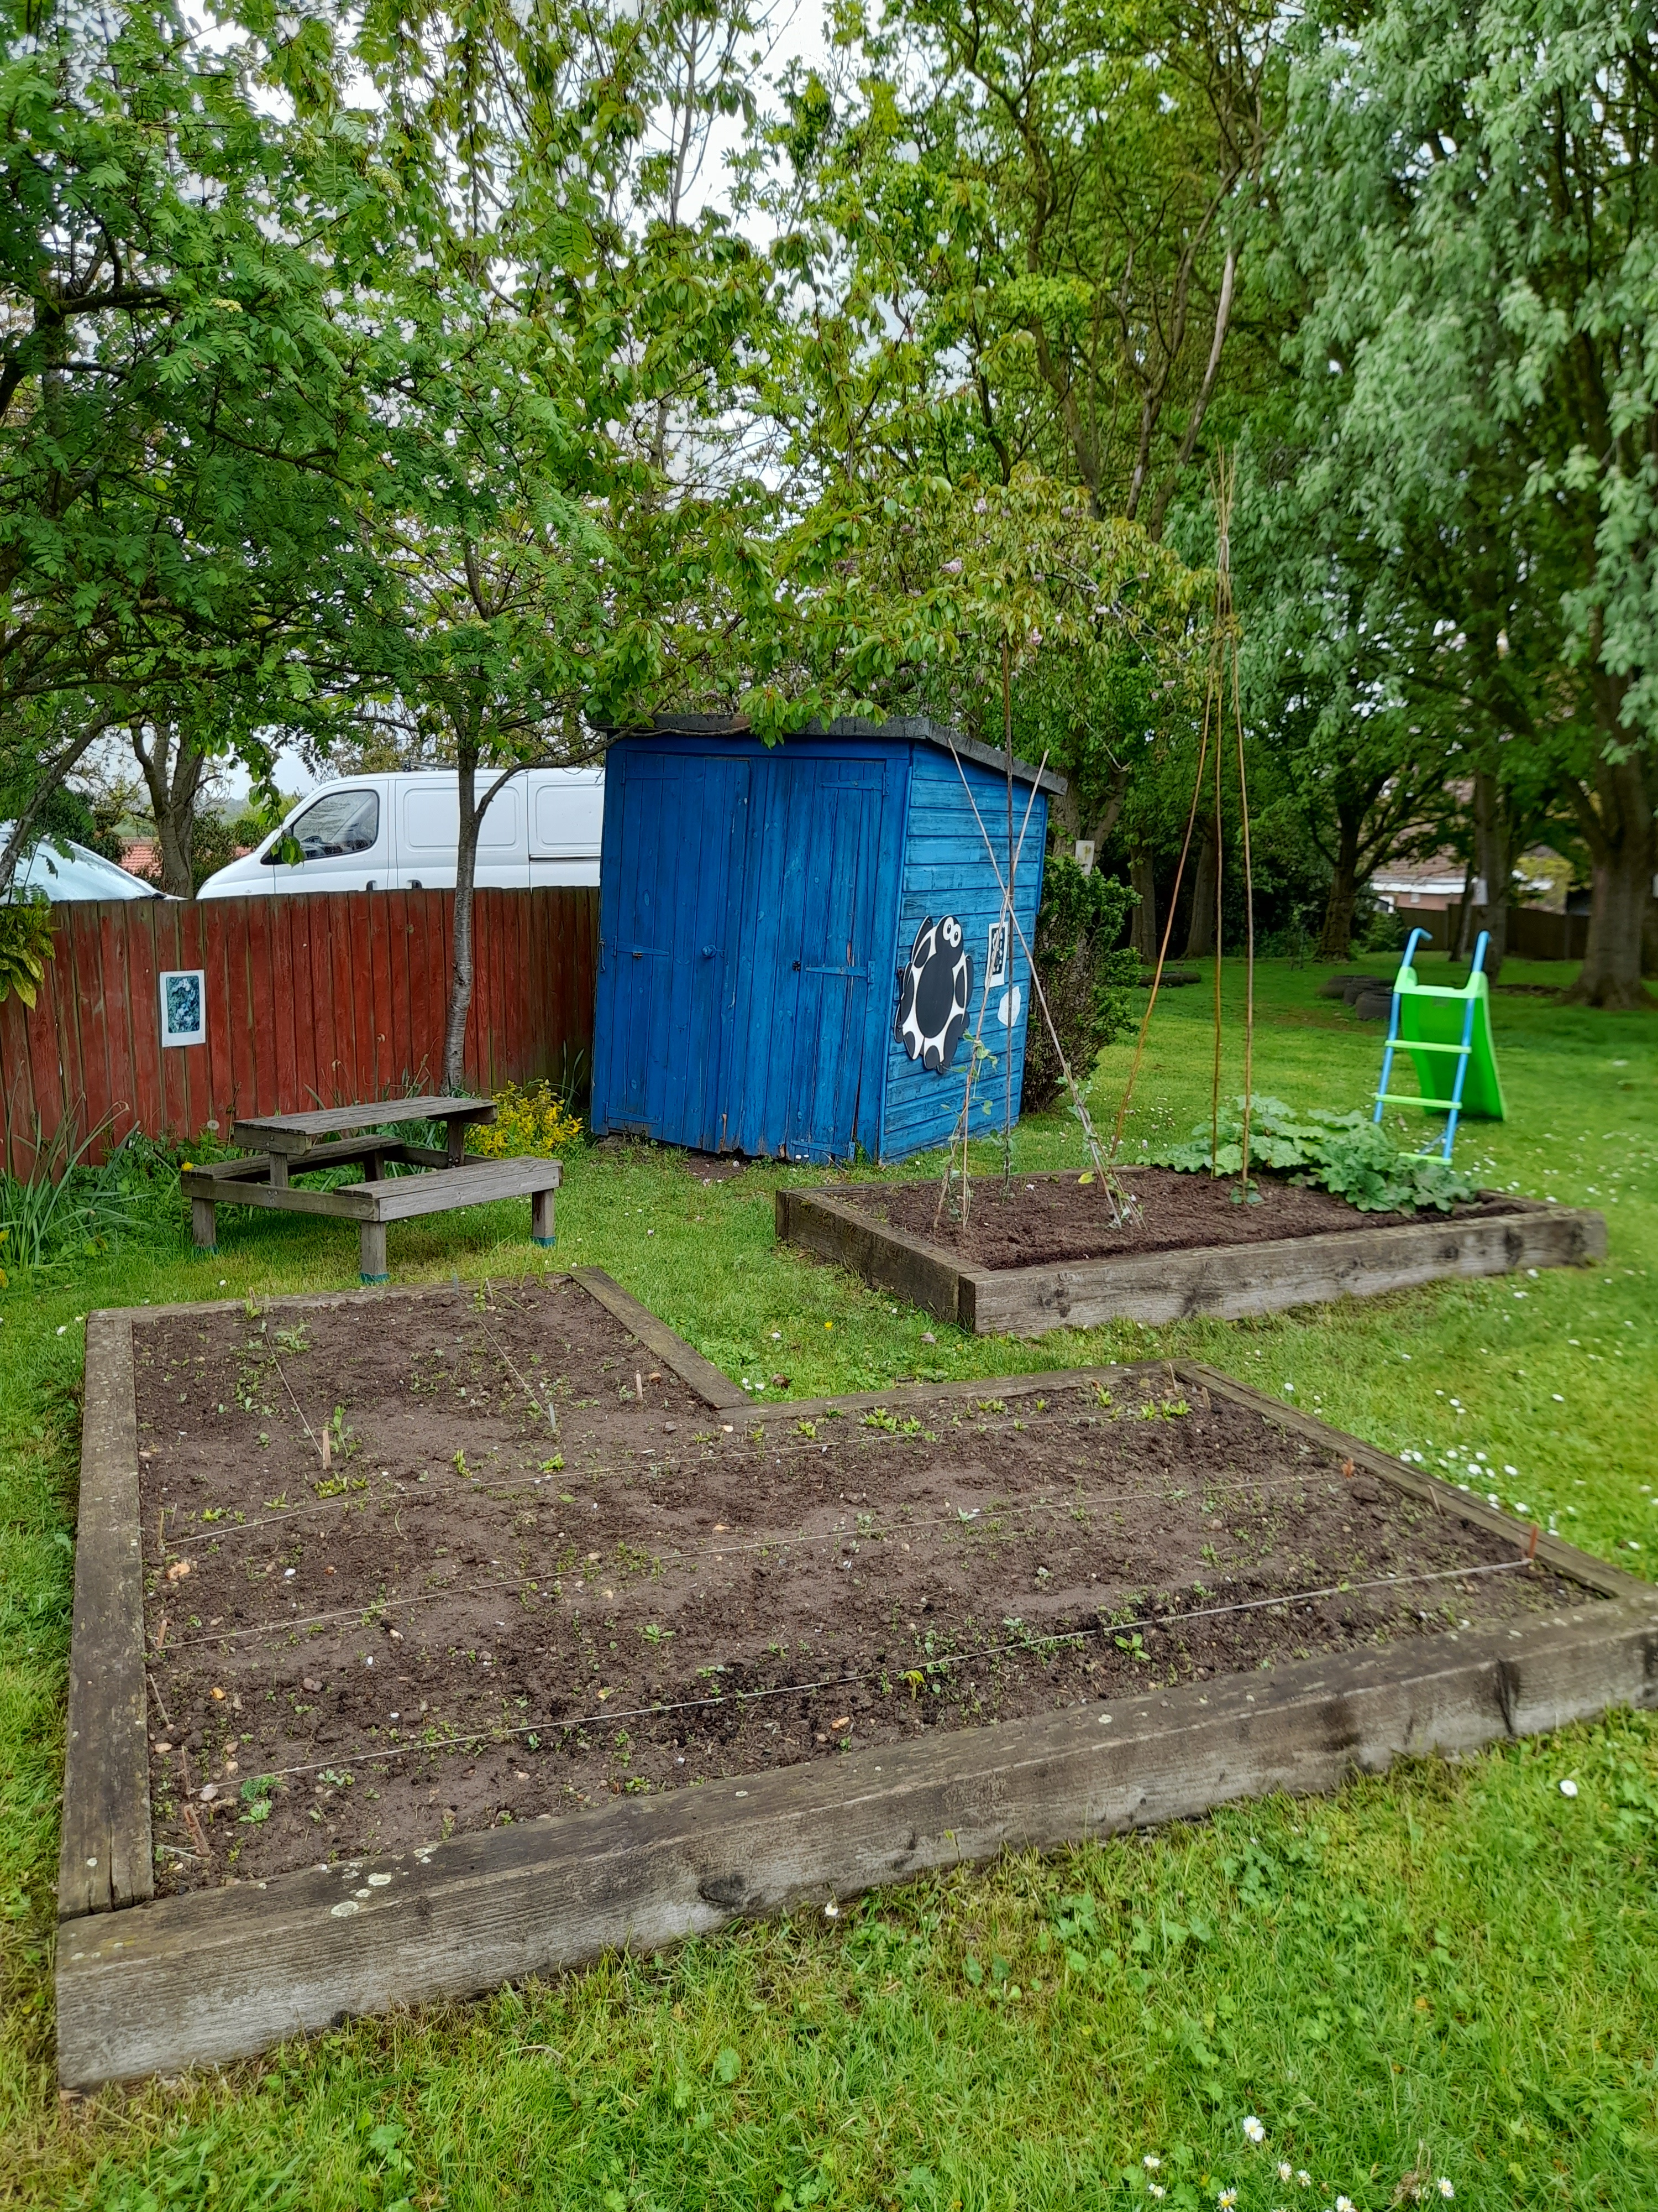
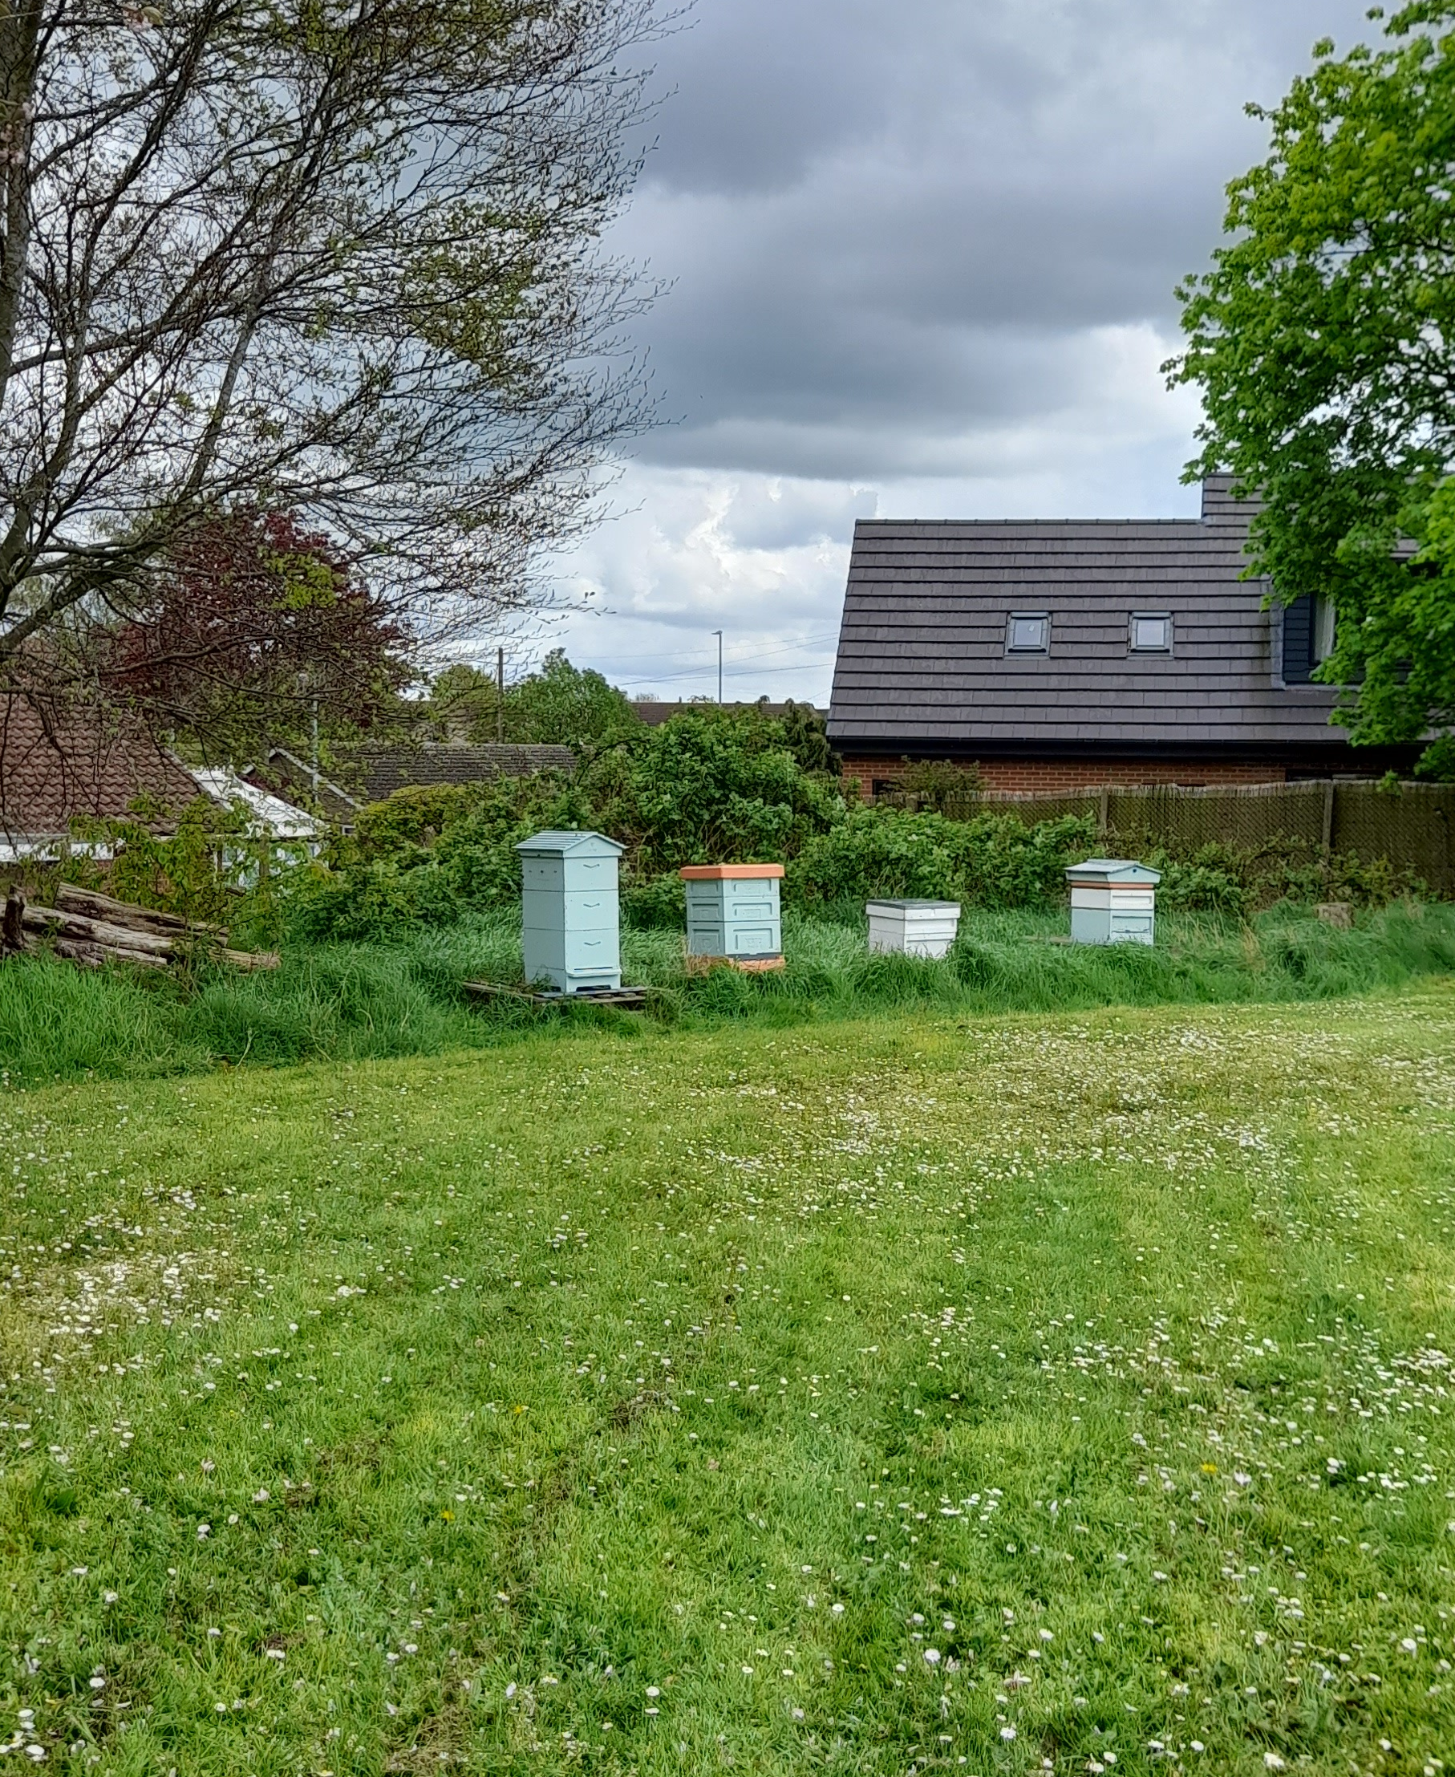
What you could grow/produce at school
Inspiration from Washingborough Academy.
Fruit cages
Raised beds
Beehives

Slide 11
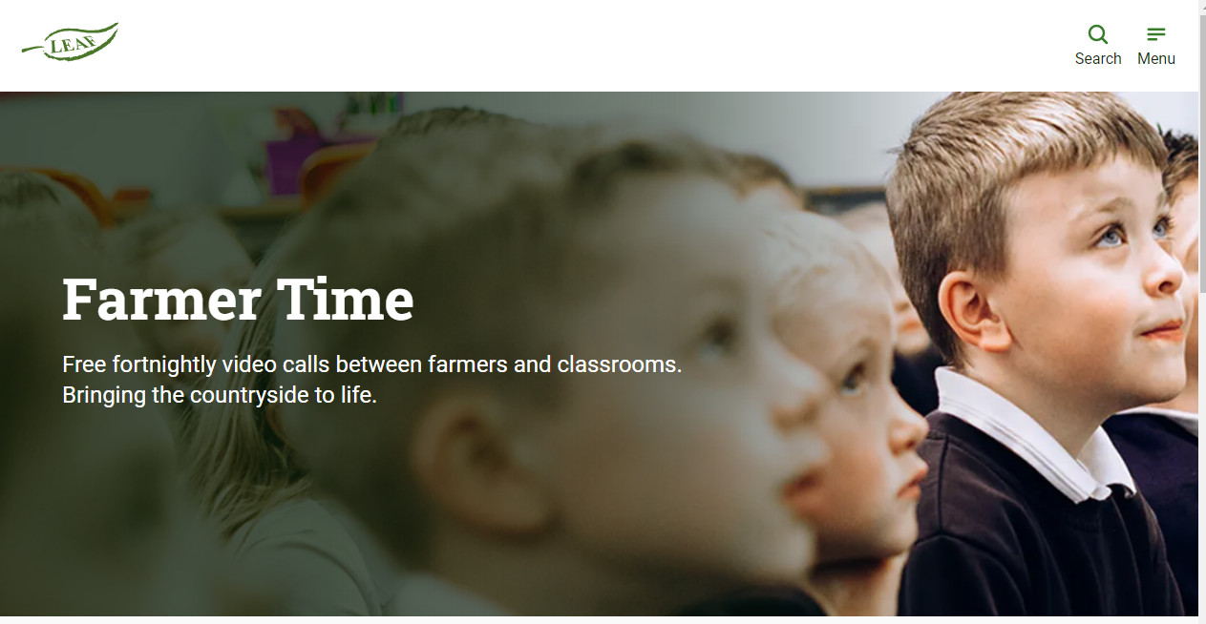
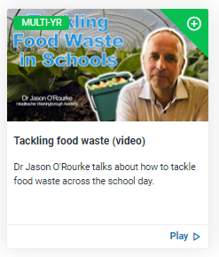
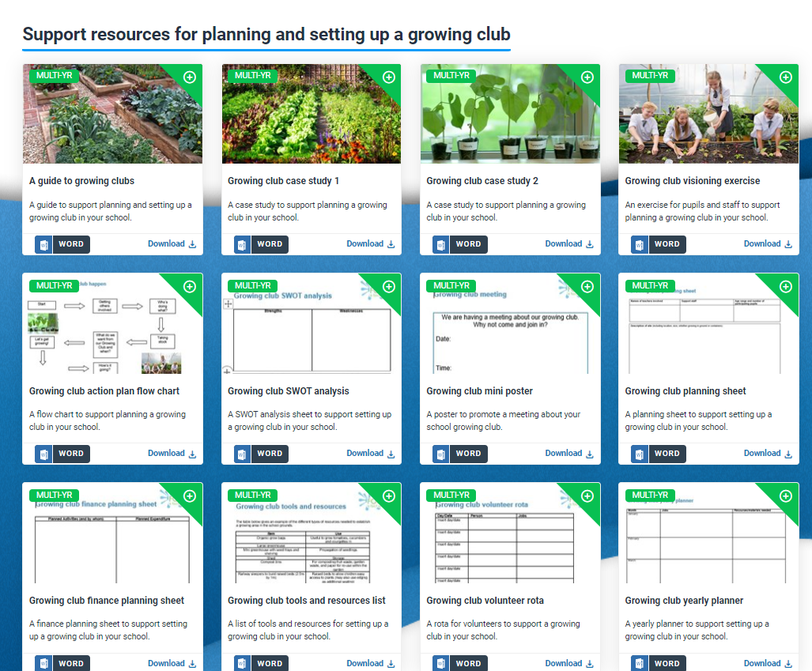
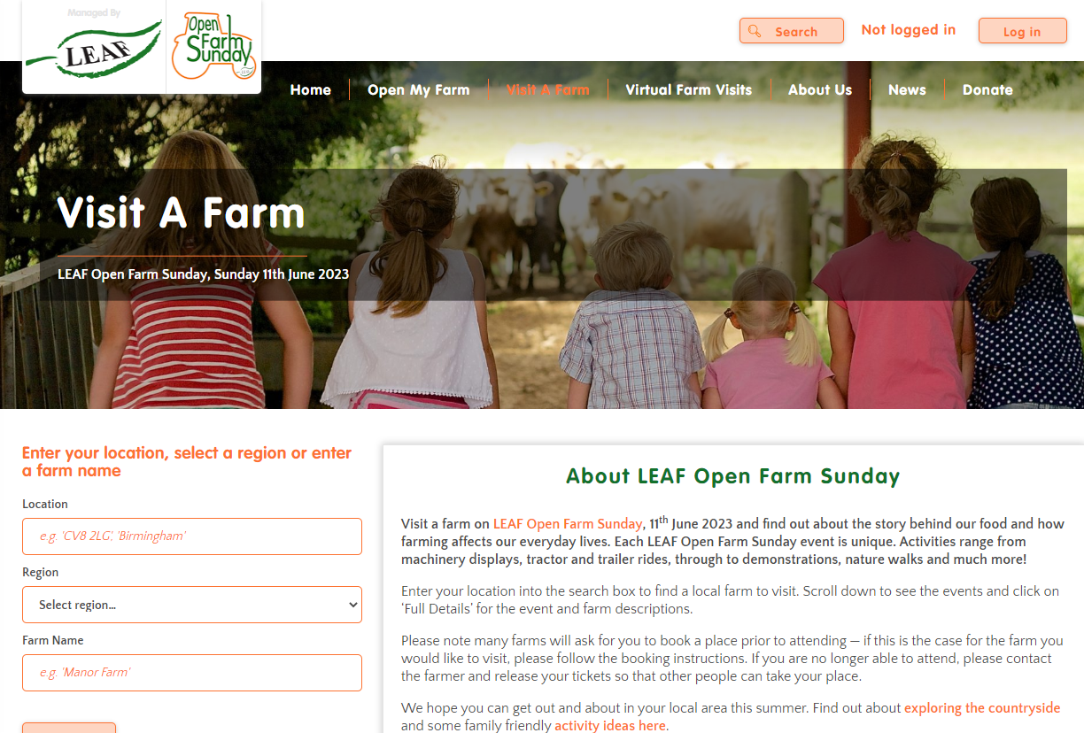
What else?
Connect with a farmer
Free fortnightly video calls between farmers and classrooms.
Farmer time
Tackling food waste webinar
Resources for setting up a growing club
Open Farm Sunday (11 June 2023)
Visit a farm! LEAF

Slide 12
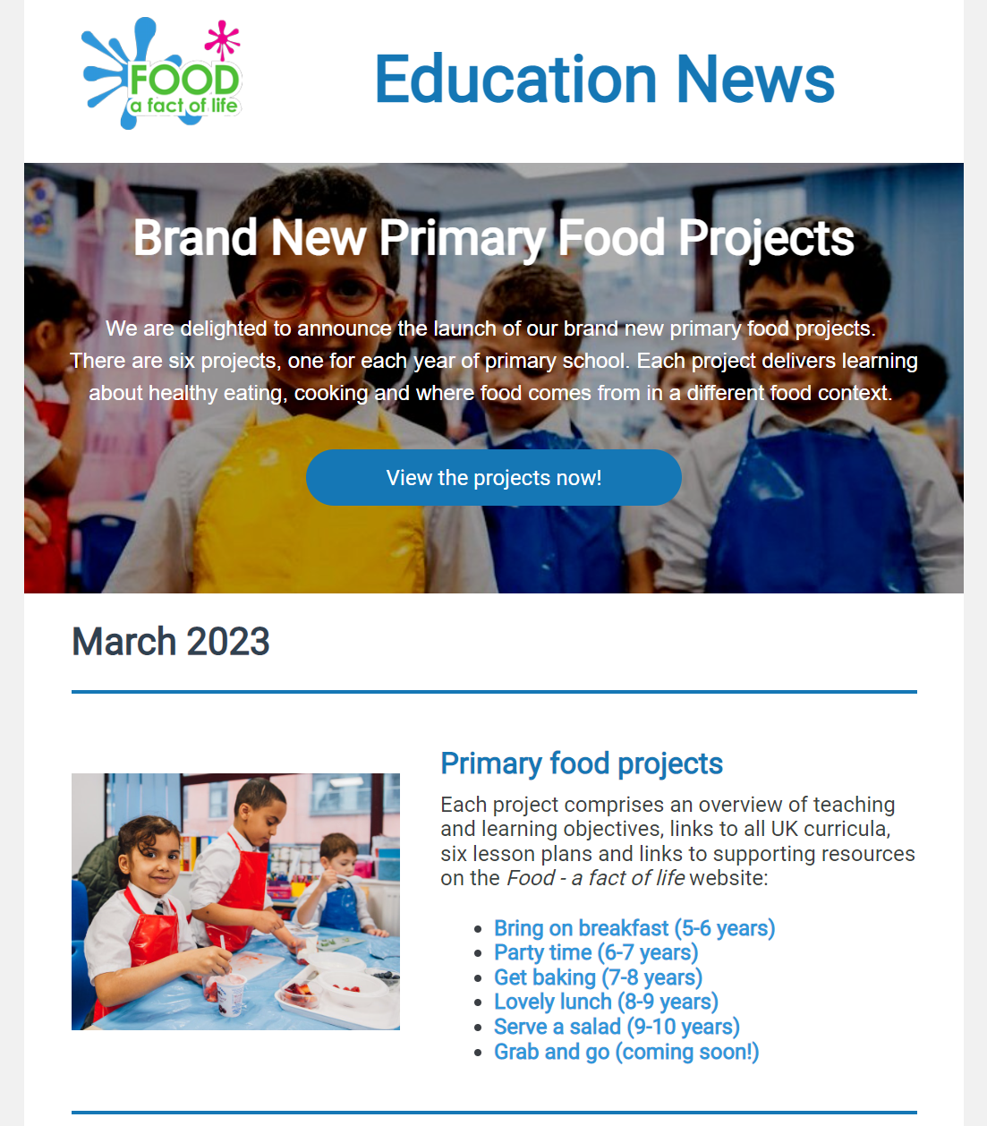
Keep up to date with our free resources and training
Education News (monthly email update)
Sign up on the homepage: www.foodafactoflife.org.uk
Follow us on Twitter @Foodafactoflife
https://twitter.com/foodafactoflife
Keep in touch: education@nutrition.org.uk
Do you know anyone who would find the TPFN programme useful?
They can visit Food – a fact of life, search ‘TPFN’ and register for free!

Slide 13

Thank you
Please complete the webinar evaluation. If you are watching a recording of this webinar, you will find a link to the evaluation at the end of the PPT presentation here.
Exploring where food comes from
You will receive a link to the certificate once you have completed the evaluation. Please download the certificate, add your name and print it out for your records.

