Slide 1
Energy

Slide 2
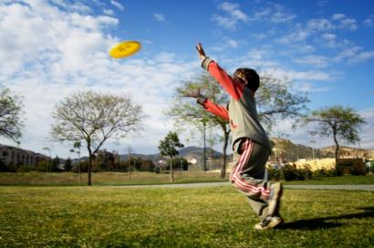
Energy
Food and drinks are the body’s source of energy.
Food and drinks provides energy.
We need energy to grow, be active and maintain health.
Different types of food provide different amounts of energy.
Energy is measured in kilojoules (kJ) and kilocalories (kcal).

Slide 3
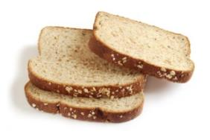
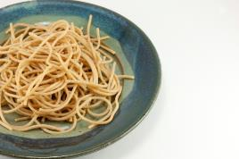

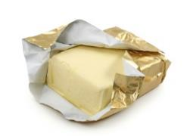
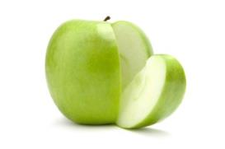
100g of these foods provide …
569kJ (134kcals)
922 kJ (217kcals)
1509 kJ (358kcals)
215 kJ (51kcals)
3059 kJ (744kcals)
Notes:
Pasta, wholewheat, spaghetti, dried, boiled in unsalted water
Butter, salted
Cake, chocolate fudge
Bread, wholemeal, average
Apples, eating, raw, flesh and skin

Slide 4
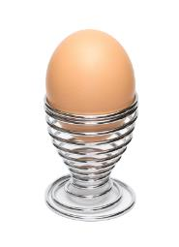
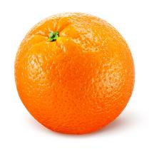
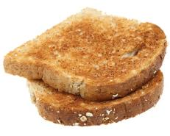
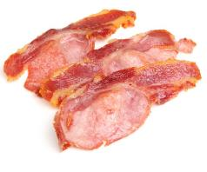
Which food provides the least energy?
1084 kJ (255kcals)
1308 kJ (313kcals)
595 kJ (143kcals)
152 kJ (36kcals)
All foods per 100g.
Notes:
Bread, wholemeal, toasted
Bacon rashers, back, grilled crispy
Eggs, chicken, whole, boiled
Oranges, flesh only

Slide 5
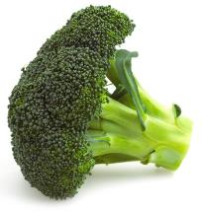
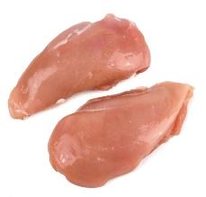
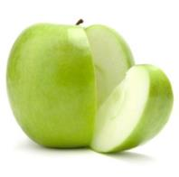
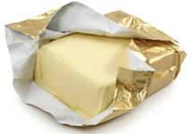
Which food provides the most energy?
215 kJ (51kcals)
3059 kJ (744kcals)
120 kJ (28kcals)
621 kJ (147kcals)
All foods per 100g.
Notes:
Apples, eating, raw, flesh and skin
Butter, salted
Broccoli, green, boiled in unsalted water
Chicken, breast, grilled with skin, meat only

Slide 6
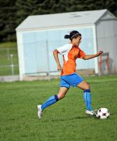
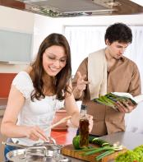

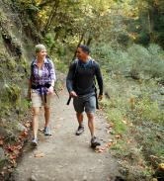
Uses of energy
Different activities use different amounts of energy.
Which activity uses the most energy?
swimming
walking
football
cooking
357kJ (84kcals) /15mins
114kJ (27kcals) /15 mins
196kJ (47kcals) /15 mins
85kJ (20kcals) /15 mins

Slide 7


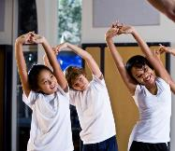
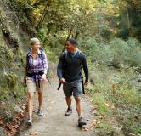
Uses of energy
Different activities use different amounts of energy.
Which activity uses the least energy?
gymnastics
walking
standing
sleeping
153kJ (35kcals) /15mins
114kJ (27kcals) /15 mins
42kJ (10kcals) /15 mins
35kJ (8kcals)/ 15 mins

Slide 8


Serving size
Different amounts of food provide different amounts of energy. We eat different amounts of different types of food.
Butter
Orange
Per 100g = 3059kJ (744kcals)
On toast (5g) = 153kJ (37kcals)
Per 100g = 152kJ (36kcals)
Small (120g) = 182kJ (43kcals)

Slide 9
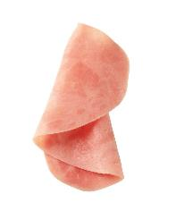

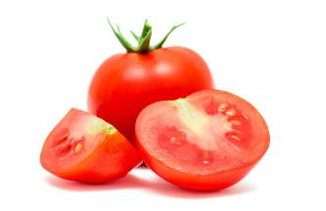
Foods providing 400kJ (96kcals) of energy
Wholemeal bread – 43g
Semi skimmed milk - 205ml
Tomatoes - 656g
Orange - 263g
Ham - 89g
Butter - 13g
Egg – 67g

Slide 10
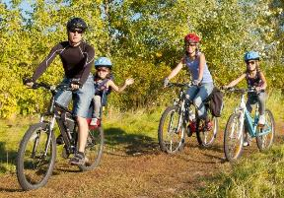
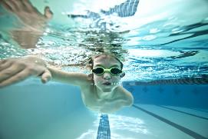
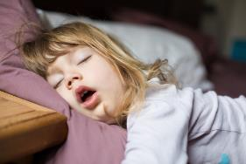
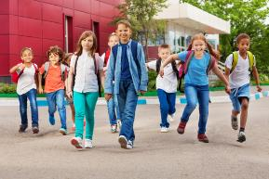
Uses of 400kJ (96kcals)
Swimming - about 24 minutes
Cycling -about 17 minutes
Sitting -about 96 minutes
Running -about 17 minutes
Sleeping -about 116 minutes
Walking -about 31 minutes

Slide 11
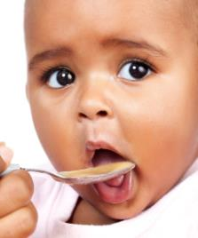
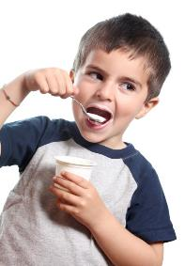
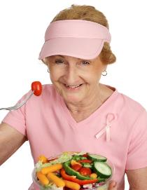

Energy needs are different
Different people need different amounts of energy. The amount of energy they need depends on their age, job, how active they are and their health.
12 month old baby girl
9 year old boy
36 year old man
65 year old woman
2,700 kJ/day
(646kcals/day)
7,700 kJ/day
(1840kcals/day)
11,000 kJ/day
(2629kcals/day)
8,000 kJ/day
(1912kcals/day)

Slide 12
Energy
For further information, go to:
www.foodafactoflife.org.uk
This resource meets the Guidelines for producers and users of school education resources about food.

