Slide 1
Heat transfer (heat exchange)

Slide 2
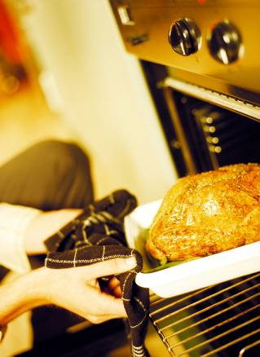
Heat transfer (exchange)
The transfer of heat to or from particular foods is important in both domestic food preparation and industrial food manufacture.

Slide 3
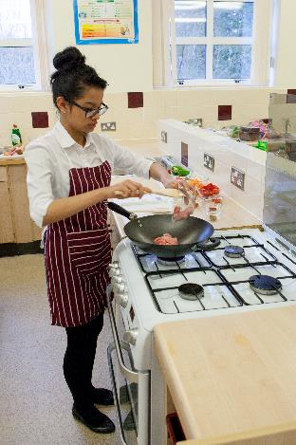
Application of heat
The application of heat in the preparation of a food or mixture may:
improve digestibility;
improve appearance, flavour, odour and texture;
increase the availability of nutrients;
prevent spoilage;
increase keeping qualities.

Slide 4
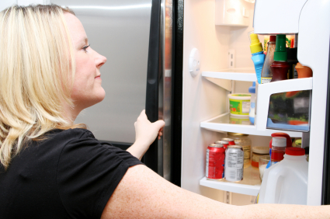
Removal of heat
The removal of heat, or cooling of foods, may:
modify appearance and texture, e.g. formation of ice crystals;
prevent spoilage, i.e. retard growth of micro-organisms;
increase keeping qualities, by preventing spoilage;
aid processing, e.g. tempering meat before slicing.

Slide 5
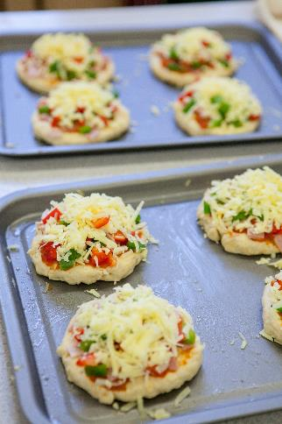
Methods of heat transfer
The principles of heat transfer are the same, whether they are applied on a small domestic or large industrial scale.
All of the following methods are used in the application of heat to, or removal of heat from, a food product.
One method or several may be in action at any time, depending on the food and the time and equipment available.

Slide 6
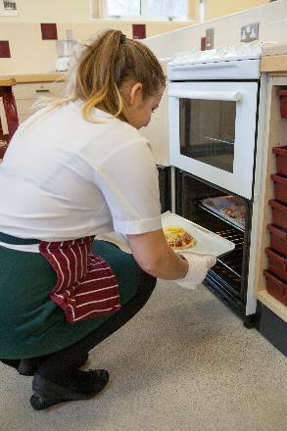
Methods of heat transfer
As a food is heated, its molecules absorb energy and vibrate more vigorously. The faster they move, the higher the temperature of the food rises. If heat is removed, the molecules become less active, reducing the food’s temperature.
Heat can be transferred in three ways:
• conduction;
• convection;
• radiation.

Slide 7
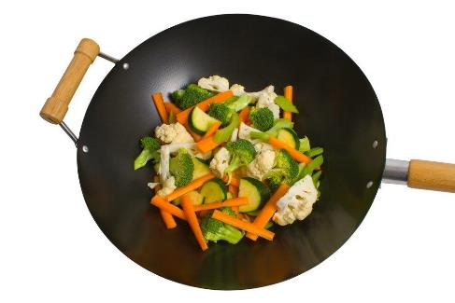
Conduction
Conduction is the transfer of heat by direct contact with foods on a surface. For example:
stir-frying vegetables in a wok;
pasteurising milk in a plate heat-exchanger;
making ice cream.

Slide 8
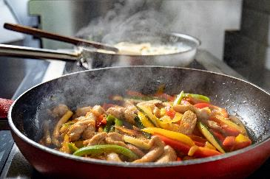
Conduction
Conduction is the direct transfer of heat energy from a hot surface. When a pan or baking tin is heated, the molecules in the metal begin to vibrate and pass the energy to neighbouring molecules.
These molecules can then directly transfer heat to the food.
Cooking by conduction depends on good contact between the:
source of heat;
cooking equipment;
food to be cooked.

Slide 9
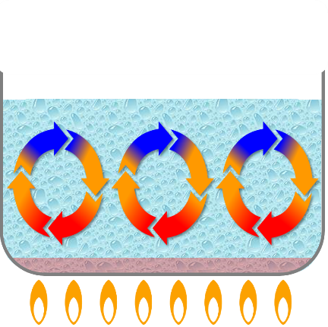
Convection
In this method of cooking, currents of hot gas or hot liquid transfer the heat energy to the food. When gases (such as air) or liquids (such as water) are heated, the molecules become more energetic. This makes them move around more quickly. Because of this, the molecules move further apart, making them less dense. This causes them to rise. Cooler liquid or gas falls to take its place. This in turn becomes heated and rises up, creating moving ‘convection currents’.

Slide 10
Convection
Food which is placed in such a liquid or gas (usually in an enclosed space) becomes cooked. This happens because the heat from the convection currents is transferred from the air or liquid to the outside of the food, then gradually through to the centre via conduction. For efficient and quicker cooking, convection currents in air need to be kept in an enclosed space, such as an oven. As hot air rises, cooler air falls – so the hottest part of an oven is at the top. Some ovens are fan assisted so that the hot air is driven around the oven to keep the temperature even from the bottom to the top.

Slide 11
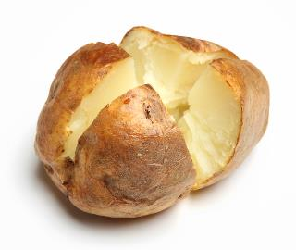
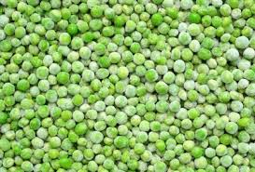
Convection
The processes of convection and conduction may work together in order to exchange heat.
For example, first the surface of a baked potato is heated by convection, then the heat is conducted through to the centre of the potato.
Convection can also be used to freeze food, e.g. blasting cold air through peas to freeze them.

Slide 12
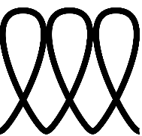
Induction cooking
Induction cooking is a modern technology that heats pans in a different way. Induction hobs do not produce heat. Instead, they use magnets to generate an electric current in a pan. Some of the energy from this current is lost as heat, which warms the pan. However, the hot pan still transfers this heat to the food through conduction or convection, as normal. Induction hobs are designed to be safer than regular hobs as they do not generate heat directly and are therefore not hot to the touch.
Similar symbols to this one can be found on pans that are suitable for induction cooking

Slide 13
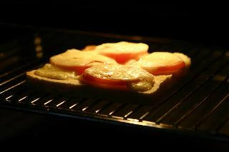
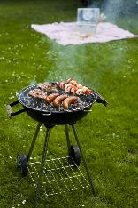
Radiation
Radiation is energy in the form of rays. The rays pass through the air until they come into contact with the food. Some are absorbed while others are reflected.
Grilling involves the use of infra-red heat rays created by gas flames, charcoal or glowing electric elements.
Heat rays from gas or electric grills travel down onto the food below.
Heat rays from a charcoal grill or barbeque travel upwards to cook the food placed above on a grid or spit.
The surface of the food nearest to the rays becomes quickly browned – and regular turning of the food is needed to ensure even cooking.

Slide 14
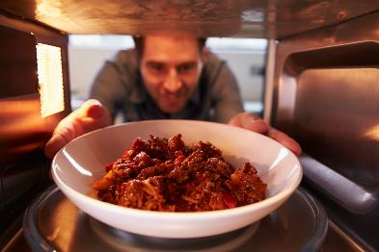
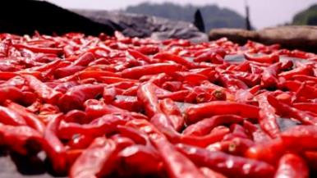
Microwave radiation
Microwaves are electromagnetic radiators of high energy and short wavelengths. They quickly heat anything containing water, by causing the water molecules to oscillate (vibrate), which produces heat. Sun drying is a traditional method of using the sun’s rays to preserve food.

Slide 15
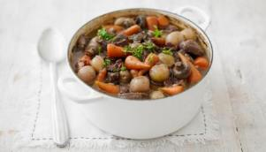
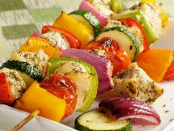
Heat transfer
One or more methods of heat transfer may be used when cooking different dishes. Identify the methods used for the following dishes:
Beef casserole
Chicken and vegetable kebabs
Lamb Rogan josh
Method of heat transfer: conduction (frying pan, oven dish and food itself) and convection (liquid in the oven).
Method of heat transfer: conduction (saucepan and food itself) and convection (liquid).
Method of heat transfer: radiation (surface) and conduction (centre).

Slide 16
Heat transfer (heat exchange)
For further information, go to:
www.foodafactoflife.org.uk
This resource meets the Guidelines for producers and users of school education resources about food.

