Slide 1
Development and maintenance of healthy teeth

Slide 2

Tooth development and structure
Two sets of teeth develop in life:
a primary set, comprising 20 teeth, these appear at about 6 months of age;
a secondary or permanent set, comprising 32 teeth. These replace the primary set between the ages of 6 and 12 years. This set can last for life if cared for properly.

Slide 3
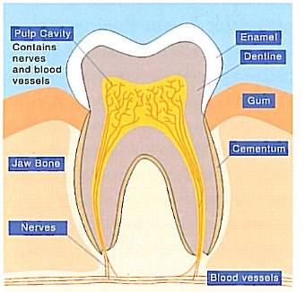
Tooth development and structure
Teeth consist of three tissues, enamel, dentine and cementum.
Enamel is a hard substance which forms the outer surface of the tooth. It is composed of calcium and phosphate.

Slide 4

Dentine
Dentine is the major component of teeth which is supplied with nerves and blood vessels. These nerve endings can cause pain if the dentine is exposed in the mouth.
Dentine is covered by a thin layer of bone-like material called cementum which holds the teeth in the jaw.

Slide 5
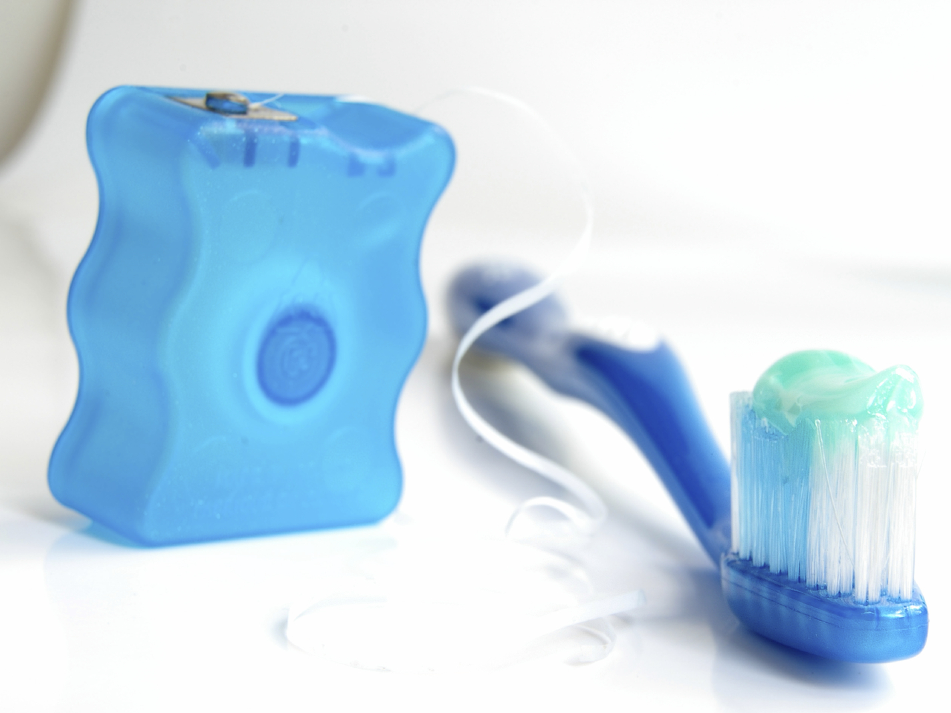
Dental plaque
Dental plaque is a sticky substance containing bacteria, which is present on the surface of teeth.
Its presence can be minimised by good oral health - regularly brushing with a fluoride toothpaste and flossing to remove plaque at the gum margin between the teeth.

Slide 6
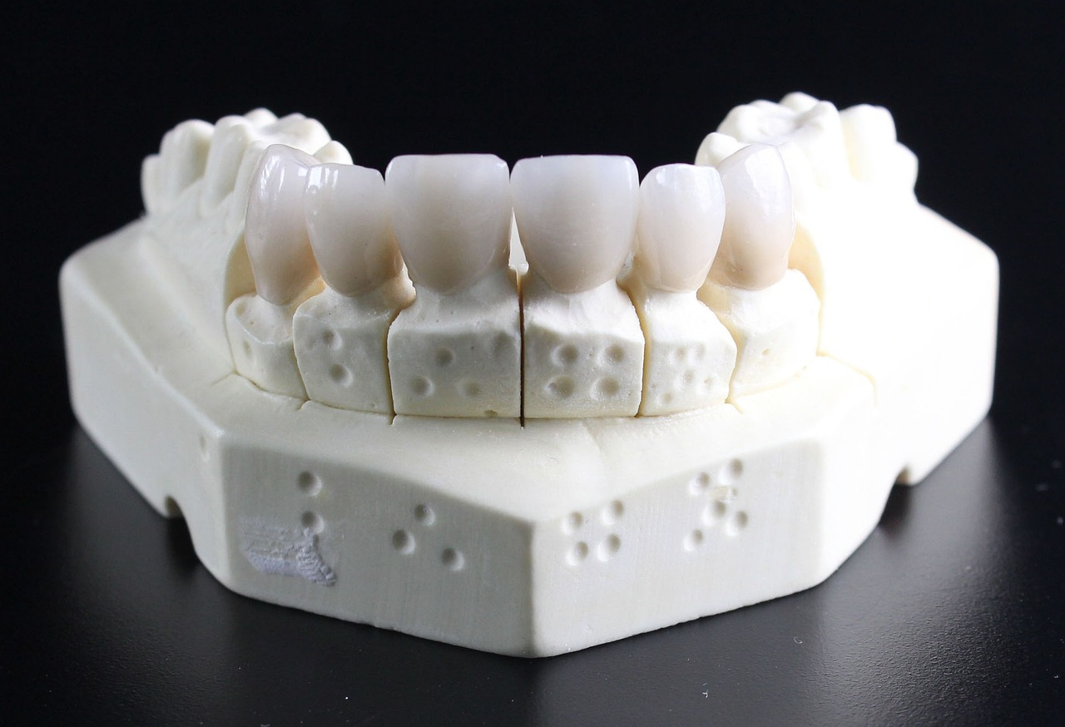
Demineralisation and remineralisation
Plaque bacteria produce acids by fermentation of sugars, which decreases the pH at the tooth surface. The sugars may already be present in foods or produced by starch breakdown in the mouth.
These acids dissolve the minerals in the enamel (calcium and phosphorous) – a process which is known as demineralisation. Enamel demineralisation takes place below a pH of about 5.5 – this has been called ‘critical pH’.

Slide 7
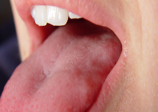
Demineralisation and remineralisation
The acids produced by bacteria in the mouth are gradually neutralised by saliva.
This causes the pH of the tooth surface to rise above ‘critical pH’.
The increase in pH causes a return of the dissolved calcium and phosphate back to the tooth enamel. This is called remineralisation.

Slide 8

Demineralisation and remineralisation
If foods or drinks containing carbohydrate are eaten frequently throughout the day, there is little chance for remineralisation to occur.
In contrast, if there is sufficient time between meals (approximately 2-3 hours) and the damage is not too great, the teeth can repair themselves through the action of salvia.

Slide 9

Dental caries
Dental caries (tooth decay) is the progressive destruction of the teeth by acid produced by the bacteria on the tooth surface.
It occurs when, over a period of time, the process of demineralisation is greater than remineralisation.
Attempts to prevent dental caries involve reducing the factors that cause demineralisation, and increasing the factors that lead to remineralisation.

Slide 10
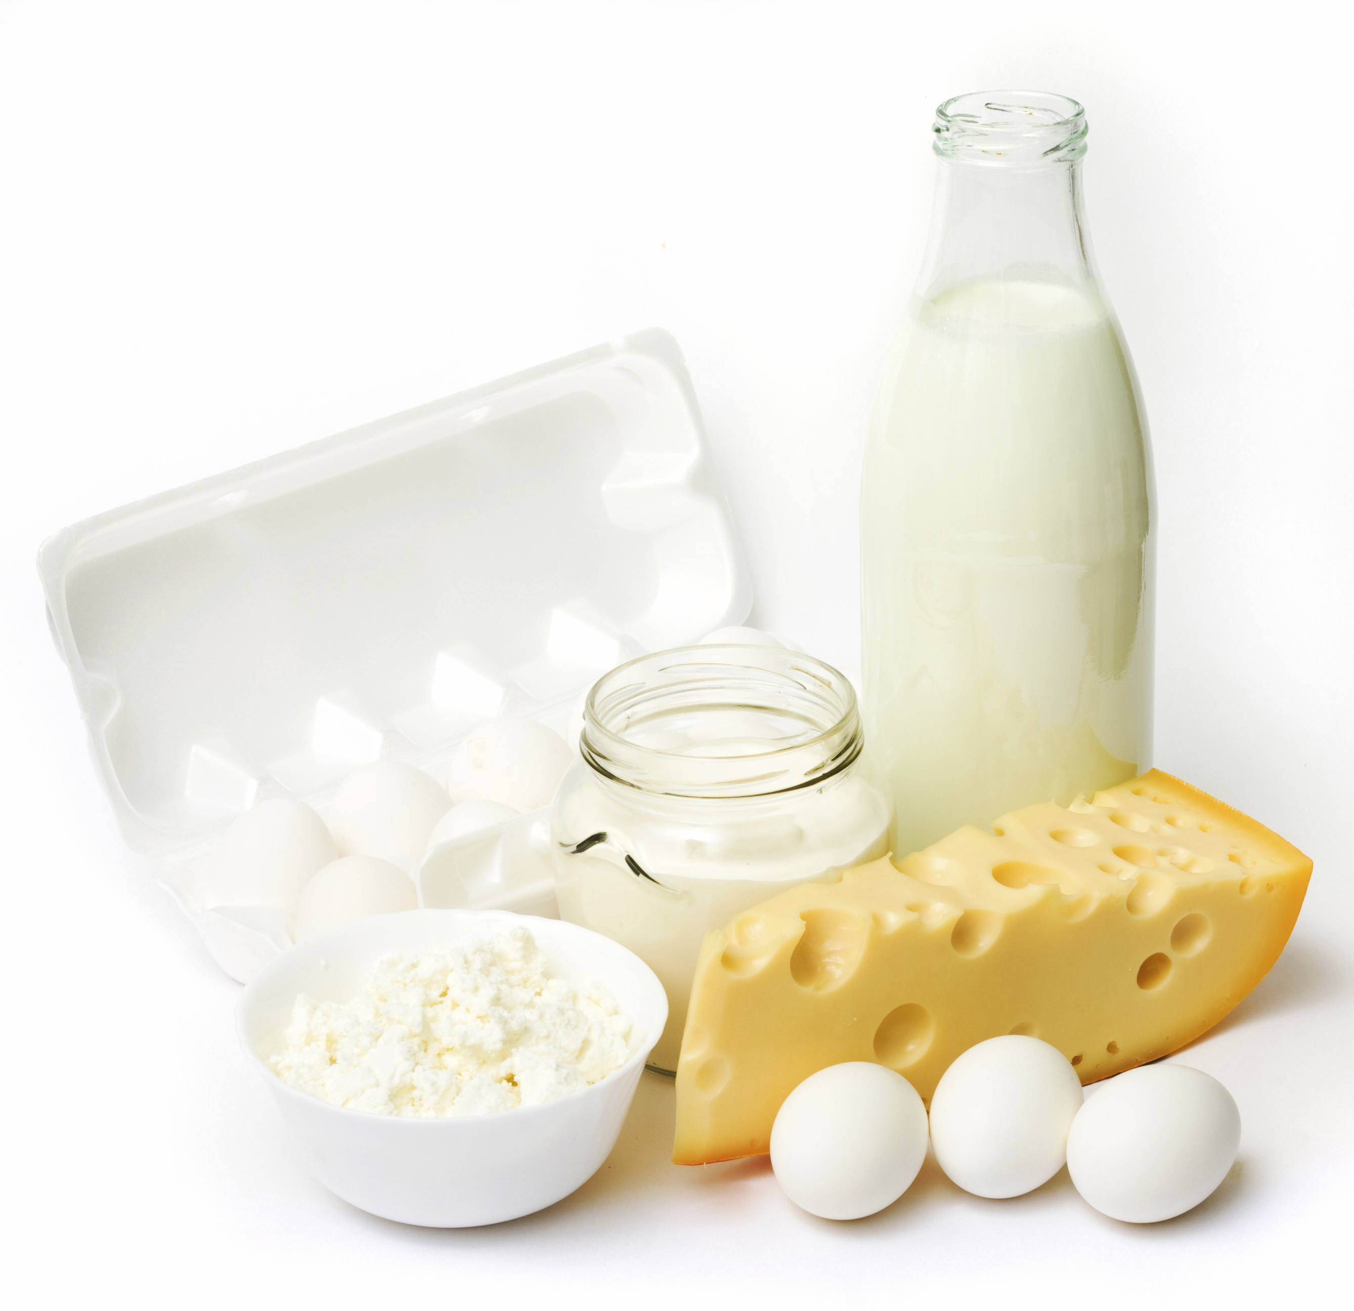
Factors affecting development of dental caries
Some foods may protect against caries.
Milk and dairy products, especially cheese, appear to be able to raise pH in the mouth and so reduce tooth exposure to acid.
Milk and cheese are both rich in calcium and phosphate, so eating these foods may encourage remineralisation.
Such foods may also increase saliva production which increases the pH level in the mouth, and encourages remineralisation.

Slide 11

Factors affecting development of dental caries
Foods high in fibre may help to increase the flow of saliva as does sugar-free chewing gum, helping to clean the surface of the tooth.
Sugar-containing chewing gum does not offer protection against dental caries, as the presence of sugar offsets the effect of increased saliva production.

Slide 12

Factors affecting development of dental caries
Fluoride is known to protect the teeth against caries.
Fluoride can be incorporated into the tooth during formation. It can also act locally once the tooth has erupted, making the enamel surface of the tooth more resistant to acid and it reduces the production of acids by bacteria in the mouth, and increases the remineralisation process.
Fluoride is naturally present in drinking water in some parts of the UK. It is often added where the fluoride content of drinking water is low.

Slide 13

Factors affecting development of dental caries
Sugars are the main dietary component associated with dental caries.
Sucrose (table sugar) is most commonly associated with dental caries, although glucose, fructose and maltose seem equally likely to cause caries.
How often sugar containing foods and drinks are consumed is more important than the amount of sugar consumed at any one time.

Slide 14

Factors affecting development of dental caries
The more frequently sugars are consumed, the greater the time during which the tooth is exposed to low pH levels at which demineralisation occurs.
It is important to encourage less frequent consumption of food and drinks containing sugar so that teeth have a chance to repair themselves.
It has been suggested that limiting sugar-containing food and drinks to mealtimes is one way to reduce the incidence of caries. This is because the presence of other foods limits the drop in pH.

Slide 15

Factors affecting development of dental caries
Fresh fruit is not strongly associated with caries. This is thought to be because the sugar is held in the cells of the fruit, and are not released until chewing breaks down the cells.
However, the acidity of some fruits and fruit juices (e.g. oranges, lemons, limes) can cause dental erosion - the progressive loss of enamel from the tooth.

Slide 16

Factors affecting development of dental caries
In fruit juice, where the sugars are no longer held in the cells of the fruit, development of caries can occur, especially if the juice is in contact with the teeth for a long period of time, e.g. fed in a baby’s feeding bottle or swished around in the mouth).

Slide 17
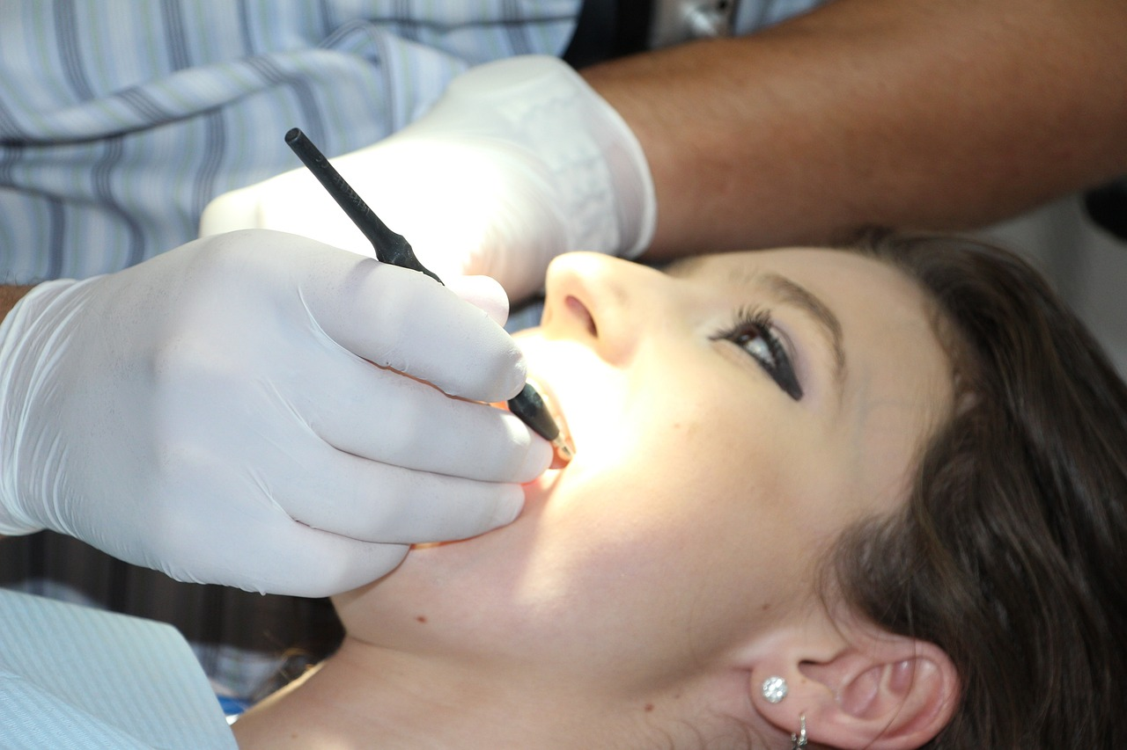
Factors affecting development of dental caries
Another factor is the retentiveness (stickiness) of the carbohydrate. Foods such as dried fruit or toffees may stick to the teeth, reducing the pH in the mouth for a long time.
It is important that teeth are brushed regularly each day, with a fluoride toothpaste, to remove any food sticking to the teeth. Regular tooth brushing and the use of dental floss also removes the dental plaque coating the tooth surface and gum margins.
Regular visits to the dentist are important to ensure that dental health is maintained.

Slide 18

Factors affecting development of dental caries
Dental erosion differs from dental caries, in that it is not caused by bacteria, but rather by the action of acid (e.g. stomach acid or acidic foods and drinks), which is accelerated by abrasion (e.g. overenthusiastic use of the toothbrush).
Approximately 50% of children aged 5 years and 30% of children aged 14 years show evidence of dental erosion.

Slide 19

Factors affecting development of dental caries
Dietary acids play a role in dental erosion. Soft drinks, particularly carbonated beverages (including diet beverages), fruit juices and vinegar all contain mild acids which can promote dental erosion.
Dental erosion can be caused by the consumption of acidic foods and drinks, such as carbonated beverages and fruit juices. Therefore, having these drinks with meals, rather than between meals, can help reduce the risk of erosion.

Slide 20
Factors affecting development of dental caries
Also consuming such drinks through a straw can help prevent erosion, as this helps reduce contact with the teeth. Swishing such drinks around the mouth, a common practice among some children, should be discouraged.
As acidic foods and beverages soften the enamel of teeth, it is important not to brush teeth for at least one hour after consumption of such foods and drinks. Leaving such a period of time between consumption and brushing will allow enamel to remineralise.
To help prevent tooth decay, remember to brush your teeth twice a day and visit the dentist regularly.

Slide 21
Kahoot Quiz
Open the link below on the main screen and get students to log onto kahoot.it on their tablets or smartphones.
They can then enter the code (that will come up on the main screen when you start the game) and their own nickname.
They can then play along with the quiz choosing the multiple-choice answers that correspond with the questions on the main screen. There will then be a leader board of the scores after each question and at the end.
https://play.kahoot.it/#/?quizId=4e101f4e-0059-46fa-94a0-4aac3fa26c67

Slide 22
Development and maintenance of healthy teeth
For further information, go to:
www.foodafactoflife.org.uk
This resource meets the Guidelines for producers and users of school education resources about food.

