Slide 1
Party food pictures

Slide 2
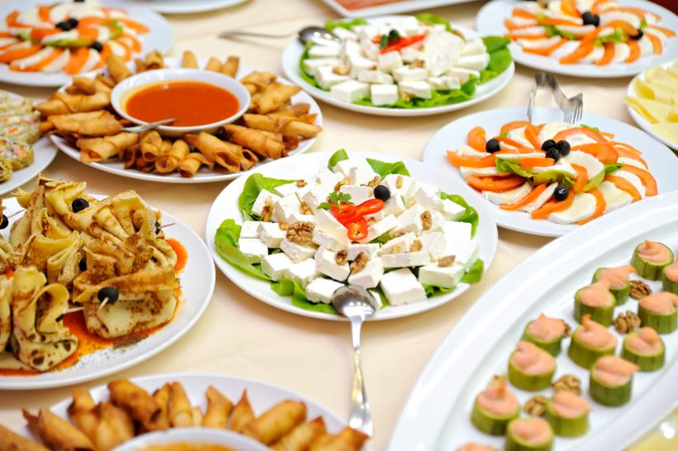
What foods can you see here?

Slide 3
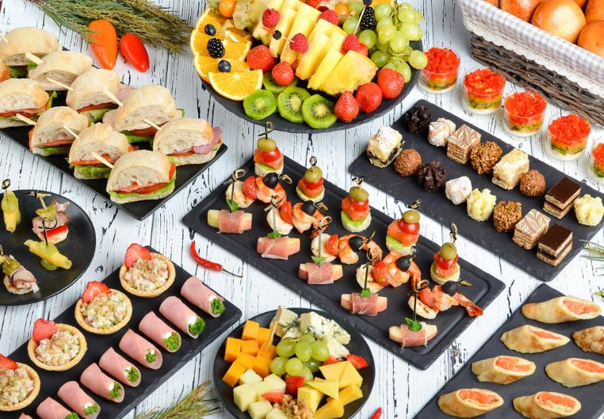
What do you notice about how this food is set out?

Slide 4
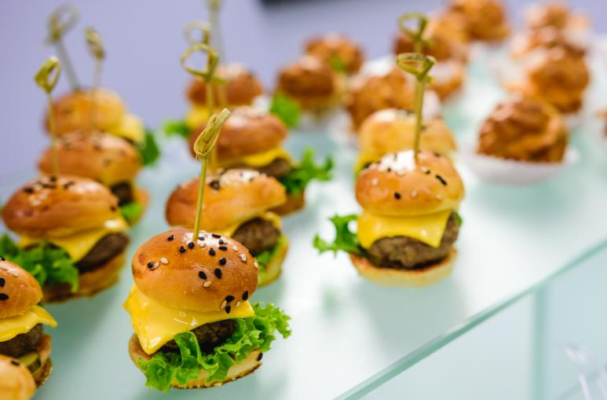
Which ingredients in this party food come from plants and which come from animals?

Slide 5
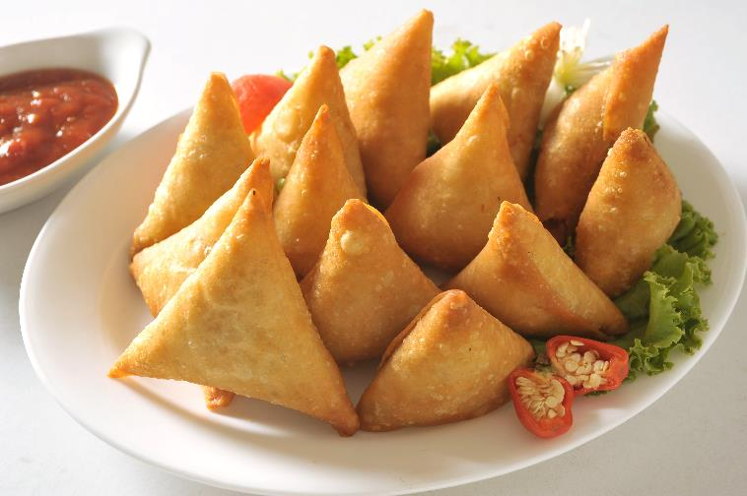
What are these called?

Slide 6
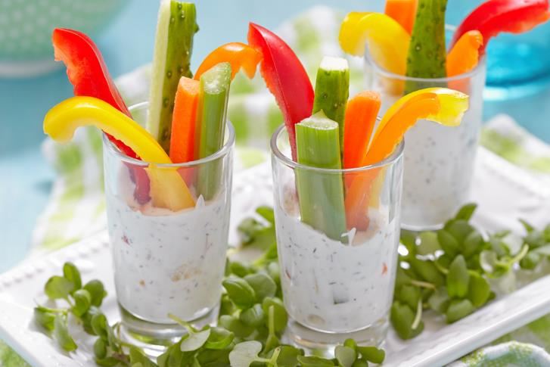
What do you think this is?

Slide 7
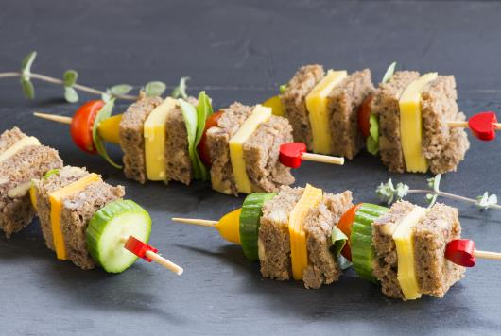
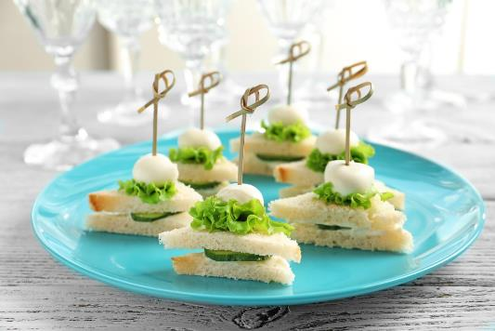
Would these be good for a party? Why?

Slide 8


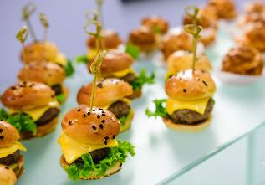

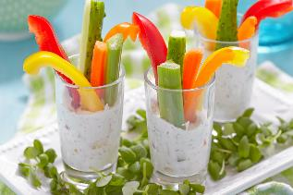
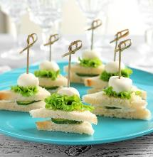
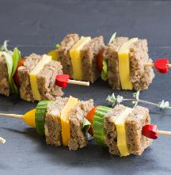
Which of these food would you most like to eat and why?

Slide 9
Party food pictures
For further information, go to:
www.foodafactoflife.org.uk

