Slide 1
Special occasions

Slide 2

People often eat different food on special occasions.
What is a special occasion?
What special occasions do you celebrate?

Slide 3
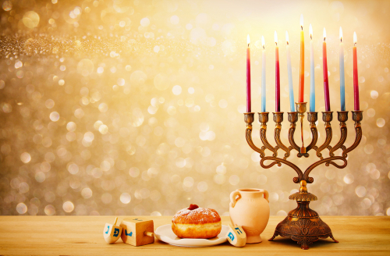
What is this special occasion?
What might people eat?
Jam filled doughnuts
Potato pancakes
Hanukah

Slide 4
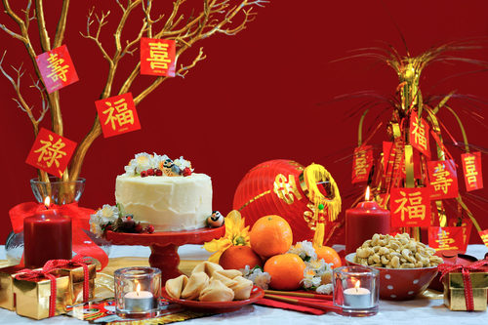
What is this special occasion?
What might people eat?
Dumplings
Tangerines
Chinese New Year

Slide 5
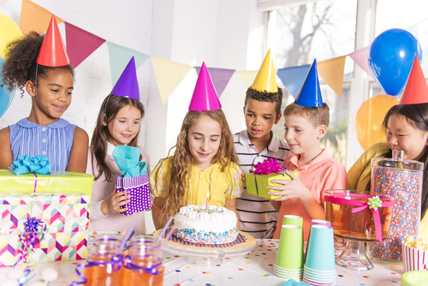
What is this special occasion?
What might people eat?
Cakes
Sausage rolls
A birthday

Slide 6
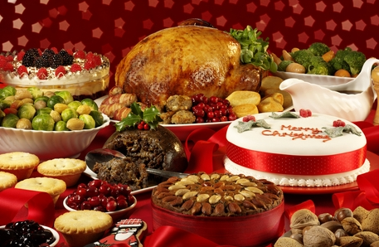
What is this special occasion?
What might people eat?
Turkey
Mince pies
Christmas

Slide 7
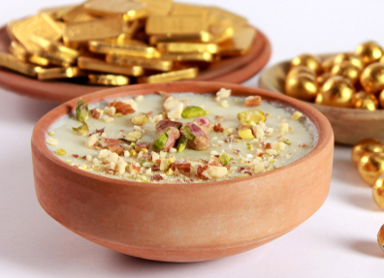
What is this special occasion?
What might people eat?
Special rice pudding
Chocolates
Eid al-Fitr

Slide 8
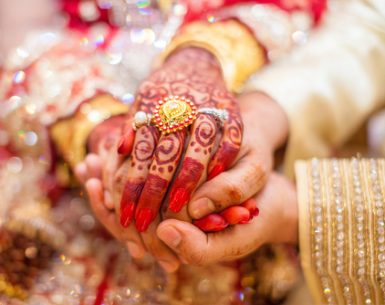
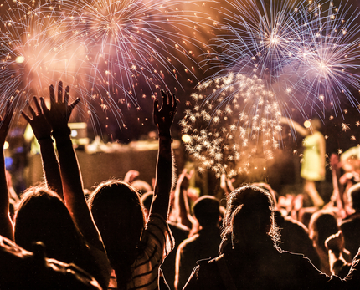
What other special occasions can you think of?
What might people eat?

Slide 9
Special occasions
For further information, go to:
www.foodafactoflife.org.uk
This resource meets the Guidelines for producers and users of school education resources about food.

