Slide 1
The digestion process

Slide 2
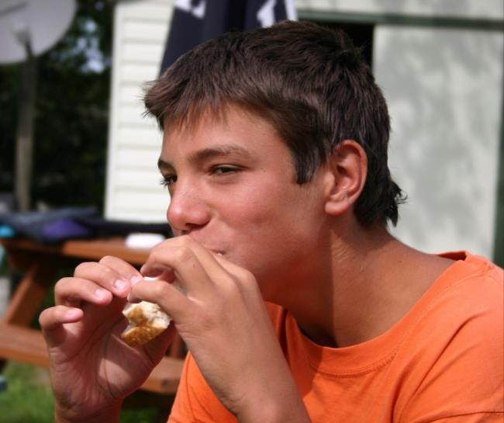
Food as a fuel
The body requires energy from food and drink.
Our bodies release the energy and nutrients from food.
Sometimes food can take 2 or 3 days to be fully digested and absorbed by the body.

Slide 3
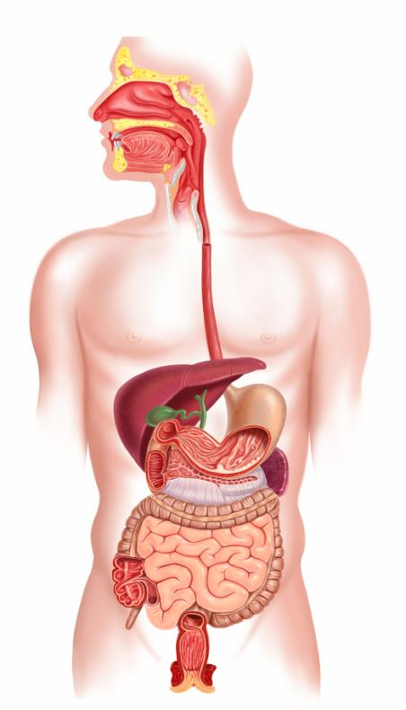
The digestion process
The gastrointestinal (GI) tract comprises:
mouth;
oesophagus;
stomach;
small intestine – duodenum, jejunum and ileum;
liver and gall bladder;
pancreas;
colon
anus.

Slide 4

The body parts used in the digestion process
Mouth
Oesophagus
Stomach
Small intestine
Colon
Anus
Rectum

Slide 5
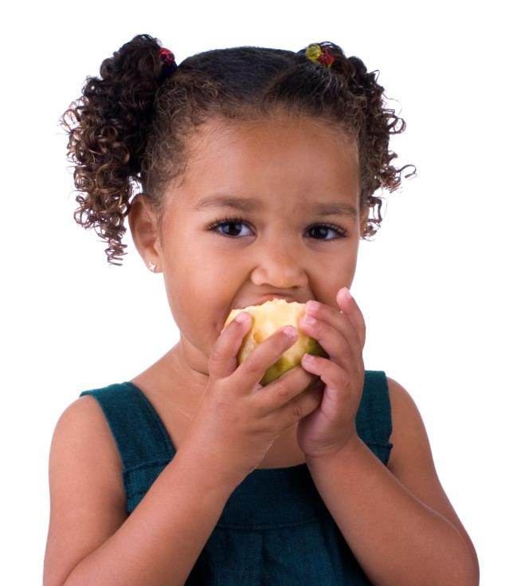
The mouth
Mastication is the action of the teeth and the jaws working together to break food down.
Food needs to be chewed and broken down into pieces small enough to swallow.
Breaking the food down also gives it a larger surface area for the digestive enzymes to work on.
Did you know?
There are two main types of teeth in the mouth:
incisors to tear food, e.g. meat;
molars to grind the food.

Slide 6
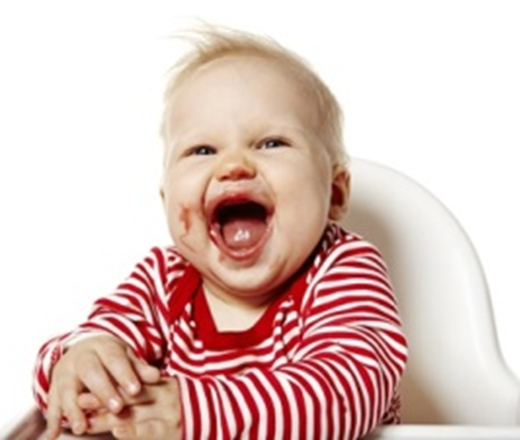
Saliva
Saliva contains the enzyme amylase which breaks down starch into simple sugars.
It also moistens the food to allow easier passage through the gastrointestinal tract.
Saliva is secreted from salivary glands around the mouth.
Did you know?
The sight, smell, taste or even the thought of food will start to increase the amount of saliva secreted.

Slide 7
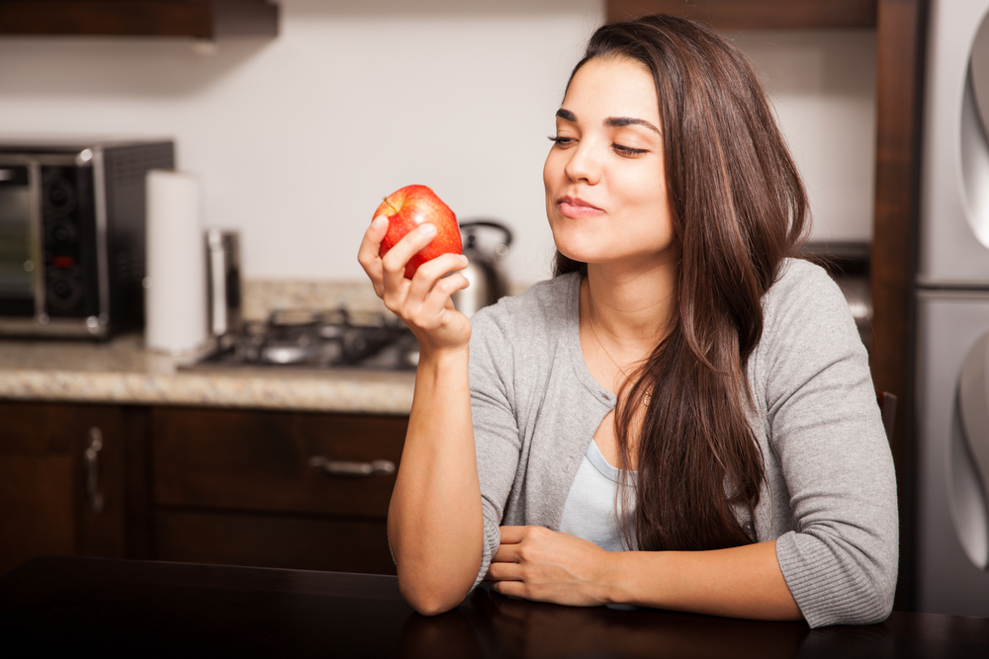
Moving on from the mouth
Food is masticated and mixed with saliva in the mouth.
The tongue and cheeks help to push the food into the teeth and also shape the food into a ball or bolus before being swallowed.
The bolus is passed through to the oesophagus.

Slide 8
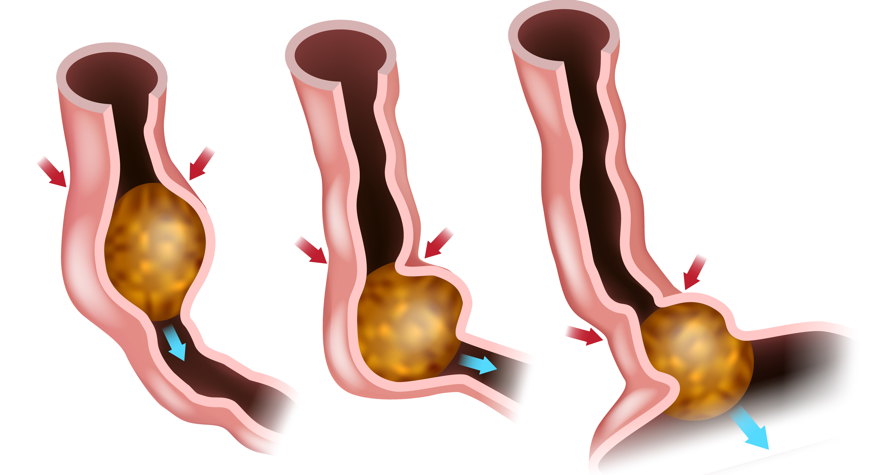
The oesophagus
The oesophagus is similar to a conveyor belt as it transfers the food bolus from the mouth to the stomach in a few seconds.
Circular muscles in the wall of the oesophagus relax in front of the bolus while circular muscles behind the food contract, pushing the food bolus onward. This is called peristalsis.
Did you know?
People do not have conscious control over the muscles in the oesophagus. Even if someone is upside down, the food will be passed on to the stomach.

Slide 9
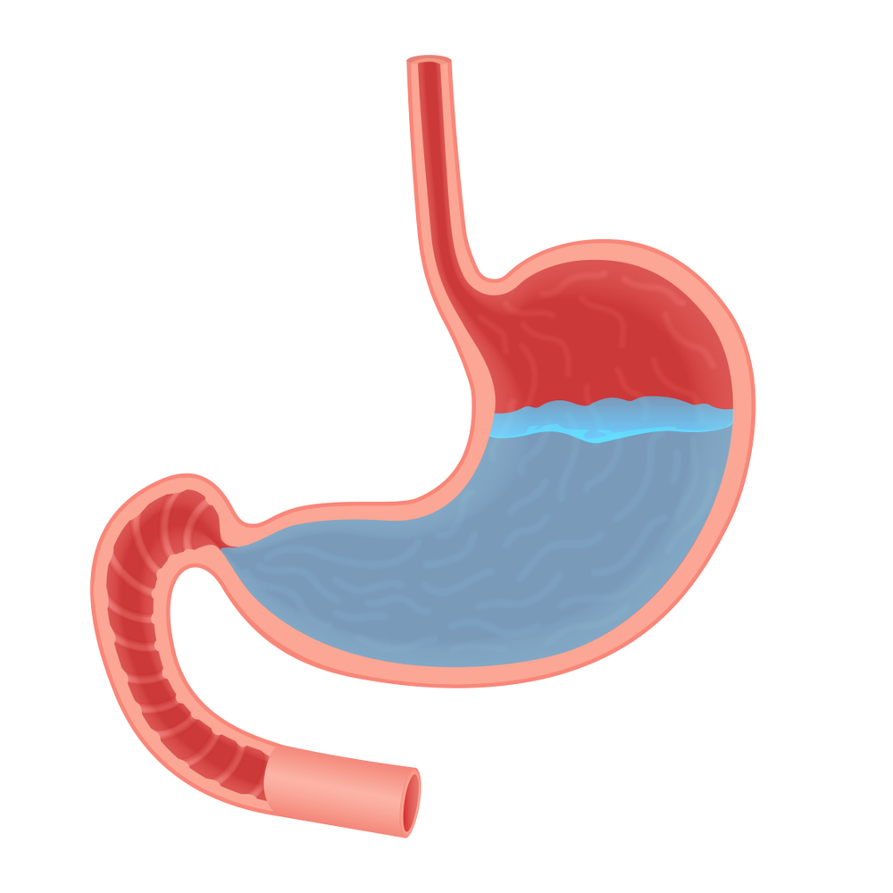
The stomach
The stomach is an expandable sack made up of three different layers of muscles where the food bolus will be churned for a few minutes or up to a few hours.
The bolus is mixed with hydrochloric acid (HCl) which helps to kill any bacteria present.

Slide 10
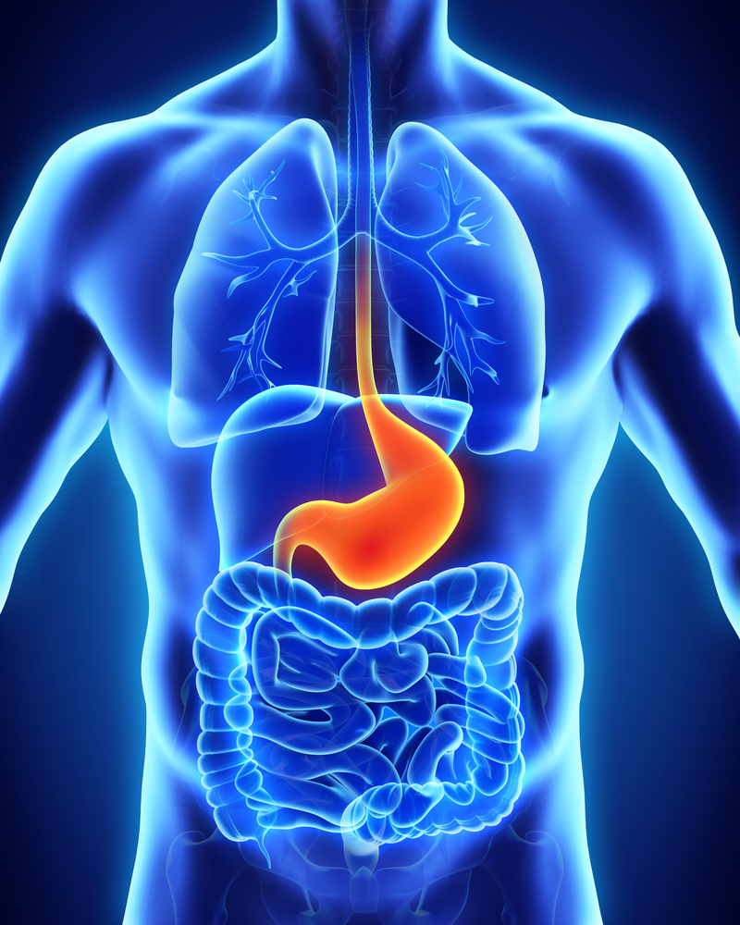
The stomach
The enzyme pepsin is also active in the stomach. It starts to break down protein to form peptides and amino acids.
Alcohol is absorbed through the stomach wall and taken to the liver where it is broken down.
When the food has been churned into a creamy mixture known as chyme, the pyloric sphincter (a ring of muscles) opens and the chyme is released gradually into the small intestine. Chyme consists of gastric juices and partly digested food.

Slide 11
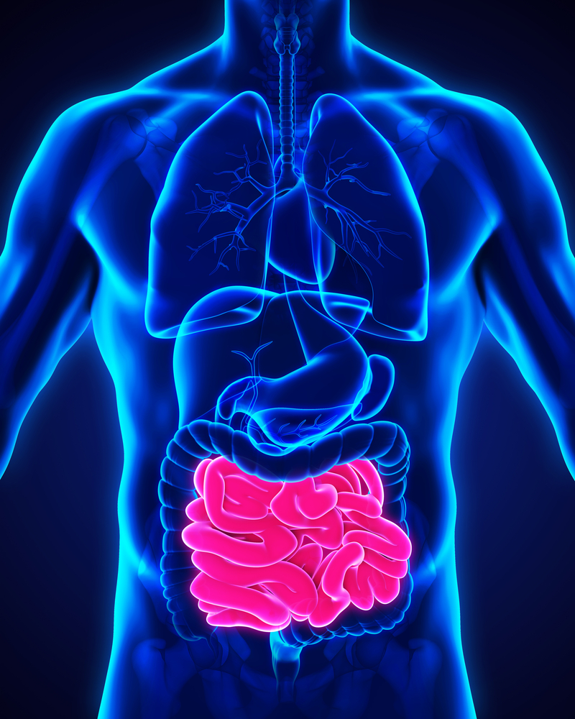
The small intestine
Chyme passes out of the stomach through the pyloric sphincter into the small intestine.
The small intestine is a tube about 6 metres long.
The small intestine is divided into three sections:
duodenum;
jejunum;
ileum.
The first section of the small intestine is the duodenum.

Slide 12
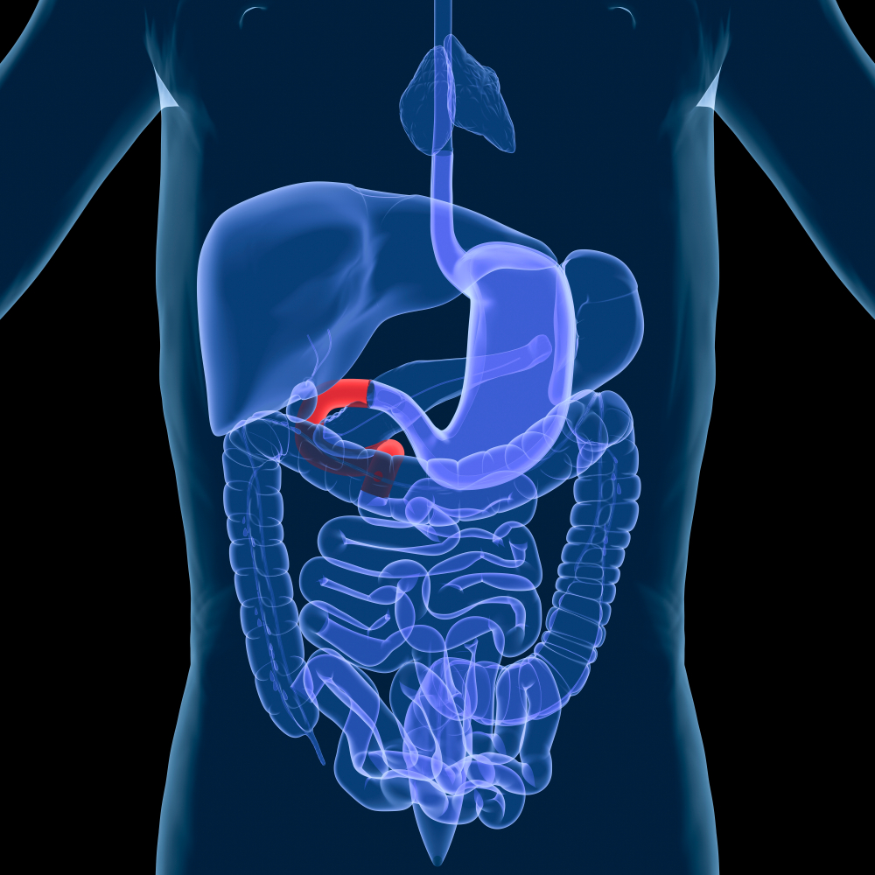
The duodenum
In the duodenum, chyme is diluted with bile salts (from the gall bladder) and pancreatic juices (from the pancreas).
Did you know?
The duodenum is about 25 centimetres long and in the shape of a horse shoe.

Slide 13
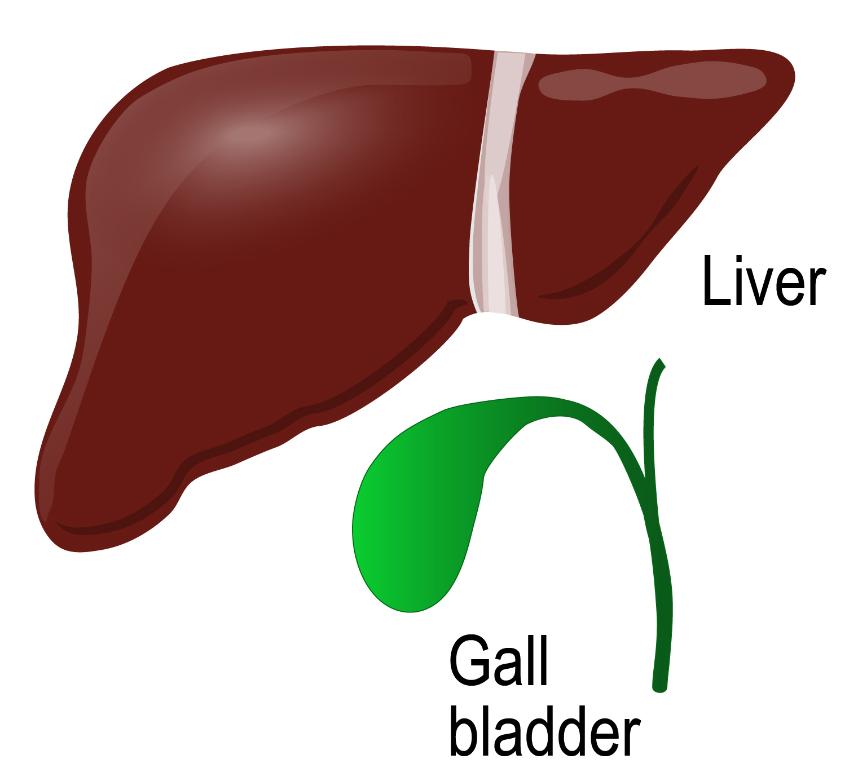
Bile
Bile is a fluid produced in the liver and stored in the gall bladder. This contains bile salts which emulsify fat, which is normally insoluble in water.
Emulsified fat droplets can then mix with the watery digestive juices, which contains the enzyme lipase to digest the fat efficiently.

Slide 14
Pancreatic juices
The pancreas secretes alkaline pancreatic juices.
These juices contain sodium bicarbonate to neutralise the hydrochloric acid mixed into the chyme from the stomach and provide an optimum pH level for the enzymes to work.
Pancreatic juices also contain digestive enzymes to break down nutrients:
Protein → Peptides + Amino acids
Trypsin and Chymotrypsin
Starch / Glycogen → Maltose
Pancreatic amylase
Fat → Fatty acids + glycerol
Pancreatic lipase

Slide 15
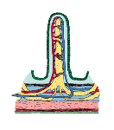
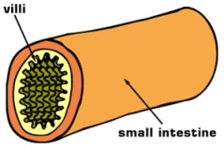
Wall of the small intestine
The inner surface of the small intestine is folded into finger-like structures called villi, which greatly increase the surface area available for absorption.
Did you know?
The villi have a surface area of about 200m², this is equivalent to the size of a tennis court.

Slide 16
Small intestine
Digestion which occurs in the wall (brush border) of the small intestine includes:
Peptides → Amino acids
Protease
Maltose → Glucose
Maltase
Sucrose → Glucose + Fructose
Sucrase
Lactose → Glucose + Galactose
Lactase
The enzymes important in each process are highlighted in bold.

Slide 17
Absorption
These substances are absorbed in the small intestine:
water;
alcohol;
sugars;
minerals;
water soluble vitamins;
peptides and amino acids;
fatty acids, glycerol and fat-soluble vitamins.

Slide 18
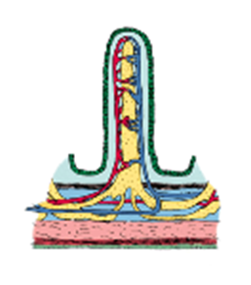
Absorption
The villi in the small intestine have a high blood supply. There are two types of absorption which occur here.
Passive –
through the process of osmosis, the nutrients pass through the wall of the small intestine into the blood supply. Passive absorption moves molecules from their higher concentration to their lower concentration.
Active –
a carrier transports nutrients through the wall of the small intestine into the blood supply. This type of absorption requires energy as it occurs against a concentration gradient.

Slide 19
Absorption
Once in the blood, the nutrients are transported to the liver via the hepatic portal vein. Most fatty acids and glycerol pass into the lymphatic system, and then into the bloodstream.
The liver filters and converts the nutrients into substances that can be used by body cells for energy and growth.
Once the nutrients have been absorbed, the undigested substances pass into the colon (large intestine).

Slide 20
Elimination – the colon (large intestine)
The colon is a tube just over 1.5 metre long and is inhabited by bacteria.
The main function of the colon is to absorb water into the bloodstream and to process waste products.
Bacteria in the colon ferment dietary fibre and produce fatty acids and gas.
Other bacteria produce vitamin K, which is also absorbed.
The products of bacterial digestion, along with water and any remaining minerals are absorbed leaving a residue behind.

Slide 21
Elimination
The watery residue moves along the colon, the faeces are formed and stored in the rectum before being excreted through the anus.
Young children gradually learn to control this action.
The time taken for faeces to pass through the colon can be reduced if the diet is high in fibre.

Slide 22
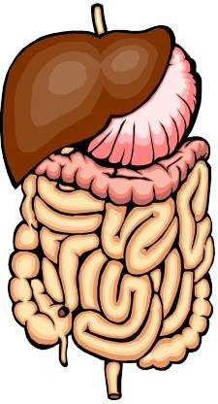
Gut bacteria
The gut contains 400 – 500 different species of bacteria and includes potentially pathogenic (e.g. Clostridia) and potentially beneficial (e.g. Bifidobacteria and Lactobacilli) bacteria.
These are measured in colony forming units per millilitres (cfu/ml).
Stomach 10¹ – 10³ cfu/ml
Duodenum & jejunum 10² – 10⁵ cfu/ml
Colon 10¹⁰ – 10¹² cfu/ml

Slide 23
Enzymes
Enzyme | Where it is made | Where it works | What it does
Protease | Stomach, pancreas, small intestine | Stomach, small intestine | Breaks protein molecules in to amino acids.
Lipase | Pancreas, small intestine | Intestine | Breaks fat molecules into fatty acids and glycerol
Carbohydrase | Salivary glands, pancreas | Mouth, small intestine | Breaks down carbohydrate into sugars

Slide 24
Summary of the phases of digestion
Ingestion
the intake of food into the gastrointestinal tract.
Digestion
a series of physical and chemical processes which begin in the mouth, but take place mainly in the stomach and small intestine.
Absorption
the passage of digested food substances across the gastrointestinal lining into the bloodstream and lymphatic system.
Elimination
the excretion of undigested food substances (such as cellulose) or waste in faeces.

Slide 25
Quiz- Kahoot
Open the link below on the main screen and get students to log onto kahoot.it on their tablets or smartphones. They can then enter the code (that will come up on the main screen when you start the game) and their own nickname. They can then play along with the quiz choosing the multiple choice answers that correspond with the questions on the main screen. There will then be a leaderboard of the scores after each question and at the end.
https://play.kahoot.it/#/?quizId=0f07089f-a94b-4760-bc22-a4789e656799

Slide 26
The digestion process
For further information, go to:
www.foodafactoflife.org.uk
This resource meets the Guidelines for producers and users of school education resources about food.

