Slide 1
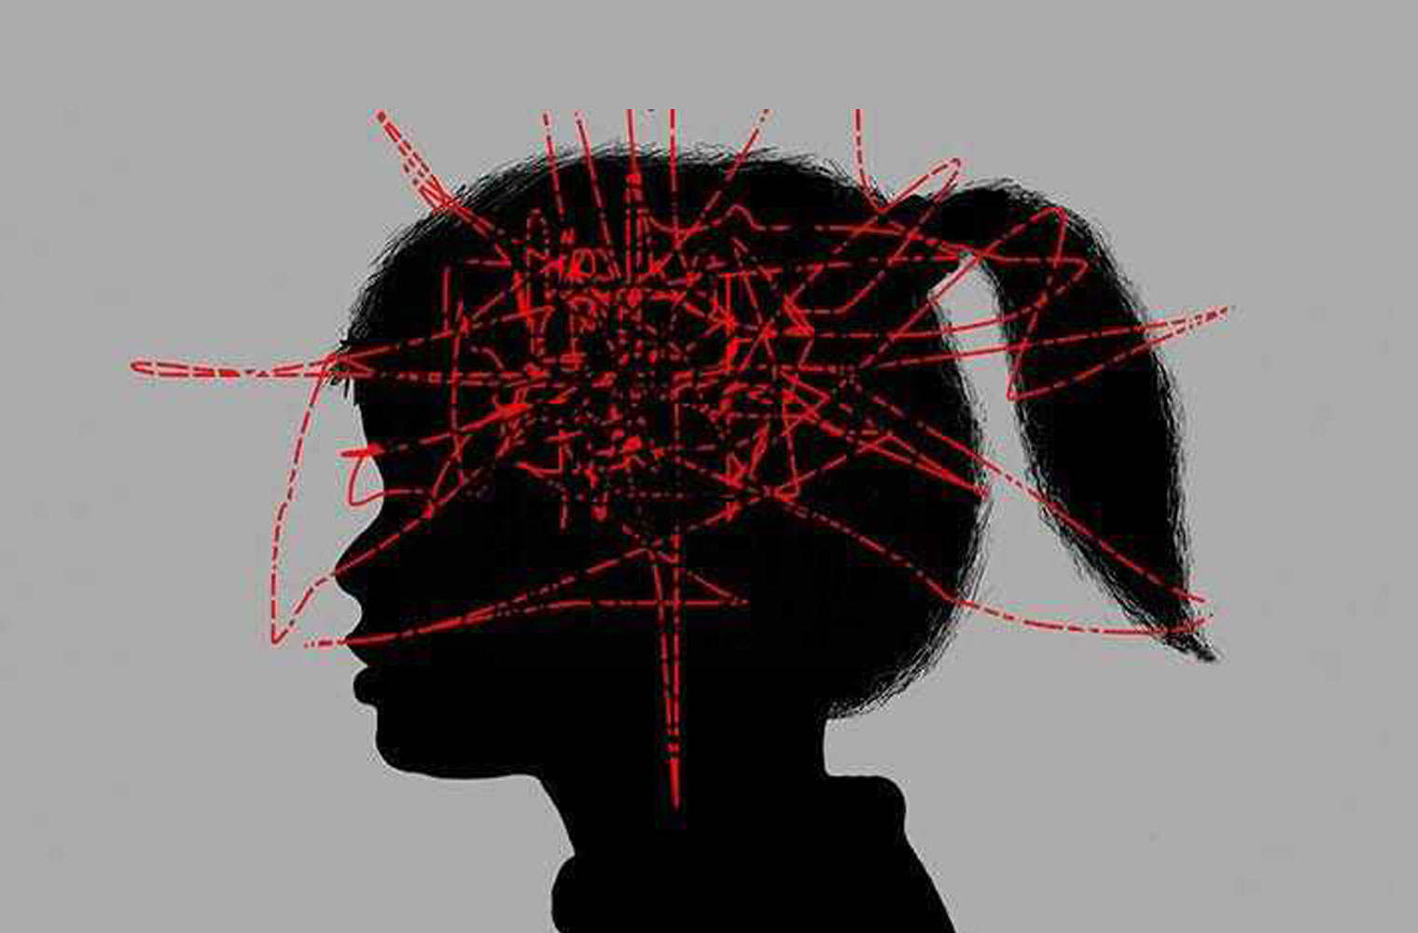
How it began
‘Trauma’s a big word. Don’t worry Suzi, children bounce back…’
Notes:
Why am I here talking to you about Trauma today? Introduce self and how this research came about. The sentence that started it all, it’s almost like thy’re traumatised… trauma’s a big word, don’t worry Suzi, children bounce back easily.

Slide 2
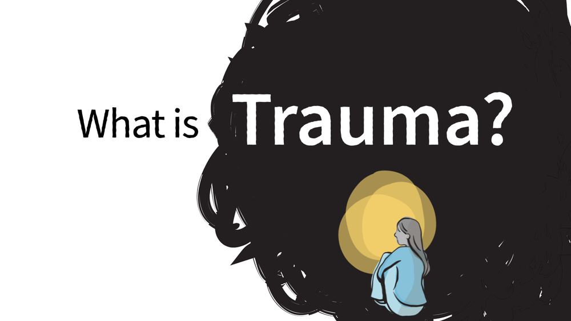
“Trauma is the emotional, psychological, and physiological residue left over from heightened stress that accompanies experiences of threat, violence, and life-challenging events” (p. 10, ACF 2010).
Trauma isn’t the event itself but the inability to discuss the event or feel understood (Mate 2021)
https://thewisdomoftrauma.com/

Slide 3
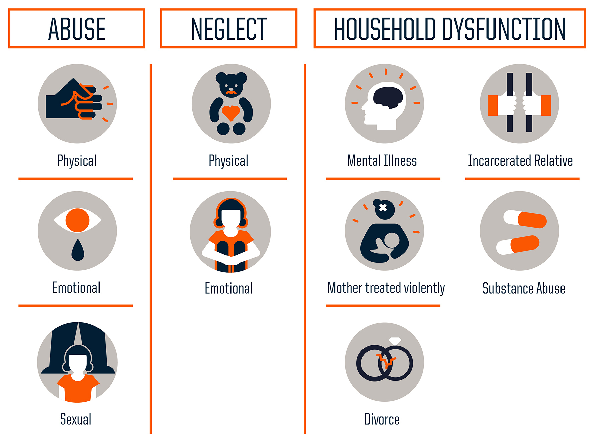
How do we know?
ACE’s Scale (Felitti et al., 1988)
Indicators of trauma, not certainties
Other indicators for trauma exist (Bartlet & Sacks, 2019), yet the only measurable scale we have.
ACE’s are common. 67% of UK population thought to have experienced at least 1 ACE in 2018, and over 8% 4 or more.
Pandemic not only made ACE’s occurring more likely, but will be categorised as an ACE in the future (TISUK 2022)

Slide 4
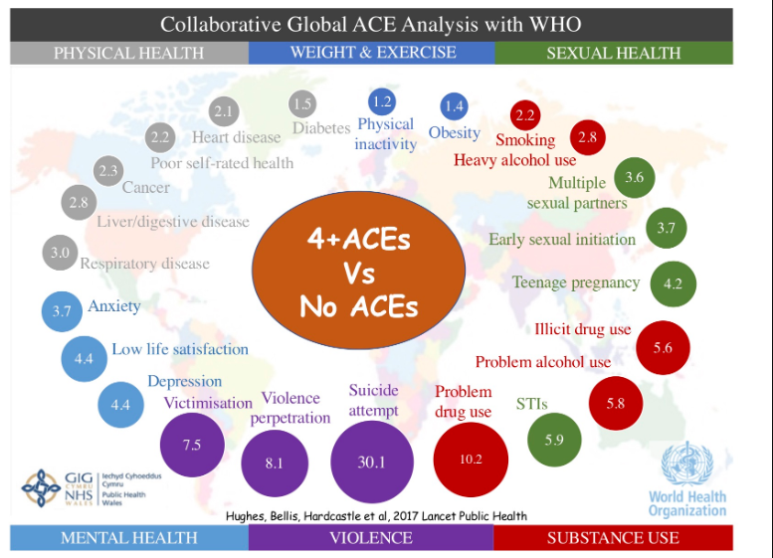
The impact…
Results of the meta-analysis by Hughes et al., (2017), who analysed the data of an estimated 250,000 participants over 37 separate ACE’s studies, which were all based on the original study by Felitti et al., (1998).

Slide 5
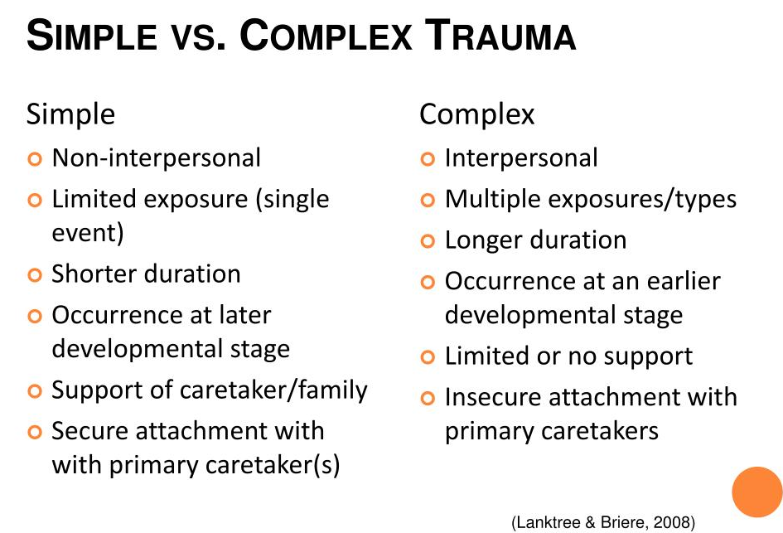
Flipping the script on our understanding of trauma.
Secondary adversary: simple can transform into complex quickly, as further repercussions can occur
Notes:
Maybe find different info graphic for this?

Slide 6
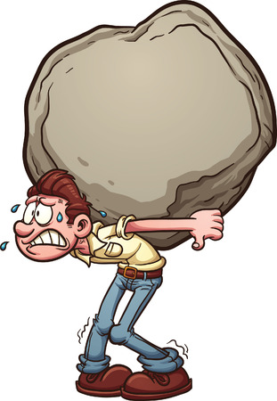


Boulders vs. Pebbles…
Big ‘T’ and little ‘t’ trauma
More obvious trauma, more obvious struggle, quicker to receive support to break the bolder into more manageable pieces
Less obvious, hidden trauma, less likely to receive support or more likely to be dismissed.. ‘it’s just a pebble’

Slide 7
Why should teachers know about it?
“Childhood trauma can have a direct, immediate, and potentially overwhelming impact on the ability of a child to learn. Yet, this issue has largely been ignored by our education system” (McInerney & McKlinton 2014).

Slide 8
The impact on education
ACE’s and Education
No ACEs:
97% had no learning difficulties or behaviour problems
3 ACEs or more
3x as likely to experience academic failure
5x as likely to have attendance problems
6x as likely to have behavioural problems
4 ACEs or more
Over 50% had learning needs
32x more likely to have behaviour problems.
TISUK 2022

Slide 9
Why KS3?
Knock on effect – the foundations are not there, so how can you build on them later on if we don’t address this now?
Children are more susceptible to adults, adolescents are driven by peers, likely to have more impact – both teachers and peers(Blakemore 2018)
Students will have less and less consideration during exams as time goes on
No foundation of self-learning within these year groups as they have had less opportunity to develop methods for independent learning and learning habits
Developing strategies at the beginning of secondary life will allow them to develop successful learning habits, with time for them to fail in more low stakes environments (Lansdown 2022)
Impact for
F&N

Slide 10
Emotional effects can be categorised in 3 main areas
Sense of safety
Feelings of connectedness
Feelings of hope
Other people and the world as unsafe and unpredictable
Students who are hyperaware, will not be able to learn (Streeck-Fischer & van der Kolk, 2000)
Students see learning as a risk (Antony & Swinson 2009) and because of the need to feel safe are willing to take less risks.
(NCTSNTC 2008)
Students will present in different ways eg, acting out, becoming more quiet and introverted, not being able to understand why they have acted in a certain way (NCTSNSC 2008)
May seek to place adults in the role of perpetrator
Various aspects of executive functioning, including cognition, comprehension, attention, and behaviour regulation that impede students’ ability to focus on classwork and be successful (Cole et al., 2005)
See themselves as incompetent and worthless
Question skills and abilities
Future as hopeless (what’s the point..?)
Impact for
F&n
(Grills-Taquechel et al., 2011; Mancini et al., 2011; SAMHSA, 2014b).
Notes:
Bridging slide between trauma and memory, look at how you phrased it in your assignment. Add in the strategies for dealing with trauma that are available already to aid regulation and safety, this can then but then find a way to bridge. Why does it effect their behaviour, brain development, then move onto memory,

Slide 11
If that wasn’t enough…Developmental Trauma
Developmental trauma is defined as trauma that has an impact on a child’s brain development.
The impact of trauma is more quickly manifested, due to the more malleable nature of a child’s brain and its developmental immaturity. It also leaves ‘deeper tracks of damage’ (pg 13, ACF 2010).
Children’s development can regress (McRory et al 2010), slow down or be impaired (Anda et al., 2006; Black et al., 2012).
This is intensified when they do not have a ‘responsible adult’ as it hinders the predictability and stability of their connections with others with whom they trust, for example, those who live with domestic violence, neglect, or experience high parental conflict (ACF 2010).

Slide 12
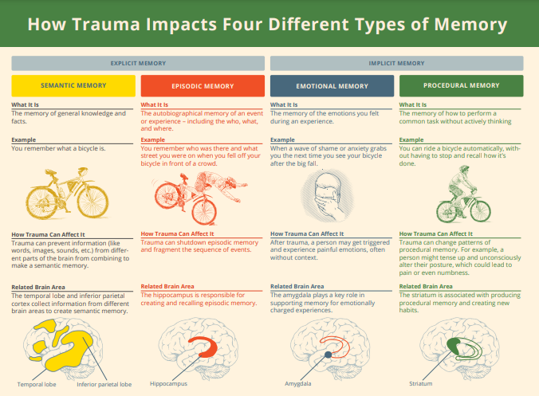
Notes:
Add this to slide 15 and highlight the key issue that is a problem for design and technology

Slide 13
The factors affecting memory
Feelings of safety
If threatened or hypervigilant in a classroom setting, students will not be able to retain information
Reduce Risk
Feelings of connectedness
May have blocked learning if learning was concurrent with trauma, or felt unsupported
Foster support
Feelings of hope
Struggle to see the point of learning, less likely to take steps to learn, but also may need support later when it’s ‘too late’
Small wins
Developmental Trauma
Trauma has directly affected the parts of the brain responsible for memory-making.
Support memory-making
Notes:
Amalgamate notes into this slide

Slide 14


Literature and strategies to support?
Feelings of safety
If threatened or hypervigilant in a classroom setting, students will not be able to retain information
Reduce Risk
Feelings of connectedness
May have blocked learning if learning was concurrent with trauma, or felt unsupported
Foster support
Feelings of hope
Struggle to see the point of learning, less likely to take steps to learn, but also may need support later when it’s ‘too late’
Small wins
Developmental Trauma
Trauma has directly affected the parts of the brain responsible for memory-making.
Support memory-making
Much COVID specific literature focussed on recall, not retention
Notes:
Amalgamate notes into this slide

Slide 15


How memory works
How we think memory should work
How memory actually works
Shutterstock
Technology review
Not a lot on how we support traumatised children to remember in a learning context, as we haven’t dealt with a global situation like this before, so focussed on strategies for individuals not classes. Literature was hard to find and again focussed on regulation. Sought strategies from other areas of literature, including executive function, metacognition and modelling thought processes

Slide 16
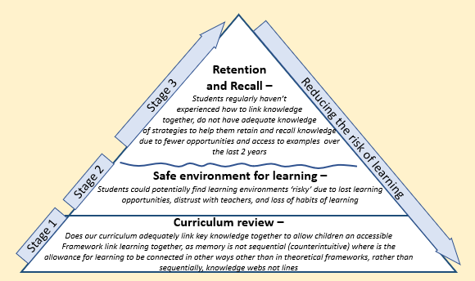
Beneath the surface
Notes:
Add gaps in here, highlighting at each level where they fit and what information you have already.

Slide 17
Adapting how we teach the Curriculum
This is not to replace external help or 1 to 1, this is to provide a framework for affected learners to feel supported to learn – not trauma investigators or mental health professionals
Due to the nature of school, students disengage with learning after every lesson.
How we help students that come into lessons without regulation
How do we help children gain knowledge that may have been lost or missed?
What learning strategies will be successful for trauma effected learners, so there are routines in place and a familiarity within the classroom when they are able to learn.
Planning for error effectively
We need to look at how you teach a curriculum with memory in mind
What can support all learners?
How do we make links between knowledge explicit?
How memory works is actually how curriculum should work - Juan Fernandez 2022 (Chartered college of teaching)

Slide 18

Stage 1
Testing – high risk for students therefore likely to shutdown
Plan for error
What content is important?
Is it taught in an order for memory or an order for practical?
Where can we recap?
Where can we find time to allow for linking frameworks to occur?
Low risk testing (assessment/knowledge recap) – rethink what we call it and our approach to it
Making links to prior learning – helps lower threat of new knowledge
Identifying key themes to pin knowledge to
Recap/knowledge recall

Slide 19

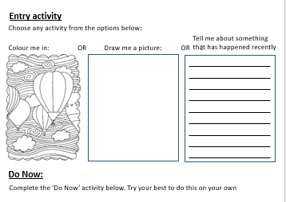
Stage 2
ENTRY
Pre’Do Now’ task – Entry Activity while completing the register
Settle into the lesson - regulation
Provides choice
Low risk start
First ‘small win’
Allow time for organisation
Then a ‘Do Now’ task, I can circulate and check in on certain students.
Notes:
CHANGE TO FOOD EXAMPLE

Slide 20
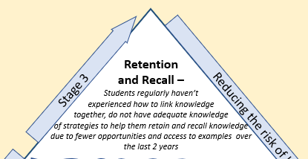
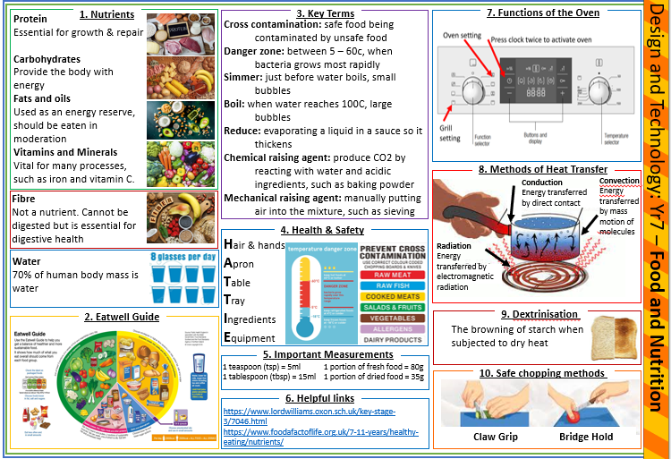

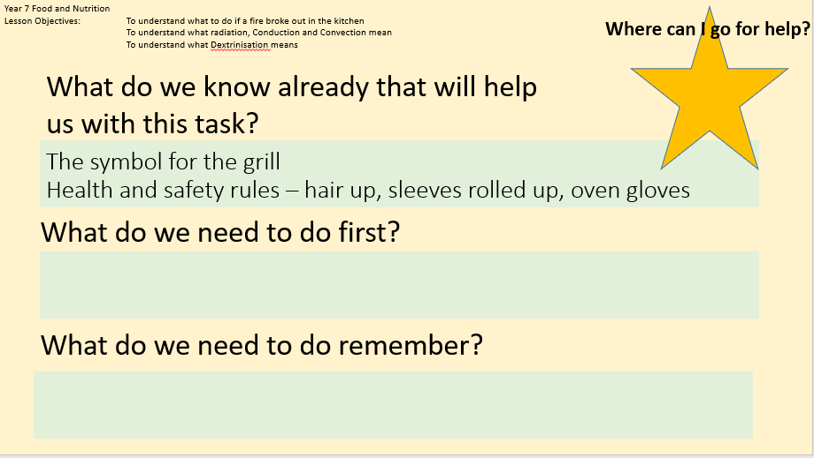
Stage 3
EXPLICIT EXAMPLES
Clear Chunked instructions
Knowledge organisers
Model thinking processes
Link prior learning – showing students the links, discussing it with them, not leaving them to make (or not make) the links themselves.
Use of ‘golden apron’ fostering support other than myself
Notes:
add level from your priamid CHANGE TO FOOD EXAMPLE

Slide 22
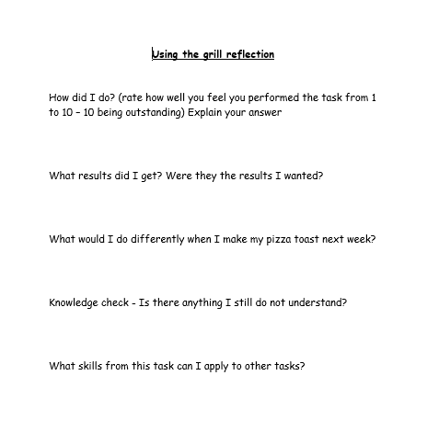
Closing
EVALUATE
Reflection on tasks
Opportunity to ask questions about elements learning not understood without having to tell you they don’t understand.

Slide 23
Why is this still important now…
As the dust is settling, this is when we all will start to see the impact of the pandemic, as we move out of survival mode (Harper 2021)
Re- traumatisation: cost of living, parents’ lives are harder, secondary adversaries thought I had recently in regard to behaviour… children depend on adults for regulation. If adults are not regulated it becomes harder for them to regulate
Look at the CAMHs waiting list, look at the students struggling with anxiety, it’s bigger than ever
The younger the events happen the more impact it has, COVID may be managed (not gone), but the effects will still be here for years to come
More students are disaffected, attendance is an issue, more lessons are lost, more knowledge to catch up on
Students have lost valuable time practicing habits connected with learning, we need to be upfront with what they are to help them
Strategies highlighted in the package of intervention will help all learners, not just traumatised ones as you don’t know who they are.
F&N – we need them to feel safe in their environment and their knowledge, otherwise the innovation we seek will not happen.

Slide 24
Top Tips
Encourage methods of communicating with you that they don’t understand without having to say it in front of others or wait behind to talk to you
Make links between knowledge explicit, what we think is obvious, they won’t necessarily link together

Slide 25
Top Tips
When using a knowledge organiser, build them into your SOW’s and LPs so that they are consistently referred to. This way students will start to automatically use them for support when unsure.
Have support for memory recall activities for students to use if they’re not sure, and a method of communicating that with you.

Slide 26
Bibliography
Antony M and Swinson R (2009) When Perfect isn’t Good Enough. Oakland: New Harbinger Publications.
Blakemore S (2018) Inventing Ourselves: The Secret Life of the Teenage Brain. London: Penguin Random House
Cole, S.F., O’Brien, J.G., Gadd, M.G., Ristuccia, J., Wallace, D.L., & Gregory, M. (2005). Helping traumatized children learn. Advocates for Children.
Felitti, V. J., Anda, R. F., Nordenberg, D., Williamson, D. F., Spitz, A. M., Edwards, V., & Marks, J. S. (1998). Relationship of childhood abuse and household dysfunction to many of the leading causes of death in adults: The Adverse Childhood Experiences (ACE) Study. American journal of preventive medicine, 14(4), 245-258.
Halladay Goldman, J., Danna, L., Maze, J. W., Pickens, I. B., & Ake III, G. S. (2020). Trauma Informed School Strategies during COVID-19. Los Angeles, CA, and Durham, NC: National Center for Child Traumatic Stress.
Harper, G. W., & Neubauer, L. C. (2021). Teaching during a pandemic: A model for trauma-informed education and administration. Pedagogy in health promotion, 7(1), 14-24.
Maté, G. (2021). The Wisdom of Trauma (Film). Sebastopol. CA: Science and Nonduality.
National Child Traumatic Stress Network Schools Committee. (October 2008). Child Trauma Toolkit for Educators. Los Angeles, CA & Durham, NC: National Center for Child Traumatic Stress
Streeck-Fischer, A., & van der Kolk, B. A. (2000). Down will come baby, cradle and all: Diagnostic and therapeutic implications of chronic trauma on child development. Australian and New Zealand Journal of Psychiatry, 34(6), 903–918
Youngminds (2021) Coronavirus: Impact on young people with mental health needs. Available at: https://youngminds.org.uk/media/4350/coronavirus-report-winter.pdf [Accessed: 01/03/21]

Slide 27
The impact of trauma on learning and memory
28/06/23

Slide 28
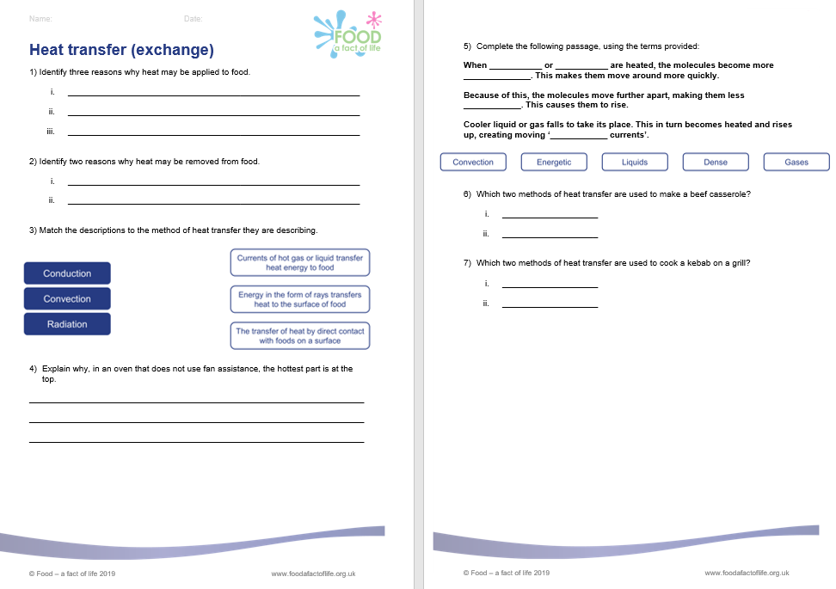
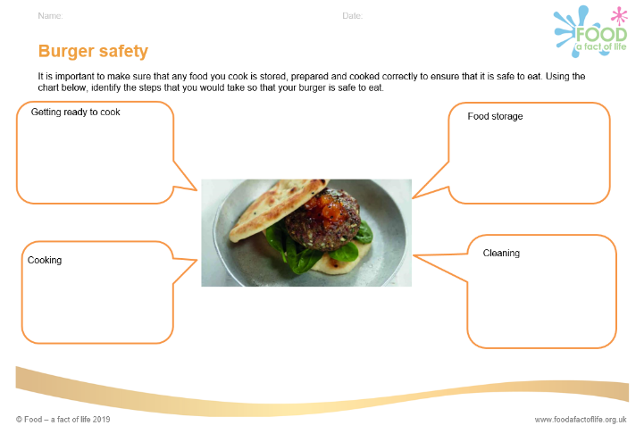
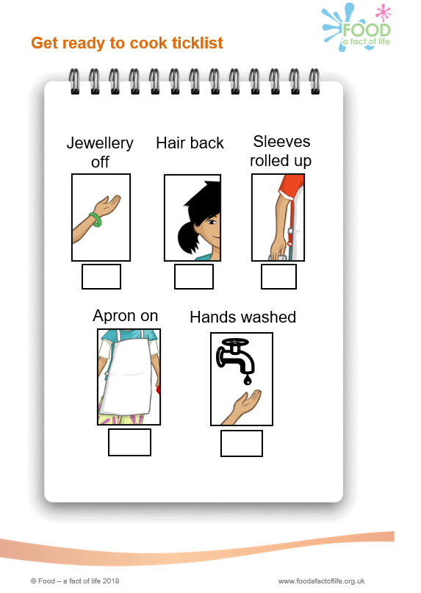
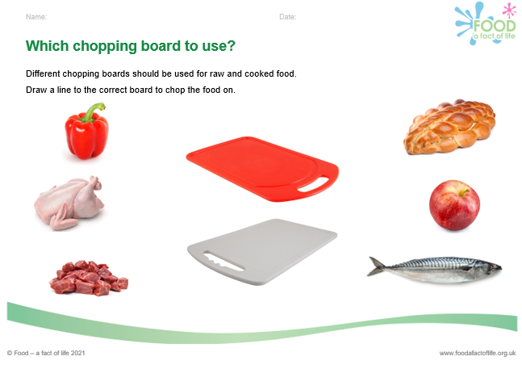
Memory retrieval - worksheets
Worksheets for each 11-14 and 14-16 presentation.
Activities to demonstrate previous learning, some with images to help recollect information from memory.
Tick lists as a visual stimulus.

Slide 29
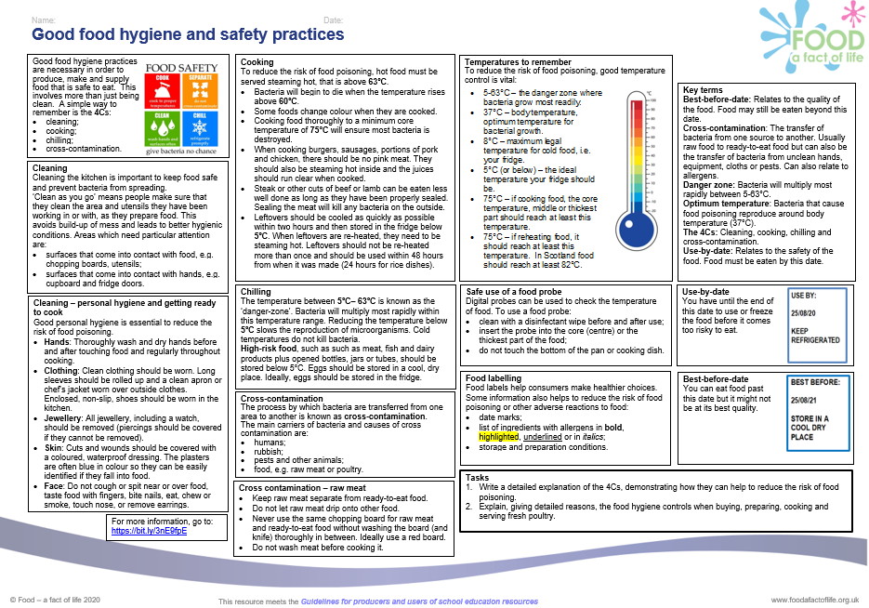
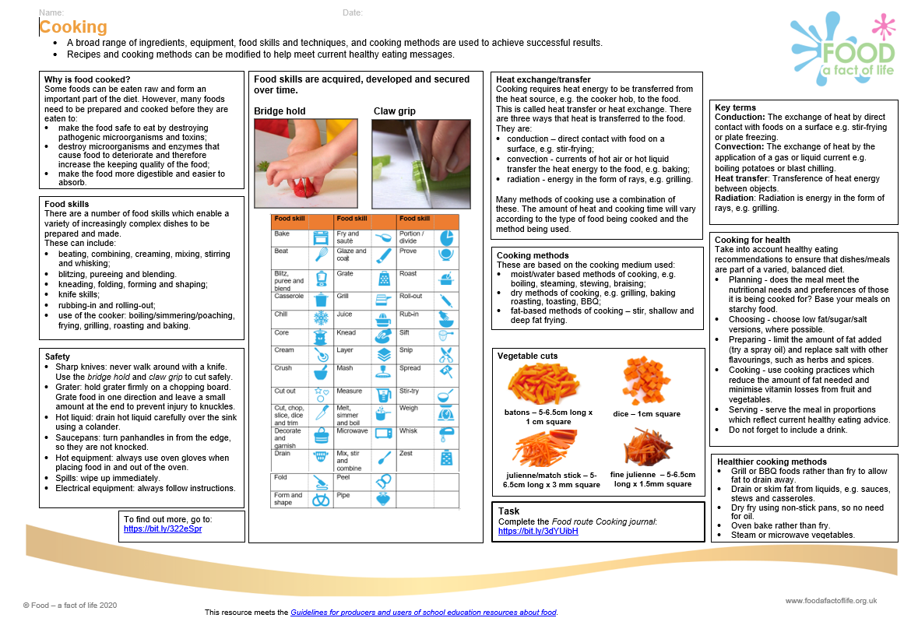
Memory retrieval – Knowledge organisers
Knowledge organisers contain sets of key facts or essential information on a topic, including visual images, which pupils need to know, and be able to recall (to demonstrate their understanding of the topic).

Slide 30
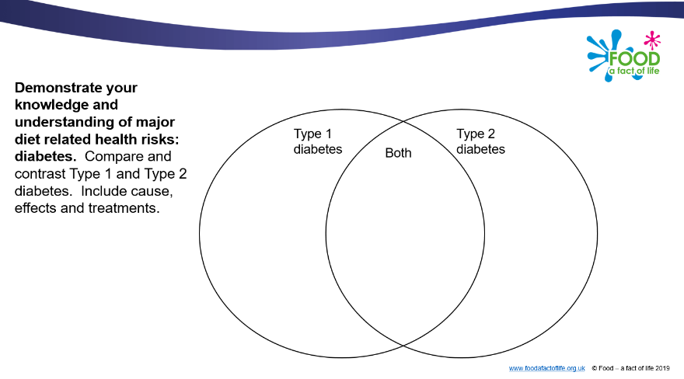
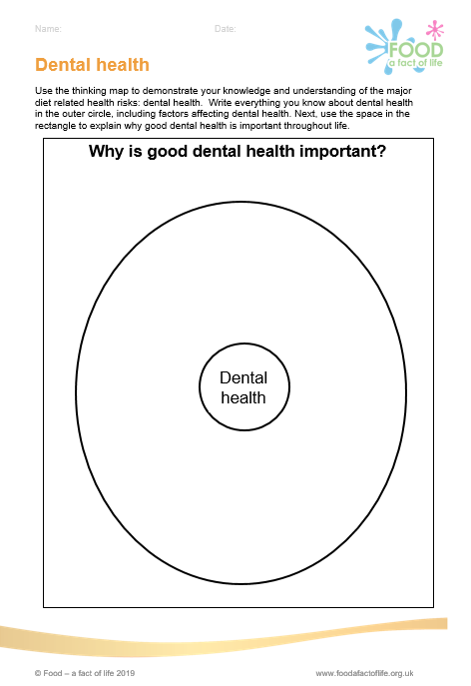
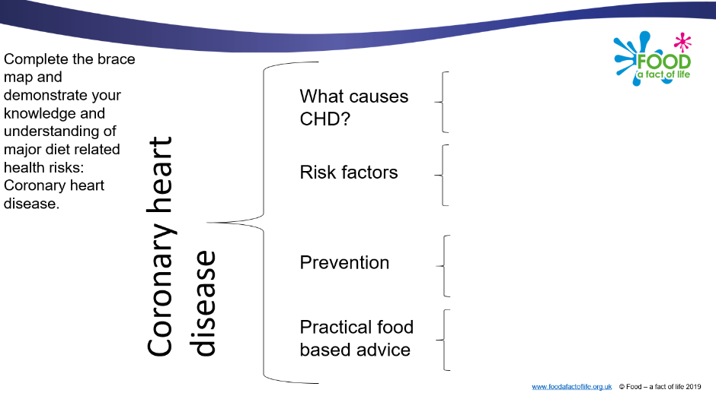
Memory retrieval – thinking maps
Thinking maps, such as circle maps, brace maps and venn diagrams.

Slide 31
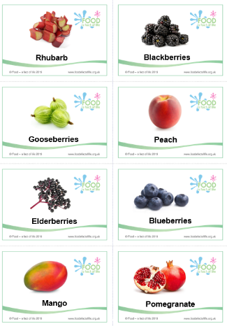
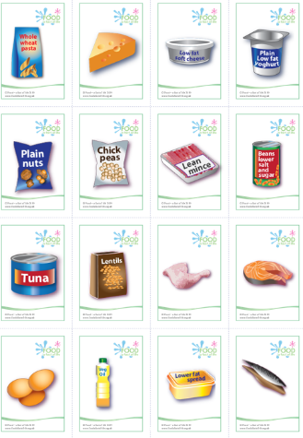
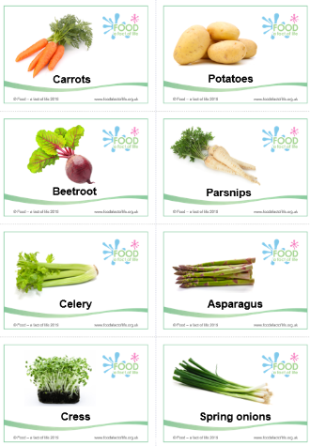
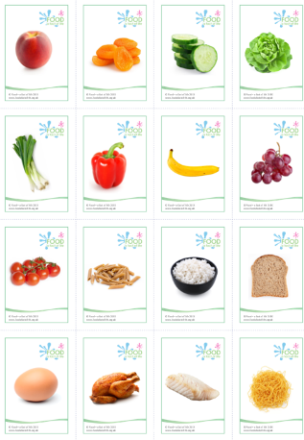
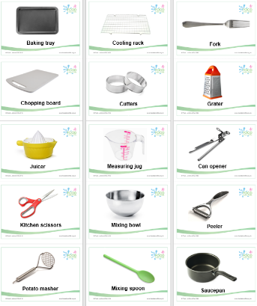
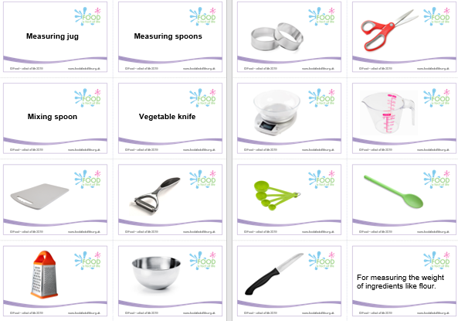
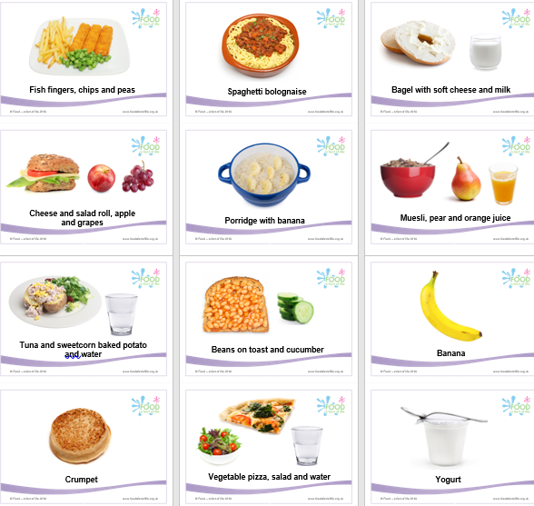
Memory retrieval – flash cards
Flash cards are effective memory reinforcement tools, they aid in quickly memorising facts, vocabulary, dates, and much more
Kitchen equipment
Eatwell Guide
Vegetables
Fruit
Food
What is it?
Meal times

Slide 32
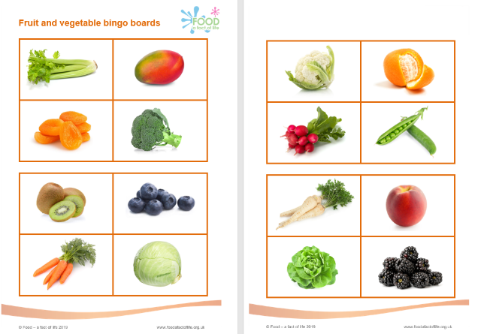

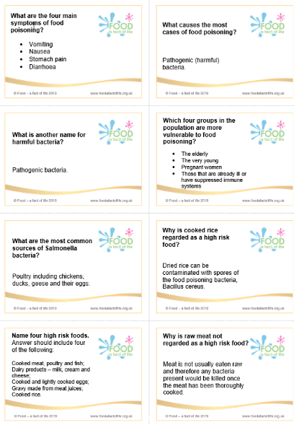
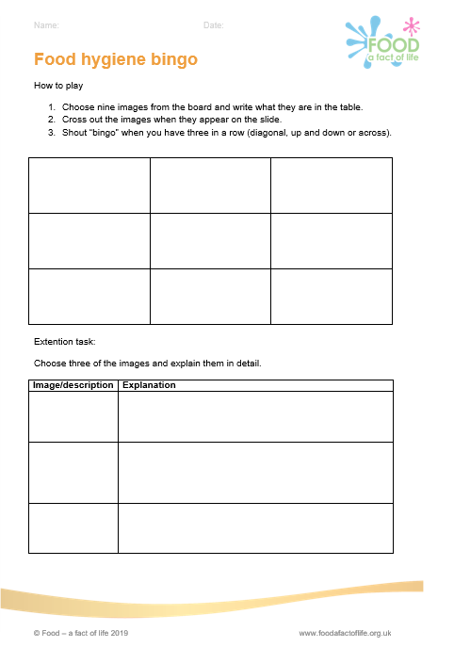
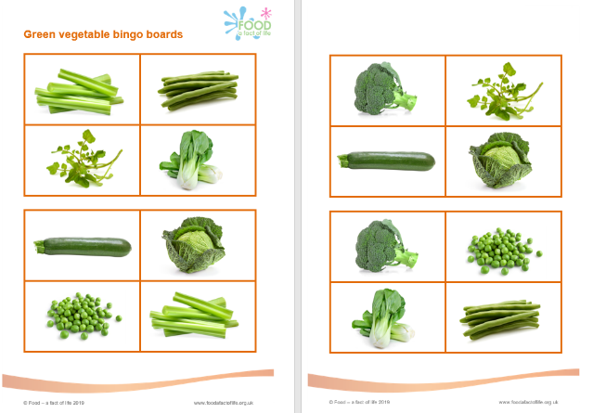
Memory retrieval – question cards and bingo
Food hygiene bingo
Fruit and vegetable bingo
Food hygiene and safety
Green vegetable bingo

Slide 33
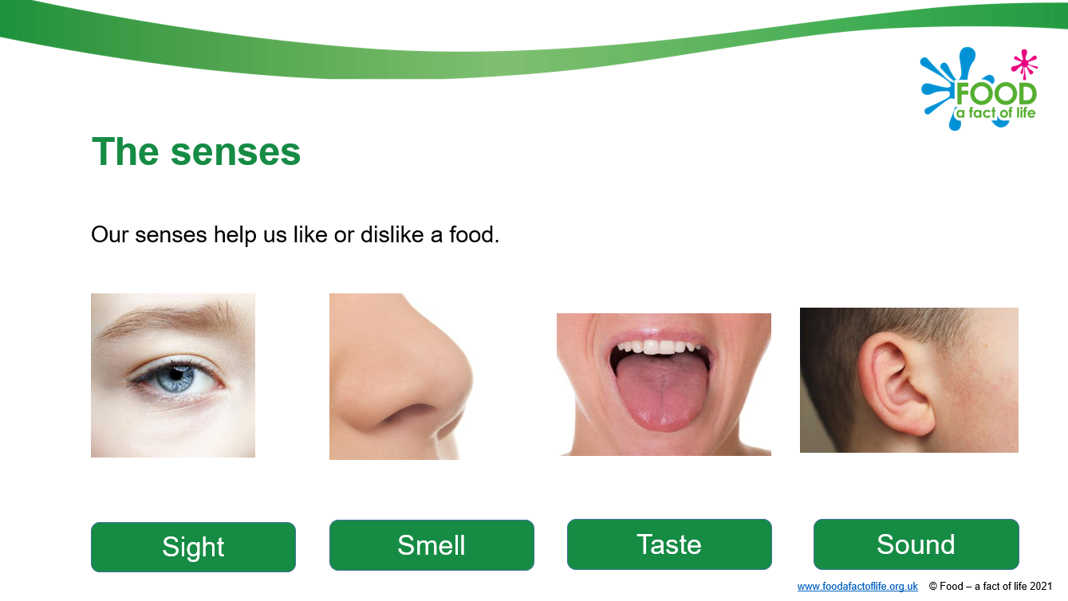
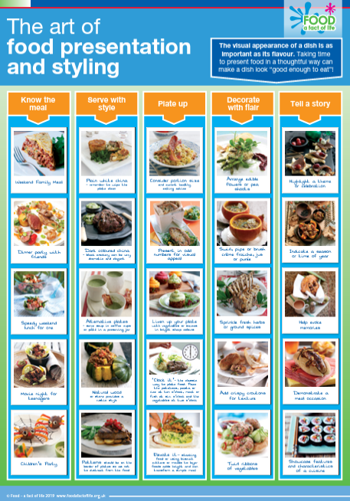
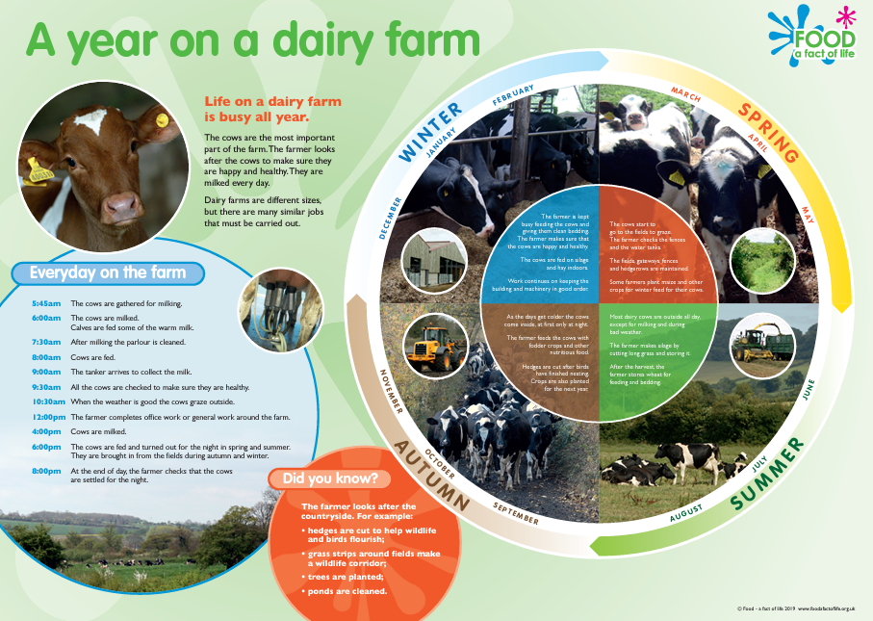
Stimulus materials and social stories
Use of stimulus materials such as PPT presentations with plenty of images, visual wall displays, and social stories can be a useful starting point for discussion and help pupils recollect information from the memory and build on knowledge.
Supporting pupils with additional needs area
Posters

Slide 34

Low stakes testing
Multiple-choice online quizzes – downloadable certificates!
Quiz worksheets.
Kahoot! Interactive class quizzes.

Slide 35
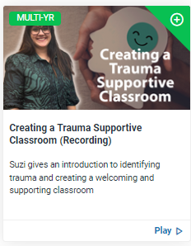
Further information and support
Creating a trauma supportive classroom (recording)
Boosting pupil performance – news article
Boost performance and memory retrieval – news article

Slide 36
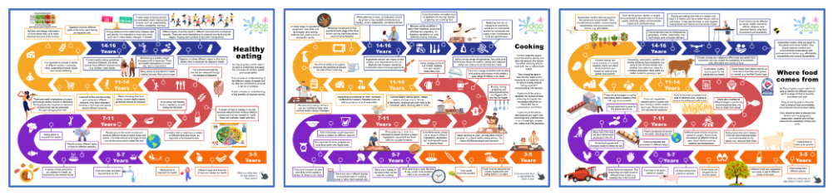
New! – FFL Roadmaps
Food - a fact of life is proud to present our very own roadmaps for the food curriculum. Each roadmap covers the key topics at each age phase, accompanied by our Key facts. Each Key fact shows progression on the topics as pupils move through each age phase. They are a visual guide to food and nutrition education from 3-16 years and are a way of representing what pupils should learn and the sequence. There are printable and interactive versions!

Slide 37

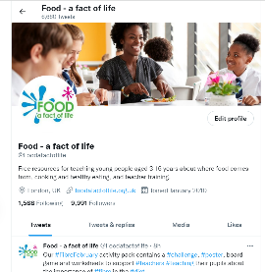
Keep up to date with our free resources and training
Education News (monthly email update)
Sign up on the homepage: www.foodafactoflife.org.uk
PPD newsletter (find out about upcoming FFL training)
https://www.foodafactoflife.org.uk/professional-development/
Follow us on Twitter @Foodafactoflife
https://twitter.com/foodafactoflife
Keep in touch:
education@nutrition.org.uk
BNF news https://www.nutrition.org.uk

