Slide 1
Beef lasagne
Complexity: medium - high

Slide 2
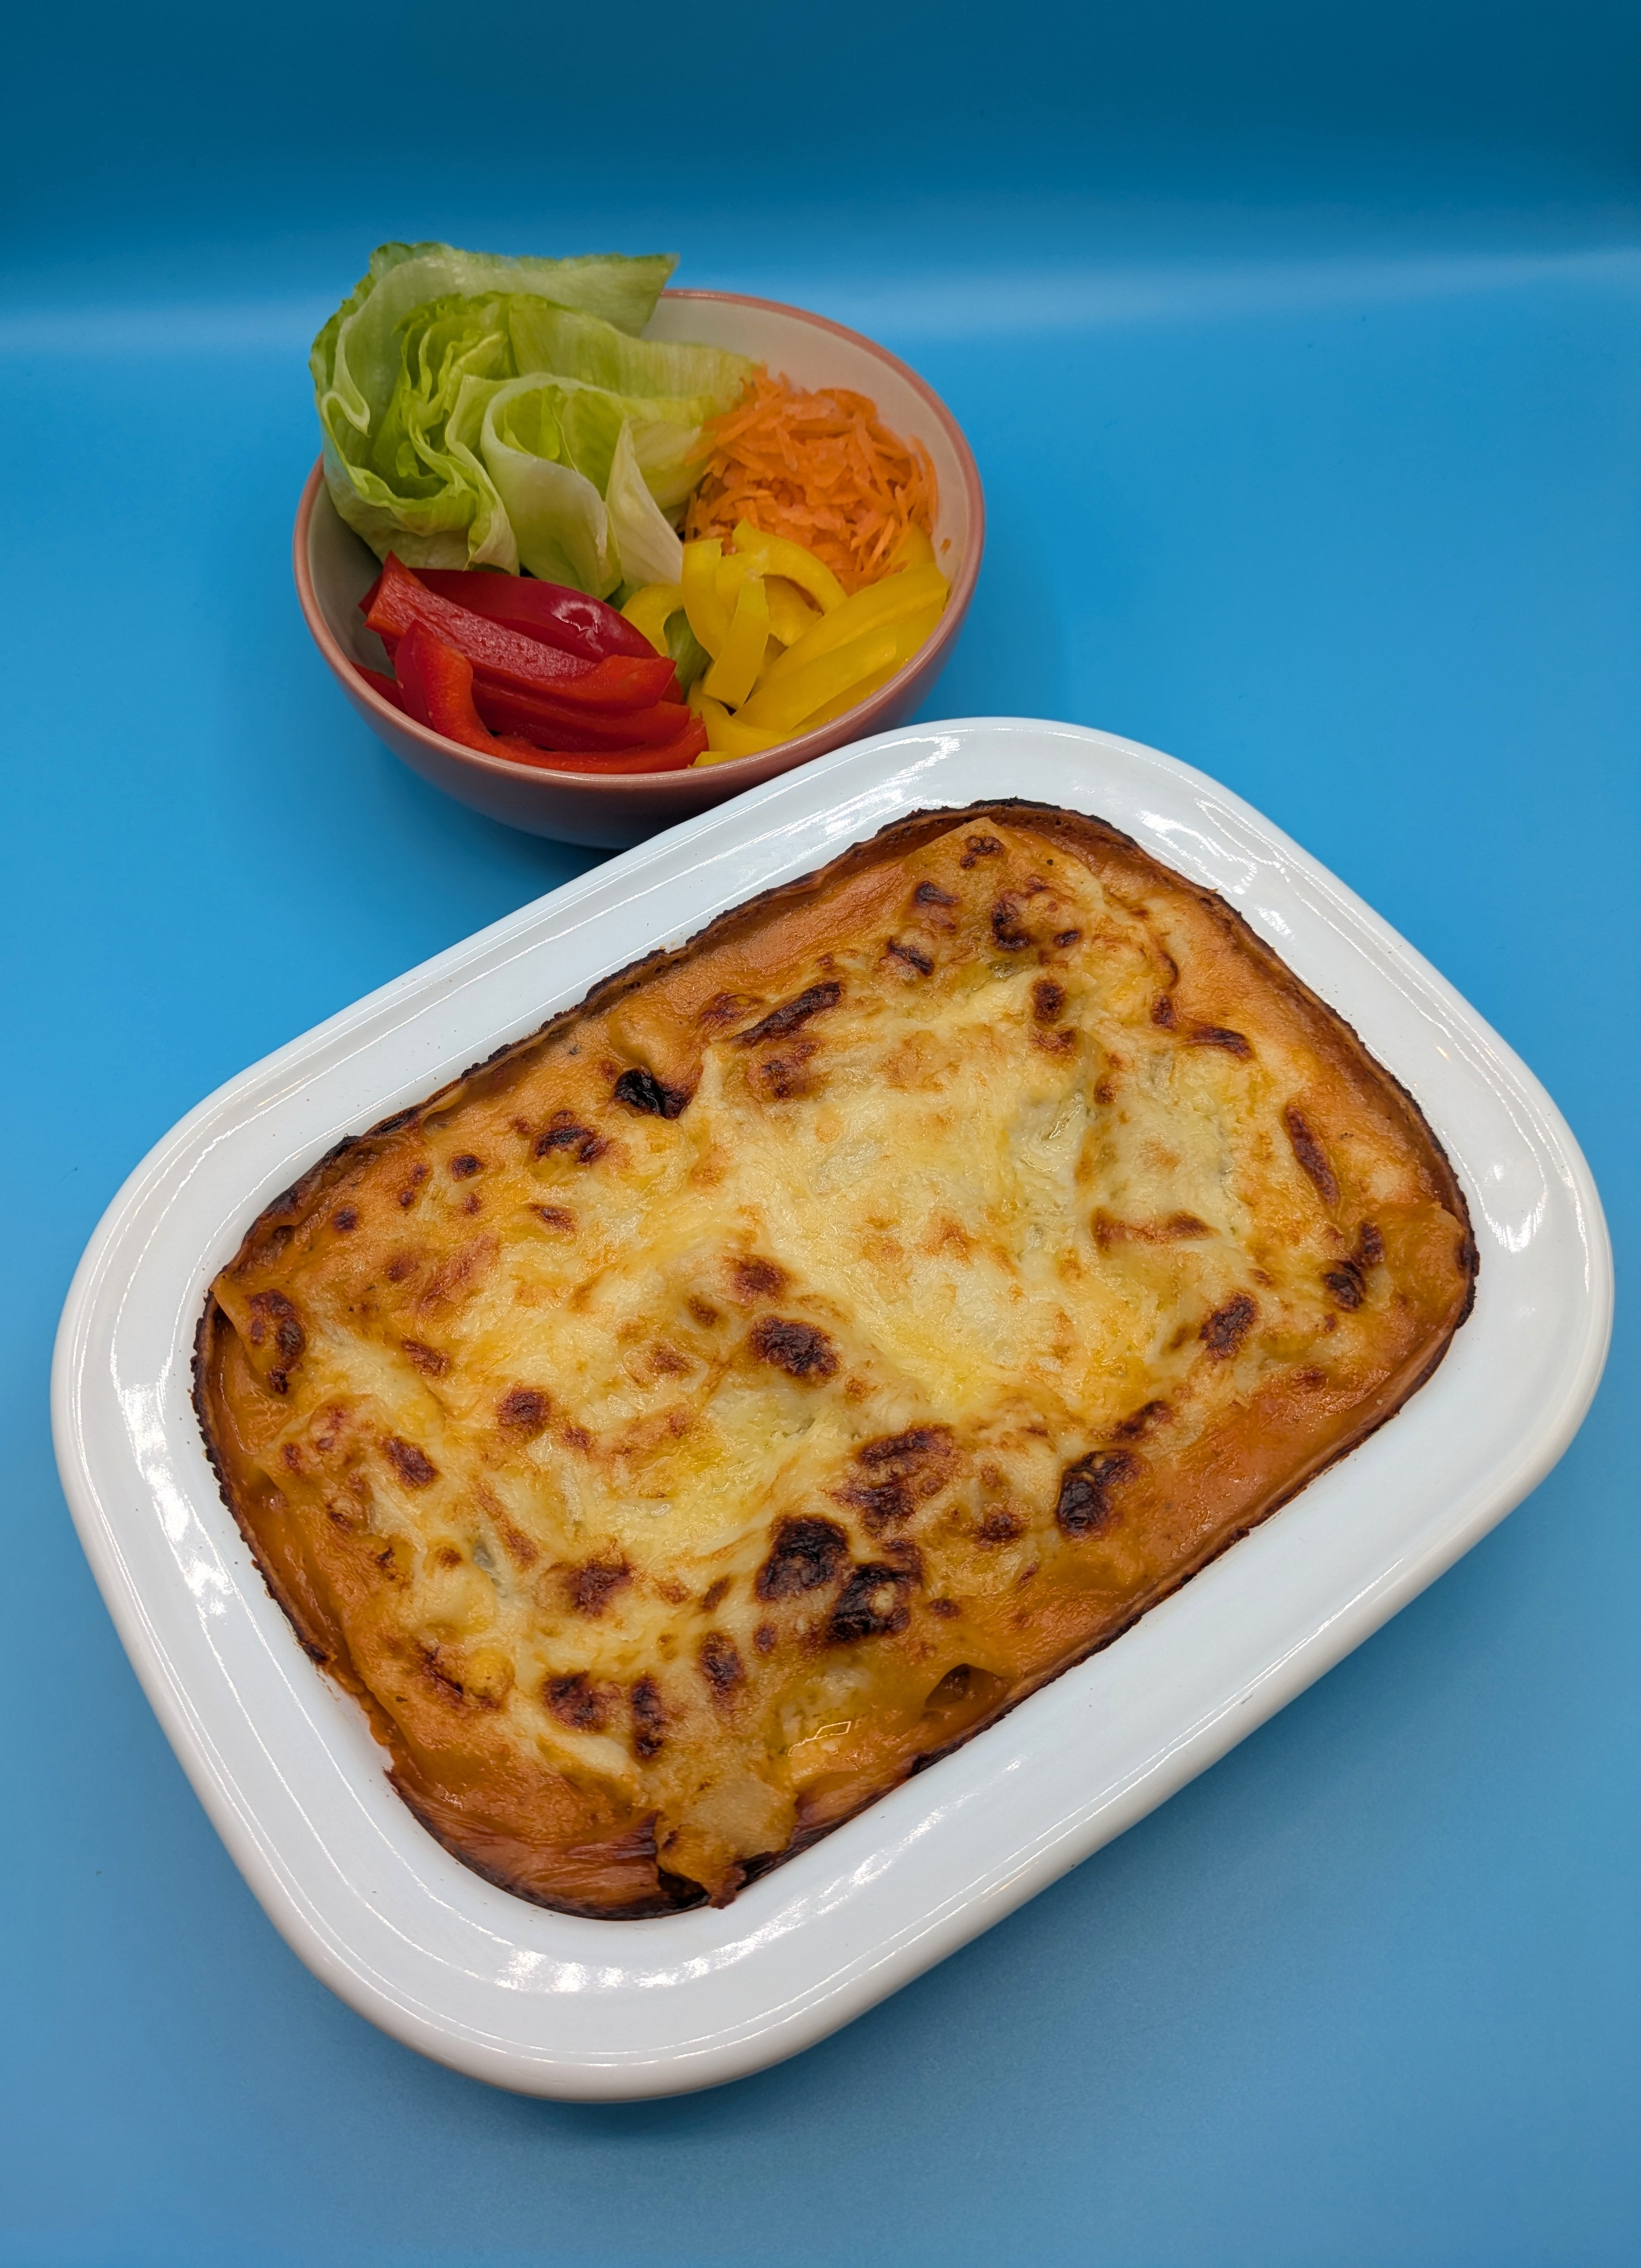
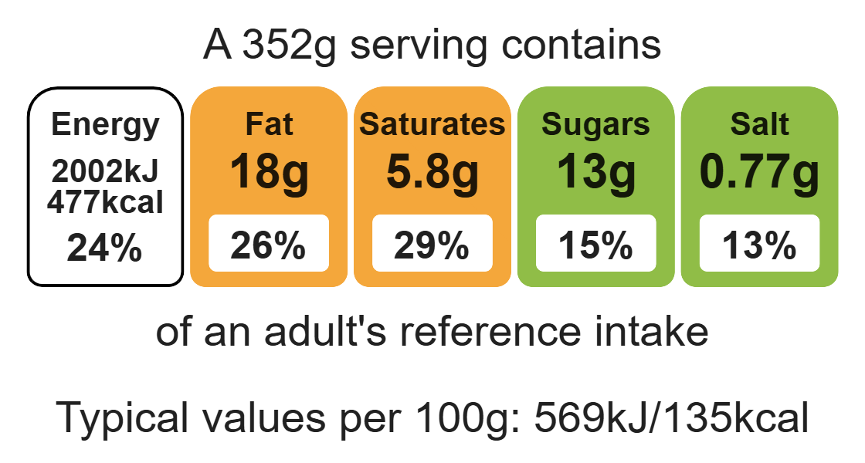
Nutritional analysis
Serves 3

Slide 3
Starter activity
Name two different types of protein.
Give two food hygiene tips when handling raw meat.
Explain cross-contamination.

Slide 4
Example responses
Name three different types of protein.
Beef, turkey, beans, pulses, eggs.
2. Give two food hygiene tips when handling raw meat.
Use a red chopping board, always wash hands after handling raw meat.
3. Explain cross-contamination.
Where bacteria is transferred from one place to another via a vehicle e.g. hands, equipment.

Slide 5
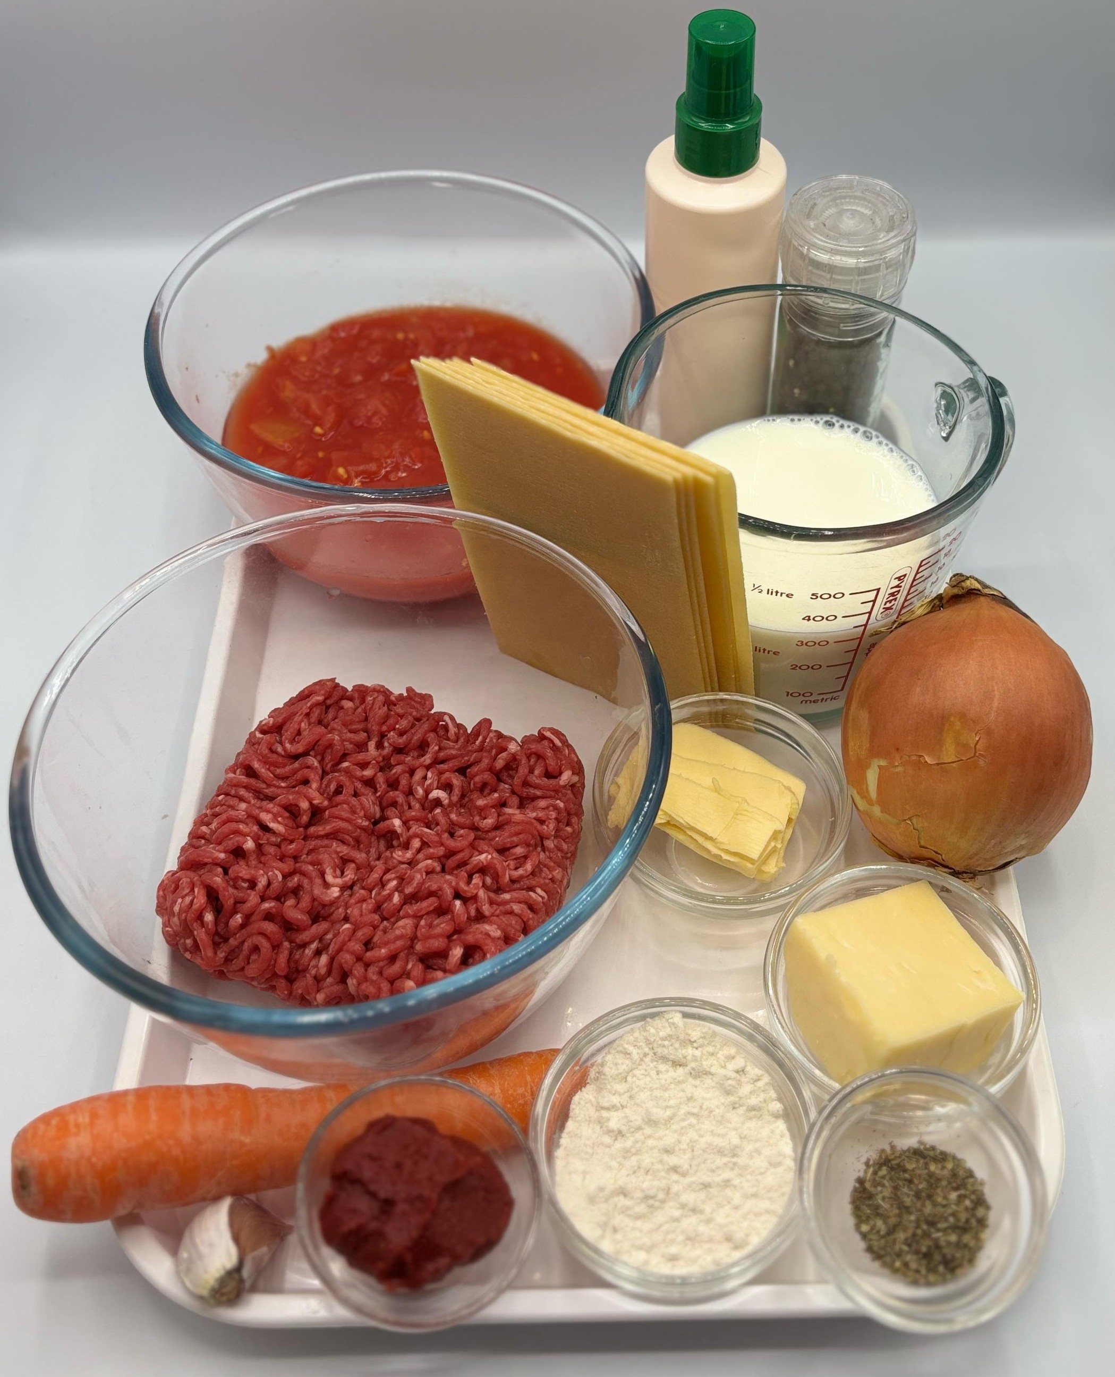

Ingredients (serves 3)
1 onion
1 clove garlic
1 carrot
1 x 15ml oil or spray oil
250g lean minced beef
400g canned chopped tomatoes
1 x 15ml spoon tomato puree
1 x 5ml spoon mixed herbs
Black pepper
25g reduced-fat spread
25g plain flour
300ml semi skimmed milk
50g reduced-fat cheese
6 lasagne sheets
100ml water
Check for any food allergy, intolerance, special dietary requirement or religious/cultural reasons for not handling or eating the ingredients in this recipe.

Slide 6
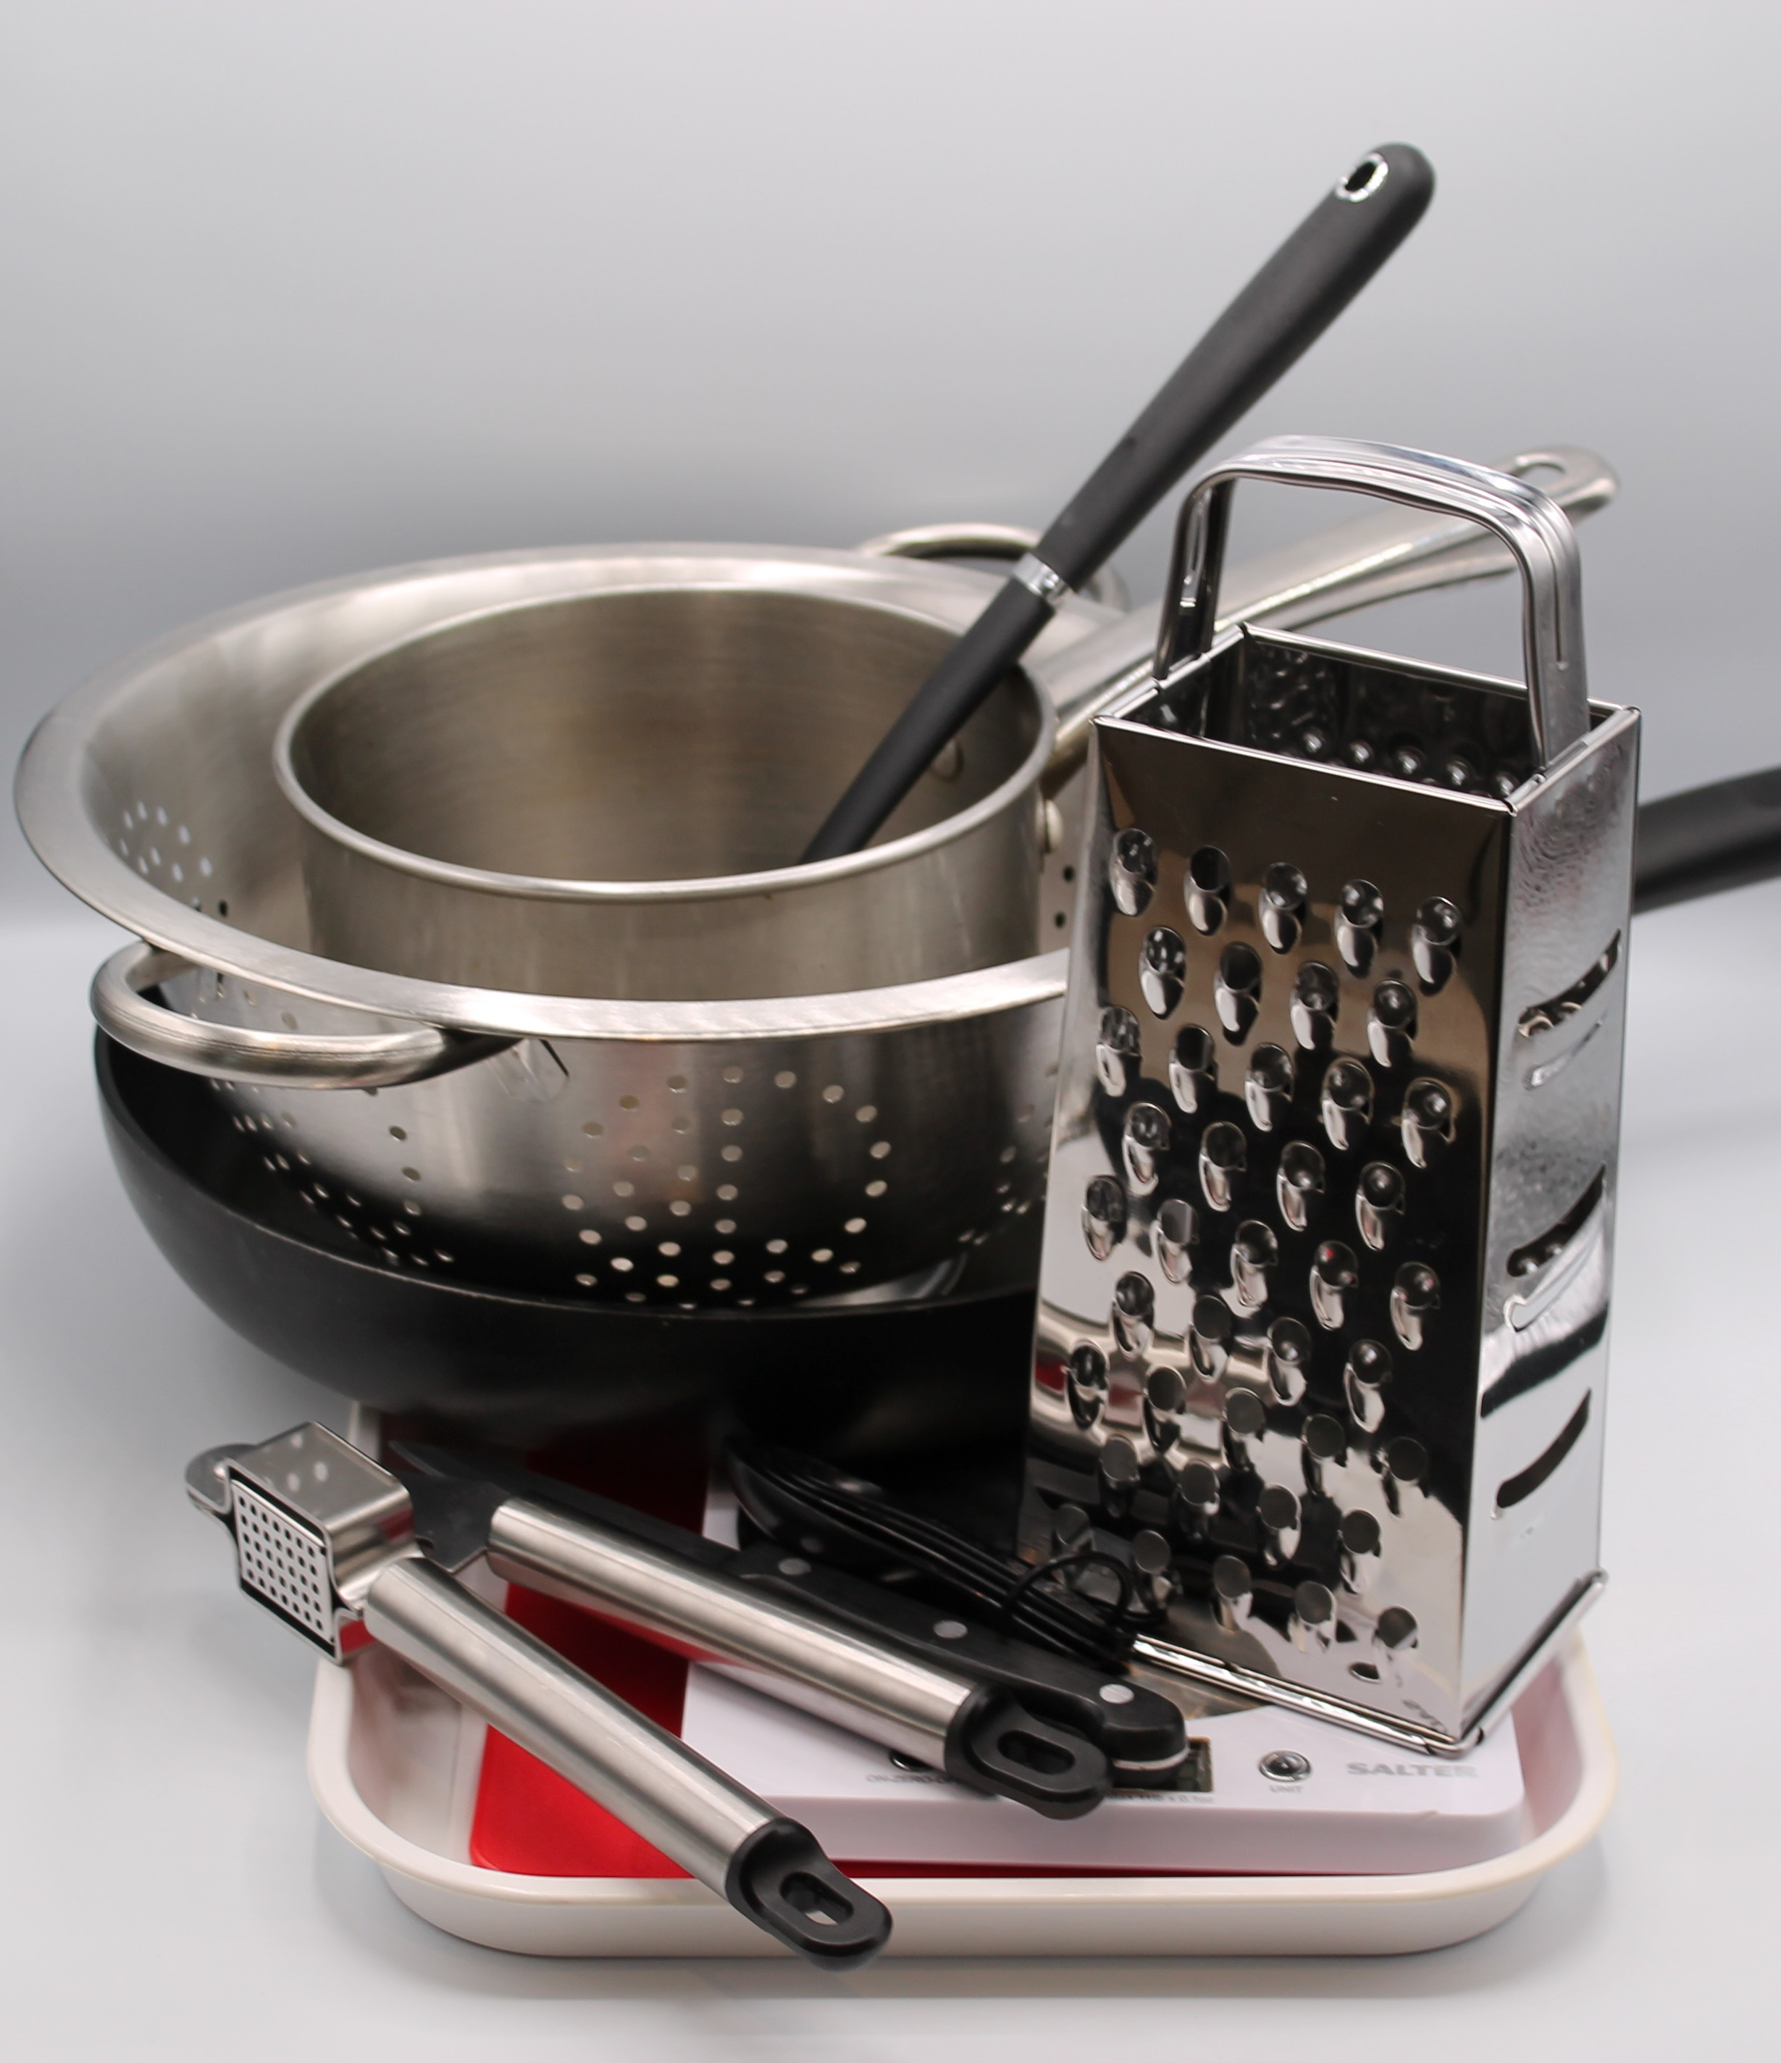
Equipment
Chopping board
Sharp knife
Garlic press
Vegetable peeler
Large frying pan
Heat resistant spoon
Measuring spoons
Measuring jug
Small saucepan ​
Grater ​
Ovenproof dish

Slide 7


Food skills
Melt
Simmer and boil
Stir and combine
Grate
Layer
Bake
Weigh
Measure
Peel
Chop
Slice
Dice and trim
Crush
Fry and sauté
Click below to see how to make an All-in-one white sauce

Slide 8
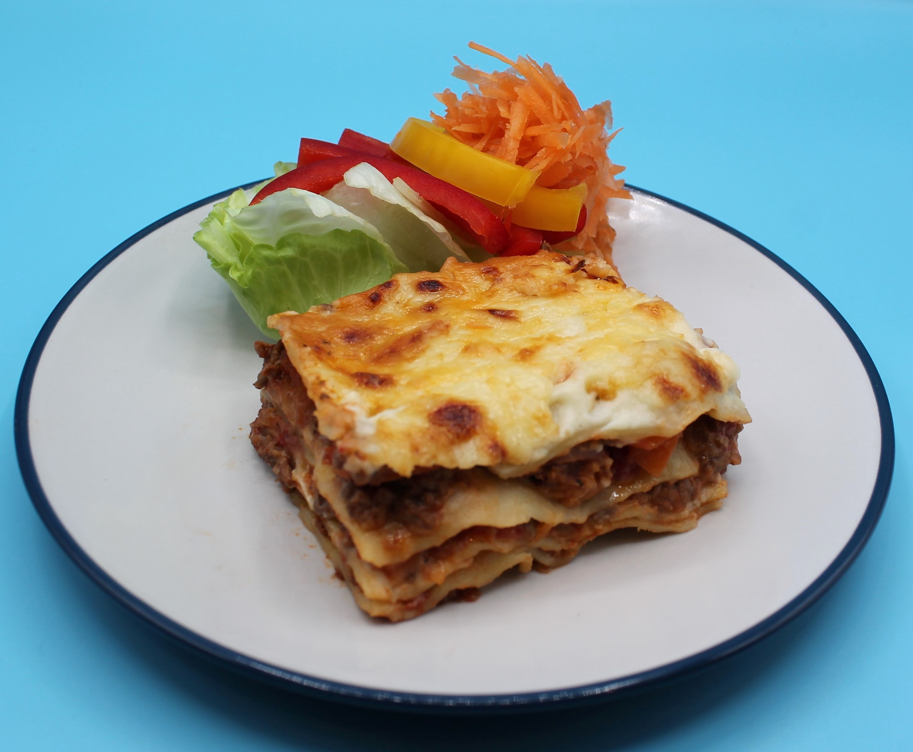
Method
1. Preheat the oven to 190°C or gas mark 5.
2. Prepare the vegetables:
Peel and dice the onion;
Peel and crush the garlic;
Peel and dice the carrot.
3. Fry the onion, garlic and carrot in the oil.
4. Add the meat and cook until the mince is lightly browned.
Add the tomatoes, tomato puree, mixed herbs, black pepper and water and mix all the ingredients together.
6. Bring to the boil, then simmer for 20 minutes.

Slide 9
Method
7. While the meat sauce is cooking, make the white sauce:
place the reduced-fat spread, flour and milk in a saucepan;
bring the sauce to a simmer, stirring continuously until it has thickened;
reduce the heat and simmer for 2 minutes;
grate the cheese and stir in half to the sauce off the heat.
8. In an ovenproof dish or foil tray, spread some meat mixture in the
bottom, cover with lasagne sheets and a little cheese sauce. Repeat
this, finishing with the sauce on top.
9. Sprinkle the remaining grated cheese and bake for 20 minutes.

Slide 10
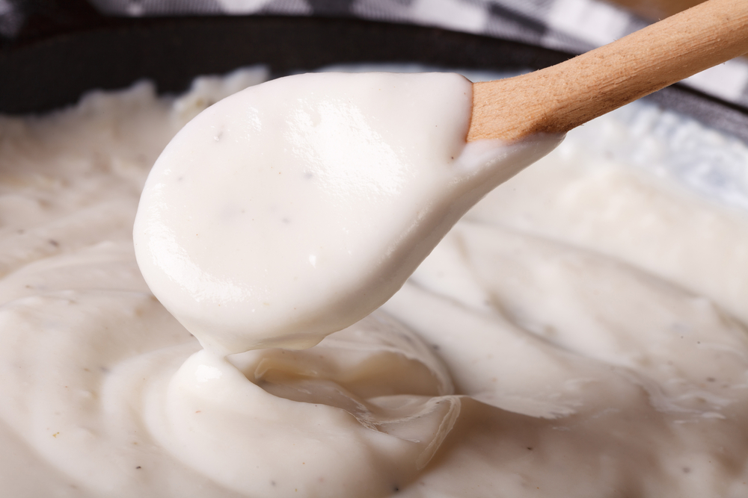
Food science
Gelatinsation of white sauce
When starch is mixed with liquid and heated, the starch granules swell and eventually rupture, absorbing liquid, which thickens the mixture.
The sauce needs to be “cooked out” to remove the floury taste.

Slide 11
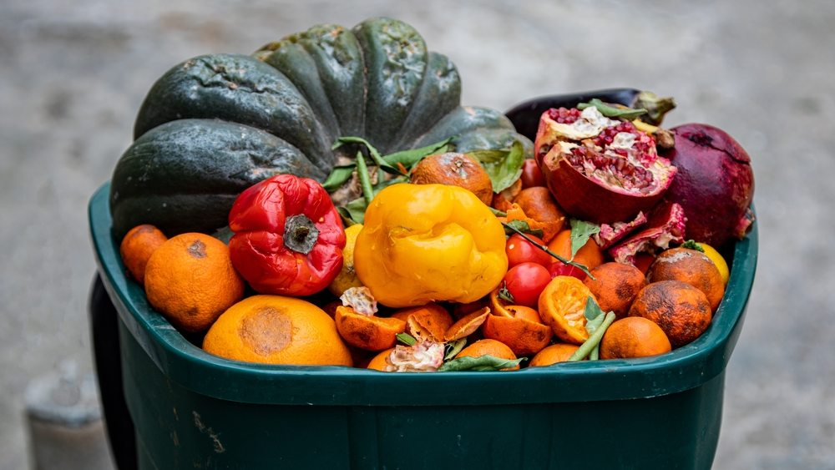
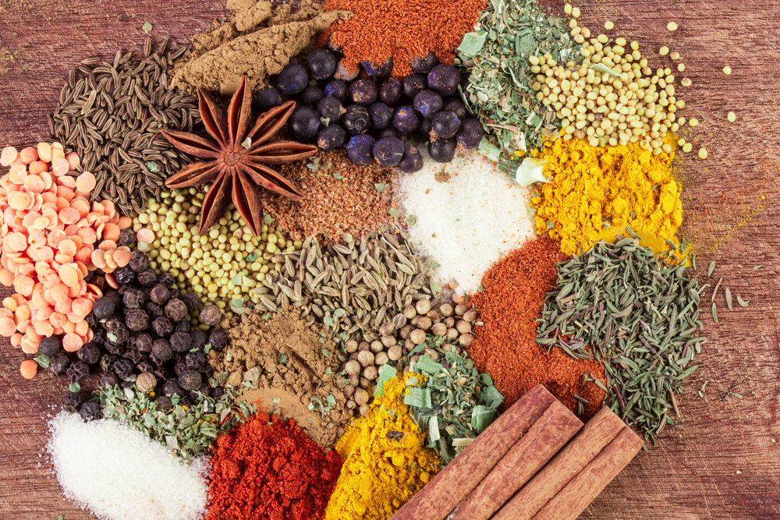
Top tips
Reduce food waste: Add any leftover vegetables to your lasagne.
Turn up the flavour: Try using lasagne sheets flavoured with spinach.
For a meat-free alternative: Add lentils or mixed beans instead of the minced beef.

Slide 12

Plenary
What went wrong?
The sauce was lumpy and tasted floury?
The sauce lacked flavour?

Slide 13
Example responses
What went wrong?
1. The sauce was lumpy and tasted floury.
The sauce was not stirred continuously when making the sauce. If the sauce is not stirred, the starch granules attract to each other and form a lumpy sauce.
The starch in sauce was not “cooked out” when gelatinisation reached.
2. The sauce lacked flavour.
Cheese not measured accurately.
Stronger flavoured cheese could be used.

Slide 14
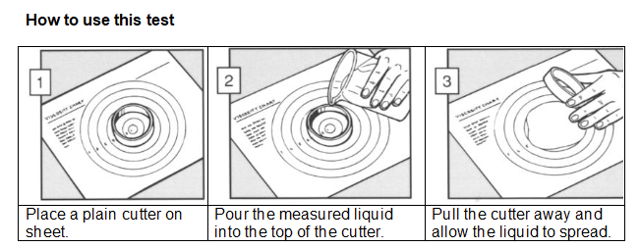
Looking for more…
Investigate gelatinsation further. Use our gelatinsation investigation and task your pupils with measuring the viscosity of different sauces made with different quantities of ingredients.
For another recipe to demonstrate using an all-in-one sauce, why not try the tuna pasta bake featured in this lesson from the Food – a fact of life Schemes of Work?

Slide 15
Beef lasagne
For further information, go to:
www.foodafactoflife.org.uk
This resource meets the Guidelines for producers and users of school education resources about food.

