Slide 1
Vegetarian lasagne
Complexity: medium

Slide 2
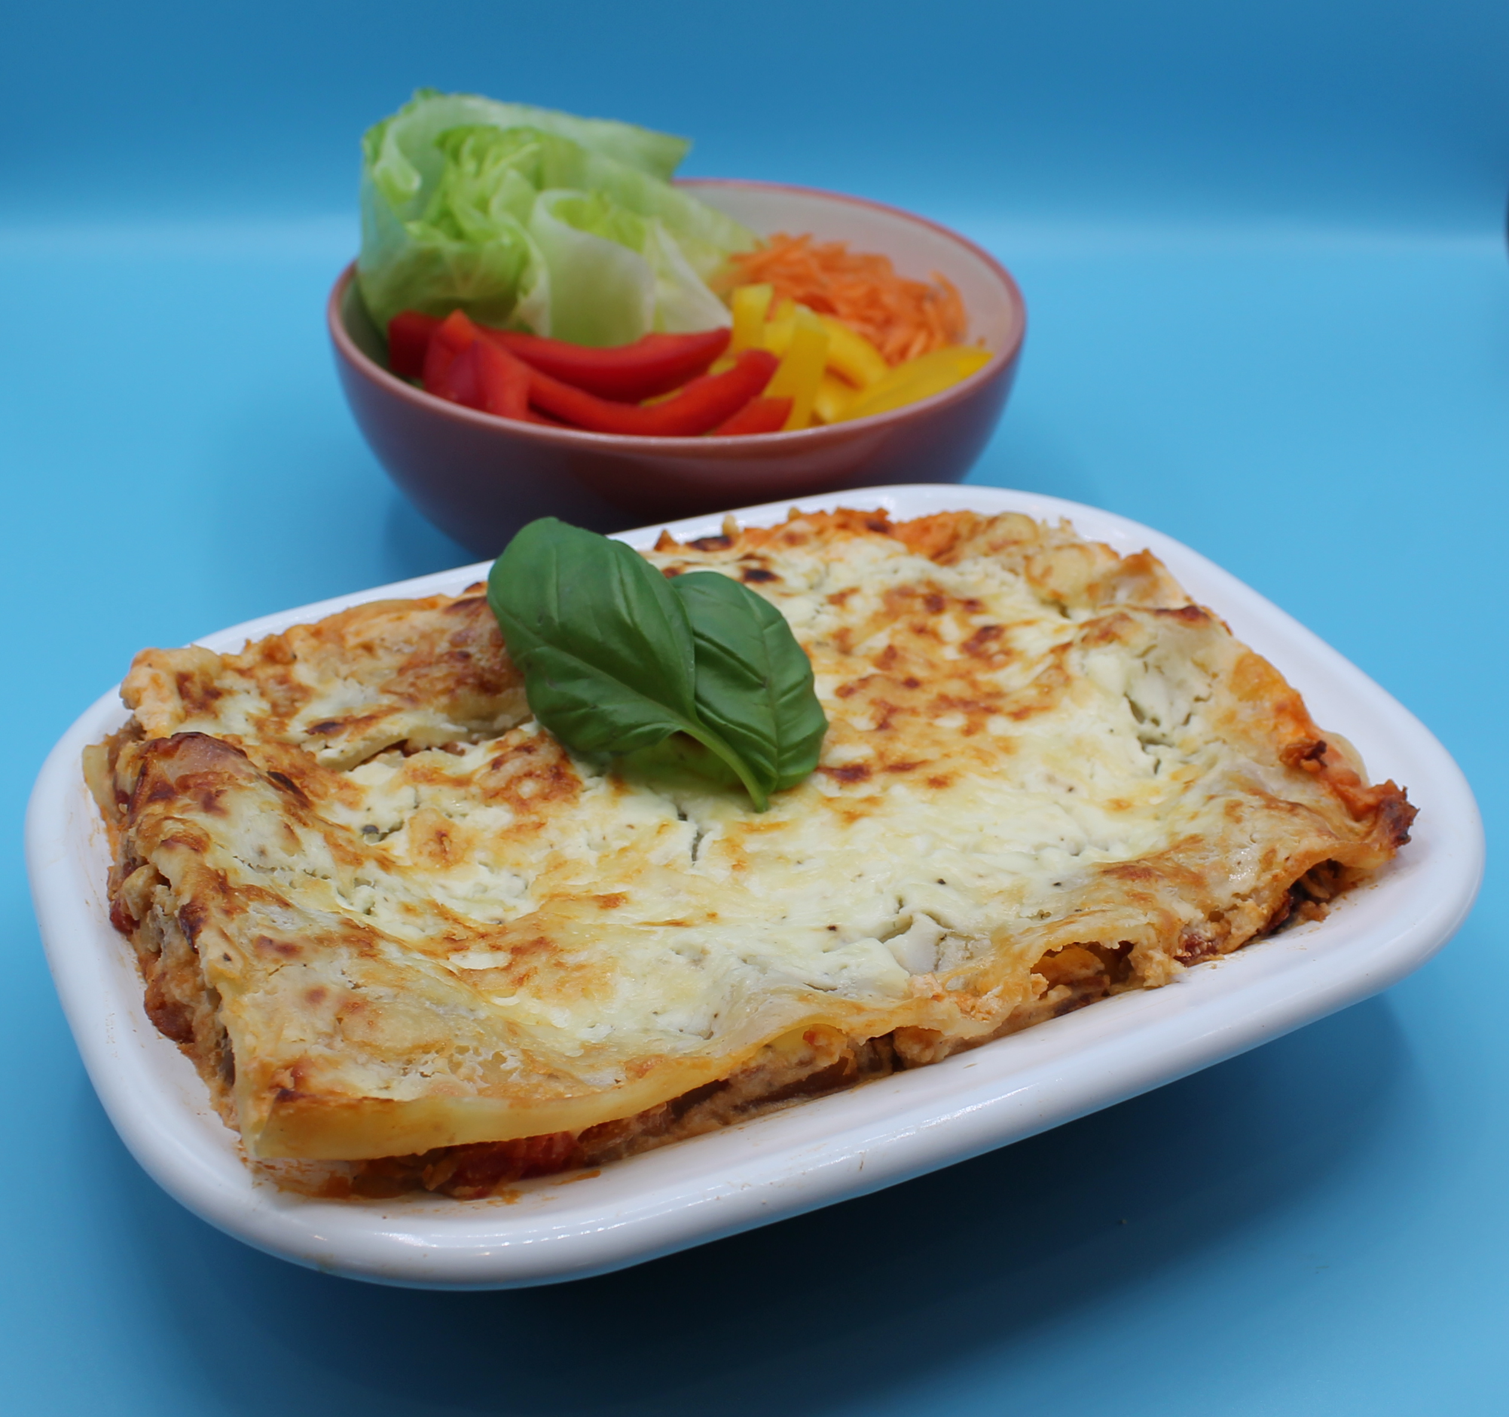
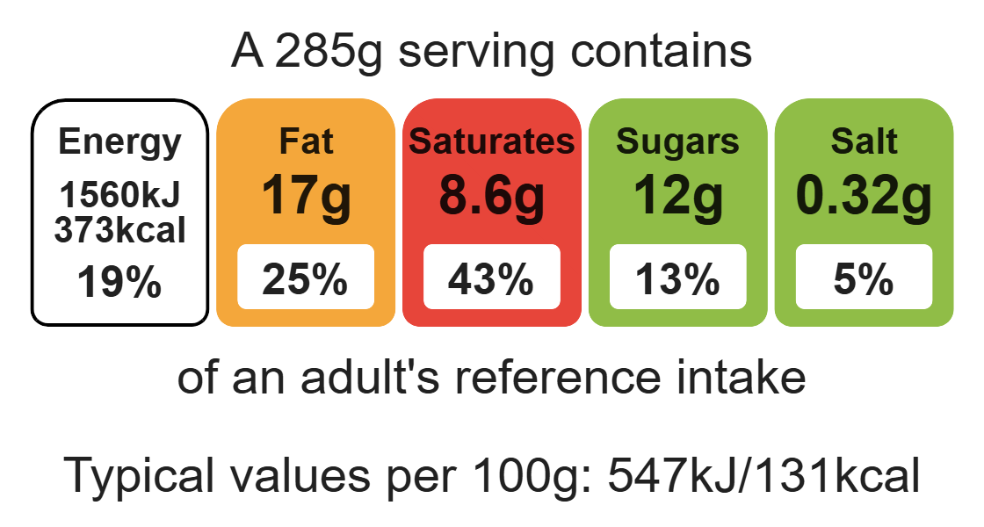
Nutritional analysis
Serves 3

Slide 3
Starter activity
Explain the difference between a vegetarian and a vegan.
Name three plant-based proteins.
Name three vegetables that could be used in a vegetarian lasagne.

Slide 4
Example responses
Explain the difference between a vegetarian and a vegan.
Vegetarians do not eat meat or fish. Vegans do not eat any food from any animals.
Name three plant-based proteins.
Beans, peas, pulses, tofu.
Name three vegetables that could be used in a vegetarian lasagne.
Courgette, aubergine, peppers.

Slide 5
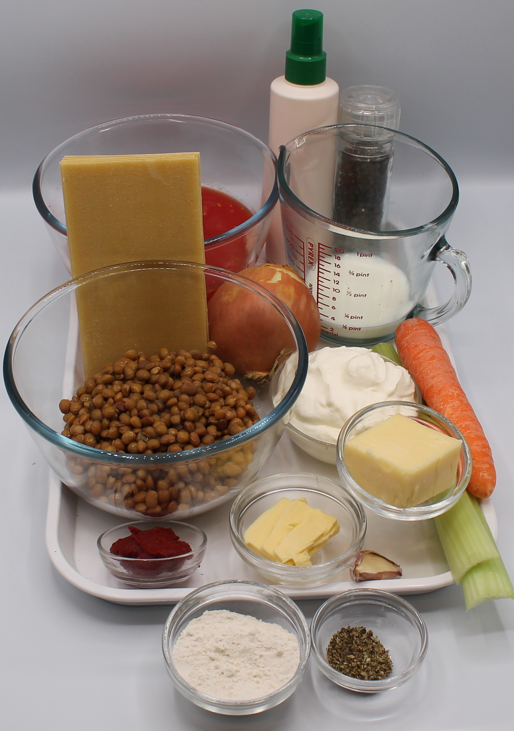

Ingredients (serves 3)
1 onion
1 garlic clove
1 carrot
2 celery sticks
100g dried lentils
1 x 10ml spoon oil or spray oil
400g canned chopped tomatoes
1 x 5ml spoon mixed herbs
1 x 15ml spoon tomato purée
200ml reduced-fat crème fraîche
25g reduced-fat cheddar
50ml semi-skimmed milk
Black pepper
6 wholemeal lasagne sheets
Check for any food allergy, intolerance, special dietary requirement or religious/cultural reasons for not handling or eating the ingredients in this recipe.

Slide 6
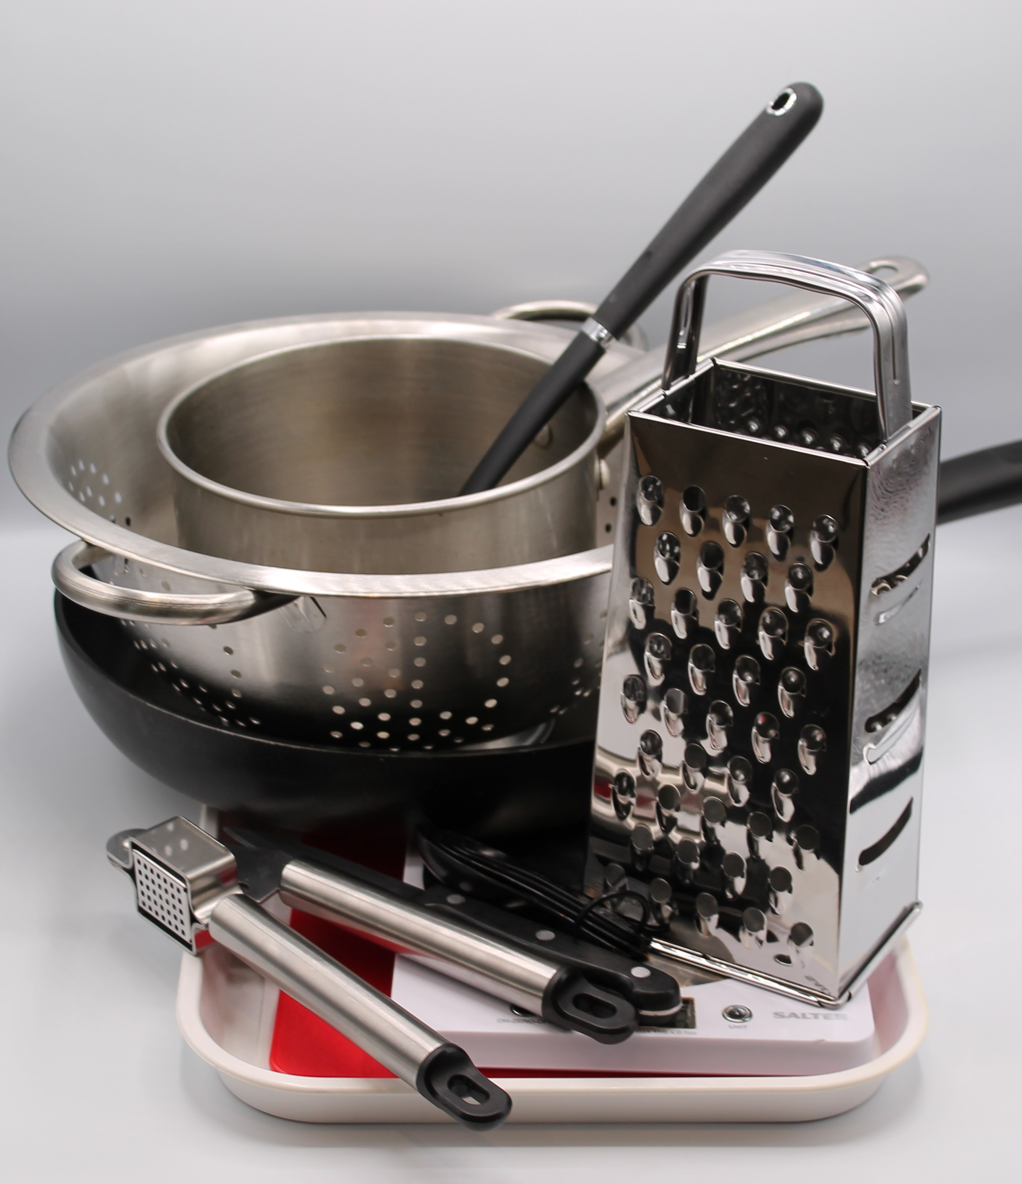
Equipment
Weighing scales
Chopping board
Sharp knife
Vegetable peeler
Garlic press
Saucepan
Frying pan
Heat resistant spoon
Grater
Measuring spoons
Measuring jug
Small bowl
Metal spoon
Ovenproof dish or foil trays

Slide 7
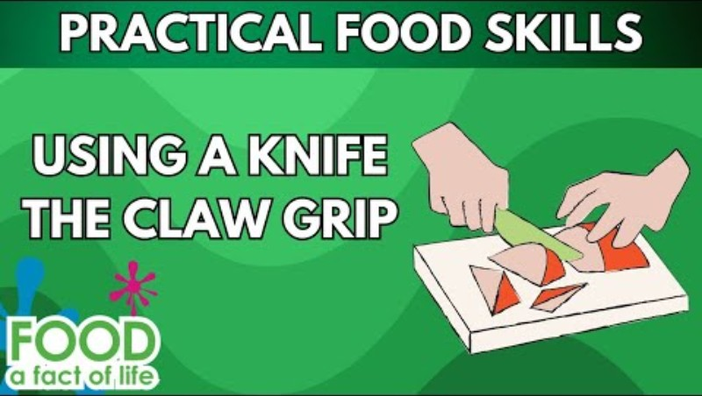
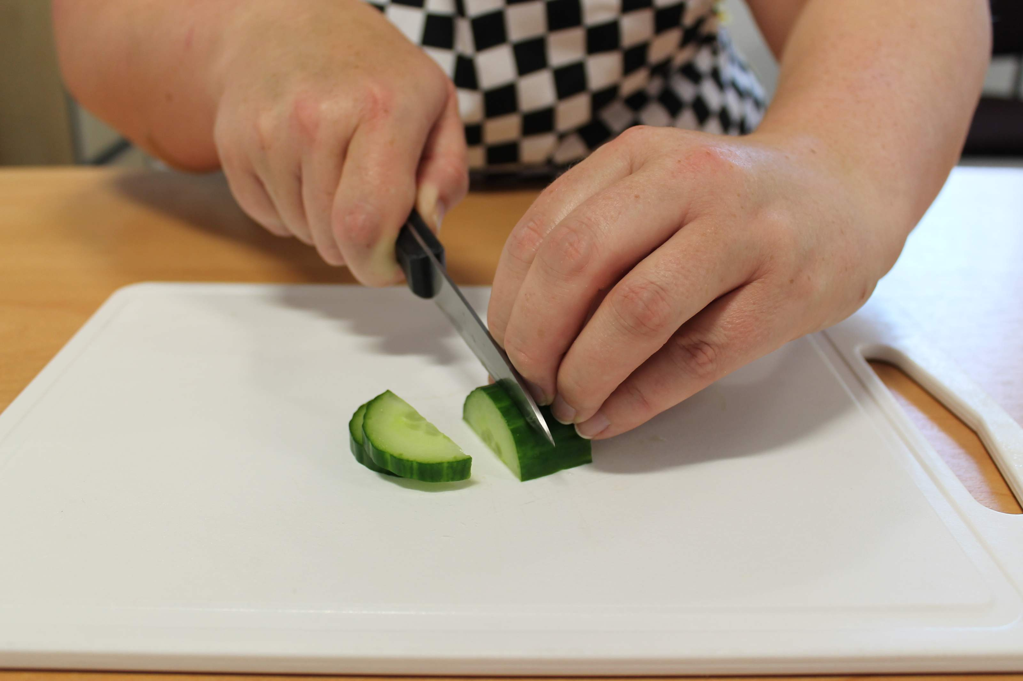

Food skills
Click below to watch the claw grip
Weigh and measure
Peel
Cut
Chop
Slice
Dice and trim
Fry and sauté
Mix
Stir and combine
Grate
Melt
Simmer and boil
Layer
Bake
Click below to watch how to use the grater safely

Slide 8
Method
Preheat the oven to 190°C or gas mark 5.
Prepare the ingredients:
peel and chop the onion;
peel and crush the garlic;
top and tail, peel and dice the carrot;
slice the celery;
grate the cheese.
Fry the onion, garlic, carrot and celery in the oil until soft, for about 4 minutes.
Add the lentils, tomatoes, herbs and tomato purée.

Slide 9
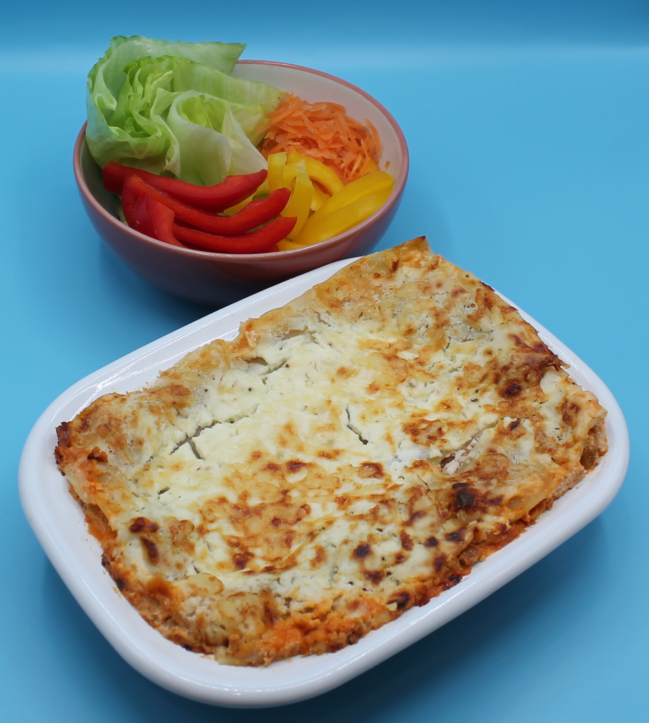
Method
Pour in just enough water to cover the mixture, bring to the boil and then allow to simmer for 15 minutes with the lid on.
Blend the crème fraîche, half the grated cheese, milk and pepper together in the small bowl.
In an ovenproof dish or foil tray, spread some lentil mixture in the bottom, cover with lasagne sheets and a little crème fraîche sauce. Repeat this, finishing with the sauce on top.
Sprinkle the remaining grated cheese on top and bake for 20 minutes.

Slide 10
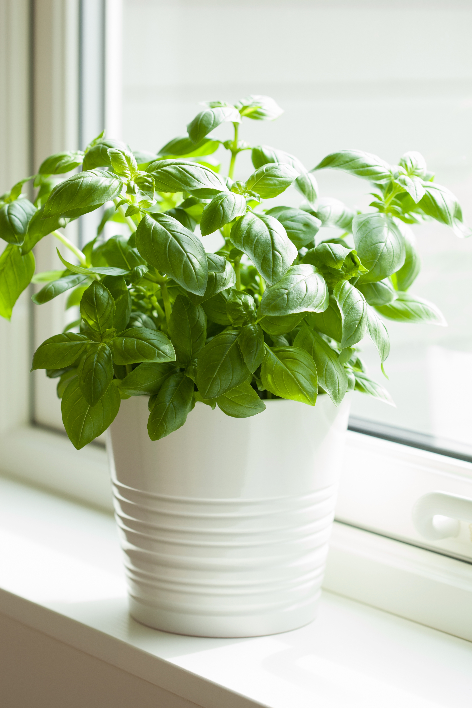
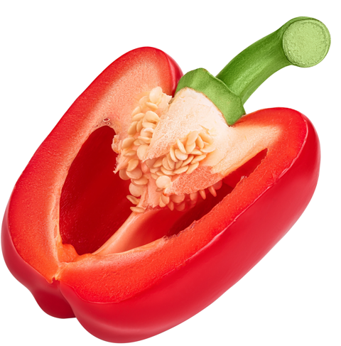
Top tips
Turn up the flavour: Experiment with different herbs, for example fresh basil or oregano.
Reduce food waste: Use different vegetables such as courgettes, peppers or aubergine. Anything that might need using up!

Slide 11
Food science
Absorption
Lentils are not edible when raw. As the lentils are heated, they absorb the liquid, creating a tender texture.
Why does cheese melt and turn brown in an oven or under the grill?
Fats in the cheese soften and the water turns to steam, causing the cheese to melt and become gooey. It browns because of heat-triggered reactions between proteins and sugars in the cheese (known as the Maillard reaction).

Slide 12



Plenary
Evaluate how well you worked today.
 |  |  |  | Comments
Peel, cut, chop, slice
Grating
Frying
Blending
Layering

Slide 13

Example responses
Evaluate how well you worked today.
 |  |  |  | Comments
Peel, cut, chop, slice |  |  |  | I chopped my onion and garlic well. I need to be more accurate with my dicing.
Grating |  |  |  | I safely grated my cheese into even pieces.
Frying |  |  |  | My hob was too hot and I needed to adjust the temperature.
Blending |  |  |  | I blended the ingredients well.
Layering |  |  |  | I need to focus on layering as I was a bit messy.

Slide 14
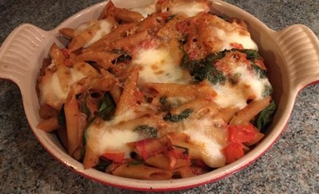
Looking for more…
Challenge your students to adapt a lasagne recipe to make it healthier.
Use our worksheet to get started!
If you are looking for a similar recipe for pupils to demonstrate a range of food skills, including cutting and chopping, grating, using the hob (frying, boiling and simmering), draining and using the grill, why not try this lesson on pasta Fiorentina? This lesson is one from the Food – a fact of life Schemes of Work.

Slide 15
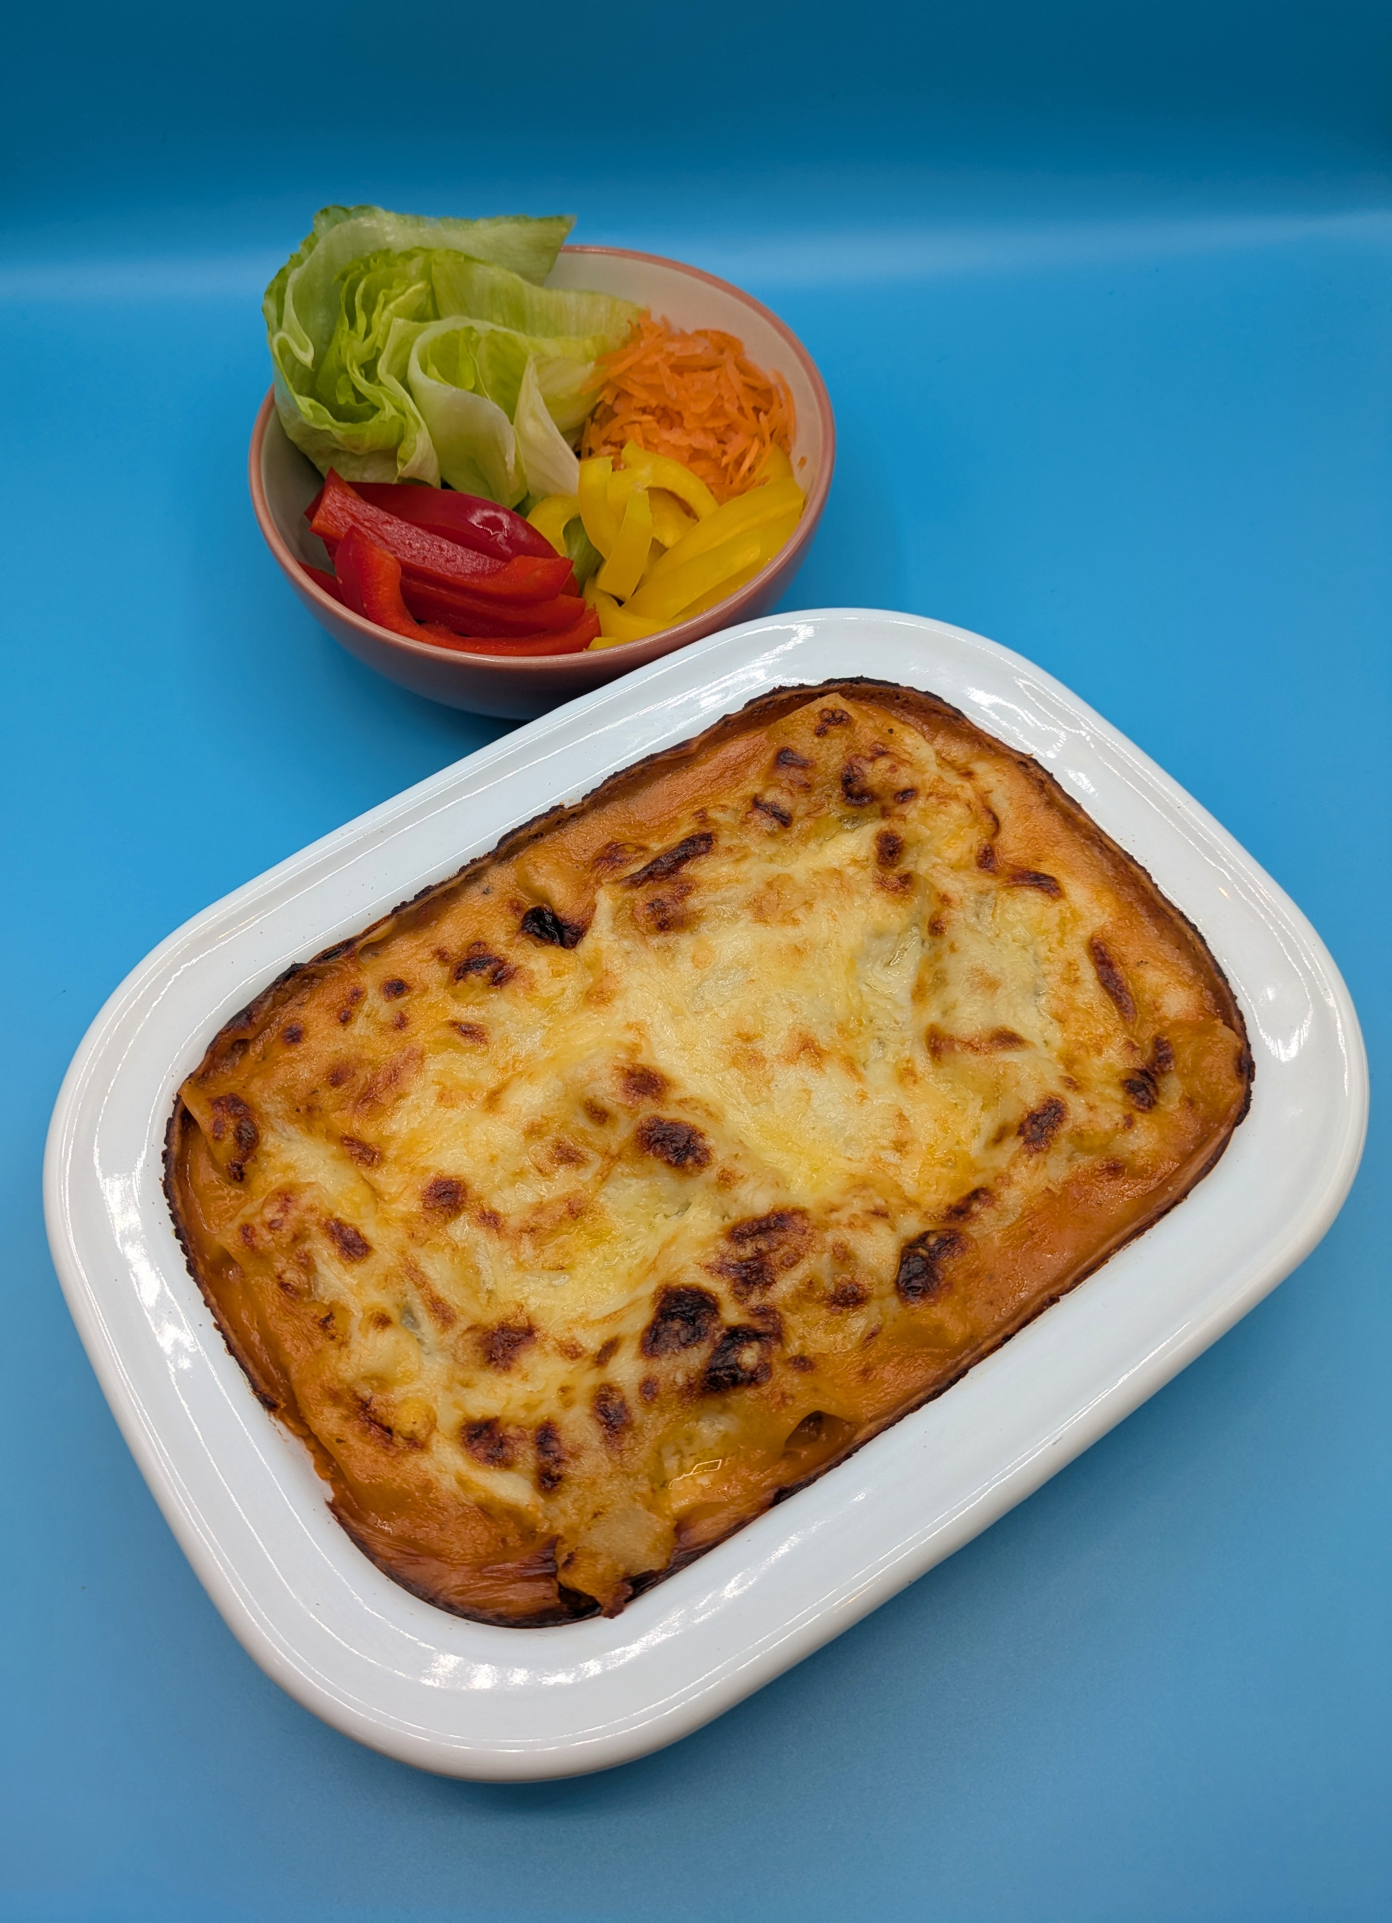
Vegetarian lasagne
For further information, go to:
www.foodafactoflife.org.uk
This resource meets the Guidelines for producers and users of school education resources about food.

