Slide 1

Healthy and sustainable diets – what needs to be considered?
Dr Simon Steenson
Nutrition Scientist

Slide 2
Today’s webinar
The need to transform food systems for human and planetary health
Areas of debate and controversy
Health and environmental benefits of following the Eatwell Guide
Suggested ‘action areas’ and tips for how we can eat a healthier and more sustainable diet
Links to Food – a fact of life resources

Slide 3





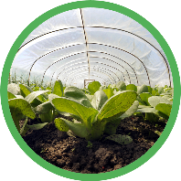
The need to transform our food systems
People
Planet
1 in 5 deaths globally is due to a poor diet
The food we eat is responsible for:
A quarter to one-third of all greenhouse gases*
2 billion adults are overweight or obese, but 500 million are underweight.
70% of freshwater use
About 40% of land use
* Depending on source. Several estimates have been published and appear in the scientific literature.

Slide 4
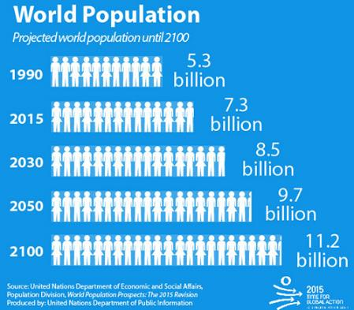
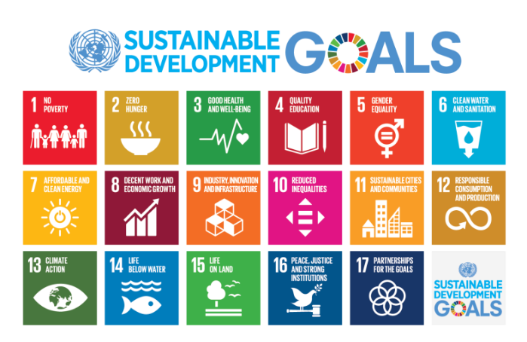
Feeding a growing population
Global population expected to increase to 9.7 billion by 2050
Worldwide food demand is expected to increase by more than 50% ⁽¹⁾
Demand for animal-based foods estimated to increase almost 70% due to rising incomes in developing nations ⁽²⁾
On current trends, food production will need to increase by more than 50% ⁽²⁾
Nutrition and food security play a pivotal role in achieving all 17 of UN’s Sustainable Development Goals
How can we feed a growing population while reducing malnutrition and the environmental effects of our current food system?
Sources: (1) WHO population estimates (https://www.un.org/en/sections/issues-depth/population/) (2) World Resources Institute ‘Creating a Sustainable Future’ (https://research.wri.org/wrr-food)

Slide 5
What do we mean by a healthier and more sustainable diet?
Healthy
Affordable
Nutritionally adequate
Healthier and more sustainable diet
Accessible
Low environmental impact
Culturally acceptable
How can we put this into practice? A lot of debate exists around what a healthier and more sustainable diet should and (should not) contain.

Slide 6

Healthy and sustainable diets: Areas of debate and controversy
Notes:
Before we look at some tips on how to achieve a healthier and more sustainable diet, I’d like to first look at some common myths, misconceptions and also controversial issues that you have not doubt heard about when it comes to sustainable diets, and to discuss how these match up with the science.

Slide 7
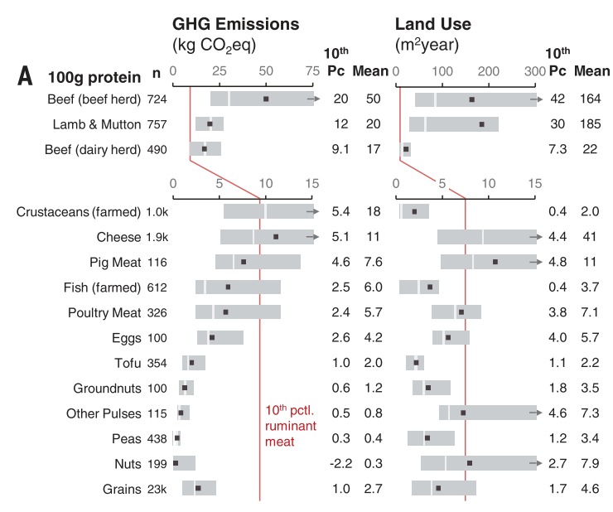
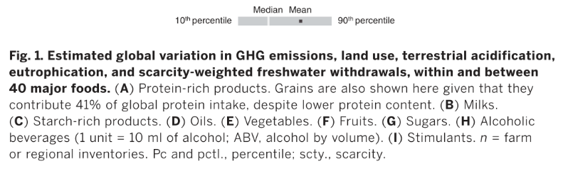
Global variation in environmental impacts
There is huge variation in the environmental impact of foods depending on where and how they are produced
For example, top 10% most impactful beef (herd) vs. bottom 10% least impactful producers ⁽¹⁾ globally:
12 times greater greenhouse gas (GHG) emissions
50 times greater land use
Most GHG emissions from the global food system occur during ‘pre-farm gate’ stage ^{(2,3)}
However, supply chain emissions (food processing, packaging, transport, household consumption, waste disposal) are becoming increasingly important ^{(2,3)}
Source: (1) Poore & Nemecek 2018 Science 360 (6392): 987-992; (2) Crippa et al (2021) Nature Food 2: 198-209. (3) FAO Analytical Brief (2021) https://www.fao.org/publications/card/en/c/CB7514EN/

Slide 8
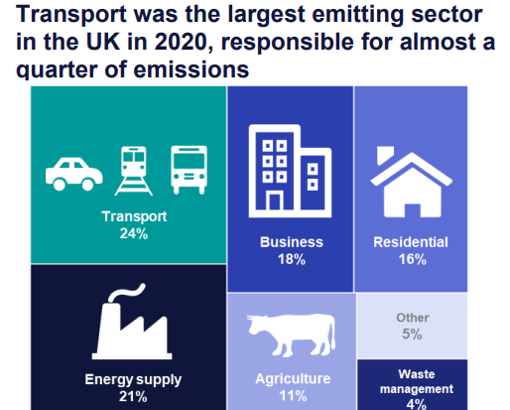
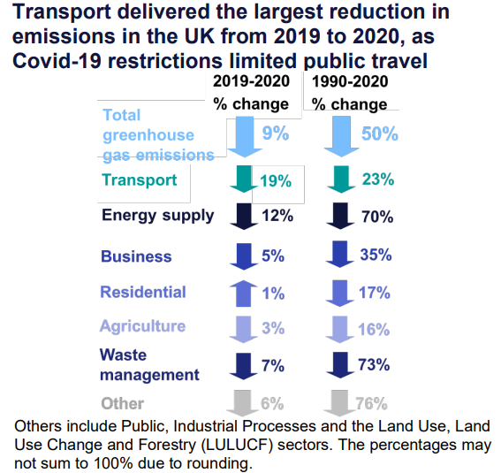
What about the UK?
UK GHG emissions from agriculture accounts for 11% of total territorial emissions (has decreased over last 30 years and vs. 2019-2020)
UK livestock (cattle, sheep, pigs, poultry) = 6.6% of total territorial emissions ⁽¹⁾
EU average for livestock = 9.1% ⁽²⁾
Important to distinguish between local and global figures for environmental impact
Sources: (1) Enteric emissions, excluding land use and land use change (accounted for separately to agriculture): UK Department for Business, Energy & Industrial Strategy (DBEIS) 2022 - https://www.gov.uk/government/statistics/final-uk-greenhouse-gas-emissions-national-statistics-1990-to-2020
(2) European Commission Joint Research Centre (2010). https://op.europa.eu/en/publication-detail/-/publication/38abd8e0-9fe1-4870-81da-2455f9fd75ad

Slide 9
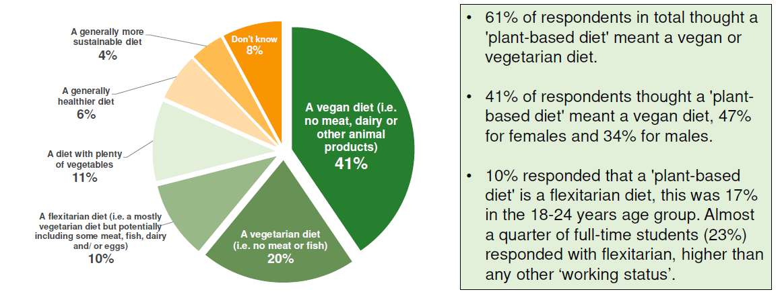
What does the term ‘plant-based diet’ mean?
Source: BNF/YouGov survey (November 2020) of 2,018 adults from across Britain. Figures have been weighted and are representative of all GB adults (aged 18+) https://www.nutrition.org.uk/news/2020/majority-unlikely-to-go-plant-based-in-the-new-year-bnf-survey-reveals/

Slide 10
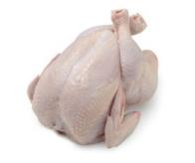
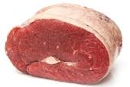
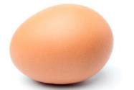
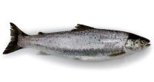
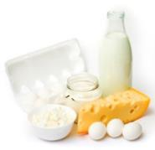

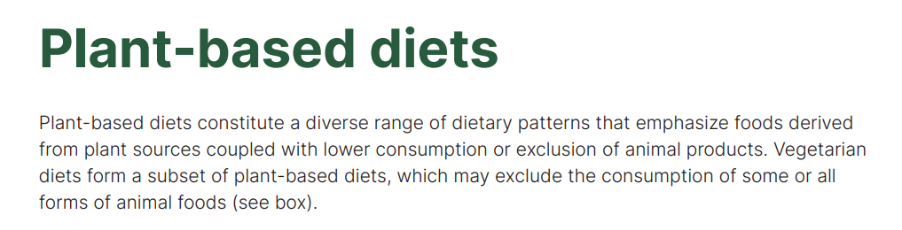
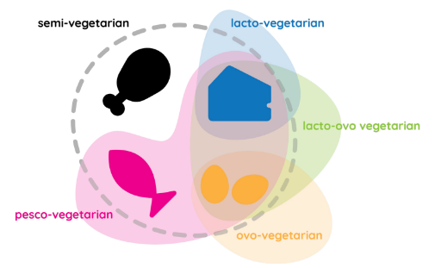
What do we mean by the term ‘plant-based’?
Currently no legal definition of a ‘plant-based’ food but products must comply with existing legislation (e.g. novel foods)
Novel plant-based alternatives are likely to be classified as ultra-processed foods
No accepted definition among industry, researchers or the public of a ‘plant-based diet’ and if this can contain animal source foods or not
?
Source: WHO European Region - https://apps.who.int/iris/handle/10665/349086

Slide 11
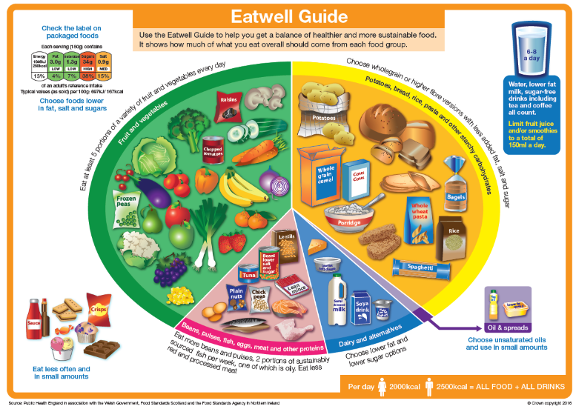
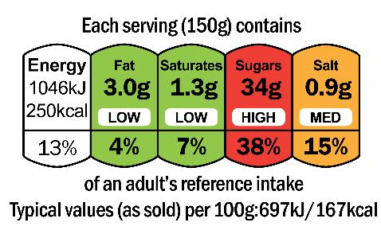
What does the term ‘plant-based diet’ mean?
Government healthy eating advice and other healthy dietary patterns are mainly ‘plant-based’ but can still include some meat, fish, dairy, and eggs in moderation
Some ‘plant-based’ products may be high in saturated fat, salt and/or sugars and might not provide important essential nutrients found in animal-based equivalent foods
Could an alternative term(s) help avoid confusion?
Plant-rich?
Plant forward?

Slide 12
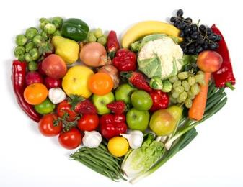
Vegan diets and sustainability
Adopting a vegan diet could lead to large reductions in GHG emissions and less land use vs. current average diets ⁽¹⁾
Associated with potential health benefits ⁽¹⁾
However…
May slightly increase water footprint (compared to current average) diets
Unrealistic for many people to adopt – currently only 1% of people in the UK are vegan (4% are vegetarian) ⁽²⁾
Excluding animal-derived foods could reduce intakes and/or ‘bioavailability’ (how well a nutrient is absorbed and used by the body) of some important nutrients, such as iron, zinc, iodine, vitamins A and B12
Potential cause for concern for some groups with evidence of low nutrient intakes and/or status (e.g. 1 in 10 UK girls aged 11-18 years is estimated to have iron deficiency and anaemia) ⁽³⁾
Sources: (1) Steenson & Buttriss Nutrition Bulletin 46:279-309; (2) FSA, Food and You 2 - Wave 3 (Jan 2022) ; (3) National Diet and Nutrition Survey (years 9 to 11; 2016/2017 to 2018/2019)

Slide 13
Nutritional contribution of animal-derived foods
Restricting or eliminating animal-based foods from the diet may make it more difficult to get adequate amounts of some nutrients if not eating a diverse diet
Nutrient | Dietary contribution of animal-based foods in UK diet*
Vitamin B12 | Typically only found naturally in foods of animal origin
Iron | 29%
Calcium | 47%
Vitamin D | 74%
Selenium | 61%
Iodine | 61%
Zinc | 53%
Iron – iron from animal sources is more ‘bioavailable’ than iron from plant sources
Vitamin D – vitamin D₃ supplements from sheep’s wool (lanolin) raise vitamin D levels more effectively than vitamin D₂ supplements⁽¹⁾
Calcium – some compounds (content can inhibit absorption (e.g. oxalic acid in spinach)
Iron and zinc – phytic acid compounds in some plant foods may reduce absorption
Iodine – milk and dairy products are the main contributors to UK intakes (all ages) ⁽²⁾ but some milk alternatives are not fortified
*Total percentage contribution from ‘Milk and milk products’, ‘Meat and meat products’, ‘Eggs and egg dishes’, ‘Fish and fish dishes’ and ‘Butter’. Source: National Diet and Nutrition Survey (NDNS; years 9 to 11)
Sources: (1) Tripkovic et al (2017) American J Clin Nutr 106:481-490 (2) National Diet and Nutrition Survey, years 9 to 11 (2016/2017 to 2018/2019)

Slide 14
How can we eat a healthier and more sustainable diet?
There is no ‘one-size-fits-all’ solution to such a complex problem…
…but there are some actions we can all take to benefit our own health and that of the planet
Follow the Eatwell Guide
Eat more fruit and vegetables
Diversify protein sources
Limit foods high in fat, salt and/or sugar
Choose sustainable sources of fish and seafood
Waste less food and drinks

Slide 15
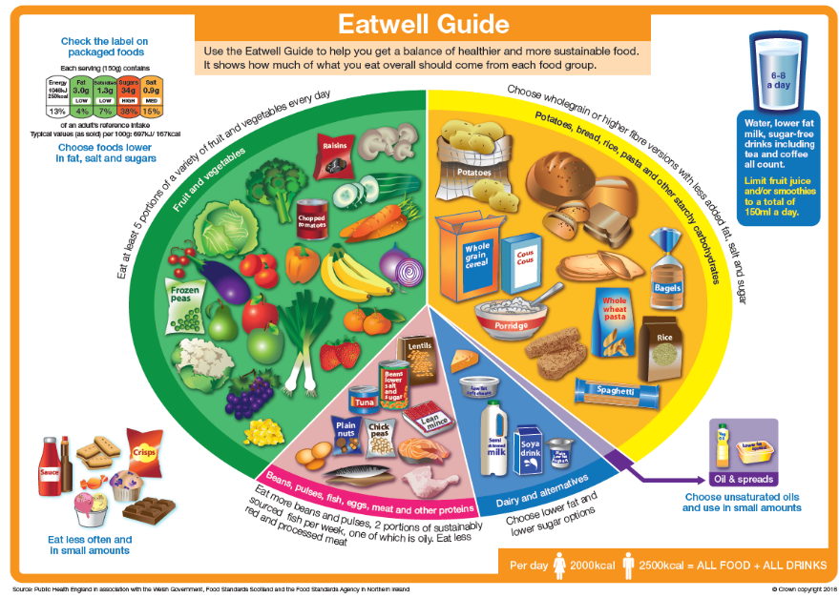



1. Follow the Eatwell Guide
Following UK’s healthy eating advice, the Eatwell Guide, more closely can have environmental and health benefits:
30% lower greenhouse gases
4% lower water use
7% lower mortality risk
Source: Scheelbeek et al. (2020) BMJ Open;10:e037554

Slide 16
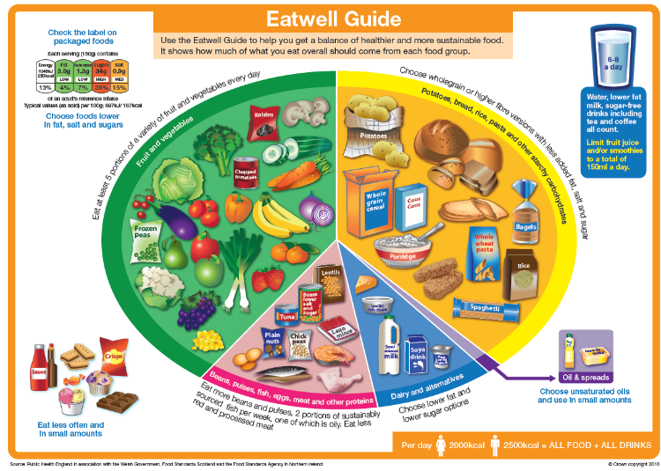
1. Follow the Eatwell Guide
Eating pattern familiar in the UK and includes nutrient-rich animal source foods in moderation
31% of people (5+ years) in UK achieve at least 5 out of 9 recommendations, but room for improvement (only 0.1% achieve all 9 recommendations) ⁽¹⁾
More fruit, vegetables, wholegrains and higher-fibre starchy foods, beans and other pulses would increase fibre intakes
Fewer than 1 in 5 children (4-10 years) and fewer than 1 in 10 adolescents (11-18 years) and adults currently meet the age-specific fibre recommendations ⁽²⁾
Sources: (1) Scheelbeek et al. (2020) BMJ Open;10:e037554; (2) National Diet and Nutrition Survey (years 9 to 11; 2016/2017 to 2018/2019)
Notes:
The Eatwell Guide is the UK’s healthy eating guidance showing proportions of main food groups that make up a healthy, balanced diet, and includes advice on specific food and drink choices.
This study compared people meeting between five and nine food and nutrient recommendations of the eatwell Guide, with those meeting zero to two of the recommendations. The nine food and nutrient recommendations included advice for: fruit and vegetables; fish and oily fish; red and processed meat; fibre; salt; free sugars; saturated and total fat.

Slide 17
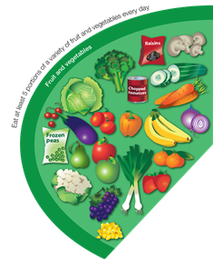

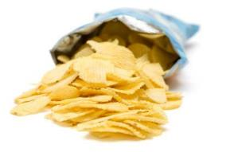
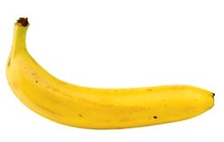
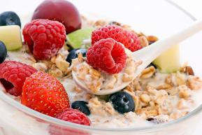
2. Eat more fruit and vegetables
Source of essential vitamins, minerals and fibre
Eating at least 5 portions a day can reduce risk of heart disease, stroke and some cancers
One portion = 80g (150 ml fruit/veg juice or smoothie counts as maximum of one portion)
Variety is important to provide different essential nutrients
Only a third of UK adults and fewer than 1 in 8 adolescents (11-18 years) get their 5 A DAY at the moment
Add fresh, frozen or canned vegetables to recipes
Snack swaps
Add fruit to breakfast cereal or porridge

Slide 18
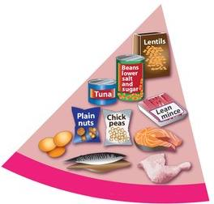
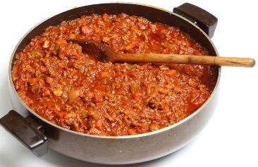
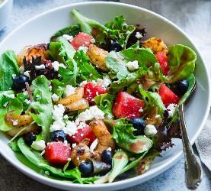
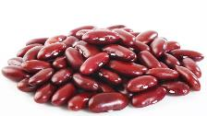
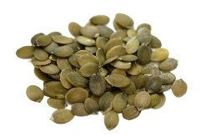
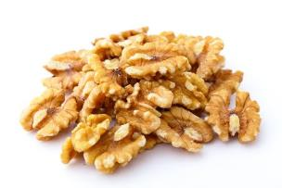
3. Diversify protein sources
Rebalance in favour of more plant-based protein sources, including beans and other pulses, nuts, seeds, and plant-based meat alternatives (not high in saturated fat/salt), alongside some meat, fish, dairy products, and eggs
It’s not just about protein – need to think about overall nutrient composition of plant-based alternatives, including essential nutrients typically provided by animal-based foods in a readily absorbed form (iron, zinc, calcium, iodine, vitamin B12)
Beans and other pulses, nuts, and seeds can also provide dietary fibre
Add canned beans or chickpeas to dishes
Have a small handful of nuts or seeds as a snack

Slide 19

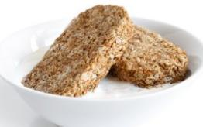


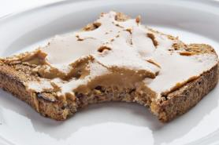
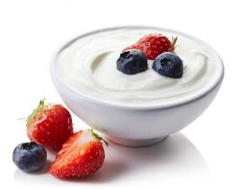
4. Limit foods high in fat, salt and/or sugar
We all know foods such as cakes, biscuits, pies and pastries are not the healthiest choices
These foods can also contribute to the GHG emissions, land and water use associated with our diets
Be portion wise
Plan ahead with healthier snack options
Lower-sugar wholewheat cereal and milk or fortified milk alternative
Wholemeal toast and peanut butter
Place a smaller amount of crisps in a bowl or buy smaller multi-packs
Fat free, no added sugar yogurt and berries

Slide 20


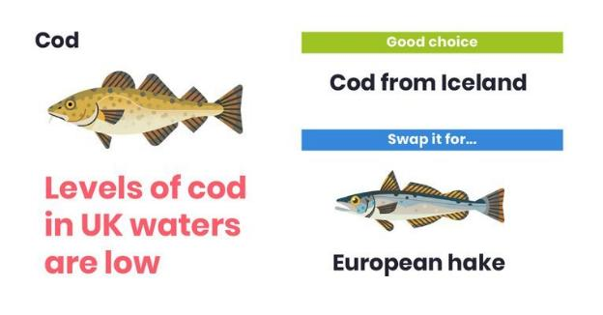

5. Choose sustainable sources of fish and seafood
Fish provides protein, vitamins and minerals, and heart healthy omega-3 fats
Recommended to eat at least two 140g portions of fish a week, and make one an oily fish like mackerel or sardines
However, a third of global fish stocks are considered ‘overfished’, so it’s important to make more sustainable choices
1. Experiment with a wider variety outside the ‘Big 5’ (cod, haddock, tuna, salmon, prawns)
TIP!
Frozen or canned fish tends to be cheaper and lasts longer
2. Look out for eco-labels
3. Use the Good Fish Guide
https://www.nutrition.org.uk/news/2021/plenty-more-fish-in-the-sea-why-we-should-choose-more-sustainable-seafood/
Notes:
According to the Marine Conservation Society (MCS), 80% of the seafood we eat in the UK comes from just 5 different species – cod, haddock, salmon, tuna, and prawns. This can place pressure on a smaller number of wild stocks or farmed species than if we choose a greater variety when shopping.

Slide 21
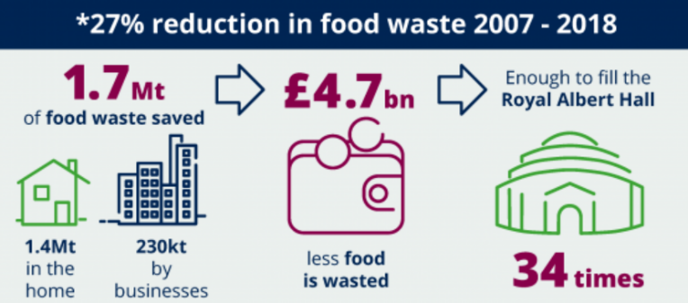


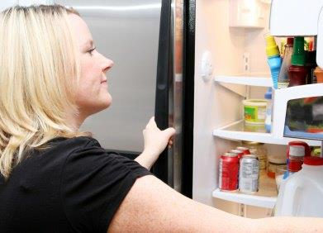
6. Waste less food and drinks
FAO estimates about of a third food is lost (in supply chain) or wasted globally ⁽¹⁾
Responsible for 8-10% of total global GHG emissions ⁽²⁾
UK has made good progress in reducing food waste in recent years (see opposite)
Courtauld Commitment 2030 aims to reduce UK food waste by 50% by 2030 (vs. 2007 baseline) ⁽³⁾
However, only about a third of UK adults (36%) see a ‘clear link’ between food waste and climate change ⁽⁴⁾
Food waste costs the average UK household (with children) £60 per month ⁽⁵⁾
https://www.wrap.org.uk/content/courtauld-commitment-2025-milestone-progress-report
Sources: (1) FAO, 2011 estimate https://www.fao.org/food-loss-and-food-waste/flw-data) (2) IPCC SPECIAL REPORT: SPECIAL REPORT ON CLIMATE CHANGE AND LAND - https://www.ipcc.ch/srccl/chapter/summary-for-policymakers/
(3) The Courtauld Commitment 2030 - https://wrap.org.uk/taking-action/food-drink/initiatives/courtauld-commitment (4) WRAP UK household food waste tracking survey Winter 2021: Behaviours, attitudes, and awareness - https://wrap.org.uk/resources/report/uk-household-food-waste-tracking-survey-winter-2021-behaviours-attitudes-and
(5) https://wrap.org.uk/sites/default/files/2021-10/food-%20surplus-and-%20waste-in-the-%20uk-key-facts-oct-21.pdf
Use food labels (e.g. best before, storage info)
Plan meals before shopping
Set your fridge correctly (0-5℃)
Notes:
In the UK, we have reduced the amount of food we waste in recent years by 7% (between 2015 and 2018) and the UK is the first country globally to progress more than halfway towards meeting the UK target to halve food waste by 2030. But there is still significant scope for improvement.
For example, one survey found that less than a third of people saw a clear link between climate change and ‘throwing away food that could have been eaten’. So, there seems a need to improve awareness. WRAP, the Waste and Resources Action Programme, held its first ever Food Waste Action Week earlier this year, and has a website highlighting the links between food waste and climate change – Wasting food: it’s out of date.
Knowing how to use the information on food labels can help us to waste less. For example, knowing that some foods are still OK to be eaten after the best before date, or following instructions for how to store foods and drinks correctly so that they stay fresh for as long as possible.
Planning meals ahead of time before going shopping can also help us to use what we already have and to buy what we need.
The average fridge temperature in the UK is 7°C; above the recommended range of 0-5°C. This means that more food is likely to spoil, especially items such as milk. The equivalent of 3 million glasses of milk are poured down household sinks in the UK every single day.

Slide 22
Key messages
There is an urgent need to transform food systems to support both human and planetary health
Healthier and more sustainable diets need to consider a range of factors including environmental impact and nutrition, but also health, cost, and cultural acceptability
The Eatwell Guide provides a familiar plant-rich dietary pattern that is higher in fibre
Following the Eatwell Guide more closely can deliver health and environmental benefits, but only 31% of people in the UK (5+ years) meet at least 5 out of 9 recommendations at the moment
We need to find ways to:
Increase our intake of fruit, vegetables, wholegrains, sustainably sourced fish and plant protein sources (e.g. beans, lentils, other pulses)
Limit less healthy foods high in fat, salt and/or sugar, and reduce the amount of food and drinks we waste

Slide 23
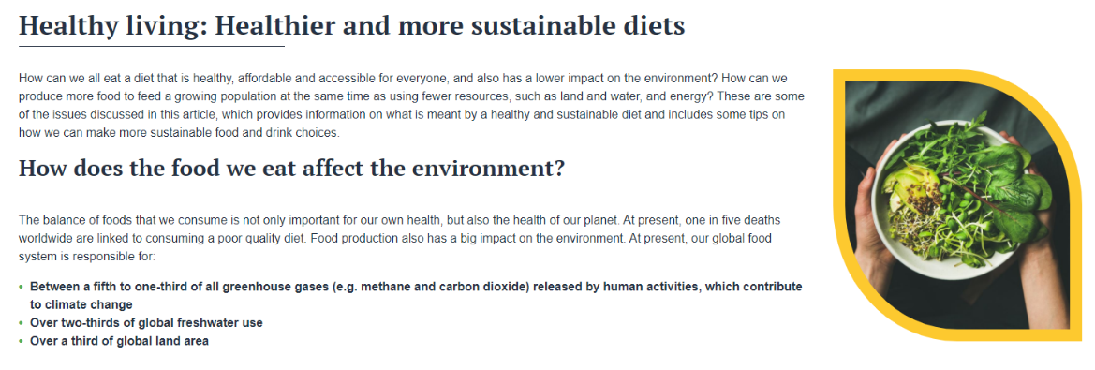
Thank you!
Visit www.nutrition.org.uk for more information on healthier and more sustainable diets
Healthier and more sustainable diets: What changes are needed in high-income countries? is available open access on the Nutrition Bulletin website https://doi.org/10.1111/nbu.12518

Slide 24
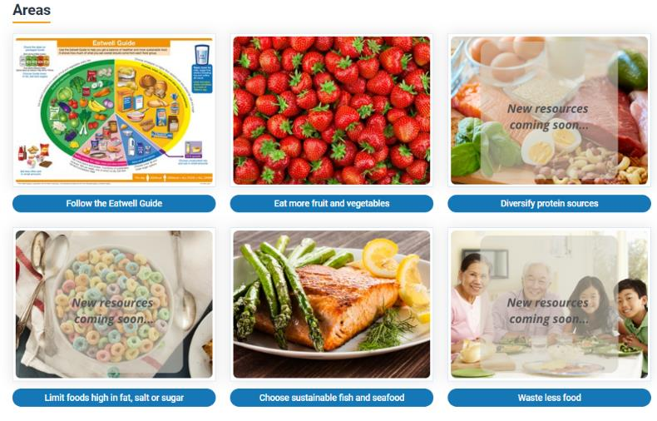
Healthier sustainable diets – support for pupils and teachers
Some resources are already available to support the six key messages for ages 5-16 years.
More resources will be created over the next year.
What would be the priority and what sort of resources would be most useful?
Food – a fact of life.org.uk
11-14 years and 14-16 years

Slide 25
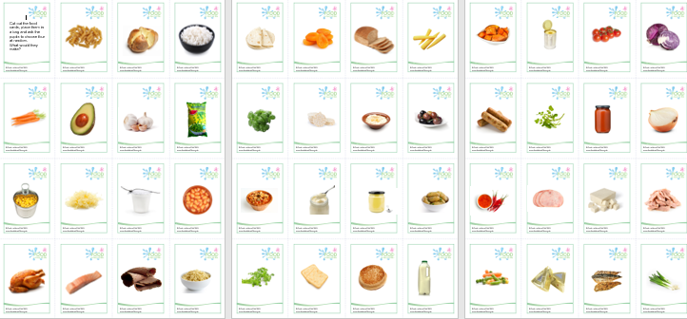
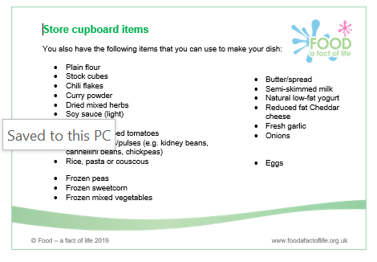
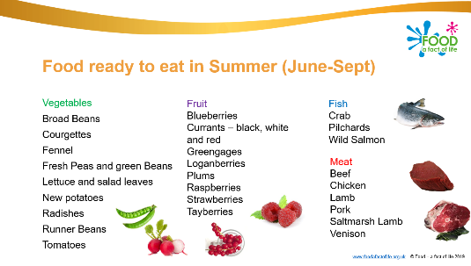
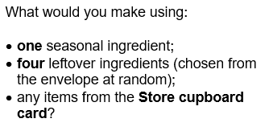
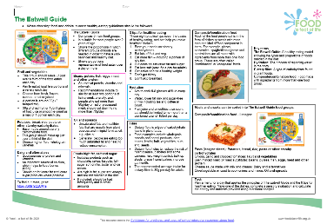
In the meantime ….
Eatwell Guide Knowledge organiser
Food commodities: Fruit and vegetables
Food commodities: Fish and seafood
Mycoprotein resources
Using leftovers – presentation and activity.
Eat your way around the UK Challenge-based activity
Journey of your meal Challenge-based activity
Farm to fork videos and quizzes

Slide 26
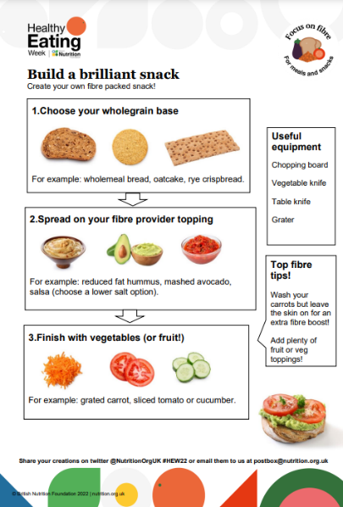
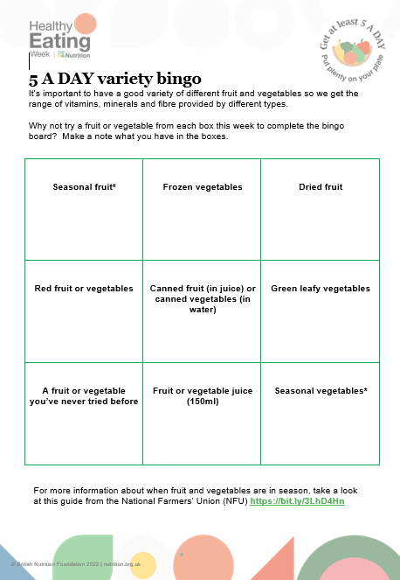
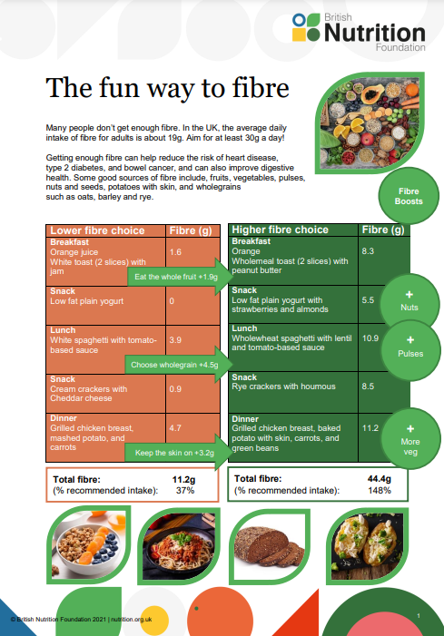
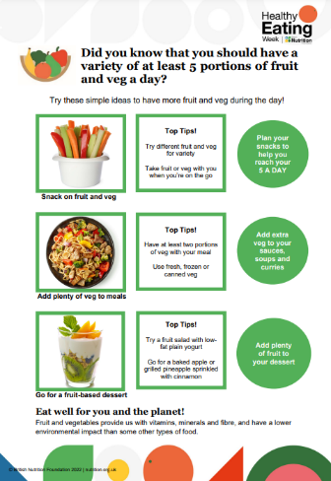
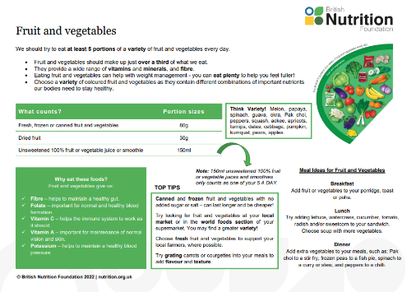
Healthy Eating Week Resources
HEW 2022 resources

Slide 27
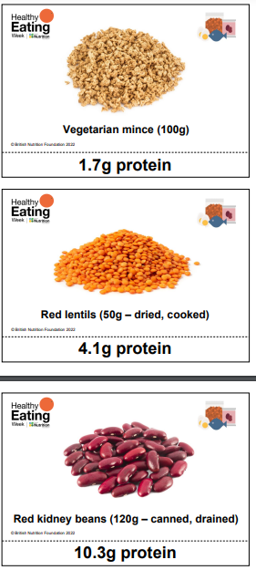
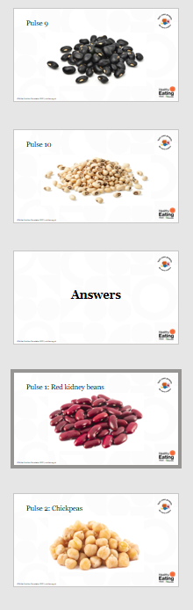






Healthy Eating Week resources
HEW 2022 resources

Slide 28
Healthy and sustainable diets – what needs to be considered?
For further information, go to:
www.foodafactoflife.org.uk

