Slide 1
Growing mussels

Slide 2
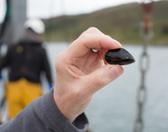
What are mussels?
Mussels are bivalve molluscs that can live in fresh or salt water. Bivalves are shellfish with a shell formed of two parts, with a ‘hinge’.
There are many different species of mussel but only a few are usually grown and eaten for food. These are mainly saltwater species that grow in the sea.
In the UK, most mussels that are grown are blue mussels (Mytilus edulis).
Mussels are grown all around the UK, including Cornwall, Devon, Scotland and Wales.

Slide 3
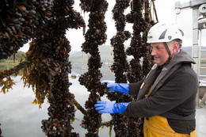
How are mussels grown?
Whilst mussels can be found attached to rocks in the sea, harvesting mussels in this way can be very time consuming.
Therefore, mussels are often grown on ropes so they can be easily harvested in large numbers.
Ropes can be hung from long lines, wrapped around poles or hung from rafts, depending on the country and conditions the mussels are growing in.
Mussels growing attached to the ropes

Slide 4
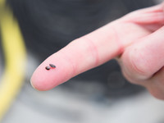
Seed mussels
Seed mussels are young mussels. They are very small, enabling them to float on the ocean currents.
The seed mussels float in the water until they can find something solid to attach to and begin to grow.
Sometimes there may not be enough seeds in the water. In these cases, seeds can be grown in a ‘hatchery’ and shipped to where they are needed.
Seed mussels are very small

Slide 5
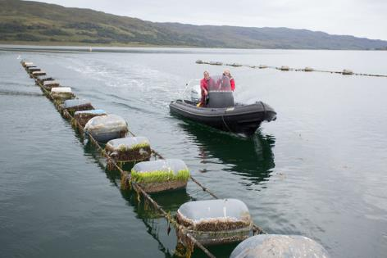
Growing mussels on ropes
A common method for growing mussels in the UK is to use long lengths of rope.
These are often between 200 and 400 metres long and are fixed in place, so they do not drift away.
Floats are attached to the top of the ropes. This keeps them near to the surface.
Growing mussels on ropes allows mussels to be collected more easily than harvesting them in the wild.

Slide 6
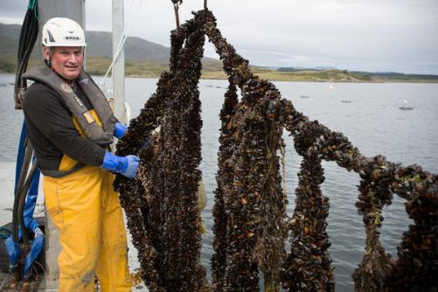
Droppers
Just one long rope in water is not enough to grow many mussels.
To increase the area for mussels to attach to and grow from, more ropes hang down into the water.
These are known as droppers. They may be between 6 and 10 metres long, depending on the depth of the water.

Slide 7
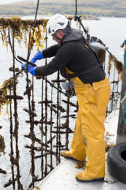
Attaching to the ropes
The seed mussels that are floating in the water come into contact with the ropes.
Once they hit the solid material of the rope, they attach themselves by using a ‘beard’.
A ‘beard’ is a group of fibres that the mussel grows and uses to stick itself to the rope.
This beard hardens, binding the mussel to the rope, from which it can no longer move.

Slide 8
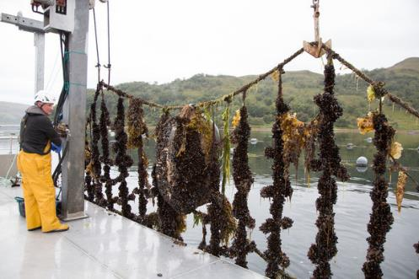
Growing and harvesting
The mussels grow for around a year, before being harvested, to allow them to grow big enough to eat.
While growing, they are regularly checked to make sure they are developing properly.
When the mussels are fully grown, the ropes are hoisted out of the water.

Slide 9
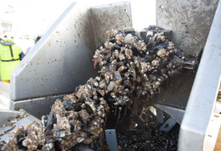
Stripping
The mussels are attached tightly to the rope and are hard to remove.
A machine is used to pull the rope through a narrow opening to remove the mussels.
The mussels cannot fit through the opening and so become detached from the rope.

Slide 10
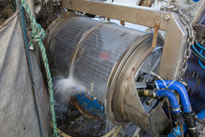
De-clumping
Once the mussels are removed from the rope, they must still be removed from each other.
Their sticky ‘beards’ mean that they stay clumped together in groups.
Another machine, called a ‘declumper’ is used to separate the mussels.
The declumper spins and sprays water on the mussels, a little like a washing machine.
This separates the mussels from each other so they can be graded.

Slide 11
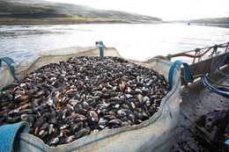
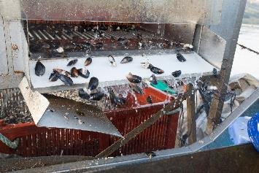
Grading and packing
Even thought the mussels have had time to grow, they are not all the same size or quality.
The mussels are put through a machine that can separate them by size.
Care needs to be taken that the mussels are not damaged during this process.
Once graded, mussels of similar size and quality are packed together in ice to keep them fresh.

Slide 12
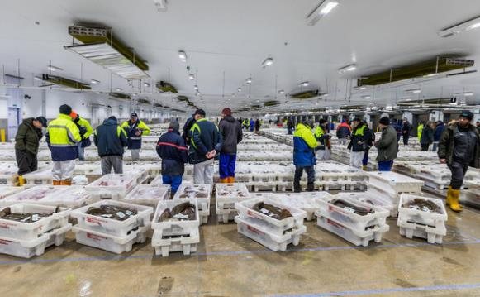
Transporting and selling
Once packed, the mussels are loaded into temperature-controlled vehicles to be sold. This can be either at a fish market or directly to food businesses and restaurants.
A fish market where mussels and other seafood are sold to wholesalers, fishmongers and restaurants

Slide 13
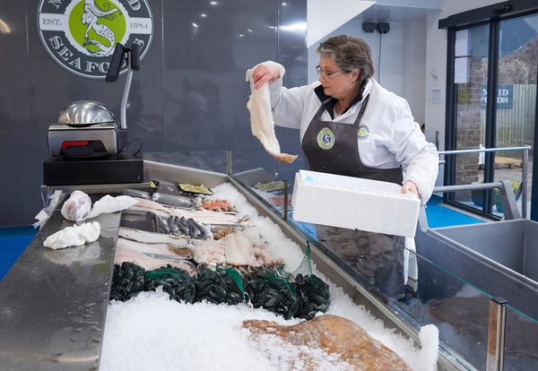
Preparing fresh mussels for cooking
When preparing fresh mussels for cooking, it is important to:
store them in a cool place (they will still be alive);
look through the mussels and discard any that are cracked, chipped or open;
soak the mussels in cold water for about 20 minutes before cooking. As the mussels breathe, they will expel any sand or grit;
remove the ‘beard’ by holding the mussel in one hand, in a dry towel, and then pulling the beard out and away from the mussel with the other hand;
use a firm brush to remove any barnacles and rinse.
Buy mussels from a reputable fishmonger or seafood counter.

Slide 14
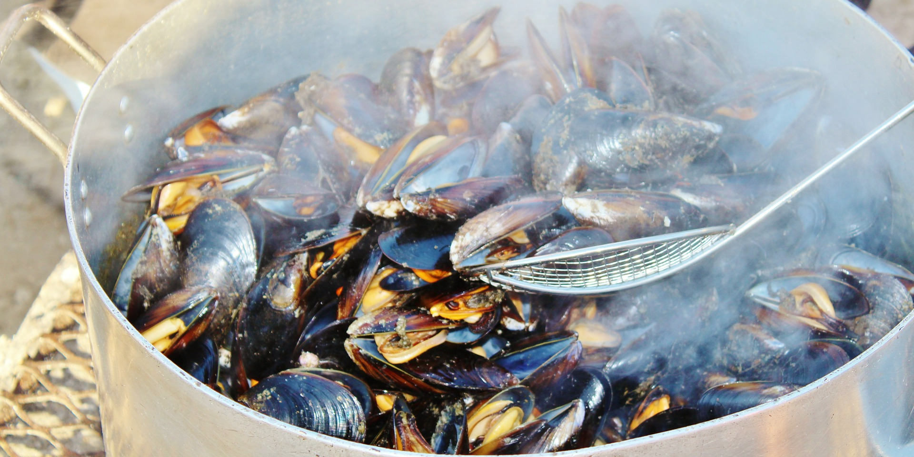
Cooking mussels
Mussels can be poached in a hot liquid, often stock, beer or wine. They should be cooked for 3-5 minutes or until they open. Any that do not open should be discarded.
The cooking liquid can be used to make a sauce or broth or thickened to make a dipping sauce.
Mussels can also be steamed.
Pre-shelled mussels can be poached, steamed or fried.
Countries such as New Zealand grow very large mussels, which can be baked or grilled.
Mussels can be poached in a hot liquid.

Slide 15
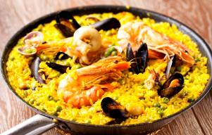
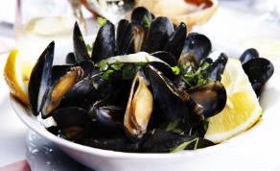
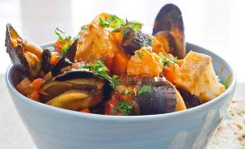
Mussel recipes
There are many dishes around the world that use mussels.
Famous European dishes include Spanish paella and French moules marinière.
They can also be used in a classic fish stew or eaten with pasta, such as linguine.
Paella
Moules marinière
Fish stew

Slide 16
Growing mussels
For further information, go to:
www.foodafactoflife.org.uk
This resource meets the Guidelines for producers and users of school education resources about food.

