Slide 1
Melting and freezing - practical

Slide 2
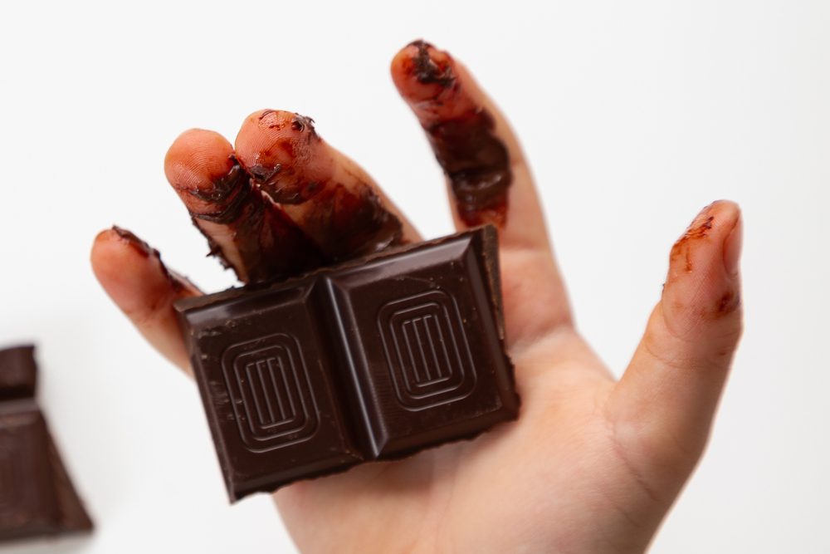
Starter
1. Collect a piece of chocolate from the front of the class.
2. Hold it in your hand and count to 100.
3. What has happened to the chocolate?

Slide 3
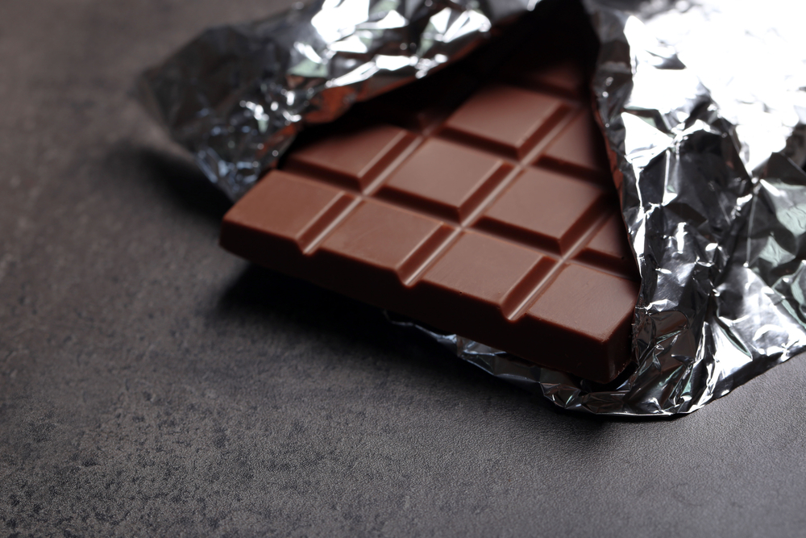


What is different between these three?

Slide 4
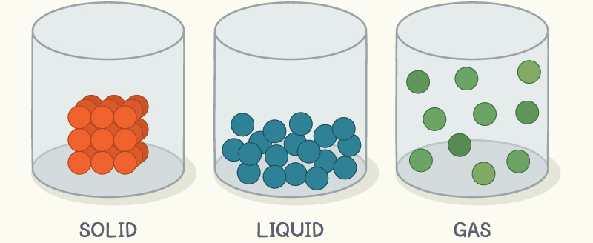
What is different between these three?

Slide 5
Particle models
1 particle
Draw out three boxes labelled solid, liquid and gas.
Draw what solid, liquid and gas particles would look like.
Solid
Liquid
Gas
‪States of Matter: Basics‬ (colorado.edu)

Slide 6

Practical – how fast chocolate takes to melt
Activity: Calculate how fast different types of chocolate (white, milk or plain) take to melt.
Create a hypothesis: Which do you think will take the longest to melt?
I think that ……………….. will take the longest to melt.

Slide 7
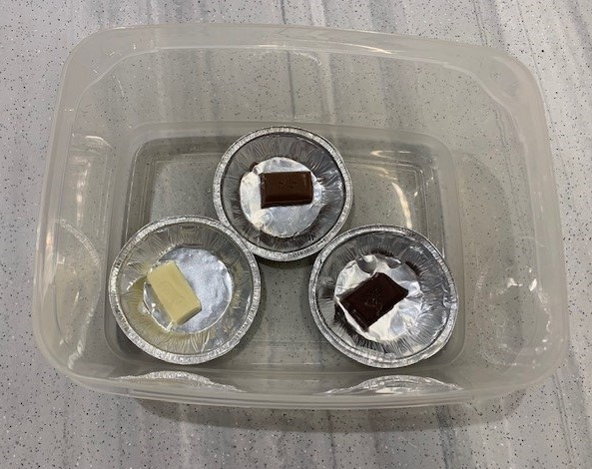
Practical – calculating a melting point
Equipment you will need:
3 deep foil pie cases;
3 large paper clips (to clip the cases to the side of the container - optional);
1 clear plastic take away food container or water bath;
stopwatch.

Slide 8

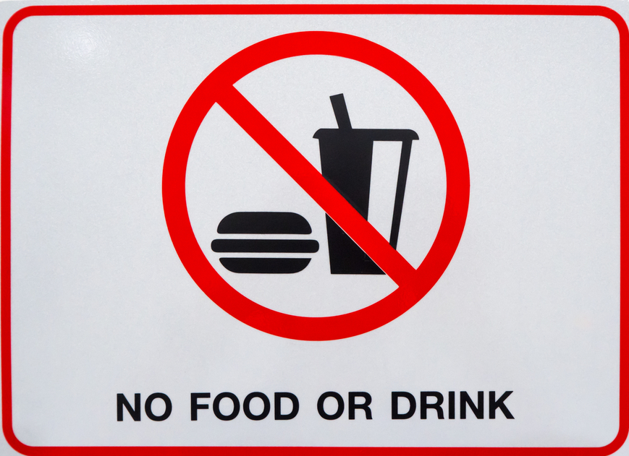
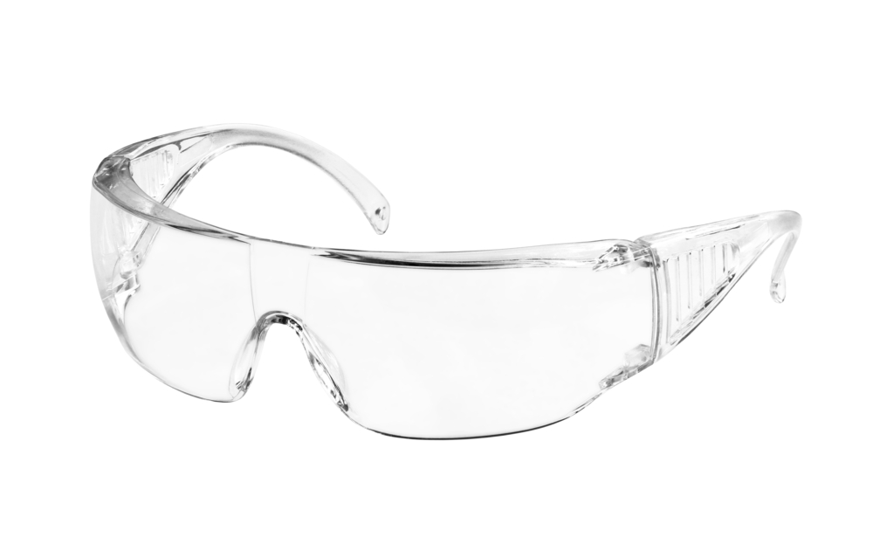

Turn and talk – how are we going to stay safe during this practical?
Wear safety goggles
Use test tube holders
Keep desks/benches tidy and make sure bags are not trip hazards

Slide 9
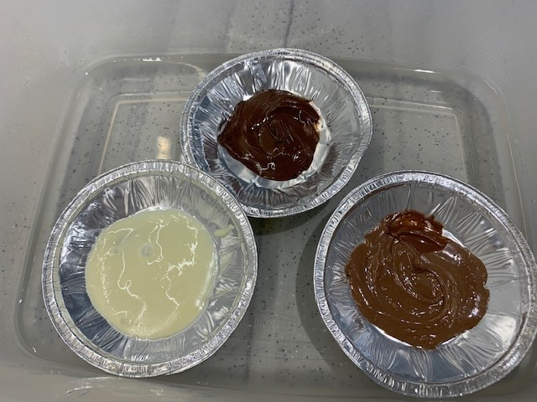
Practical – calculating a melting point
Set up the apparatus as shown in the photo.
Collect equal sized pieces of the three different types of chocolate and add to each foil cup.
Ask the teacher to pour hot water into the tub (at this point start your timer).
Carefully stir each piece of chocolate as soon as the hot water has been added to the takeaway tray (use a separate stirrer for each). Make sure that water doesn’t splash into the foil cup.
Record the time when each has completely melted in your results table.

Slide 10
Results table
Type of chocolate | Time taken to melt (seconds)
White
Milk
Dark

Slide 11
What is happening to the chocolate?
Describe what is happening to the chocolate as it melts. Use the idea of the particle theory to explain this.
When the solid is heated, the particles…
Key words:
Particles
Solid
Liquid
Faster
Move
Energy
Kinetic
Remember – particles DON’T expand, they move further away from each other.

Slide 12
What is happening to the chocolate?
When the solid is heated, the particles vibrate faster about their fixed points. This is because they are gaining kinetic energy.
When a certain temperature is reached, the particles start to break away from their fixed shape and move away from each other. This shows the state change from a solid to a liquid.
Key words:
Particles
Solid
Liquid
Faster
Move
Energy
Kinetic
Remember – particles DON’T expand, they move further away from each other.

Slide 13
What is happening to the chocolate?
Now you have your melted, liquid chocolate, you want to get it back to solid chocolate.
Describe how could you go about doing this, using the particle model.
Key words:
Particles
Solid
Liquid
Faster
Move
Energy
Kinetic
Remember – particles DON’T expand, they move further away from each other.

Slide 14
What is happening to the chocolate?
You can freeze a liquid to turn it back into a solid.
When the liquid is cooled, the particles vibrate slower. This is because they are losing kinetic energy.
When a certain temperature is reached, the particles are moving so slowly that they start to form a rigid structure and they stay in a fixed shape (a solid).
Key words:
Particles
Solid
Liquid
Faster
Move
Energy
Kinetic
Remember – particles DON’T expand, they move further away from each other.

Slide 15
Variables
THE VARIABLES SONG: Sung to the tune (if you’re happy and you know it)
There are three types of variables:
Dependent variables
Independent variables
Control variables
Independent variables are ones you ________
Independent variables are ones you ________
Dependent ones you _________
Get it wrong you’ll feel displeasure
Independent variables are ones you ________
Independent variables go on the ____ -axis
Independent variables go on the ____ -axis
Dependent ones go high
On the axis known as ____
Independent variables go on the ____ -axis
change
change
measure
change
x
x
y
x

Slide 16
Graph peer marking
Pencil & ruler used
Graph at least 2/3rds of a page
Axis the correct way round
X-axis scale even
X-axis and Y-axis labelled
X-axis units
Y-axis scale even
Y-axis units
Neat plots with an x to indicate a point
Smooth curve/ line of best fit or no correlation clearly written on graph
Give your partner a score out of 10 for their graph

Slide 17
Homework - Poster
Solid | Liquid | Gas
Hard to compress | Can not be compressed | Easy to compress
Fixed shape and volume | Can flow and pour | Fill their container
More dense | Usually less dense than solids | Much less dense than solids/liquids
Very slow/no diffusion | Diffusion quicker than in solids | Diffusion very fast
Research using the internet about the different properties of solids, liquids and gases.
Create an A4 poster that includes:
At least two examples of each
The particle diagrams
Information on whether each flows, can be squashed or if it’s shape be changed.
Some information to include is in the table on this slide.

Slide 18
Key words
Key word​ | Meaning​
Flow | To move and change shape smoothly.
Volume | The amount of room something takes up.
Density | The amount of mass of an object, divided by its volume.
Compress | Squashing into a smaller volume.
Viscosity | The thickness of a liquid product mixture, e.g., a roux sauce.
Diffusion | Particles spread out from a high to a low concentration.

Slide 19
Teachers’ guide

Slide 20
Lesson structure
Starter: Use the chocolate as an introduction to the lesson, leave the next slide on the bord and discuss the answers.
Discuss the ideas of changing states with reference to particles – this interactive resource (link on slide 5 of this presentation) works well ‪States of Matter: Basics‬ (colorado.edu)*– task pupils to draw the particle diagrams.
Practical of melting chocolate.
Practical analysis – ask students to work through the post practical questions.
Discuss the different variables that have been used within the practical.
Pupils draw a graph of results.
*Licensed under the Creative Commons-Attribution (CC-BY), PhET Interactive Simulations, University of Colorado Boulder http://phet.colorado.edu/

Slide 21
Teaching about states of matter
Explain states of matter.
Describe the properties of states of matter.
Describe the particle theory and how this explains the change from solid to liquid.
Describe the particle theory and how this explains the change from liquid to solid.
Identify substances’ state of matter and explain why using key words.

Slide 22
Running a practical classroom
Common misconceptions:
The particles expand when heated – focus on the idea the particles always stay the same size. This is also in the mark scheme for questions on drawing particle diagrams (particles have to look the same size). Particles DON’T expand, they move further away from each other.
Confusion between the different variables – you can use the variables song (on slide 15 in this presentation) or can remember using Independent (I=I change), DEPendent (Dep=Depends on the independent), Control (You need to control = keep the same).

Slide 23
Running a practical classroom
Common pitfalls:
Bottlenecking in the classroom – spread out the equipment as far as you can around the room. If you have time, you can set out the equipment prior to the lesson and spread pairs around.
Practical taking different times for different students – ask students who are finished to pack away and move onto the next section. They can use this time to start thinking about their conclusions and drawing their graph.
Chocolate taking too long to melt – practise the practical activity and see what temperature shows melting at the speed that fits into your lesson. Somewhere between 50-60 degrees Celsius should melt the chocolate relatively quickly.

Slide 24
Progressing the learning
The topic of states of matter remains an essential underpinning for learning throughout Chemistry.
The progression from understanding particle theory would be to look at heating and cooling curves. You can adapt this experiment by including looking at specific melting points or by discussing the temperature staying the same as the chocolate is melting.

Slide 25
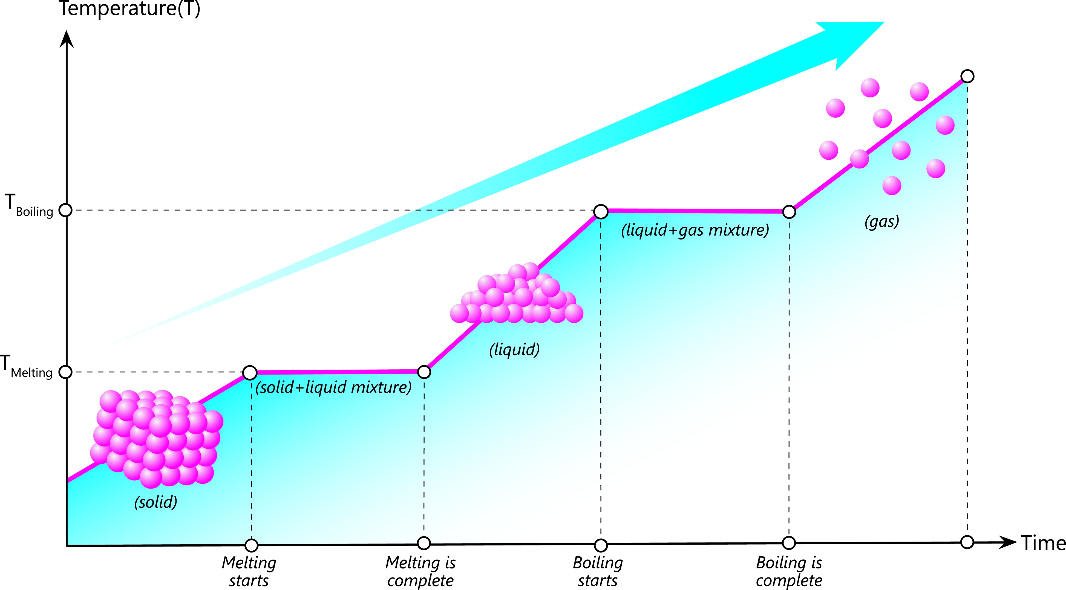
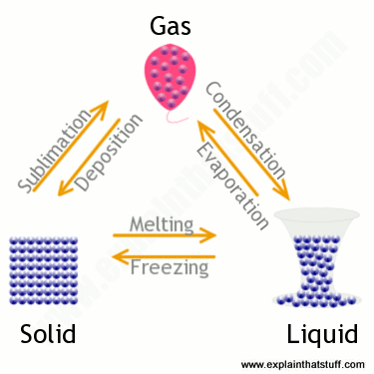
Changing states is all to do with ENERGY!
Changing states (Solid-Liquid-Gas)
Remember!
If temp is increasing, particles are absorbing energy.
If temperature is stable, bonds are absorbing energy.

Slide 26
Melting and freezing - practical
For further information, go to:
www.foodafactoflife.org.uk
This science pack is one of a series of resources produced for the pHood Futures project, supported by the Royal Society of Chemistry.
This resource meets the Guidelines for producers and users of school education resources about food.

