Slide 1
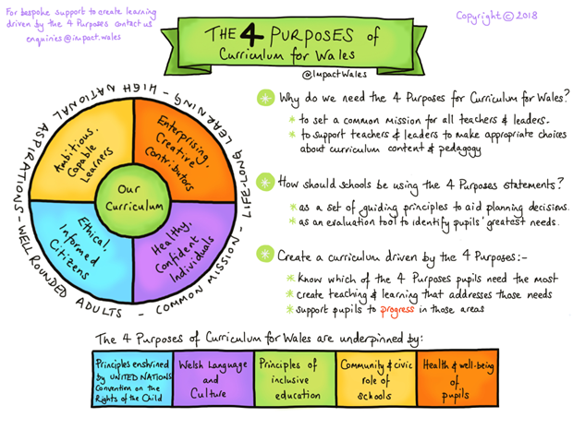
IncorporatingThe New
Curriculum

Slide 2
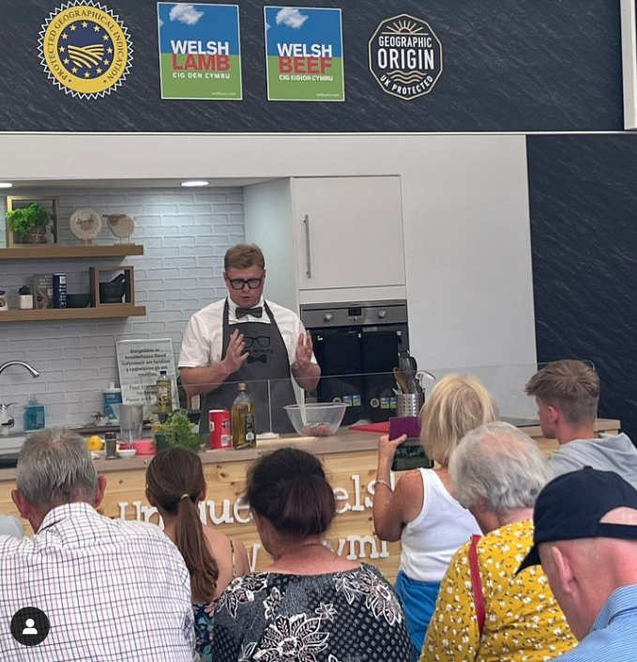


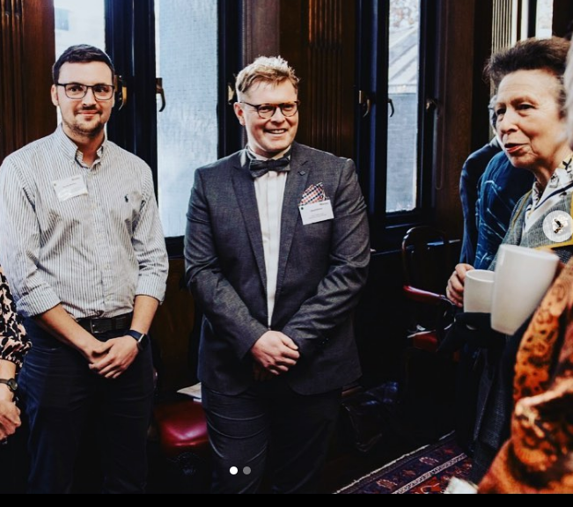
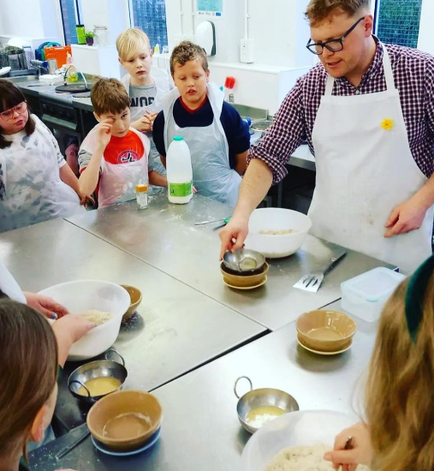
Lloyd Henry
Teaching for 10 + years
Ysgol Gyfun Gwyr
BNF/ Hybu Cig Cymru
@ Cegin Mr Henry

Slide 3
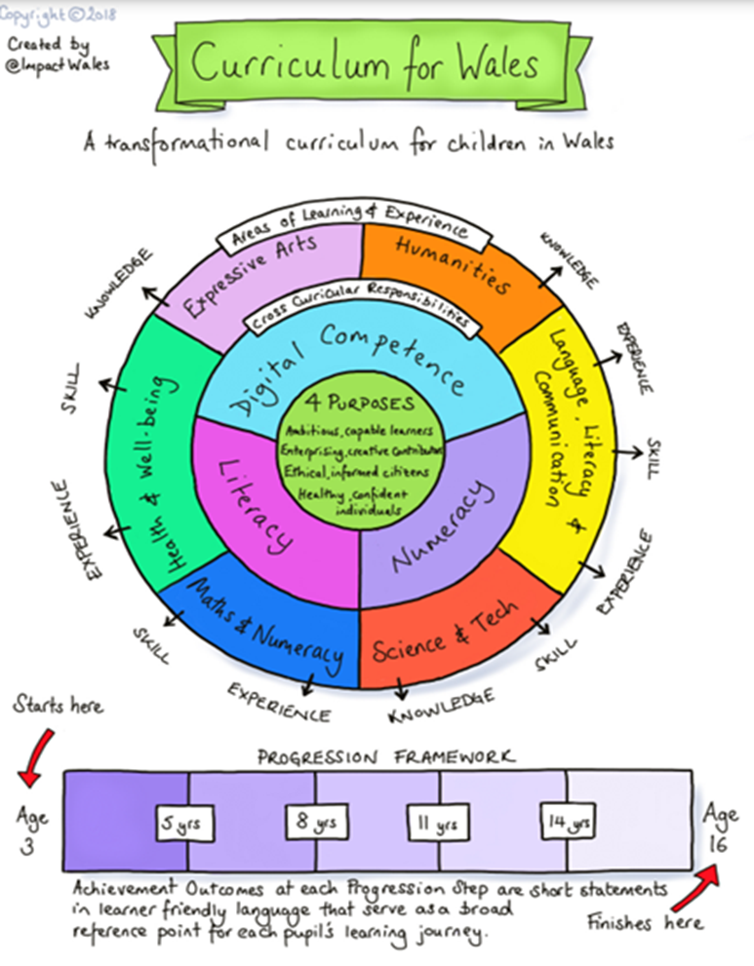
The New Curriculum
The purpose of the new curriculum is to support our children and young people to be:
Ambitious, capable learners, ready to learn throughout their lives
Enterprising, creative contributors, ready to play a full part in life and work
Ethical, informed citizens of Wales and the world
Healthy, confident individuals, ready to lead fulfilling lives as valued members of society

Slide 4
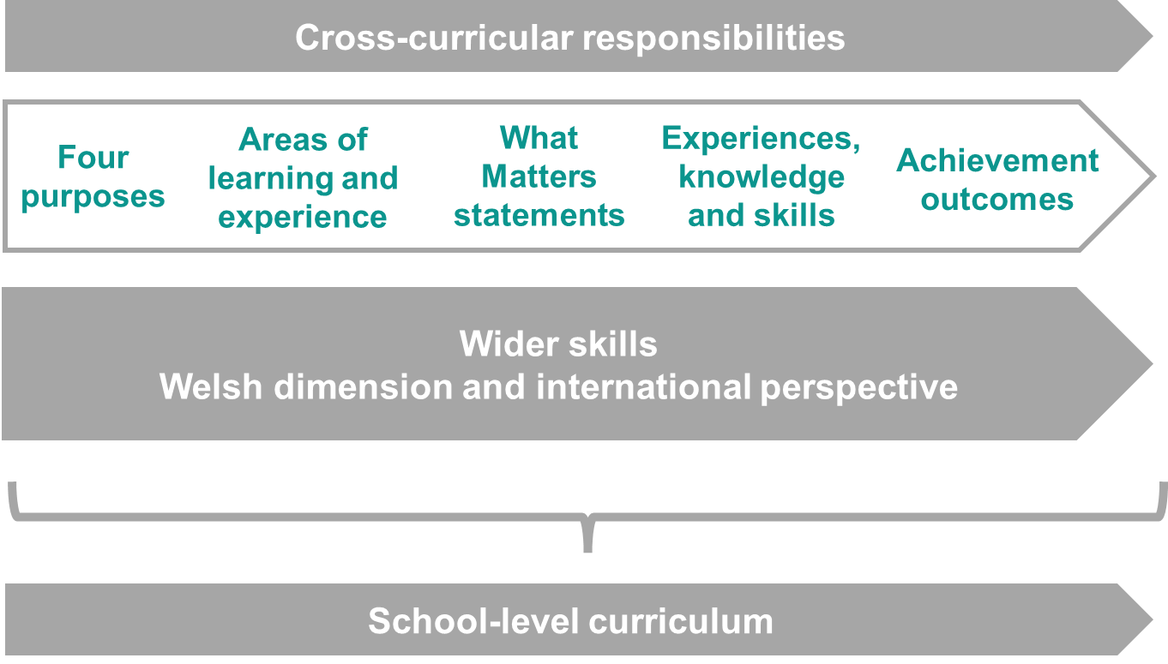
Guidance suggests that schools use the following 2 questions as a starting point for their improvement activities:
1.How well do learners progress in the ways described in the progress principles, supporting them to develop towards the four purposes?
2.Is the pace of learners' progress in line with teacher and curriculum expectations?

Slide 5

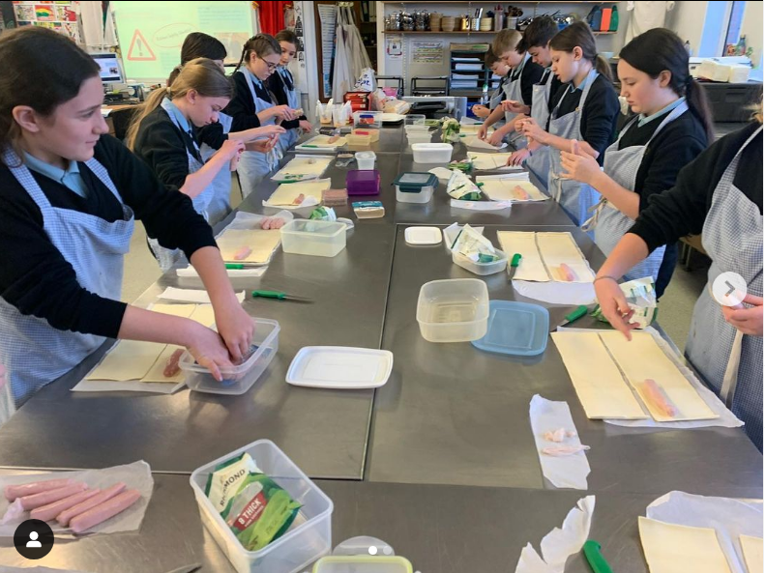

So how do you incorporate food education into the new curriculum in Wales?
To do number 1
To do number 2
To do number 3
To do number 4

Slide 6
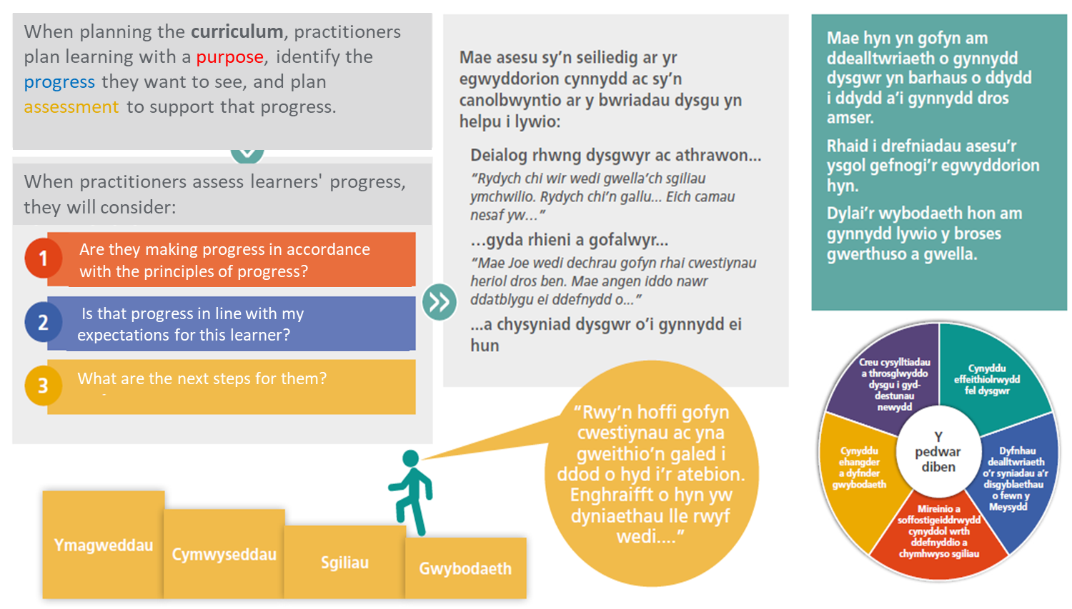
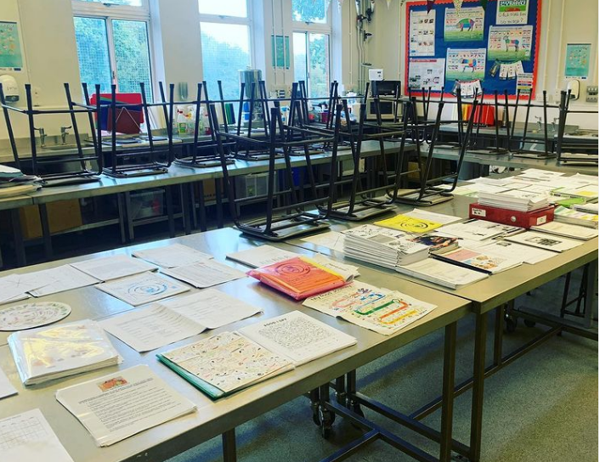
How do you plan for the unkown?

Slide 7

Here are a few questions we as teachers should be able to answer when considering what is progress in the curriculum for Wales
What skills have been demonstrated and how can they be used in new learning experiences?
What progress have learners made?
What evidence can there be?
What do I as a teacher need to do to move the person/group/class learning forward? [Responsive learning]
What have the learners understood and how do you know that?
What misconceptions can be identified and how can they be overcome? Do I need to adjust what I have planned?

Slide 8
Cooking/practical skills
Health and Safety
Food Science
Diet And Healthy Living
Customer Awareness
Food choices
????????
What are your Key Areas of Focus?

Slide 9
1.Nutritional Science:.
2.Meal Planning and Preparation:
3.Food and Culture
4.Food and the Environment
5.Food and Society:
6.Cooking Skills:
7.Mindful Eating:
Here are some ideas for incorporating food education at Key Stage 3 (KS3) in the new Welsh curriculum:

Slide 10
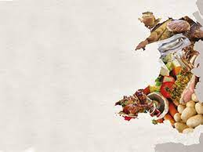
Welsh Food History:
Welsh Food Producers:
Welsh Food Traditions:.
Welsh Food and the Environment:
Welsh Food and Well-being:
When incorporating the Welsh element into food education in the new curriculum for Wales, it would be important to focus on the unique food culture and traditions of Wales. Here are some ideas:

Slide 11
Food and Technology:
Digital Research:
Food Blogging and Social Media:
Recipe Creation and Management:
Digital Cooking Tools:
Incorporating digital competency into food education in the new curriculum for Wales can help students develop important 21st century skills and prepare them for an increasingly digital world. Here are some ideas for incorporating digital competency into food education:

Slide 12
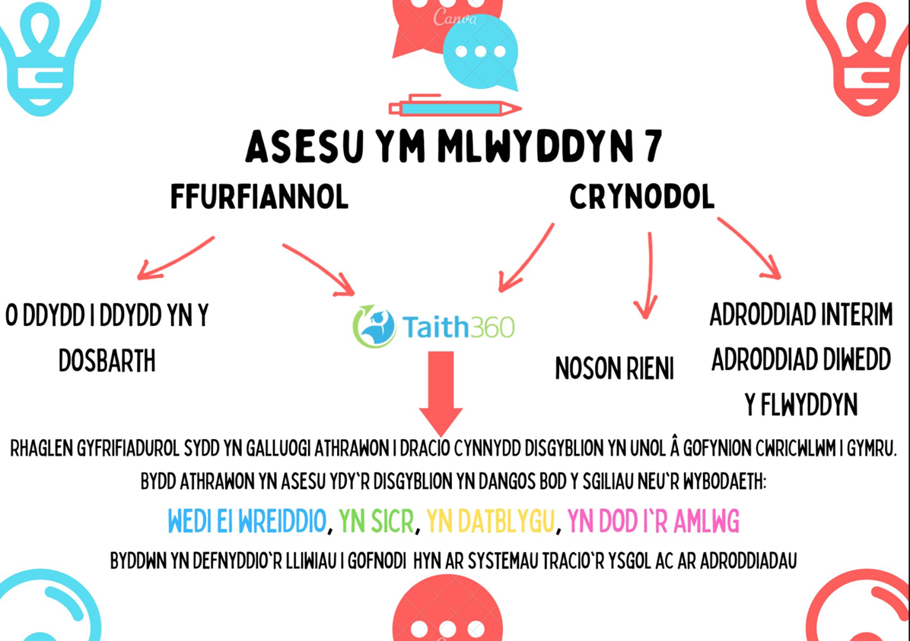
So How do we assess?
Embedded
Sure/competent
In development
Emerging
Formative Assessment:
' The Principles of day-to-day’
Summative Assessment:
Taith360
Agreed Success Criteria
Challenge and Standards

Slide 13
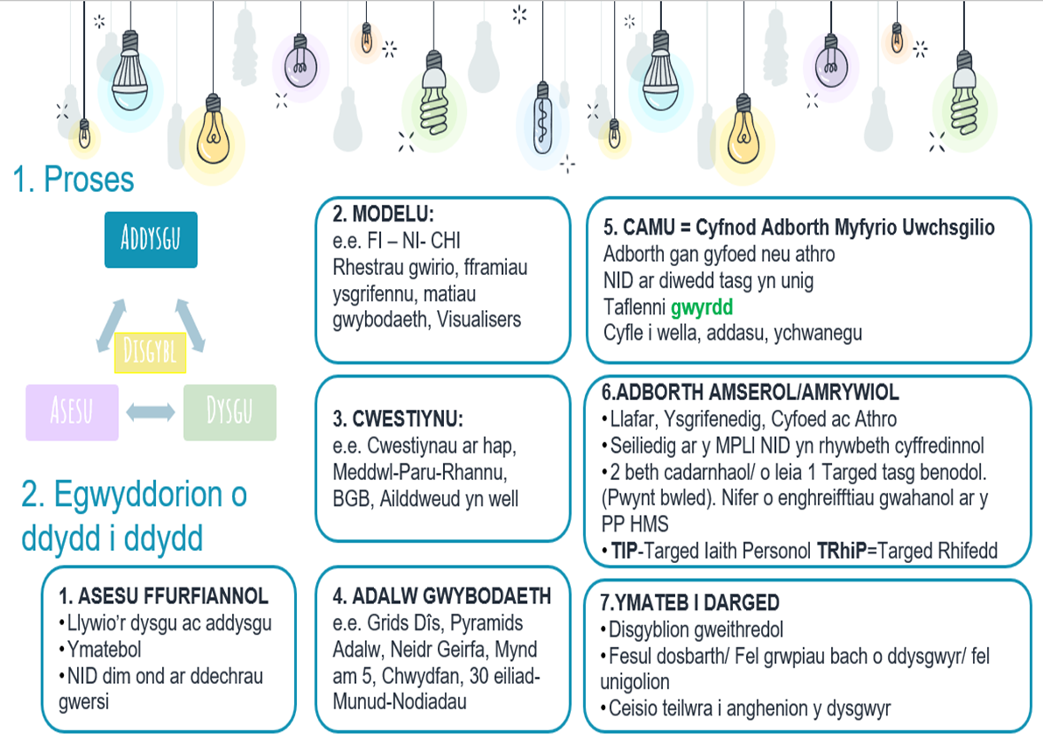
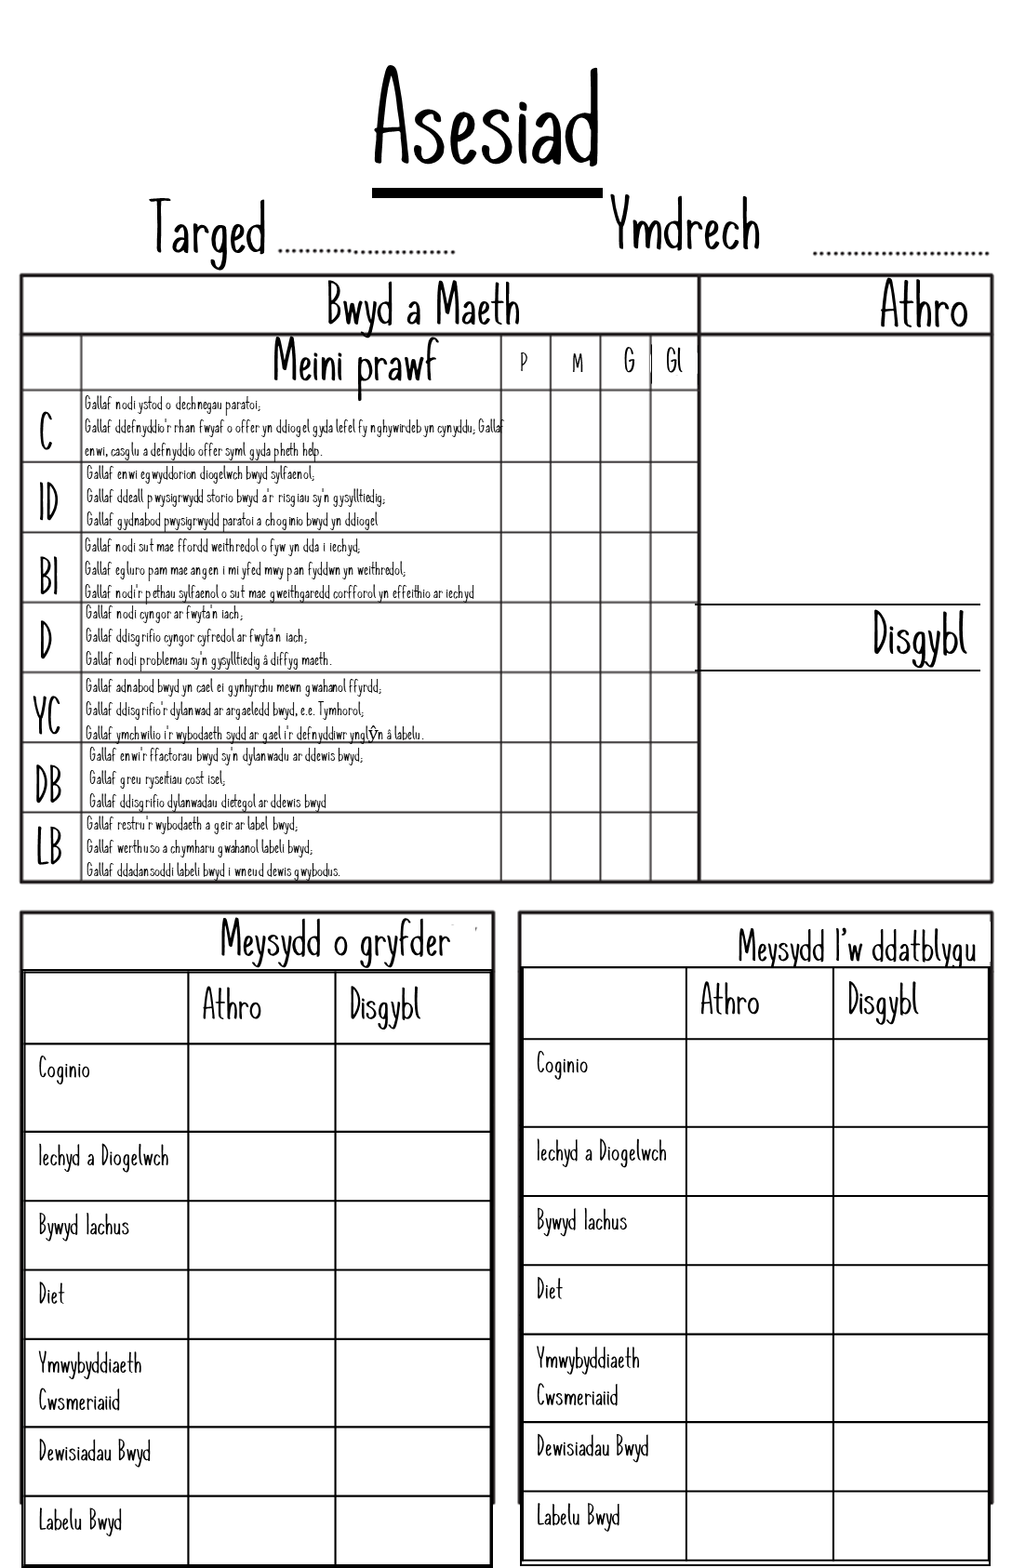
An Agreed understanding of Progress
Formative Assessment:
' The Principles of day-to-day’
Summative Assessment:
Taith360
Agreed Success Criteria
Challenge and Standards

Slide 14
Establish the purpose. Identify the learning. Basics of learning
Designing high quality assessment opportunities
Using the principles of progress
So what can i do if i havent started yet ?
Planning for Learning

Slide 15




Henrya12@hwbcymru.net
Good
Luck!!!!

