Slide 1
Physical activity guidelines

Slide 2
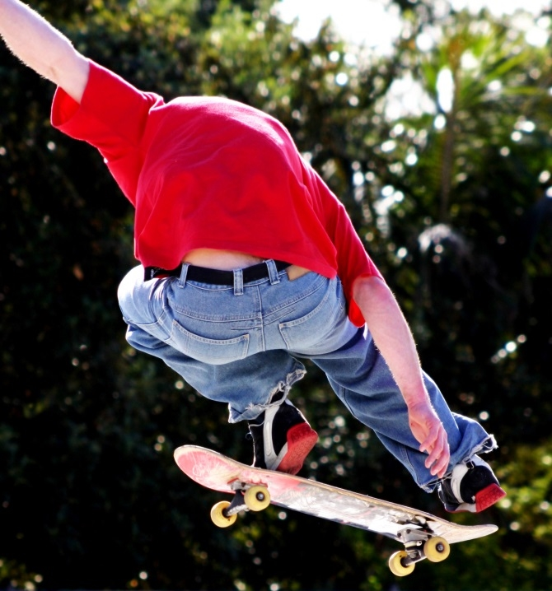

Physical activity
Physical activity is essential for physical and mental health and wellbeing, and it can reduce the risk of disease.
There are a variety of activity types that can contribute to the physical activity we do in a day.

Slide 3
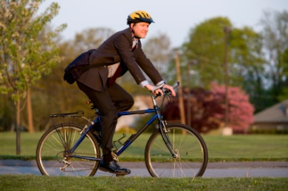
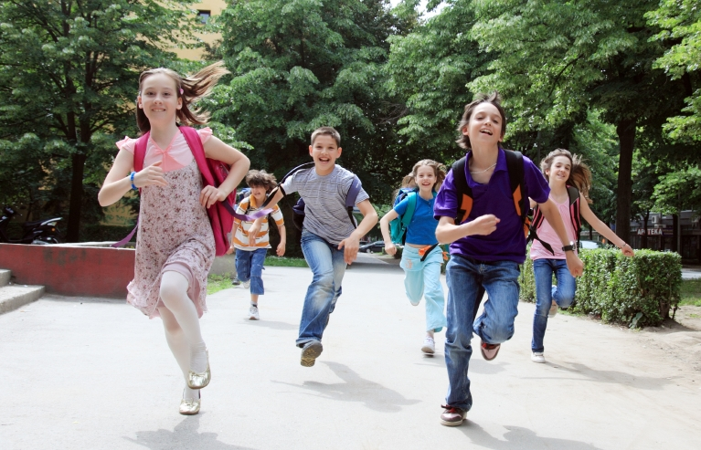
Physical activity guidelines
How much physical activity you need to do each week depends on your age.
There are physical activity guidelines in place for both children and adults.

Slide 4
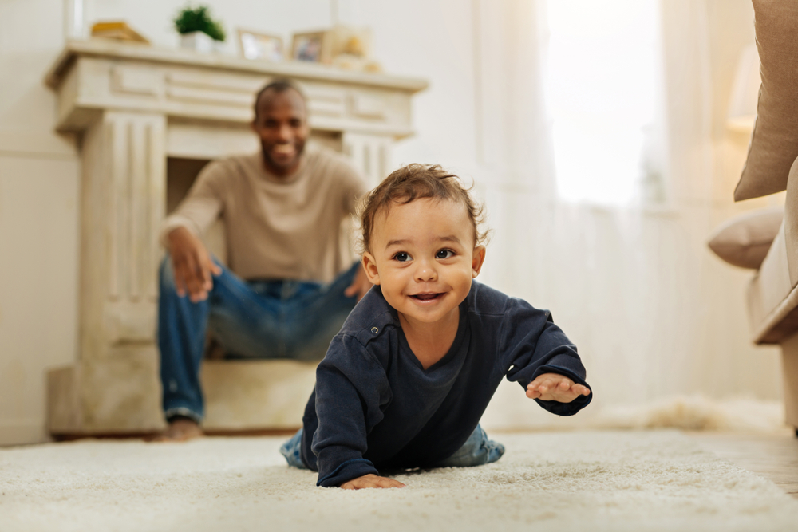
Physical activity guidelines for children (under 5 years)
Babies should be encouraged to be active throughout the day, every day.
Children who can walk on their own should be physically active every day for at least 180 minutes (3 hours).
Children under 5 should not be inactive for long periods, except when they are asleep.
NHS activity guidelines

Slide 5
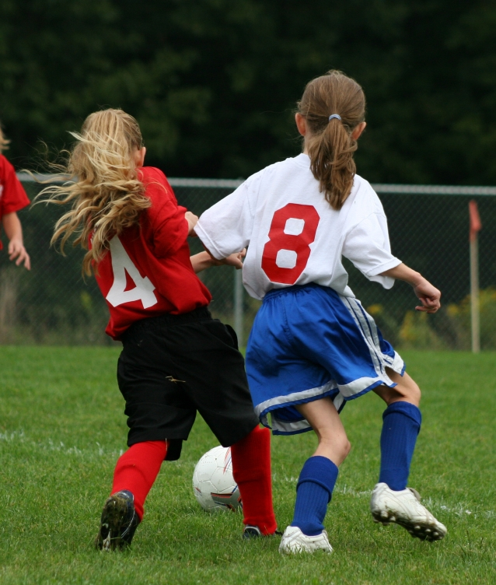
Physical activity guidelines for children and young people (5-18 years)
The recommendations for children and young people aged are:
to undertake at least 60 minutes of physical activity every day;
involve exercises that develop strong muscles and bones on three days a week.
NHS activity guidelines

Slide 6
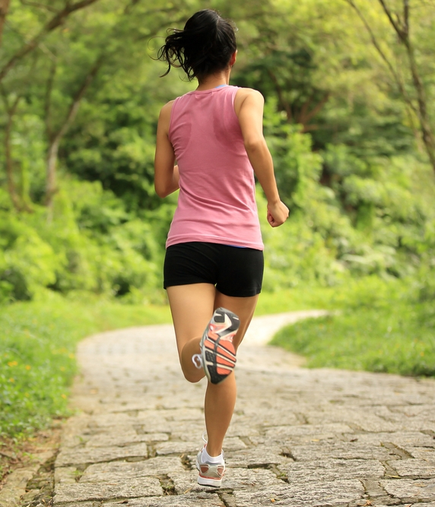
Physical activity guidelines for adults (19+ years)
The recommendations are:
to try to be active daily;
undertake at least 150 minutes of moderate aerobic activity (or 75 minutes of vigorous aerobic activity) every week;
involve strength exercises on 2 or more days a week that work all the major muscles.
NHS activity guidelines

Slide 7
What counts as moderate physical activity?
brisk walking
water aerobics
riding a bike on level ground or with few hills
rollerblading
doubles tennis
pushing a lawn mower
hiking
skateboarding
basketball
gardening
volleyball
Public Health England

Slide 8
What counts as vigorous physical activity?
swimming fast
aerobics
gymnastics
martial arts
singles tennis
football
rugby
skipping rope
hockey
jogging or running
riding a bike fast or on hills
Public Health England

Slide 9
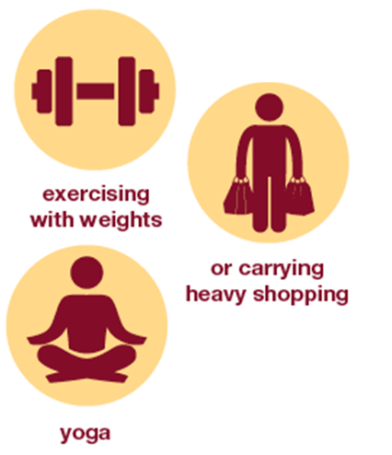
What activities strengthen muscles?
heavy gardening, such as digging and shovelling
yoga
working with resistance bands
lifting weights
bodyweight exercises (e.g. push-ups and sit-ups)
Pilates
Public Health England

Slide 10
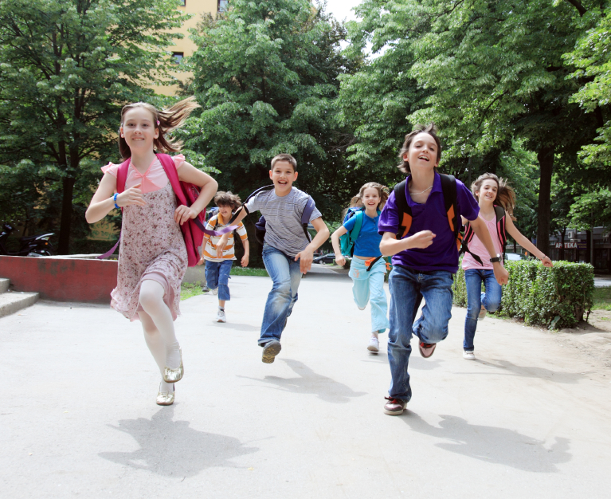
How active are we?
67% of adults were considered active (as per government guidelines).
47% of children and young people were meeting the current physical activity guidelines.
Statistics on Obesity, Physical Activity and Diet 2021

Slide 11
Physical activity guidelines
For further information, go to:
www.foodafactoflife.org.uk
This resource meets the Guidelines for producers and users of school education resources about food.

