Slide 1
New food

Slide 2
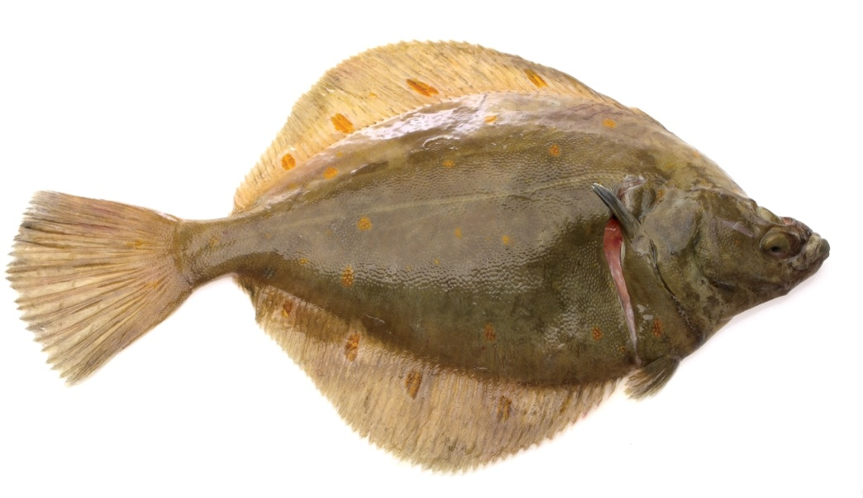
What is this?
plaice
This is a

Slide 3
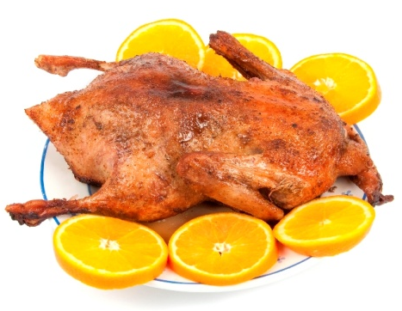
What is this?
roast duck
This is a

Slide 4
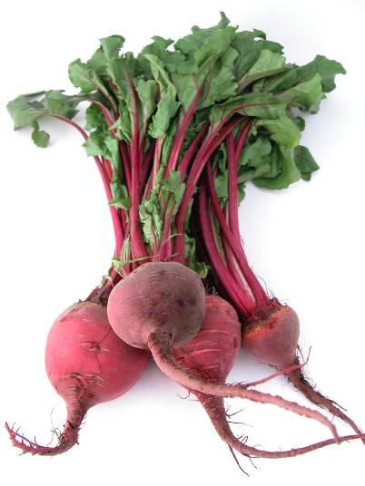
What is this?
beetroot
This is a

Slide 5
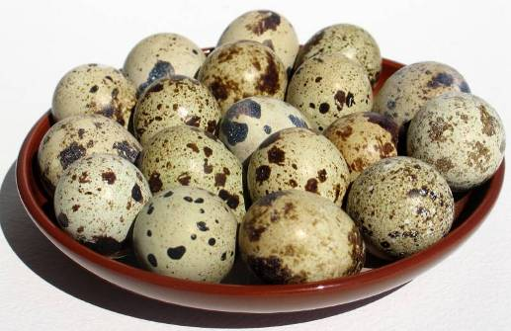
What are these?
quail eggs
These are

Slide 6
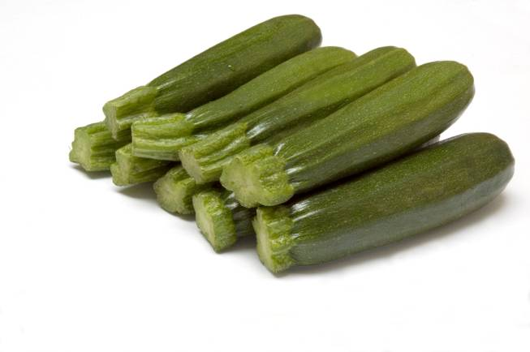
What are these?
courgettes
These are

Slide 7
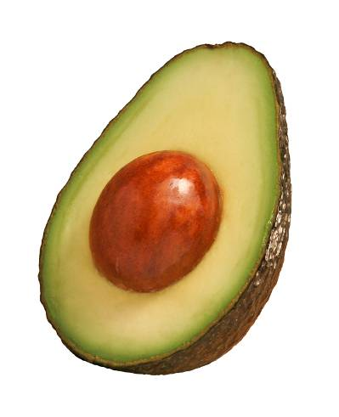
What is this?
avocado
This is an

Slide 8
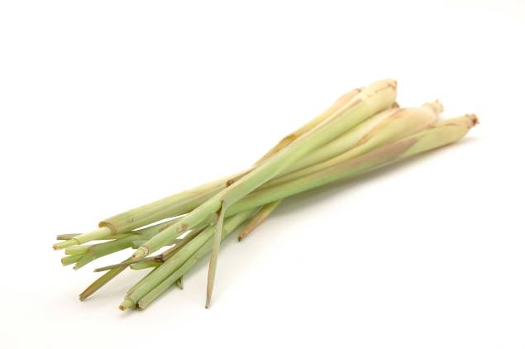
What is this?
lemongrass
This is

Slide 9
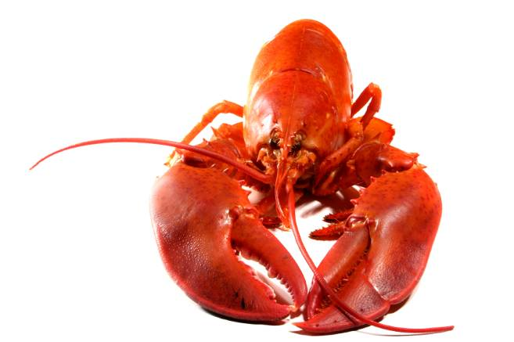
What is this?
lobster
This is a

Slide 10
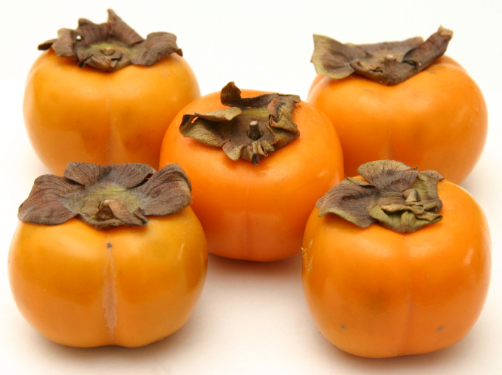
What is this?
persimmon
This is a

Slide 11
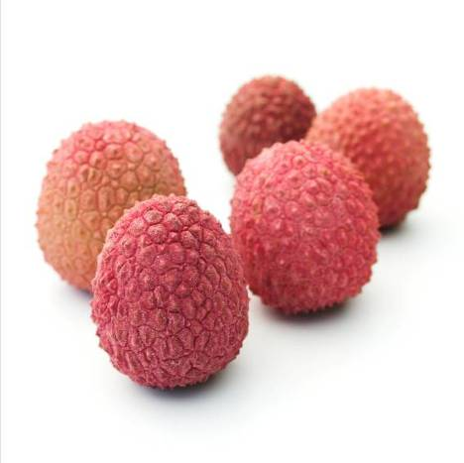
What are these?
lychees
These are

Slide 12
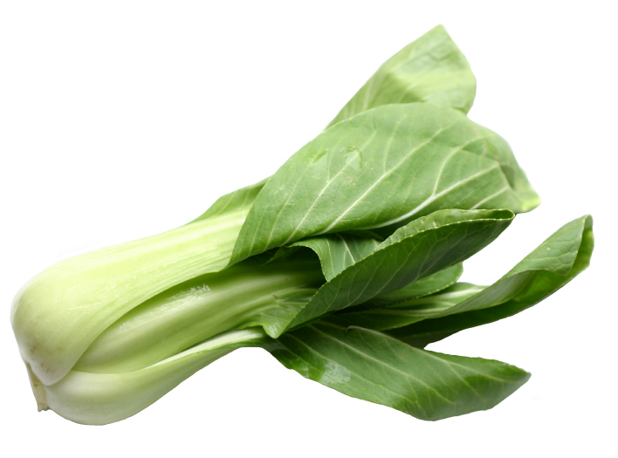
What is this?
bok choi
This is a

Slide 13
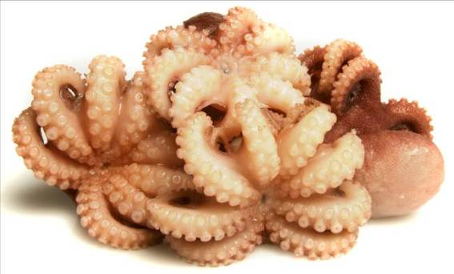
What is this?
octopus
This is an

Slide 14
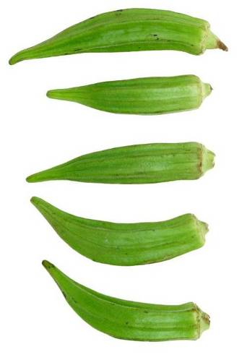
What is this?
okra
This is

Slide 15
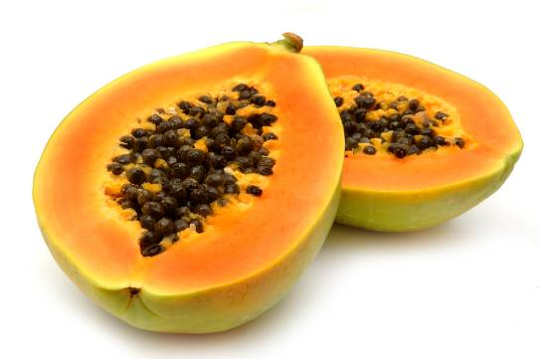
What is this?
papaya
This is a

Slide 16
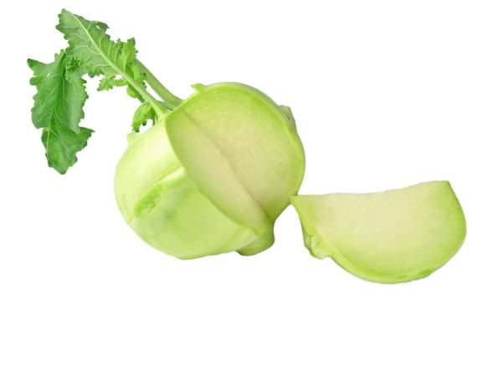
What is this?
kohlrabi
This is a

Slide 17
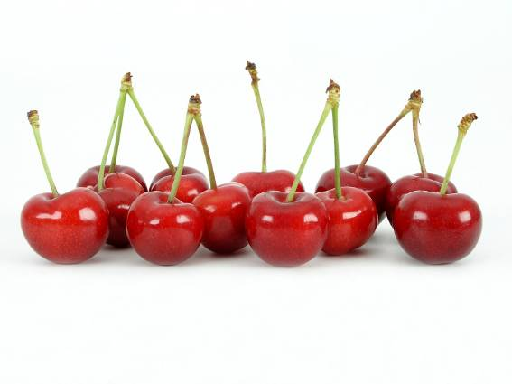
What are these?
cherries
These are

Slide 18
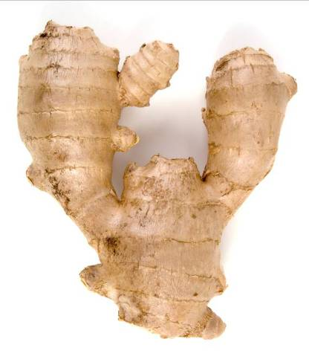
What is this?
root ginger
This is

Slide 19
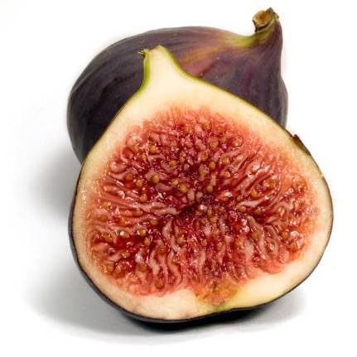
What is this?
fig
This is a

Slide 20
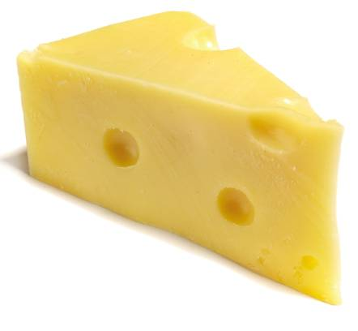
What is this?
Swiss cheese
This is a

Slide 21
New food
For further information, go to:
www.foodafactoflife.org.uk
This resource meets the Guidelines for producers and users of school education resources about food.

