Slide 1
Food hygiene and safety scenarios

Slide 2
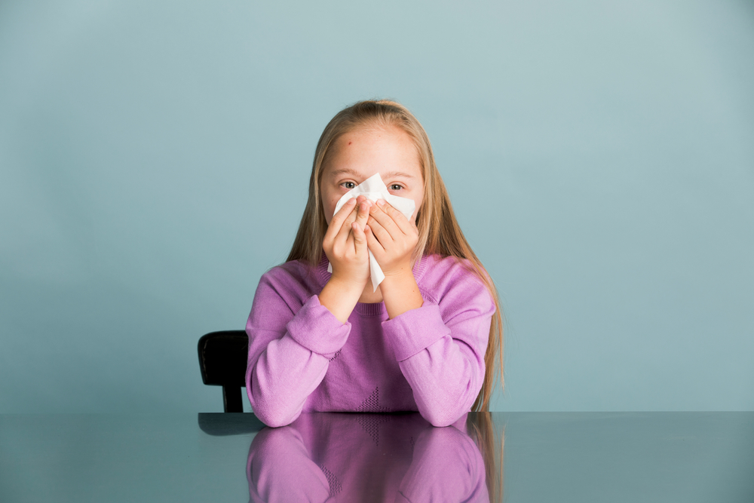
During cooking - sneezing
What would you do if you felt you wanted to sneeze while you were cooking?
Cover your nose with a tissue.
Throw the tissue in the bin.
Wash and dry your hands again.

Slide 3
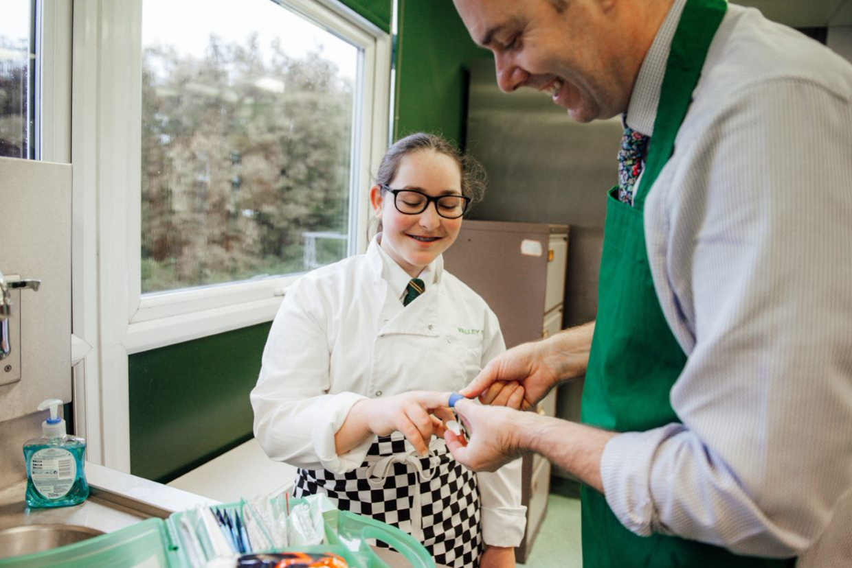
During cooking – hurting yourself
What would you do if you cut yourself while cooking?
Tell a teacher who will:
rinse the cut under water;
dry it with a paper towel;
cover it with a plaster.

Slide 4

During cooking – going to the toilet
What would you do if you needed to go to the toilet while you were cooking?
Tell your teacher.
Take off your apron.
Wash and dry your hands again when you get back to the classroom.
Put your apron back on.

Slide 5
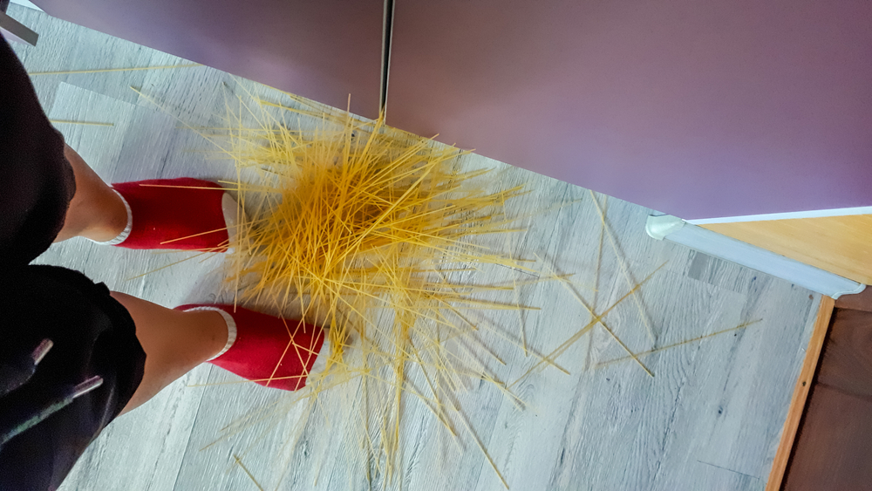
During cooking – food on the floor
What would you do if some of the food you were working with fell on the floor?
Stop what you are doing.
Pick up the food and put it in the bin.
Wash and dry your hands.

Slide 6
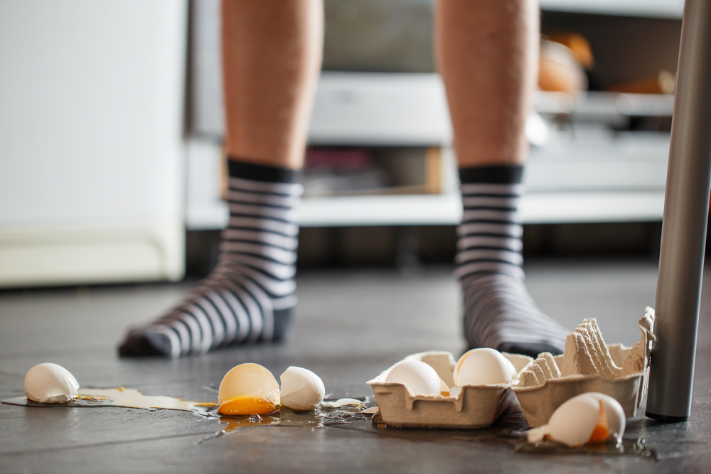

During cooking – spilling something on the floor
What would you do if something runny got spilt on the floor?
Stop what you are doing.
Tell the teacher.
Wipe up what has been spilled using a paper towel or a mop.
Cover the area with a hazard sign.
Wash and dry your hands again.

Slide 7
Food hygiene and safety scenarios
For further information, go to:
www.foodafactoflife.org.uk
This resource meets the Guidelines for producers and users of school education resources about food.

