Slide 1
Bagel brushetta

Slide 2
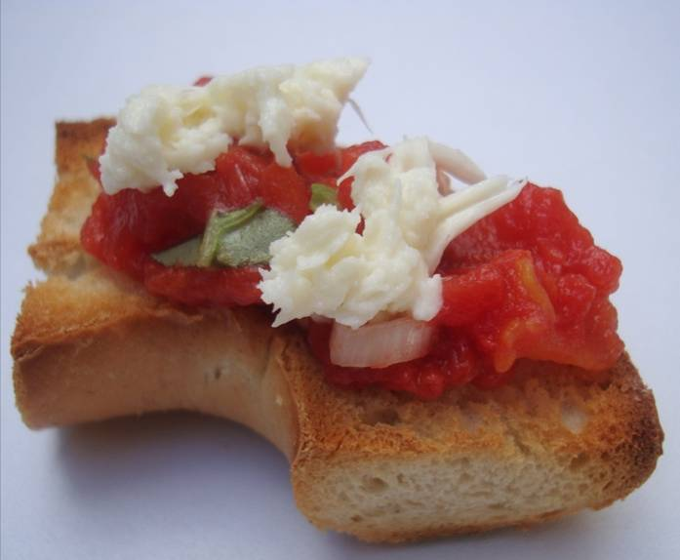

Slide 3
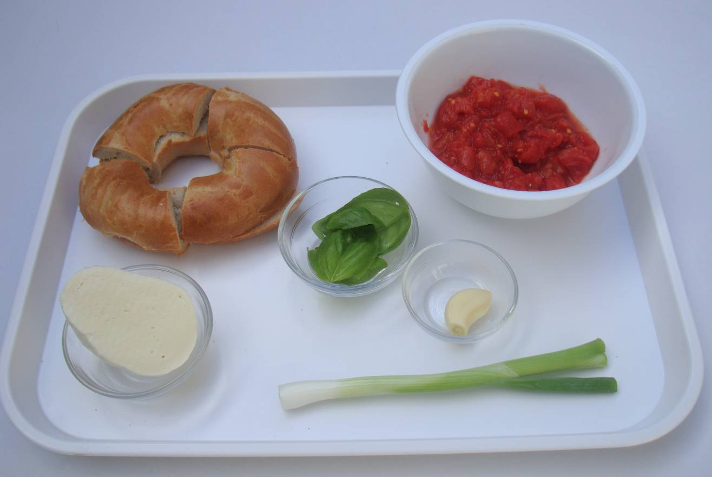
Ingredients
1 x bagel, quartered and sliced
1 x 200g can chopped tomatoes, strained
1 x spring onion
¼ ball low fat mozzarella
2 – 3 basil leaves
1 x garlic clove, peeled

Slide 4
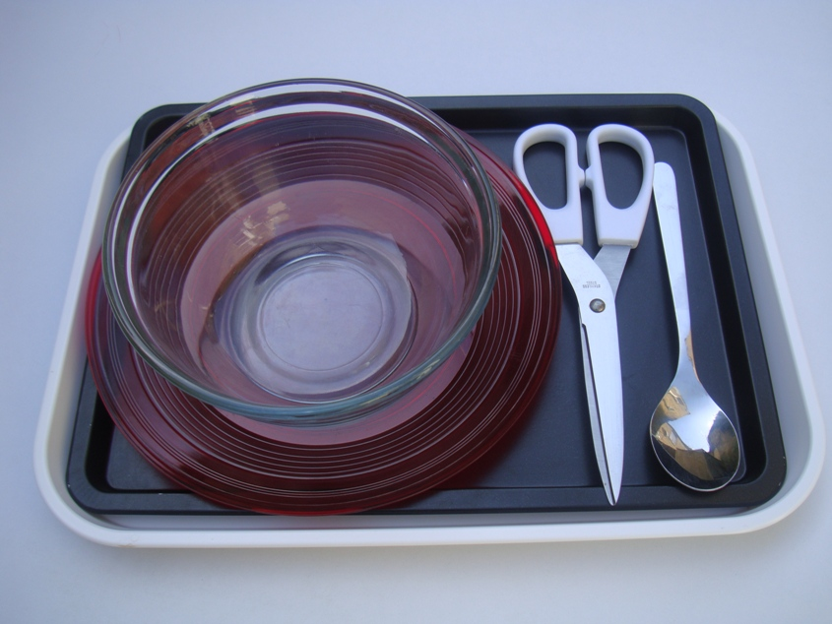
Equipment
Mixing bowl
Spoon
Kitchen scissors
Baking tray
Plate

Slide 5
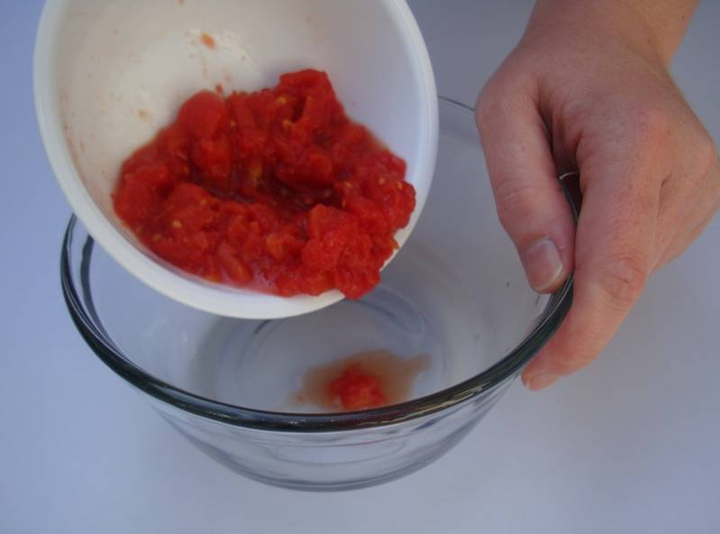
Method
Pour the tomatoes into the bowl.

Slide 6
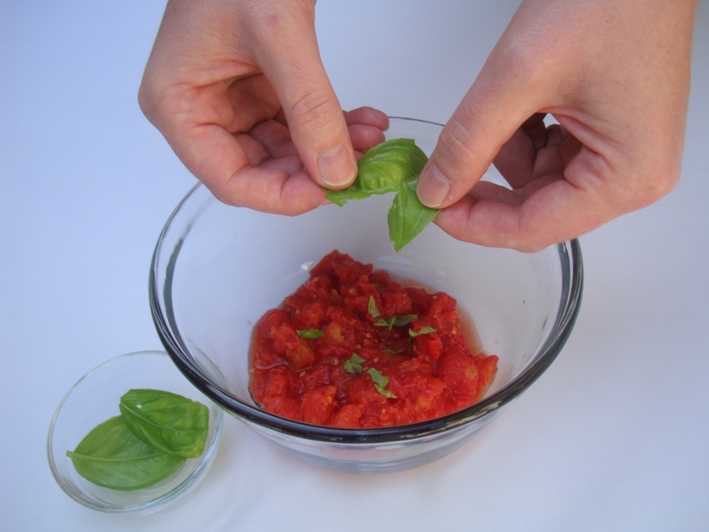
2. Tear the basil into the bowl.

Slide 7
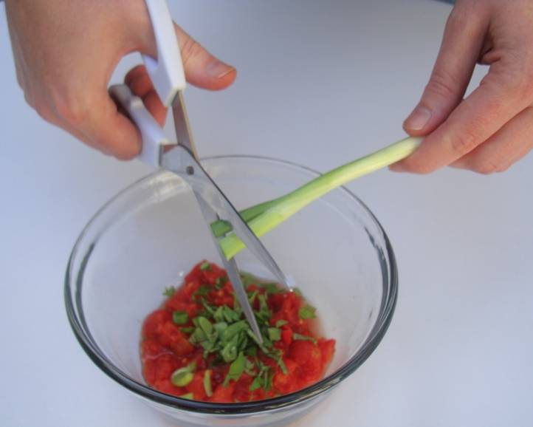
3. Snip the spring onions into the bowl.

Slide 8
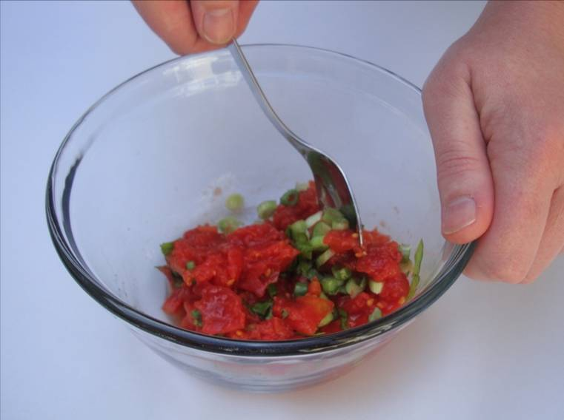
4. Stir everything together.

Slide 9
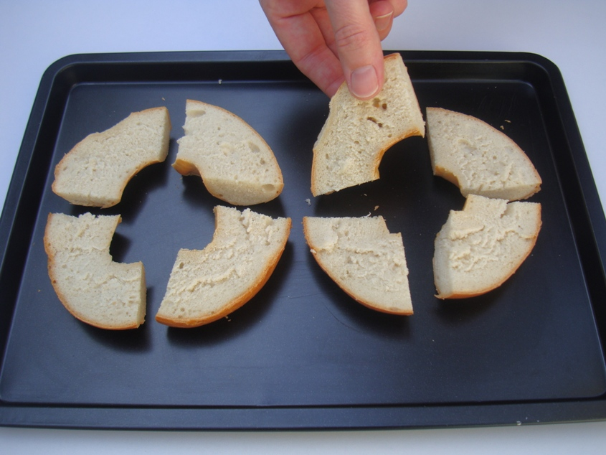
5. Bake for 5-8 minutes.

Slide 10
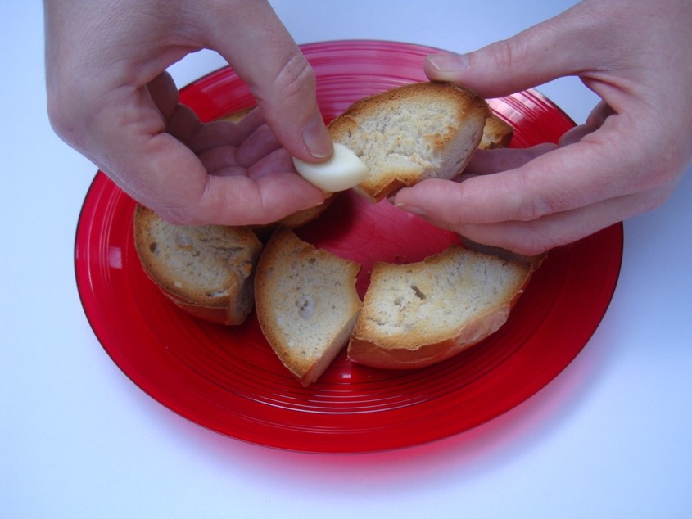
6. Rub garlic over the bagel pieces.

Slide 11
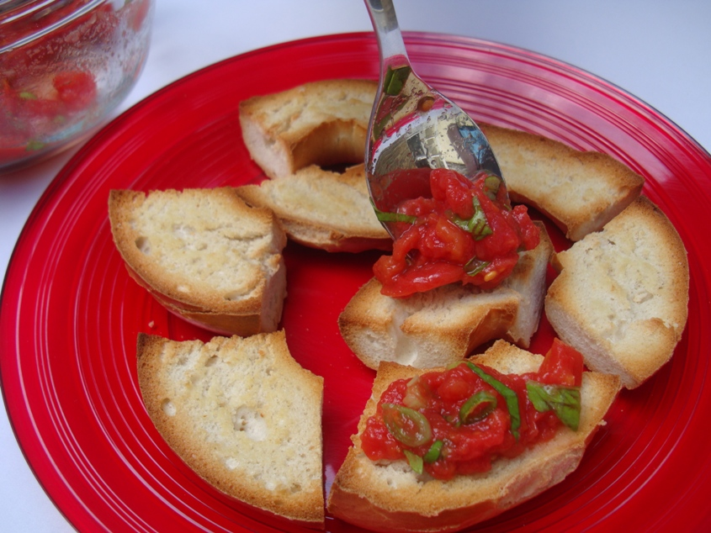
7. Spoon the tomatoes onto the bagel pieces.

Slide 12
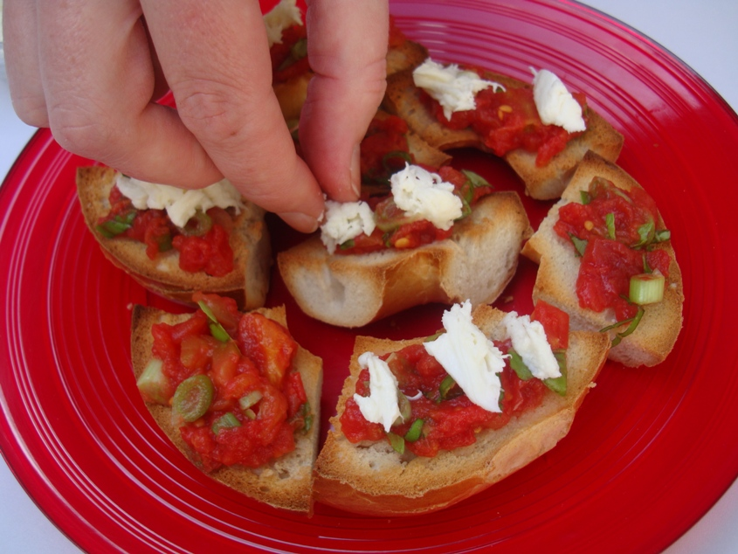
8. Top with small pieces of mozzarella.

Slide 13
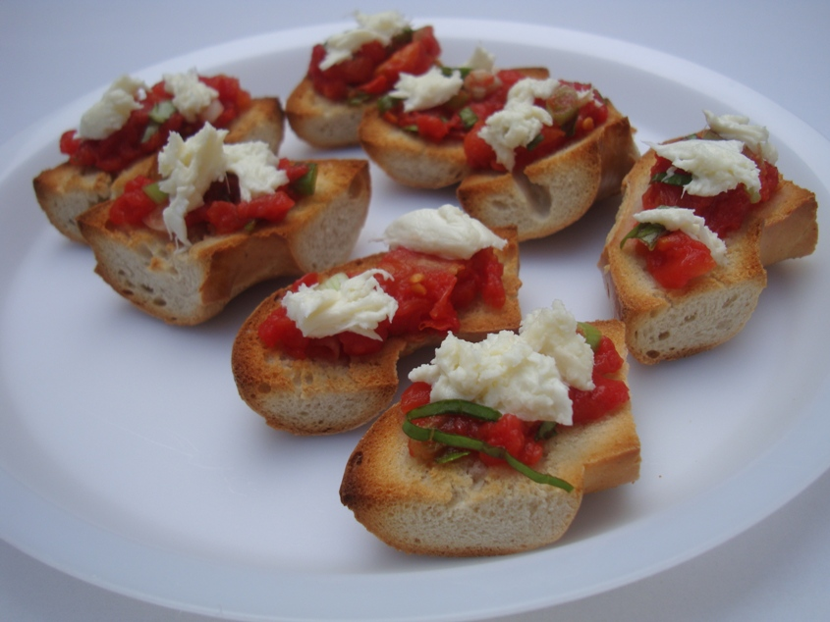
9. Serve.

Slide 14
Top tips
Food skills
Try different types of bread, e.g. slices of ciabatta or baguette, bread rolls.
Try different types of cheese, e.g. Lancashire, Edam.
Try different herbs, e.g. chives, coriander.
Drain
Snip
Mix, stir and combine
Cut
Portion/divide

Slide 15
Bagel bruschetta
For further information, go to:
www.foodafactoflife.org.uk
This resource meets the Guidelines for producers and users of school education resources about food.

