Slide 1
Careers in food and drink
09/03/22

Slide 2
Covered in today’s webinar
Careers in food and drink.
Skills, knowledge and experience required.
Training routes available.
Support for teachers, pupils and parents/carers.
Experiences of young people working in food and drink.
Links to Food – a fact of life.
Suggestions for further reading and sources of information.

Slide 3
National Skills Academy for Food & Drink
Amy Crooks
Head of Marketing
Notes:
Amy

Slide 4
Who are the NSAFD?
We are not-for-profit and focussed entirely on supporting the sector around skills
We are the voice of the industry on skills
  We make sure employers are heard at the very top
  We simplify the skills landscape and make it easier to understand
We are the leading experts on Food & Drink Apprenticeships
  Led the design of new standards
  Support organisations around career strategies
We are completely independent
  Sit outside the Skills Funding System – funded by the industry
  Impartial advice for employers, providers and schools
Promote careers and work to improve the image of the industry
  Work with DEFRA, DWP, UK Governments, Youth Employment UK
  Employability programmes

Slide 5
The Food & Drink Sector
The Food and Drink industry is an exciting place to work. We have a well-deserved reputation for our world-class produce and are recognised for our quality & innovation.
Often described as ‘farm to fork’ or ‘gate to plate’ the Food and Drink industry covers the growing and producing of food (primary production) through to the manufacture and processing and retail of food.
Our Sectors
Over 30 different sectors make up the Food Manufacturing Industry
Largest of these is the bakery sector followed by meat processing, drinks industries, dairies, animal feed and fish processing
Factories ranging from small units with a few workers to large factories employing thousands
Also Agriculture, farming, hospitality and retail in the food supply chain.
Notes:
From designing high tech robots to developing new products and everything in between the Food and Drink industry is not only tasty, it’s fast moving, creative and innovative. One thing is for certain, people will always have to eat, so the industry will always have customers and will need a workforce to meet those customer’s needs

Slide 6
A Diverse Sector
The pressure for new ideas and healthier products will ensure that there are good jobs for people of all ages in the industry. The benefits are:
Opportunities for those with all levels of qualifications
Opportunities for career development are huge
Rewarding careers with rapid progression
The industry has a high average pay compared to other industries
A fast paced environment which is constantly changing to keep up with consumer demands

Slide 7

Tasty Careers
The Food & Drink Sector

Slide 8
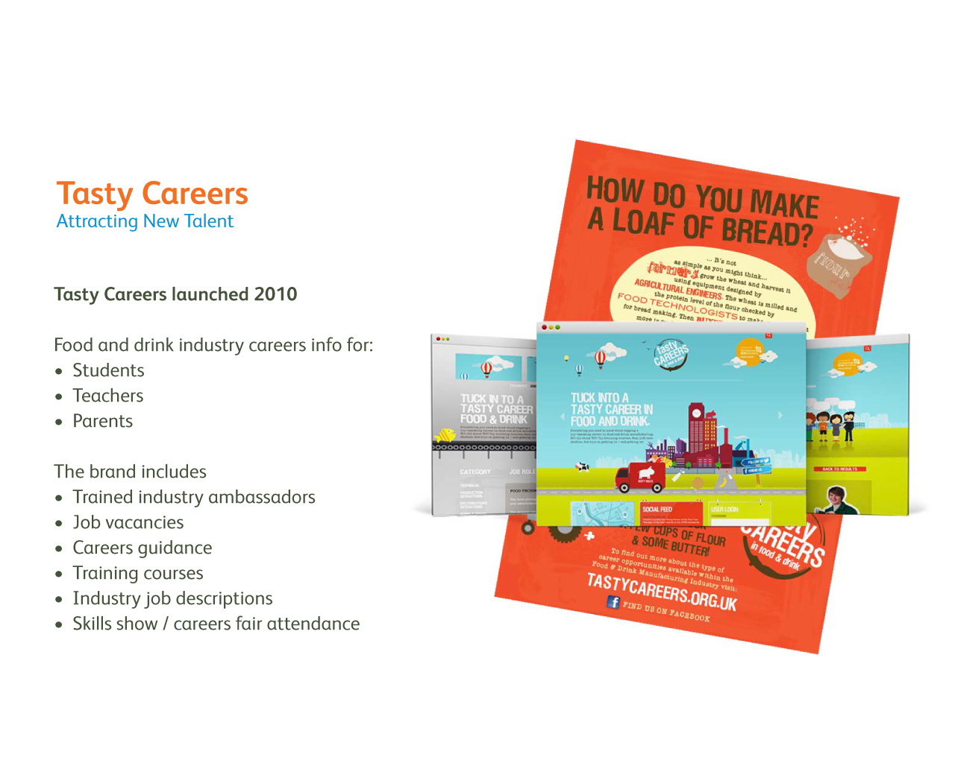
Tasty Careers

Slide 9
Tasty Careers - Purpose
1. To raise awareness of and interest in jobs and careers in the industry;
  Train industry ambassadors for school visits & career fairs
  Provide resources for schools, colleges & ambassadors
  Online presence to profile the range of job roles in the industry
  Take students into businesses to experience food and drink production first hand
2. To turn interest into positive action by signposting interested young people to:
  Job opportunities (entry level, with training)
  Study opportunities at high quality providers including apprenticeships, full time learning and employability programmes

Slide 10
Benefits for Schools
We offer a range of FREE opportunities to discuss careers in this sector
We provide lesson plans and resources
We offer talks in schools by our Tasty Career Ambassadors
This will provide career advice to your students
Meeting some of the GATSBY benchmark requirements: -
– 2 – Learning from Career and Labour Market information
– 4 - Linking Curriculum learning to Careers.
– 5 – Encounter with Employers and Employees.
– 6 – Experience of Work places.

Slide 11
Website & Digital Engagement
Tasty Careers website is an industry-wide platform to encourage talented young people into food and drink manufacturing.
It puts careers in food and drink firmly on the radar of young people
It challenges myths and perceptions of working in the industry in a positive way
It provides a platform of direct engagement with young people making crucial study and careers choices
Partner with Youth Employment UK promoting careers in Food and Drink – 100,000 young people visit every month

Slide 12

Website & Digital Engagement
Development of Tasty Careers website to ensure visibility and interaction with young people, teachers and parents.
Apprenticeship zone showing all available apprenticeships in the sector with details information on each one
Information, advice & guidance for students, teachers and parents
Downloadable resources such as case studies, career maps and job descriptions
Jobs board with listings of entry level positions in the industry

Slide 13
Tasty Ambassadors
Young apprentices and graduates trained to present “their story” of how and why they work in the food industry
Ambassadors go into schools & present at careers events, promoting the wide variety of careers available in the Food & Drink industry
Main presentation focuses on the careers map and the range of careers and entrance points available in the sector
Case studies and information on the website
180 Tasty Ambassadors UK wide

Slide 14
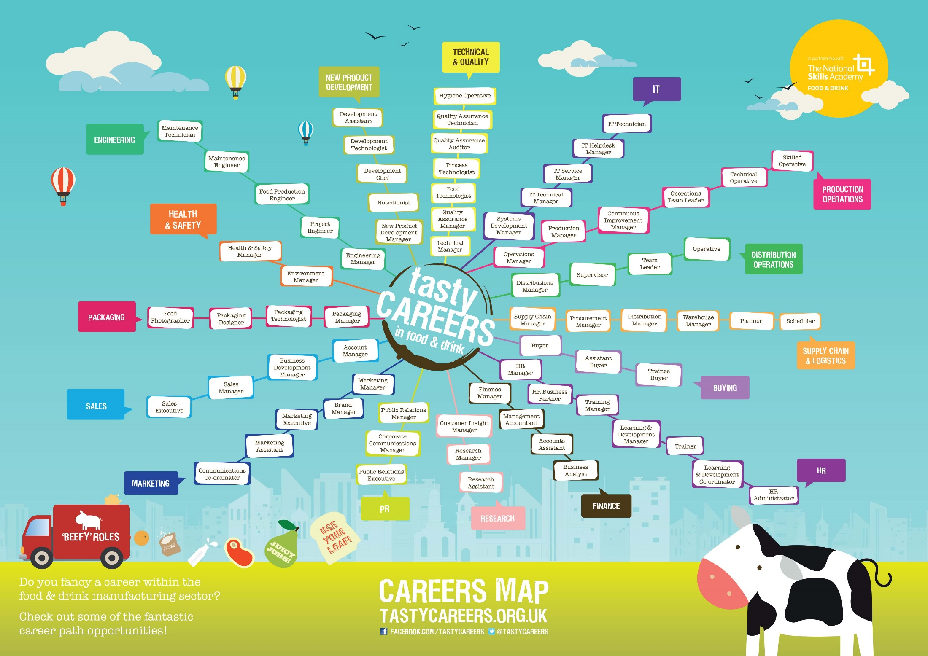

Slide 15
How Can we Support You?
Food and Drink Sector Guide
  Resources for Teachers, Students and Parents
  Myth Busting sheets
Employer visits
Tasty Maps for use in schools
Tasty Ambassadors visits to schools and careers fairs
Materials for Schools challenge with local food businesses

Slide 17

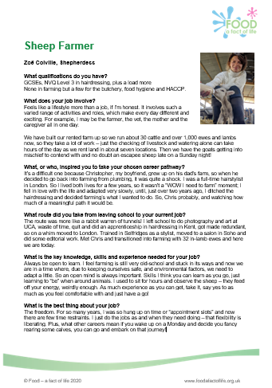
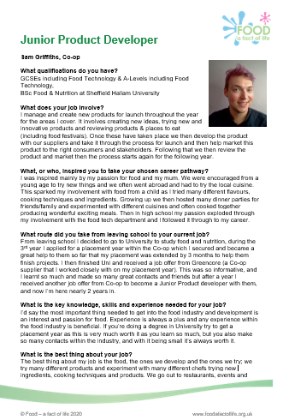

Food – a fact of life resources
Careers poster and case studies.
Support for pupils with additional needs around developing skills for work, including hospitality and catering.
Careers in catering and hospitality for young people with additional needs – webinar presentation and video recording.

Slide 18
Suggestions for further sources of information
Careers Wales
Chilled Education – careers resources for students and teachers, Chilled Food Ambassadors
DYW Scotland
Food and Drink Federation
Food and Drink Federation Scotland
Institute of Food Science and Technology
National Careers week
National Farmers Union – careers
NI Direct – careers advice, guidance and support
Springboard
Tasty Careers – resources for students, teachers and parents

Slide 19
And finally….
Virtual practical workshops
Food skills, recipes and diversity
Middle Eastern cuisines – 23 March 2022
Eastern Asian cuisines – 6 April 2022
Caribbean Islands cuisines – 4 May 2022
South American cuisines – 18 May 2022
Eastern European cuisines – 15 June 2022
Online courses available too!

Slide 20
Careers in food and drink
For further information, go to:
www.foodafactoflife.org.uk

