Slide 1
Where does milk come from?

Slide 2
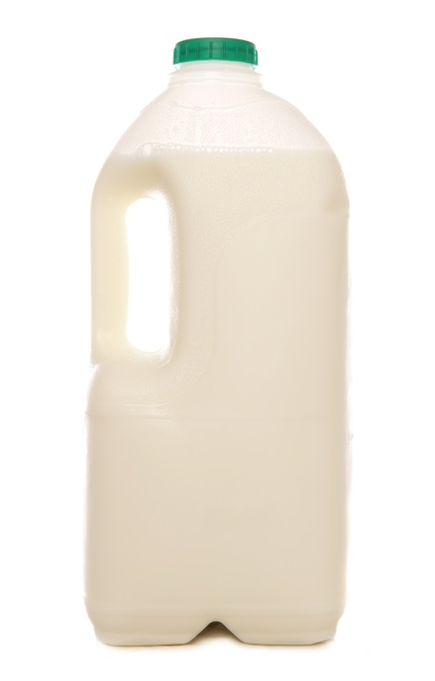
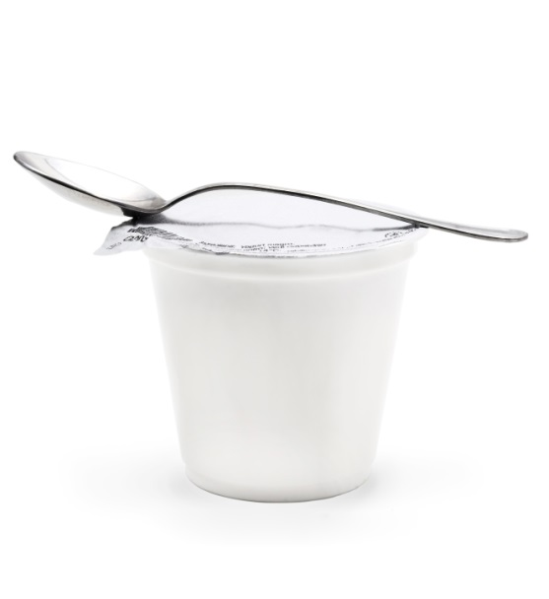
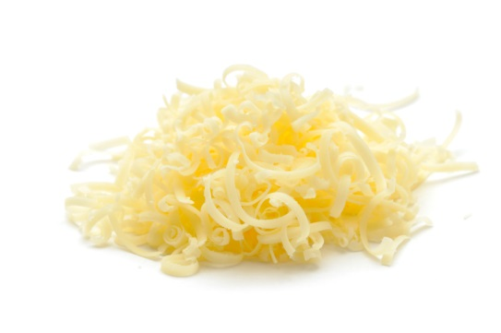
What are these?
Milk
Yogurt
Cheese

Slide 3
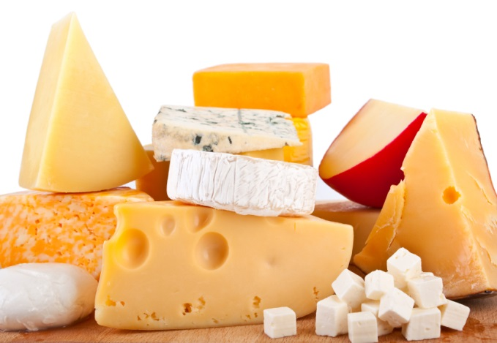
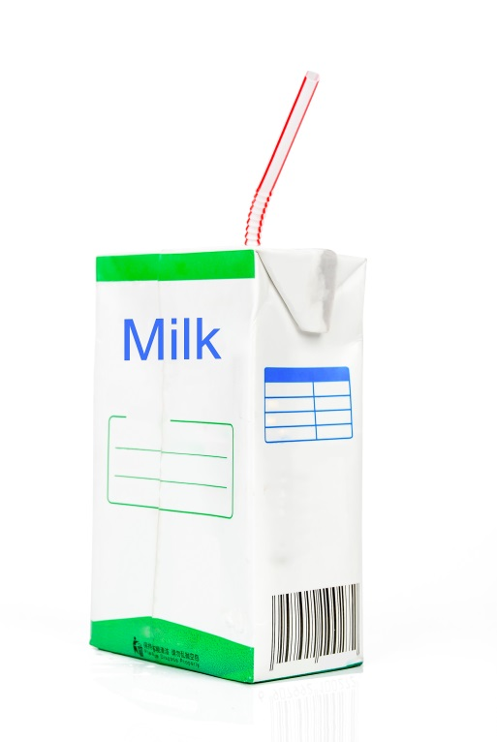
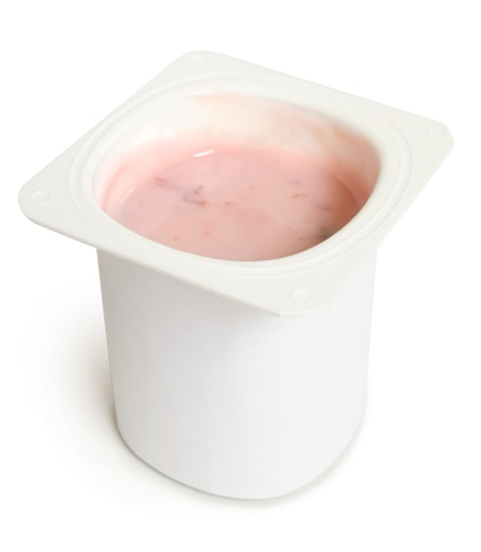
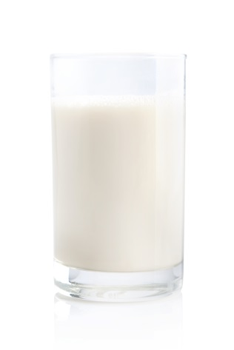
These are all dairy foods.
What are they made from?
They are all made from milk.

Slide 4
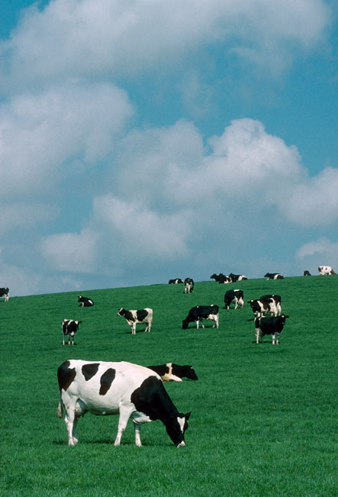
Where does milk come from?
Milk is from a dairy cow.
Dairy cows are reared by farmers around the UK.
Have you seen a dairy cow before?

Slide 5
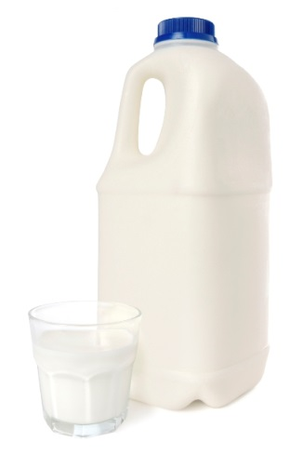

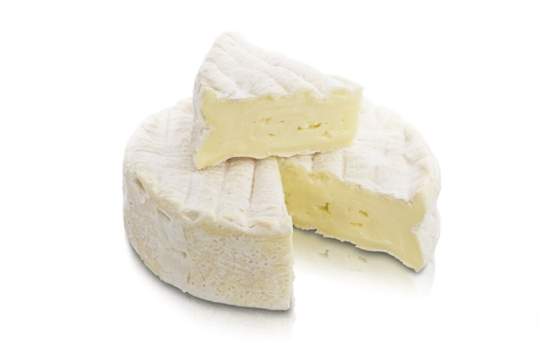
What other food is made from milk?
There are different types of milk, yogurt and cheese.

Slide 6
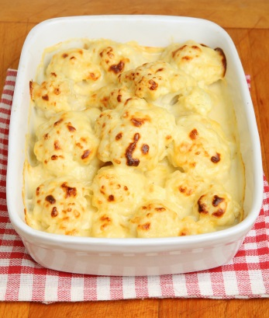
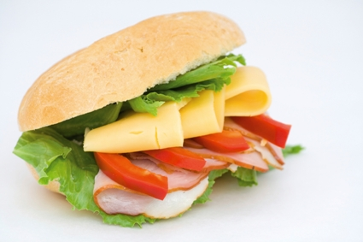
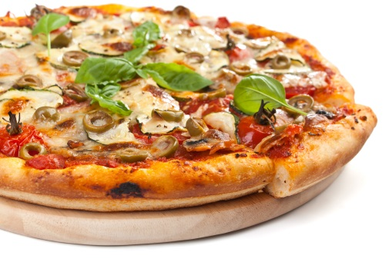
What other food is made from milk?
Milk, yogurt and cheese can be used in lots of dishes.

Slide 7

Summary
Milk is from a dairy cow.
Milk – from the dairy cow.
Yogurt and cheese is made from milk.

Slide 8
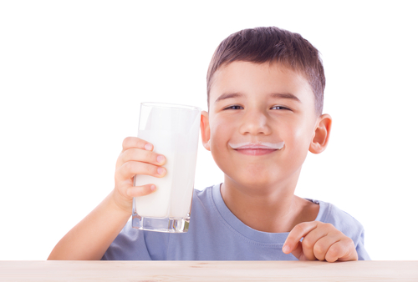
Do you like milk?

Slide 9
For further information, go to:
www.foodafactoflife.org.uk

