Slide 1
Soil health and plant nutrients

Slide 2
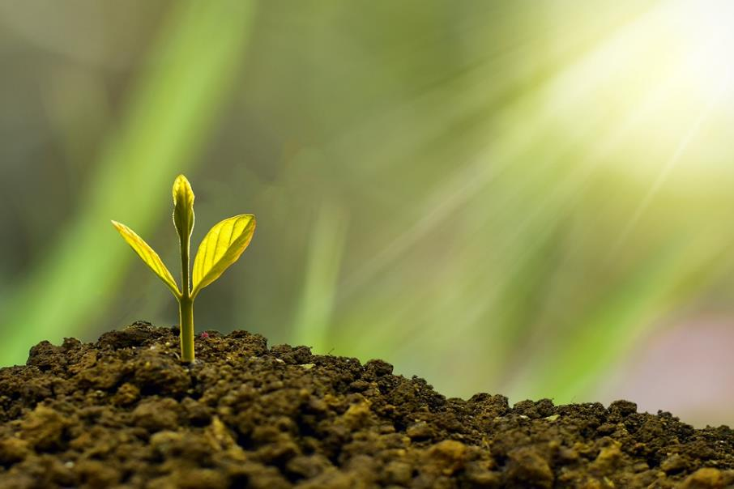
Starter
Where do plants get nutrients from?
What might plants need nutrients for?

Slide 3
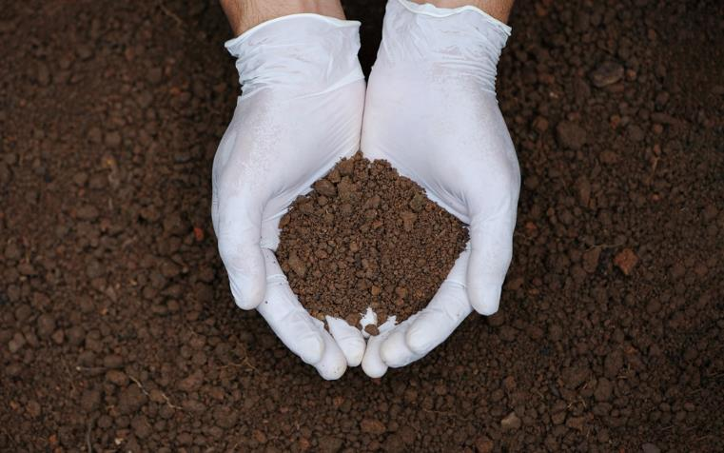
Soil health
Soil is an essential natural resource.
Healthy soil is when the chemical, physical and biological properties of soil are optimal (the best).
Chemical properties include pH, levels of nutrients and any contaminants.
Physical properties include soil structure and water balance.
Biological properties include earthworms, microbes and plant roots.

Slide 4
Soil health
Healthy soil helps plants to grow and helps to keep the animals that eat plants healthy.
Healthy soil means better crops and more livestock for us to eat.
Soil also contains important microorganisms that help plants to grow well.

Slide 5
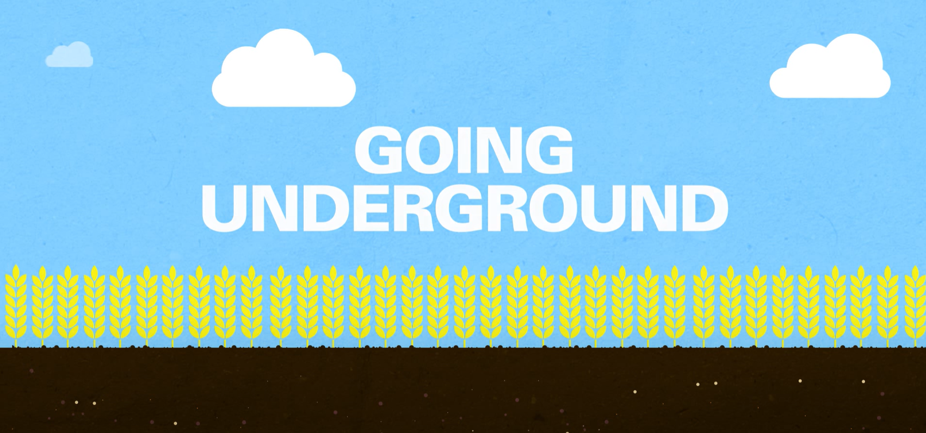
What does soil do?
Soil can:
Exchange gases with the air and store carbon.
Regulate the flow of water
Provide nutrients for plant growth
Break down organic materials (through microorganisms that live there)
Break down contamination from human activities.
Watch the video above for more information on soil health

Slide 6
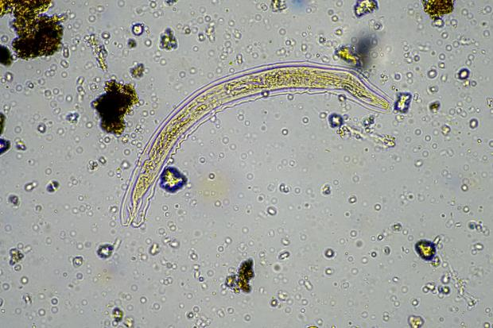
What’s in the soil?
Soil contains a large number of different organisms.
Earthworms, moles and insects burrow through the soil, creating aeration and making space for roots to grow.
Bacteria and fungi live in the soil. They can decompose organic matter to provide nutrients for the plants growing in the soil. Some can also interact with plant roots. Some fungi grow around plant roots and exchange nutrients to keep both plants and fungus healthy.
Other tiny worms called nematodes also live in the soil and can help to release nutrients that plants use.
Some nematodes are parasitic, which can cause crop losses and do not indicate good soil health.
Microscopic nematodes, like this one seen through a microscope, they can be good indicators of soil health.

Slide 7

Minerals
Minerals are naturally occurring inorganic substances.
Humans need minerals but we aren’t the only ones! Just like humans, plants need minerals for healthy growth.
Plants use minerals from the soil to build the complex molecules they need to survive and grow. The minerals are absorbed into the root hair cells and are then transported around the plant in the xylem tubes.

Slide 8
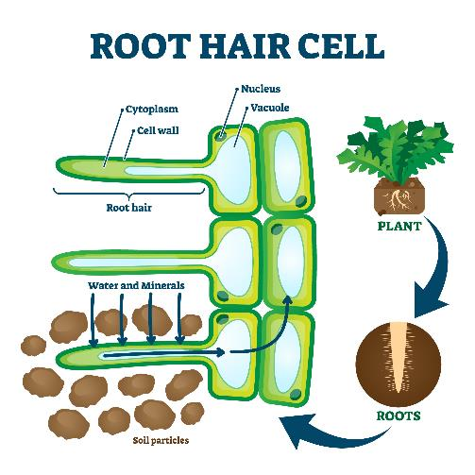
Absorbing minerals
As plants need minerals for their health, they must absorb minerals and need healthy soil to do this.
Plants can only absorb soluble minerals (those that can dissolve in water). They absorb minerals dissolved in solution from the soil through their root hair cells. The concentration of minerals in the soil is very low.
Minerals cannot be absorbed by osmosis because this is the movement of water only. They cannot be absorbed by diffusion, because the minerals are in very low concentration. Instead, active transport is used.

Slide 9
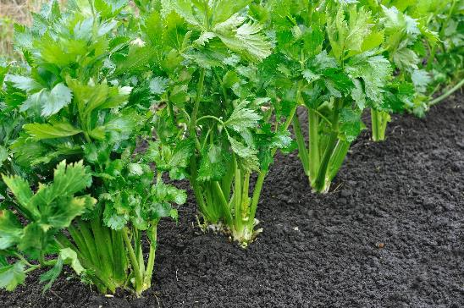
Plants need minerals for growth
Plants need the following minerals along with others…
Nitrogen for growth.
Phosphorous for healthy roots.
Potassium for healthy leaves and flowers.
Magnesium for making chlorophyll.
If a plant does not have enough of these minerals, it may suffer from mineral deficiency. Poor plant growth may be due to a deficiency in one or more minerals.
How do farmers reduce the risk of plants having mineral deficiencies?

Slide 10
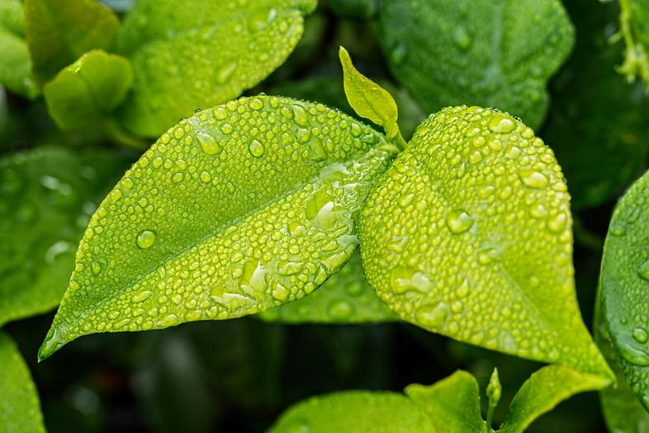
Magnesium used for making chlorophyll
Magnesium is part of the chlorophyll in all green plants and essential for photosynthesis. It also helps activate many plant enzymes needed for growth.
If a plant does not have enough magnesium the lower leaves will start to turn yellow.

Slide 11
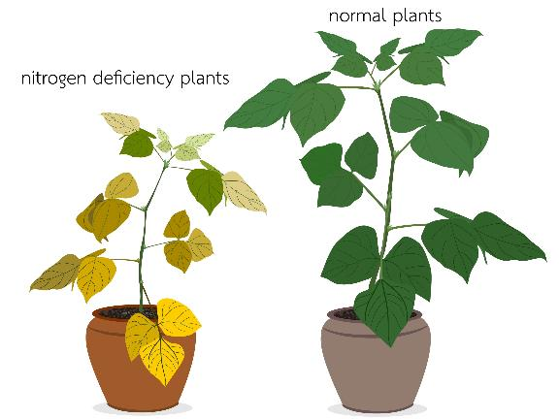
Nitrogen needed for growth
Nitrogen is used by plants to make proteins, including those to make leaves.
Plants need larger amounts of nitrogen than any other mineral. Nitrogen is a part of chlorophyll, the green pigment of the plant that is responsible for photosynthesis. Nitrogen helps with rapid growth of the plant, increases seed and fruit production and improves the quality of crops.
Nitrogen-deficient plants have poor growth and weak stems. The leaves will turn yellow and eventually die.

Slide 12
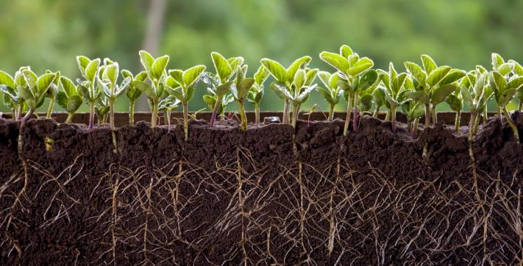
Phosphorous needed for healthy roots
Plants that do not receive enough phosphorous have discoloured, purple leaves and small roots.
Phosphorus is an essential part of the process of photosynthesis. It is involved in the formation of oils, sugars and starches. It also helps to transform solar energy into chemical energy.
Plants need phosphorous to make roots. If plants don’t have proper roots, they will not be able to reach or locate all the nutrients it needs.
Excess phosphorus can inhibit magnesium absorption in plants.

Slide 13
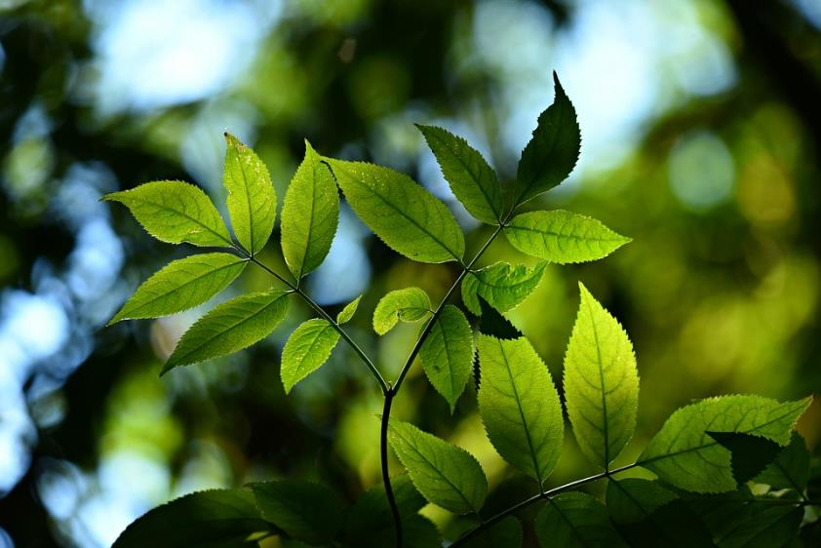
Potassium for healthy leaves and flowers
Potassium helps the plants to build protein and it is needed during photosynthesis. Potassium is also used to make flowers and fruit.
Too much potassium can hinder the absorption of magnesium.
If the plants don’t have enough potassium, they have poor flower and fruit growth.
The leaves will be yellow with dead spots.

Slide 14
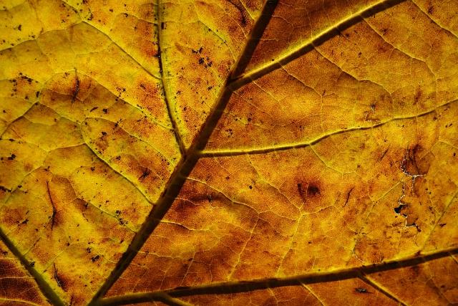
Mineral deficiency
Mineral deficiencies occur when a plant cannot get enough of a particular mineral from the soil for healthy growth. Different minerals are needed for different reasons, so each one causes different symptoms of mineral deficiency.
Nitrogen deficiency – plant will have poor growth and older leaves turn yellow.
Magnesium deficiency – plant leaves will turn yellow.
Phosphorus deficiency – plant will have poor root growth and younger leaves look purple.
Potassium deficiency – plant leaves go yellow and there are dead patches.

Slide 15
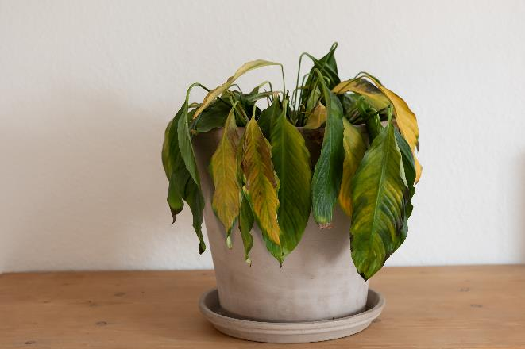
There’s been a murder!
Sam the plant has been found dead in their apartment.
You need to work together to find out how and why they died.
Look around the room for clues. These will determine how they died – and who may have done it?
Look out for signs of a mineral deficiency.

Slide 16

There’s been a murder!
Sam the plant, was a vibrant happy plant that mysteriously died.
Their leaves started to turn yellow, stems weakened and eventually Sam died. With the leaves being yellow Sam could not produce chlorophyll and could not carry out photosynthesis.
We need you to figure out who killed Sam, and how?

Slide 17

Suspect 1: The gardener
I was working hard to make Sam’s soil perfect, but I got a little excited with a new fertiliser I bought.
I added extra phosphorous thinking it would make the roots healthier. I didn’t realise that it could inhibit with magnesium absorption.
I might have overdone it!

Slide 18
Suspect 2: The neighbouring plant
I have always been competitive with Sam about who can grow faster and bigger.
Recently, I overheard how too much nitrate in the soil can make a plant grow too fast.
I thought maybe if I gave Sam’s soil a little more nitrogen, they would get too big and strong and not survive.
But I never expected their leaves to turn yellow!

Slide 19
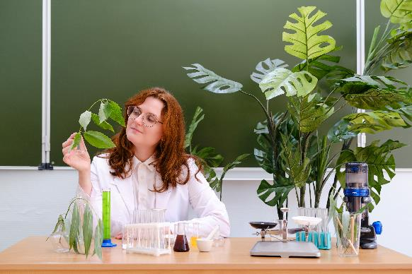
Suspect 3: The teacher
In our class experiment, I was testing the effects of different nutrients in the soil.
I read that potassium helps form healthy leaves and flowers. So, I added extra potassium to Sams’s soil.
I didn’t think that it could block the absorption of other minerals such as magnesium!

Slide 20
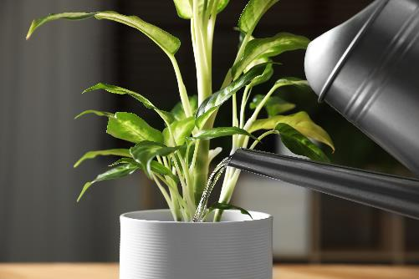
Suspect 4: The watering can
I have had a very busy few weeks.
I will admit I have been neglecting Sam and I did not water them as much as I should have been.
But their yellow leaves were not wilted, so I don’t believe my actions killed Sam!

Slide 21
Who killed Sam and why?
Sam the plant has been murdered by …
Sam died from…
This occurred because…

Slide 22
There’s been a murder!
Sam the plant has been murdered by.. the teacher
Sam died from… magnesium deficiency
This occurred because… the teacher added too much potassium to the soil, this meant Sam could not absorb the magnesium needed. As a result, they could not produce chlorophyll, and their leaves turned yellow.

Slide 23
Complete this table
Name of mineral | Symbol | Why is it important? | What do deficiency symptoms look like?

Slide 24
Answers
Name of mineral | Symbol | Why is it important? | What do deficiency symptoms look like?
Magnesium | Mg | For growth | Plant will have poor growth and older leaves turn yellow.
Potassium | K | For healthy roots | Plants leaves will turn yellow.
Phosphorous | P | For healthy leaves and flowers | Plant will have poor root growth and younger leaves look purple.
Nitrogen | N | For making chlorophyll | Plants leaves go yellow and there are dead patches.

Slide 25
Mix and match
Nitrogen deficiency
Plants leaves will turn yellow
Magnesium deficiency
Plant will have poor root growth and younger leaves look purple
Phosphorus deficiency
Plant will have poor growth and older leaves turn yellow
Potassium deficiency
Plants leaves go yellow and there are dead patches

Slide 26
Mix and match
Nitrogen deficiency
Plants leaves will turn yellow
Magnesium deficiency
Plant will have poor root growth and younger leaves look purple
Phosphorus deficiency
Plant will have poor growth and older leaves turn yellow
Potassium deficiency
Plants leaves go yellow and there are dead patches

Slide 27
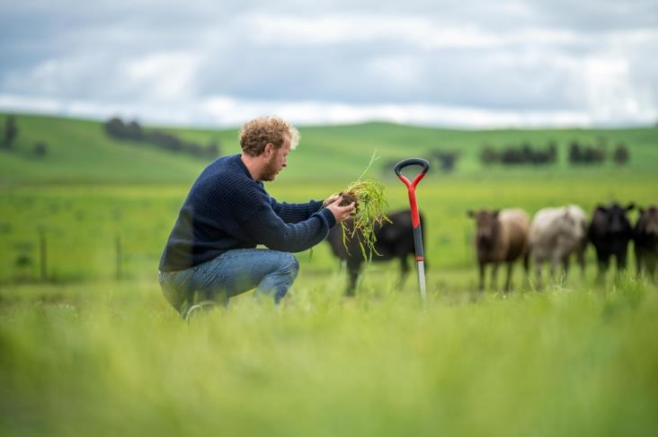
Supporting plant health
Farmers may support plant health by adding fertilisers to the soil.
Fertilisers provide mineral ions needed for healthy growth in plants that have been lost from the soil.
As plants grow, they absorb mineral ions from the water in the soil through their root hair cells. Over time, the concentration of these ions decreases, so farmers and gardeners add fertilisers to the soil.
Some farming practises, like regenerative farming, use other techniques and fewer fertilisers.

Slide 28
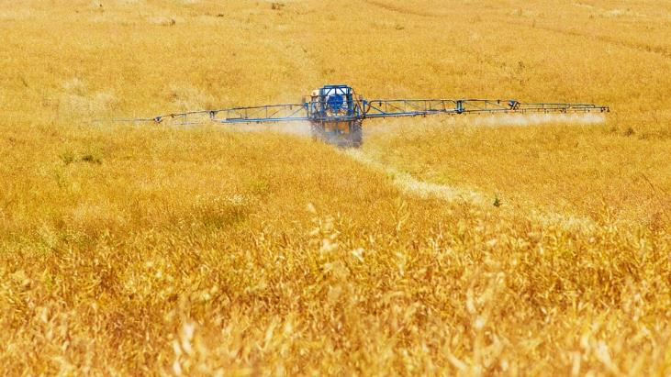
Fertilisers
When crops are harvested, minerals get removed from the ground as minerals can come from the plants that die or the shed leaves. This is an issue as mineral deficiencies lead to inadequate growth by the plant.
There are two types of fertilisers:
Manufactured fertilisers which are made using chemicals;
Organic fertilisers which originate from humans, plants or livestock e.g. manure or compost.

Slide 29
Fertilisers
Farmers overcome mineral deficiencies and support plant growth by adding fertilisers to the soil. Fertilisers contain minerals such as:
nitrogen;
phosphorous;
potassium compounds.

Slide 30
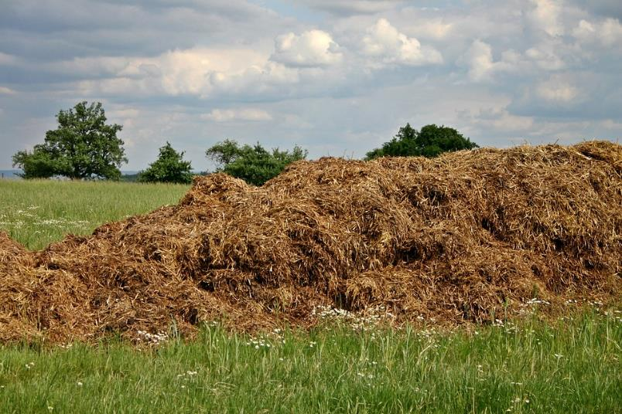
Nitrogen, phosphorus and potassium
Usually, fertilisers contain nitrogen, phosphorus and potassium compounds. Fertilisers that supply all three elements are often called NPK fertilisers, after the chemical symbols for these three elements.
NPK (Nitrogen, phosphorus and potassium) values show the relative proportions of nitrates, phosphates and potassium in a fertiliser. They help farmers decide which fertiliser is best for the soil conditions in their fields and the specific requirements of the crop being grown.

Slide 31
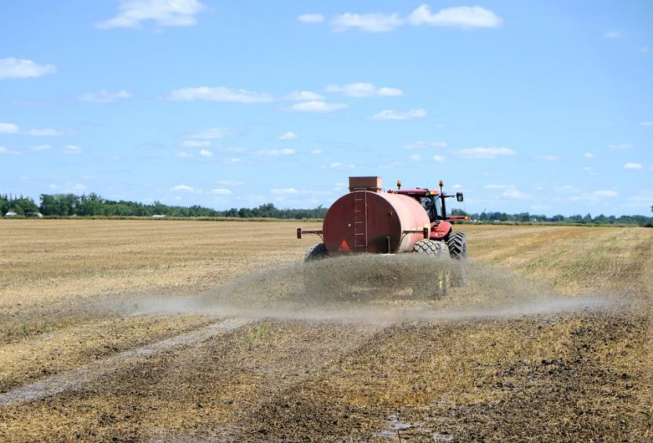
Nitrogen, phosphorus and potassium
Fertiliser compounds must be soluble in water so they can be absorbed by the root hair cells. These can include:
ammonium and nitrate ions (sources of nitrogen);
phosphate ions (source of soluble phosphorus);
all common potassium compounds dissolve in water to produce potassium ions.

Slide 32
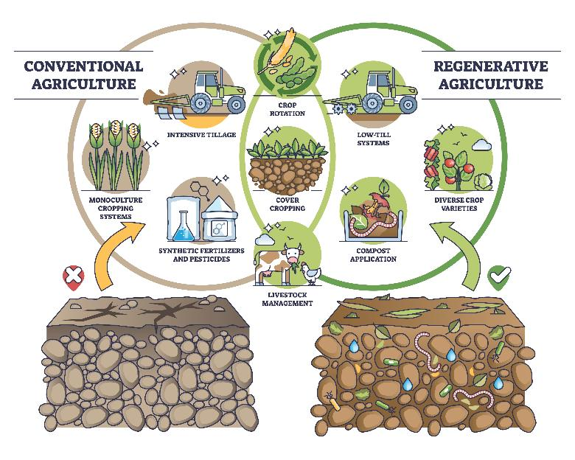
Regenerative farming
Regenerative farming (or regenerative agriculture) is a way of farming that maintains soil health, reduces a farm’s impact on climate change and encourages biodiversity.
Farms will usually reduce the amount of soil disturbance (tillage), and use compost to keep the soil fertile.
Another important technique is ‘crop rotation’. This involves planting different crops in different seasons or years to restore the balance of nutrients in the soil. For example, planting peas or beans helps to maintain nitrogen in the soil for other crops that may need it.

Slide 33
Soil health and plant nutrients
For further information, go to:
www.foodafactoflife.org.uk
This resource meets the Guidelines for producers and users of school education resources about food.

