Slide 1
Sensory evaluation

Slide 2
Sensory evaluation
“How we experience food is a multisensory experience involving taste, feel of the food in our mouths, aroma, and the feasting of our eyes” Professor Charles Spence, Oxford University

Slide 3
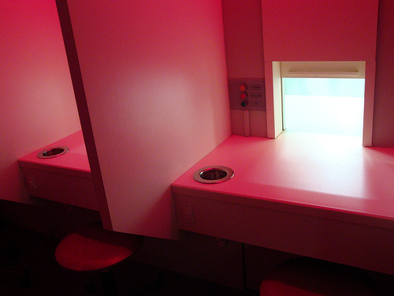
What is sensory evaluation?
Sensory evaluation is a scientific discipline that analyses and measures human responses to the composition of food and drink, e.g. appearance, touch, odour, texture, temperature and taste.

Slide 4
Why use sensory evaluation?
Sensory evaluation can be used to:
compare similarities/differences in a range of dishes/products;
evaluate a range of existing dishes/food products; analyse food samples for improvements;
gauge responses to a dish/product, e.g. acceptable v unacceptable;
explore specific characteristics of an ingredient or dish/food product;
check whether a final dish/food product meets its original specification;
provide objective and subjective feedback data to enable informed decisions to be made.

Slide 5

The senses
There are five senses used when tasting food and drink: sight, smell, taste, hearing and touch.
The senses help to develop food preferences (likes and dislikes) and evaluate foods through preference or discrimination tests.

Slide 6


Sight and smell
The size, shape, colour, temperature and surface texture all play an important part in helping to determine the first reaction to a food.
Smell (odour) and taste work together to produce flavour. This is the reason why people with a blocked nose find it difficult to determine the flavours of foods. Smell can trigger memories and either encourage or discourage someone from eating a food.

Slide 7
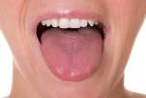


Taste, hearing and touch
We can detect five basic tastes: bitter, salt, sour, sweet and umami.
The sound of food being prepared, cooked, served and eaten all help to influence food preferences. The sounds also influence our understanding of whether they are fresh or ripe, e.g. a crisp, crunchy apple.
Food texture is the way food is felt by the fingertips, tongue, teeth and palate. When food is placed in the mouth, the surface of the tongue and other sensitive skin reacts to its surface texture. This sensation is known as mouthfeel.

Slide 8
Taste receptors
The classical "taste map" is an over simplification.
Sensitivity to all tastes is distributed across the whole tongue (and other regions of the mouth where there are taste buds), but some areas are more responsive to certain tastes than others.
Our tongues are covered with taste buds, which are designed to sense chemicals in the mouth. Most taste buds are located in the top outer edges of the tongue, but there are also receptors at the back of the tongue as well as on the walls of the mouth and at the back of the throat.
As we chew food, molecules mix with saliva, enter taste pores and interact with gustatory hairs, also known as taste receptors. This triggers nerve impulses that are transmitted to the brain.

Slide 9
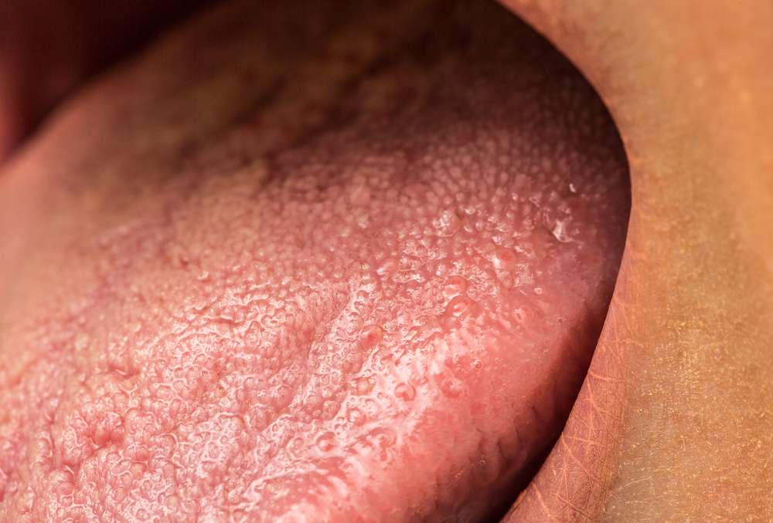
Taste receptors
Human tongues are covered with 2,000 to 10,000 taste buds, and each bud contains between 50 and 100 taste receptor cells. Taste buds are activated very quickly; a salty or sweet taste that touches a taste bud for even one tenth of a second will trigger a neural impulse.
On average, taste buds live for about 5 days, after which new taste buds are created to replace them.
As we get older, the rate of creation decreases making us less sensitive to taste.

Slide 10

Why is sensory evaluation important?
Sensory evaluation is used at several stages during product development and production to:
evaluate a range of existing food products;
analyse a test kitchen sample for improvements;
gauge consumer response to a product;
check that a final product meets its original specification;
detect differences between products from different runs or batches;
monitor quality control by checking regular samples against specification.

Slide 11
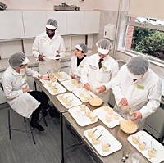
Setting up a tasting area
Everyone has different perceptions of tastes, so the tasters should understand that no-one has the ‘right’ answer.
During a tasting session, the tasters should not talk or share ideas, or look at the expressions on the faces of the other tasters. In industry, tasting booths are used to prevent this from happening.

Slide 12

Fair testing
In order to obtain reliable results, the tests are set up in a controlled way to ensure fair testing. This could include:
a quiet environment controlled by lighting and temperature;
an atmosphere free from smells;
individual booths to reduce influence from other testers;
food samples presented on or in identical sized and shaped plain containers;

Slide 13
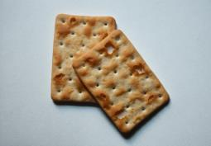
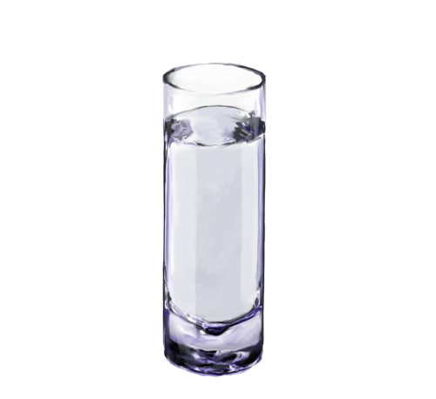
Controls
Controls to ensure fair testing also include:
all samples served in the same way, at the same temperature (appropriate to the food);
tasters allowed to sip water or eat a plain biscuit in between each tasting to clear the palate;
a small number of samples presented at one time, otherwise their taste buds get tired.

Slide 14

Controls
Controls to ensure fair testing also include:
samples of food coded randomly to avoid the tasters having a preference – e.g. three random numbers or letters, such as 327 or DTH. Single numbers such as 1,2,3 are avoided as these numbers can imply that the food has an order already;
clear instructions are given to the taster;
straight forward response sheets are used to record the results.

Slide 15
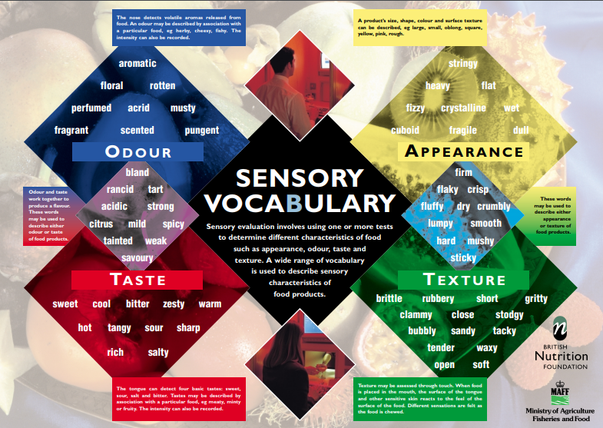

Slide 16
Sensory evaluation
For further information, go to:
www.foodafactoflife.org.uk
This resource meets the Guidelines for producers and users of school education resources about food.

