Slide 1
Sandwich images

Slide 2

Cheese and salad in a sesame seed bagel

Slide 3
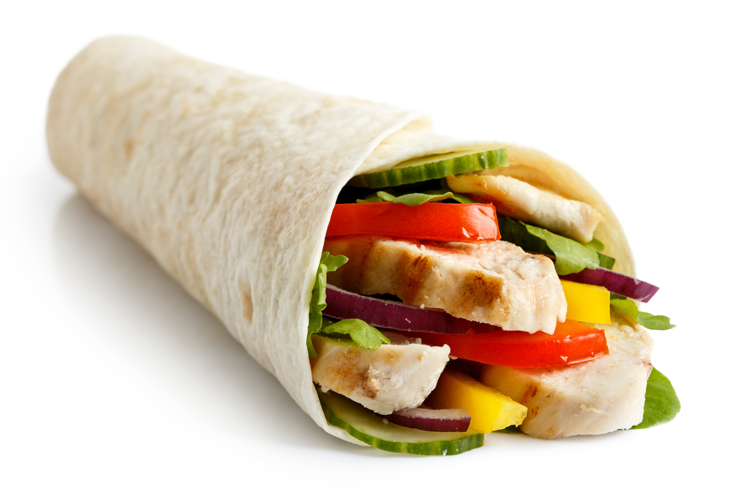
Chicken and salad in a wrap

Slide 4
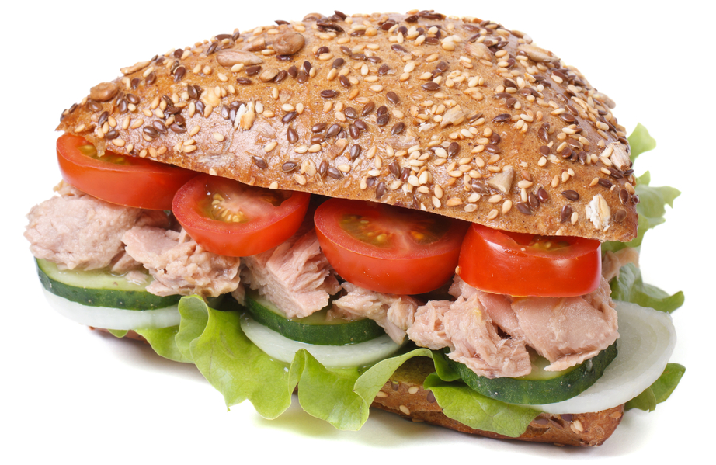
Tuna and salad in a seeded roll

Slide 5
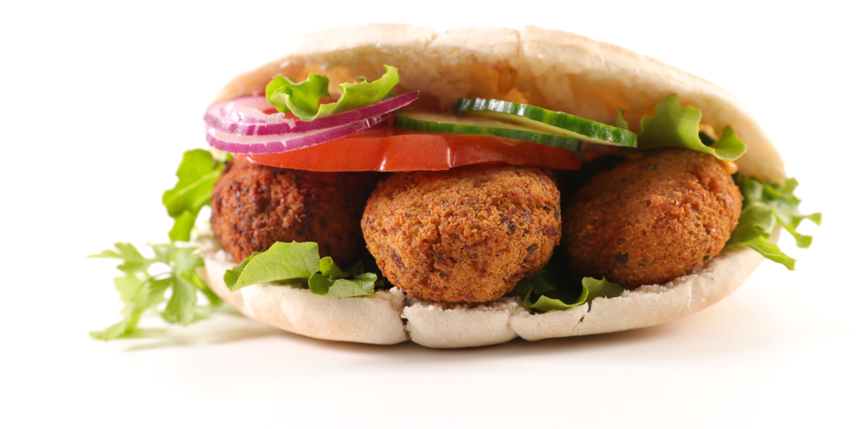
Falafel and salad in a pitta bread

Slide 6
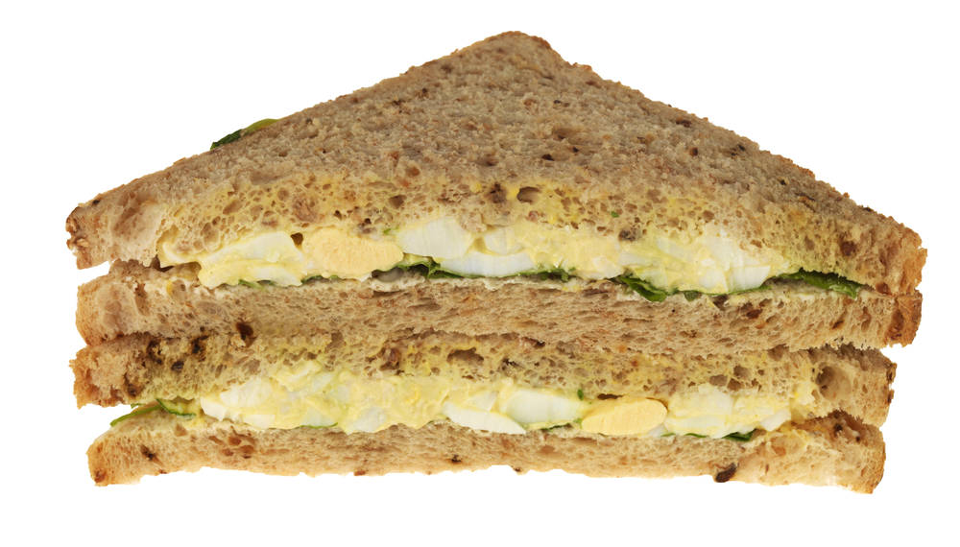
Egg mayonnaise on granary bread

Slide 7
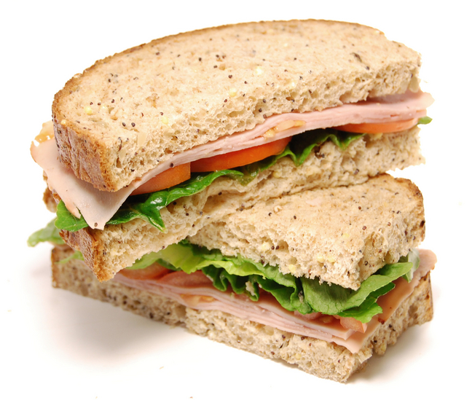
Ham and salad on seeded bread

Slide 8
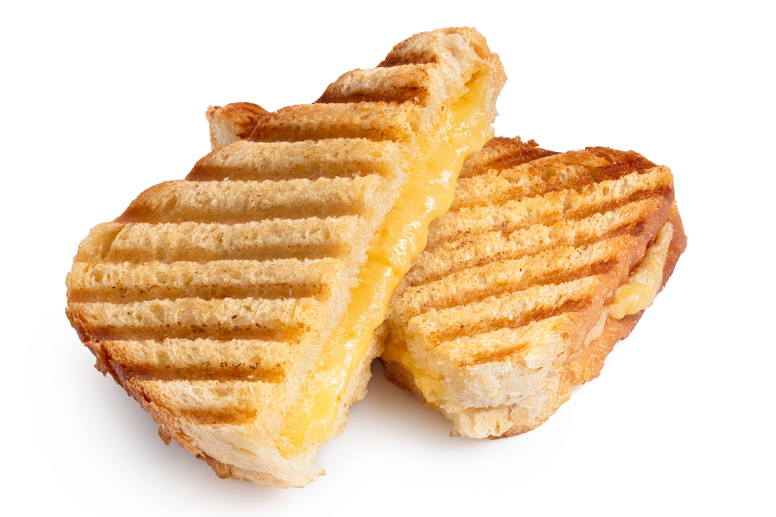
Toasted cheese sandwich

Slide 9
Sandwich images
For further information, go to:
www.foodafactoflife.org.uk

