Slide 1
Tackling food waste in schools
29/06/2022

Slide 2
Covered in today’s webinar
Why reducing food waste is important in schools.
Bringing the school community on the journey – pupils, staff and parents.
How to reduce food waste throughout the school day.
Tips to reducing food waste in food and nutrition lessons.
Links to Food – a fact of life resources.
Sources of further information and support.
Links to Food – a fact of life and British Nutrition Foundation resources.

Slide 3

A quick quiz to set the context!
How many tonnes of food and drink is wasted in the UK each year that could have been eaten?
1.8 million tonnes
2.4 million tonnes
3.6 million tonnes
4.5 million tonnes
What proportion of edible fresh vegetables and salad are wasted?
20%
24%
28%
4.5 million tonnes!
28%
HEW 2022 Food waste quiz

Slide 4

Why reducing food waste is important in schools

Slide 5
Bringing the school community on the journey – pupils, staff and parents.

Slide 6
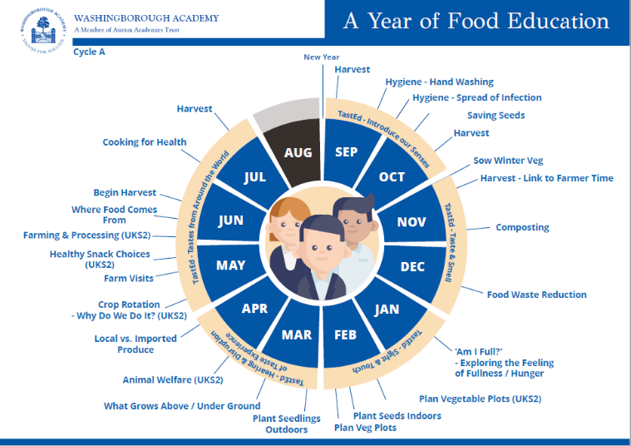

Slide 7
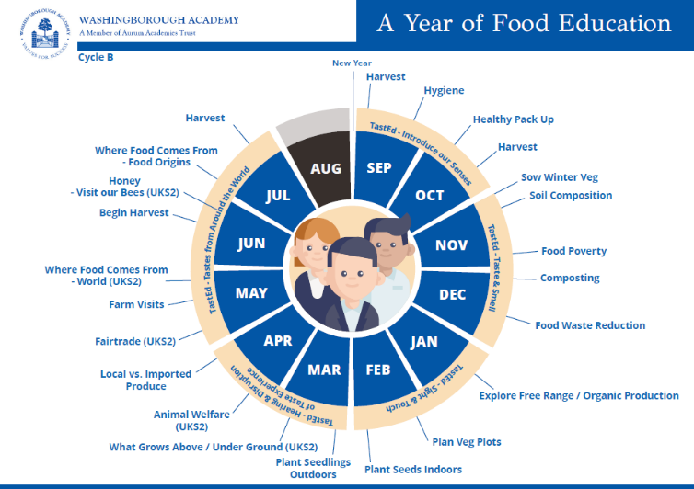

Slide 8
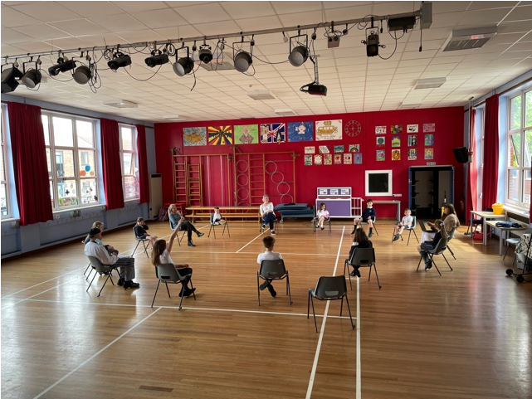
Children’s voice

Slide 9


Guardian’s of the Earth

Slide 10
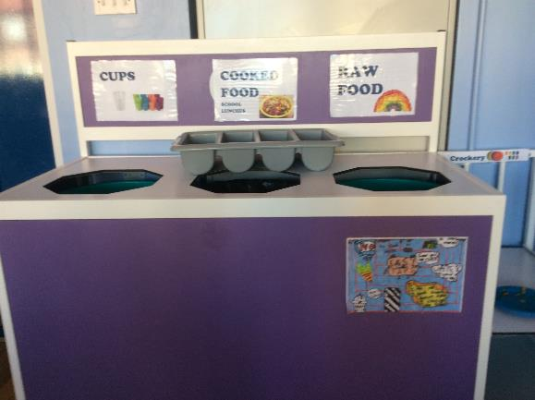
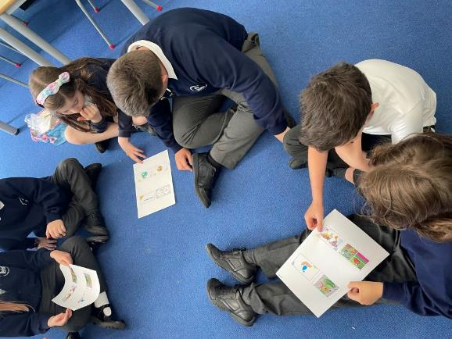
Our Meetings:
We come together to have meetings.
We have decided what areas of our school need to become more sustainable and we decided our top priority was at lunch time and the waste both in the kitchen and in the bins.
Other areas we wanted to help were conserving rain water and getting rid of litter on the playground.

Slide 11




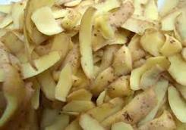
International Project
The school is part of a big international project called ‘Learn4Earth’ which include the countries Slovenia, Denmark, Italy and Spain.
We had a meeting with scientists in Italy where we shared our problem of waste in the kitchen and in the hall.
The chef collected all the vegetable waste and one of the biggest was potato peelings.
The scientists sent us some fantastic facts about potatoes and why we should eat potato skins.

Slide 12


YOU CAN MAKE THE DIFFERENCE IN OUR SCHOOL AND THE WORLD!
When you have a jacket potato at school PLEASE try the skin
If we eat more hot dinners in school it is less packaging from packed lunches and more sustainable.
Let’s get excited about potatoes!

Slide 13
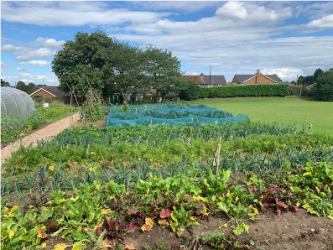
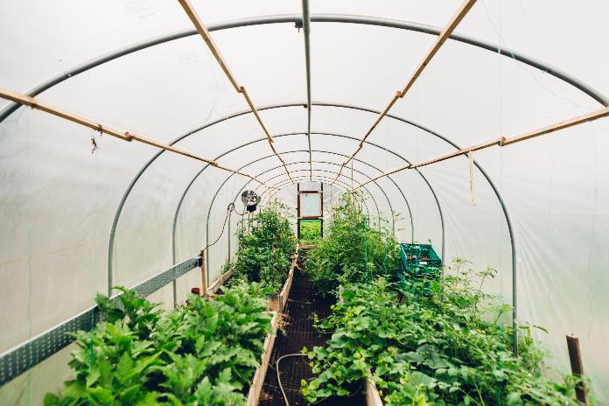
School kitchen garden

Slide 14
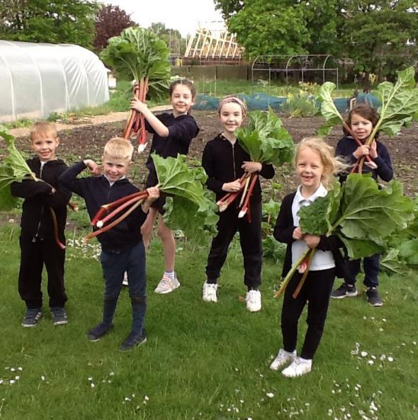
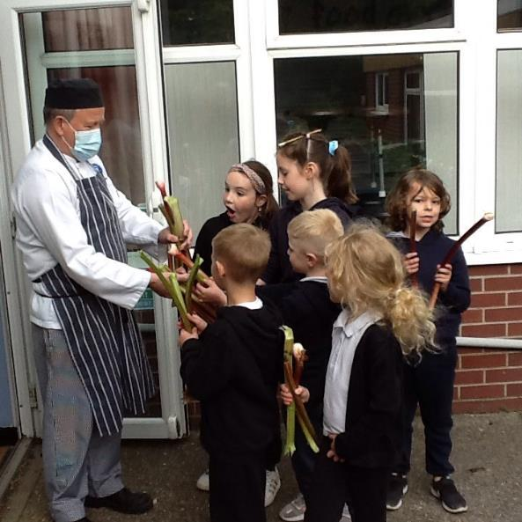
School kitchen garden

Slide 15
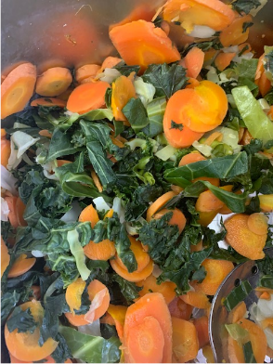
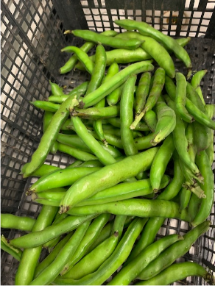
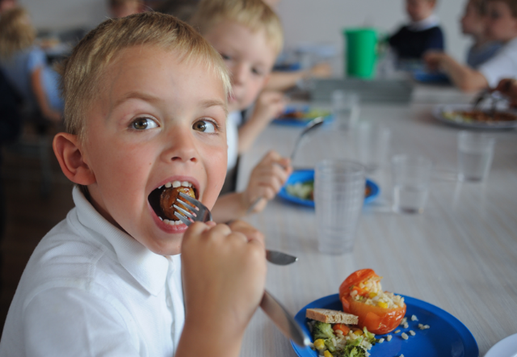
From school plot to school lunch plate

Slide 16
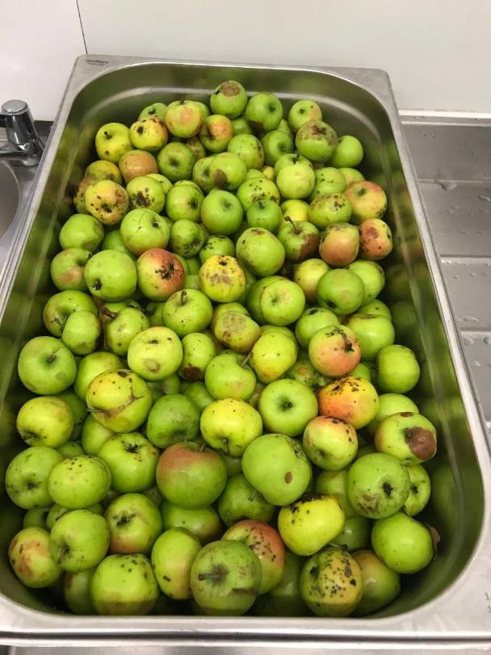
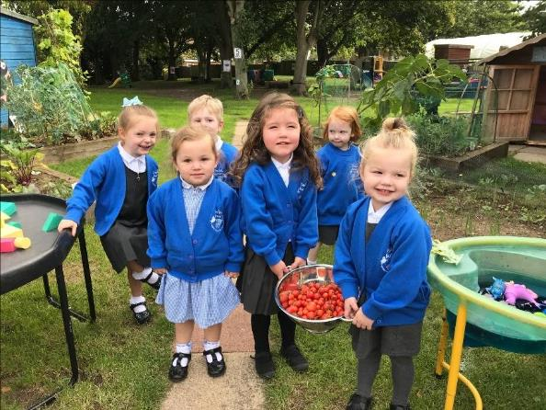
Harvesting

Slide 17
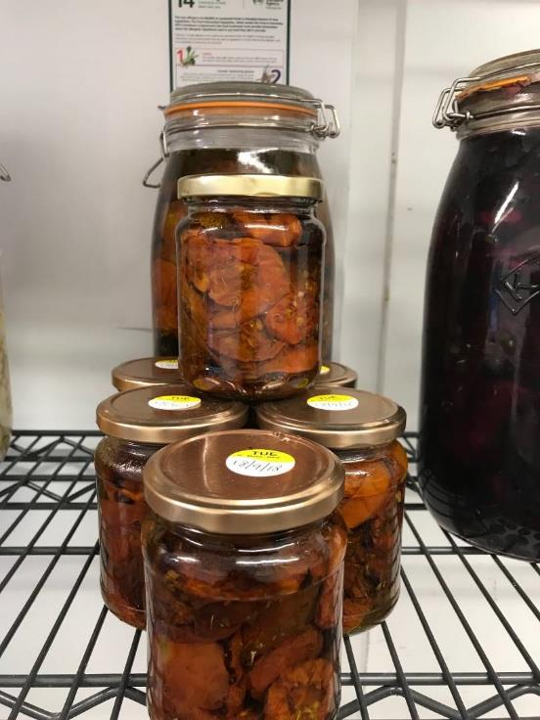
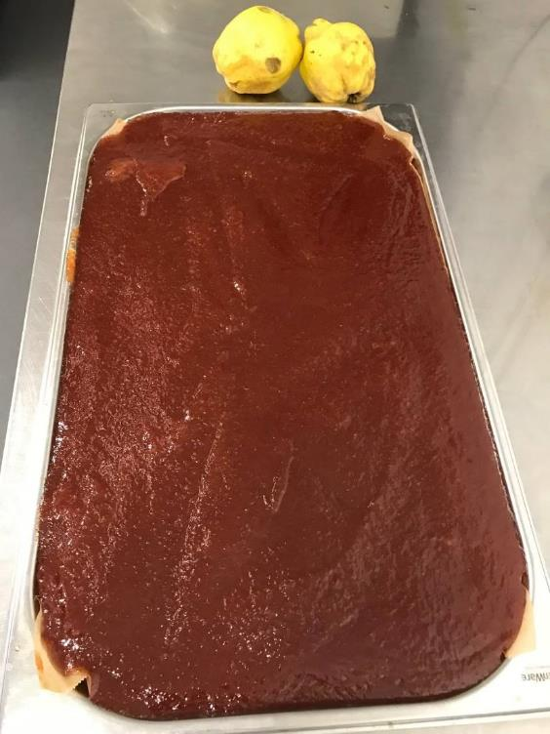
Preserving

Slide 18
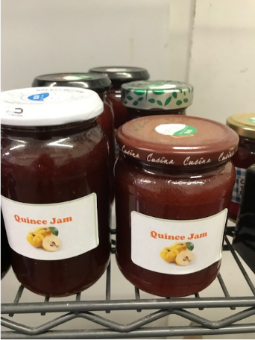
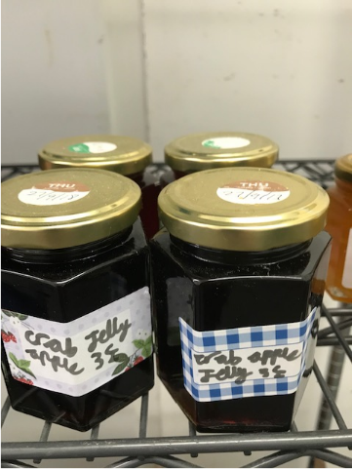
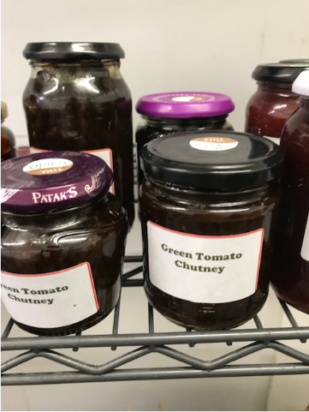
Preserving

Slide 19
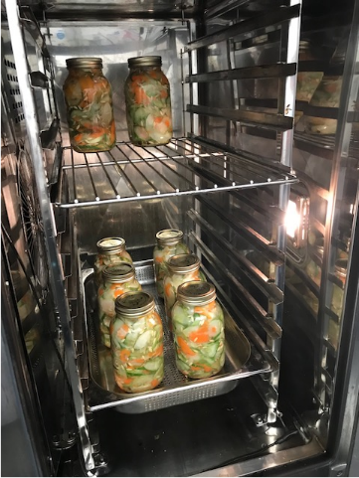
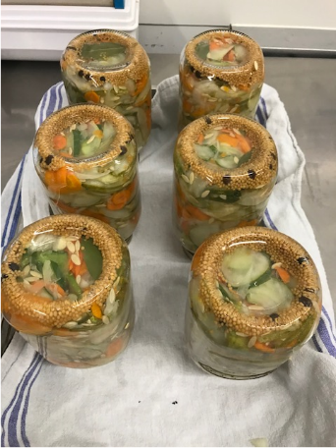
Preserving

Slide 20
How to reduce food waste throughout the school day.

Slide 21
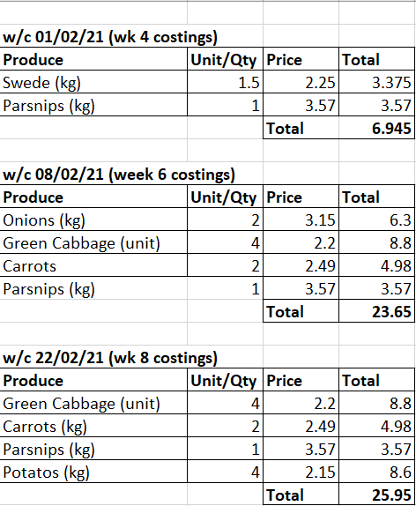
Our school kitchen garden
Notes:
It all comes down to planning and challenging your school meals provider to ensure that numbers are right and that the school is getting not only high quality food, but also value for money and being aware of the environmental impact of school lunches and food waste.

Slide 22
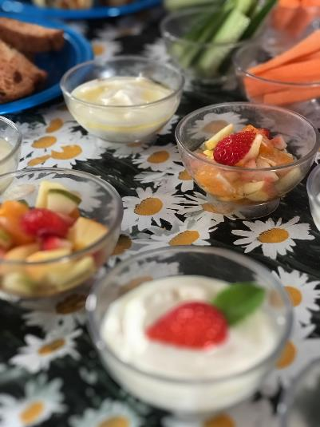
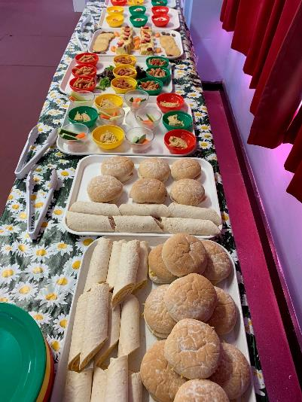
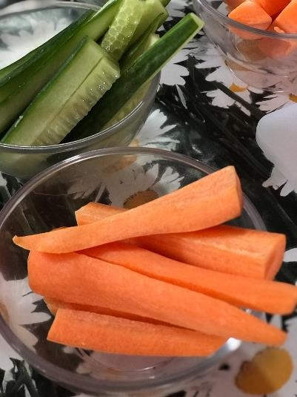
Ready to Rumble

Slide 23
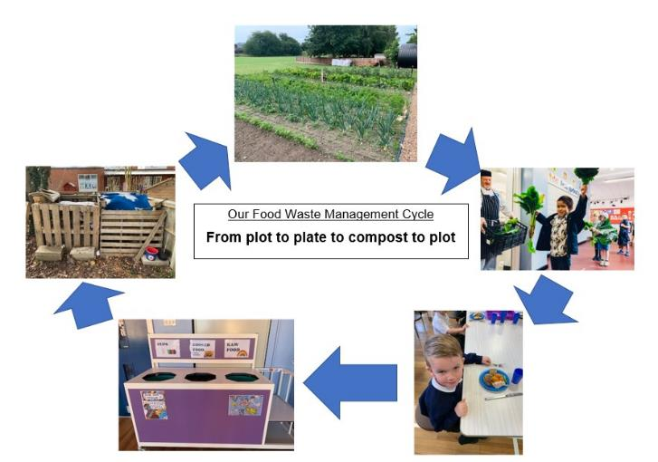
Our food waste cycle

Slide 24
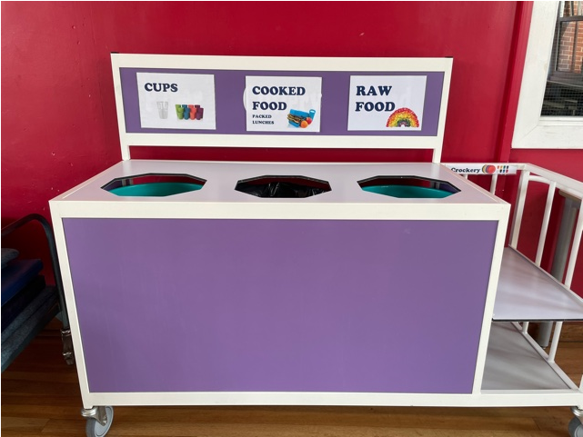
Collecting & measuring our food waste

Slide 25
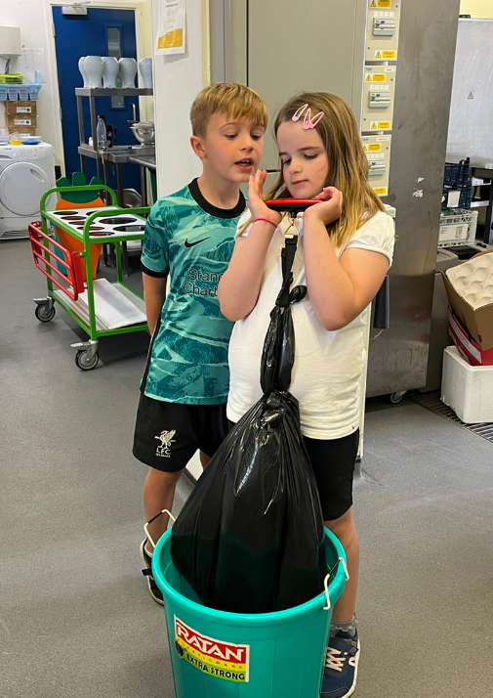
Daily measuring of our non-compostable waste

Slide 26
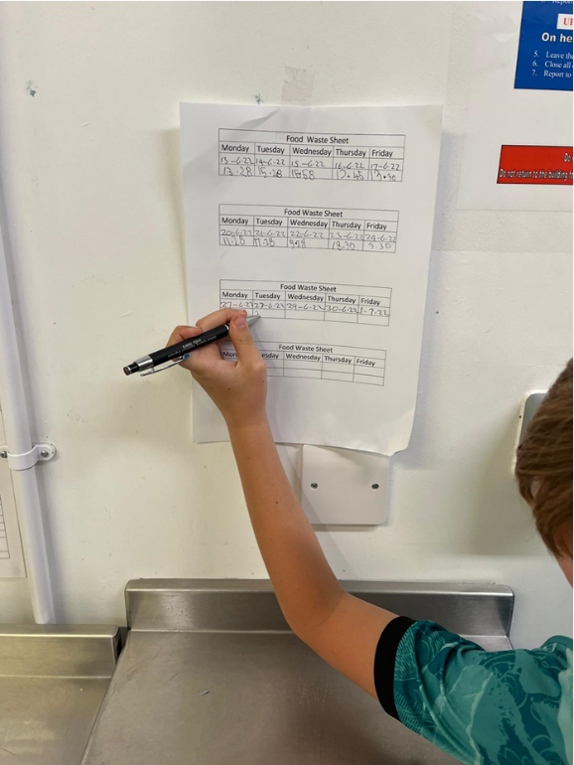
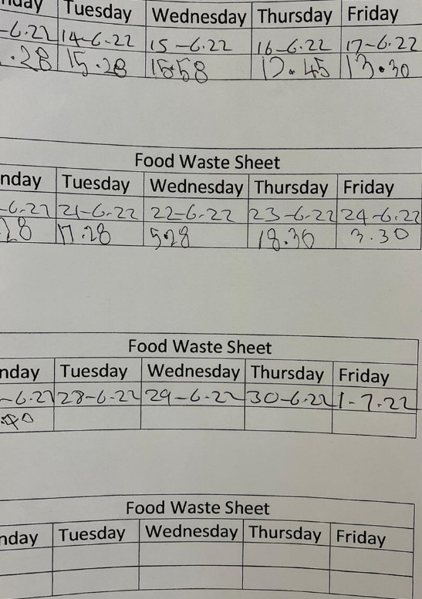
Daily measuring of our non-compostable waste

Slide 27
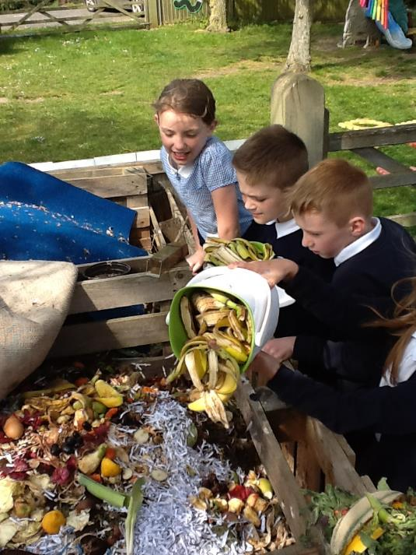
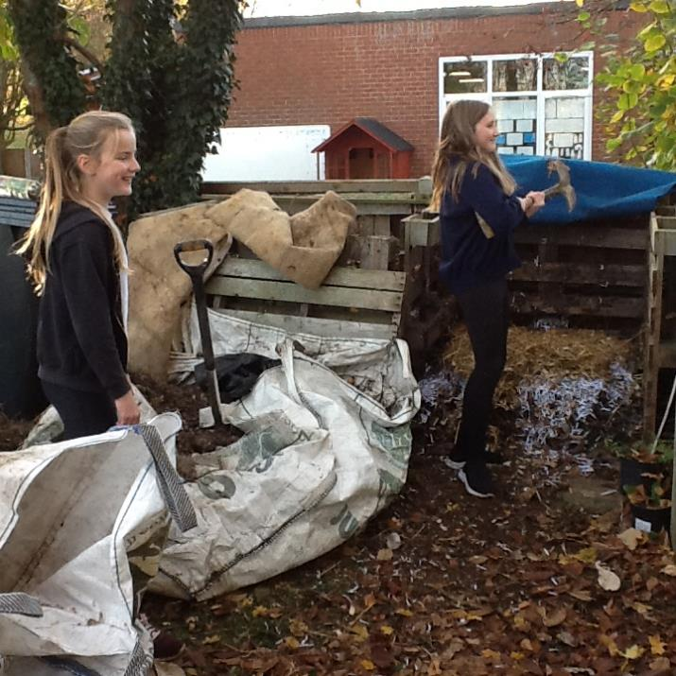
Collecting our compostable waste

Slide 28
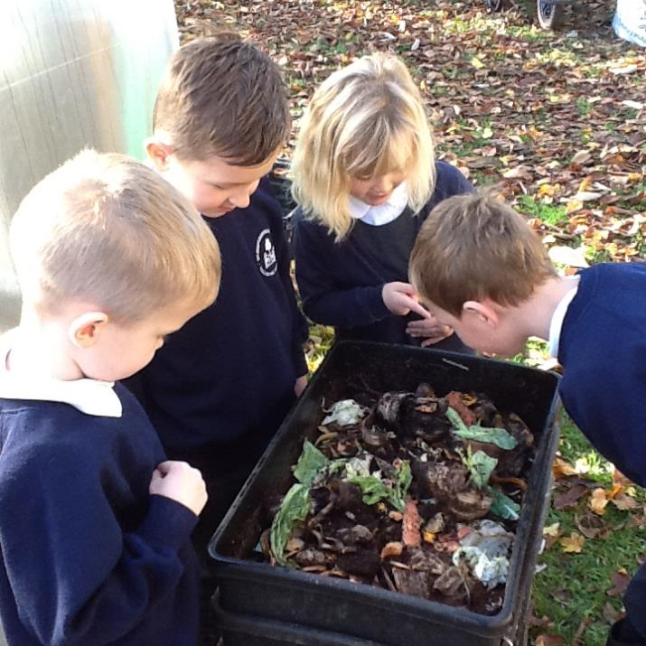
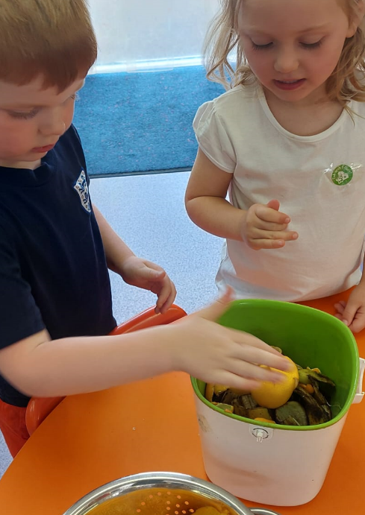
Collecting our compostable waste

Slide 29
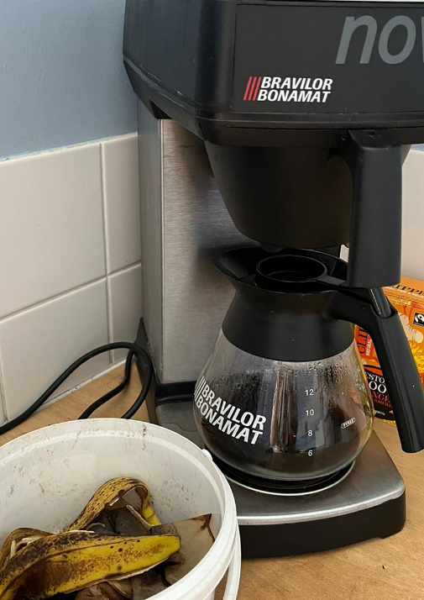
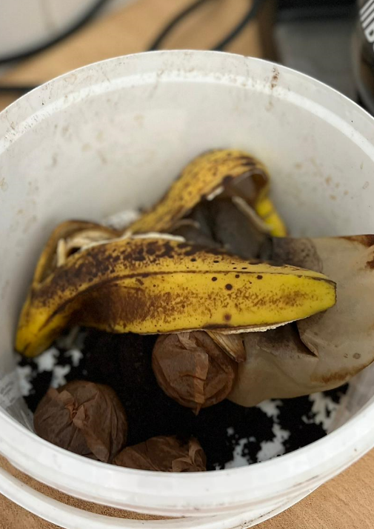
Teacher awareness

Slide 30

Supporting children’s health and well-being and helping to reduce food waste

Slide 31

What is TastEd?
Sensory food education for children
Use 5 senses to explore fruit and vegetables
Evidence-based, practical approach to food education
Simple, hands on lessons for children
Helps children learn to enjoy eating fruits & vegetables
Scheme of work that includes over 100 resources for teachers to use in nurseries and primary schools
Notes:
TastEd is an exciting and unique scheme of work. It is sensory food education which enables children to develop a new relationship with fresh fruit and vegetables.
The lessons have been designed to be taught by teachers and other members of staff. There are comprehensive lesson plans and PowerPoints to accompany the lessons
They have been successfully taught and embedded into large, diverse schools in London and other cities, but also in smaller, rural settings.
This simple new method allows children to experience fresh produce on their terms by exploring it with their senses.
It’s food education that can be delivered in any classroom using minimal resources.
It can be used to deliver other curriculum areas and requires no prior subject knowledge.
Cross curricular links including HISTORY
It’s a way to deliver the primary National Curriculum D & T requirements for Nutrition and Cooking as well as the new PSHE requirement for healthy eating. It can also give children confidence in literacy, especially speech and writing.

Slide 32
Why TastEd Works
Golden Rules remove pressure from children to taste and like new foods
  “No one has to try”
  “No one has to like”
Learning by doing
  Using the all 5 senses to explore food
  Research shows sensory food education improves children’s willingness to try new foods
The classroom is a safe environment to learn new skills
  Presence of a trusted adult
  Children feel safe to try something new
  Peers can have a positive effect
  No correct answers mean children are highly engaged in lessons
Children are encouraged to express likes and dislikes
  Giving children opportunities to explore and understand their food preferences e.g. soft or hard foods
Notes:
TastEd is an evidence-based approach to sensory food education which teaches children about food in an experiential way,
It works because the lessons are exciting, fun, yet simple.
It has been likened to artefact led teaching, popular amongst museum educators.
Generating CURIOSITY and dialogue is at the heart of the TastEd pedagogy.
There are no correct answers, and through asking open questions, children are encouraged to talk about what they can see, smell, touch, hear and taste as teachers bring fresh produce into the classroom each week.
Children learn about food through fun food facts and they also learn to explore it.
The feedback from our beacon school highlights that for many children TastEd lessons are their favourite lessons of the week.
TastEd lessons enable teachers to not only provide children with a new lens for experiencing and understanding food, but they also provide teachers with a pedagogical approach which promotes high levels of wellbeing and engagement with learning across all aspects of the curriculum.

Slide 33
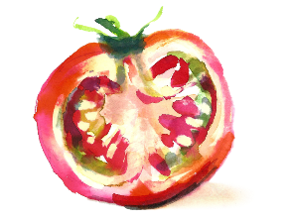
Benefits of TastEd for children
Fun!
Helps children to learn to love eating fruit & vegetables
  Research shows sensory food education improves children’s willingness to try new foods
Boosts children's self confidence
Promotes a ‘can do attitude’
Children get to explore and try a wider variety of foods
Everyone can talk about food, making lessons accessible to all abilities
Open questions mean there are no wrong answers
Helps them to understand their likes and dislikes, and why
Develop wider vocabulary and literacy skills
Notes:
TastEd is an evidence-based approach to sensory food education which teaches children about food in an experiential way,
It works because the lessons are exciting, fun, yet simple.
It has been likened to artefact led teaching, popular amongst museum educators.
Generating CURIOSITY and dialogue is at the heart of the TastEd pedagogy.
There are no correct answers, and through asking open questions, children are encouraged to talk about what they can see, smell, touch, hear and taste as teachers bring fresh produce into the classroom each week.
Children learn about food through fun food facts and they also learn to explore it.
The feedback from our beacon school highlights that for many children TastEd lessons are their favourite lessons of the week.
TastEd lessons enable teachers to not only provide children with a new lens for experiencing and understanding food, but they also provide teachers with a pedagogical approach which promotes high levels of wellbeing and engagement with learning across all aspects of the curriculum.

Slide 34





Structure of TastEd
TastEd has lessons for every year of primary
Each year group has at least 5 lessons, one covering each of the five senses.
Every lesson in every year group includes:
EYFS
Yr 1
Yr 2
Yr3
Yr 4
Yr 5
Yr 6
The 5 senses
2 Golden Rules
Where food comes from
Exploring food using a sense
Opportunity to try the food
Chance for children to share their experience
Asks if they tried something new
Notes:
TastEd is an evidence-based approach to sensory food education which teaches children about food in an experiential way,
It works because the lessons are exciting, fun, yet simple.
It has been likened to artefact led teaching, popular amongst museum educators.
Generating CURIOSITY and dialogue is at the heart of the TastEd pedagogy.
There are no correct answers, and through asking open questions, children are encouraged to talk about what they can see, smell, touch, hear and taste as teachers bring fresh produce into the classroom each week.
Children learn about food through fun food facts and they also learn to explore it.
The feedback from our beacon school highlights that for many children TastEd lessons are their favourite lessons of the week.
TastEd lessons enable teachers to not only provide children with a new lens for experiencing and understanding food, but they also provide teachers with a pedagogical approach which promotes high levels of wellbeing and engagement with learning across all aspects of the curriculum.

Slide 35
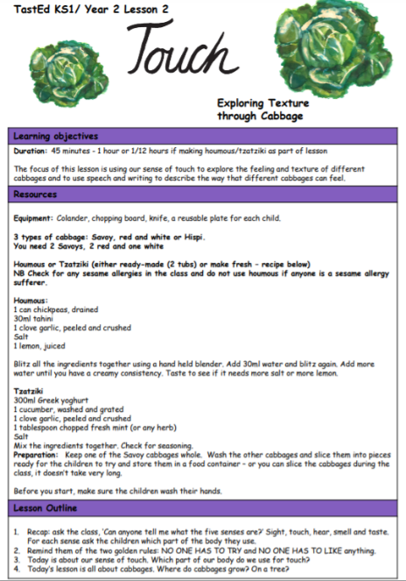
TastEd lesson plans
Each lesson plan includes:
Learning Objectives
Resources
Lesson Outline
Word Bank
Success Criteria
Curriculum Links
School Kitchen
Reading Links
Optional Further Activities
Background Facts
Notes:
TastEd is an evidence-based approach to sensory food education which teaches children about food in an experiential way,
It works because the lessons are exciting, fun, yet simple.
It has been likened to artefact led teaching, popular amongst museum educators.
Generating CURIOSITY and dialogue is at the heart of the TastEd pedagogy.
There are no correct answers, and through asking open questions, children are encouraged to talk about what they can see, smell, touch, hear and taste as teachers bring fresh produce into the classroom each week.
Children learn about food through fun food facts and they also learn to explore it.
The feedback from our beacon school highlights that for many children TastEd lessons are their favourite lessons of the week.
TastEd lessons enable teachers to not only provide children with a new lens for experiencing and understanding food, but they also provide teachers with a pedagogical approach which promotes high levels of wellbeing and engagement with learning across all aspects of the curriculum.

Slide 36
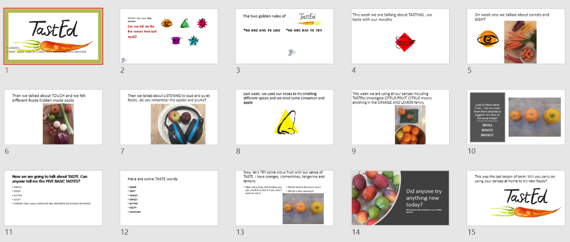
TastEd PowerPoints
Notes:
TastEd is an evidence-based approach to sensory food education which teaches children about food in an experiential way,
It works because the lessons are exciting, fun, yet simple.
It has been likened to artefact led teaching, popular amongst museum educators.
Generating CURIOSITY and dialogue is at the heart of the TastEd pedagogy.
There are no correct answers, and through asking open questions, children are encouraged to talk about what they can see, smell, touch, hear and taste as teachers bring fresh produce into the classroom each week.
Children learn about food through fun food facts and they also learn to explore it.
The feedback from our beacon school highlights that for many children TastEd lessons are their favourite lessons of the week.
TastEd lessons enable teachers to not only provide children with a new lens for experiencing and understanding food, but they also provide teachers with a pedagogical approach which promotes high levels of wellbeing and engagement with learning across all aspects of the curriculum.

Slide 37
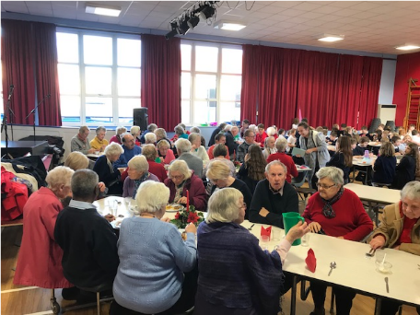
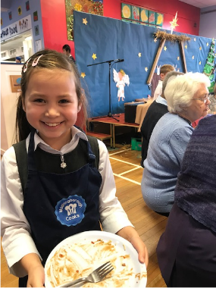
The social aspect of food - commensality
Family & Community Health

Slide 38
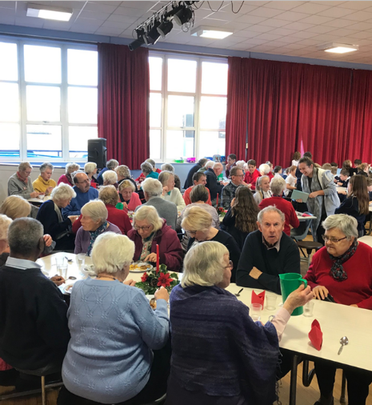
The social aspect of food - commensality
Family & Community awareness
Developing community links
Using the whole school approach to food to support the community becoming more involved in the life of the school with the latent aim being that this will have a positive impact on the education of the children as the parents are engaged in their school life – developing school connectedness
Notes:
Again the values based leadership approach is evident here as the participants used this to create opportunities within their schools curriculum to reinforce the sense of collective - to reinforce social bonds and to create community cohesion. This not only was seen as supporting the children's academic outcomes, but also by sharing and enhancing the collective ethos of the school reinforcing strong community relationships.

Slide 39

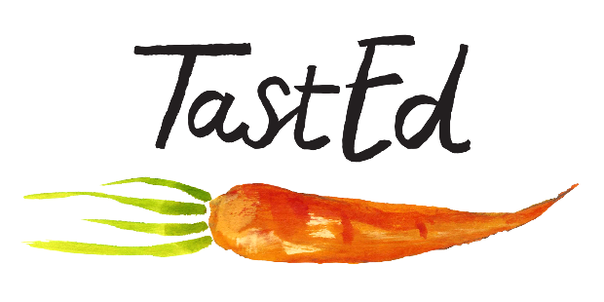
www.tasteeducation.com
info@tasteeducation.com
@tastedfeed
@jasorourke

Slide 40
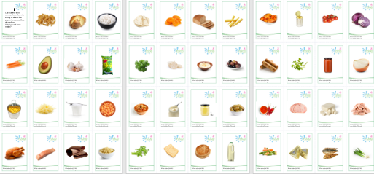
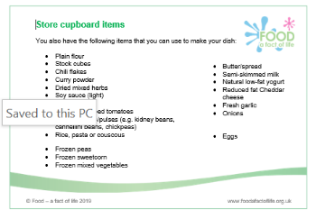
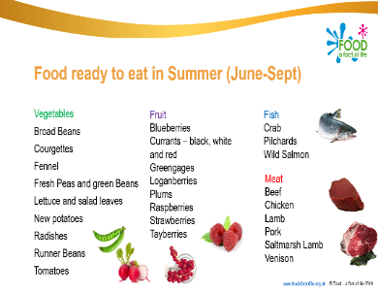

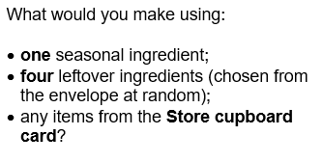
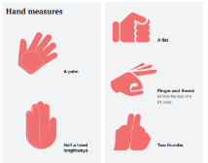
Reducing food waste in food and nutrition lessons
Teach pupils about:
meal planning;
writing shopping lists;
checking what is in the cupboard /fridge/ freezer;
batch cooking;
using leftovers;
knowing their dates;
portion control;
temperature control (fridge/freezer).
Using leftovers – presentation and activity.
Pupils with additional needs resources
Get portion wise booklet

Slide 41
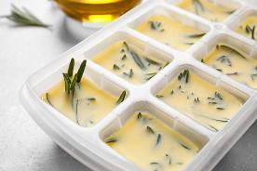



Reducing food waste in food and nutrition lessons – some suggestions
Reduce recipes size (1 or 2 portions).
Task pupils to work in groups or pairs to reduce the ingredients needed/cost.
Adapt recipes depending on what you have in stock.
Consider buying in bulk/order on a weekly basis.
Collect food waste and compost where possible.
Provide herbs, spices, vinegar, yeast sachets, oil for your pupils to use.
Freeze fresh herbs in olive oil or water.
Freeze fresh ginger and grate as much as you need.
Dice onions and garlic in bulk and freeze.
Use the whole of the herb/spring onion in recipes.

Slide 42



Reducing food waste in food and nutrition lessons – some suggestions
Potato skin crisps!
Wash and scrub the potatoes and then peel.
Spray with oil and sprinkle with herbs and spices.
Roast in a hot oven (200C/180 fan/gas 6) for 25-30 minutes.
Ditch the peeler – if you do peel save the skins!
Make pesto with leftover herbs or vegetables – use traditional basil or parsley, coriander, mint, sage or tarragon or leafy greens, such as spinach, kale, watercress.
Make jams, pickles or kimchi.
Dehydrate fruit or vegetables.
Make soup with leftover vegetables.
Store cut veg in water to extend life.
Re-grow veg!
Pickled cauliflower or cabbage: One-part vinegar, one-part sugar and one-part water. Add caraway seeds, thyme, bay leaf, garlic and sliced onion.

Slide 43



Reducing food waste in food and nutrition lessons – some suggestions
Freeze coconut milk, passata, egg yolks and whites.
Be creative with leftovers to reduce food waste, e.g. roasted chickpeas, asparagus end soup or bean pod fritters!
Try recipes using canned food.
Make aquafaba meringues.
Try a BoF pie, curry, soup or stew …..
Make breadcrumbs and freeze (then use for goujons, fish cakes or nuggets).
Have an ingredient amnesty box.
Check your school fridge temperature!

Slide 44




Sources of information
EUFIC
Guardians of Grub
Healthy Eating Week 2022 resources and recipes
IFST food waste fact sheet
Love Food Hate Waste
RHS Campaign for school gardening
Western Riverside Waste Authority (food waste calculator, plate waste survey, information about engaging pupils in food and improving the dining experience)
WRAP
UKHarvest – education resources

Slide 45
Tackling food waste in schools
For further information, go to:
www.foodafactoflife.org.uk

