Slide 1
Developing skills for independent living: Food and drink
09/06/2022

Slide 2
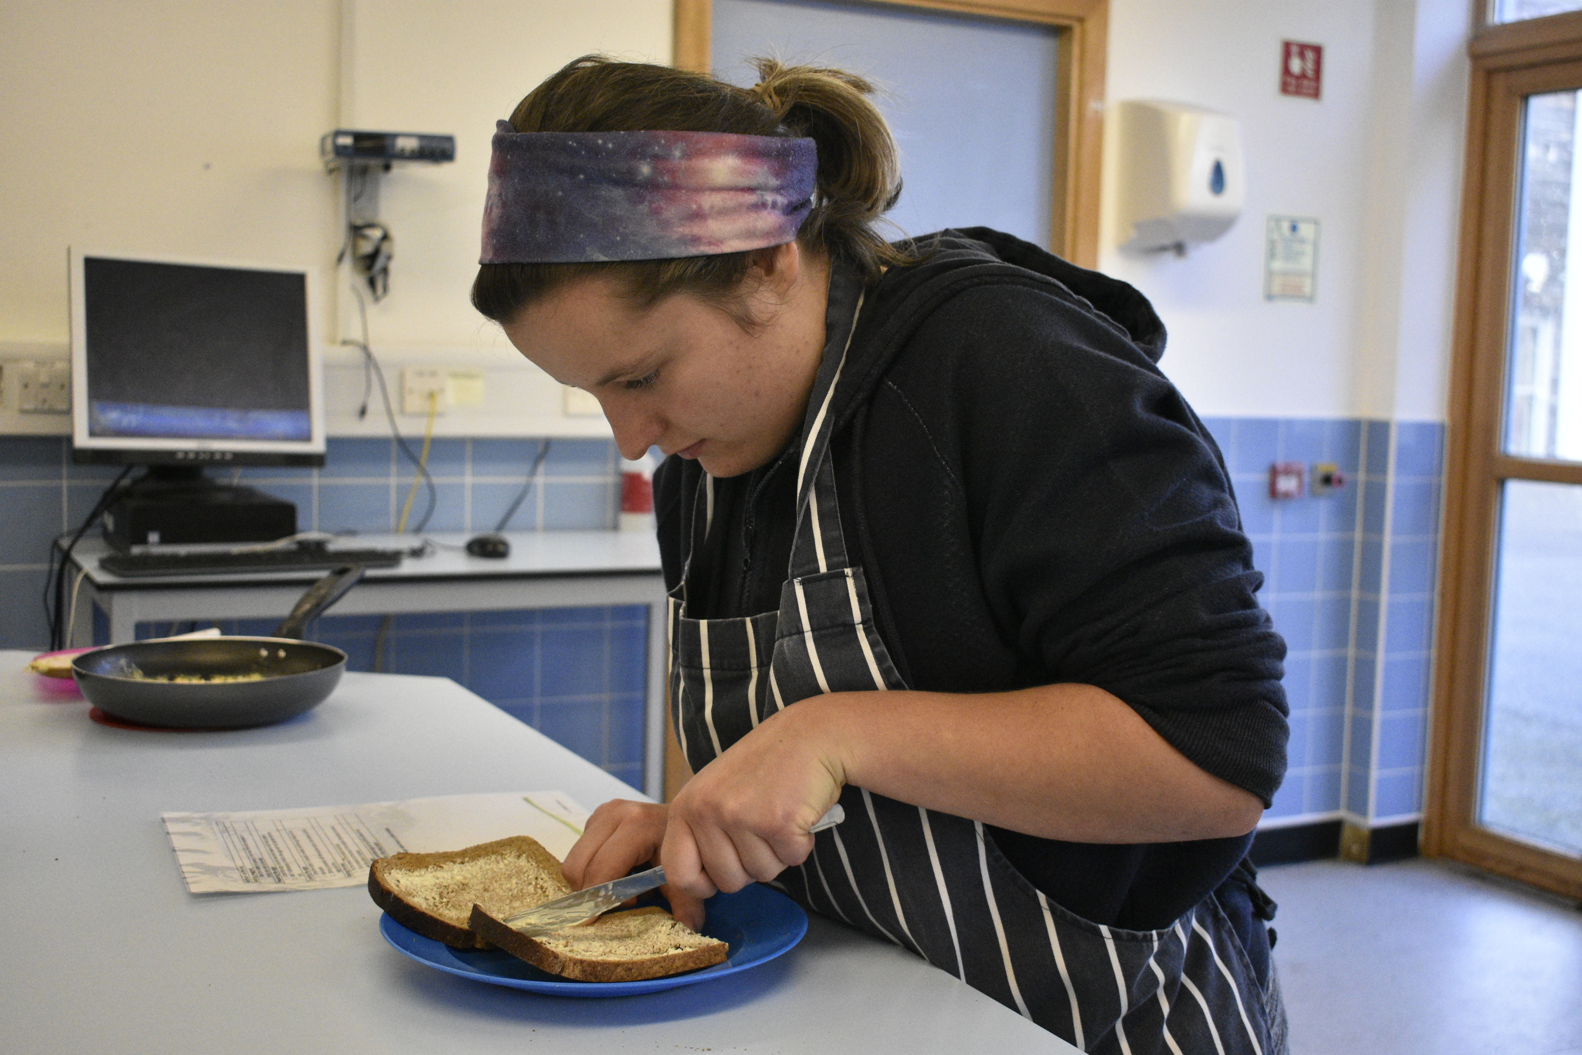
Supporting teachers of pupils with additional needs
Characteristics of good practice in teaching food and nutrition education to pupils with additional needs guide.
A mapping document highlighting Food – a fact life resources that support pupils with lower levels of numeracy and literacy.
Resources to provide a framework and structure for teaching around the key themes of Healthy eating, Cooking and Where food comes from.
Resources to support developing skills for independent living*.
Teacher training – webinar recordings available.
*resources created with the support of the Sodexo Stop Hunger Foundation

Slide 3
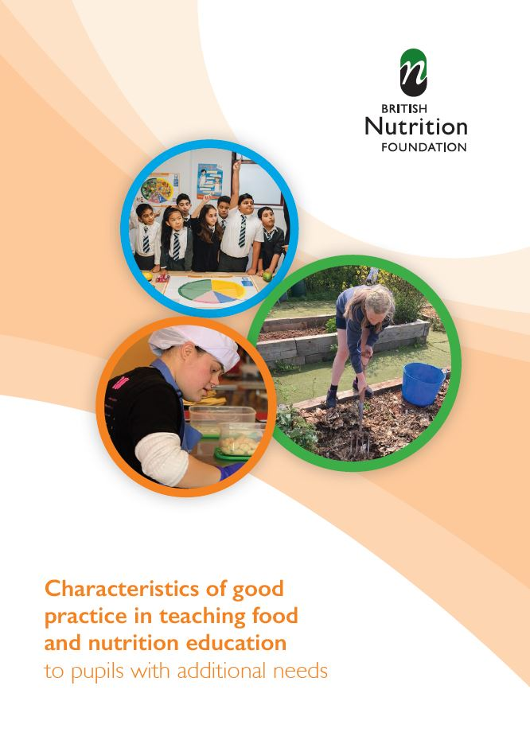
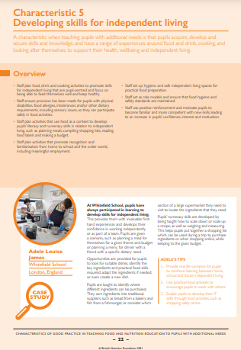
Characteristics of good practice in teaching food and nutrition education to pupils with additional needs
Defines the key characteristics of good practice that are specific to teaching food and nutrition to pupils with additional needs.
• Exemplifies these characteristics of good practice in UK schools, both special and mainstream.
Includes Developing skills for independent living and skills for work.
The British Nutrition Foundation would like to gratefully acknowledge the financial support provided by the Savoy Educational Trust for the production of this Guide.
Guide and supporting resources

Slide 4
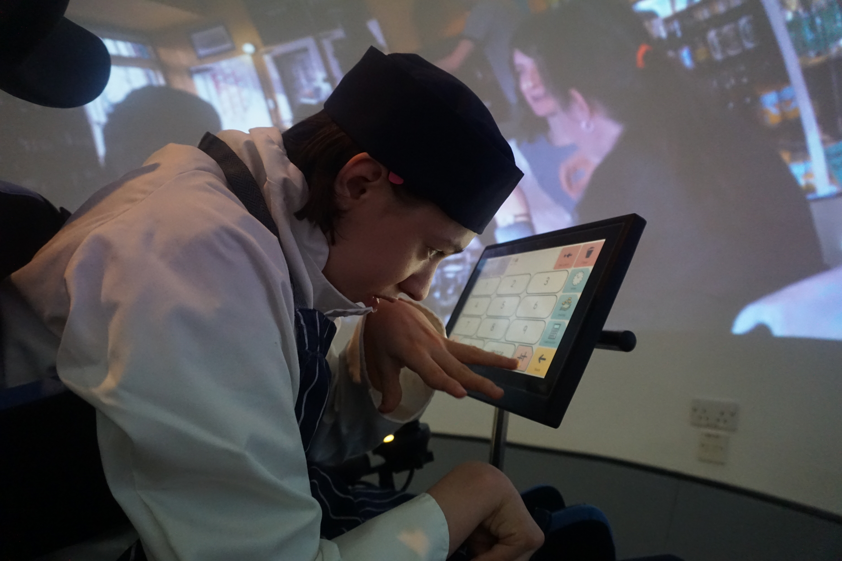
Developing skills for independent living
Pupils should be enabled to acquire, develop and secure skills and knowledge, and have a range of experiences around food and drink, cooking, and looking after themselves, to support their health, wellbeing and independent living.
Where appropriate, they should develop skills around:
Planning what to buy and eat.
Making choices and using information.
Following recipes.
Using practical food skills.
Food hygiene and safety.
Working with others/social situations.
Using and communicating with IT.

Slide 5
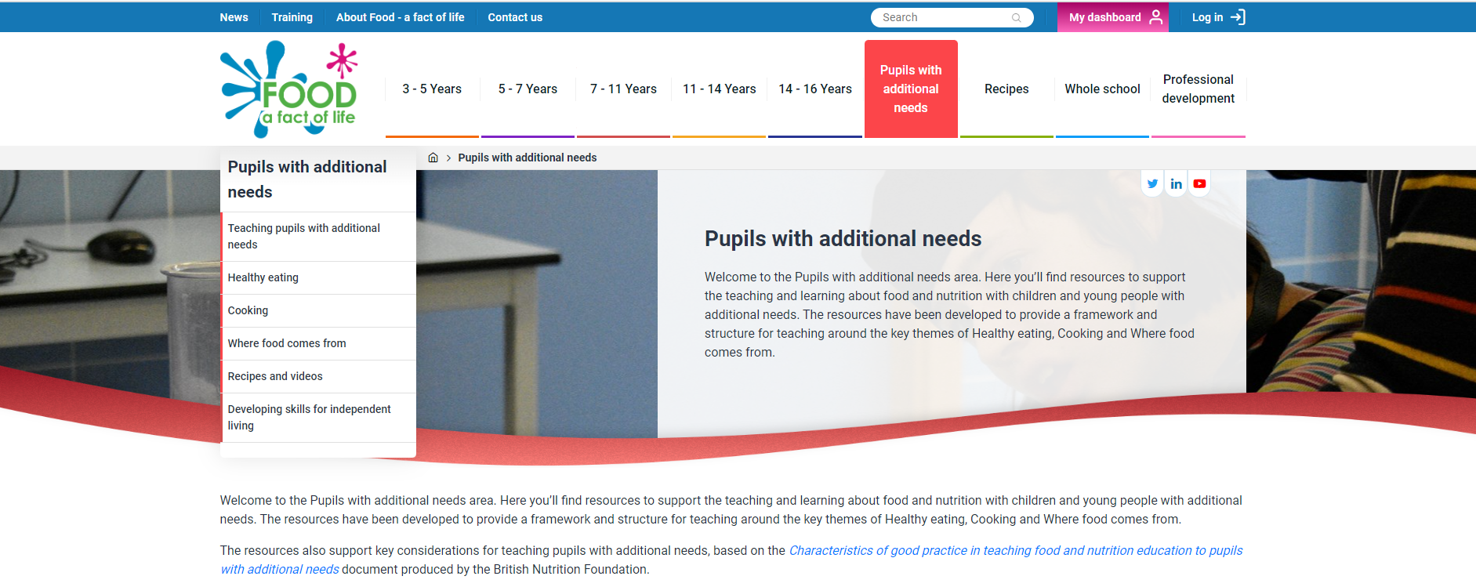
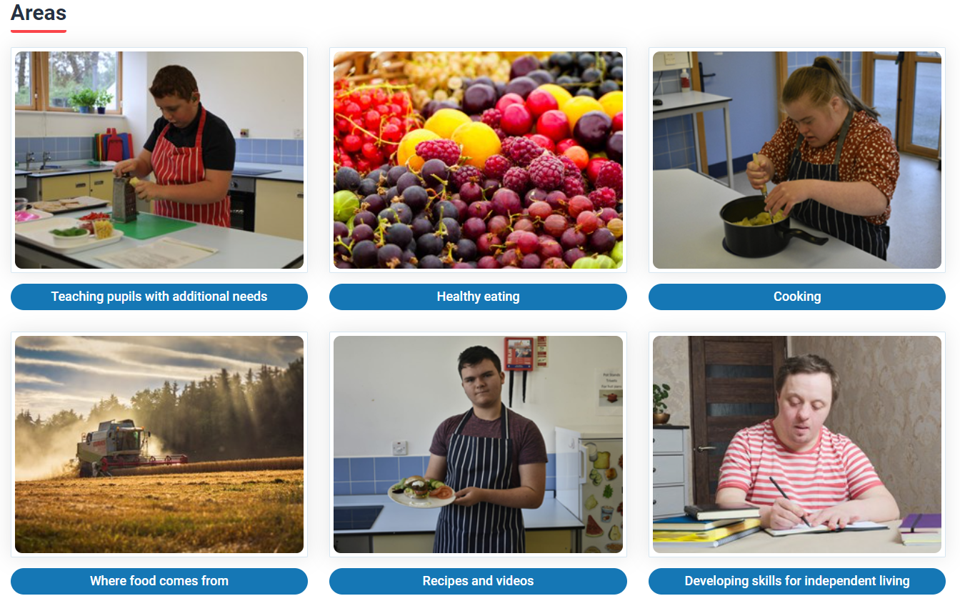
New dedicated area on Food – a fact of life
Pupils with additional needs

Slide 6
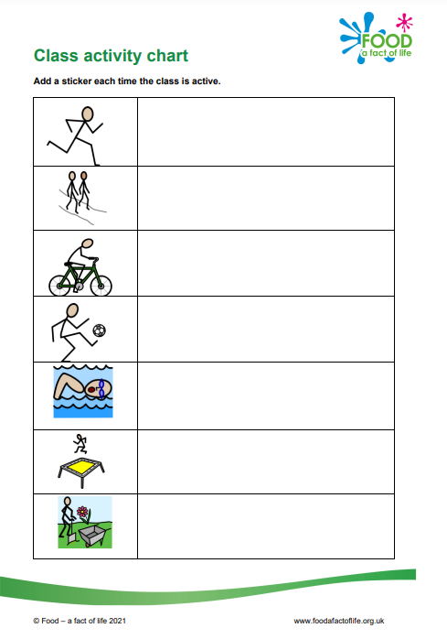
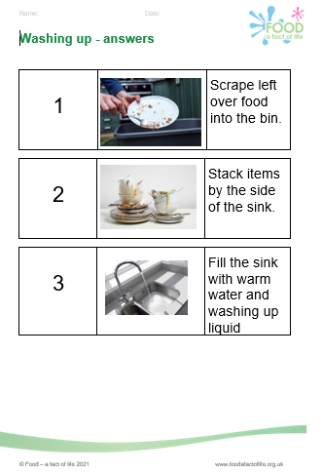
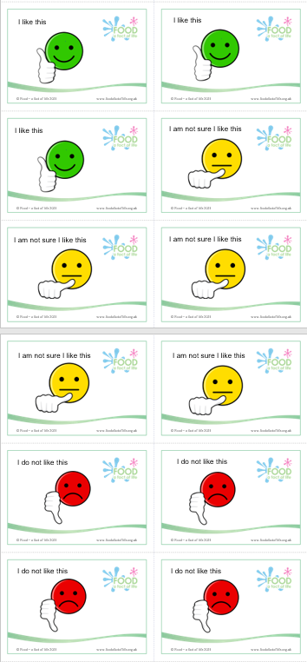
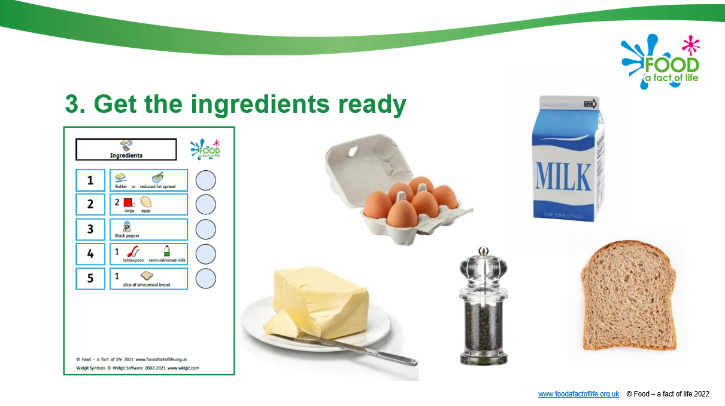
Food – a fact of life resources
The resources for pupils with additional needs cover nine key areas:
Food and drink for life
Variety (eat well)
Being active
Choice, preference and occasions
Cooking (including food hygiene and safety)
Serving and sharing
Food origins
Food is produced and processed
Shopping
Plus Peer-to-peer recipe videos and adapted recipes
*resources created with the support of the Sodexo Stop Hunger Foundation

Slide 7
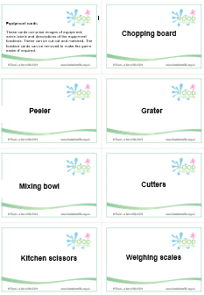
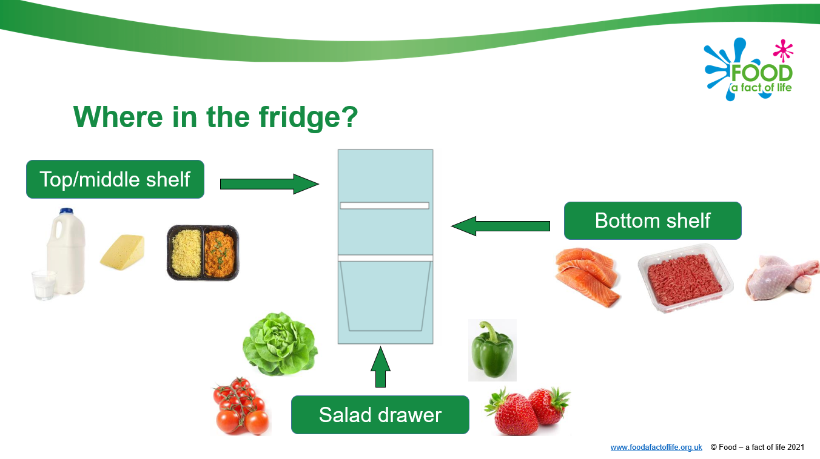
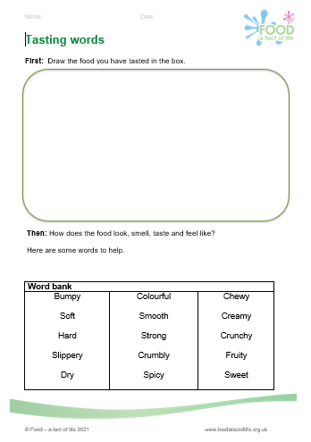
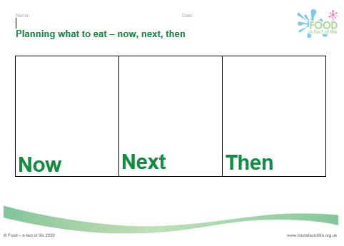
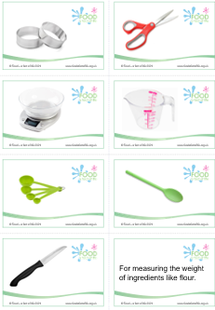
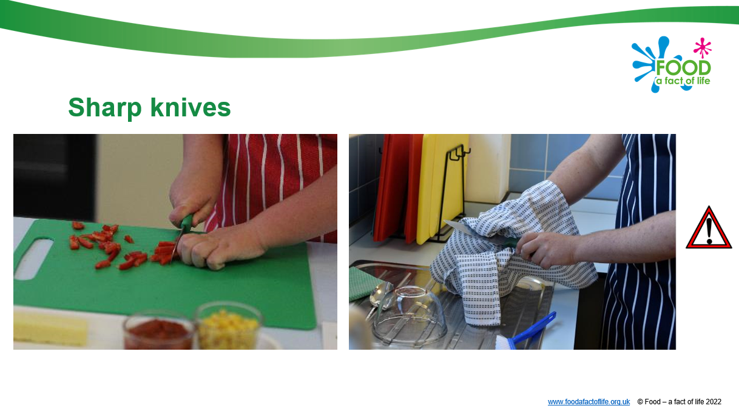
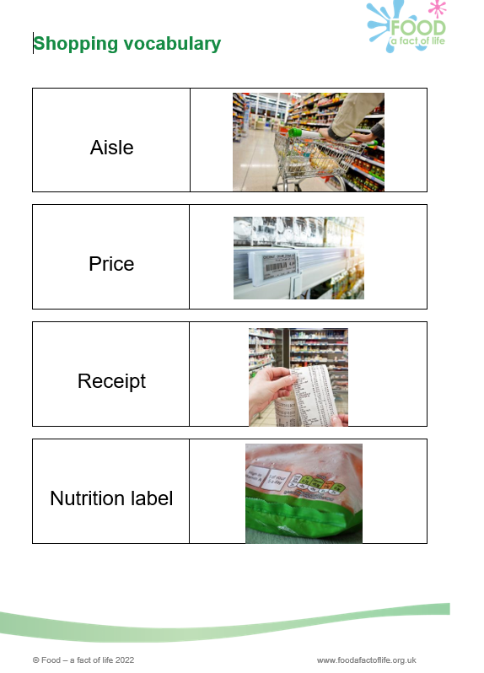
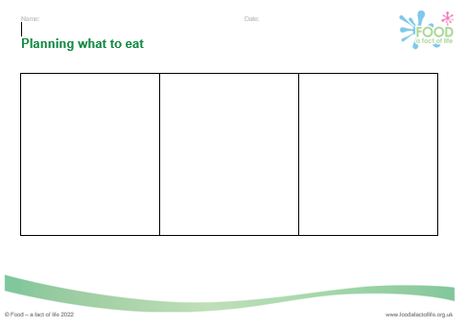
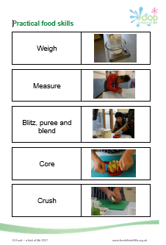
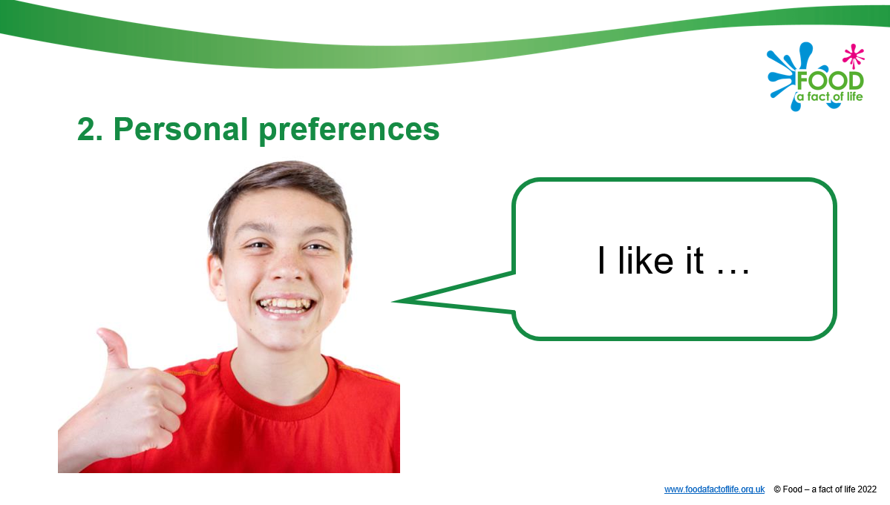

Slide 8
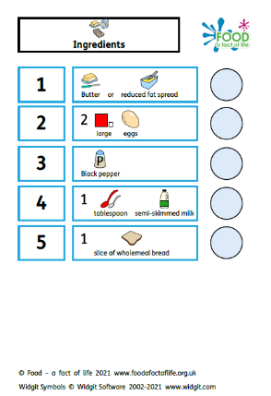
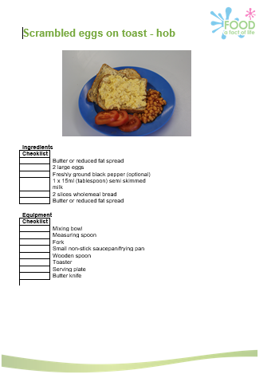
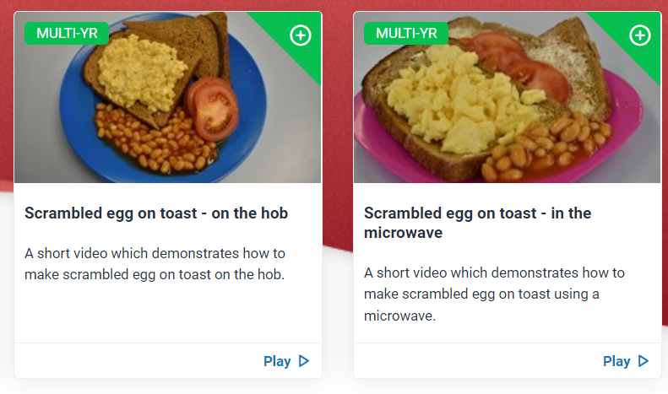
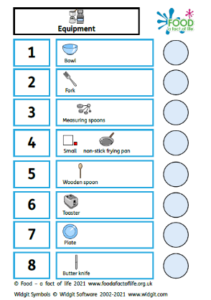
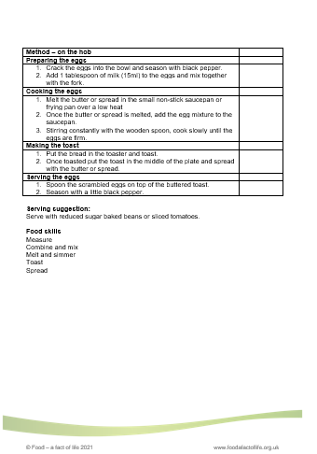
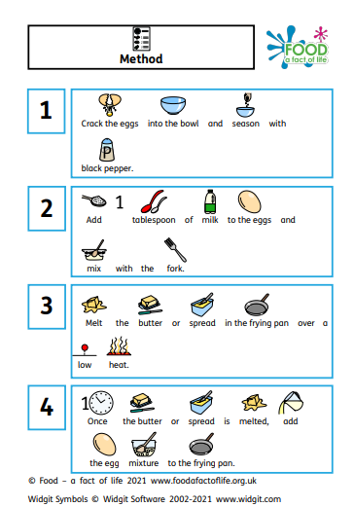
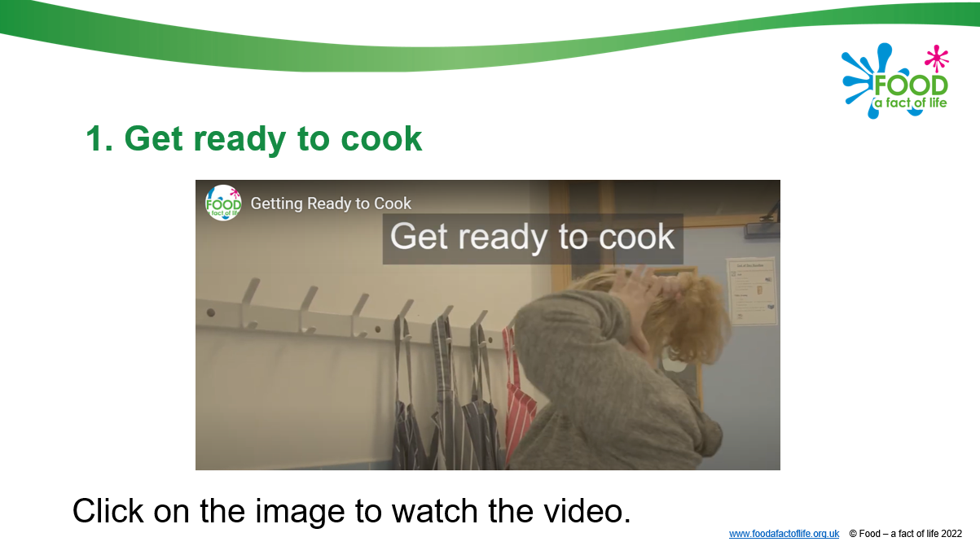

Slide 9
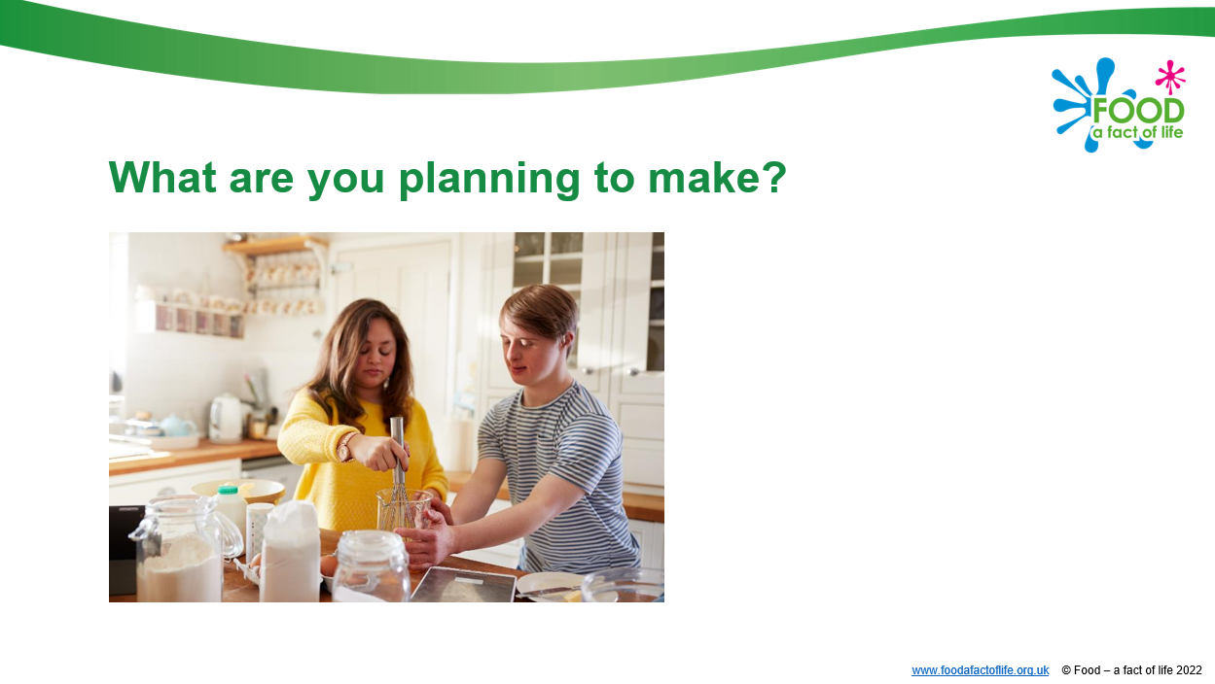
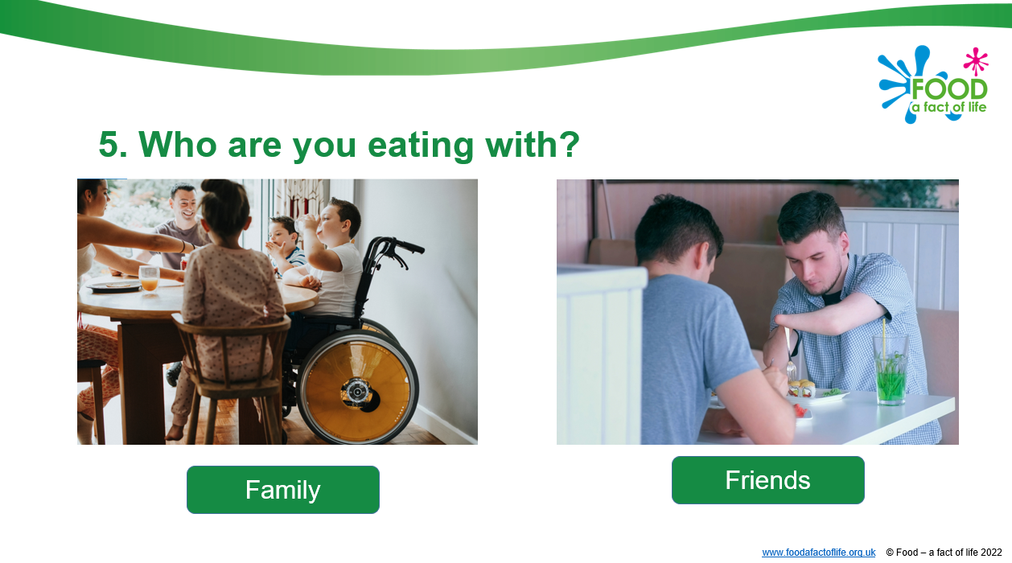
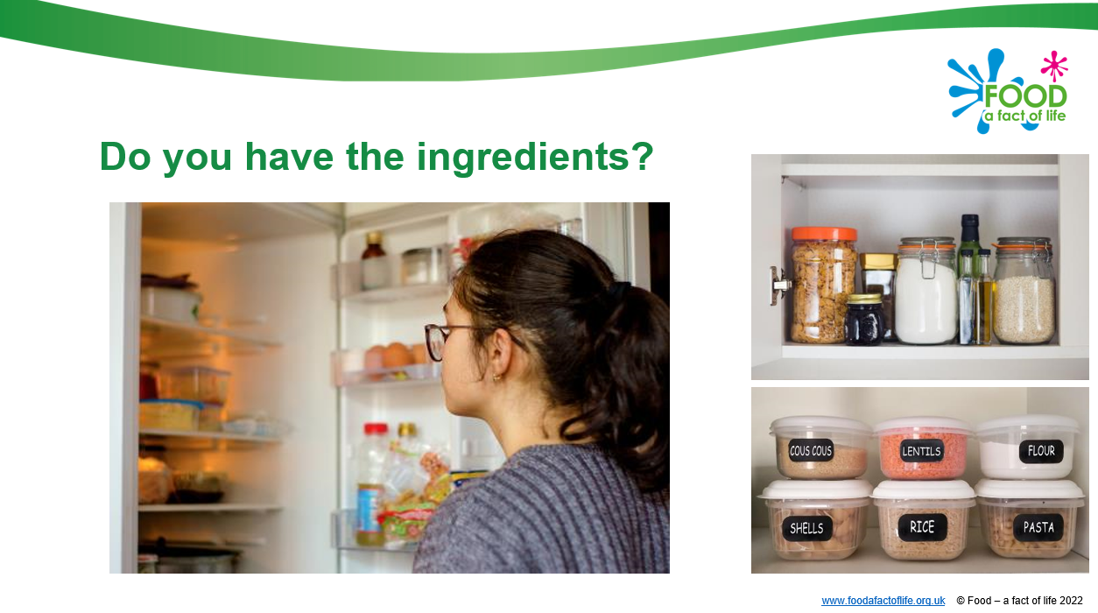
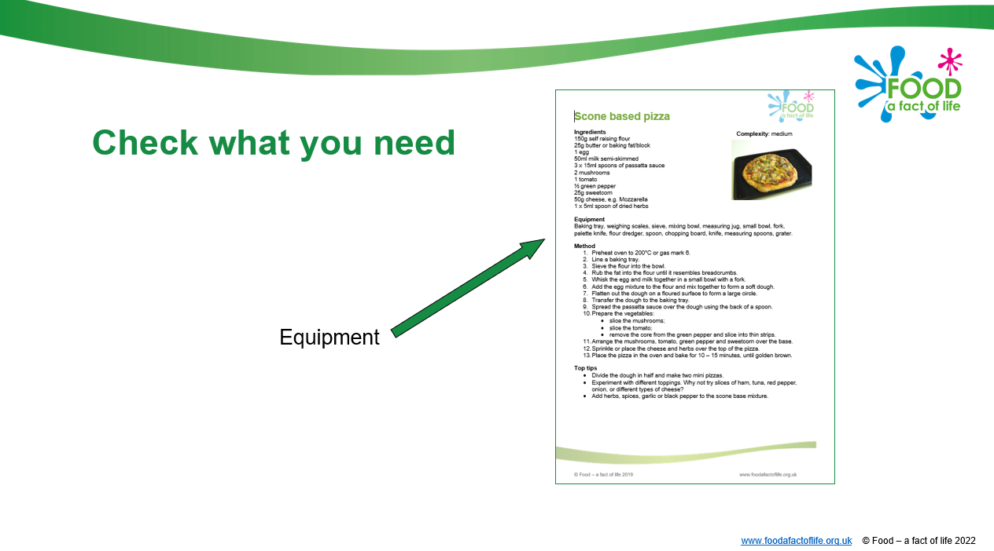

Developing skills for independent living
Planning what to eat
Teachers guide with suggested activities and questions to ask.
Social story - planning what to eat, getting inspiration for what to cook and writing a shopping list.
Supporting resources.

Slide 10
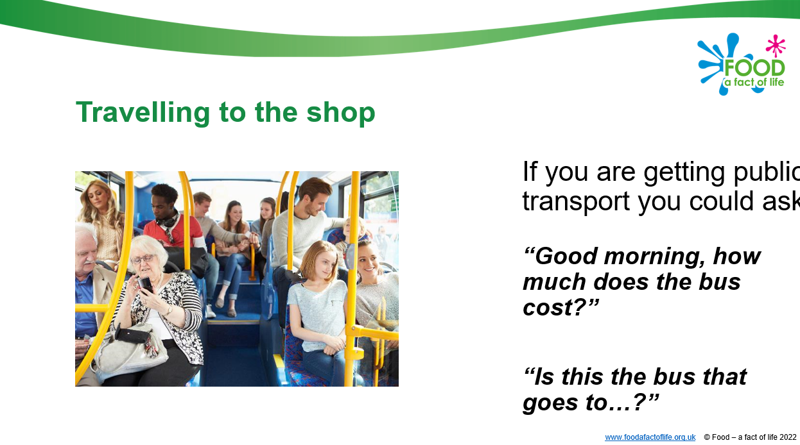
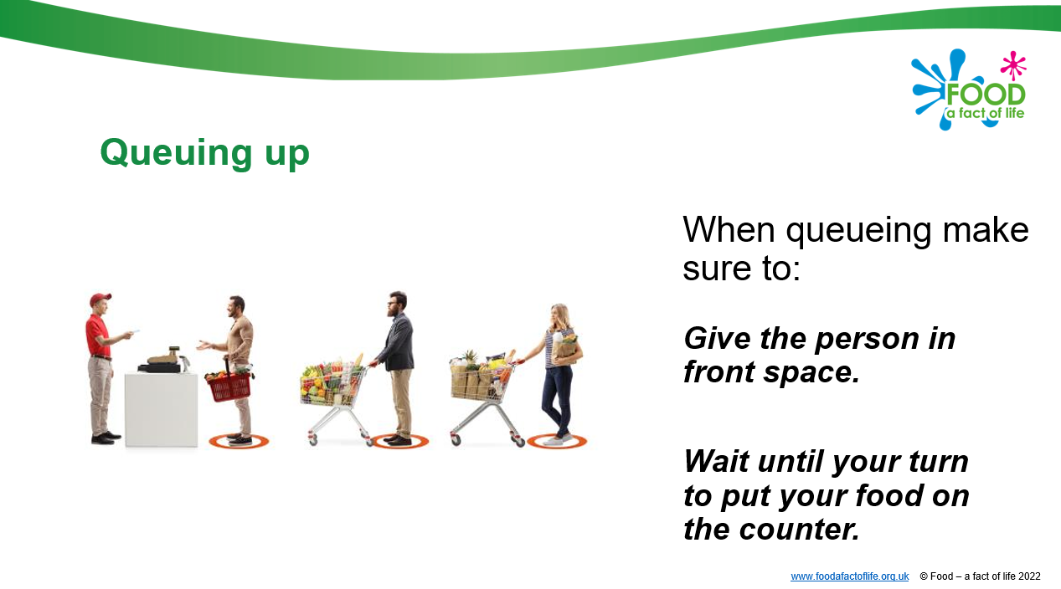
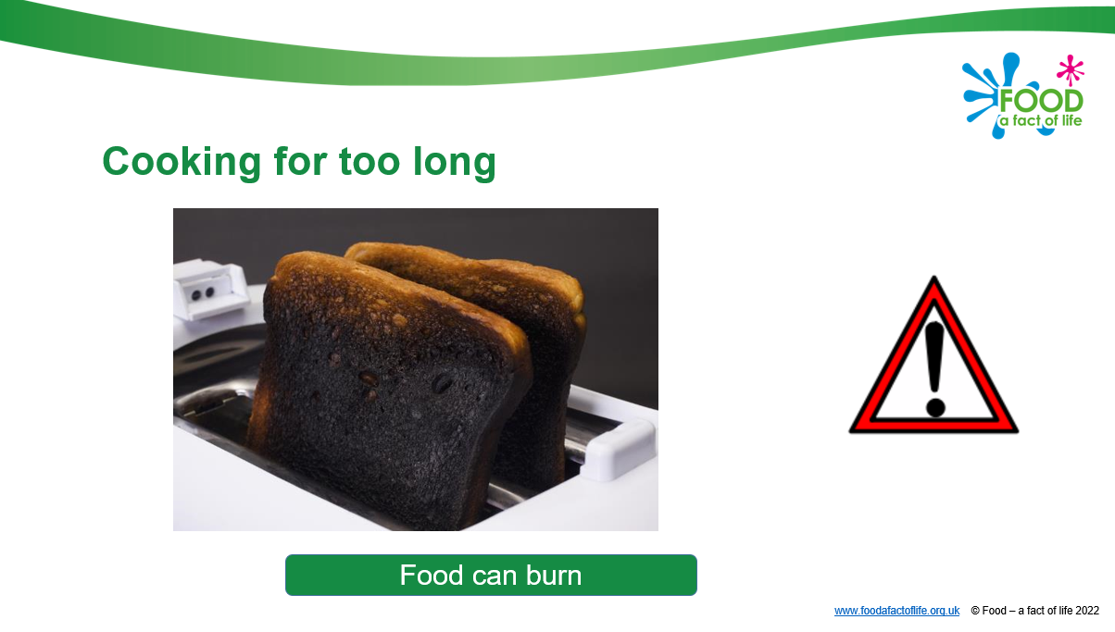
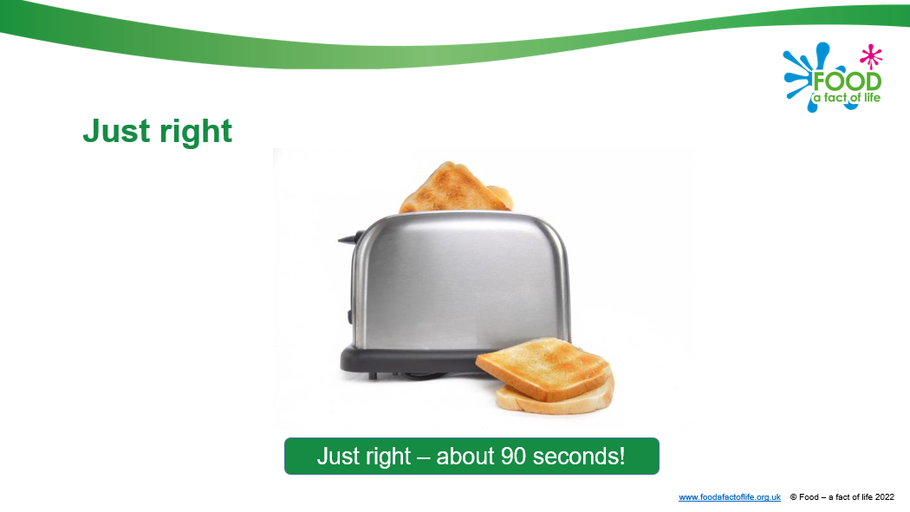
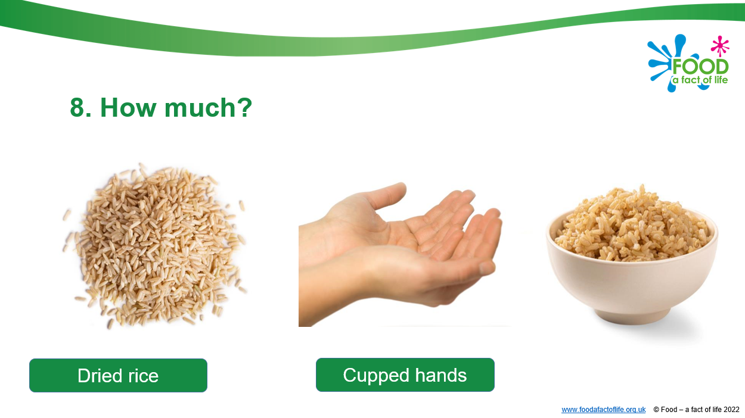
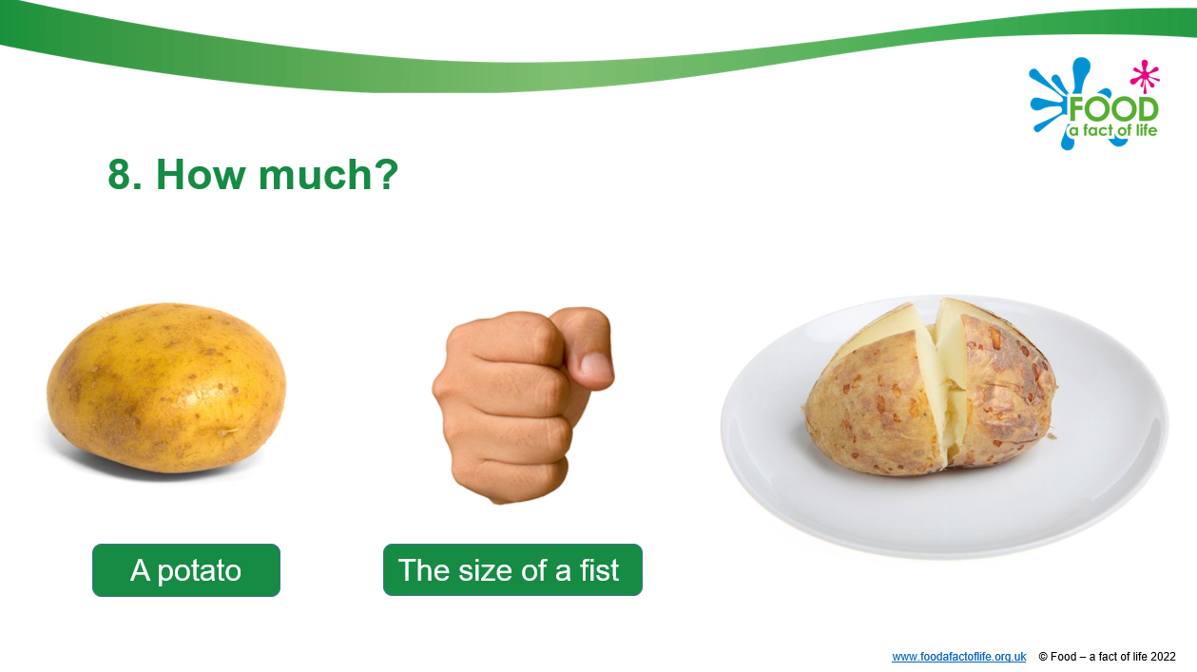
Developing skills for independent living
Going shopping
Cooking
Eating and sharing

Slide 11
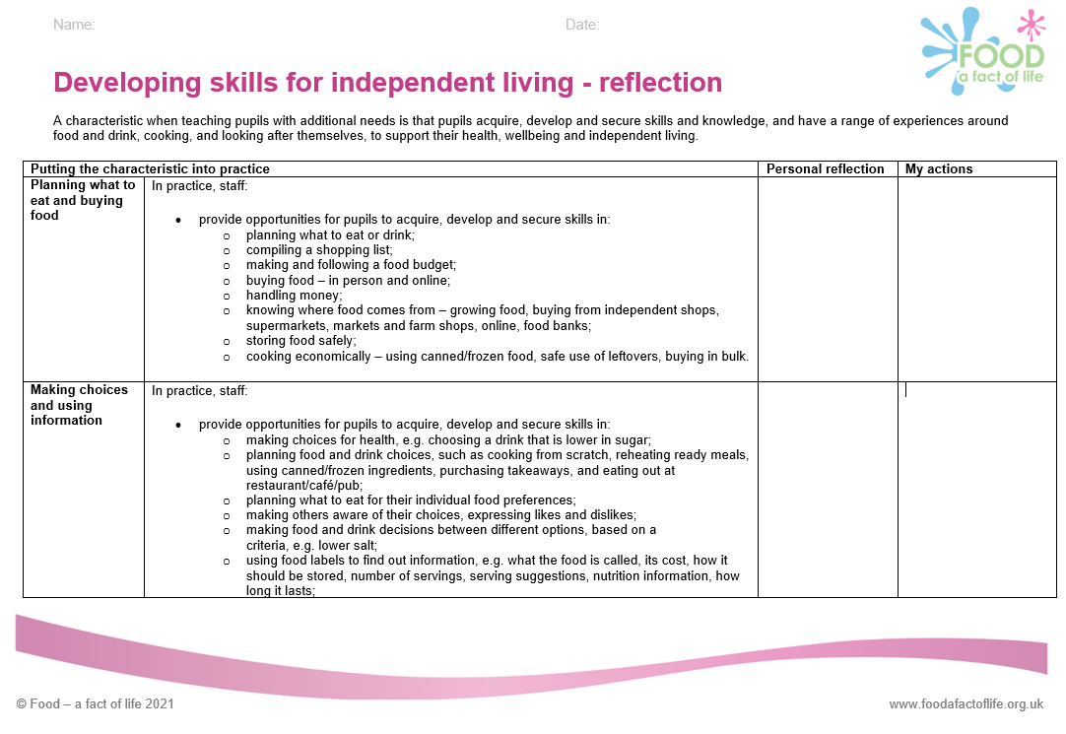
Support for your professional development
Reflection documents
Help develop reflective practice.
Ideal for staff at all career stages.
Provide an opportunity to reflect on personal practice and identify future actions.
There are also resources to support needs analysis and planning your own professional journey based on the Teaching food in primary/secondary schools: A framework of knowledge and skills.
Reflection documents

Slide 12
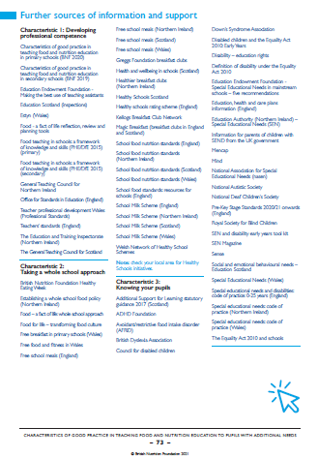
Sources of support and further information
Three pages of websites and useful information/ documents can be found at the end of the Characteristics of good practice in teaching food and nutrition to pupils with additional needs guide.

Slide 13
Developing skills for independent living: Food and drink
For further information, go to:
www.foodafactoflife.org.uk
The British Nutrition Foundation gratefully acknowledges the support from the Sodexo Stop Hunger Foundation which has enabled us to develop and produce resources around Developing skills for independent living, as well as host training events for teachers.

