Slide 1
Grow the seasons
A Where food comes from Challenge for pupils aged 5-7 years

Slide 2
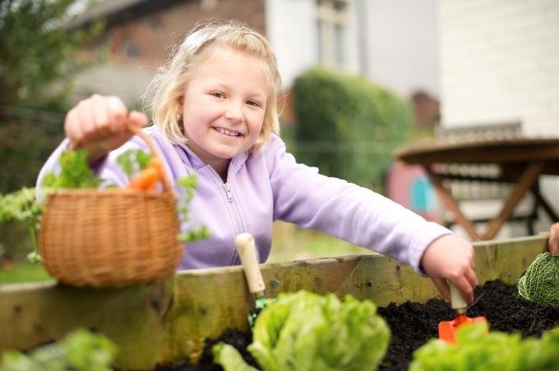
The challenge
Plan a growing area in your school grounds or classroom.
Grow and harvest your own seasonal ingredients.

Slide 3
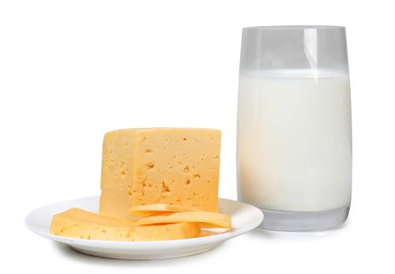
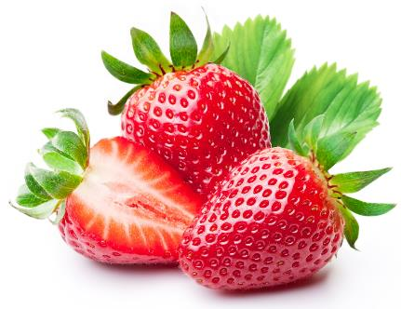
Let’s get started – the Challenge is on!
Food comes from plants or animals.
Name two foods that come from animals.
Name two foods that come from plants.

Slide 4
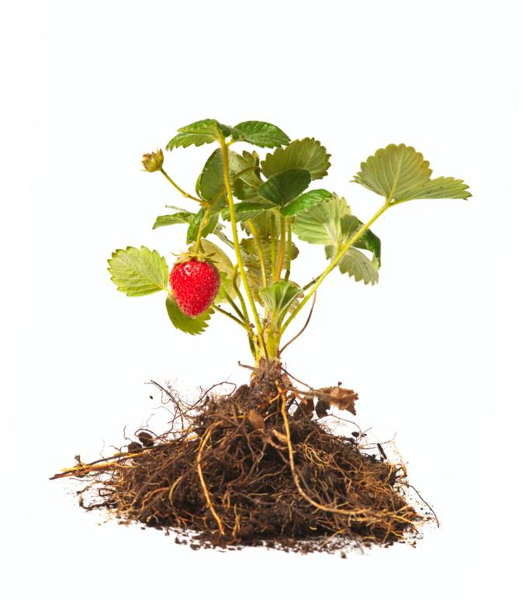
Food from plants
Lots of our food comes from plants.
What are the main parts of this plant?
Did you name the:
root;
stem;
flower;
leaf;
fruit?

Slide 5
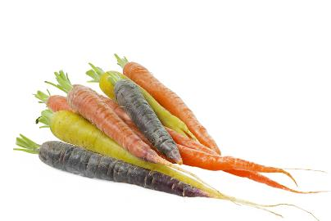
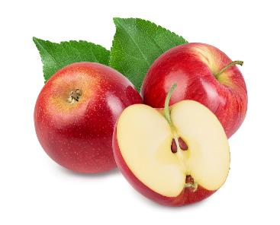
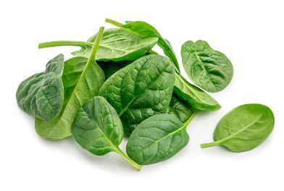
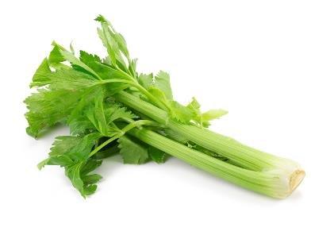
Did you know?
We eat different parts of plants.
Sometimes we just eat the root.
We can eat the fruit of lots of plants.
Stems and leaves taste good too!
Name two more examples of roots that we eat.

Slide 6
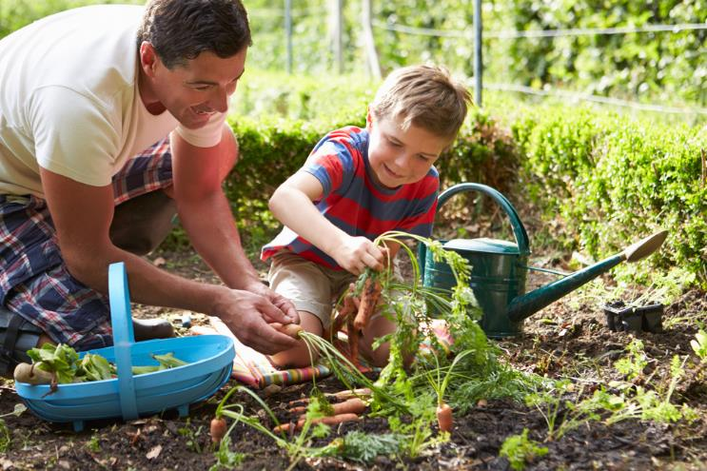
What do plants need to grow?
What can you see in this picture?
Plants need the right conditions to help them grow. Plants need:
soil to grow in;
water;
sunlight.

Slide 7
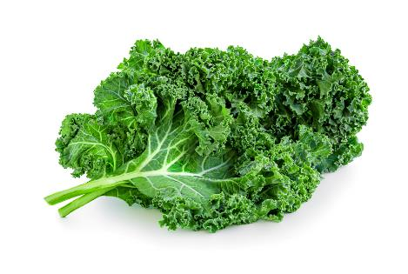
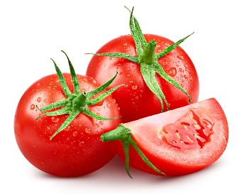
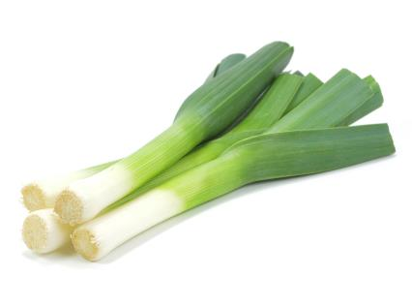
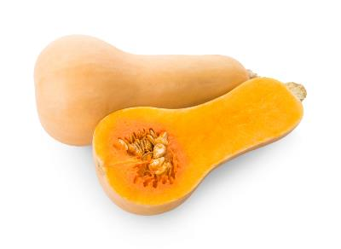
Did you know?
Spring
Summer
There are four seasons in a year - spring, summer, autumn and winter.
Different fruit and vegetables are ready to eat in different seasons.
It is good to try and eat fruit and vegetables when they are in season because they are usually:
at their best;
cheaper, as there are plenty available.
Autumn
Winter

Slide 8
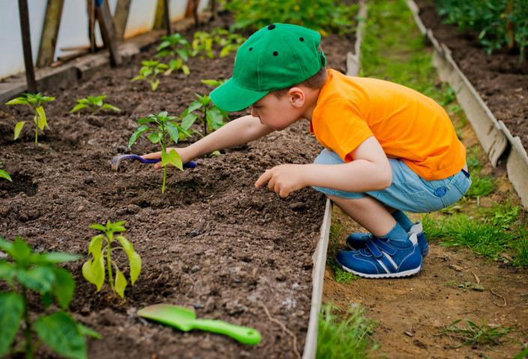
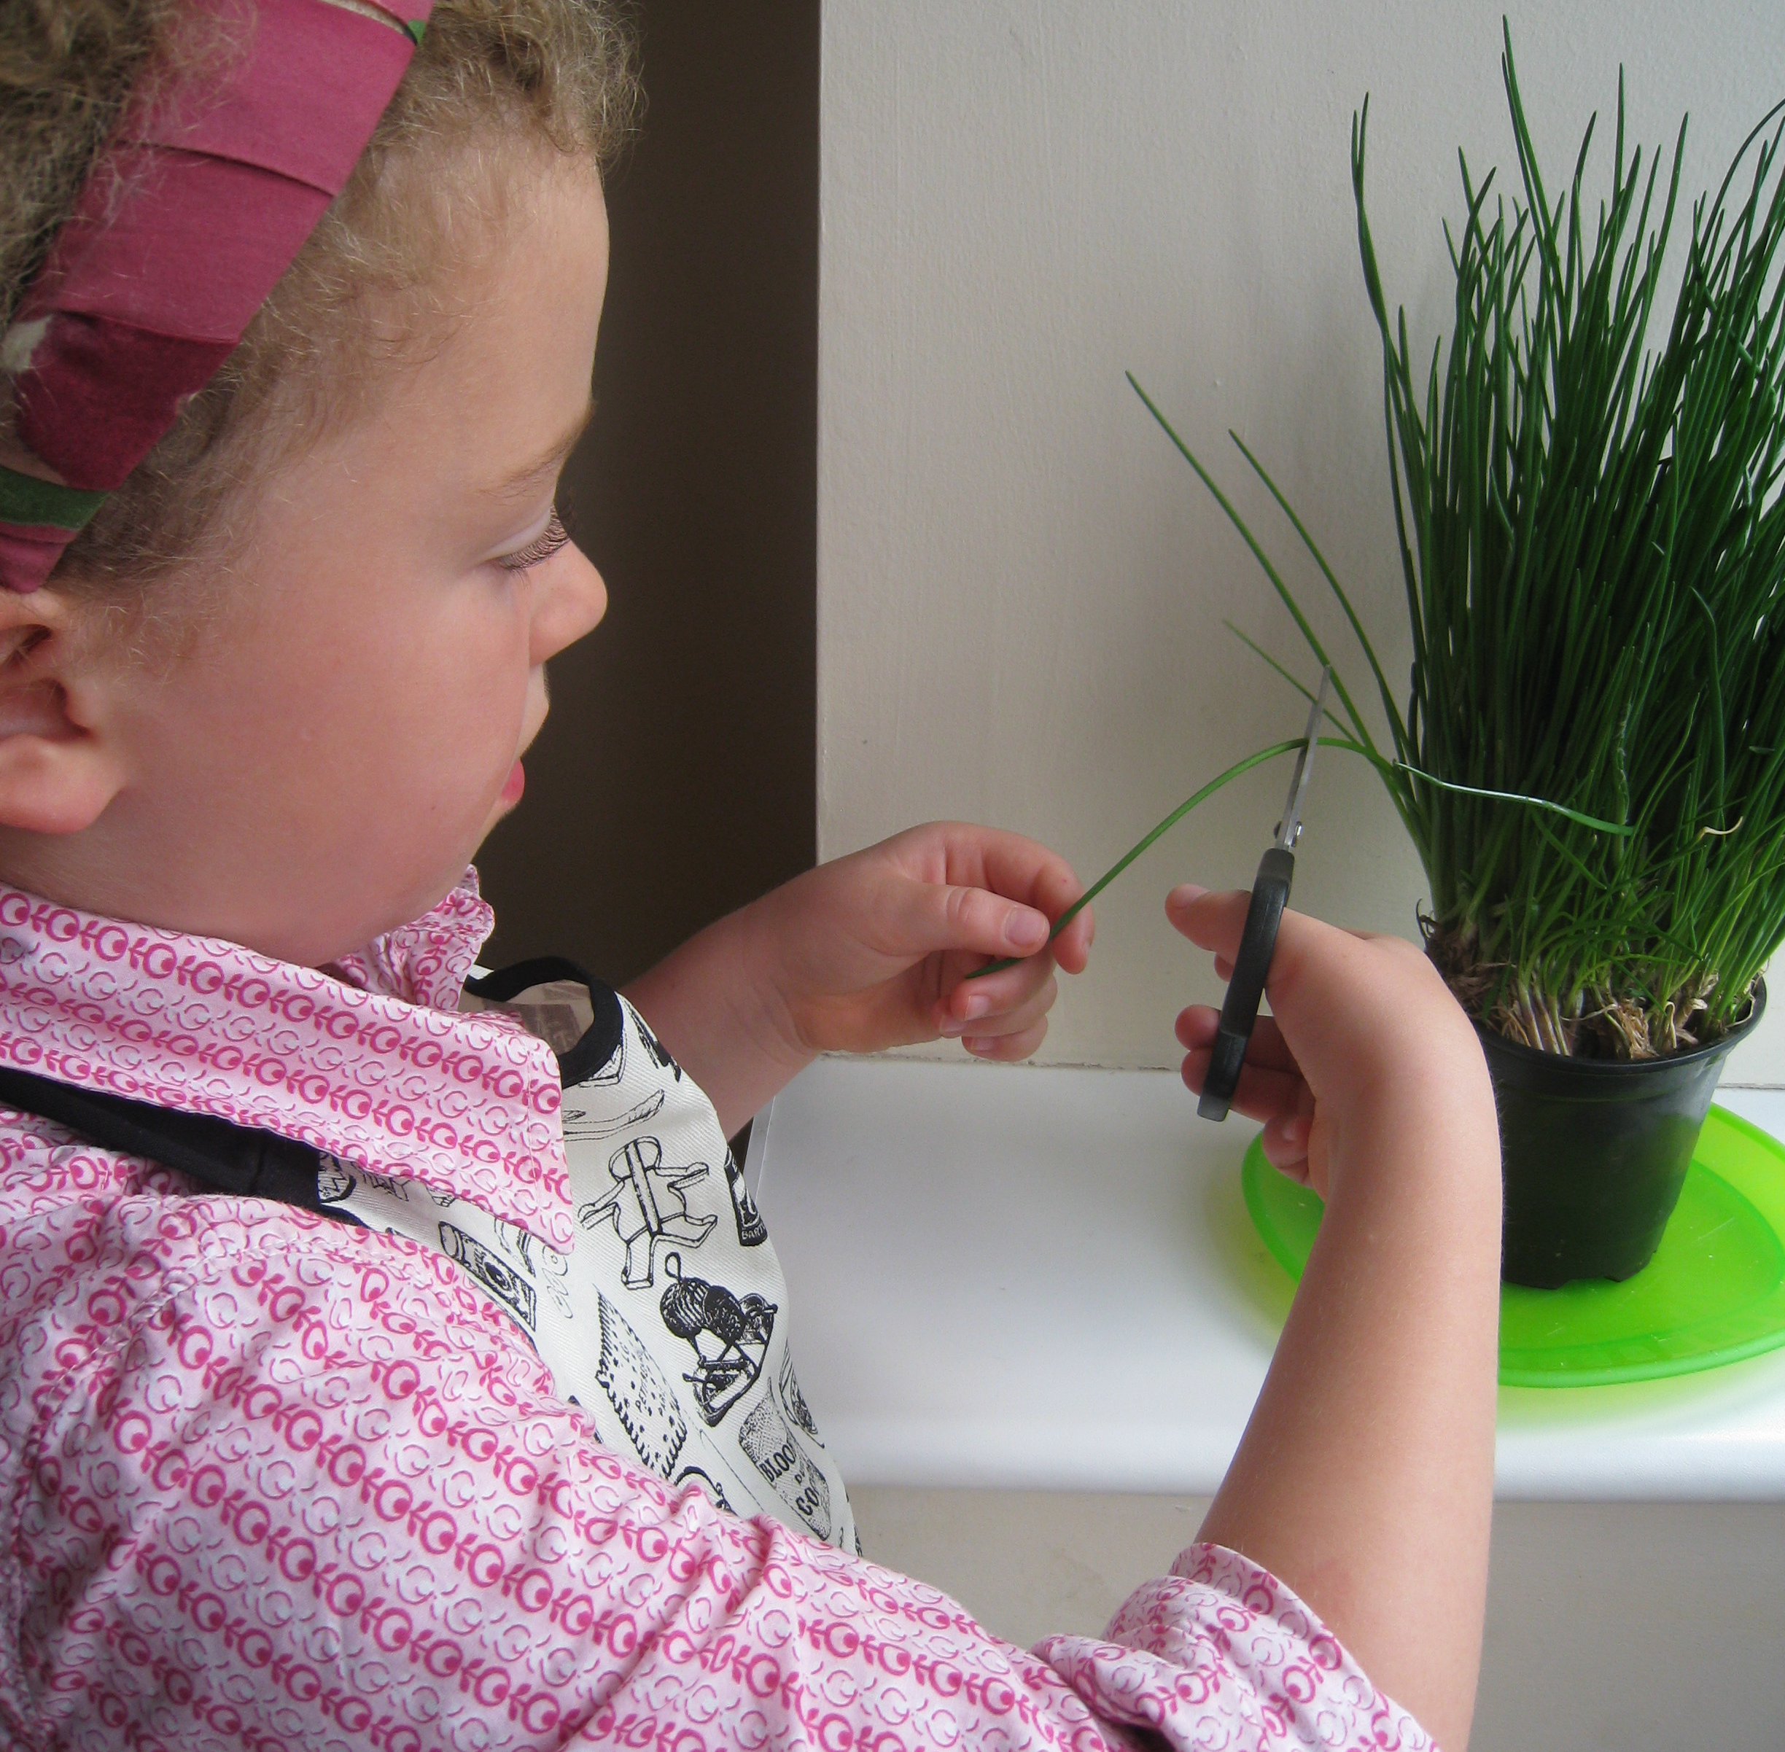
Where can plants be grown?
Plants can grow in different places:
in pots and containers inside and outside;
in greenhouses;
in the ground or in growing bags;
in raised containers and boxes;
in a vegetable garden or an orchard;
on an allotment;
on a farm.
Where else can plants be grown?

Slide 9
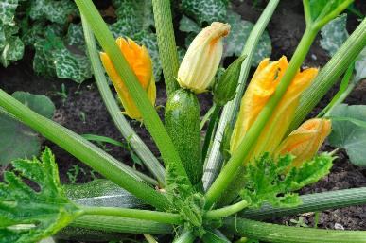
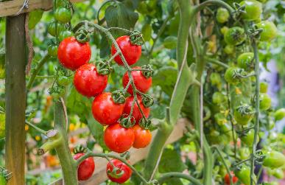
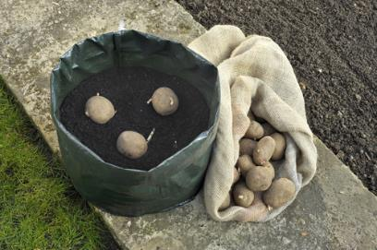
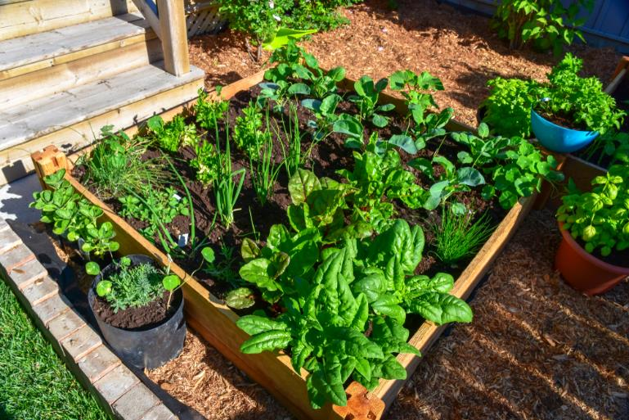
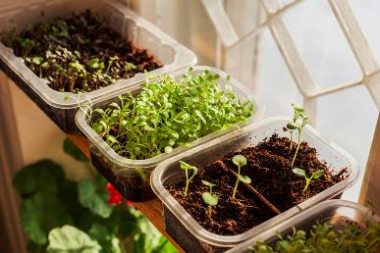
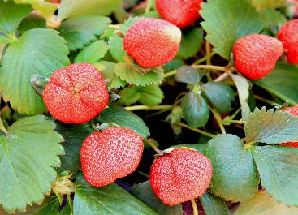
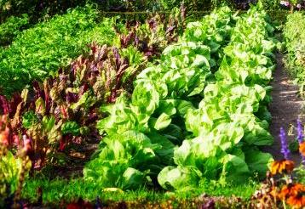
What could you grow?
Here are some ideas of what you could grow.
Courgettes
Tomatoes
Potatoes
Herbs
Find out when these can be planted and when they are ready to eat.
Cress
Strawberries
Lettuce

Slide 10
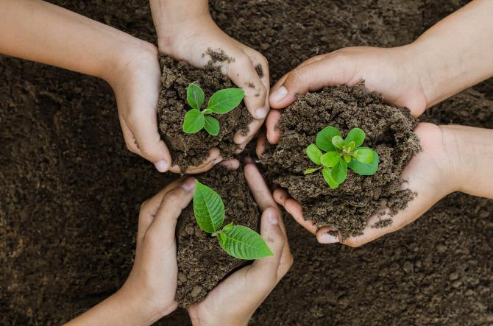
Planning
Where will your growing area be in school?
What do you need for your growing area?
Who will help look after the growing area?
In which season will you start planting?
What will you grow?

Slide 11

Planning
Talk to your teacher about your growing area.
Work out a plan to grow your ingredients.
Plan how you will take care of your plants.

Slide 12
The challenge
Plan a growing area in your school grounds or classroom.
Grow and harvest your own seasonal ingredients.
Good luck!

Slide 13
Teachers’ guide

Slide 14
The Food – a fact of life Challenges
The Food – a fact of life Challenge activities have been written to support teachers not following the national curriculum for their specific country or those following a challenge or theme-based approach. However, they could be used in any school across the UK.
The Challenges cover Healthy eating, Cooking and Where food comes from and provide a wide range of activities that teachers can select depending on their pupils’ needs, age and abilities, and the time available.
There are 12 Challenges developed to be used with nursery, primary or secondary pupils.
Each Challenge comprises the Challenge, opportunities for learning and a variety of pupil activities that can be completed individually or in groups. Each Challenge culminates in a final outcome, which could be paper based, such as a report, poster, newspaper article or presentation, video, interactive activity, recipe, dish/range of dishes or menu depending on the theme of the Challenge.
An optional pupil certificate is available to download and personalise once the Challenge has been achieved.

Slide 15
The Challenge
Plan a growing area in your school grounds or classroom.
Grow and harvest your own seasonal ingredients.

Slide 16
Opportunities for learning
By undertaking this challenge, the opportunities for learning include:
investigating food origins, plant and animal food sources;
investigating how food is grown and harvested;
seasonality of food;
how food can be grown and the conditions required;
planning and setting up a growing area in school.

Slide 17
How can pupils complete the Challenge?
A range of activity suggestions have been provided – you choose the ones that are most suitable for your pupils and the time that you have available to complete the challenge.
Activities include:
Finding out – investigating plant and animal sources of food, investigating how food can be grown on farms, allotments and in gardens, linking growing food to the seasons, planning what is needed to create a growing area (from windowsill to a playground garden), how to look after and harvest plants.
Making and evaluating – applying knowledge to successfully grow their chosen ingredients, activities that use their produce to make a dish, demonstrating a range of food skills, using sensory evaluation.
Bringing it all together – planning and creating an area in school to grow and harvest food.

Slide 18
Teacher resources
Although these support resources are based on planning and setting up a growing club, they could be used effectively to support this challenge.
A guide to growing clubs
Growing club case study 1
Growing club case study 2
Growing club visioning exercise
Growing club action plan flow chart
Growing club tools and resources list
This webinar – Using school gardens to explore where food comes from – provides ideas and inspiration. Also available in presentation format.

Slide 19
Finding out - activities
Pupils, individually or in groups, could:
use the Food cards to identify if a food comes from a plant or animal.
Use the Where food comes from cards to match foods to their plant or animal origin.
complete the Plant and animal sheet using the use the Plant or animal pictures.
watch a video looking at growing on a large scale – From wheat to bread or a presentation Growing strawberries.
find out more about seasonal food using the Season cards.

Slide 20
Finding out - activities
watch one of these videos about where food comes from. Write or draw a story which show other children how the food is produced.
complete the Plant or animal interactive resource and match the 10 foods to whether they are from a plant or animal.
use the Where food comes from knowledge organiser to consolidate learning and develop subject specific vocabulary/terminology.
use the Bucket Garden story and resources to introduce growing and to support cross-curricular/ inter-disciplinary learning.

Slide 21
Making and evaluating - activities
Pupils, individually or in groups, could:
talk about what has to happen before some food or ingredients can be eaten. Show a selection of food, or use the Food photo cards. Discuss what must be done with some food and what can be optional, e.g. washing, peeling, cooking, eating raw.
look at some of recipe videos and talk about how the ingredients are prepared in order to make the different dishes.
make a Food – a fact of life recipe using the ingredients they have grown.
carry out a tasting session to encourage the children to taste and evaluate their dishes. Use the Sensory vocabulary cards to provide a set of descriptive words.
Tasting guide and ingredient check letter for teacher guidance.

Slide 22
Bringing it all together
Pupils should:
Plan a growing area in your school grounds or classroom. Grow and harvest your own seasonal ingredients.
The planning and growing of their ingredients should demonstrate their knowledge and skill development of:
food origins, plant and animal sources;
how food can be grown and the conditions required;
planning, growing and harvesting their own ingredients.

Slide 23
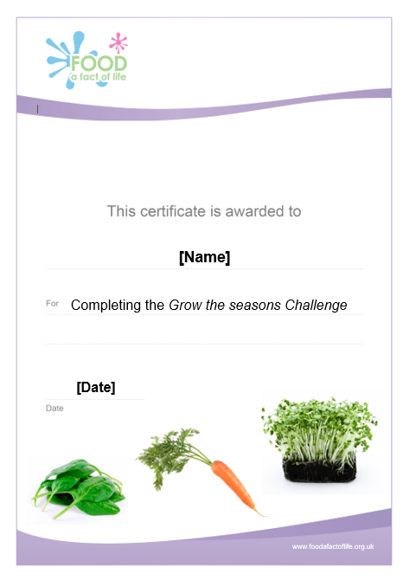
Celebrate!
An optional pupil certificate is available to download and personalise once the Challenge has been achieved.
Why not present the certificate at a celebration assembly?

Slide 24
Grow the seasons
For further information, go to:
www.foodafactoflife.org.uk
This resource meets the Guidelines for producers and users of school education resources about food.

