Slide 1
Hygiene

Slide 2
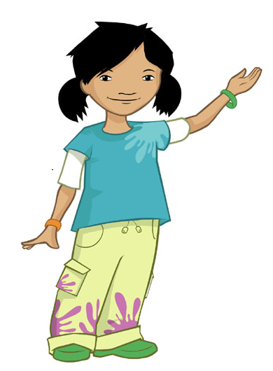
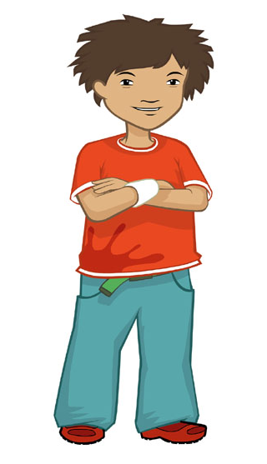
What must we do before we cook?

Slide 3
What must you do with your hair?
I need to tie my hair at the back of my head.
If you have long hair, you need to tie it back.

Slide 4
What must you do if you are wearing jewellery?
Me too!
I will need to take off my wrist band.
Remove any jewellery.

Slide 5
What must you do with long sleeves?
My sleeves are above my elbows, so they will be OK.
If you have long sleeves, you must roll them up.

Slide 6
What must you do with your hands?
If you are wearing nail varnish, take it off.
Wash your hands well with soap and warm water and dry them properly.
I do not wear nail varnish so that will save me a job!

Slide 7
What about your clothes?
Wearing an apron will help stop any lint, hair or dirt on my clothes getting into the food and also help keep my clothes clean.
You must wear an apron.

Slide 8
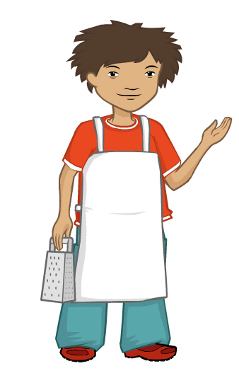
Can you remember what we must do before we cook?
How many steps can you remember?

Slide 9
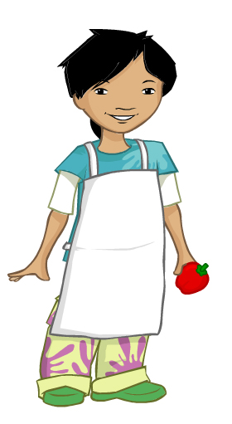
Did you remember all these steps?
Tie long hair at the back of your head.
Remove jewellery.
Remove nail varnish.
Roll up long sleeves.
Put on an apron.
Wash and dry hands.

Slide 10
Hygiene
For further information, go to:
www.foodafactoflife.org.uk
This resource meets the Guidelines for producers and users of school education resources about food.

