Slide 1
Food poisoning

Slide 2
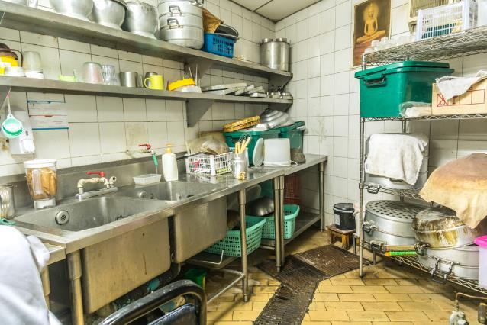
Food poisoning
There are thousands of cases of food poisoning each year, many of which are not reported or recorded in official statistics.
Food poisoning may result from poor domestic food preparation, or poor food processing in industry including restaurants, cafes and take-away food.

Slide 3
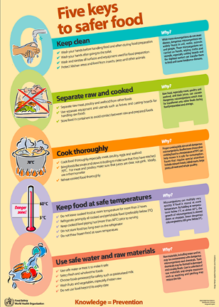
Food poisoning
Food safety is not just a UK problem, the World Health Organisation estimates that approximately 600 million, almost 1 in 10 people in the world, fall ill after eating contaminated food and 420 000 die every year, resulting in the loss of 33 million healthy life years.
Therefore, it is essential that all food handlers, whether they are cooking and serving food for consumers to purchase or cooking for themselves or their families at home, take the steps necessary to reduce the risk of food poisoning.
World Health Organisation
Five keys to safer food

Slide 4

Symptoms of food poisoning
The symptoms of food poisoning include:
nausea;
vomiting;
stomach pains;
diarrhoea.

Slide 5


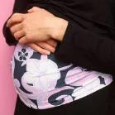
People at high risk
Elderly people, babies and anyone who is ill or pregnant needs to be extra careful about the food they eat.
For example, pregnant women or anyone with low resistance to infection should avoid high risk foods such as unpasteurised soft cheese.

Slide 6
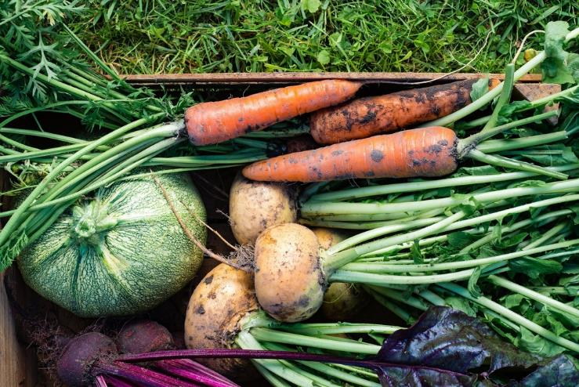
Food poisoning micro-organisms
Micro-organisms occur naturally in the environment, on cereals, vegetables, fruit, animals, people, water, soil and in the air.
Most bacteria are harmless, but a small number can cause illness.
Food which is contaminated with food poisoning micro-organisms can look, taste and smell normal.

Slide 7
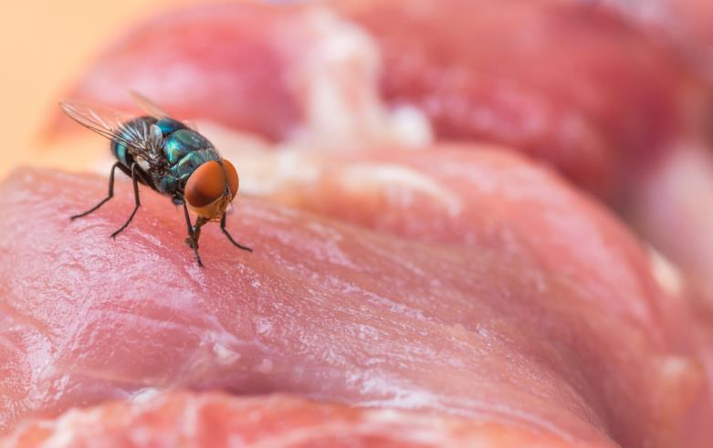
Food poisoning micro-organisms
Changes in food, either through enzyme deterioration of food or micro-organism growth, will eventually lead to the food becoming inedible or unsafe if eaten.
Contaminants may be already present in the food, e.g. salmonella in chicken or transferred to the food by humans, flies, rodents and other pests.

Slide 8
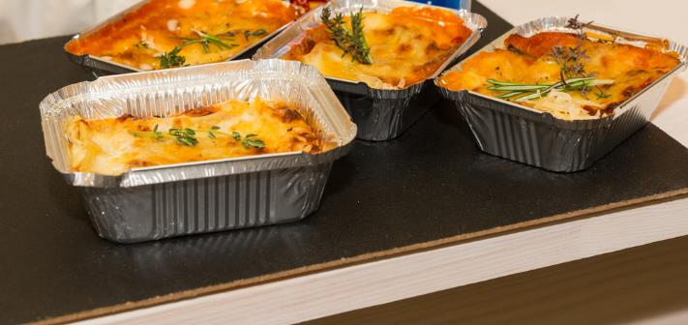
Bacterial growth and multiplication
All bacteria, including those that are harmful, have four requirements to survive and grow:
food;
moisture;
warmth;
time.

Slide 9
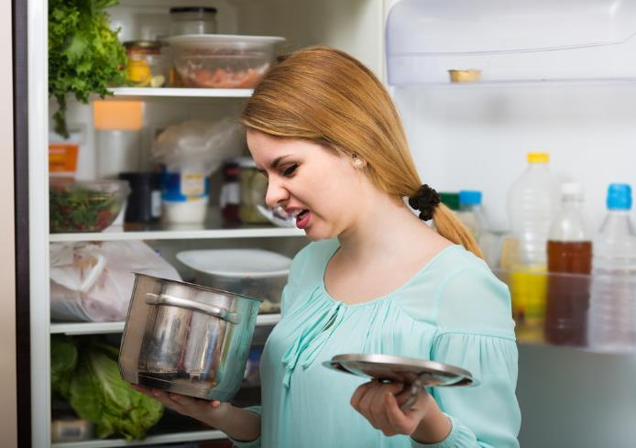
Food
Bacteria can grow and multiply on all foods. This means that all food must be stored, handled and, if appropriate, cooked correctly.
However, some foods, more than others, provide the ideal conditions needed for harmful micro-organisms to grow and are known as ‘high risk foods’.
High risk foods are often high in fat and protein, such as cooked meat, cooked fish, dairy and eggs. Cooked pasta and rice, although not high in fat and protein, are also regarded as high-risk foods if they are not cooled quickly and stored below 5°C.

Slide 10
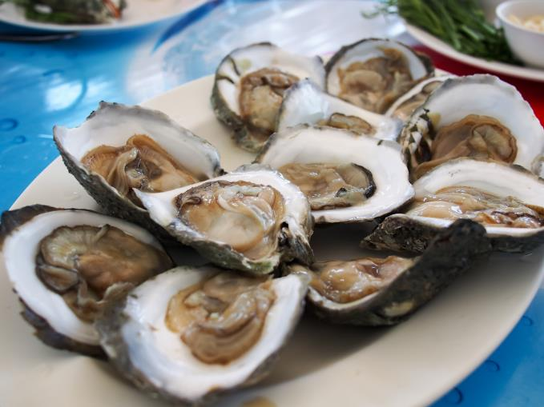
High risk foods
High risk foods include:
meat, meat products and poultry;
milk and dairy products;
eggs – uncooked and lightly cooked;
shellfish and seafood;
prepared salads and vegetables;
cooked rice and pasta.

Slide 11
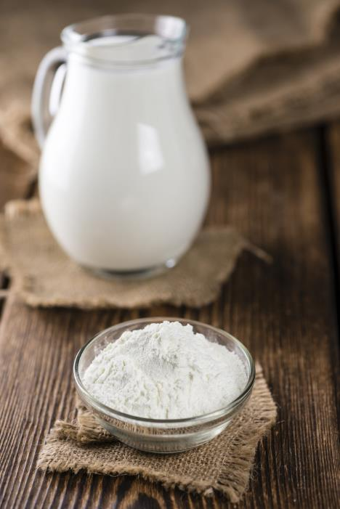
Moisture
The moisture which bacteria need to survive is found in many foods. Dried foods, such as powdered milk, cereals or dried egg do not support their growth if properly stored.
However, if moisture is added, any bacteria still alive in these products can quickly begin to multiply.

Slide 12
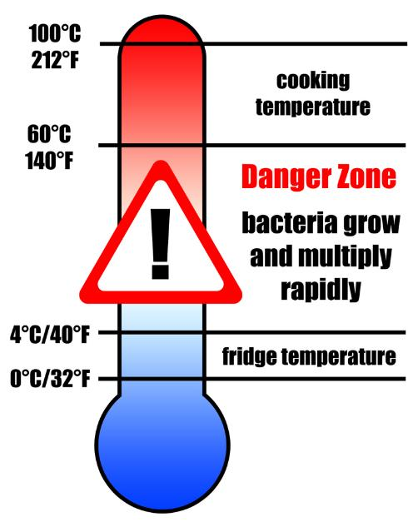
Warmth – temperature control
Poor temperature control is the most common cause of food poisoning problems.
Bacteria will grow rapidly in foods, particularly high-risk foods, that are left within the temperature danger zone - 5-63°C.
Bacteria do not grow or grow only very slowly, at temperatures below 5°C.
They do not grow at temperatures above 63°C.

Slide 13
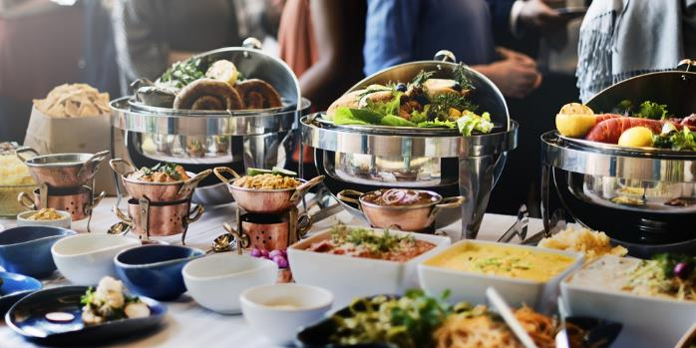
Warmth
In order to prevent bacterial multiplication, it is important to:
keep hot food hot;
keep cold food cold;
keep prepared food out of the danger zone.

Slide 14
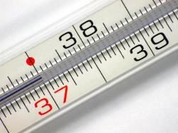
Temperatures to remember
To reduce the risk of food poisoning, good temperature control is vital:
5-63°C – the danger zone where bacteria grow most readily.
37°C – body temperature, optimum temperature for bacterial growth.
8°C – maximum legal temperature for cold food, i.e. your fridge.
5°C (or below) – the ideal temperature your fridge should be.

Slide 15
Temperatures to remember
To reduce the risk of food poisoning, good temperature control is vital:
-18° - the temperature your freezer should be.
75° - if cooking food, the core temperature, middle or thickest part should reach at least this temperature.
75° - if reheating food, it should reach at least this temperature. Remember to reheat food only once!
If you are in Scotland, the core temperature should be at least 82°C when cooking or reheating food.

Slide 16
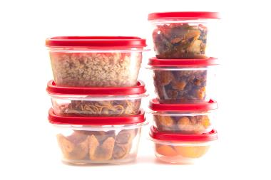
Time
When bacteria spend enough time on the right types of food at warm temperatures, they can multiply to levels that cause illness. In order to prevent this, you should:
reduce the time bacteria have to grow by getting perishable, chilled and frozen foods home and properly stored as quickly as you can;
keep chilled food in the fridge until just before you need to prepare or serve it;
eat all perishable foods by their ‘use by’ date;
use any left overs within 48 hours and re-heat until steaming hot.

Slide 17
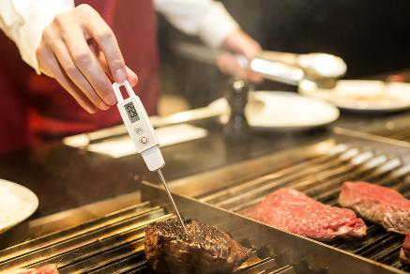
Preventing bacterial multiplication
If you take away any one of the four requirements that bacteria need to survive, the ability of bacteria to grow and cause food poisoning is reduced.
It is therefore important to:
store, prepare and cook high risk foods carefully;
store food either hot (above 63°C) or cold (below 5°C), never warm;
reduce the time food is in the danger zone;
cook food for the correct time at the right temperature – make sure it is piping hot and no pink remains in poultry, burgers or sausages.

Slide 18
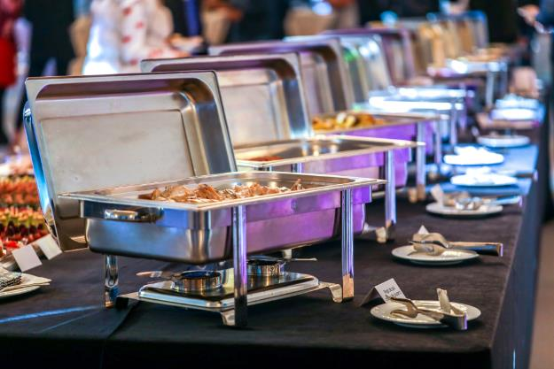
Factors affecting food poisoning
Some of the common factors leading to food poisoning include:
preparation of food too far in advance;
storage at ambient temperature;
inadequate cooling;
inadequate reheating;
under cooking;
inadequate thawing.

Slide 19
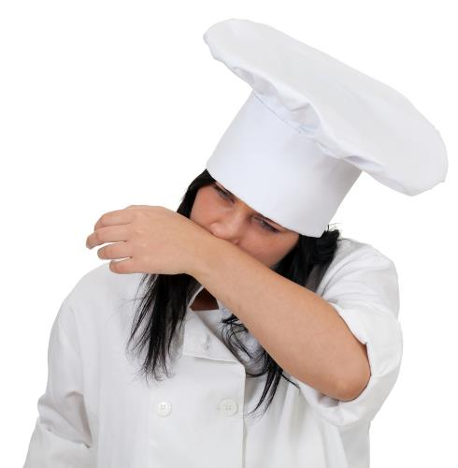
Factors affecting food poisoning
More common factors leading to food poisoning include:
consuming raw food;
improper warm holding (i.e. holding ‘hot’ food below 63ºC);
infected food handlers;
contaminated processed food;
poor hygiene.

Slide 20
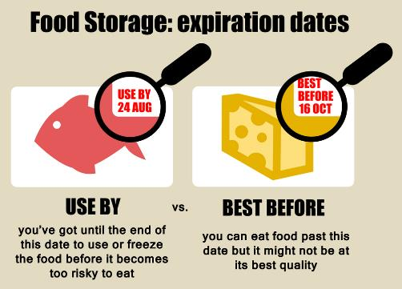
Preventing food spoilage, contamination and poisoning
Tips for buying food include:
it is illegal to sell food that has passed its ‘use by’ date;
dented, blown or rusted cans of food should not be purchased;
frozen food which has frozen together in the pack should not be purchased;
do not buy food where the packaging has been damaged;
only shop in clean and hygienic stores.

Slide 21
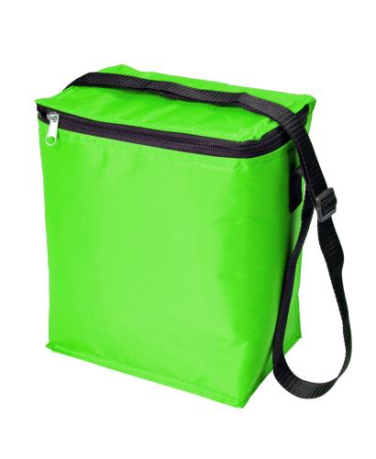
Preventing food spoilage, contamination and poisoning
Tips for transporting food back home:
buy chilled and frozen foods at the end of the shopping trip;
keep frozen and chilled foods cold, by using cool boxes/bags and packing these types of foods together;
cooked and uncooked foods should be kept separate;

Slide 22
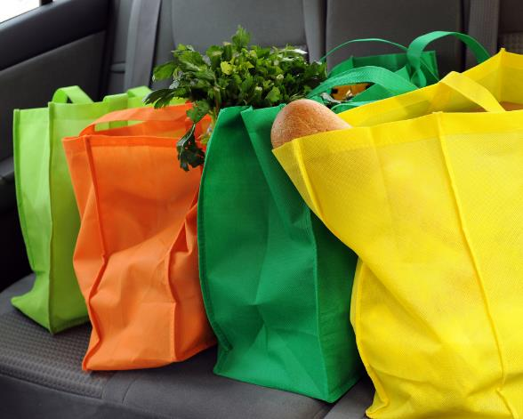
Preventing food spoilage, contamination and poisoning
Further tips for transporting food back home include:
packing dry and moist foods separately;
packing household chemicals separately.

Slide 23
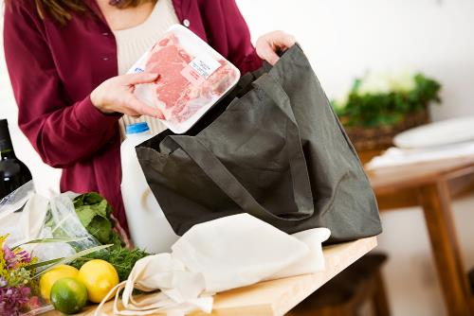
Preventing food spoilage, contamination and poisoning
Tips for storing food in the home:
food should be unpacked as soon as possible;
old stocks of food should be used before buying new ones (first in, first out theory);
store food in the correct place, i.e. dry food, in cool, dry clean places and chilled food in the refrigerator.
Storing food correctly can also help to reduce food waste.

Slide 24
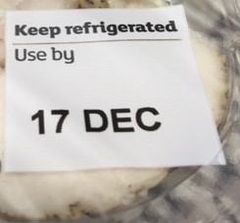
Reducing the risks
To reduce the risk of food poisoning, follow these simple rules:
always follow ‘use by’ dates;
store food correctly, either cold or hot, never warm;
separate raw and cooked food;
wash fruits and vegetables.

Slide 25
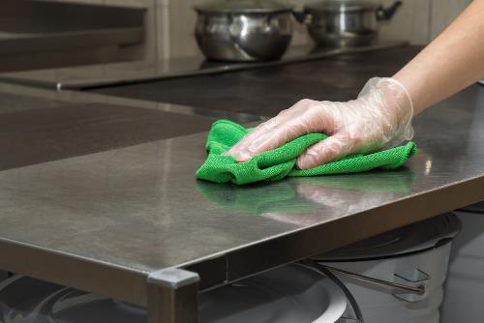

Reducing the risks
To reduce the risk of food poisoning, follow these simples rules:
thoroughly cook food;
keep yourself and your workspace clean;
don’t cough or sneeze over food;
thoroughly wash and dry hands regularly.

Slide 26
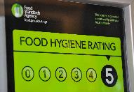
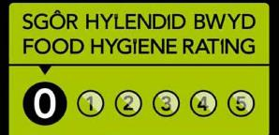
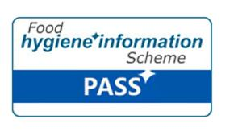
Eating out
If you are eating in a restaurant, take-away, café or other food outlet away from home and are wanting to know if the establishment can be relied upon for good food hygiene standards, look for the Food Standards Agency Food Hygiene Rating sticker in the window.
The scheme is set out in law in Wales and Northern Ireland but display of the rating sticker is voluntary in England.
In Scotland, the Food Hygiene Information Scheme is operated, and food premises may choose whether to display their rating on their website or premises.

Slide 27
Eating out
One Food Standards Agency consumer survey showed:
42% of respondents reported checking the food hygiene rating of a business in the previous 12 months.
86% of respondents reported that they had heard of the Food Hygiene Rating Scheme (FHRS). Around 6 in 10 (57%) respondents reported that they had heard of the FHRS and had at least a bit of knowledge about it.
Food and You 2: Wave 8 September 2024

Slide 28
Food poisoning
For further information, go to:
www.foodafactoflife.org.uk
This resource meets the Guidelines for producers and users of school education resources about food.

