Slide 1
Marble pear traybake
Complexity: medium

Slide 2
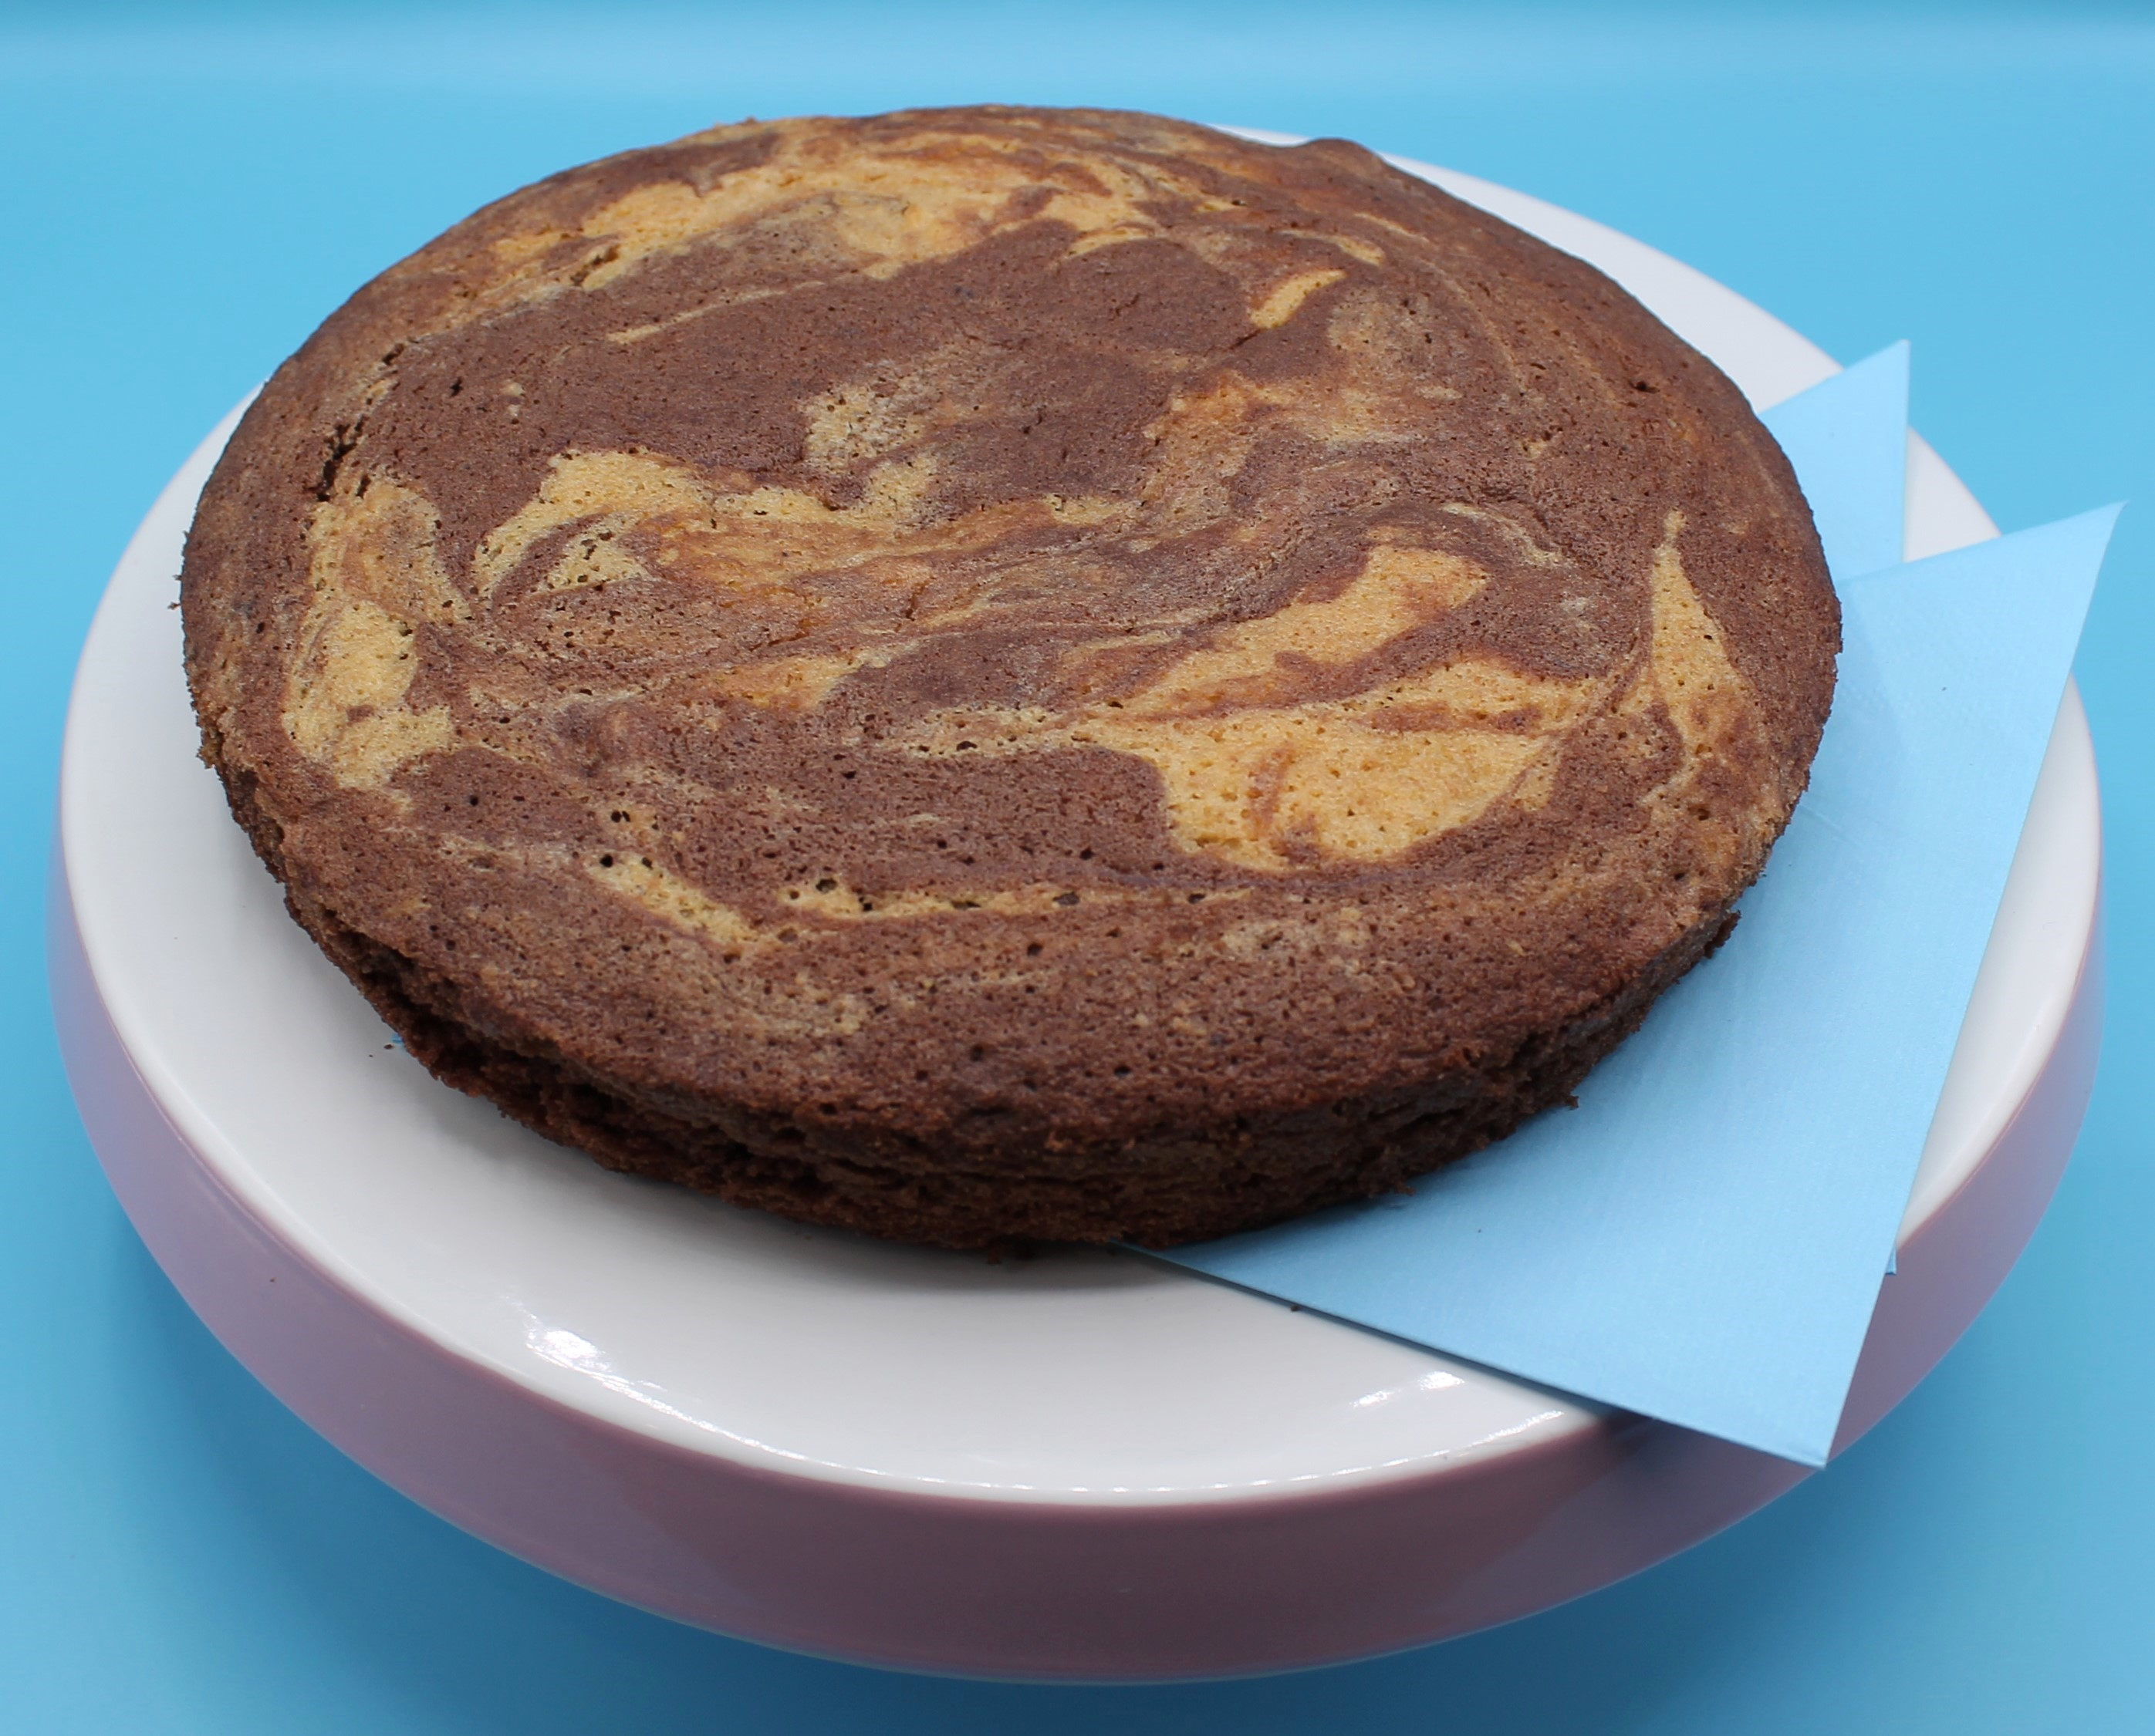
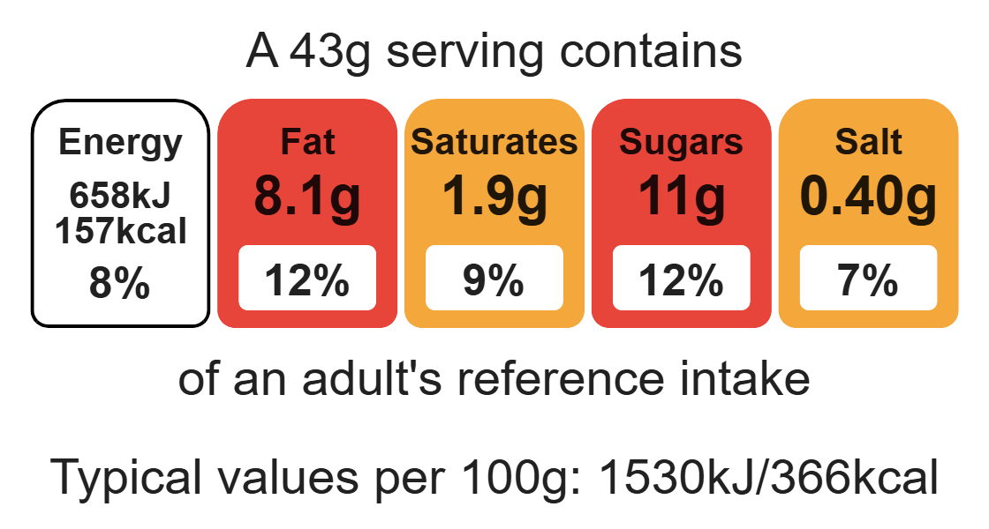
Nutritional analysis
Serves 10

Slide 3
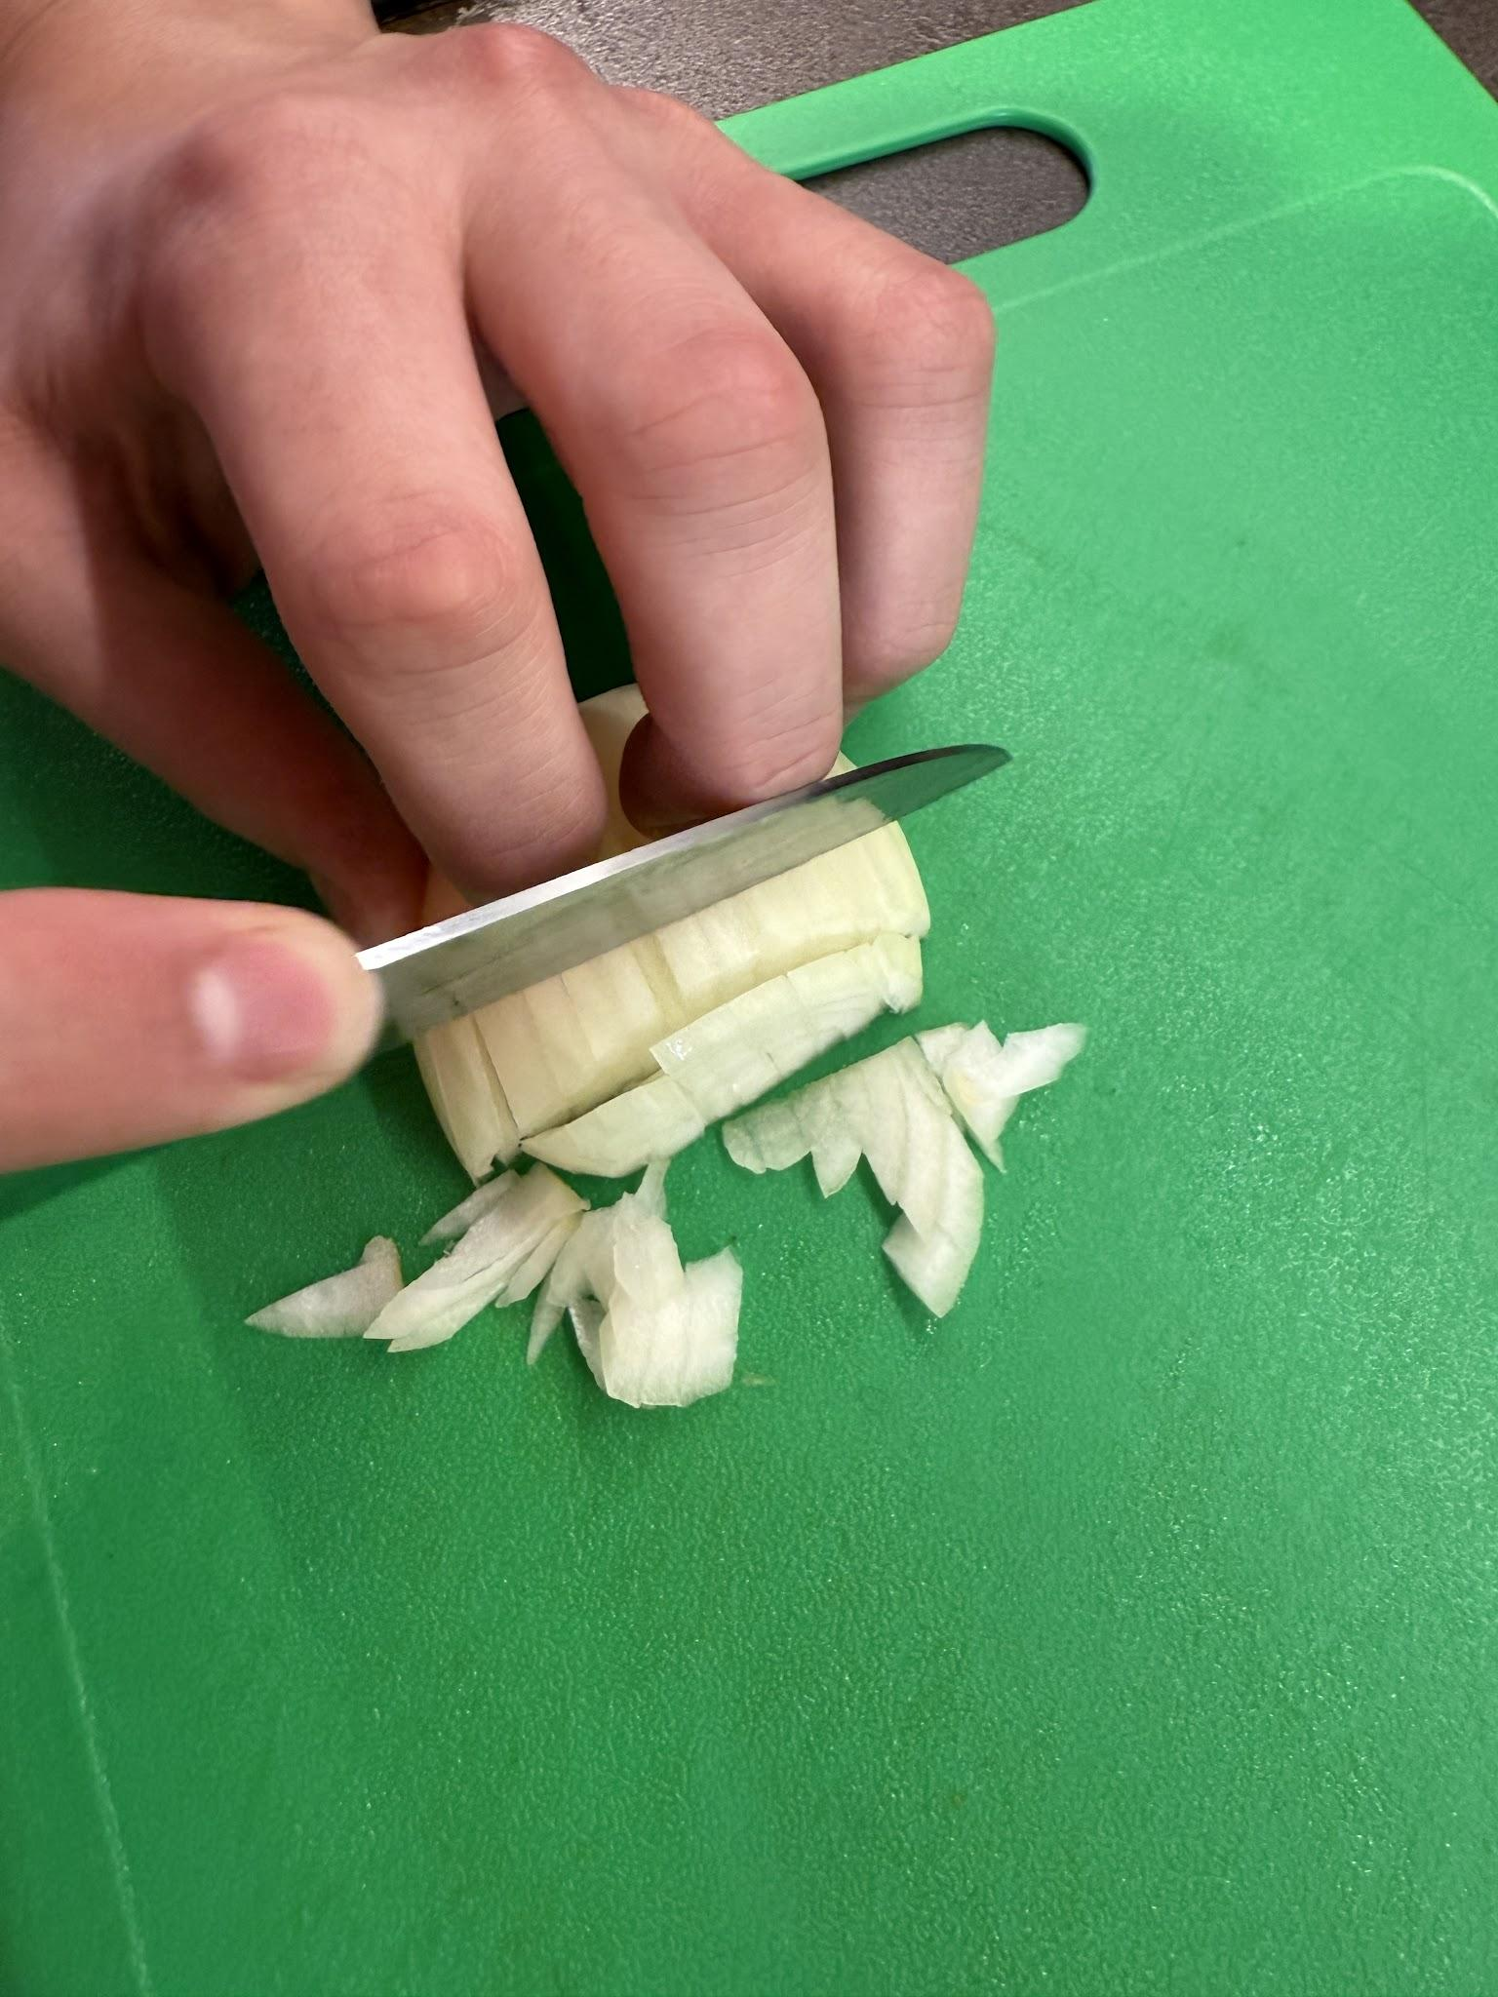
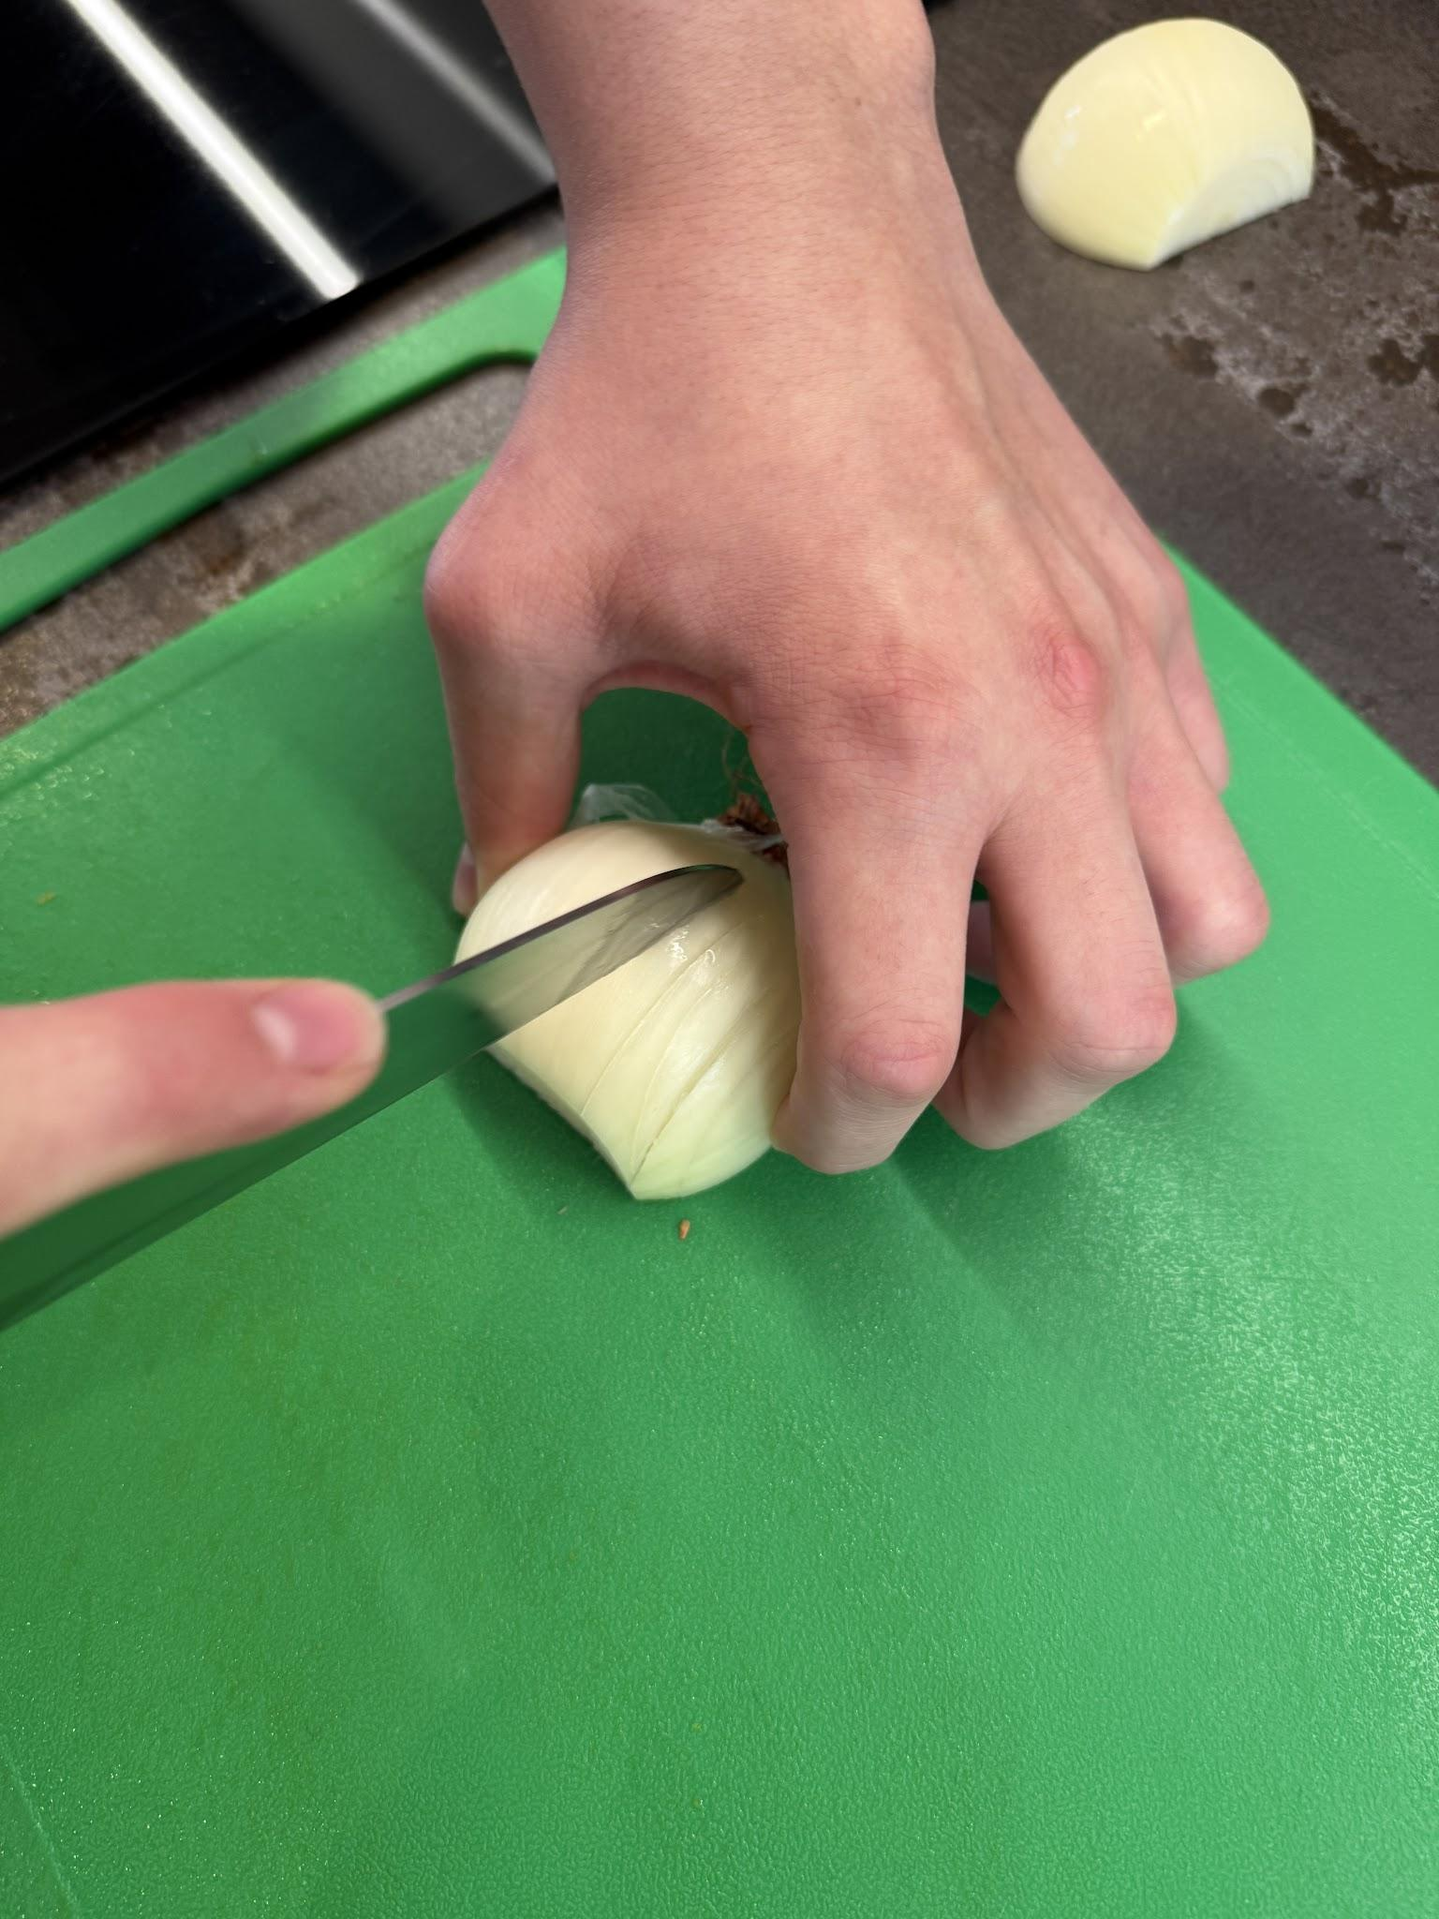
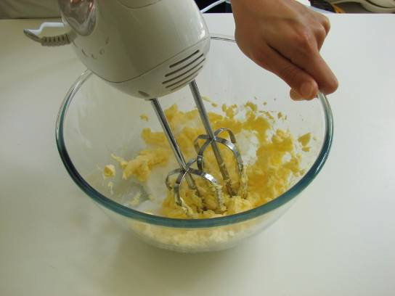
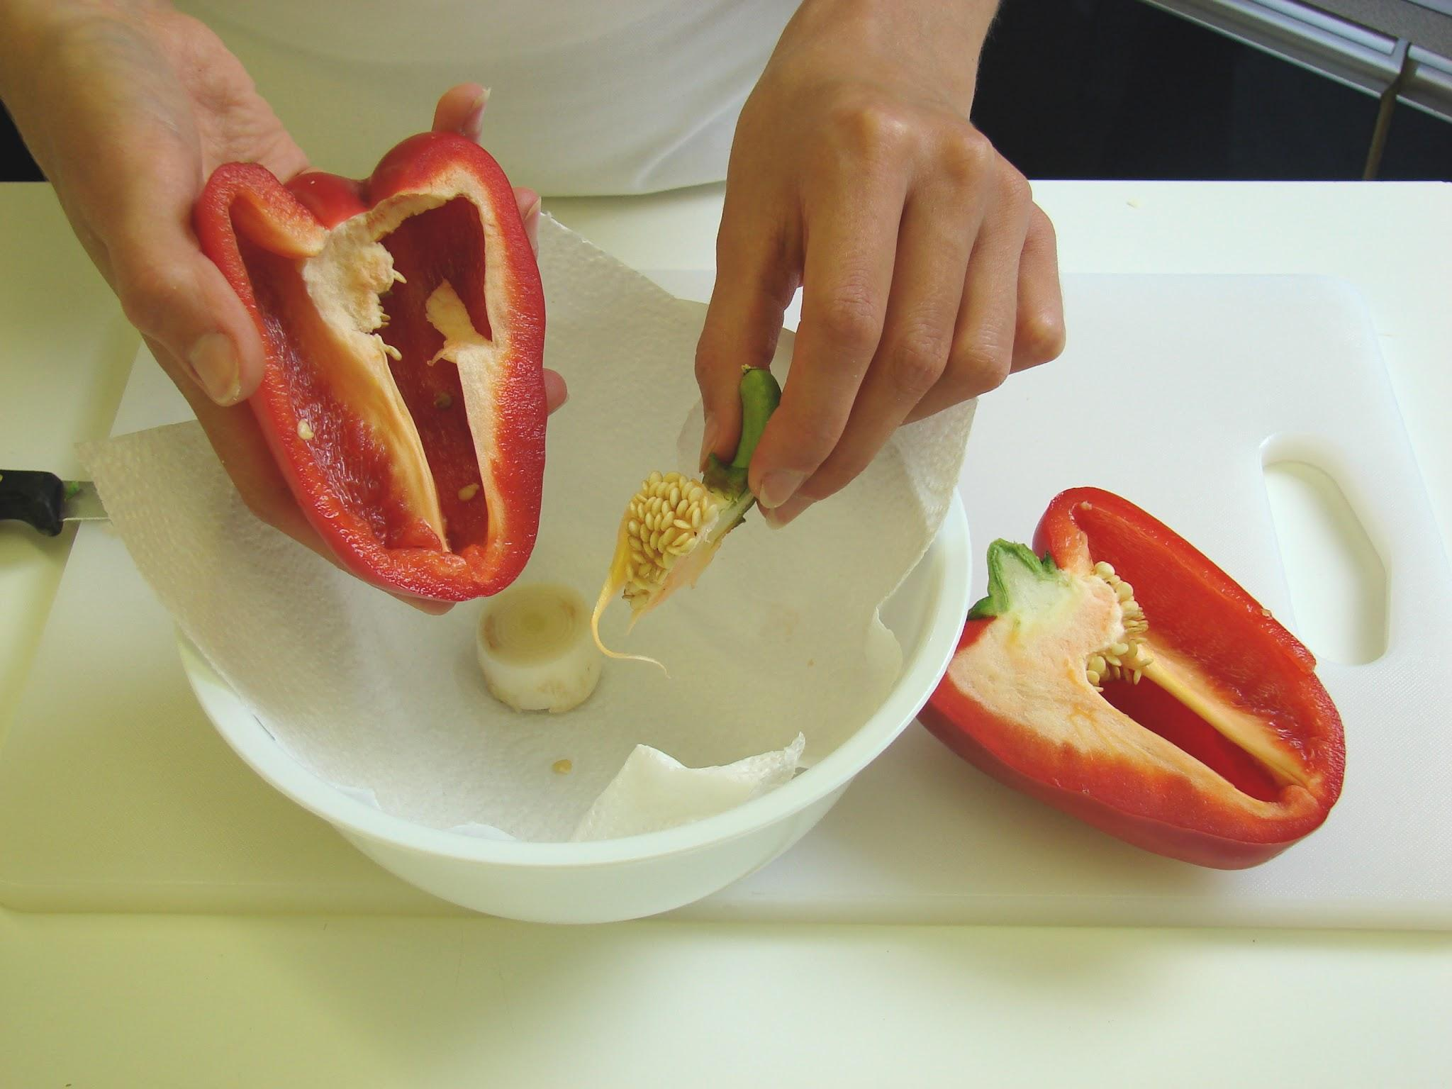
Starter activity
Which food preparation skills are being demonstrated?

Slide 4
Example responses
Which food preparation skills and techniques are being demonstrated?
Claw grip
Bridge hold
Creaming
Deseeding

Slide 5
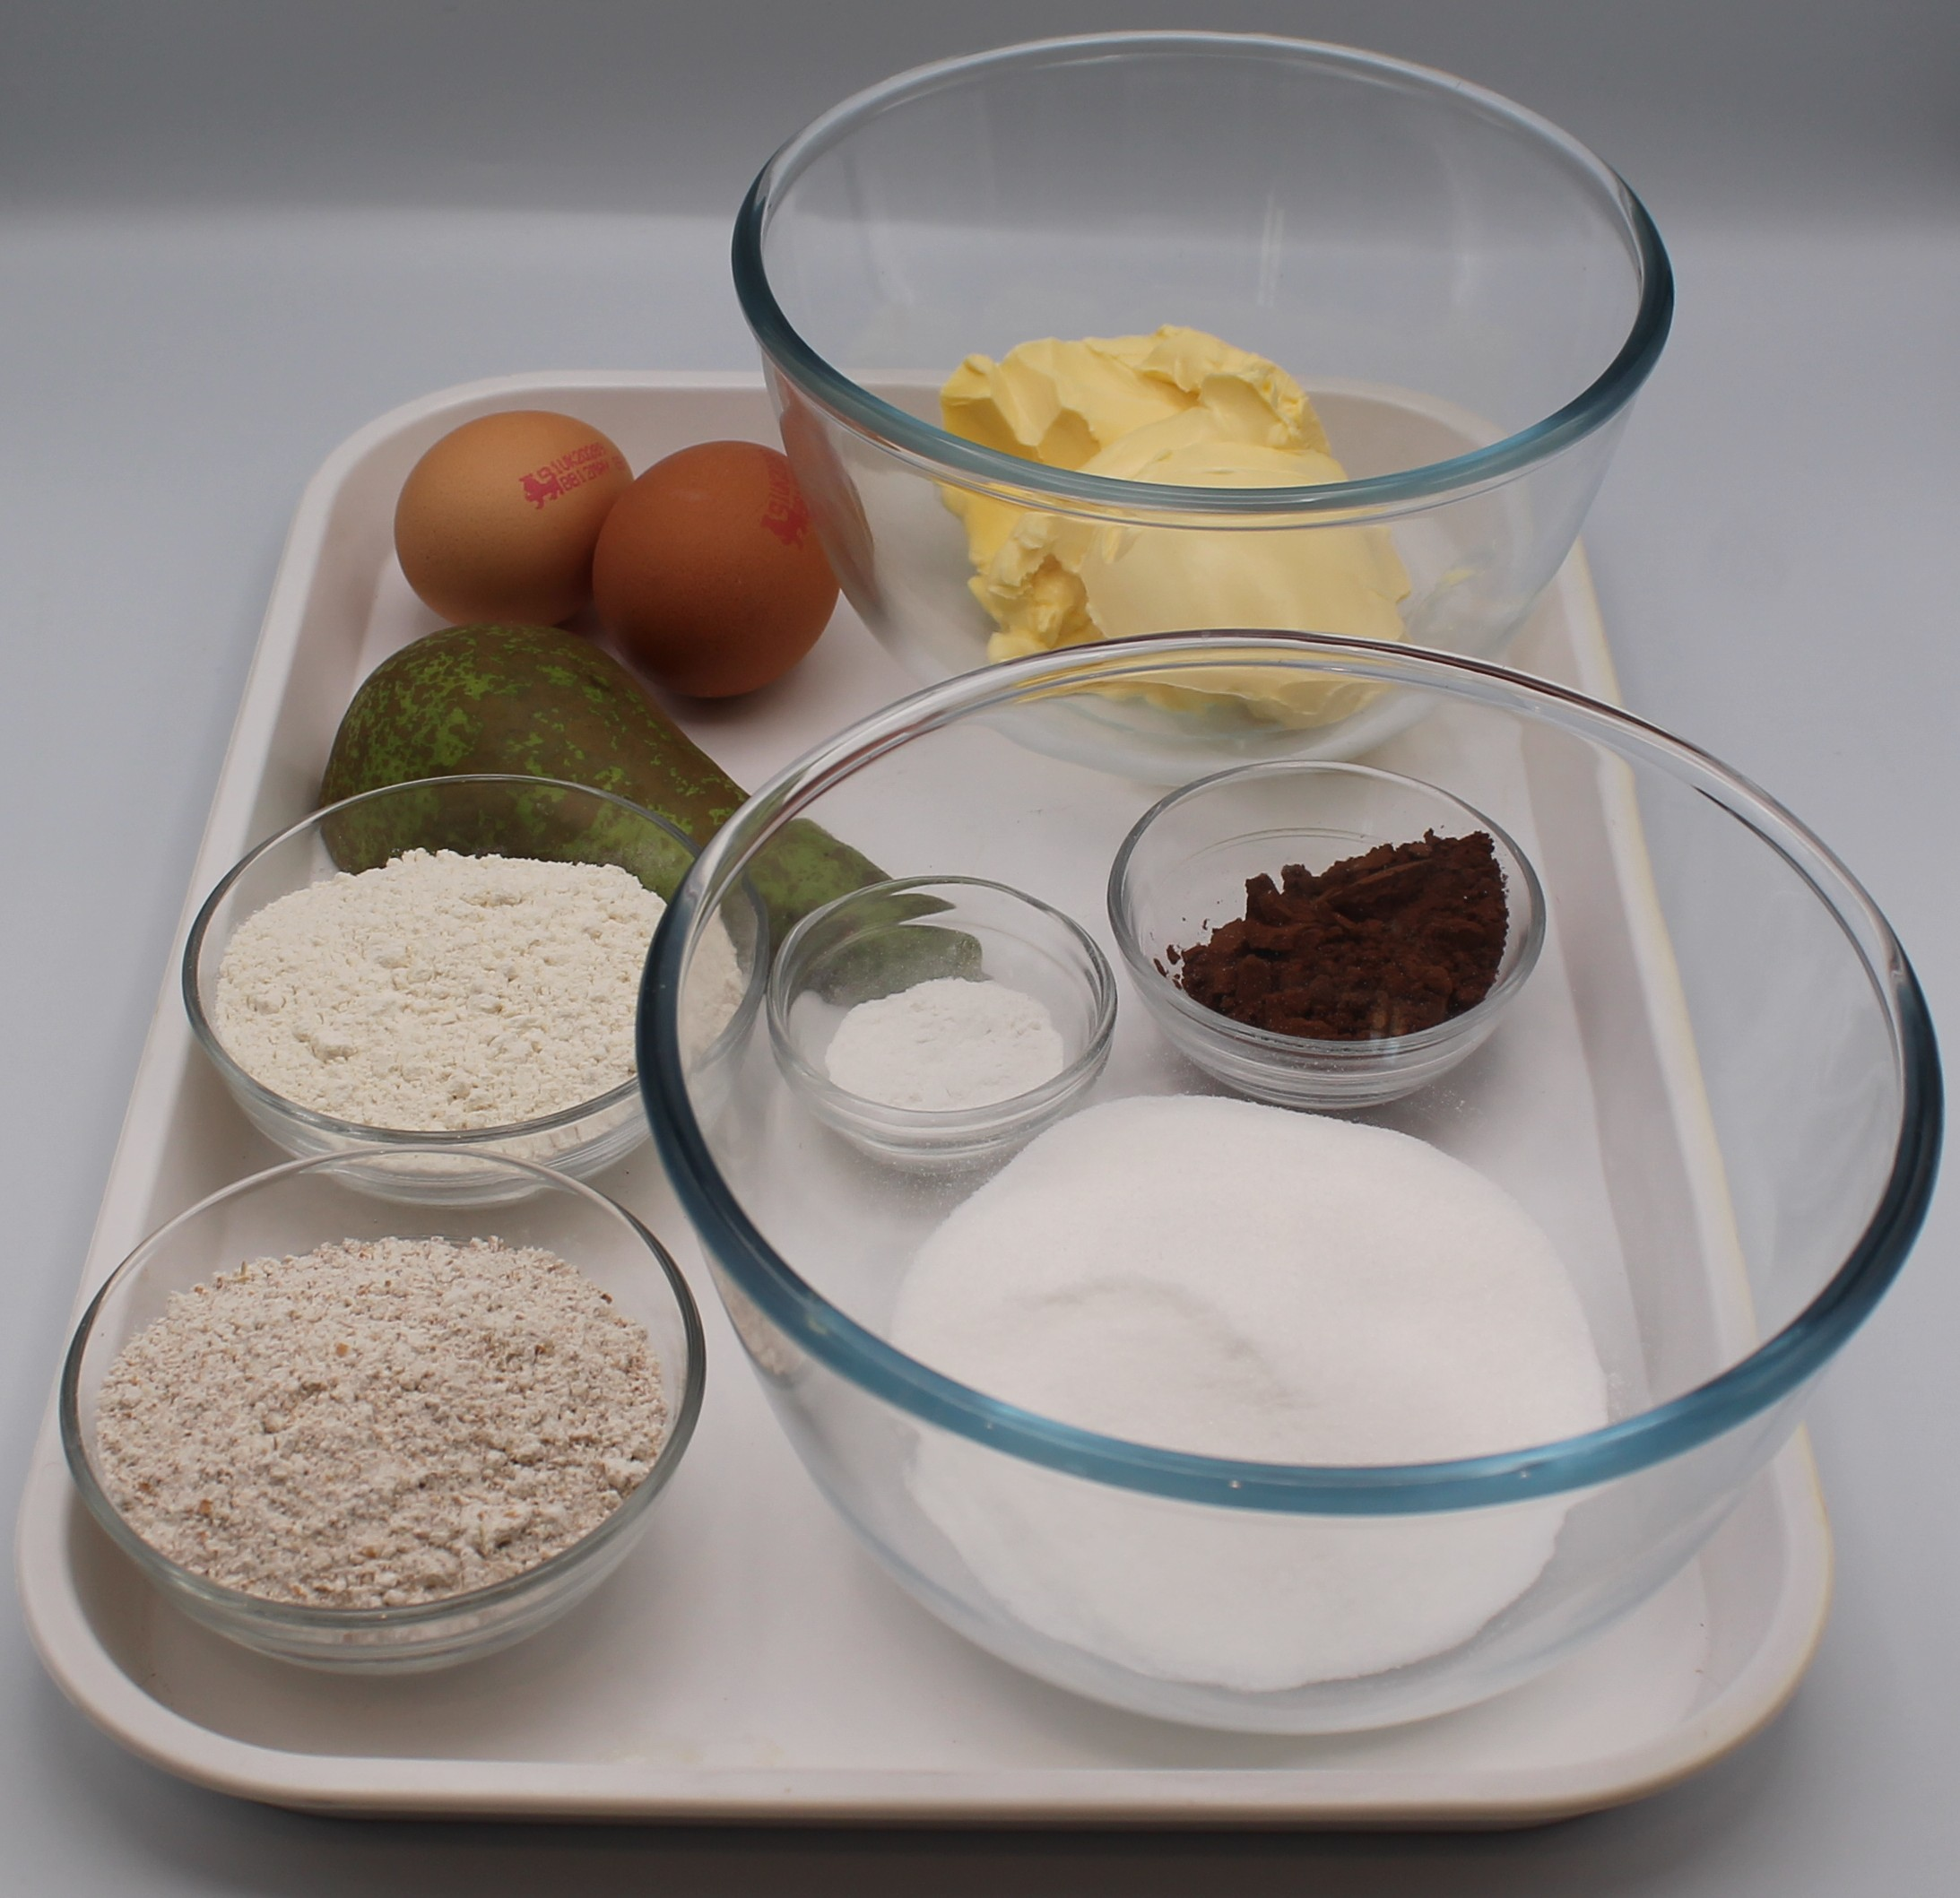

Ingredients (serves 10)
½ pear
100g caster sugar
100g reduced-fat spread
2 eggs
50g self-raising white flour
50g self-raising wholemeal flour
1 x 5ml spoon baking powder
1 x 15ml spoon cocoa powder
Check for any food allergy, intolerance, special dietary requirement or religious/cultural reasons for not handling or eating the ingredients in this recipe.

Slide 6
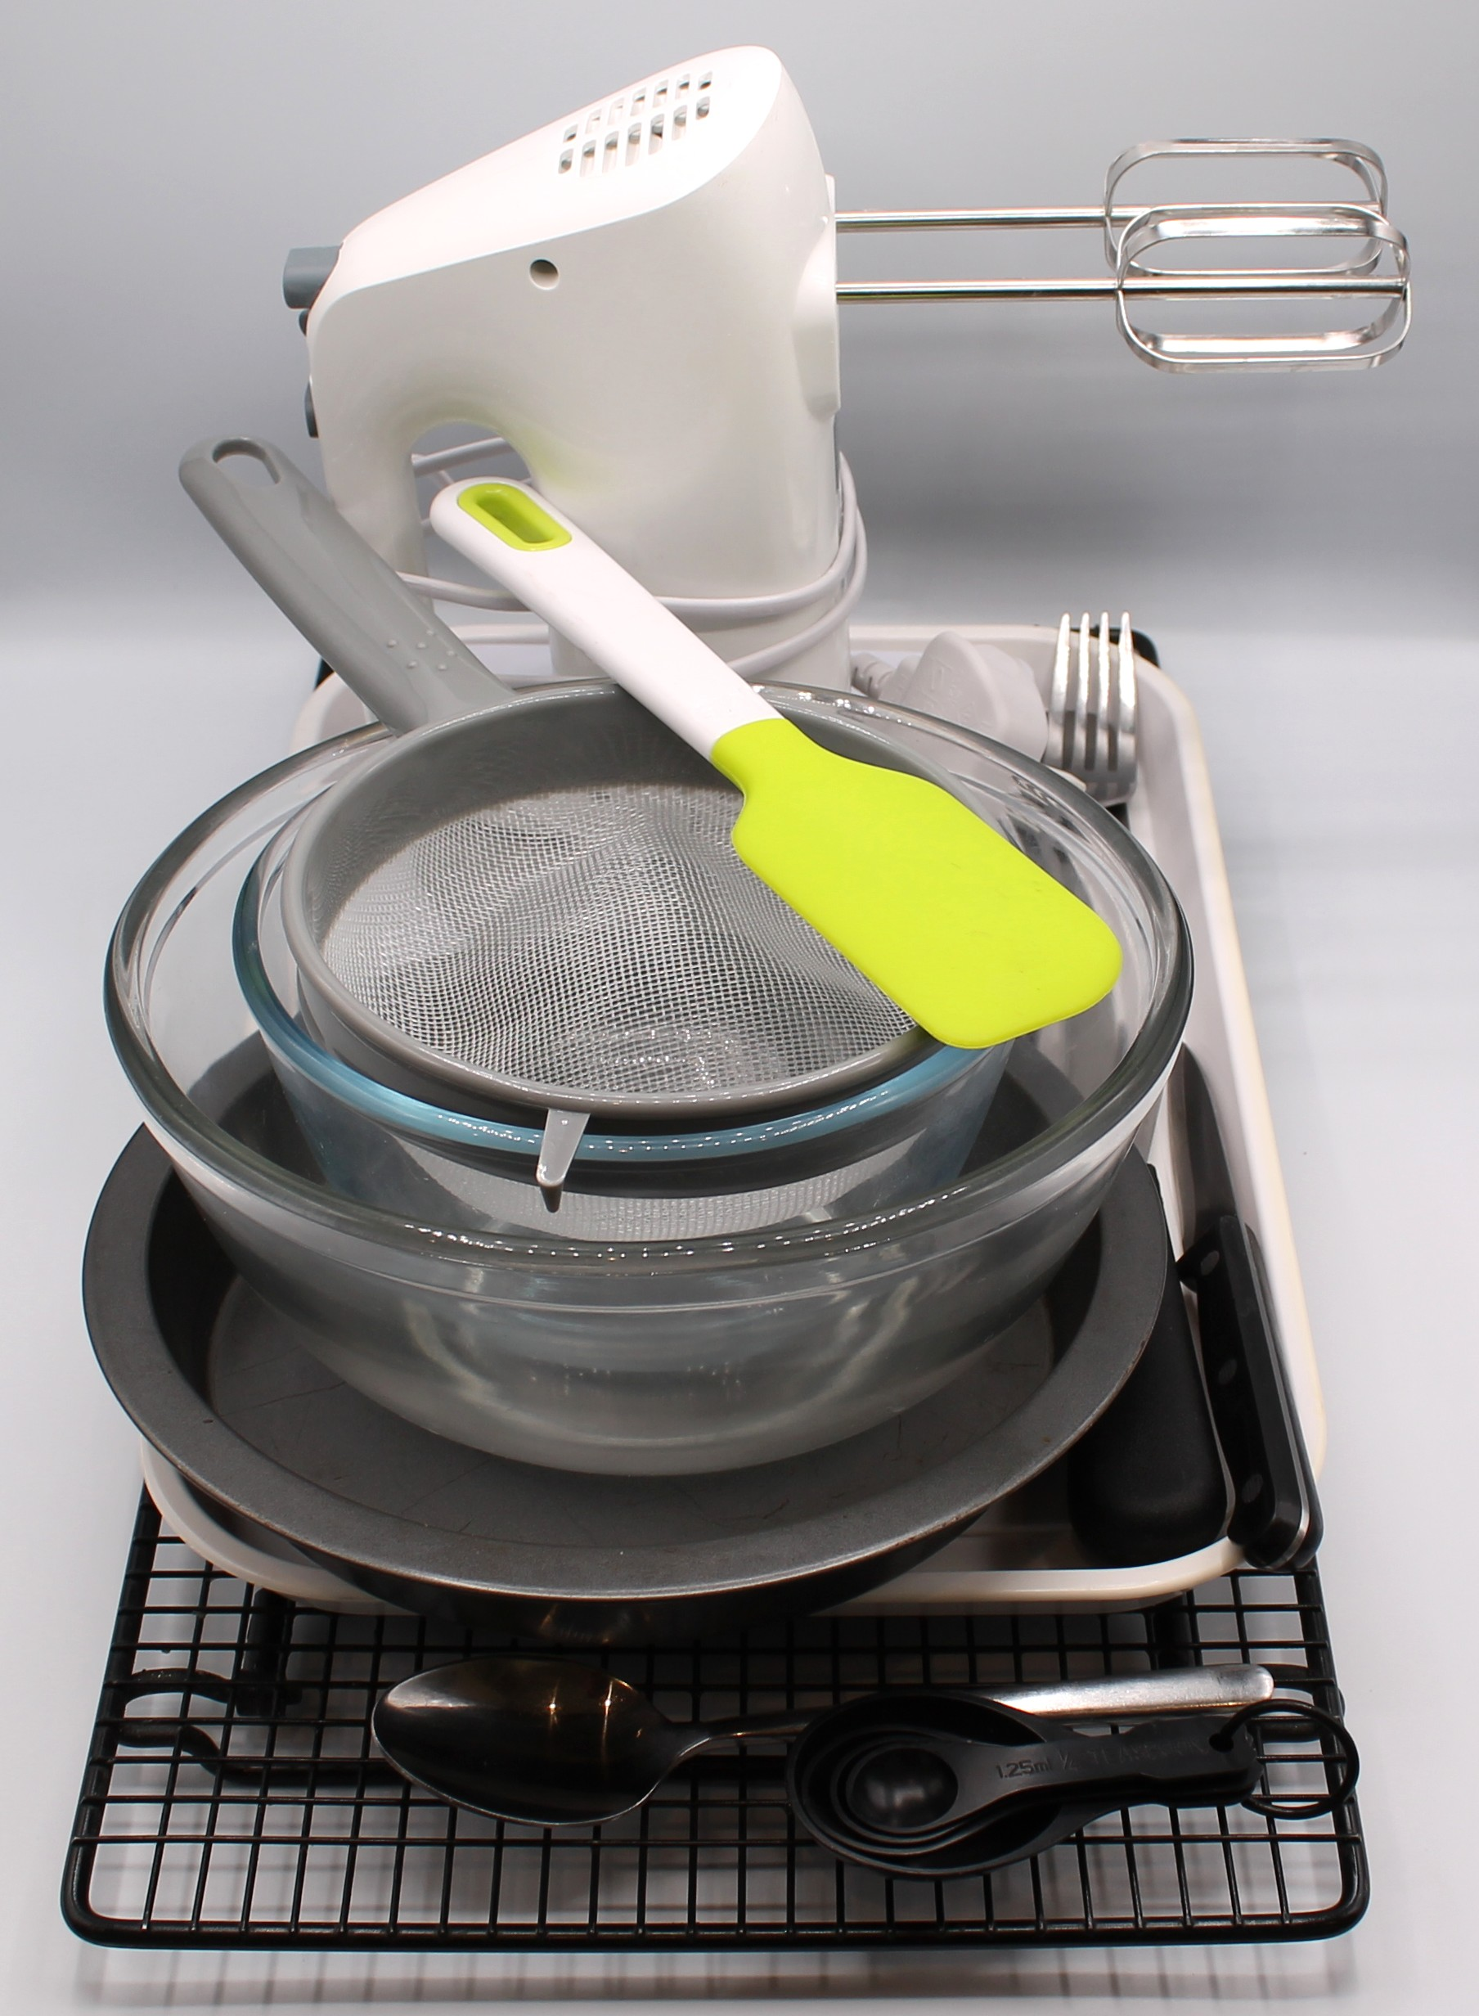
Equipment
Baking tin or foil tray (20cm)
Weighing scales
Chopping board
Sharp knife
Mixing bowl
Electric hand whisk
Measuring spoons
Small bowl
Sieve
Mixing spoon
Fork
Spatula
Cooling rack

Slide 7
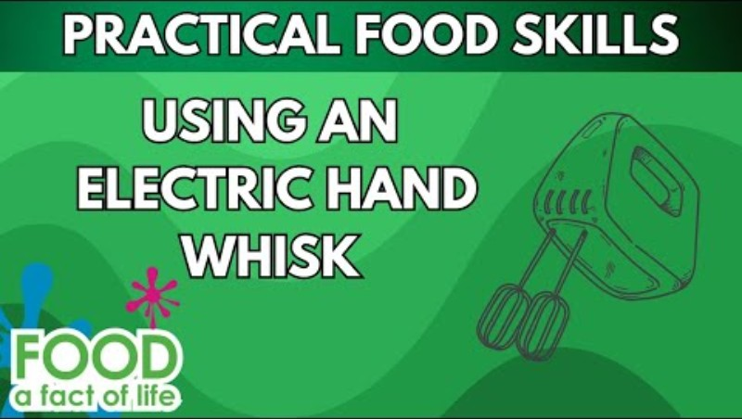
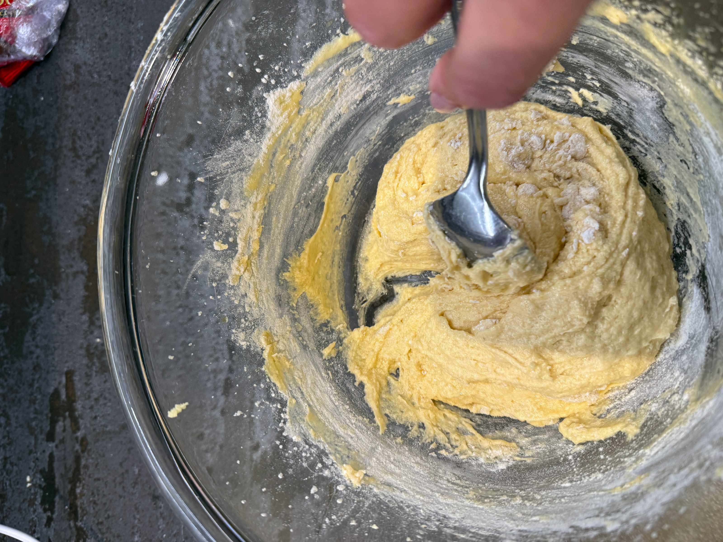
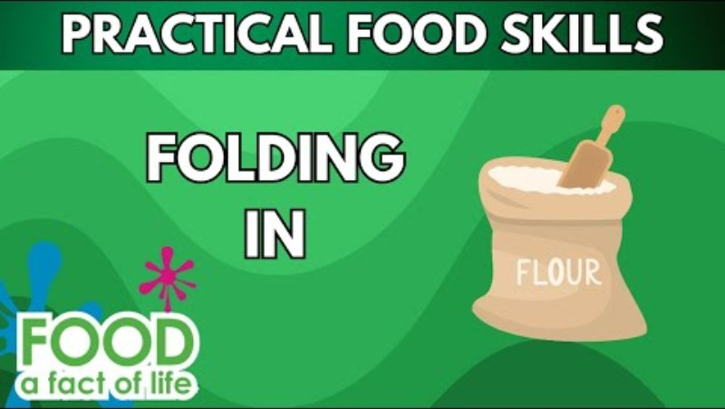
Food skills
Weigh
Measure
Core
Cut
Chop
Slice
Cream
Beat
Sift
Fold
Stir and combine
Bake
Click below to watch how to use an electric hand whisk safely
Click below to watch how to fold in flour

Slide 8
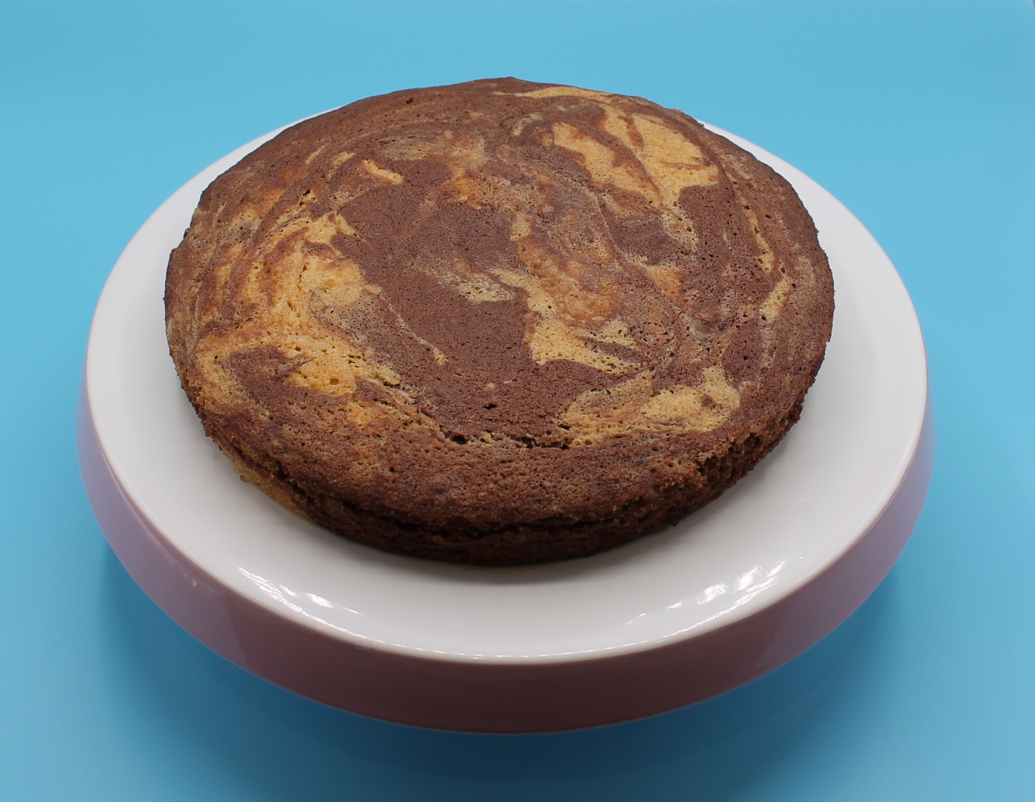
Method
Preheat the oven to 180ºC or gas mark 4.
Grease and line the baking tin or foil tray.
Core and chop the pear into small pieces. There is no need to peel the pear. Place the chopped pear into the lined baking tin.
Cream the sugar and fat together in a large bowl, ideally using an electric hand whisk, until light and fluffy.
In a small bowl, beat the eggs with a fork.
Add the beaten egg, a little at a time, to the fat and sugar.
Sift the flour and baking powder into a bowl.
Fold the flour and baking powder into the mixture, a spoonful at a time.

Slide 9
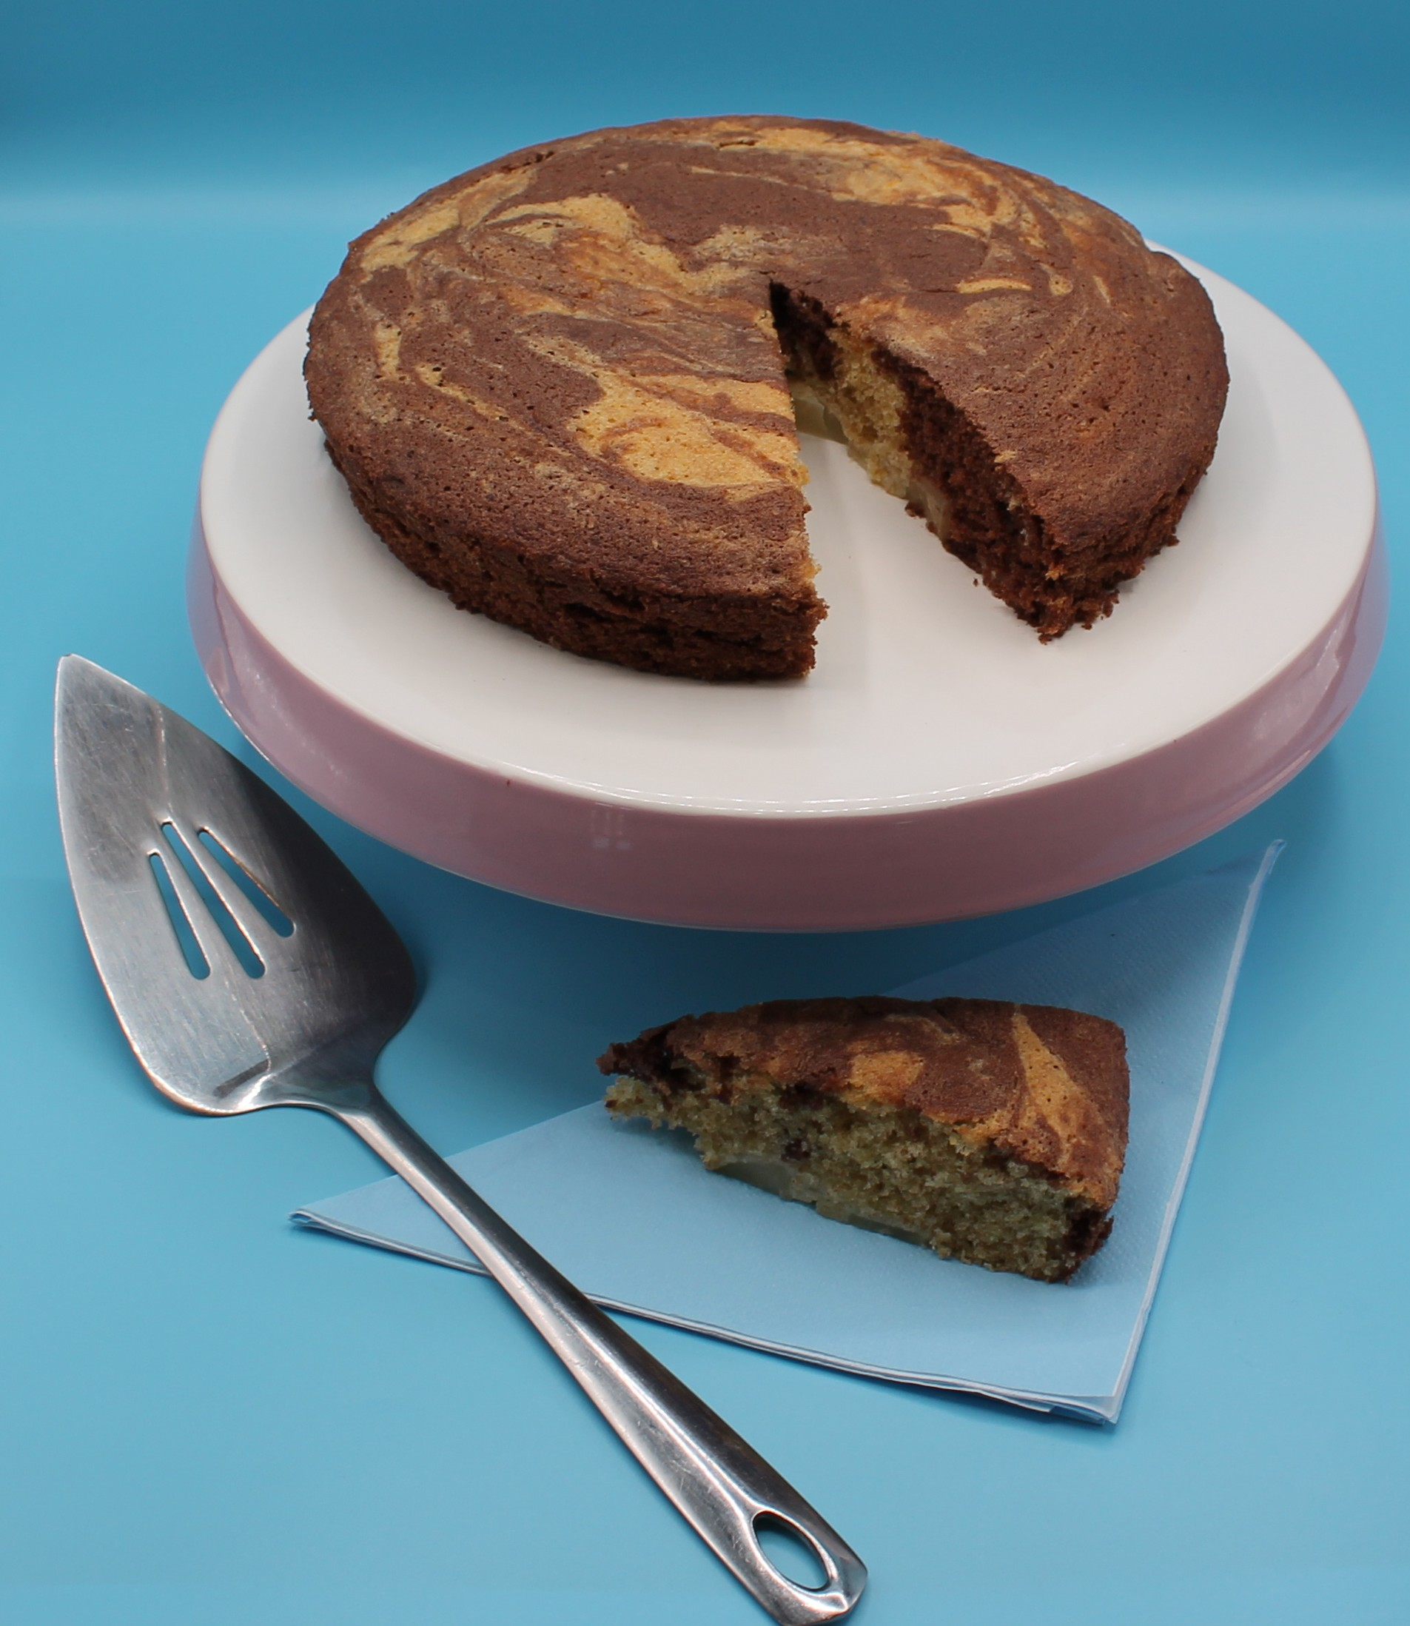
Method
Spoon half of the plain cake mixture into the tin on top of the
pear (do not spread it across the pear)
Stir-in the cocoa to the cake mixture remaining in the bowl.
Spoon the chocolate mixture into the baking tin and then swirl the two mixtures together to create a marble effect.
Place in the oven and bake for 25 minutes, until golden brown and springy to the touch.
Remove from the oven and allow to cool.

Slide 10
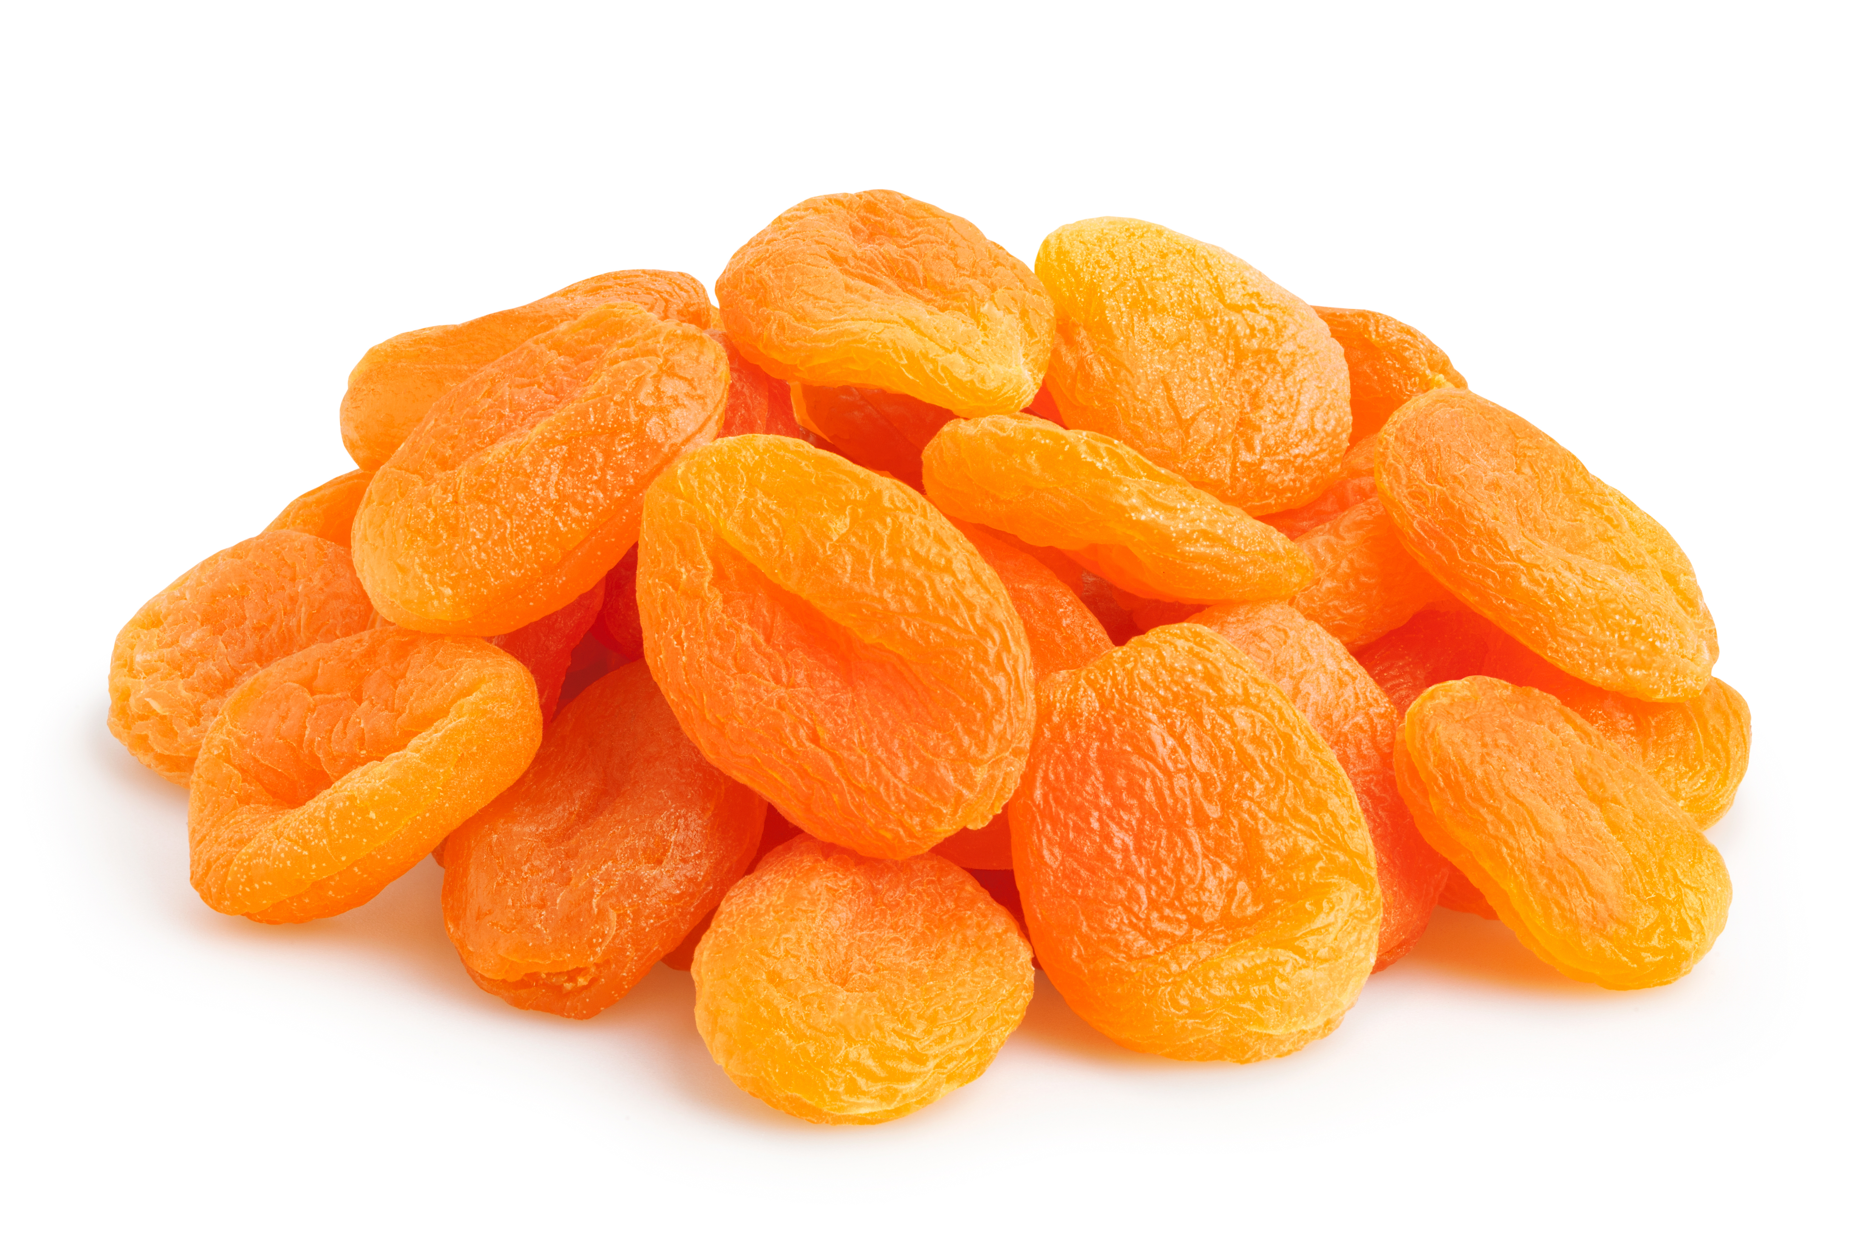
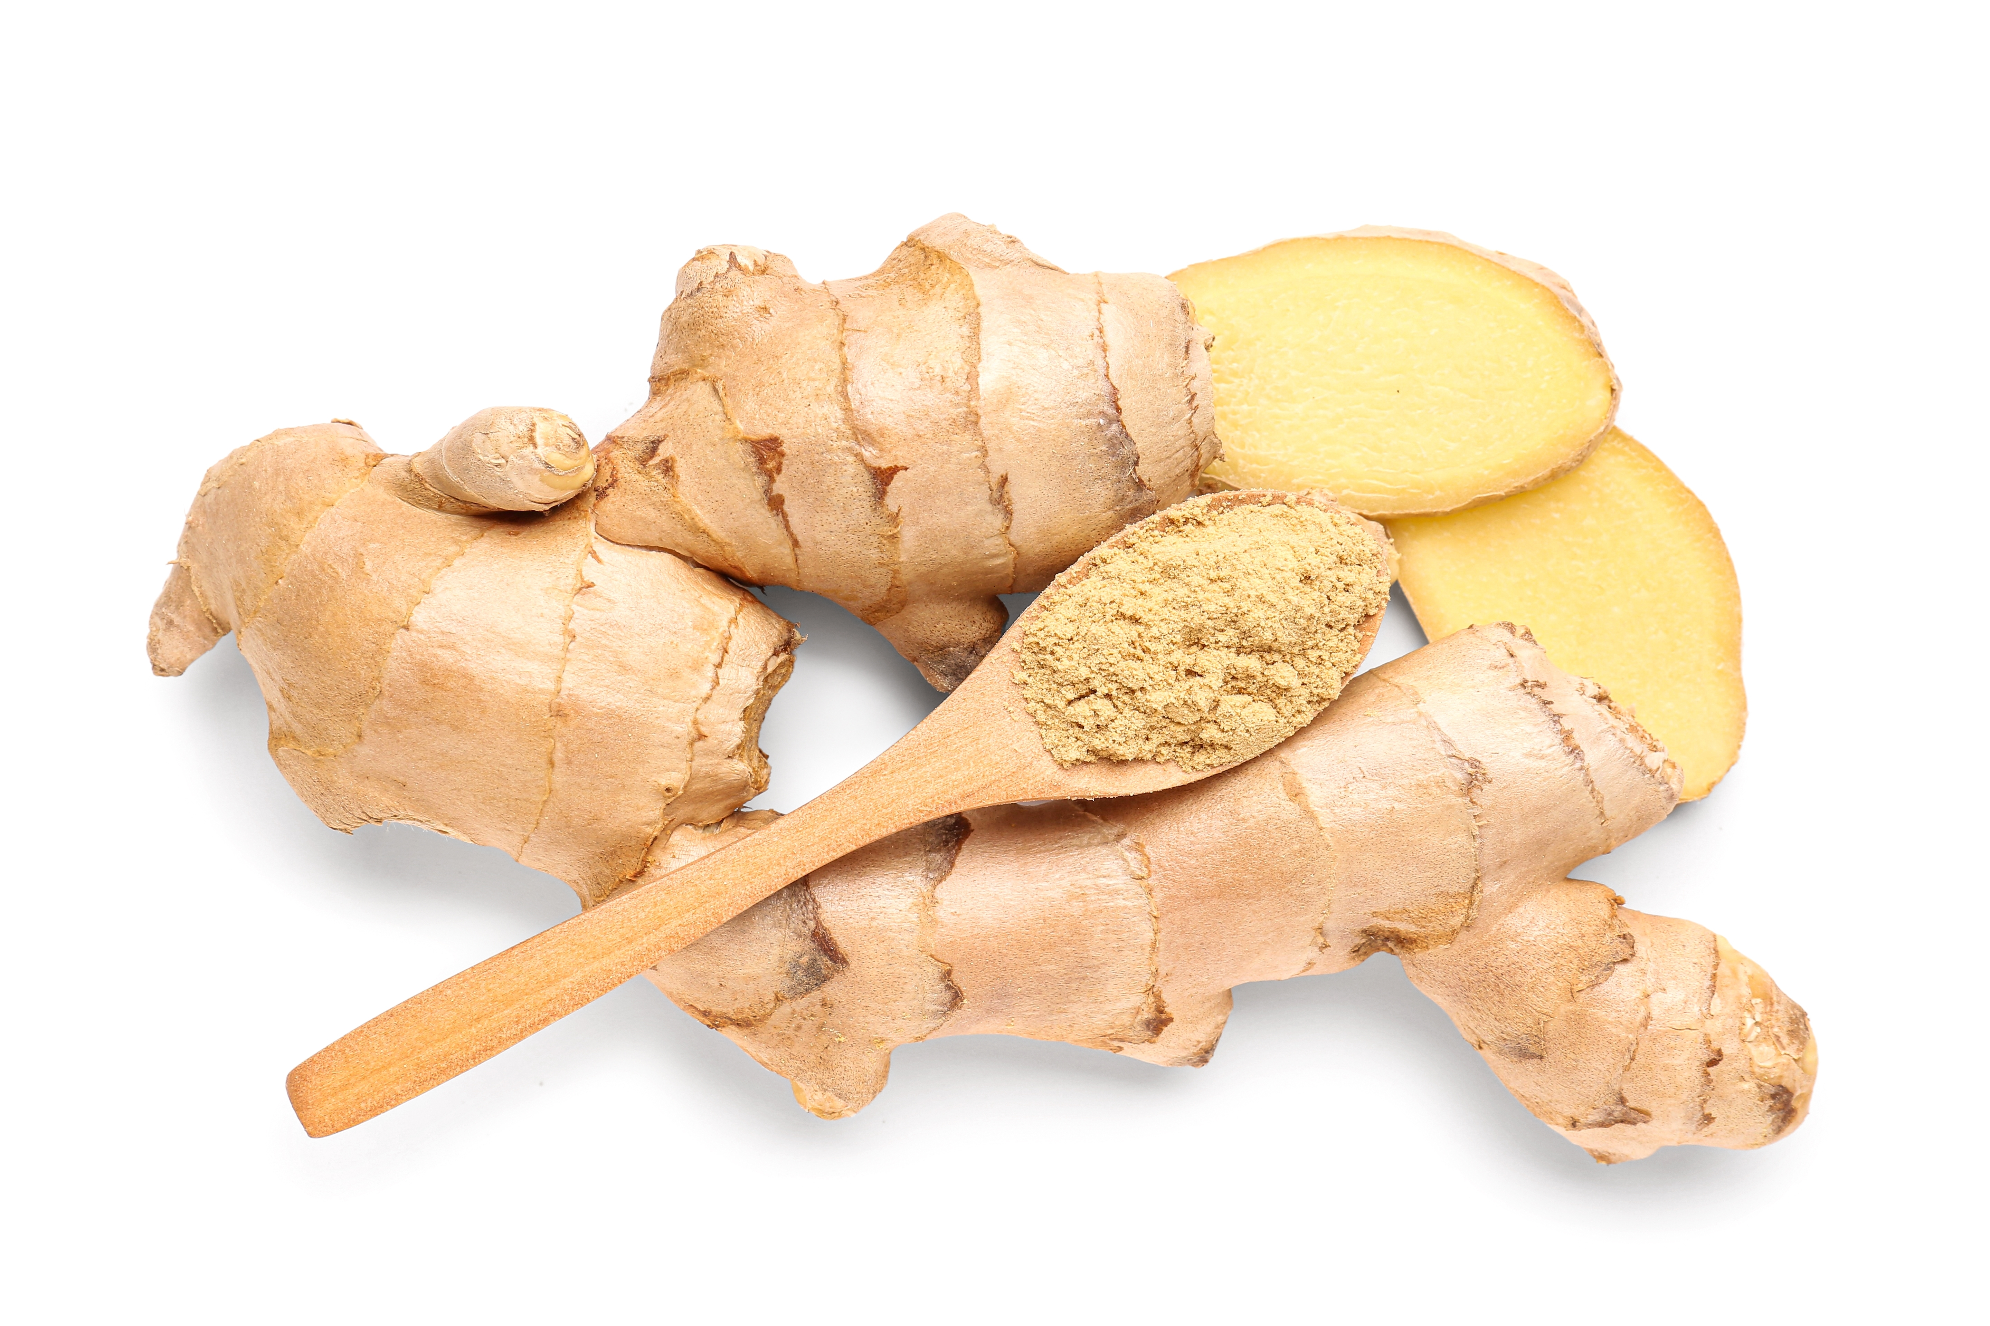
Top tips
Turn up the flavour: Instead of cocoa powder, try spices and fruit, e.g. mixed spice or ginger and apricots.
Focus on fibre: Replace the white flour with 50g wholemeal flour for an extra fibre boost.
When lining the baking tin, it is only necessary to line the bottom. The sides can be greased with oil and pastry brush

Slide 11
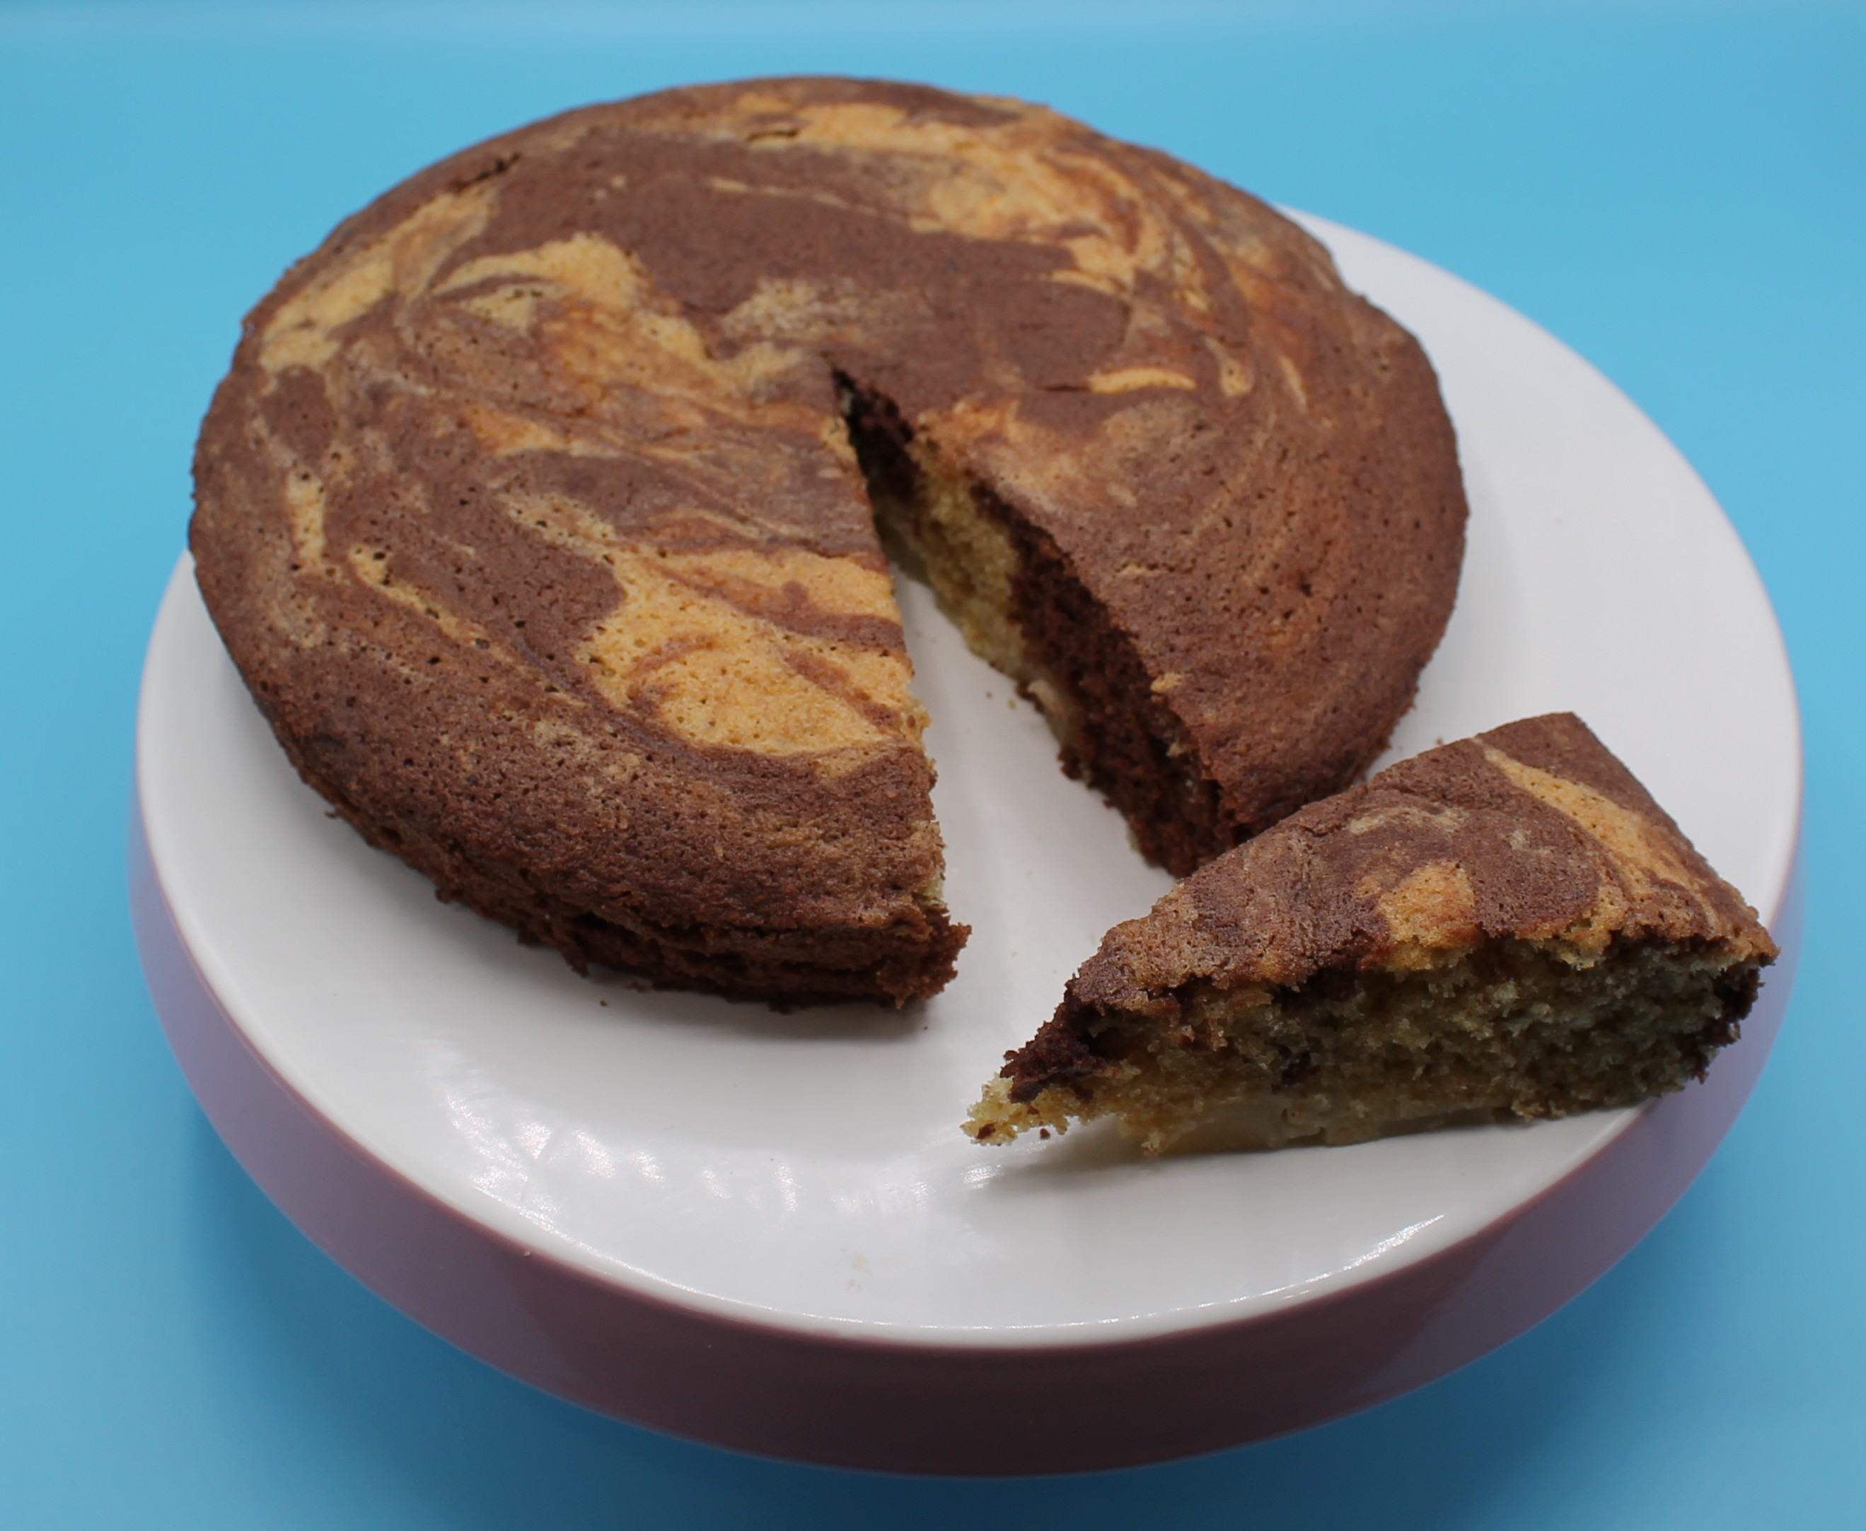
Food science
Aeration
Products such as creamed cakes need air incorporated into the mixture in order to give a well-risen texture. This is achieved by creaming a fat, such as butter or baking spread, with caster sugar.
Small bubbles of air are incorporated and form a stable foam.

Slide 12
Plenary
1) List and rate five food skills you used to make a marble pear tray bake.
 | I need help |  | I am confident | Comments
2) Did you work independently and confidently?
How could you improve next time?

Slide 13

Example response
1) List and rate five food skills you used to make a marble pear tray bake.
 | I need help |  | I am confident | Comments
Measuring |  |  |  | I weighed and measured accurately.
Coring |  |  |  | I needed help with coring.
Creaming |  |  |  | I enjoyed using the whisk and making the cake mixture light and creamy.
Folding |  |  |  | I did not use the edge of the spoon and mixed more than folded, which knocked the air out of the mixture.
Marbling |  |  |  | My marbling of the plain and chocolate cake mixture could have been better.

Slide 14
Example responses
2) Did you work independently and confidently?
How could you improve next time?
Overall, my marble tray bake came out well. I needed help with my knife skills when coring the pear and how to carry out the folding technique correctly.
Next time I will make sure to watch the video on how to fold correctly before starting. When marbling I will do this gently to avoid overmixing.

Slide 15
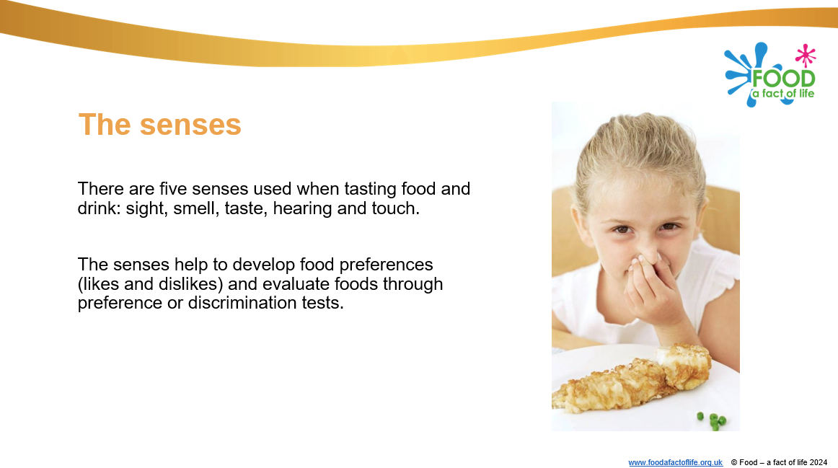
Looking for more…
Why not challenge your students to sensory evaluate the marble tray bake?
Use our sensory evaluation presentation and teacher guide to help you plan your lesson.
For a lesson that includes cake making (using the melting method) and sensory evaluation, why not look at this lesson from the Food – a fact of life Schemes of Work?

Slide 16
Marble pear tray bake
For further information, go to:
www.foodafactoflife.org.uk
This resource meets the Guidelines for producers and users of school education resources about food.

