Slide 1
Modified Atmosphere Packaging (MAP) and ambient foods

Slide 2
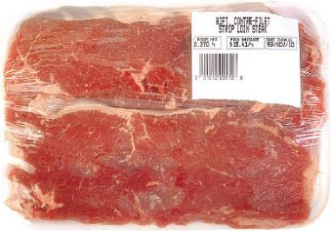
Food preservation
Chilling food can have a preservative effect by reducing and delaying microbial activity.
However, the shelf-life of a chilled product can be increased by modifying the gases surrounding the food.

Slide 3
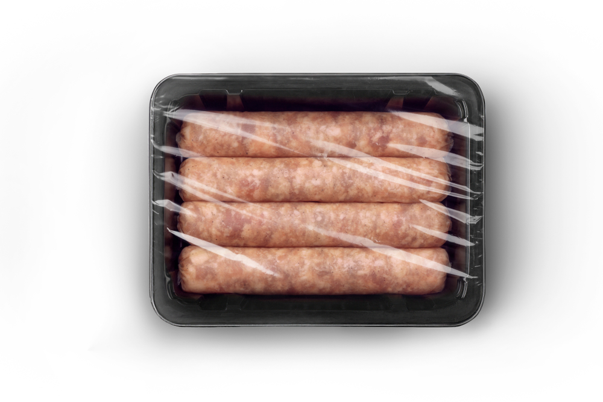
Modified Atmosphere Packaging (MAP)
Modified atmosphere packaging is the enclosure of a food, e.g. bacon, in a package in which the atmosphere has been changed by altering the proportions of carbon dioxide, oxygen, nitrogen, water vapour and trace gases.
The process limits microbial as well as biochemical activity. This modification is performed by gas flush packaging – air is removed and replaced by a controlled mixture of gases.

Slide 4
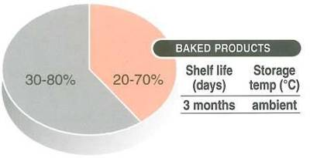
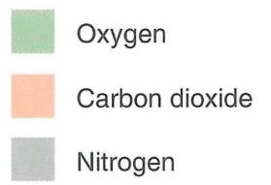
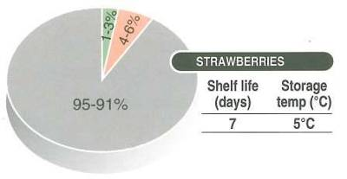
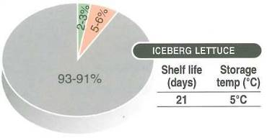
Proportion of gases in packaging

Slide 5
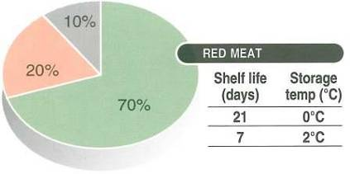
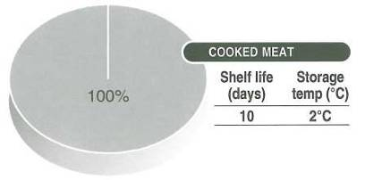

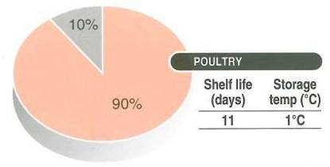
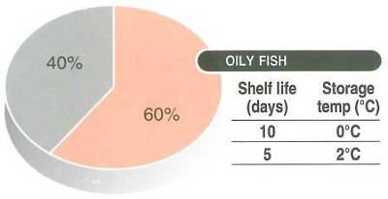
Proportion of gases

Slide 6
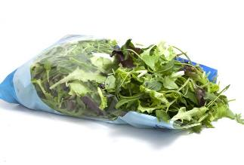
Thermoplastic polymers
Nearly all packaging for this process is based on thermoplastic polymers. The reasons for this are that they:
have greater flexibility, i.e. can be formed into different shapes;
are light in weight;
provide a gas barrier;
can be sealed easily;
can be printed on.

Slide 7
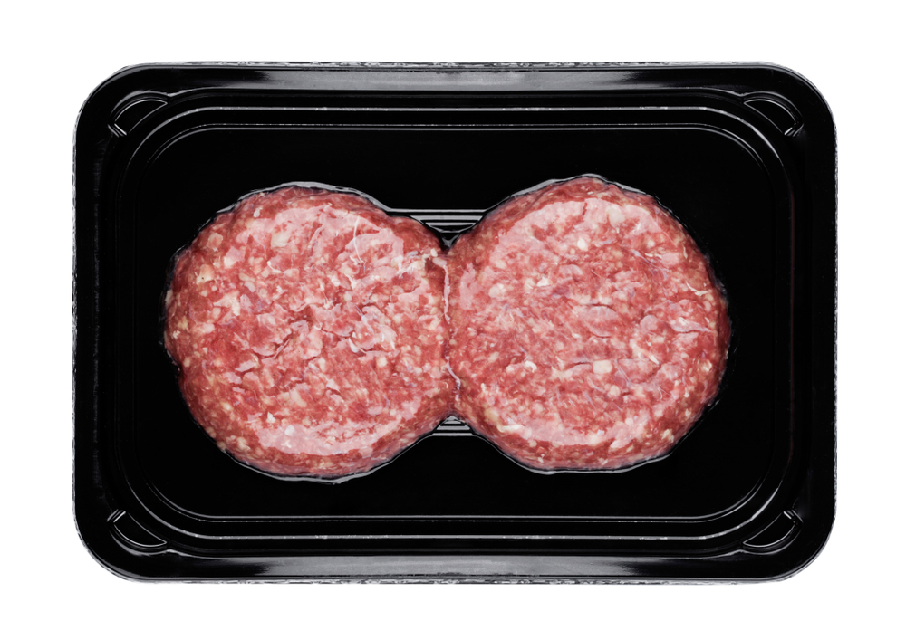
Thermoplastic polymers
Thermoplastic polymers are also used because they:
are resistant to physical pressures of manufacturing, distributing and retailing;
have good aesthetic properties;
can be multi-layered with other materials to enhance overall properties.

Slide 8
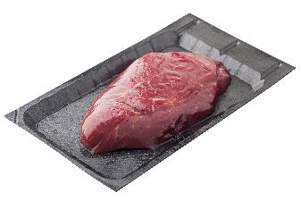
Vacuum packaging
Many spoilage microorganisms are ‘aerobic’, meaning that they grow best in an environment with oxygen. Removing much of the air within packaging can therefore limit the growth of these organisms. Vacuum packing also prevents aromatic compounds in the food product from evaporating off, allowing the product to maintain scents and flavours it might otherwise lose. Because vacuum packing does not destroy anaerobic bacteria, such as Listeria, it is usually combined with other preservation methods in order to limit their growth (e.g. maintaining cold temperatures).

Slide 9
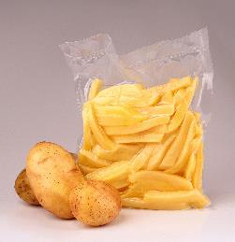
Vacuum packaging at home
If vacuum packaging food in the home, the food should be eaten within ten days.
The packet should be sealed and left in the fridge until it is eaten to keep it safe.
Once the packaging is opened, it should still be kept in the fridge like other chilled foods and eaten within two days.

Slide 10
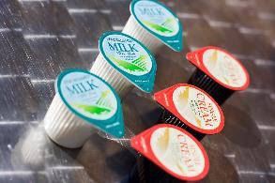
Ambient food products
Ambient food is stored and sold at room temperature.
Canned and aseptically packaged food are examples of ambient products, e.g. ready meals, fruit juices, UHT milk.
They are intended to have a long shelf-life, and undergo rigorous heat treatment to destroy potentially harmful microorganisms.
Pasteurisation and sterilisation are the two main heat processes used.
Some ambient food is not heat treated, e.g. cereals.

Slide 11
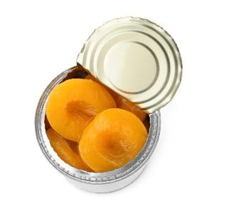
Ambient food products
Only harmless micro-organisms can be allowed to survive processing treatment. Canned fruit juice, which may contain spore-forming bacteria, will be safe as long as the pH is low enough to ensure the bacterial growth could not occur.
Low-acidic food undergoes a rigorous heat treatment known as the ‘Botulinum cook’ – to reduce the numbers of clostridium botulinum spores to a safe level.
This is because these spores are very resistant to heat.

Slide 12
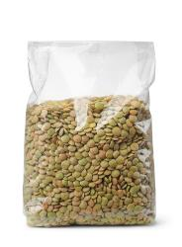
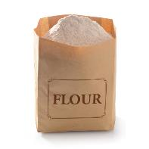
Ambient food products
Ambient food, such as cereals, rice and pulses must be stored carefully.
The moisture content for each needs to be kept low to prevent mould and yeast spoilage.

Slide 13
Modified Atmosphere Packaging (MAP) and ambient foods
For further information, go to:
www.foodafactoflife.org.uk
This resource meets the Guidelines for producers and users of school education resources about food.

