Slide 1
Sustainable healthy diets

Slide 2
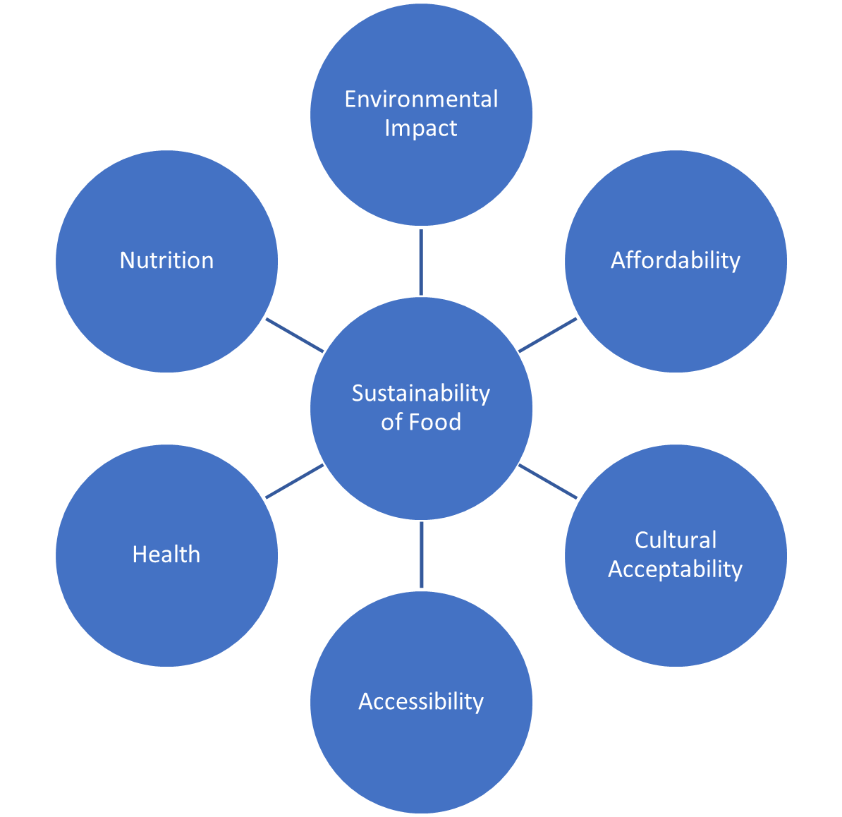
Introduction
This presentation is an introduction to a sustainable, healthy diet.
The diagram on the right shows the factors that make up a sustainable diet. In this presentation, nutrition and health are grouped together, as are affordability, acceptability and accessibility.
(including safety)
Adapted from FAO, 2012

Slide 3
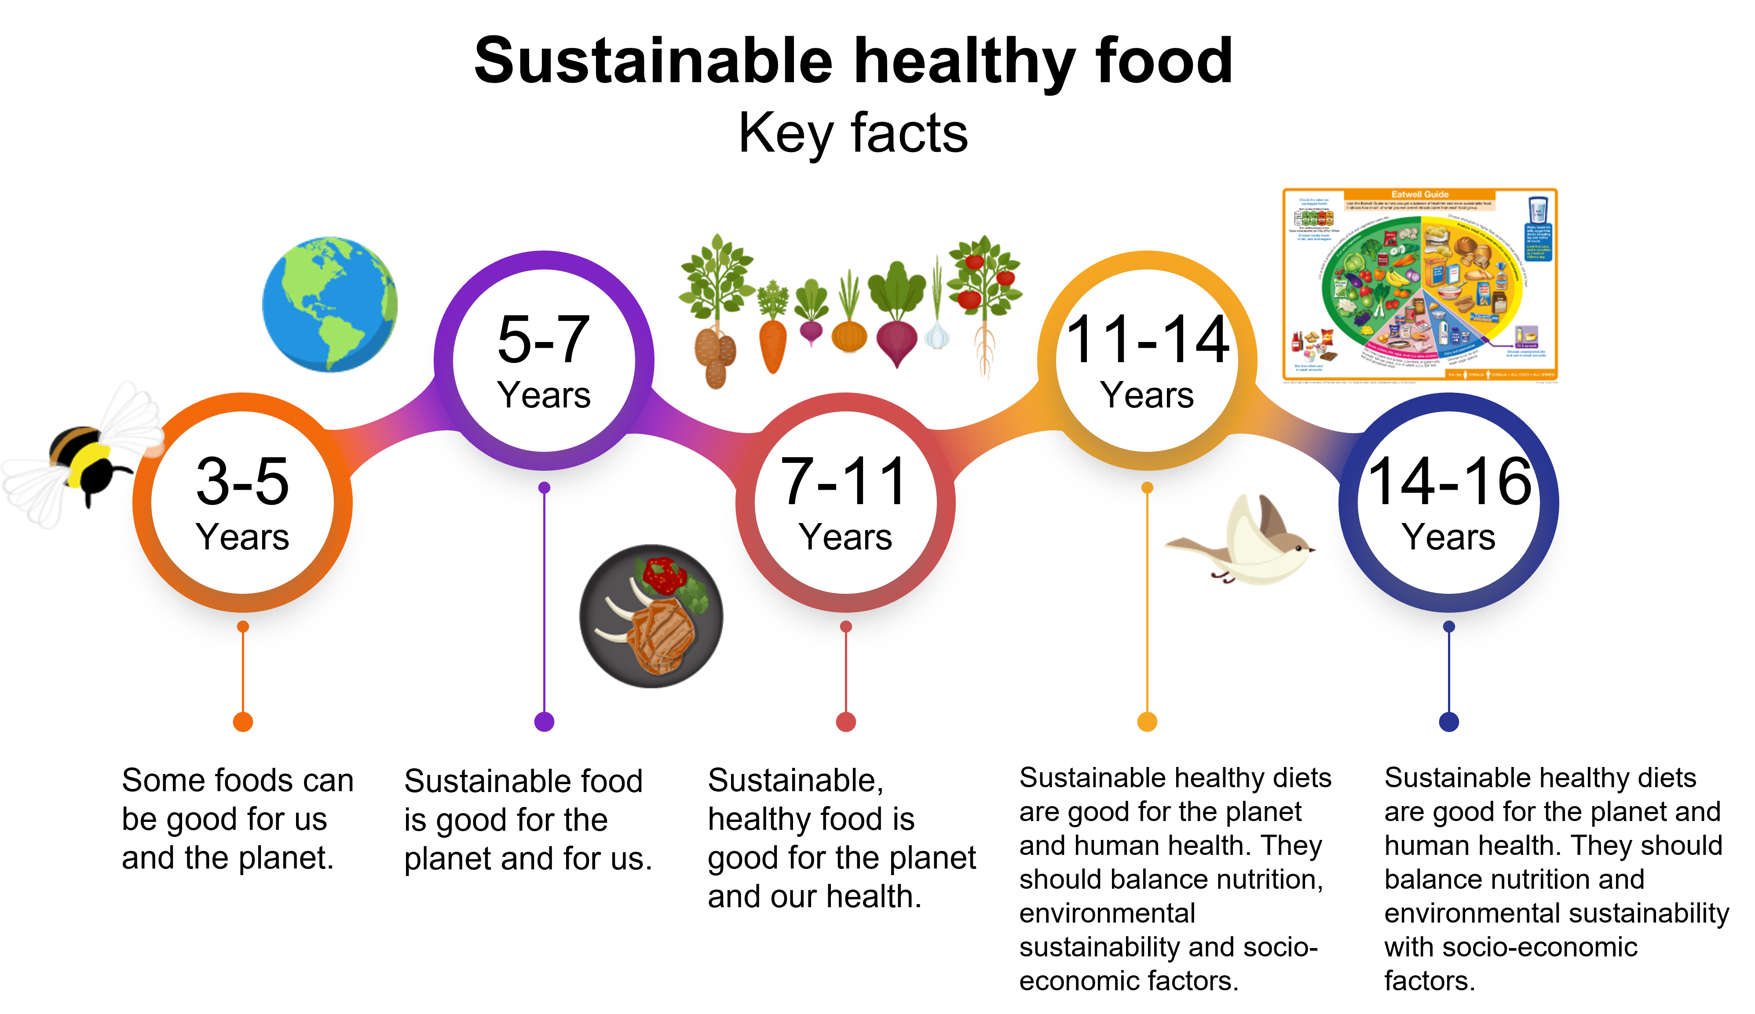
Sustainable, healthy diets Key facts
Each section is based on one of the Food – a fact of life Key facts, which progress through the age phases.
The Key facts cover the core competences for children and young people aged 5-16 years and indicate what a pupil should know at each stage of their learning journey.
See our Curriculum roadmaps to find out more about the Key facts

Slide 4
Sustainable healthy diets
Summarised Key Fact:
Sustainable healthy diets are good for the planet and human health. They should balance nutrition, environmental sustainability and socio-economic factors, e.g. affordability.
Sustainability is a complex topic and must consider both the planet and people.
Balance is important to consider. For example, a food might be affordable, but not nutritious or produced with care for the environment.
Another food might be produced with care for the environment and nutritious, but not be affordable or accessible.

Slide 5
Contents
Environmental impact
The greenhouse effect
Climate change and food production
Biodiversity
Sustainable farming in the UK
Nutrition and health
Affordability, acceptability and accessibility
The presentation can be used in its entirety, or you can use the hyperlinks above to choose the slides most relevant to the particular focus of your teaching and learning around sustainable healthy food. There are a few short questions at the end of each section, with answers on the next slide.

Slide 6
Environmental impact

Slide 7
Sustainable healthy diets
Key fact
Sustainable food is produced and processed with care for the environment, e.g. low carbon emissions and supporting biodiversity.
Reducing the amount of food wasted at each stage of the farm to fork journey has financial and environmental benefits.
When we think about the environment, we are considering more than just greenhouse gases. For example, we should also consider water and land used to produce the foods that we eat, and food lost and wasted before it is eaten.

Slide 8



Impact of the changing environment
An increase in global temperatures.
An increase in extreme weather, such as hurricanes and flooding.
A change in the climate of an area.

Slide 9
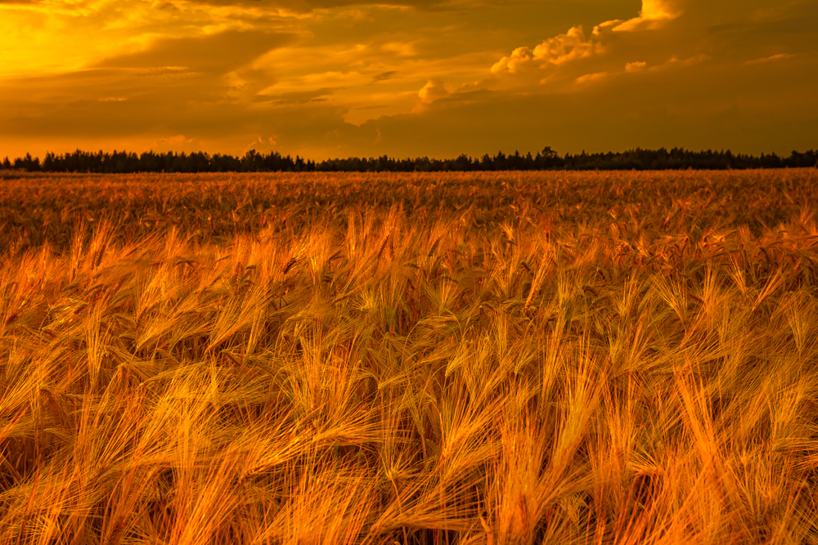
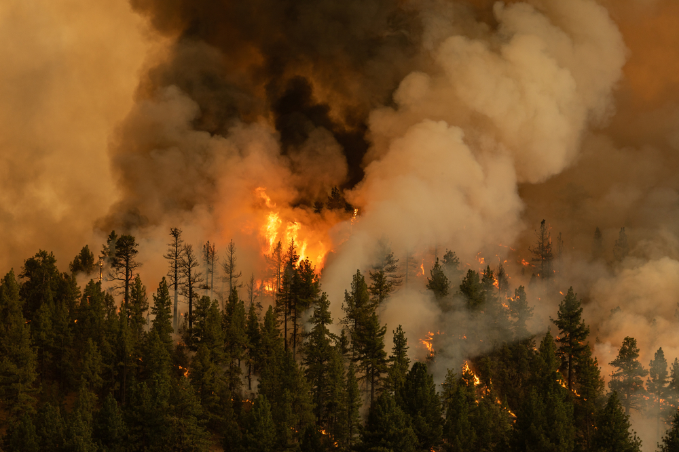

Impact of the changing environment
Climate change can cause extreme or unusual weather, which can affect food production and impact on national and global food security. This can result in:
Conditions changing so it can be harder to grow food.
An increase in fires.
The polar ice caps melting.

Slide 10
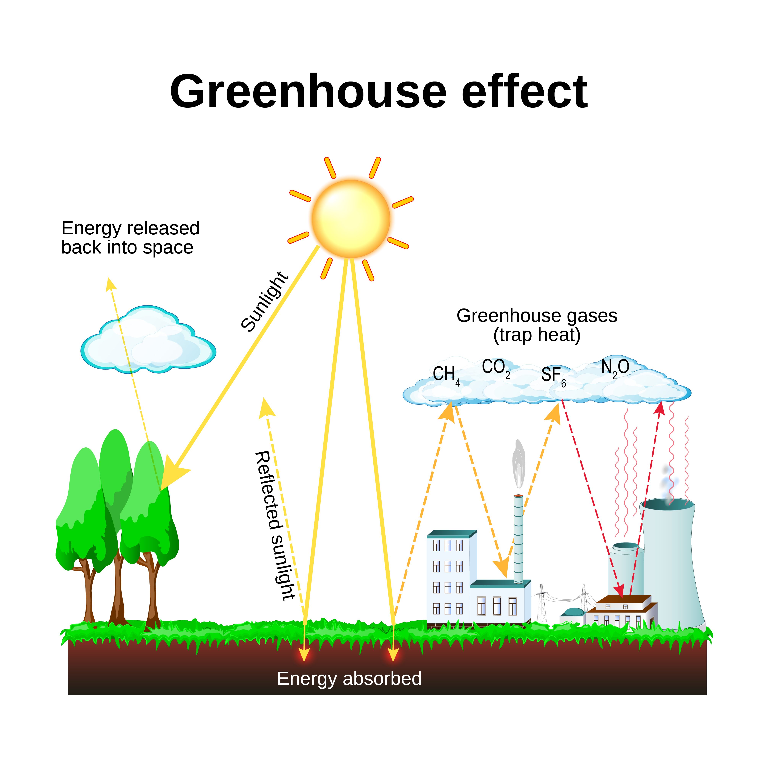
The greenhouse effect
Humans can affect climate change through the release of greenhouse gases, which trap the Sun's heat.
This makes the Earth warmer.
To reduce this effect, we need to reduce the amount of these gases we release.

Slide 11
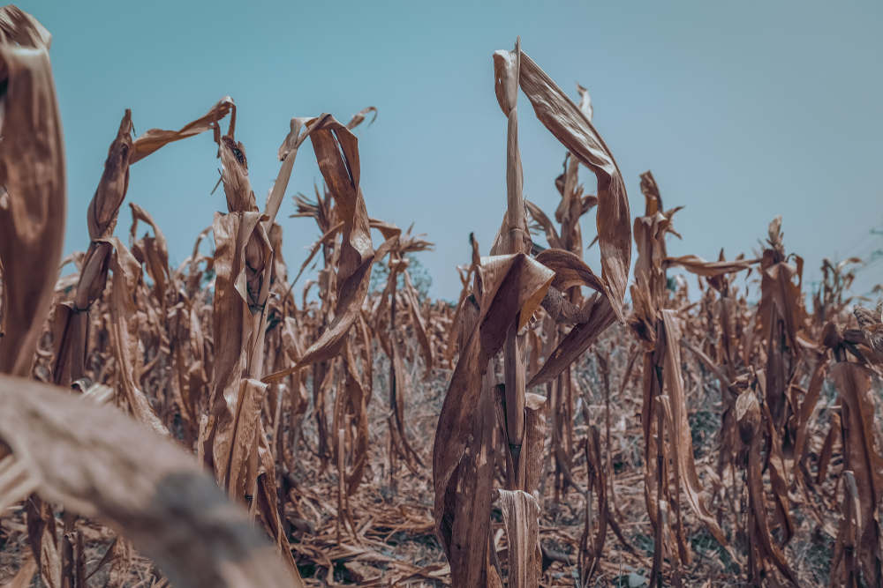
Climate change and food production
Climate change can affect food production:
Longer dry periods can cause water to dry up and crops to die.
Longer wet periods can flood fields and wash soil away.
Warm conditions can harm farm animals and damage the grass they feed on.
Changing weather can cause different diseases in crops and animals.
Increased wind and rain can cause crops to collapse, and animals may have to be kept inside more often.

Slide 12
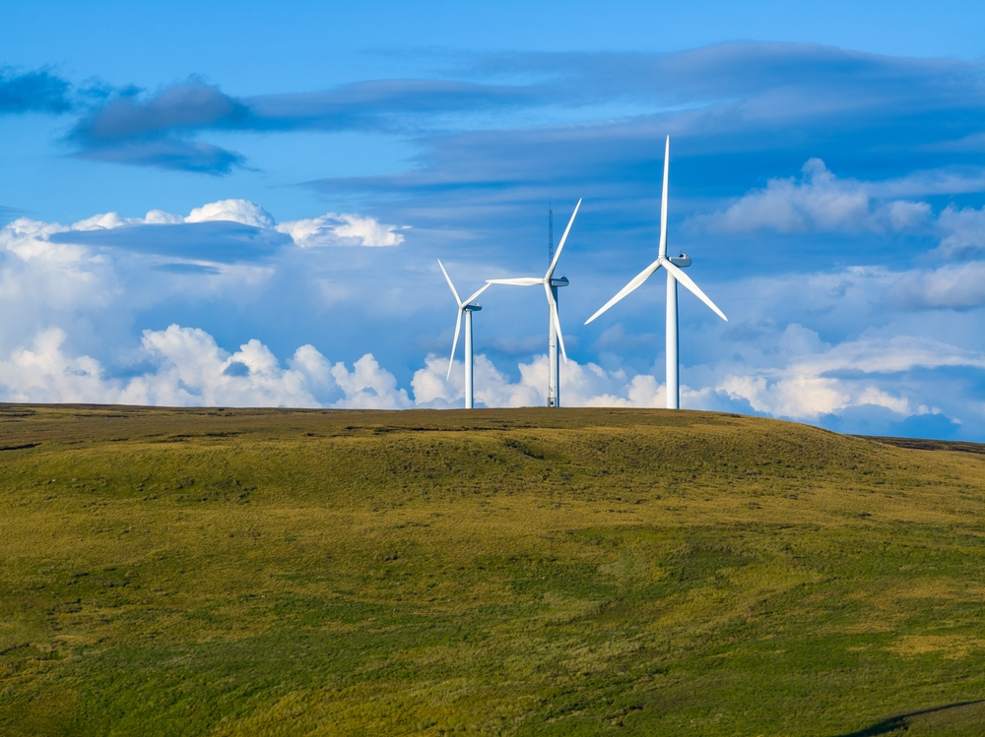
Combatting climate change
Combatting climate change requires two goals:
Reducing the amount of greenhouse gases emitted (main goal).
Storing as much carbon as possible (secondary goal).
Replacing fossil fuel burning with renewable energy, e.g. solar or wind, is the main way to reduce emissions.

Slide 13
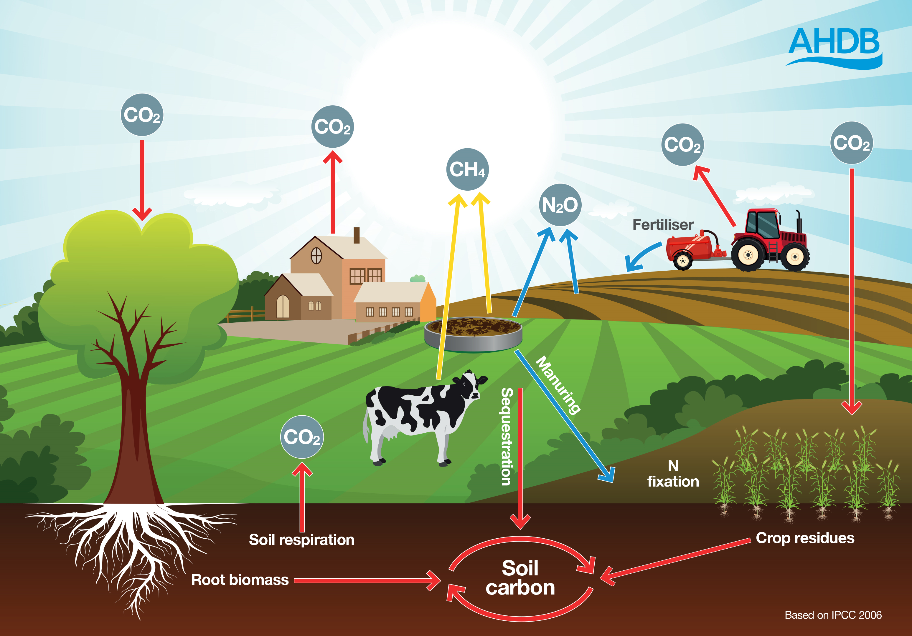
Carbon storage
Farms can store some carbon, in the soil and plants. This can help to remove some carbon from the atmosphere.
How farmers use and care for the land can impact how much carbon can be absorbed.
To store more carbon, farmers can reduce ploughing, improve soil health and plant additional trees and hedgerows.
However, the total amount of carbon that can be stored by farmland is often debated.
Carbon dioxide and other gases may be released from energy usage, livestock and fertilising. Some of this carbon can be stored in plants or in the soil.

Slide 14
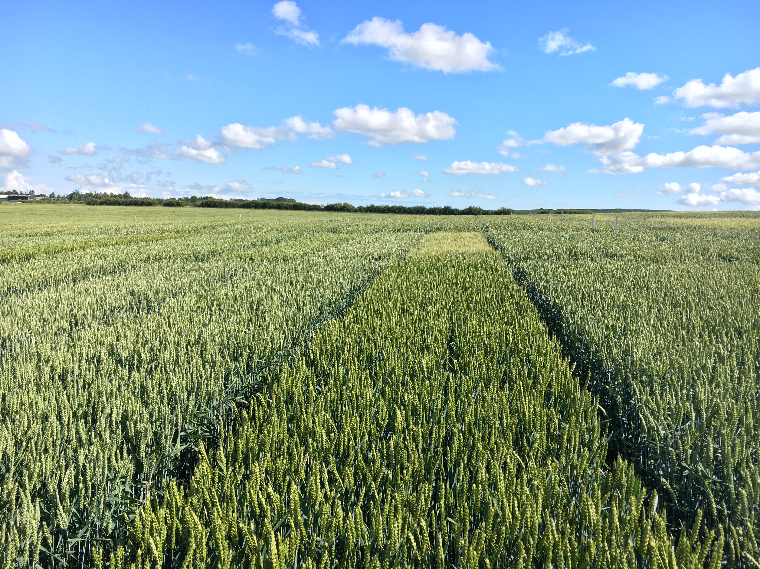
Adapting to climate change
Changing the way food is grown and reared can help maintain or increase food production. This includes:
Breeding crops that resist extreme weather.
Storing and managing water to use in periods of drought and flooding.
Rotating between animals and crops, to improve soil health and reduce fertiliser usage.
Bringing animals inside during high temperatures.
Planting trees to provide shade to animals.
Using new technologies to make farming more efficient.
This image shows a trial site for new wheat crop varieties in the UK

Slide 15
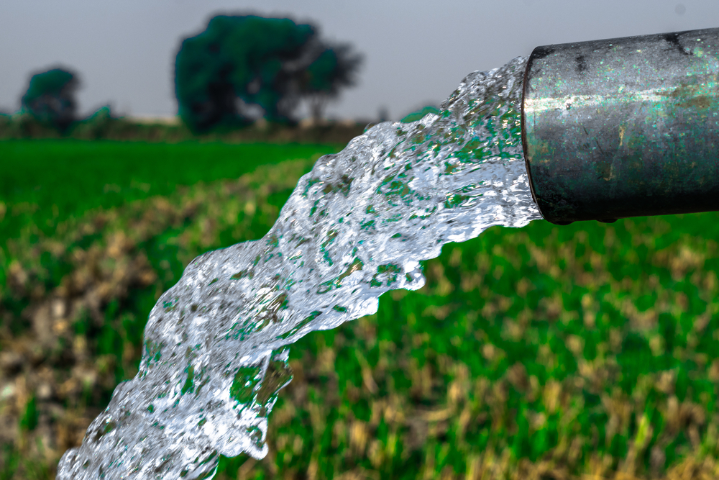
Water usage
Earth is about 70% water, but in many places, accessing clean water is difficult.
Water is needed to keep crops and animals healthy, and care should be taken not to waste water.
Climate change means that some places have even less water than usual, which can pose a risk to crops and animals.
Heavy rains may also wash soil and nutrients into rivers and streams, which can harm wildlife.

Slide 16
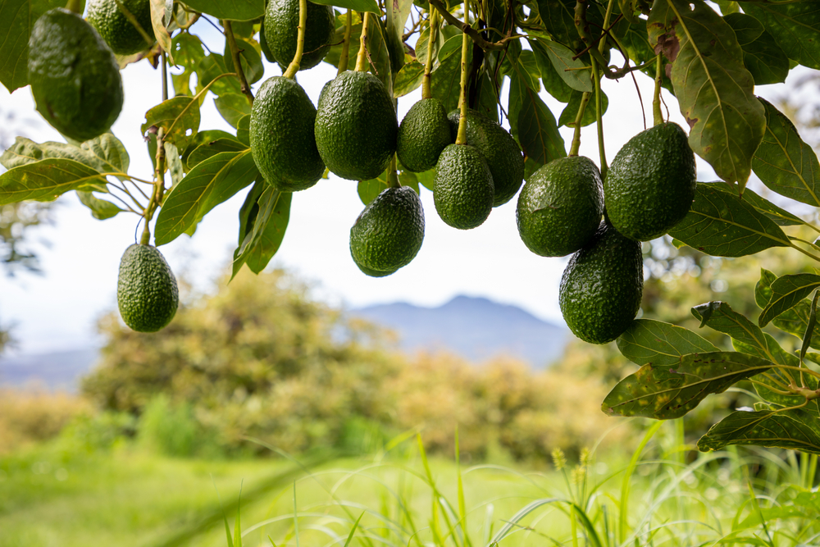
Water usage
Some crops may need more water to grow. For example, avocados, almonds and green beans require large amounts of water.
Most water used for food production in the UK is rainwater. Using rainwater is less wasteful and more sustainable than pumping in water from elsewhere.
Avocados growing on a tree. Avocados are native to The Americas.

Slide 17
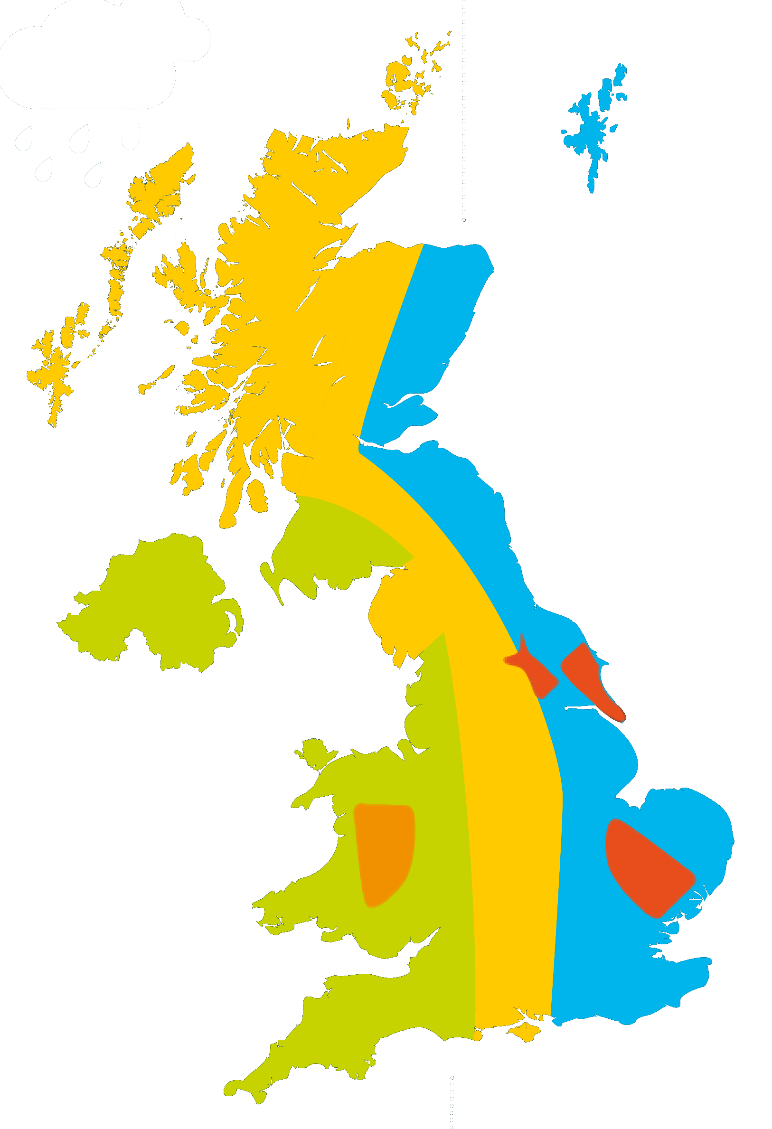
Land usage
Not all land is suitable for the same purpose.
Flatter land is generally more suitable for crops. Fertilising soils can also help to increase the land area available for crops.
Some land may be very stony or steep. This land may be more useful for grazing animals and/or growing trees.
Sheep
Dairy
Mixed
Arable
Pigs
More information about land use in the UK can be found in the Where food comes from Knowledge organiser.

Slide 18
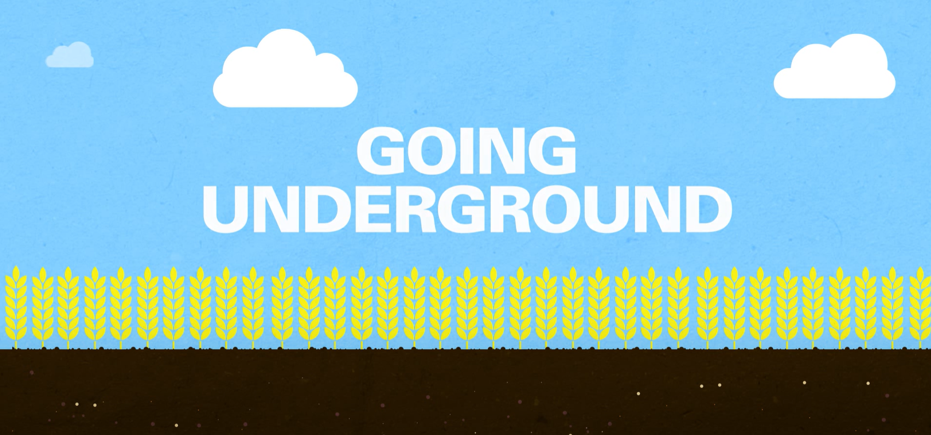
What does soil do and why is it important for food production?
Soil can:
  store carbon dioxide;
  regulate the flow of water;
  provide nutrients for plant growth;
  increase biodiversity;
  break down organic materials (through microorganisms that live there).
Watch the video above for more information on soil health (source: AHDB)

Slide 19
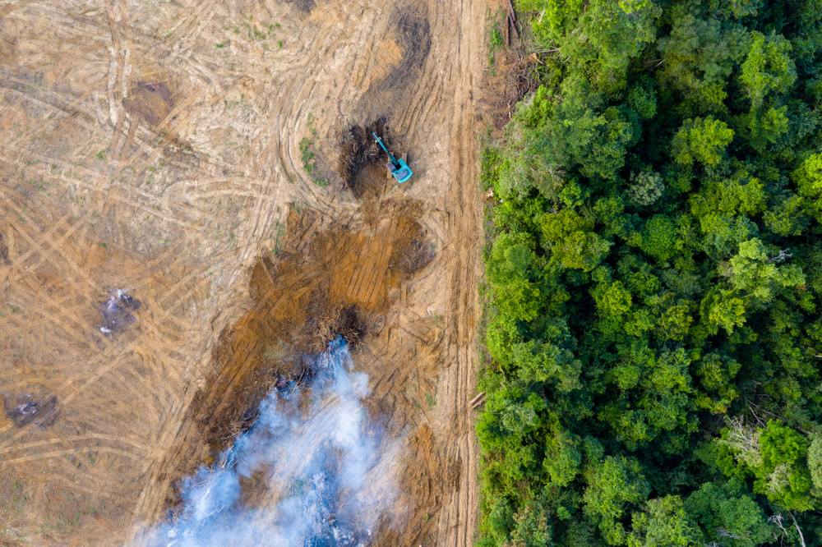
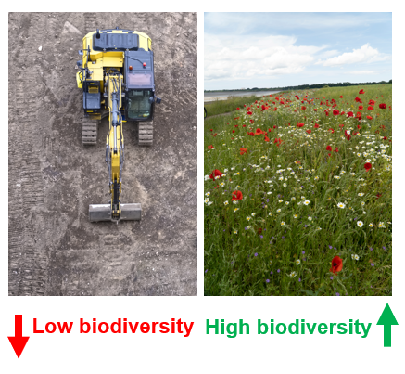
Biodiversity
Low biodiversity
High biodiversity
Biodiversity is a measure of how many different species live in an area.
If biodiversity is lowered, this can have effects on other plants and animals in the area.
Biodiversity is important in growing food by promoting a healthy and balanced ecosystem e.g. encouraging insects and birds to live near fields can help keep pests under control and help to pollinate some crops.
The image above shows an area of ‘deforestation’ in Borneo, where trees have been cut down (left). This area has low biodiversity as there are no plants and no habitats for animals. The remaining forest (right) has higher biodiversity because the plants form a habitat for other animals to live in.

Slide 20
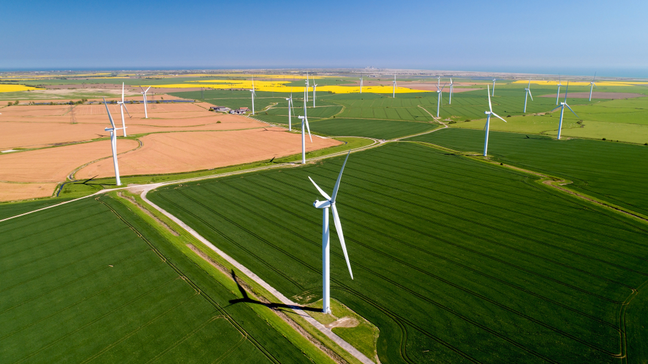
Sustainable farming in the UK
In the UK, greenhouse gas emissions from agriculture have fallen over the last 20 years, but more work still needs to be done to reduce emissions.
New measures are being tried, such as altering animal feed to reduce greenhouse gases (from their burps!) and increasing renewable energy methods like wind and solar power.
2021 UK Greenhouse Gas Emissions, Final Figures, 2023

Slide 21
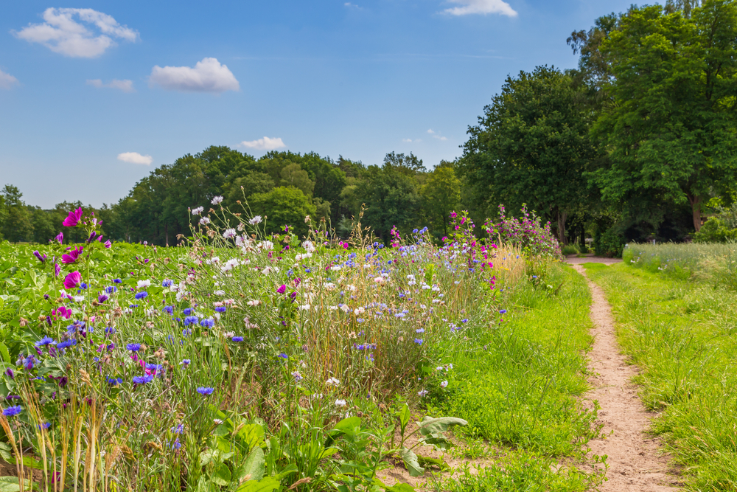
What are farmers and food producers doing?
Switching to more sustainable methods of farming can help to reduce its impact on the environment.
Methods can include:
improving soil health;
using organic fertiliser such as manure;
creating field margins and areas to increase biodiversity;
growing trees and hedgerows to capture carbon;
rotating animals and crops, to improve soil health and reduce fertiliser usage.

Slide 22
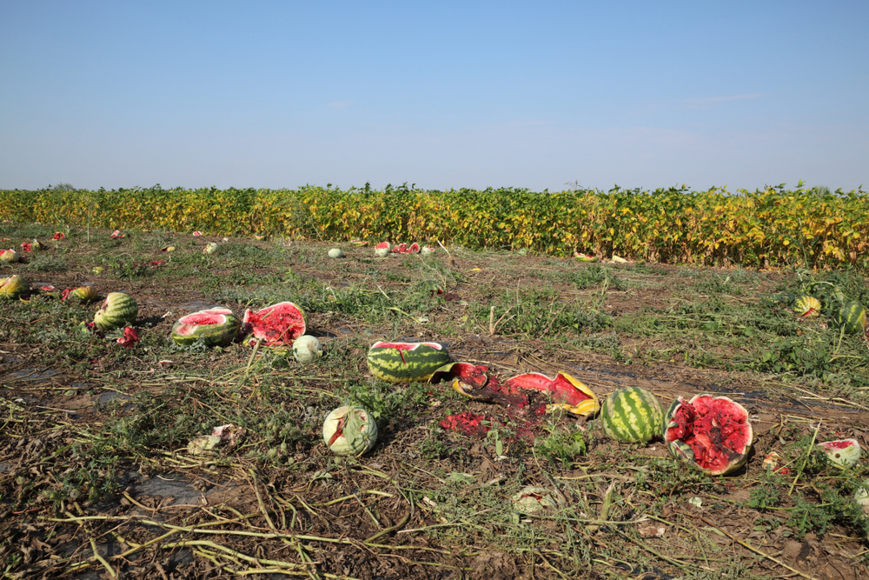
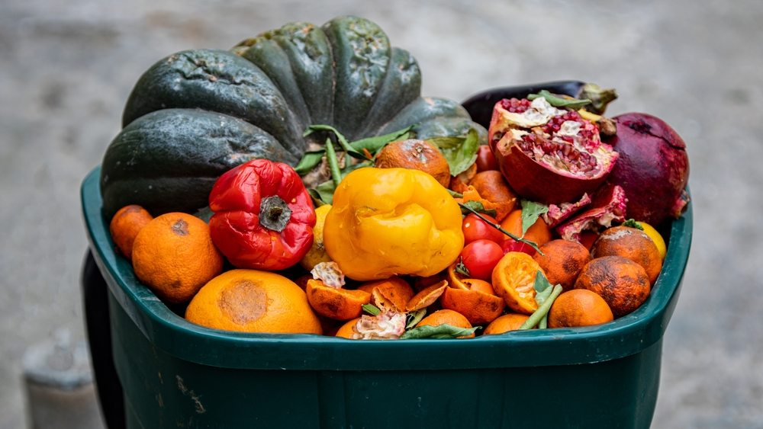
Food loss and food waste
About one third of all food is lost or wasted.
This waste also contributes to greenhouse gases being released.
In the UK:
About 70% of food is wasted at home;
About 30% is lost on farms or in supermarkets.
The average household spends £470 on food that ends up in the bin every year!
Farmers and retailers are trying to find ways to reduce food that is lost and wasted, e.g. selling ‘wonky veg’ that would otherwise be thrown away and turning waste into food for animals.
Food loss is food that is lost before it makes it to stores. Food waste is food we waste at home or in stores.
Source: Food Waste – 2024 Facts & Statistics

Slide 23
Questions – Environmental impact
State why biodiversity is important.
Explain how a changing climate can impact on food production.
True or false? In the UK, most food waste occurs in the home.
Name two ways to reduce the impact of climate change in food production.

Slide 24
Answers – Environmental impact
State why biodiversity is important. Answers could include:
Lower biodiversity can affect other plants and animals in the area
Biodiversity promotes a healthy and balanced ecosystem
An example of a benefit (e.g. insects and birds near fields can control pests and pollinate crops).
2. Explain how a changing climate can impact on food production. Answers could include:
Longer dry periods can cause water to dry up and crops to die.
Longer wet periods can flood fields and wash soil away.
Warm conditions can harm farm animals and damage the grass they feed on.
Changing weather can cause different diseases in crops and animals.
Increased wind and rain can cause crops to collapse, and animals may have to be kept inside more often.

Slide 25
Answers – Environmental impact
True or false? In the UK, most food waste occurs in the home.
True
Name two ways to reduce the impact of climate change in food production. Answers could include:
  Switch to renewable energy sources
  Capture carbon
  Reduce carbon emissions by farming and processing food more efficiently
  Reduce fertiliser usage
  Rotate animals and crops to improve soil heath
  Use different fertilisers, such as manure

Slide 26
Sustainable healthy food
Key fact
Sustainable and healthy diets are dietary patterns that promote health and wellbeing.
The human impacts of sustainable, healthy diets are important to consider.
Ideally, sustainably produced foods should also provide benefits to our health.

Slide 27
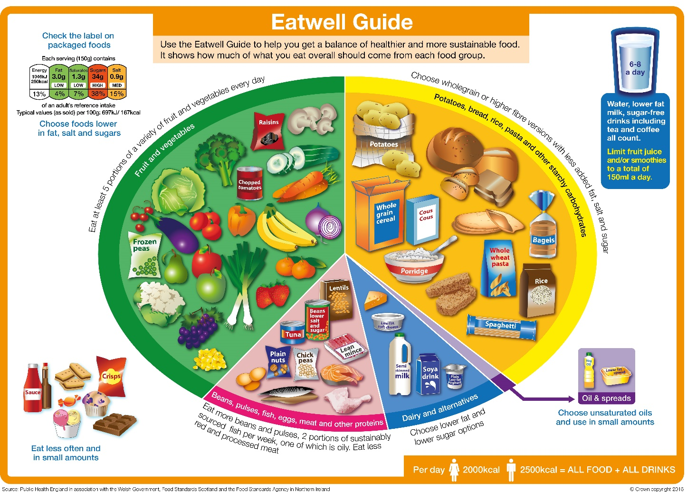
The Eatwell Guide
The Eatwell Guide shows which different groups of foods are needed in order to have a well-balanced and healthy diet.
People should choose variety of different foods from each food group to help get the wide range of nutrients the body needs to stay healthy.
If everyone in the UK followed the Eatwell Guide, our diets would have a much lower environmental impact than they currently do.*
*Source: The Carbon Trust

Slide 28
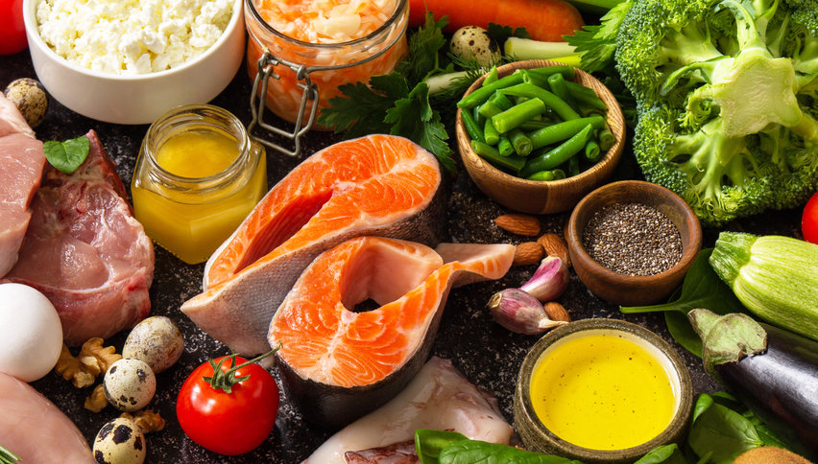
Nutrients
There are a wide variety of nutrients that we need to consume to stay healthy.
Having a varied and balanced diet that follows the Eatwell Guide helps to ensure that different nutrients are eaten.
A lack of access to, or a higher cost of some foods found in the Eatwell Guide, may result in lower intake of key nutrients.

Slide 29

Energy
Energy is essential for life and is needed to support growth and activities.
To maintain weight, it is necessary to balance energy intake (from food and drink) with energy expenditure (from activity).
Activities such as cycling or walking use energy and produce fewer greenhouse gases than travelling by car.

Slide 30
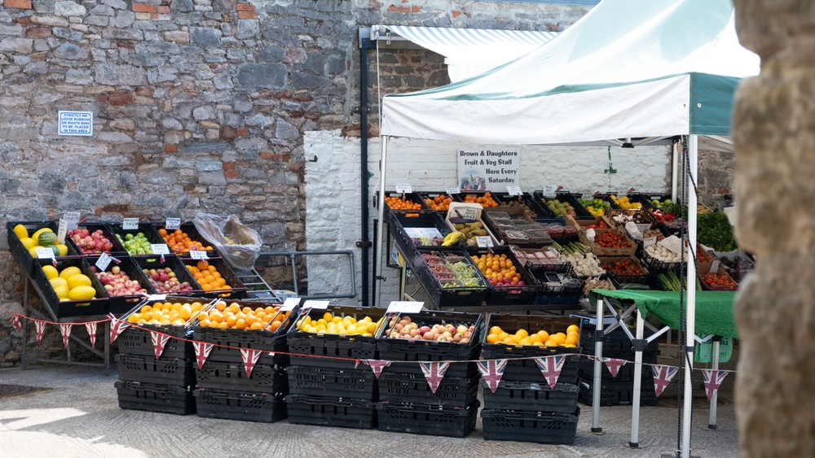
5 A DAY
We should eat at least 5 portions of vegetables and fruit per day.
Variety is important, because different vegetables and fruits contain different nutrients and in different amounts.
In the UK, we are eating far less than 5 portions per day¹.
Buying local produce, where available, can reduce the distance it has to travel (the ‘food miles’) and therefore be more sustainable. Fresh produce can be cheaper when it is in season (e.g. strawberries in June/July), because more of it is available.
1. National Diet and Nutrition Survey, 2020

Slide 31
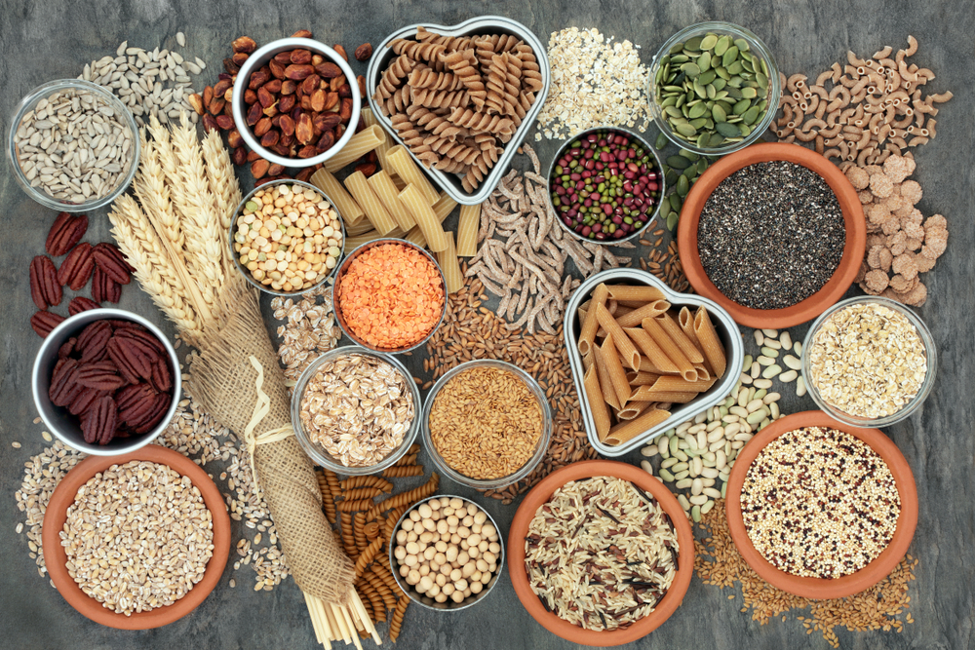
Fibre
Dietary fibre is important for our digestive health and can help to reduce constipation. It may reduce the risk of some diseases.
High-fibre foods provide a low amount of energy (calories) per gram. They may be able to keep people feeling fuller for longer, reducing overall energy (calorie) intake.
Higher fibre foods are often also foods that are more sustainable, particularly those grown in the UK.

Slide 32
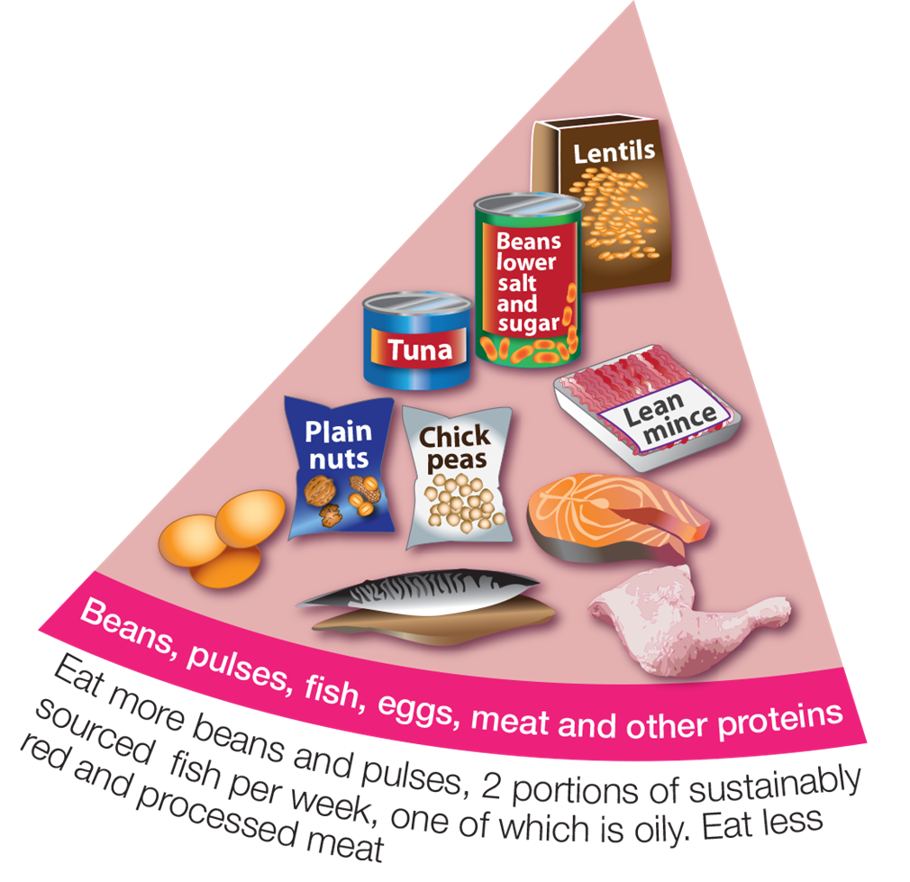
Beans, pulses, fish, eggs, meat and other proteins
These foods are sources of protein, vitamins and minerals.
Aim for at least two portions (2 x 140g) of sustainably sourced fish a week, including a portion of oily fish*.
It is recommended that you do not eat too much red meat, processed meat or meat that is high in saturated fats as this can lead to health problems. However, some nutrients, such as B12 are mostly found in animal products.
*MSC in the UK | Marine Stewardship Council

Slide 33
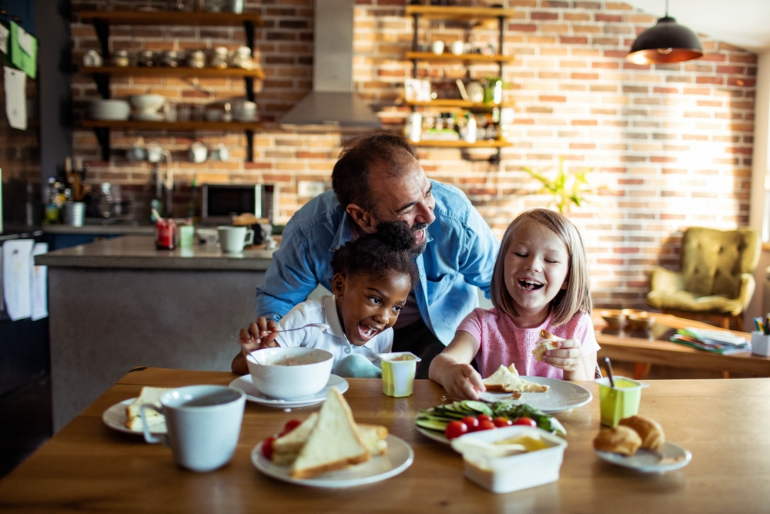
Plant-rich diets
Generally, plant-rich diets (those that contain mostly plant foods) are more sustainable than those that contain high amounts of meat and dairy.
Beans, peas and lentils are plant-based protein sources. They’re naturally low in fat, and they’re high in fibre, protein and vitamins and minerals.
Plant protein sources are often more sustainable options. However, UK meat and dairy production is more sustainable than in many other countries.*
*Net zero carbon UK livestock report October 2020, CIEL, 2020 & British Nutrition Foundation, 2023

Slide 34
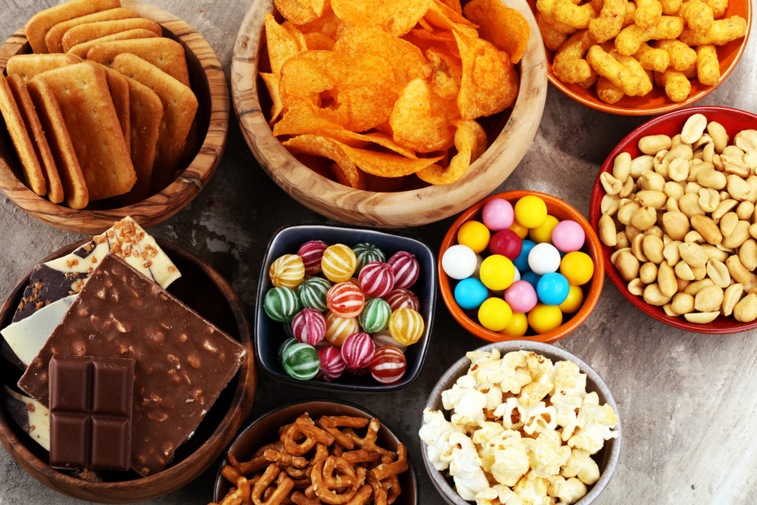
Foods high in fat, salt and sugar
Foods that are high in fat, salt and sugar (HFSS) are generally less sustainable options than those that are not.
This is because of the higher amount of energy required to process these foods and produce and transport the individual ingredients.
These foods are less healthy options and sit outside the Eatwell Guide. They should be eaten infrequently and in small amounts.
A healthy, sustainable diet. British Nutrition Foundation, 2023

Slide 35

Hydration
Our body is nearly two-thirds water, so drinking enough to stay hydrated is important.
The body loses water all the time, when we go to the toilet, from sweat and also evaporation from skin. If we do not consume enough water, we become dehydrated.
To be more sustainable, we should try to limit the amount of water we waste.
Choosing tap water (where safe) is more sustainable than bottled water. Soft drinks will usually have an even bigger environmental impact.

Slide 36
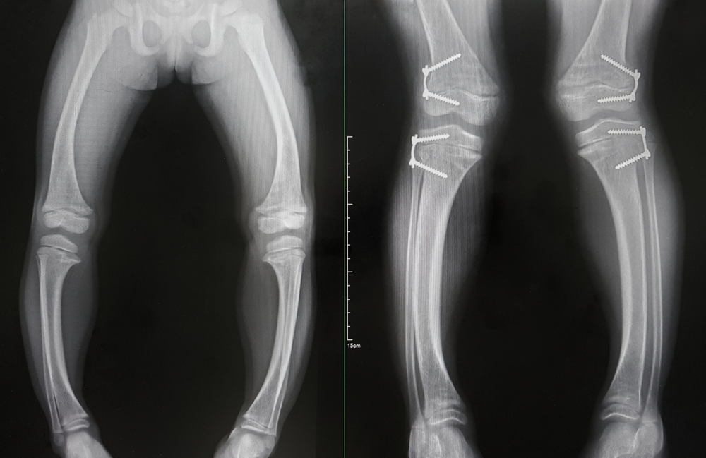
Health conditions
Access to a healthy, balanced diet is important to reduce the risk of certain health conditions.
In the UK, increased food costs and poor diets (amongst other factors) have resulted in increased levels of malnutrition over the last decade or so.
Having access to affordable, healthy food is important, when thinking about sustainability.
Rickets is a rare condition that results from a prolonged vitamin D deficiency. This prevents calcium from being properly absorbed and leads to a softening of bones.
Source: NHS digital

Slide 37
Questions – Nutrition and health
How many portions of fruit and vegetables should we eat each week?
Describe how to hydrate in a more sustainable way.
Explain what a ‘plant-rich’ diet is and how it may be more sustainable.
True or false? Foods high in fat, salt and sugar are normally more sustainable.

Slide 38
Answers – Nutrition and health
How many portions of fruit and vegetables should we eat every day?
At least 5 a day
Describe how to hydrate in a more sustainable way.
Drink tap water (where safe to do so) instead of bottled water or soft drinks.
Explain what a ‘plant-rich’ diet is and how it may be more sustainable.
A plant-rich diet is one that contains mostly foods made from plants. These foods are generally more sustainable, as they produce fewer greenhouse gases to get from farm to fork. A plant-rich diet can also include some lean meat, dairy foods, fish and eggs depending on dietary choices.
True or false? Foods high in fat, salt and sugar are normally more sustainable.
False

Slide 39
Sustainable healthy food
Key fact
Sustainable healthy diets are accessible, affordable, and safe.
If a food is produced with care for the environment and is nutritious, but is not accessible, affordable or safe, then some people cannot obtain the benefits.
Therefore, ensuring that everybody has access to these foods is a key component of sustainability.

Slide 40
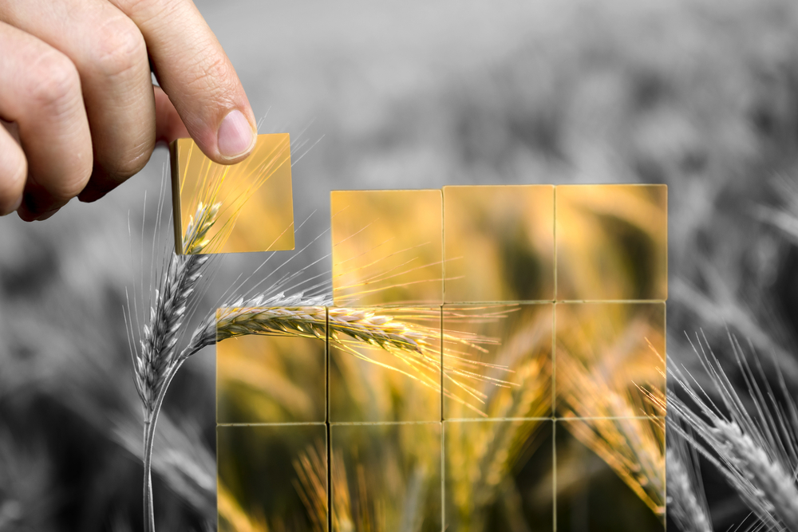
Food security
Food security means having access to enough safe and nutritious food.
The food should also meet the need for an active and healthy life.
Food security may be affected by:
economic factors, e.g. the price of food rising;
physical factors, e.g. droughts and flooding destroying crops;
social factors, e.g. wars and conflict.
Food security is an increasing concern in the UK. The percentage of people in food insecure houses went from 7% in 2022, to 11% one year later.
Sources: UN Committee on World Food Security
House of Commons, Who is experiencing food insecurity in the UK? (2024)

Slide 41
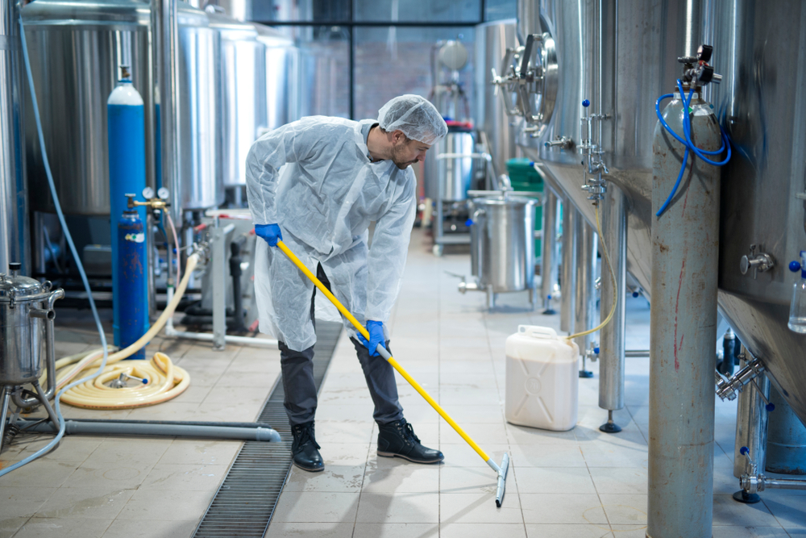
Food hygiene and safety
Sustainably produced foods should also be safe to eat.
Good food hygiene, production and storage practices can ensure that food poses little risk to health.
Many countries with low food security may also have reduced access to safe and hygienically produced foods.

Slide 42
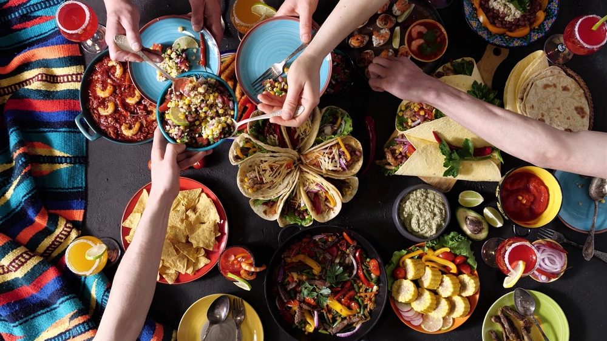
Cultural considerations
Some foods may not be culturally or religiously acceptable to all groups.
For example, foods in Islamic cultures must be ‘halal’, whilst those in Jewish cultures should be ‘kosher’.
Some people may also be vegetarian or vegan, have allergies or another reason why they don’t eat certain foods. These people still need access to a healthy diet that fulfils their needs.
Food traditions are recognised as an important part of culture by organisations like the Food and Agriculture Organization of the United Nations.

Slide 43
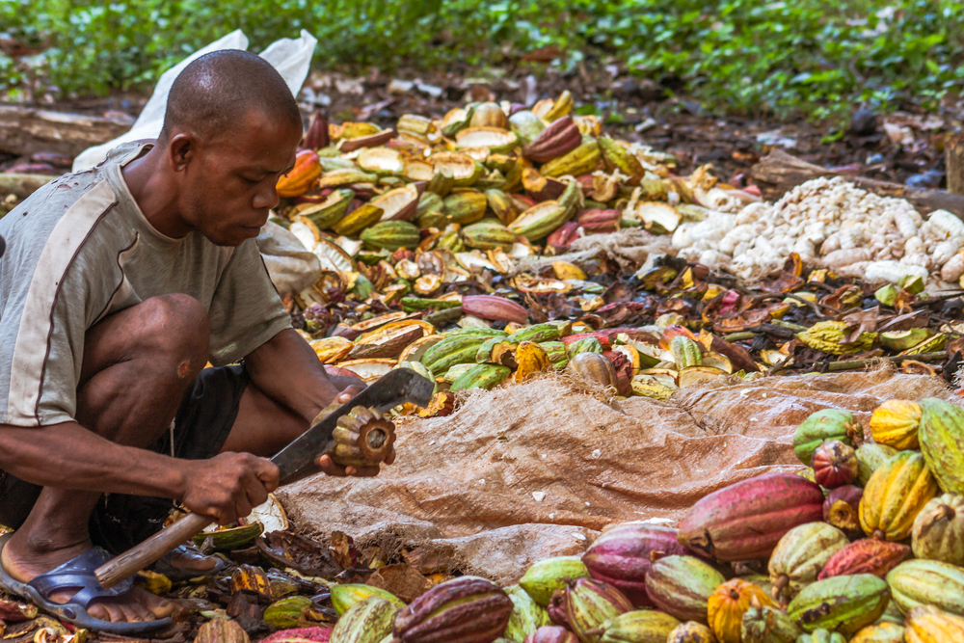
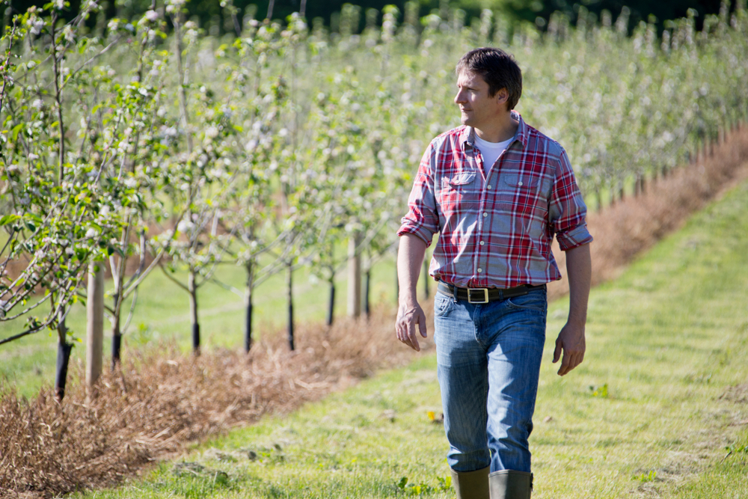
Social considerations
Social considerations in food production include:
ensuring that farmers and growers are paid fairly;
ensuring safe labour practices;
ensuring animal welfare;
ensuring that people living near areas where food is produced are not negatively affected;
ensuring that countries or areas that grow food are not exploited.

Slide 44
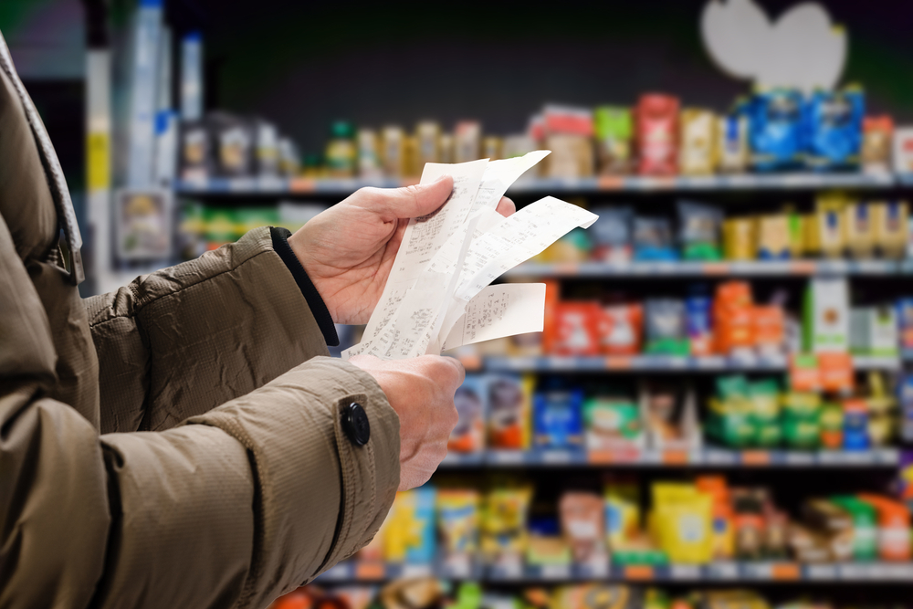
Economic considerations
A truly sustainable food should also be affordable and produced in a way that is fair to farmers and producers.
Products can be healthy and be produced sustainably but might cost more money than less sustainable alternatives.
For most consumers, price and taste are usually most important, so if more sustainable foods are more expensive, then they may be bought less often.

Slide 45
Questions – Affordability, acceptability and accessibility
Explain what is meant by ‘food security’.
Describe why good food hygiene is important during food production.
State two social considerations that should be made when ensuring that food is healthy and sustainable.
Explain how price may impact consumer’s choices around healthy, sustainable food.

Slide 46
Answers – Affordability, acceptability and accessibility
Explain what is meant by ‘food security’.
Food security means having access to enough safe and nutritious food.
The food should also meet the need for an active and healthy life.
Describe why good food hygiene is important during food production.
Good food hygiene is important to ensure that food is safe to eat.
Poor hygiene can increase the risk of illness through bacteria, viruses or other contaminants.

Slide 47
Answers – Affordability, acceptability and accessibility
State two social considerations that should be made when ensuring that food is healthy and sustainable. Answers could include:
Ensuring that farmers and growers are paid fairly.
Ensuring safe labour practices.
Ensuring animal welfare.
Ensuring that people living near areas where food is produced are not negatively affected.
Ensuring that countries or areas that grow food are not exploited.
Explain how price may impact consumer’s choices around healthy, sustainable food.
Price and taste are usually more important factors than health and sustainability. This means that if healthy and sustainable foods are more expensive, many consumers will be less likely to buy them. Many healthier and more sustainable foods can cost more to produce, so may be more expensive.

Slide 48
Conclusion
Balance is the key consideration when deciding whether food is sustainable. It is important that the following are balanced:
environmental factors
nutritional and health factors
socioeconomic factors
The origins of the foods we eat can be complicated and not all foods may balance all of these factors perfectly.
However, as a society, we should aim to grow, sell, promote, and buy foods that meet as many of these criteria as possible. We should also try to minimise the loss and waste of food as much as we can.

Slide 49
Sustainable healthy diets
For further information, go to:
www.foodafactoflife.org.uk
This resource meets the Guidelines for producers and users of school education resources about food.

