Slide 1
Adverse reactions to food

Slide 2
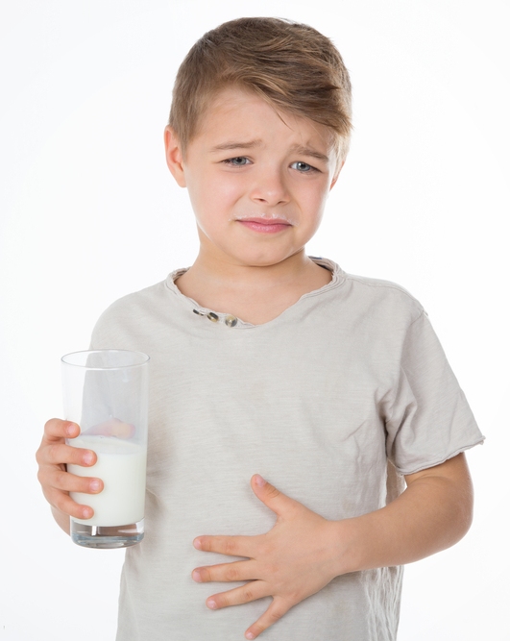
Food intolerance
Most people can eat foods without any problems although they may have different likes or dislikes that influence what they choose.
However, some people react to certain foods and eating them may cause uncomfortable symptoms or, in rare cases, a severe illness.
Food intolerance is the general term used to describe a range of adverse responses to food, including allergic reactions, adverse reactions resulting from enzyme deficiencies, pharmacological reactions and other non-defined responses.

Slide 3

Food intolerance
Food intolerance does not include food poisoning from bacteria and viruses, moulds, chemicals, toxins and irritants in foods, nor does it include food aversion (dislike and subsequent avoidance of various foods).

Slide 4
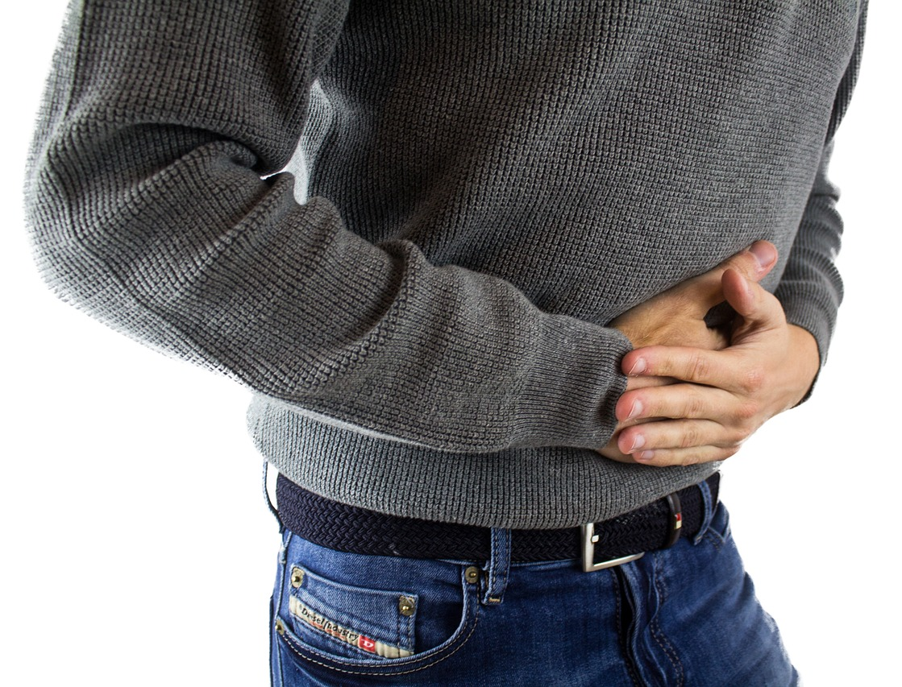
Food intolerance
People with food intolerance or allergy concerns should take advice from a doctor or dietitian to make sure that the medical condition is properly diagnosed.
Care needs to be taken to ensure that their diet contains a wide variety of foods to provide all the nutrients they need, particularly the nutrient/s normally provided by the foods they cannot eat.
It is important to consume a healthy and varied diet for good health.

Slide 5
Food allergy
Rates of food allergy and intolerance vary across the world. In the UK, 6% of the UK adult population have a clinically confirmed allergy. This is around 2.4 million adults. These figures exclude those with food intolerances such as lactose intolerance.
Recent research found that in the UK:
foods such as peanuts and tree nuts like hazelnuts, walnuts and almonds, are most likely to cause an allergic reaction;
many individuals also had allergies to fresh fruits such as apple, peach and kiwi fruit;
allergies to foods like milk, fish, shrimp and mussels were uncommon;
childhood food allergies persist into early adulthood, and then further increase with around half of food allergies developing in later adulthood.
PAFA project

Slide 6
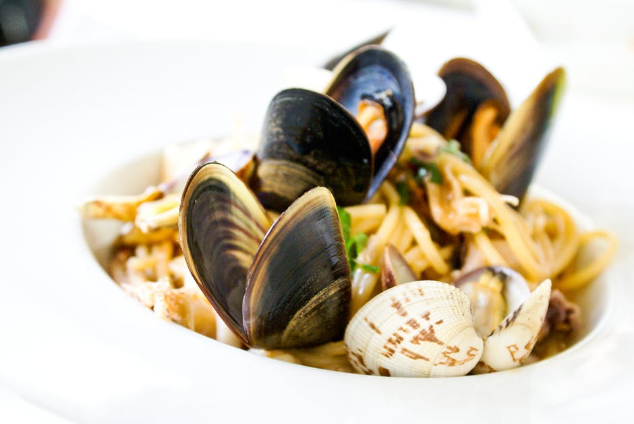
Adverse reactions to food
According to a recent Food Standards report:
12% of respondents reported that they have a food intolerance, 4% reported having a food allergy, and 1% reported having coeliac disease.
58% of respondents who have a food hypersensitivity reported that they had experienced a reaction in the previous 12 months and 37% reported that they had not experienced a reaction.
Food and You 2: Wave 8

Slide 7

Food allergy
An allergic reaction to a food can be described as an inappropriate reaction by the body's immune system to the ingestion of a food that in the majority of individuals causes no adverse effects. Allergic reactions to foods vary in severity and can be potentially fatal.
In food allergy the immune system does not recognise as safe a protein component of the food to which the individual is sensitive (such as some peanut, milk and egg proteins).

Slide 8
Food allergens
The most common allergens are present in:
cereals containing gluten;
crustaceans;
eggs;
fish;
peanuts;
soybeans;
milk;
nuts;
celery;
mustard;
sesame seeds;
sulphur dioxide and sulphites;
lupin;
molluscs.

Slide 9
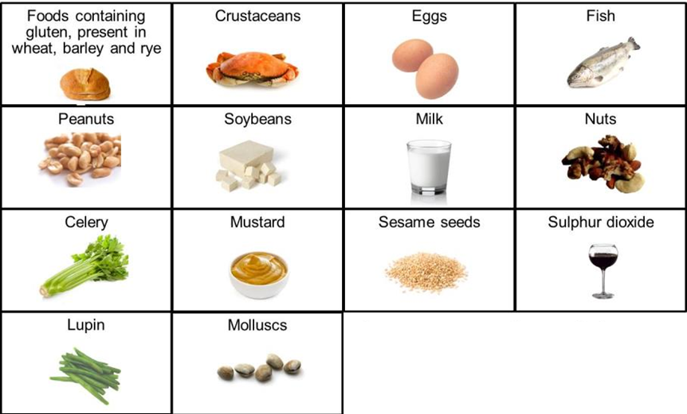
The presence of any of these in pre-packaged products has to be declared.

Slide 10
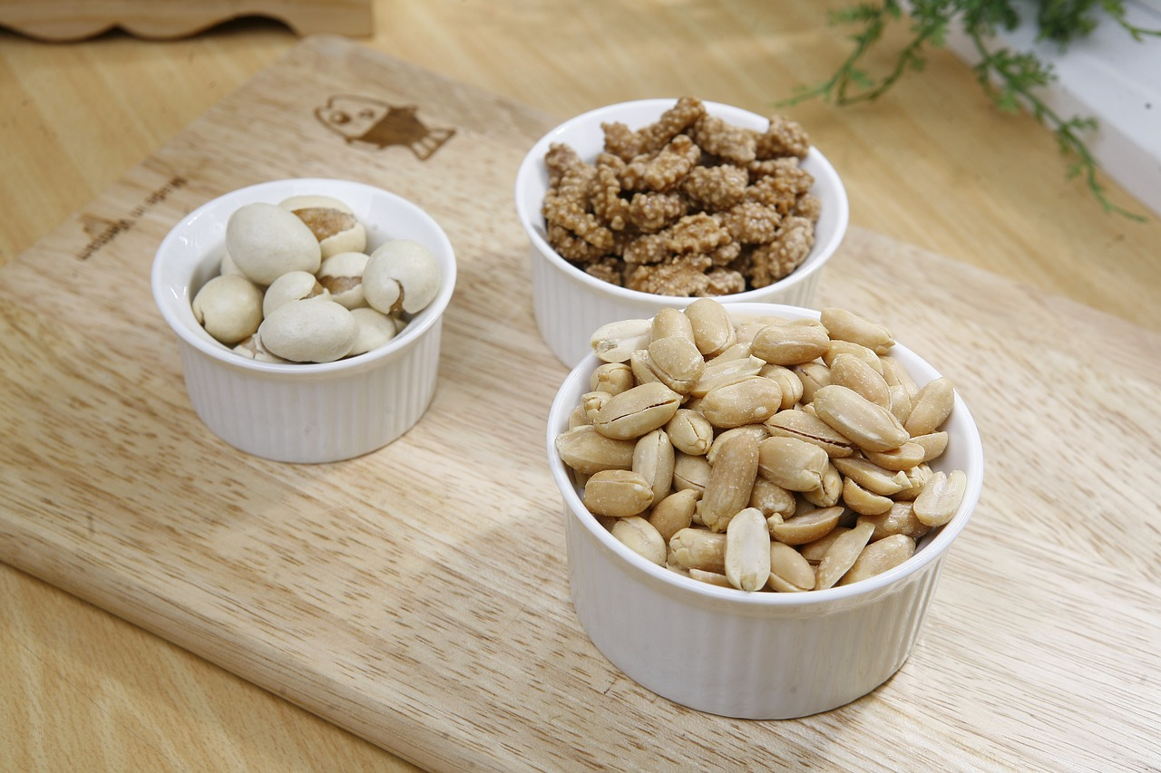
Food allergies in children
Allergies tend to run in families. The most common food allergy reactions in childhood are to:
eggs;
cow’s milk and milk products;
nuts (including peanuts);
soya;
wheat.
It is common for most children to grow out of food allergies early in their childhood.

Slide 11
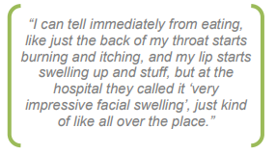
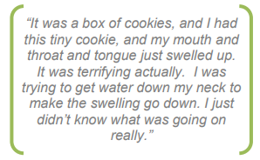
Food allergy symptoms
A food allergy usually occurs between a few minutes and a few hours after eating a particular food. The symptoms of food allergies vary from person to person and can include:
coughing;
dry, itchy throat and tongue;
nausea and feeling bloated;
wheezing and shortness of breath;
swelling of the lips and throat;
runny or blocked nose;
sore, red and itchy eyes.
Quotes from the FSA Food Allergy and Intolerance Programme report

Slide 12
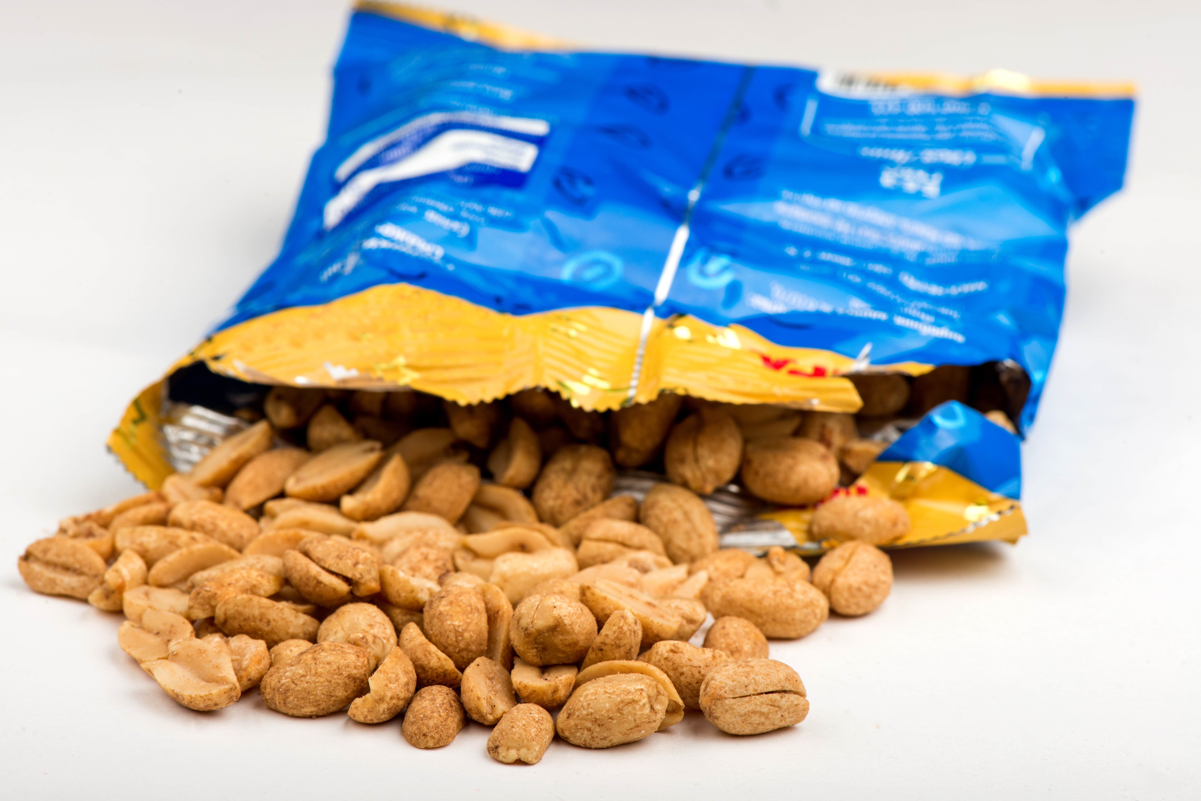
Peanut allergy
Peanuts are a common cause of food allergy, caused when the immune system reacts to the protein found in peanuts.
Peanut allergy affects around 2% (1 in 50) of children in the UK and has been increasing in recent decades.
www.allergyuk.org

Slide 13

Anaphylaxis
A severe allergic reaction can sometimes lead to anaphylaxis. When someone has an anaphylactic reaction, they may have serious symptoms in different parts of the body at the same time. These symptoms can develop within minutes.
Anaphylaxis is a severe, life threatening allergic reaction which involves several organs in the body, particularly the heart and lungs, and can develop within minutes.
Although it is rare, some of the foods known to cause anaphylaxis in the UK include peanuts, tree nuts, cows’ milk, eggs, fish, shellfish and some fruits.

Slide 14
Anaphylaxis treatment
This severe reaction can be fatal if it is not treated immediately. Treatment is usually an injection of adrenaline (epinephrine). Most people with severe allergies will have pre-loaded syringes with them wherever they go.
Anaphylaxis can also be caused by other things, such as insect bites and drug allergies.

Slide 15

Food aversion
Some people’s symptoms only occur if they know that they are eating a particular food – they do not occur if the food is disguised. This is called food aversion.
It may be because they believe the food will cause symptoms, or because the food has been associated with illness in the past.

Slide 16
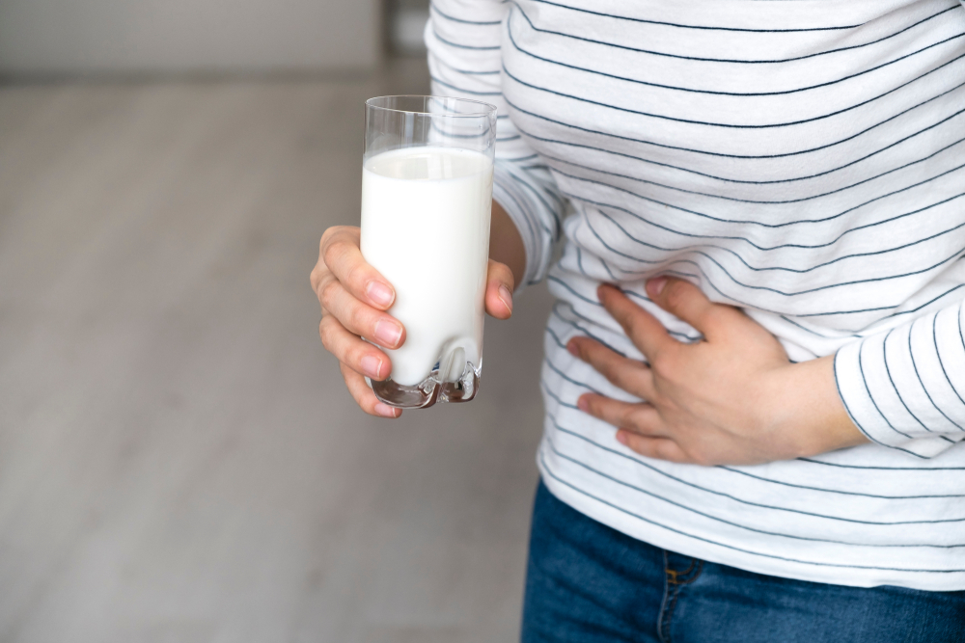
Lactose intolerance
One type of food intolerance is caused by the lack of an enzyme that is needed to digest a component of food.
The most common example of this is lactose intolerance where sufferers have low levels of the enzyme lactase needed to digest lactose, the sugar found in milk. Lactase breaks down the lactose so that it can be absorbed.

Slide 17
Lactose intolerance
Children are usually born with sufficient lactase but in some parts of the world, levels fall rapidly after childhood. If lactase levels are low, undigested lactose passes into the large intestine where it causes pain and diarrhoea.
Lactose intolerance is typically seen in adults and is more common in Africa, India and South America.

Slide 18
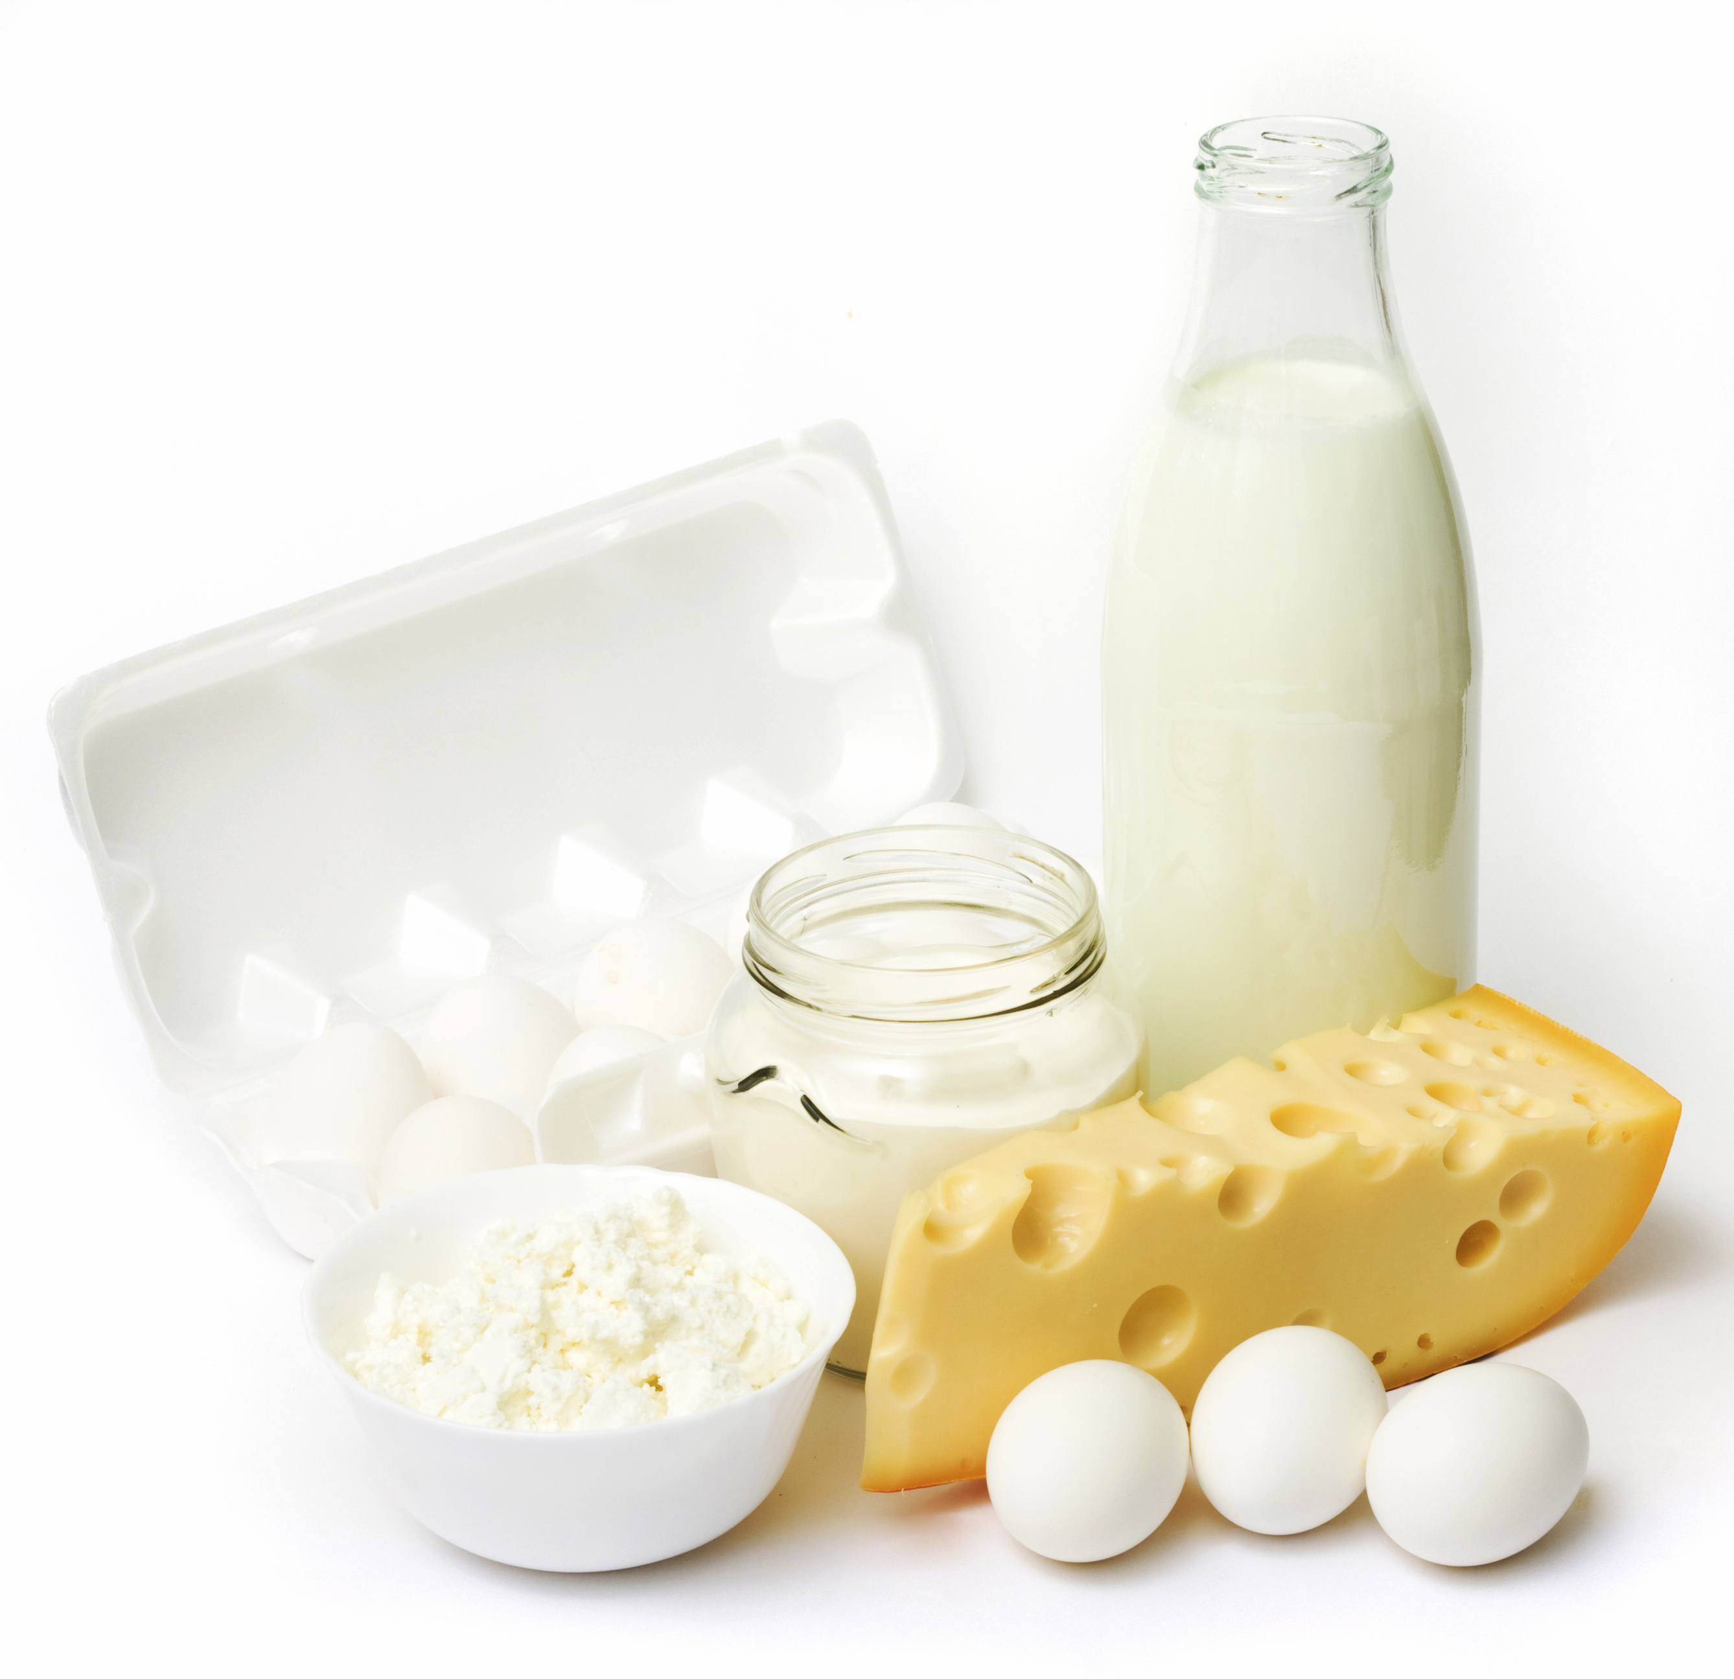
Lactose intolerance
People with lactose intolerance can often tolerate some dairy products, especially hard cheese which contains only trace amounts of lactose. Yogurt is usually better tolerated than ordinary milk. This is thought to be due in part to the fact that an enzyme very similar to human lactase is present in the bacteria used in the manufacture of yogurt (the bacterial culture).
Lactose intolerance isn't the same as a milk or dairy allergy, which involves the immune system.

Slide 19
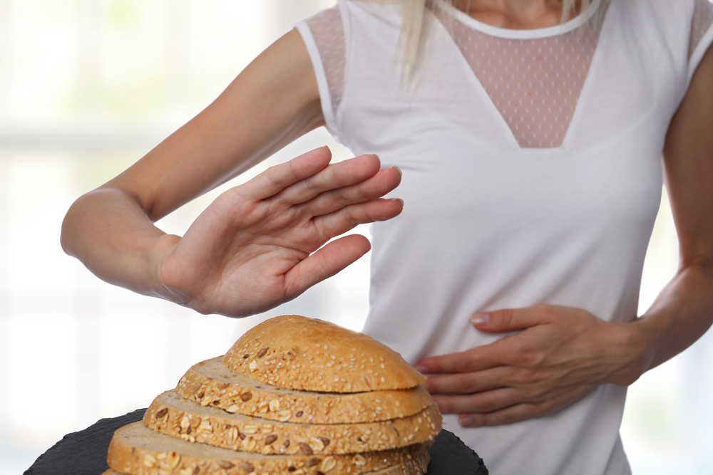
Coeliac disease
Coeliac disease is a reaction to gluten, a protein found in cereals such as wheat, rye and barley. It is an autoimmune disease, where the body’s immune system turns against itself.
The gluten damages the small intestine so people with coeliac disease cannot absorb nutrients from food normally. Sufferers typically have stomach pain and diarrhoea after eating foods that contain gluten.

Slide 20
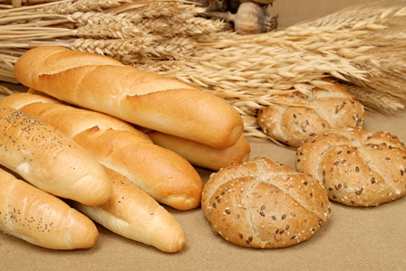
Coeliac disease
Coeliac disease is usually first noticed in childhood, but can go undetected into adulthood. In order to diagnose coeliac disease, patients need to be consuming gluten. It is important that people seek medical advice rather than simply changing their diet.
The disease can affect growth or cause weight loss. People with coeliac disease must avoid foods that contain gluten throughout their life, for example, bread cakes, and biscuits. Many foods have small amounts of wheat, barley or rye added, so people with coeliac disease must check food labels carefully.

Slide 21
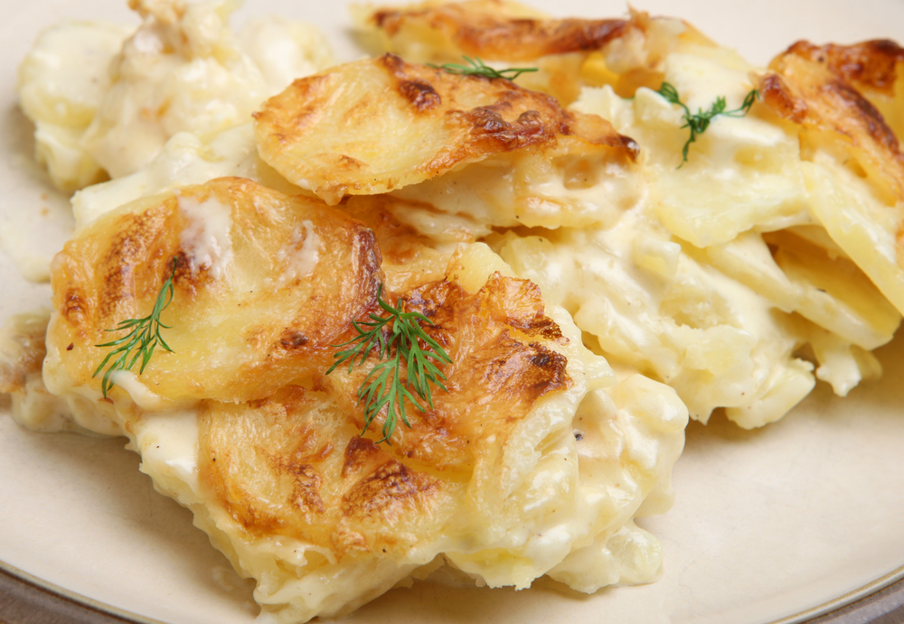
Coeliac disease
Rice, maize and potatoes do not contain gluten so are good sources of starchy carbohydrate , and gluten-free versions of foods such as bread and pasta are available.
Coeliac disease affects at least 1 in 100 people in the UK.
However, only 30% of people who have the condition have been clinically diagnosed.
NHS

Slide 22
Adverse reactions to food
For further information, go to:
www.foodafactoflife.org.uk
This resource meets the Guidelines for producers and users of school education resources about food.

