Slide 1
Proteins and their functional properties in food products

Slide 2
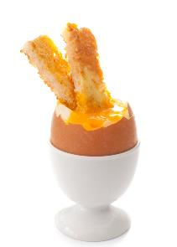
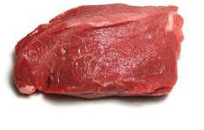
Proteins and their functional properties in food products
Most foods contain proteins, such as collagen in meat, gluten in wheat flour and albumin in egg white.
Some types of protein help with reactions – these are called enzymes, whilst others form part of the structure of the cells.

Slide 3
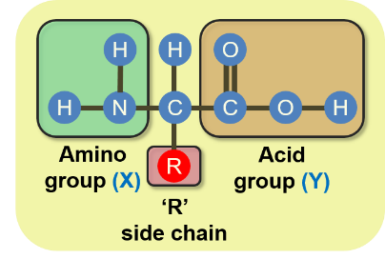
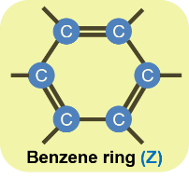
Amino acids
Proteins are made up of small units called amino acids. Amino acids are compounds which contain carbon, hydrogen, oxygen and nitrogen. A few also contain sulphur and phosphorous.
There are around 20 different amino acids commonly found in plant and animal proteins.
All amino acids have an amino group (X) and an acid group (Y). The rest of the amino acid is represented by ‘R’ and is different for every amino acid. In the simplest amino acid (glycine) ‘R’ is a hydrogen atom, but in other amino acids ‘R’ is much more complex and may contain a benzene ring (Z).

Slide 4
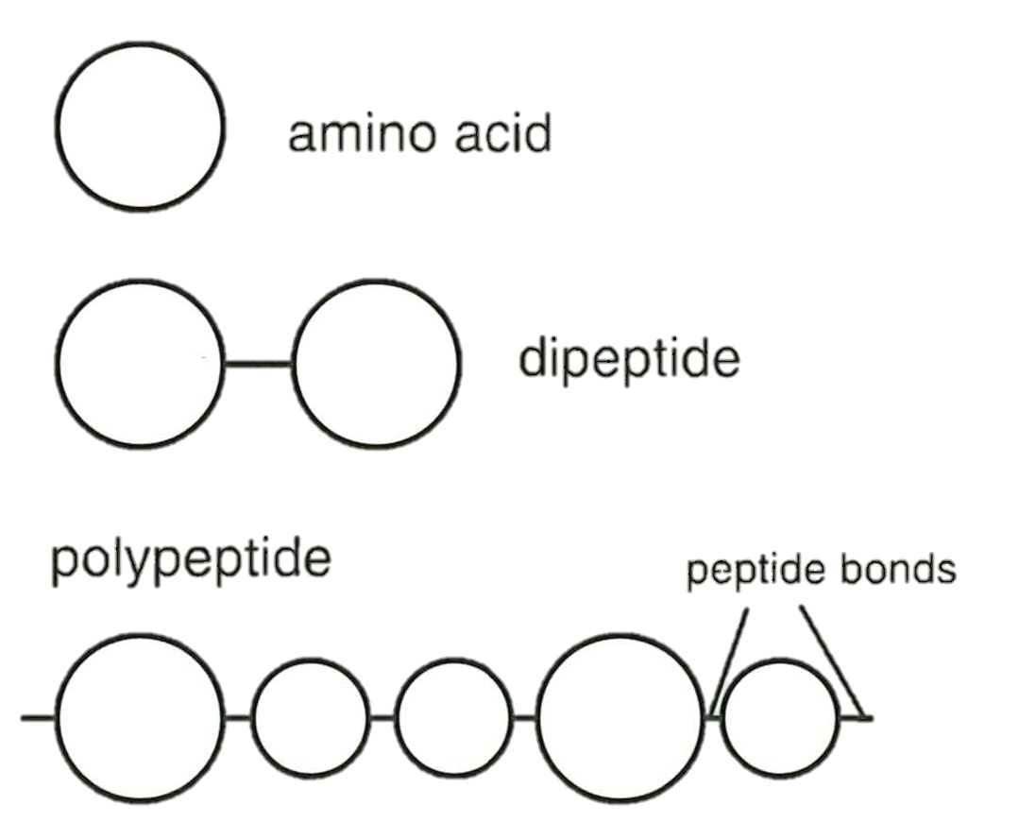
Dipeptides and polypeptides
When two amino acids form a bond between each other, a dipeptide is formed.
A polypeptide is created when many amino acids are joined together.
A typical protein may contain 500 or more amino acids, joined together by peptide bonds.

Slide 5
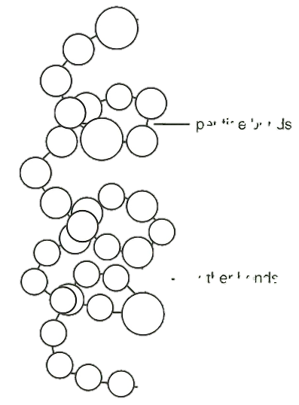
Protein folding
Each protein has its own specific number and sequence of amino acids.
The chains of amino acids making up the structure are also held together by bonds, often between sulphur atoms.
The shape of the molecule is important as it often determines the function of the protein.

Slide 6
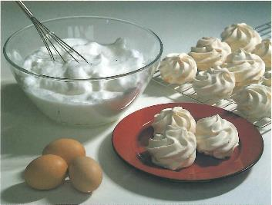
Denaturation
Denaturation is the change in structure of protein molecules. The process results in the unfolding of the protein’s structure. Factors which contribute to denaturation are heat, salts, pH and mechanical action.
Denaturation is a partially reversible change. For example, when an egg white is whisked it incorporates air to form a foam.
If the foam is left to stand, it will collapse back to form liquid egg white.
However, as the change is only partially reversed, trying to make a new foam from the previously collapsed one will not work well.

Slide 7
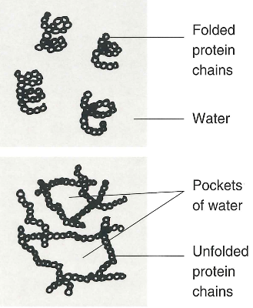
Coagulation
Coagulation follows denaturation. For example, when egg white is cooked it changes colour and becomes firmer (sets).
The heat causes egg proteins to unfold from their coiled state and form a solid, stable network.
This change is irreversible.

Slide 8
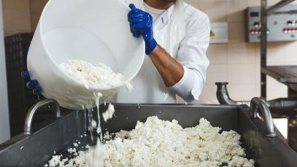
Coagulation
Another form of coagulation occurs in the production of cheese. Rennet (which contains the enzyme rennin) is added to milk, causing the protein casein to clot, producing curds (solid) and whey (liquid).
Rennet is traditionally sourced from the stomachs of calves, but vegetarian options are now also available.
Other applications of coagulation are:
cheese and yogurt production;
thickening of sauces with beaten egg;
binding ingredients together, e.g. fishcakes;
reformed meats;
providing a coating for products, e.g. scotch eggs.

Slide 9
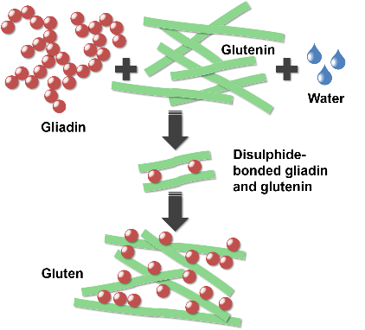
Gluten formation
Two proteins, gliadin and glutenin, found in wheat flour, form gluten when mixed with water.
Gluten is strong, elastic and forms a 3D network in dough. In the production of bread, kneading helps untangle the gluten strands and align them.
Gluten helps give structure to the bread and keeps in the gases that expand during cooking. The amount and type of protein present depends on the flour type and quality. Strong flour contains a maximum of 17% protein, plain flour 10%.
Some other flours also contain gluten, including rye and barley flours.

Slide 10
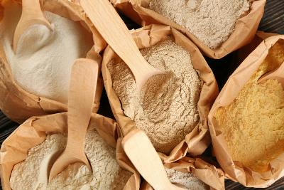
Flour strength
Products that require short (non-elastic) textures, such as biscuits and cakes, use flours with lower protein contents.
The lower the amount of gluten, the more crumbly and less elastic the final dough will be.
The amount of kneading is also important, as the more a dough is kneaded, the more gluten formation occurs.
These products may also use solid fats called shortenings, which can reduce gluten formation even further.

Slide 11
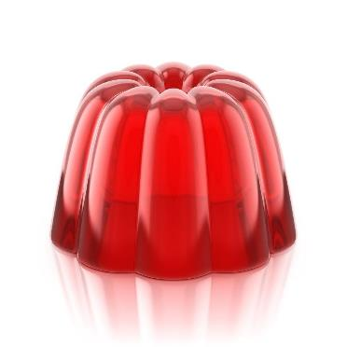
Gelation
Gelatine is a protein which is extracted from collagen, present in animal connective tissue.
When it is mixed with warm water, the gelatine protein molecules start to unwind.
On cooling, a stable, solid network is formed, trapping the liquid.
There are many other molecules which can be used to form gels, not all of which are proteins.
In some cases, gelation is reversible.

Slide 12
Proteins and their functional properties in food products
For further information, go to:
www.foodafactoflife.org.uk
This resource meets the Guidelines for producers and users of school education resources about food.

