Slide 1
Reformulation for health – supporting the food industry through education
01/02/23

Slide 2
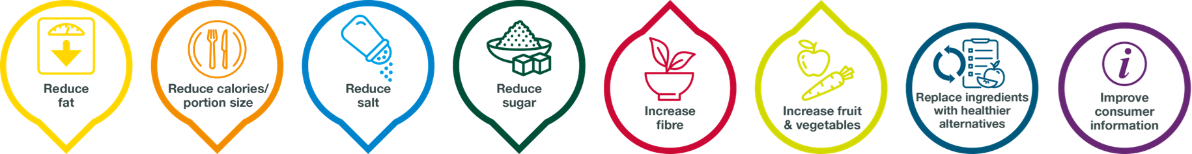

Reformulation for Health
Supporting the food industry through education
Small changes can make a big difference!
Harriet Heath, Reformulation for Health Executive

Slide 3

Scotland’s Health: Most Scottish people consider their health to be good
Source: Scottish Government: The Scottish Health Survey 2018

Slide 4
Scotland’s Health: However, the majority are also overweight
Source: Scottish Government: The Scottish Health Survey 2018

Slide 5
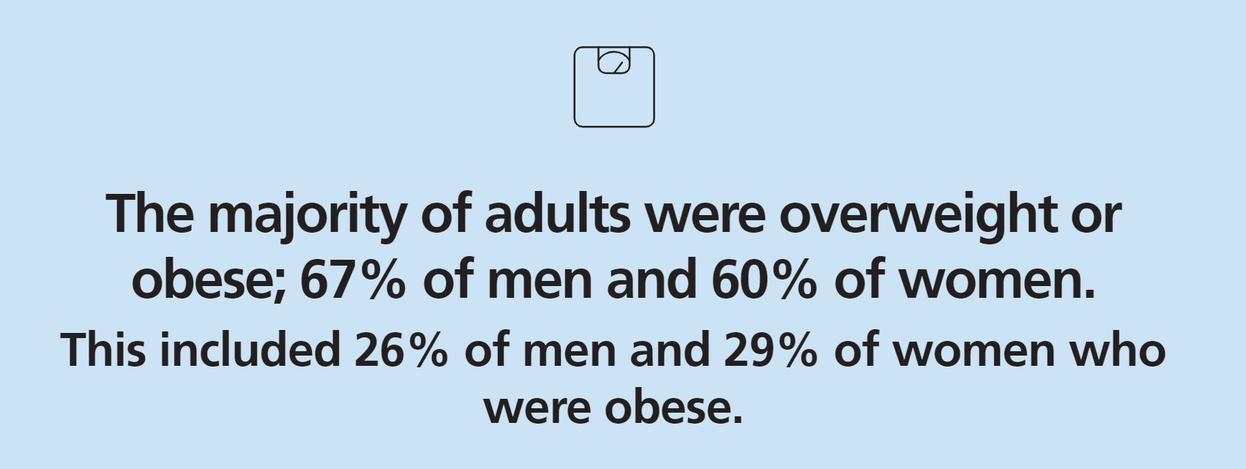
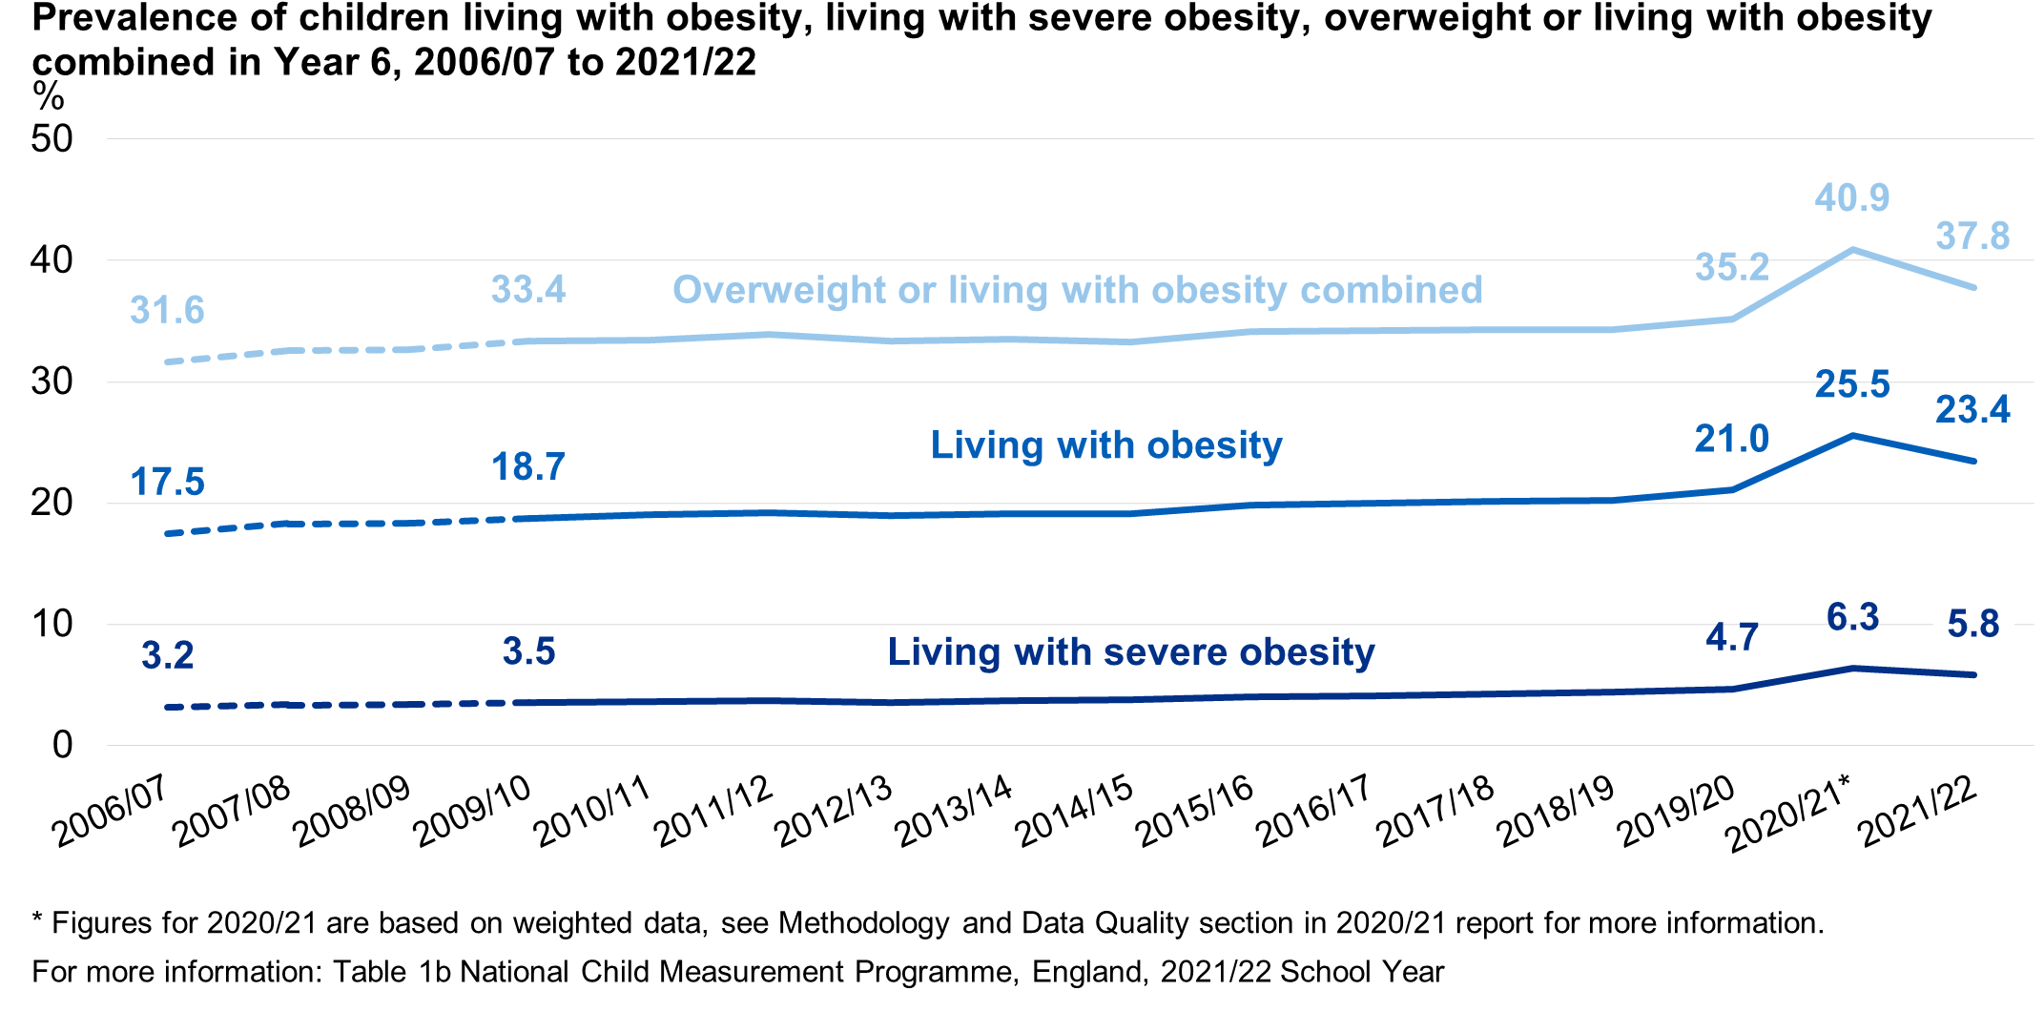
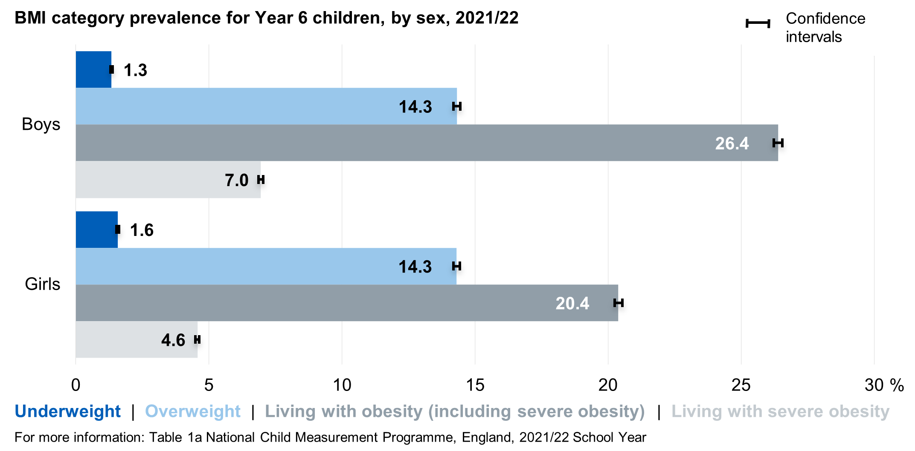
Data for England
Sources: National Child Measurement Programme 2022
Statistics on Obesity, Physical Activity and Diet, England, 2020

Slide 6
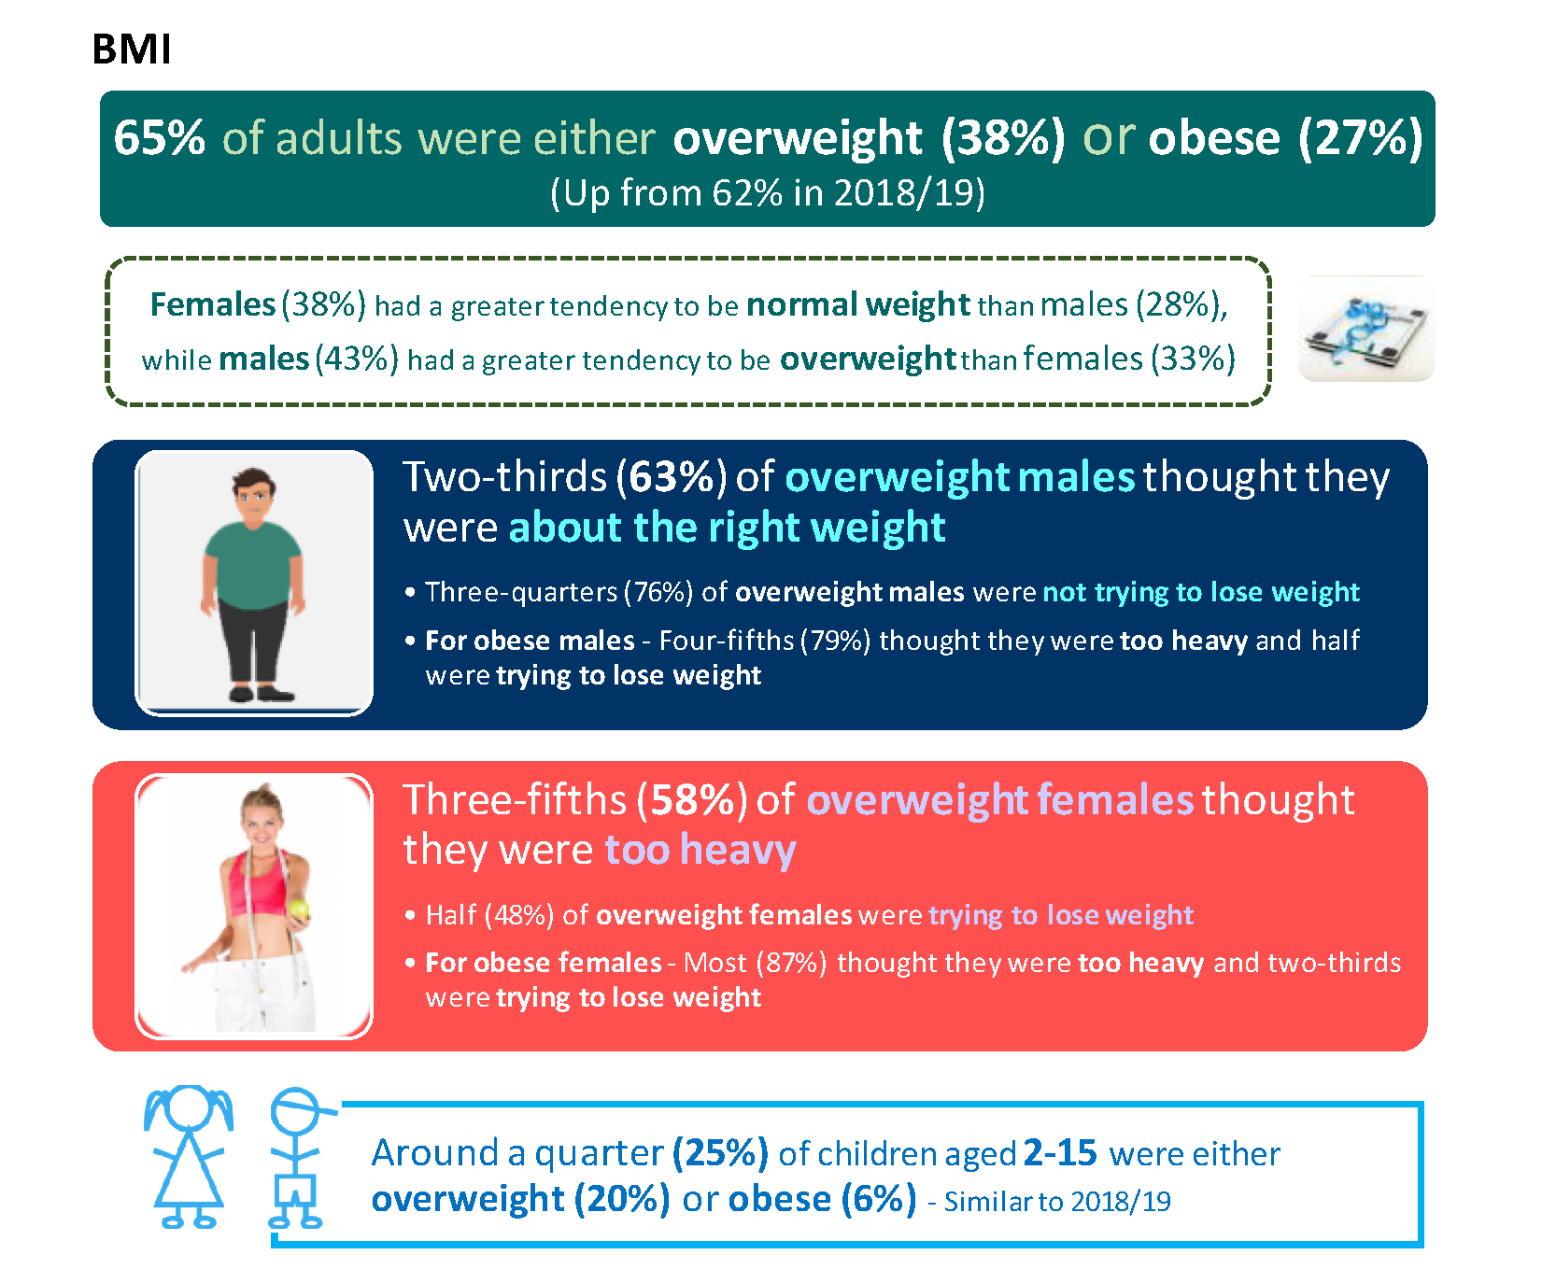
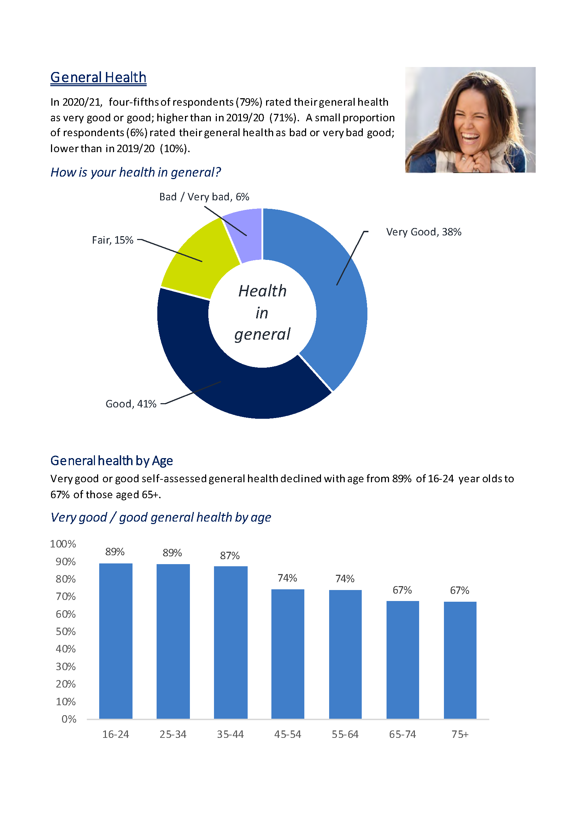
Data for Northern Ireland
Sources: Health Survey (NI) 2019/20
Health Survey (NI) 2020/21

Slide 7
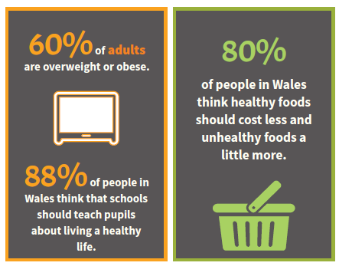
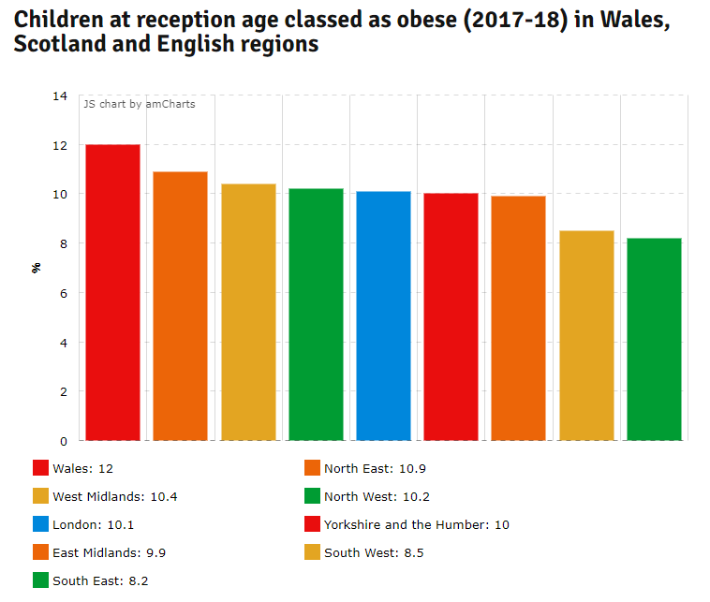

Data for Wales
Sources: Healthy Weight: Healthy Wales (2019)
Child Measurement Programme Report 2020-2021

Slide 8

Business v consumer
Top 3 challenges in reformulating
Top 3 things consumers judge reformulation on
Taste
Achieving comparable taste
65%
Taste and cost of ingredients are the biggest barriers to reformulating….also the top 2 considerations for consumers.
Highlighting potentially where businesses may need most support.
Price
Cost of alternative ingredients
58%
Achieving comparable mouthfeel/
Texture
52%
Healthiness of alternative ingredients

Slide 9
Challenges to reducing portion size
Top 3 challenges reducing portion size
Budget to change packaging 39%
Time
22%
Criticism from customers 17%
To help companies reduce portion sizes, support may be needed to change packaging.

Slide 10
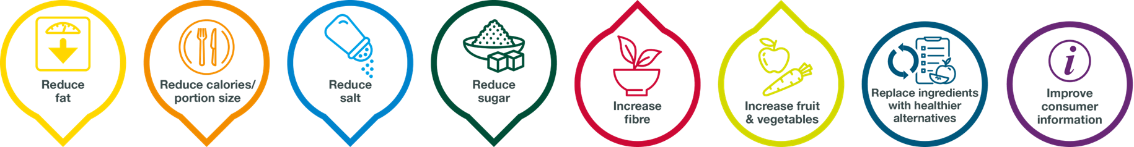
Do they just take things out?
Reduce Increase Replace
Fat * Fibre Replace ingredients with healthier
Saturated fat * Fruit alternatives – functional fibres,
Salt * Vegetables fat replacers, lower sodium salts
Sugar sweeteners
Calories

Slide 11

20% reduction of fat, does not equate to 20% reduction of new product.
Change in final weight and increase of other ingredients

Slide 12


What are the practical challenges?
Salt
texture
Binding agent
Seasoning/flavour
Binding agent
Raising agent
Preservation
Ways to reduce salt
Gradual decrease
Sodium alternatives
Seaweeds and yeasts
Distribution
Flavour technologies
Reasons to change
SACN recommendations
Salt reduction targets 2024
Nutritional claims

Slide 13

Spotlight on sugars
Sugar
Structure
Fermentation
Shelf life
Stabilising
Sweetness / flavour
Colour
Ways to reduce sugar
Reduce portions
Reduce components/ratio of a product
Sugar replacers
Bulking agents
Bulk sweeteners
Intense sweeteners
Functional fibres
Reasons to change
Nutritional claims
HFSS nutritional claims
Sugar reduction programme

Slide 14
Chewing the Fat
Appearance
Flavour
Emulsions
Shortening
Texture
Solubility
Fat
Ways to reduce fat
Unsaturated fat alternatives
Replacement with lower fat alternatives
Alter cooking process
Reducing individual components
Fat replacers
Functional Fibre
Interesterified fat
Reasons to change
Nutritional claims
Front of Pack labelling
Calorie reduction programme

Slide 15

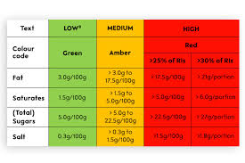

Drivers for change
NPM HFSS restrictions
Salt Reduction targets 2024
Calorie reduction programme
Mandatory calorie labelling
Front of Pack labelling
Health Claims
Improve health of product
Customer request
Retailer request

Slide 16
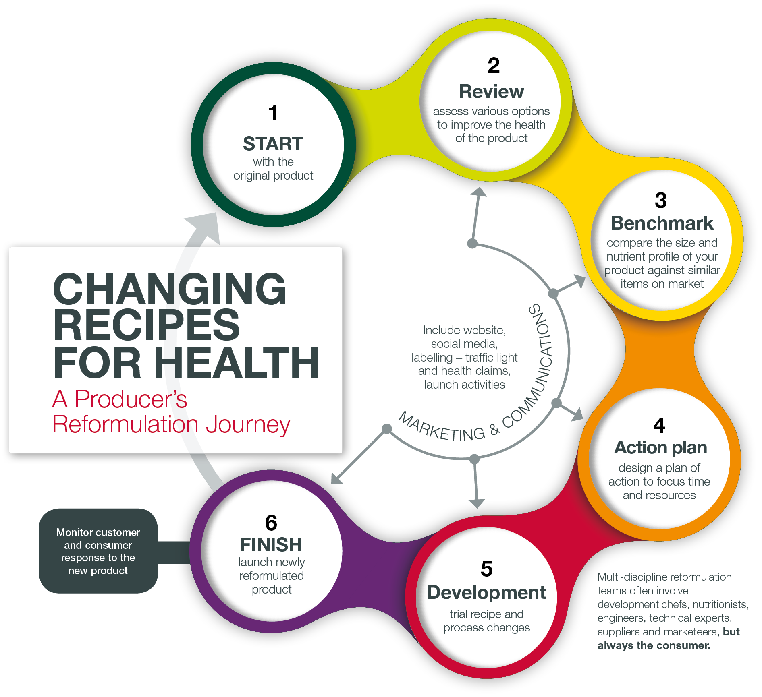
Supporting food futures
Resources to support reformulation knowledge
Reformulation fact sheets for teachers 15%
Reformulation fact sheets for students 15%
Learning packs on healthy sustainable diets for students 15%
Learning packs for healthy sustainable diets for teachers 12%
Skills pathways for food science/reformulation 12%
Online training tool for students 10%
Top 3 nutrients for learning resources
Fat reduction 33% Calorie reduction 24%
sugar reduction 13%
Fruit & Veg enrichment 12% salt reduction 10%

Slide 17
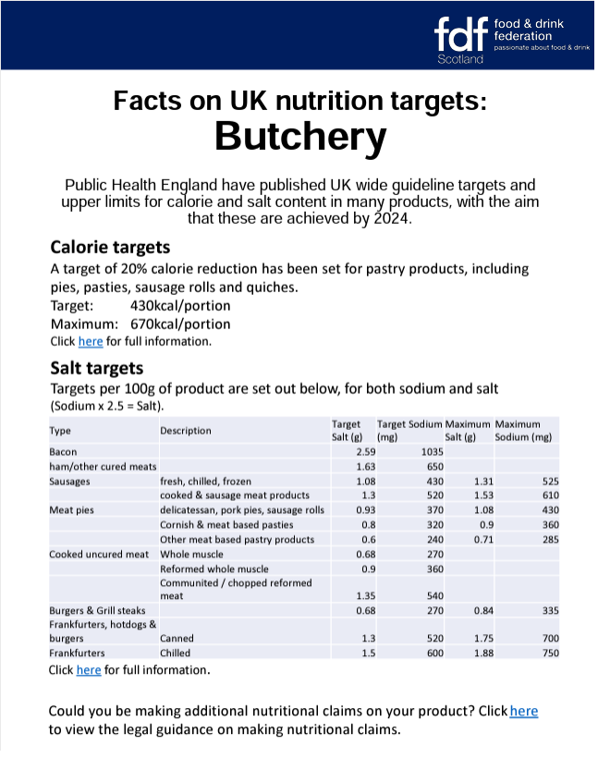
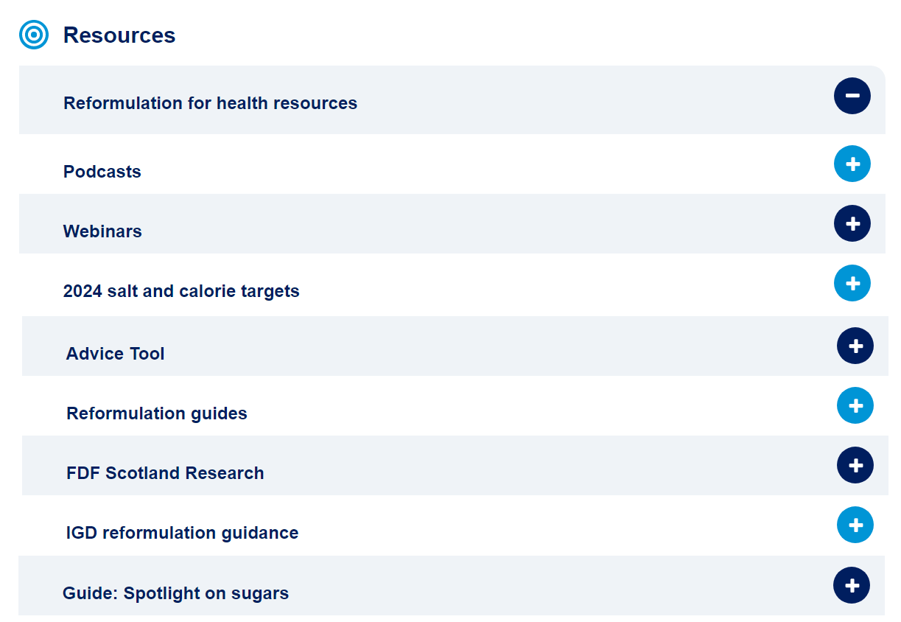


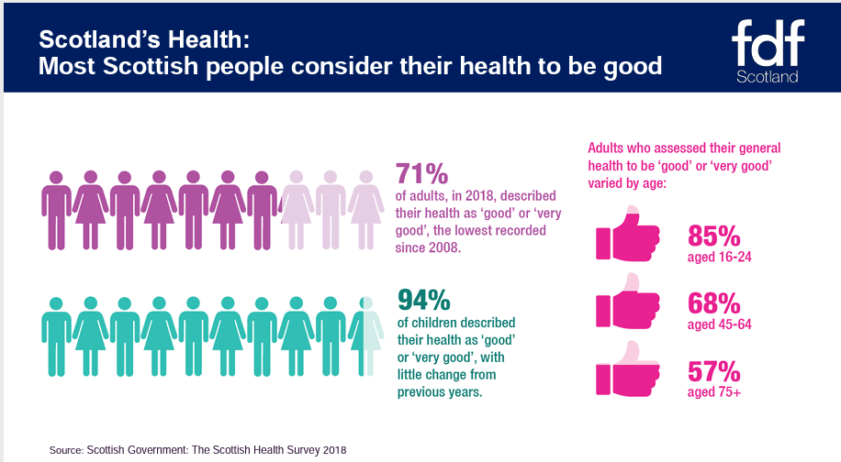

Toolkit
Free to access resources

Slide 18

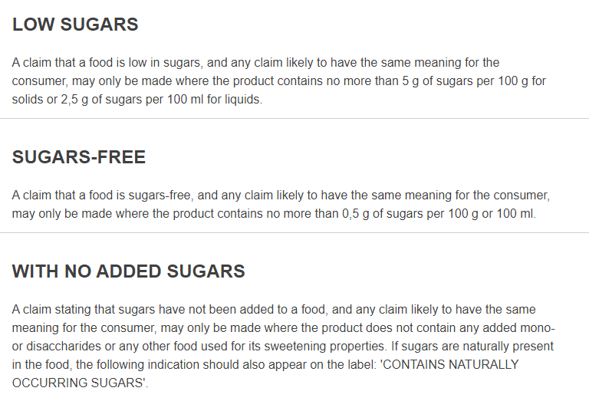
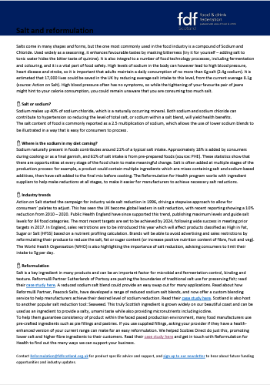
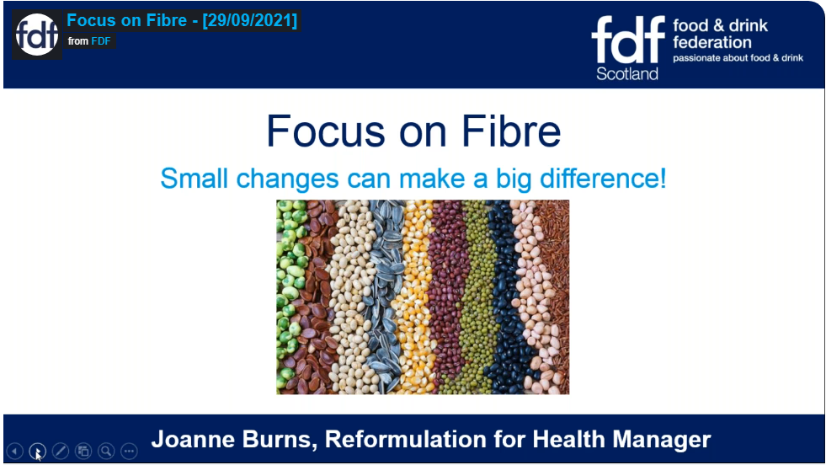

Quarterly focus campaigns
Fibre, Sugar, Sodium
Podcasts
Webinars
Interactive newsletter
Social media

Slide 19
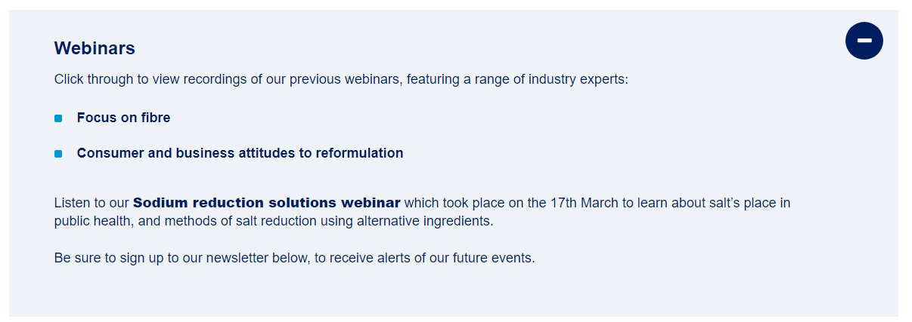
Webinars
Consumer and business attitudes to reformulation
Sugar Reduction in Bakery Products
Salt Reduction in Pastry Products
Sodium Reduction Solutions
Focus on Fibre

Slide 20
Podcasts
Search “FDF Scotland”
Sodium solutions
A spotlight on sugars
Focus on Fibre
The process of reformulating food and drink
How bakers can make their products healthier
Consumer and business attitudes to reformulation
How butchers can make their products healthier
How the food industry can help consumers make healthier choices

Slide 21
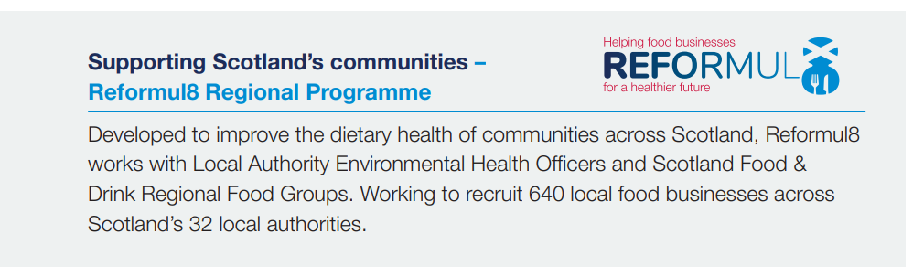
Reformul8 Regional Programme

Slide 22
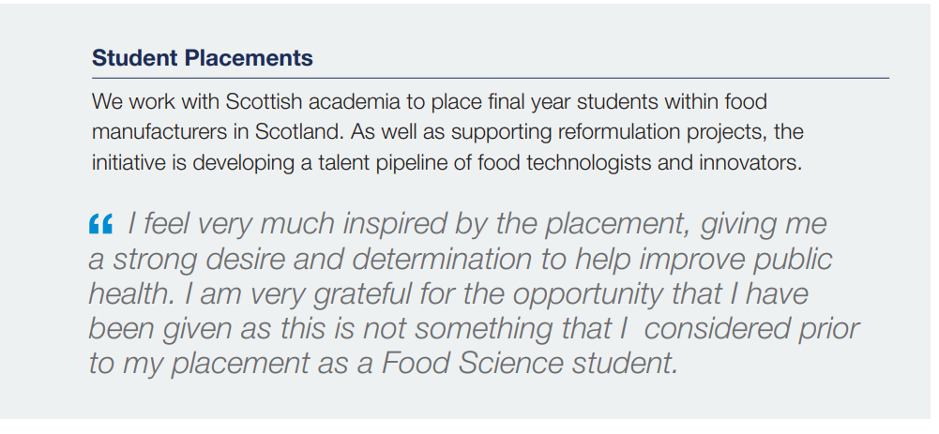
Student placements
14 student placements facilitated

Slide 23
Reformul8 Challenge Fund
With thanks to Scotland Food & Drink
£97,000 to industry to support reformulation
Financial Support – Reformul8 Challenge Fund
Assisting with the associated costs of reformulation, including trialling recipes and process changes, improving production capacity, and accessing nutritional testing and technical support. To date, 70 applications have ben received and 46 projects awarded funding, including Bells, Malcolm Allan, Simon Howie, We Hae Meat, Borders, Deans, Arran Dairies, Strathmore foods, JG Ross and Cobbs

Slide 24

























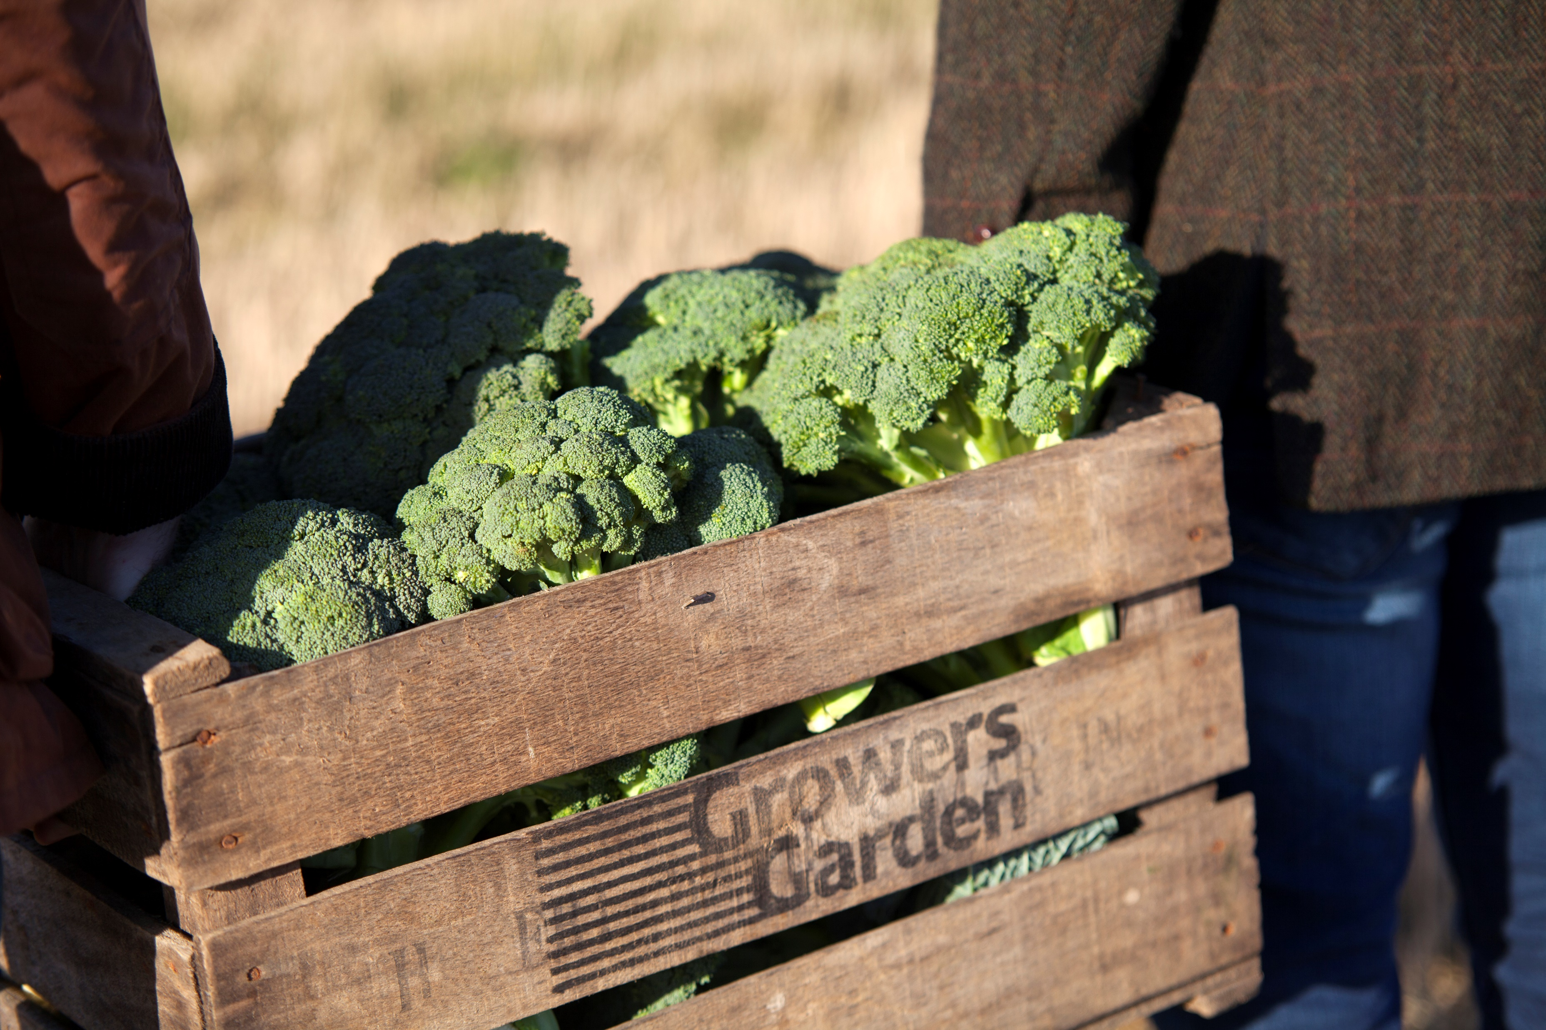



Scottish brands are reformulating

Slide 25
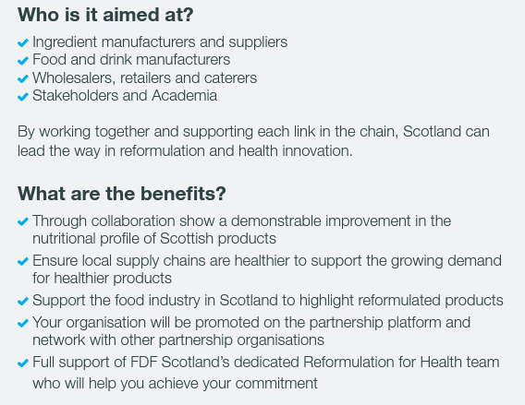


Reformul8 Partnership

Slide 26


Slide 27
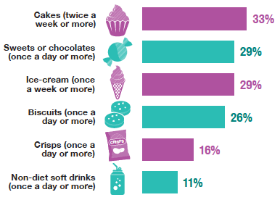
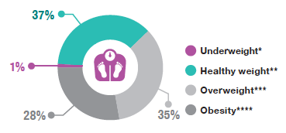
Where are we now?
Just over a third of adults were within the healthy weight range
Source: Scottish Government, The Scottish Health Survey 2020

Slide 28





@fdf_Scotland
@FDFScotland
@fdfscotland
@FDF Scotland
Harriet.Heath@fdfscotland.org.uk

Slide 29
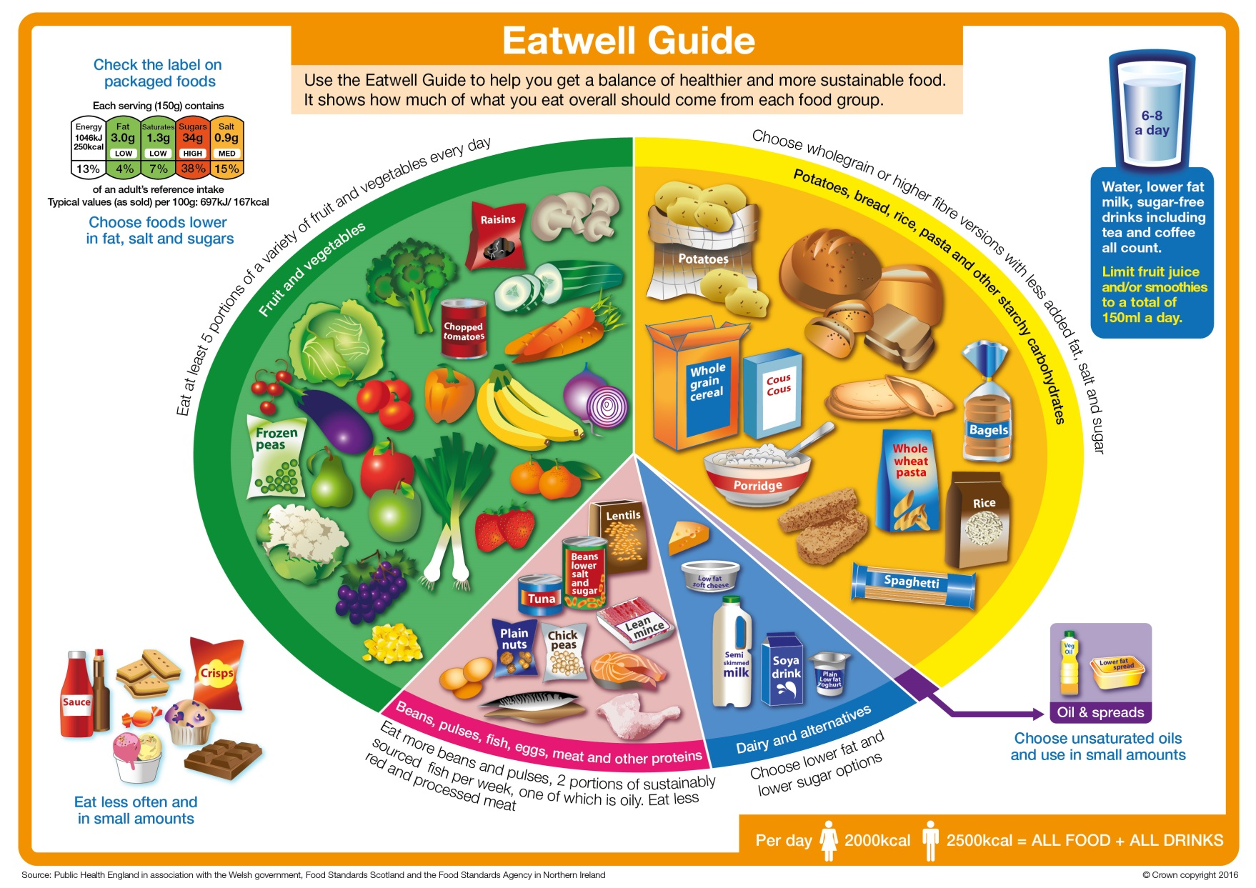
Modifying recipes
When modifying recipes to make them healthier, consider the principles of the Eatwell Guide.
Eat lots of fruit and vegetables
Cut down on saturated fat, salt and sugar
Eat more fish, including a portion of oily fish per week
Base meals on starchy carbohydrates
Choose lower fat and lower sugar dairy
Choose unsaturated oils and spreads

Slide 30
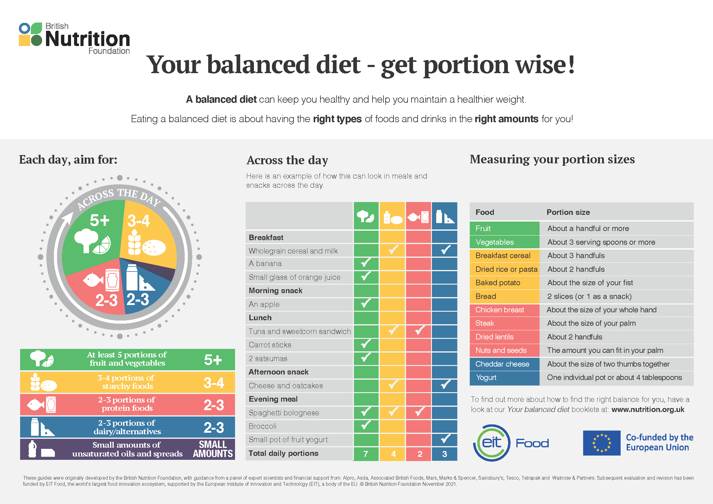
Tips for modification
Reduce salt by adding other seasonings, such as herbs, spices, chilli, lemon etc.
Increase the proportion of fruit and vegetables.
Choose lean meat where possible.
Choose fruit canned in juice, rather than syrup.
Use reduced fat varieties of dairy and spreads, where possible.
Swap ‘white’ carbs for wholegrain varieties.
Change the cooking method.
Consider portion size guidance – is the portion size too large? Download the Explore Food teachers’ notes for portion size estimates.
The British Nutrition Foundation recently updated guidance on portion sizes, including simple measures, estimated with your hands!

Slide 31
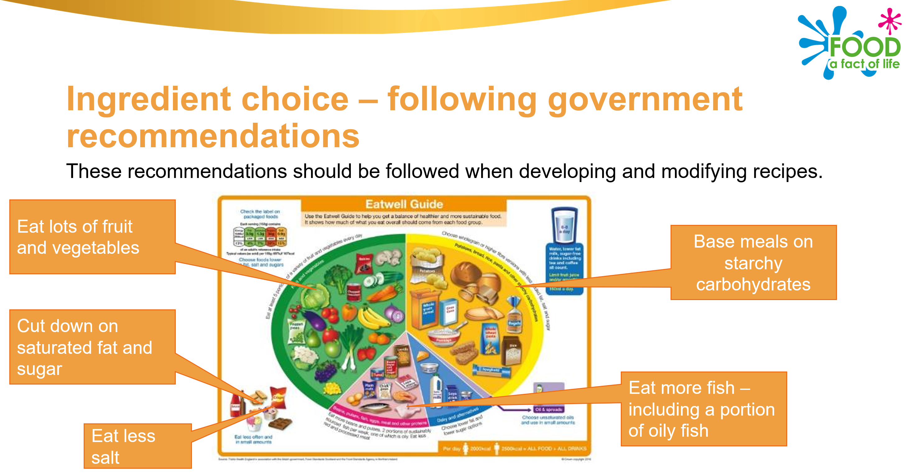
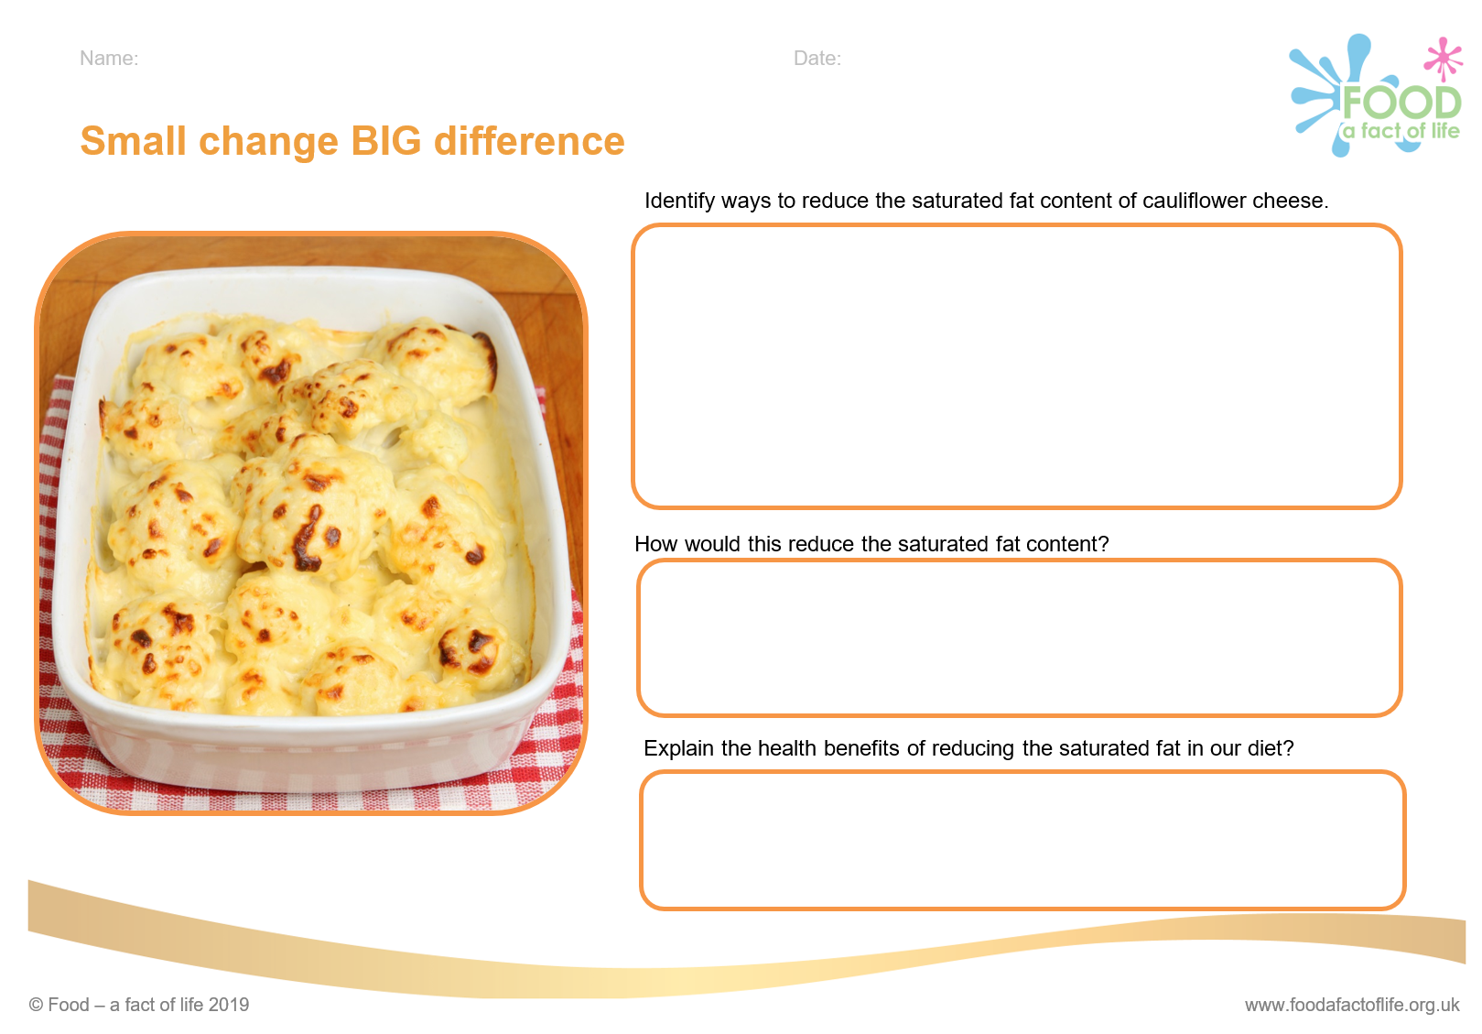
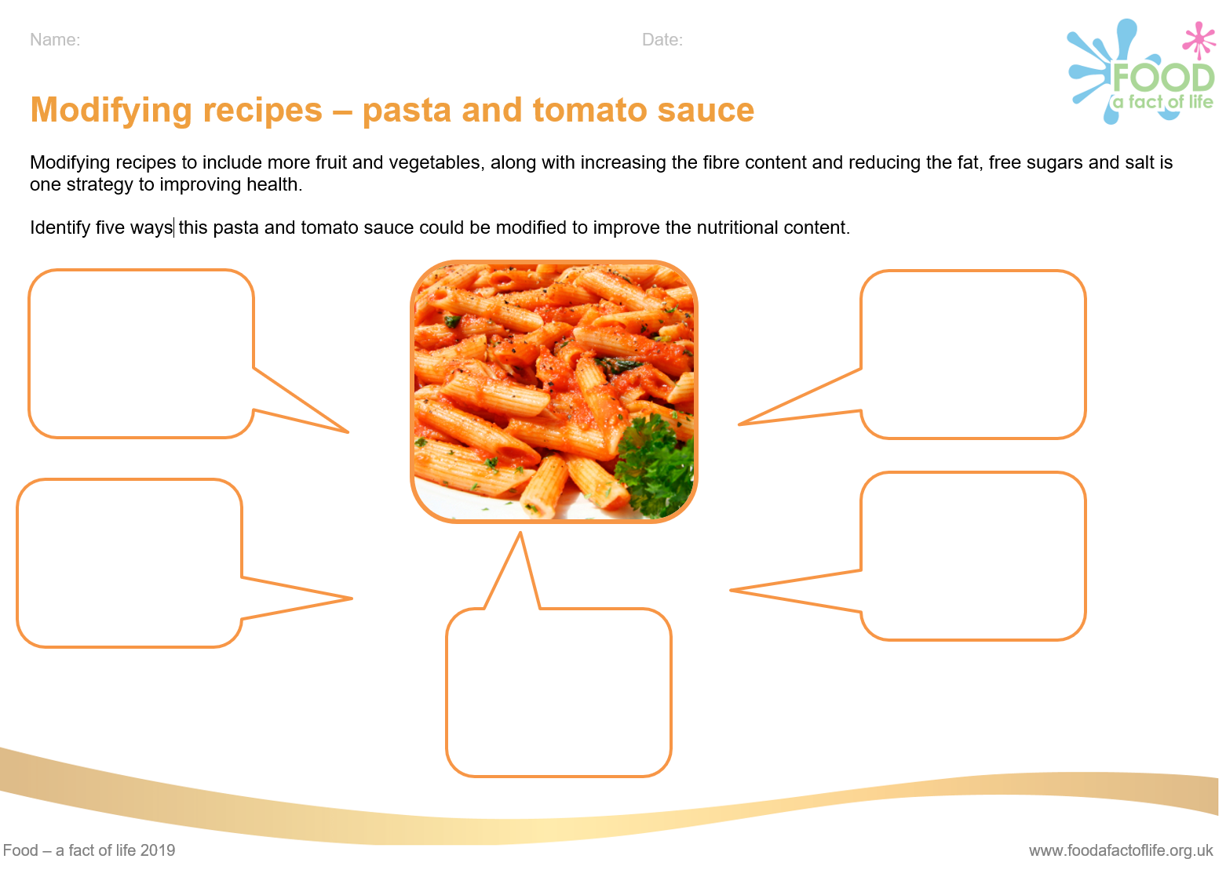
Modifying recipes resources
Cooking for health – Modifying recipes

Slide 32
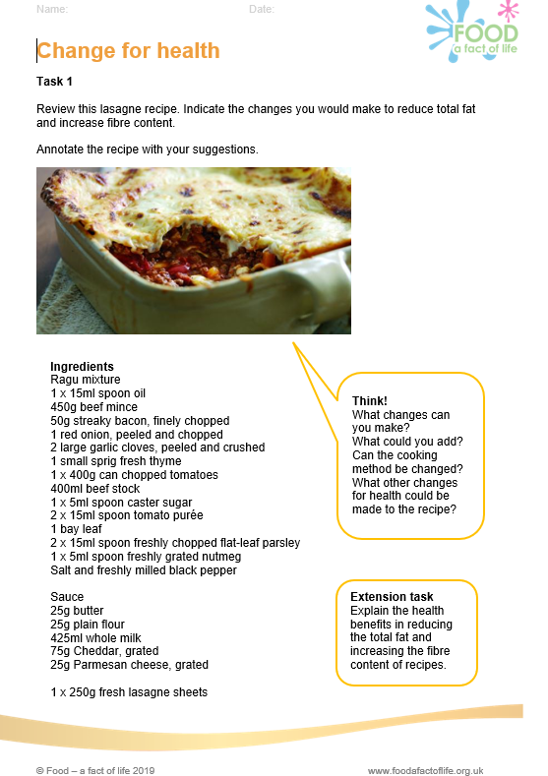
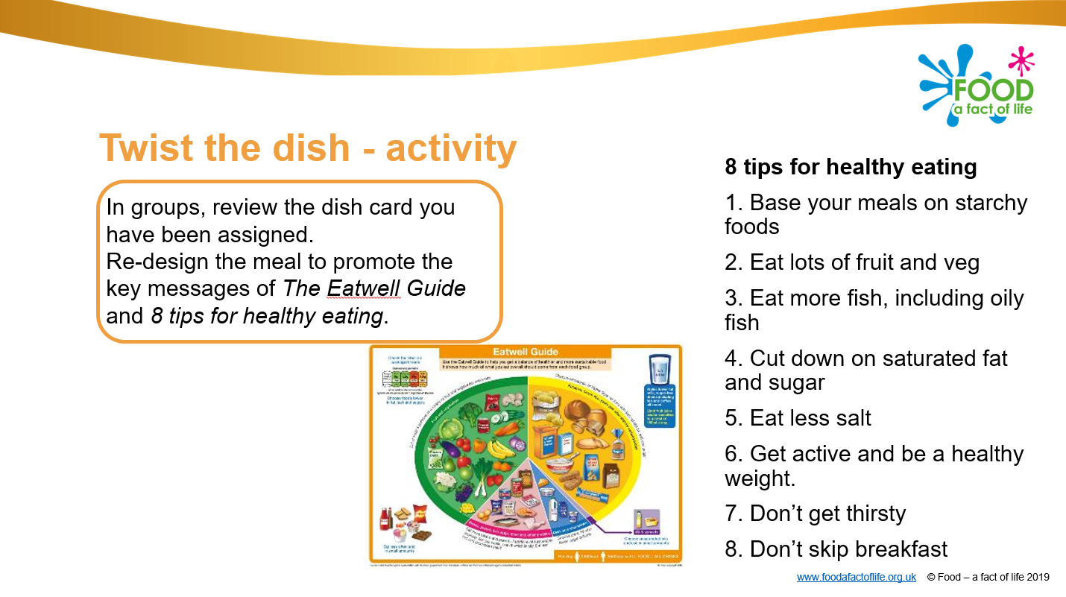
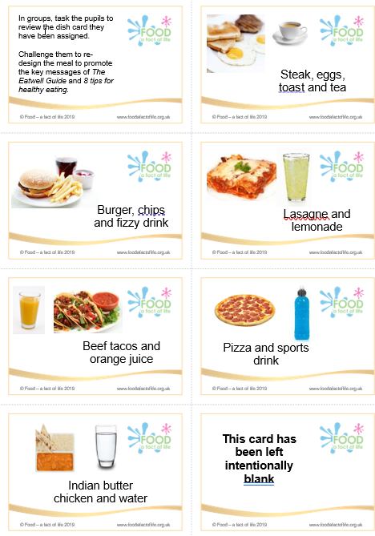
Modifying recipes resources
Extension task - Use a nutritional analysis programme such as Explore food to calculate the total fat and fibre content of the original and modified recipe.
What did you find? Has the fat been reduced? Has the fibre been increased?
Cooking for health – Modifying recipes

Slide 33


Keep up to date with our free resources and training
Education News (monthly email update)
Sign up on the homepage: www.foodafactoflife.org.uk
PPD newsletter (find out about upcoming FFL training)
https://www.foodafactoflife.org.uk/professional-development/
Follow us on Twitter @Foodafactoflife
https://twitter.com/foodafactoflife
Keep in touch:
education@nutrition.org.uk

Slide 34
Reformulation for health – supporting the food industry through education
For further information, go to:
www.foodafactoflife.org.uk

