Slide 1
Digestive system treasure hunt

Slide 2
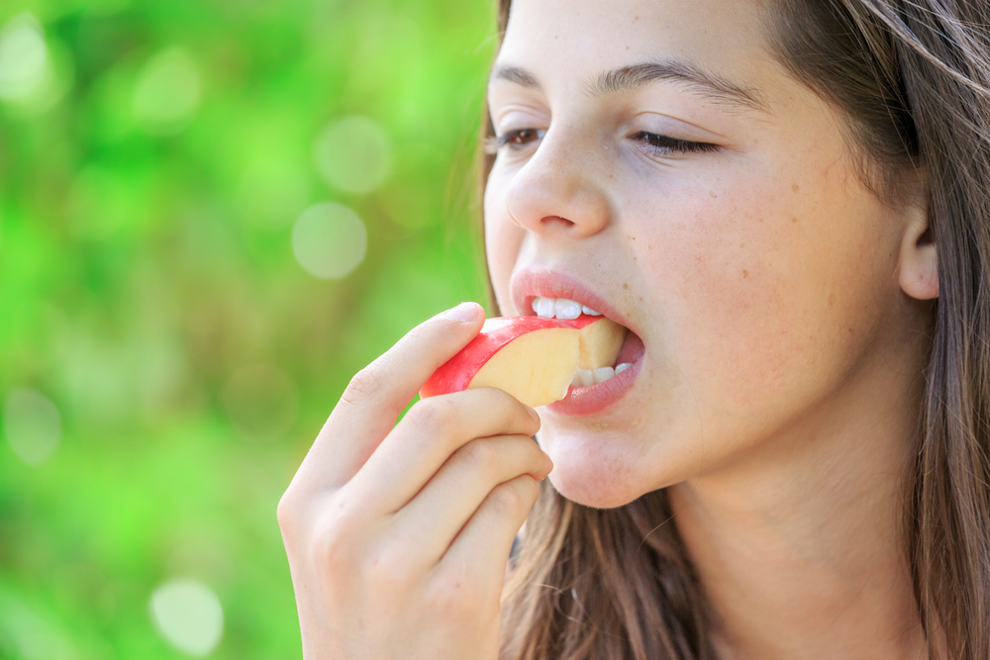
The mouth
Food needs to be chewed and broken down into pieces small enough to swallow.
Mastication is the action of the teeth and the jaws working together to break food down.
Breaking the food down also gives it a larger surface area for the digestive enzymes to work on.
Did you know?
There are two main types of teeth in the mouth:
incisors to tear food, e.g. meat;
molars to grind the food.

Slide 3
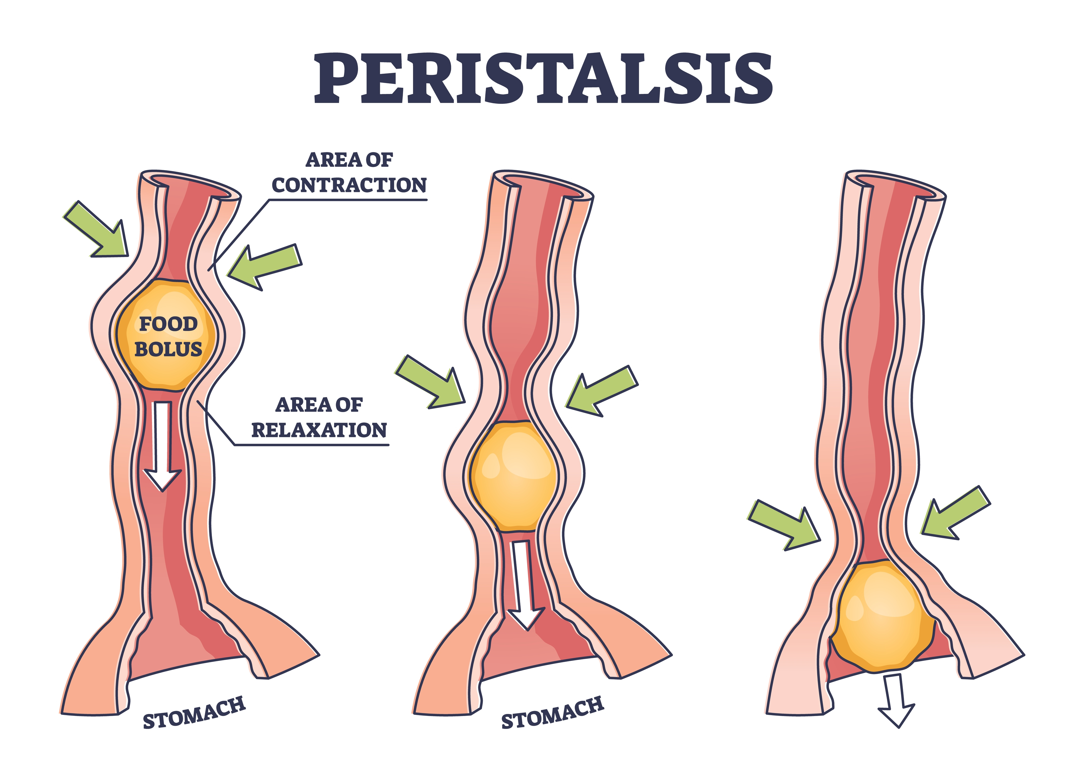
The oesophagus
The oesophagus is similar to a conveyor belt as it transfers the food bolus from the mouth to the stomach in a few seconds.
Circular muscles in the wall of the oesophagus relax in front of the bolus while circular muscles behind the food contract, pushing the food bolus onward. This is called peristalsis.
Did you know?
People do not have conscious control over the muscles in the oesophagus. Even if someone is upside down, the food will be passed on to the stomach.

Slide 4
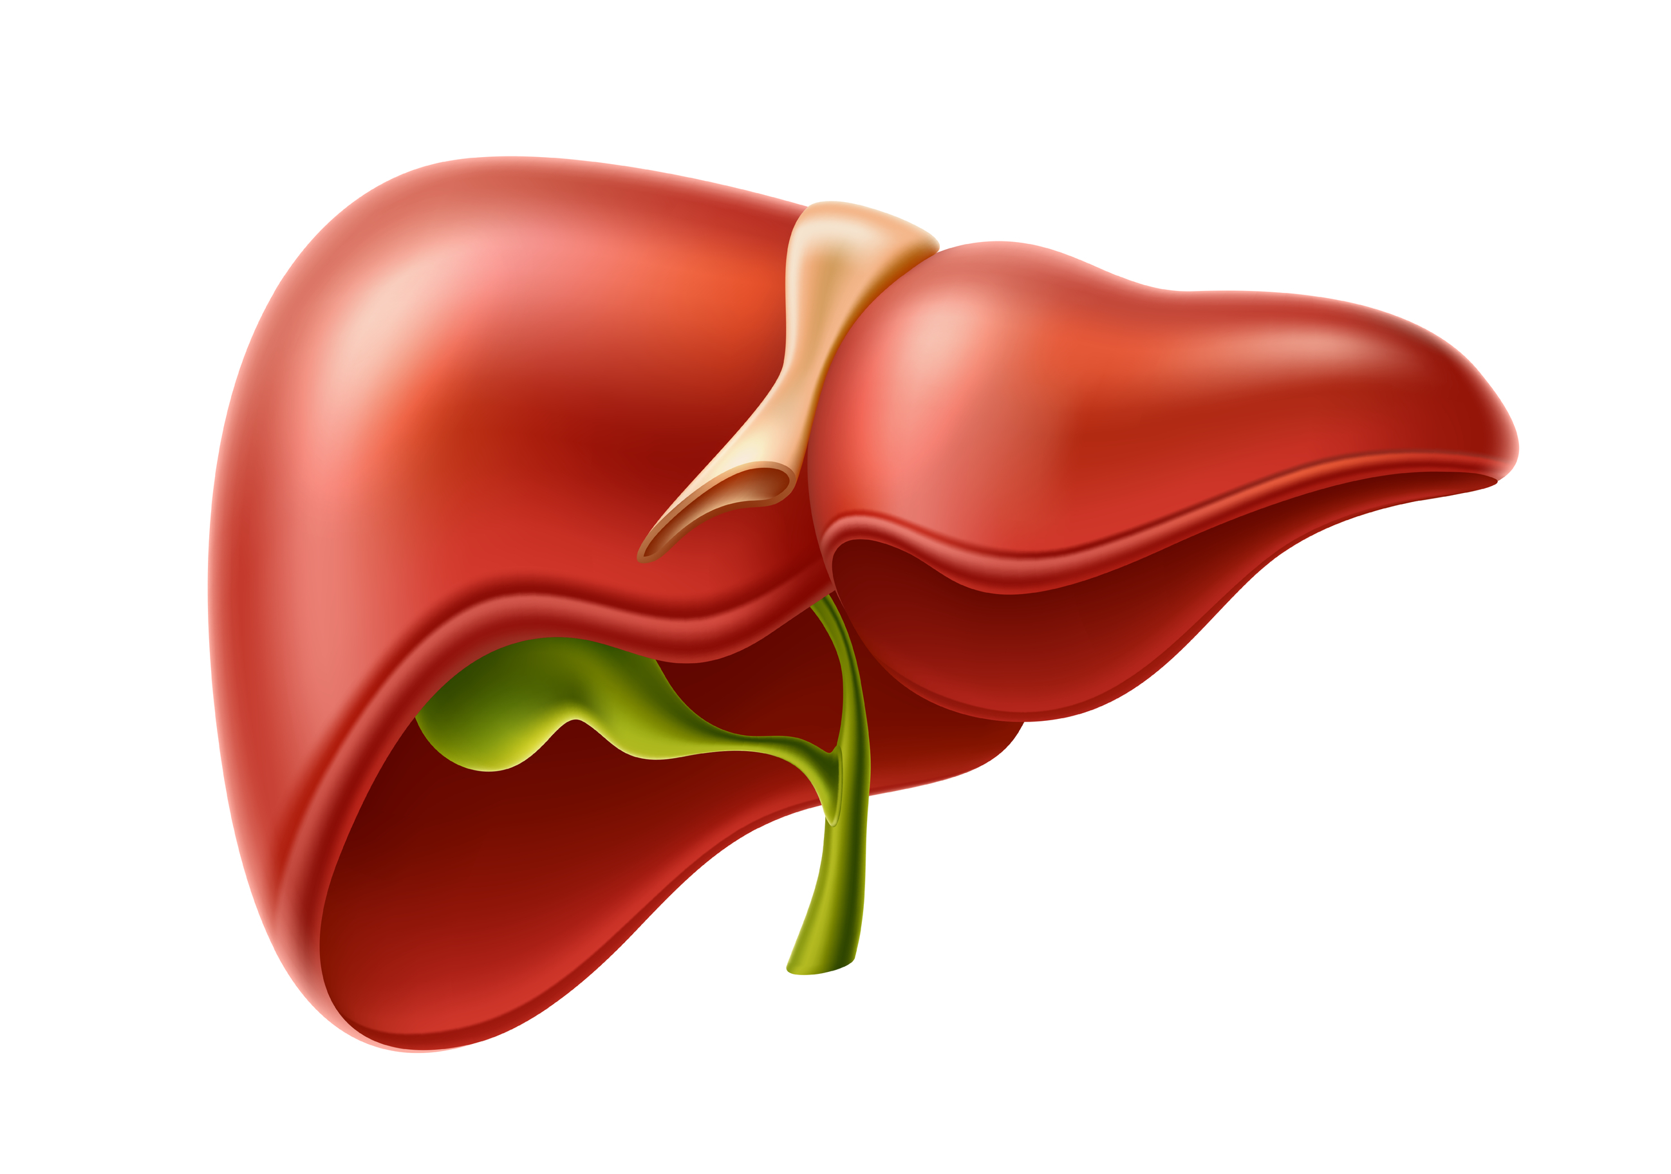
The liver
The liver’s main function within the digestive system is to process the blood containing the nutrients absorbed from the small intestine.
Bile made in the liver and secreted into the small intestine also plays an important role in digesting fat.

Slide 5
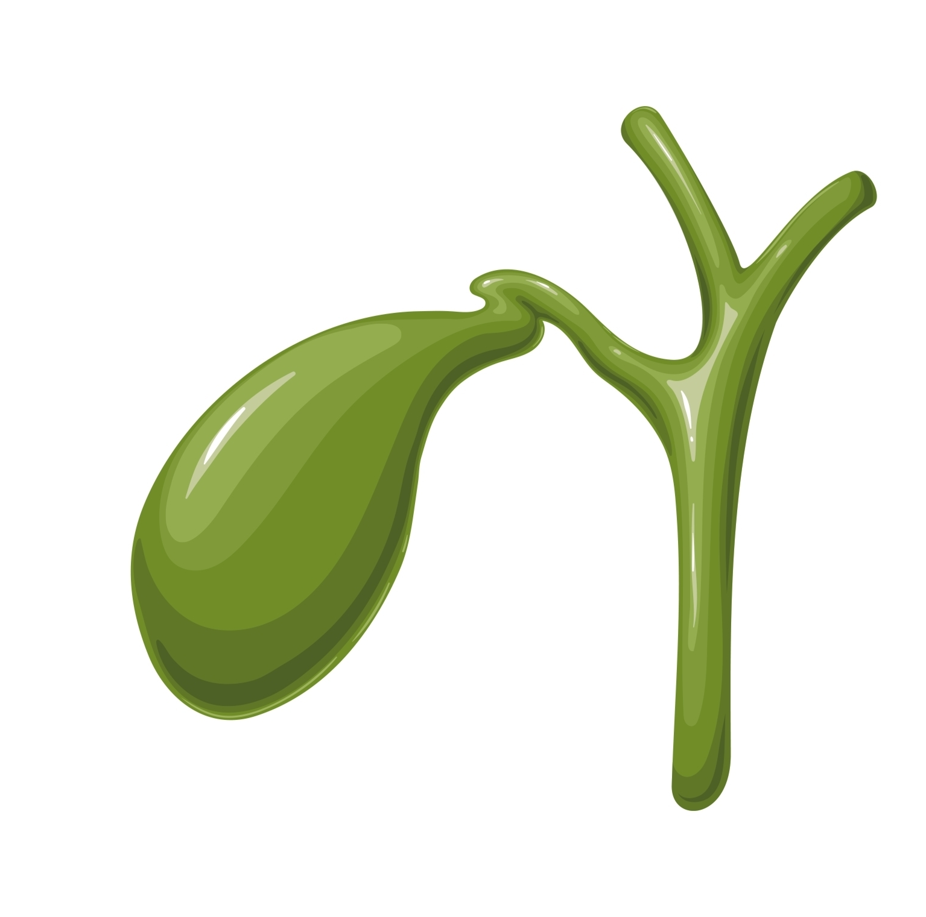
The gallbladder
The gallbladder is a storage sac for excess bile. Bile made in the liver travels to the small intestine via the bile ducts.
Bile serves two main purposes:
First, it helps absorb fats in the diet.
Secondly, it carries waste from the liver that cannot go through the kidneys.

Slide 6
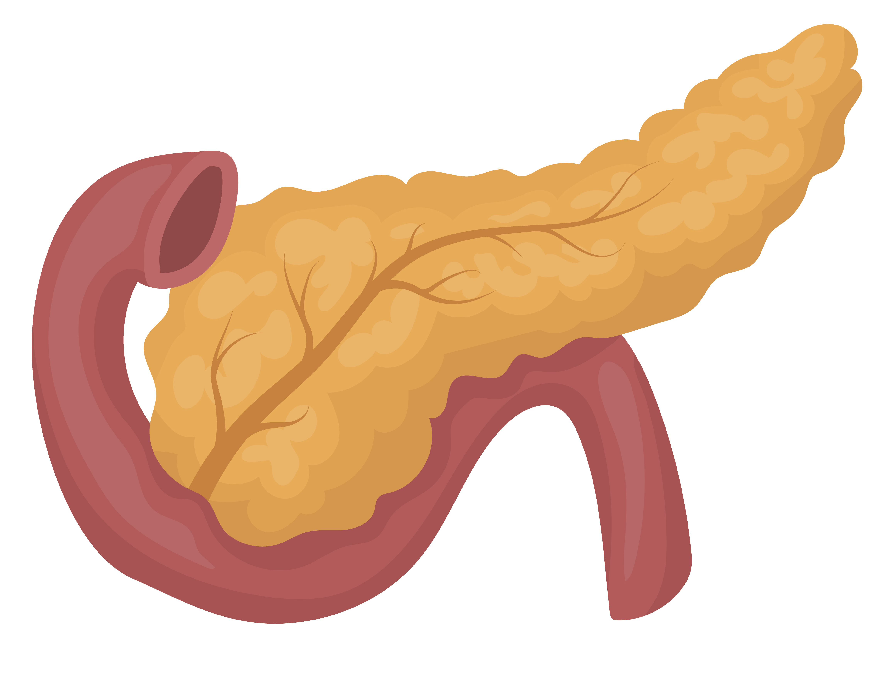
The pancreas
In digestion, the pancreas’ main job is to produce digestive enzymes. These are secreted into the first segment of the small intestine and break down protein, fats, and carbohydrates.
The pancreas also makes insulin, which helps control blood sugar levels.

Slide 7
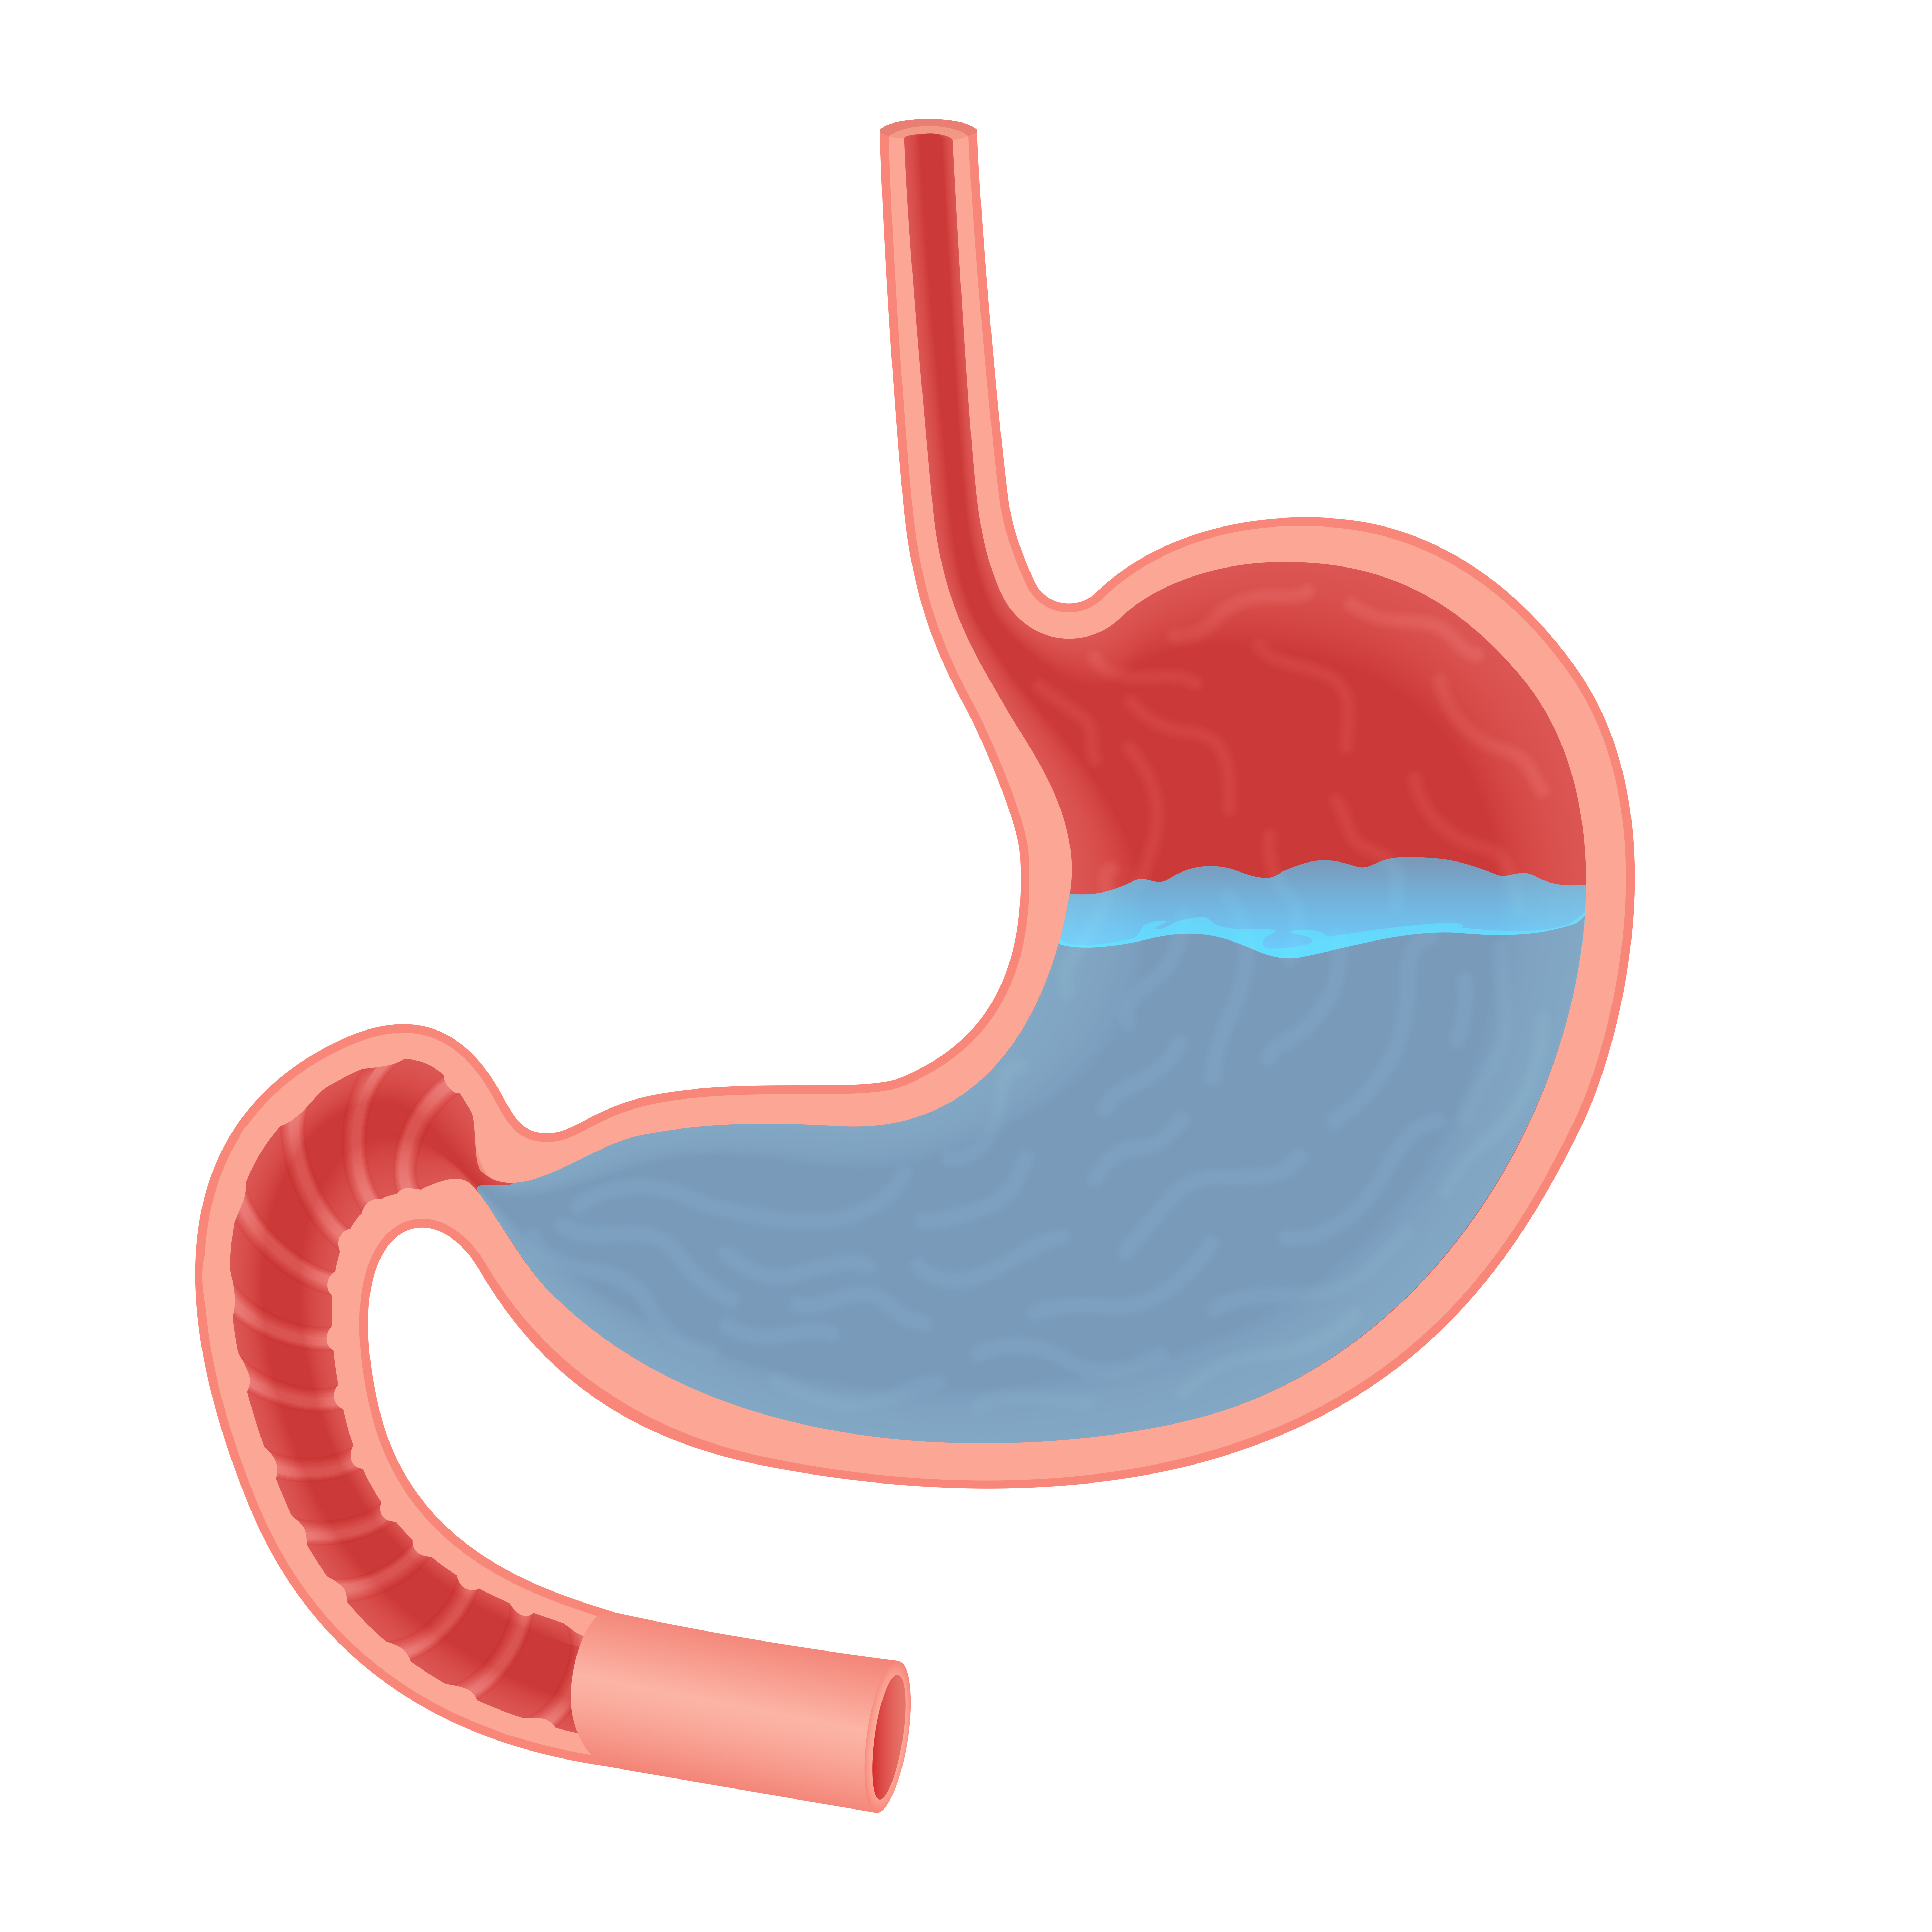
The stomach
The stomach is an expandable sack made up of three different layers of muscles where the food bolus will be churned for a few minutes or up to a few hours.
The bolus is mixed with hydrochloric acid (HCl) which helps to kill any bacteria present.

Slide 8
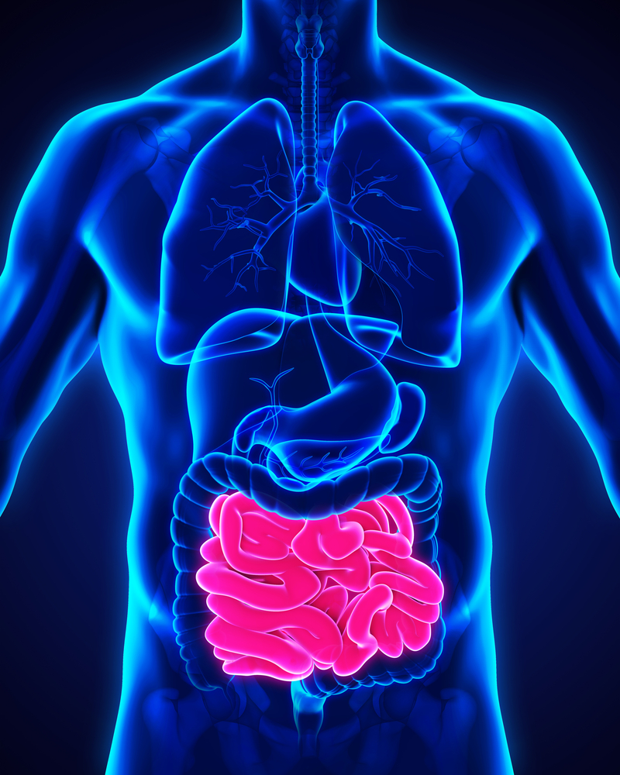
The small intestine
Chyme passes out of the stomach through the pyloric sphincter into the small intestine.
The small intestine is a tube about 6 metres long.
The inner surface of the small intestine is folded into finger-like structures called villi, which greatly increase the surface area available for absorption.

Slide 9
The colon (large intestine)
The colon is a tube just over 1.5 metre long and is inhabited by bacteria.
The main function of the colon is to absorb water into the bloodstream and to process waste products.
Bacteria in the colon ferment dietary fibre and produce fatty acids and gas.
Other bacteria produce vitamin K, which is also absorbed.
The products of bacterial digestion, along with water and any remaining minerals are absorbed leaving a residue behind.

Slide 10
The rectum
The rectum is an eight-inch chamber that connects the colon to the anus.
It receives faeces from the large intestine, lets the person know there is a faeces that needs to leave the body and holds it until it is able to leave.

Slide 11
The anus
The watery residue moves along the colon, the faeces are formed and stored in the rectum before being excreted through the anus.
Young children gradually learn to control this action.
The time taken for faeces to pass through the colon can be reduced if the diet is high in fibre.

Slide 12
Digestive system treasure hunt
For further information, go to:
www.foodafactoflife.org.uk
This resource was produced for the pHood Futures project, supported by the Royal Society of Chemistry.
This resource meets the Guidelines for producers and users of school education resources about food.

