Slide 1
Going shopping social story

Slide 2
What does this social story cover?
Leaving home – what do you need?
Going to the shop – where are you going?
Getting there
Arriving at the shop and different types of shop
Choosing food
Queuing to pay
Packing food
Paying for your shopping
Going home
Other ways to buy food

Slide 3


1. Leaving home - what do you need?

Slide 4
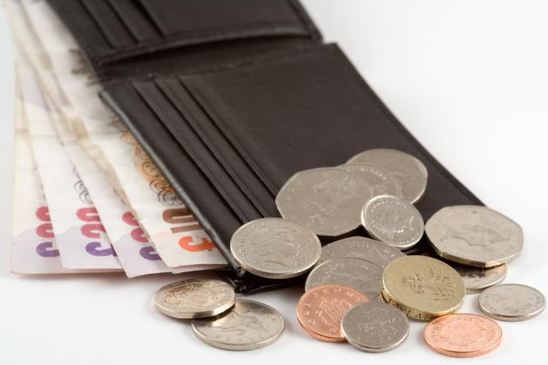
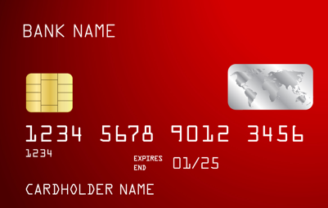
Money
Cash – notes and coins
Card

Slide 5
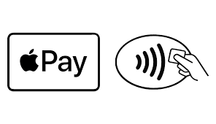


Mobile phones
Pay for food and drink using a phone.

Slide 6
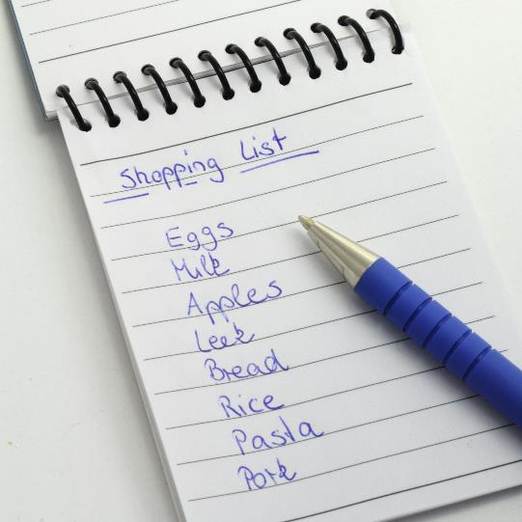
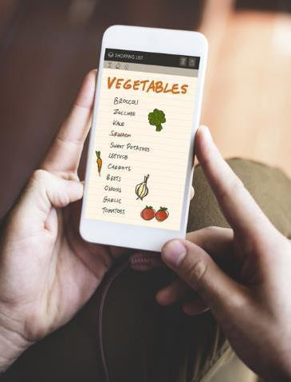
Shopping list

Slide 7
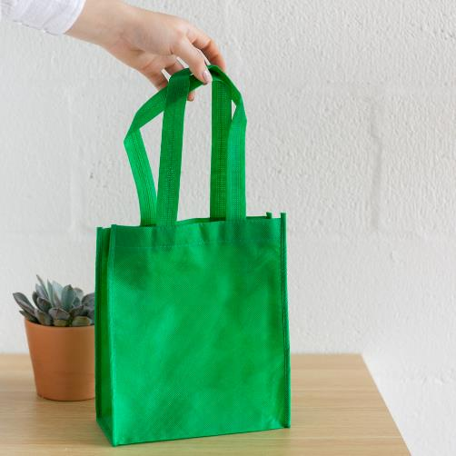
Shopping bag

Slide 8
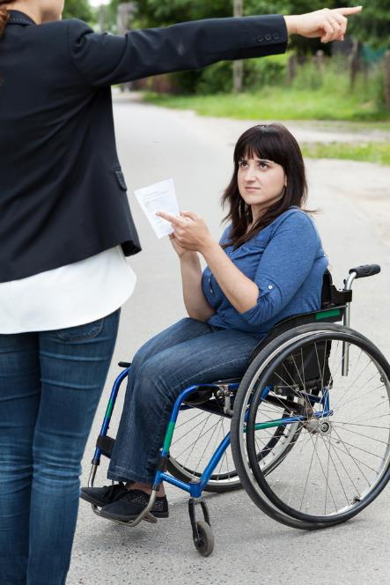

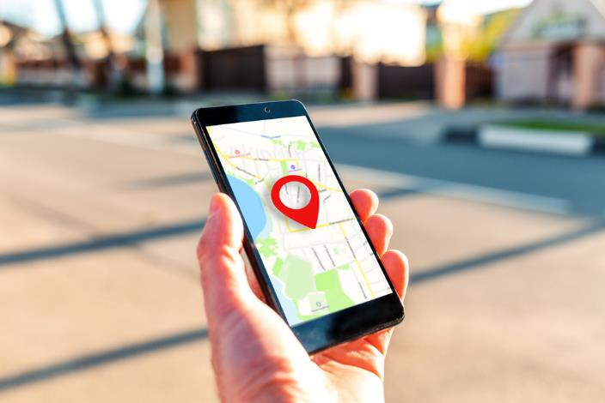
2. Where are you going?
Do you need directions?

Slide 9
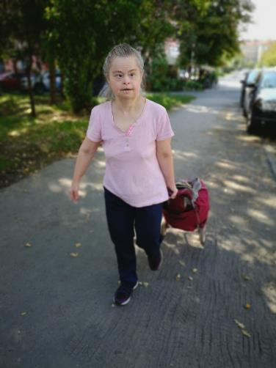
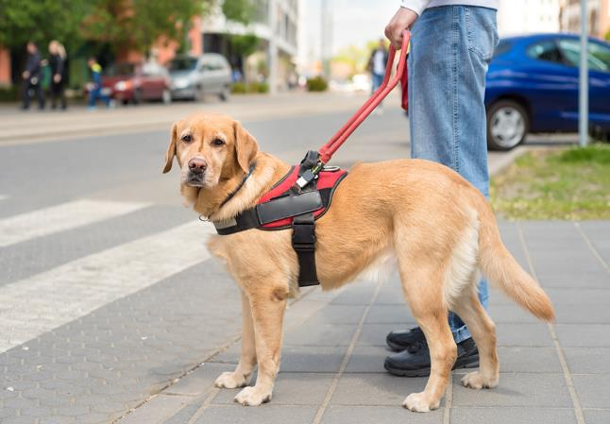
3. Getting there
You could ….
Walk

Slide 10

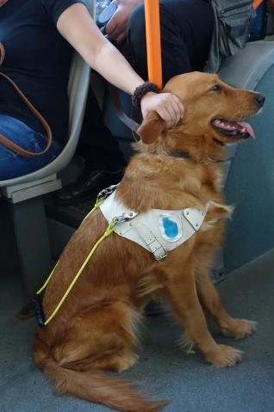
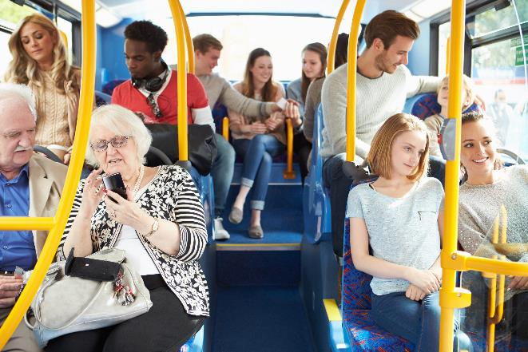
3. Getting there
You could ….
Catch the train or bus

Slide 11
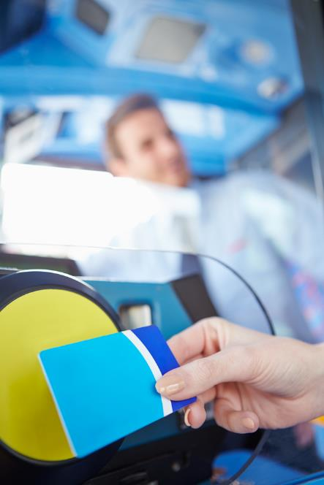
Remember your bus or train pass!

Slide 12


3. Getting there
You could ….
Go by bike

Slide 13


3. Getting there
You could ….
Go in a car

Slide 14
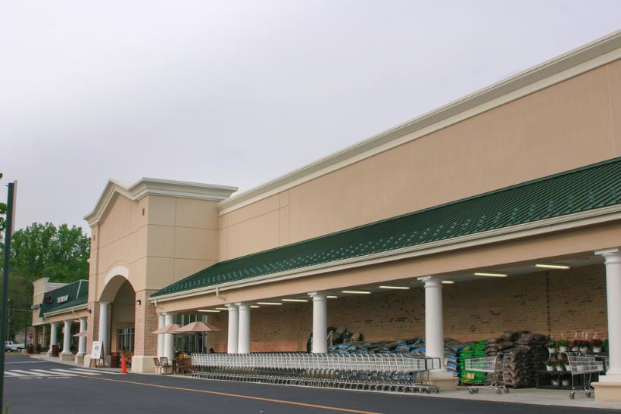
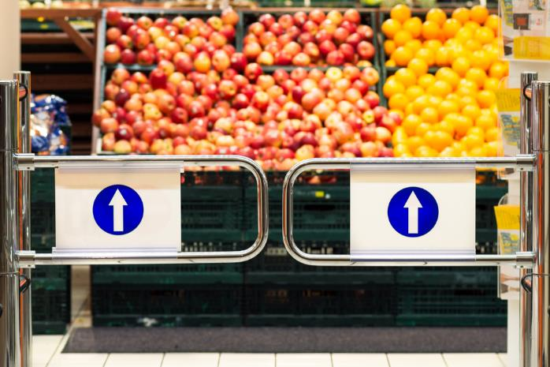
4. Arriving at the shop

Slide 15
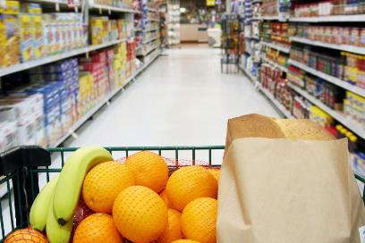
Different types of shop
Supermarket

Slide 16
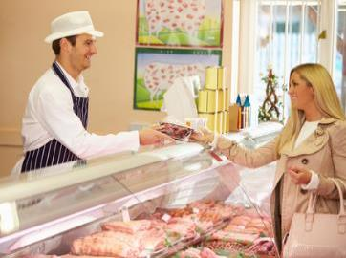
Different types of shop
Butcher

Slide 17
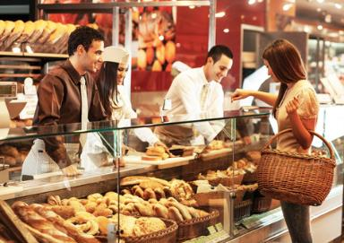
Different types of shop
Baker

Slide 18

Different types of shop
Fishmonger

Slide 19
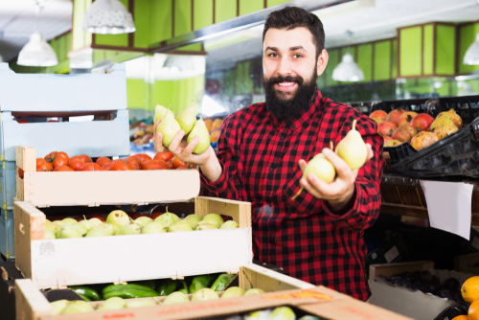
Different types of shop
Greengrocer

Slide 20
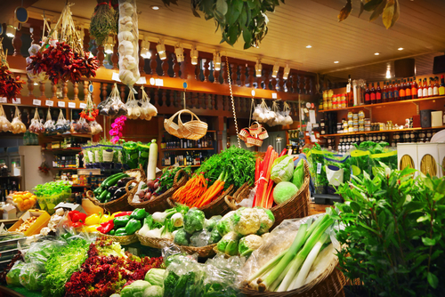
Different types of shop
Farmers market

Slide 21
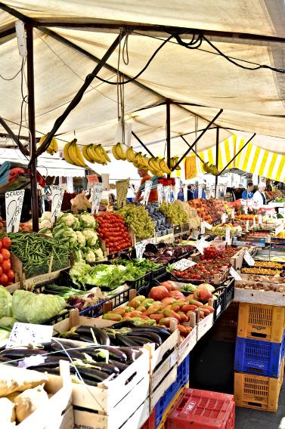
Different types of shop
Indoor or outdoor market

Slide 22
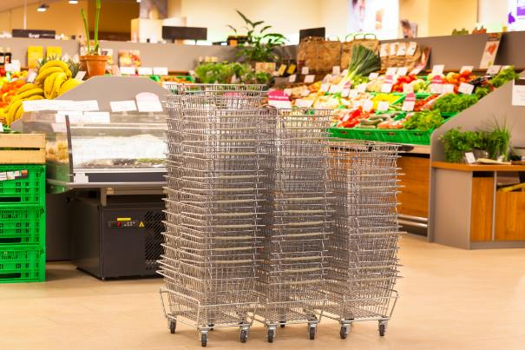

4. Arriving at the shop
What will you need?
A basket
A trolley

Slide 23
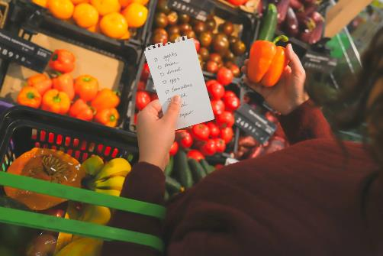
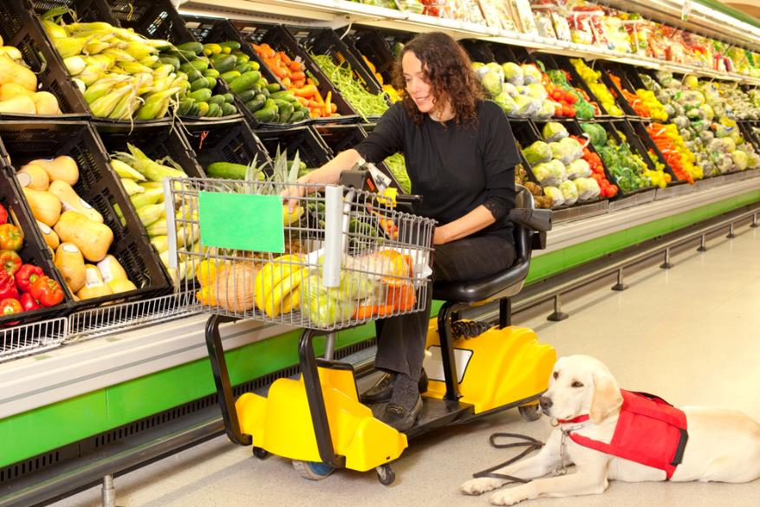
5. Choosing food

Slide 24

5. Choosing food

Slide 25
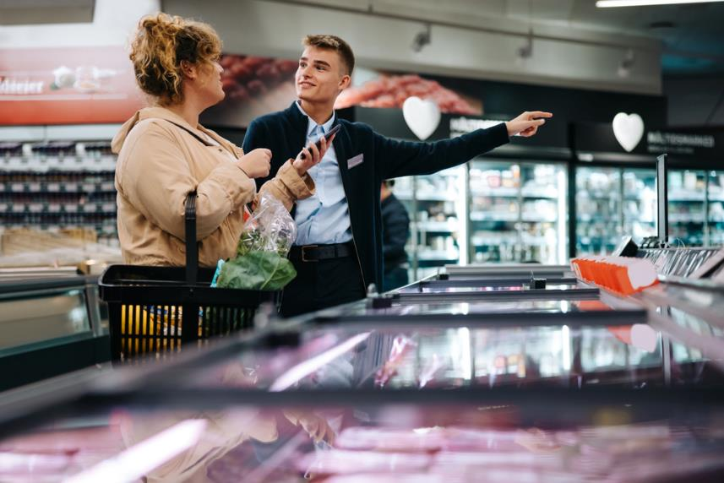
Can’t find something – ask someone

Slide 26
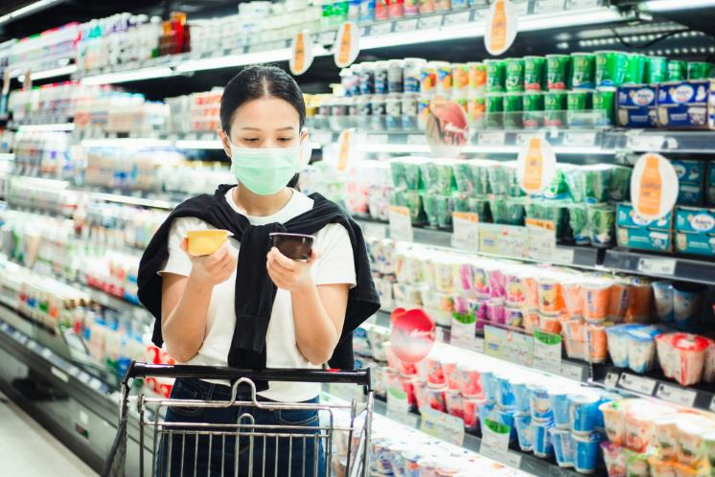
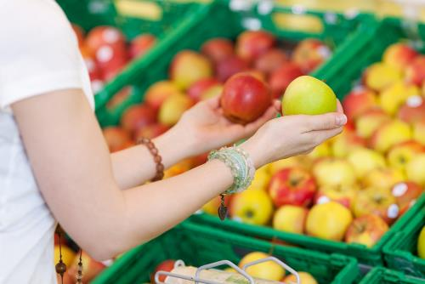

Comparing food

Slide 27
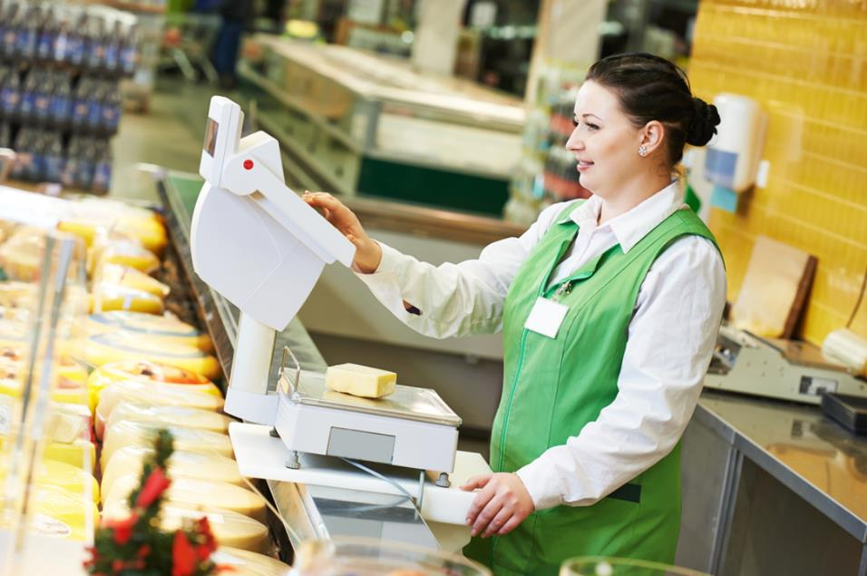

Loose or in containers?
Or

Slide 28
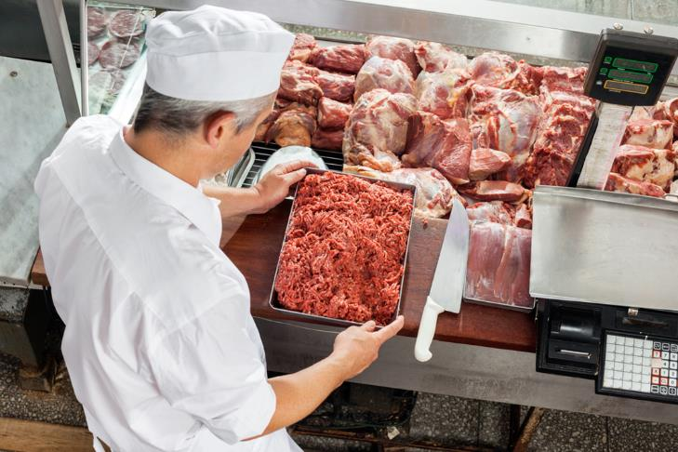
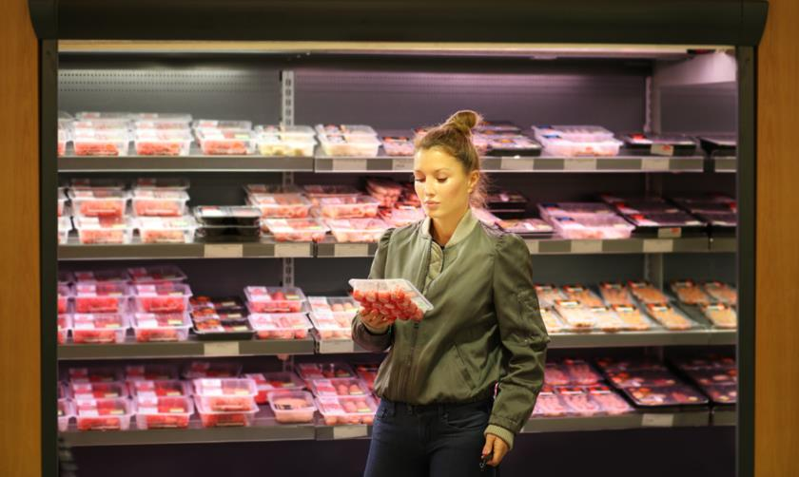
Loose or in containers?
Or

Slide 29
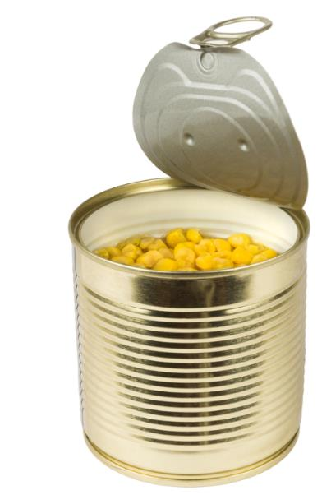
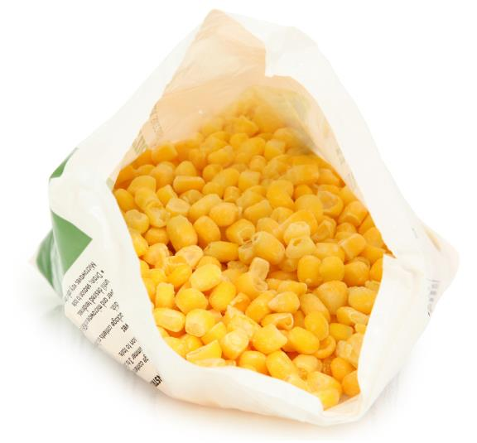
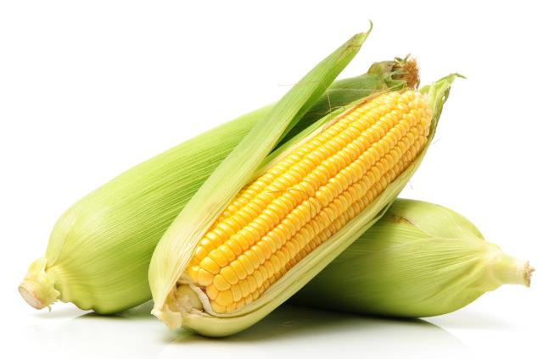
Loose or in containers?
Or
Or

Slide 30
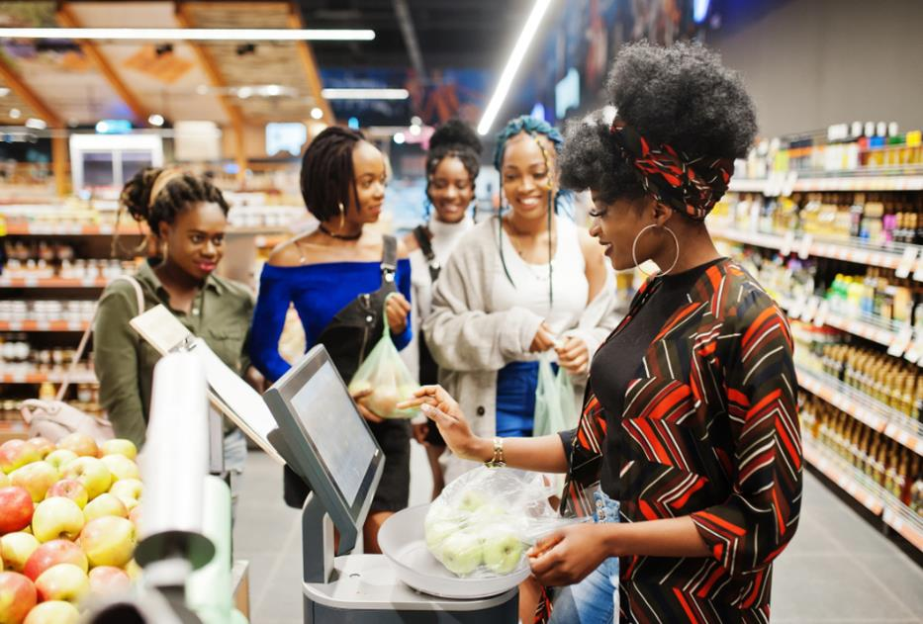
How much do you need?

Slide 31


How much do you need?
Or

Slide 32
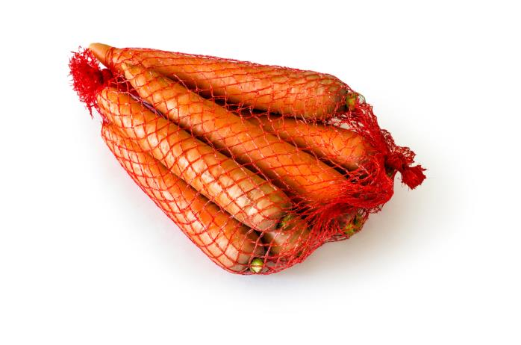
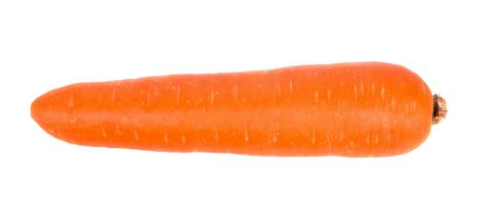
How much do you need?
Or

Slide 33


How much do you need?
BEANS
Or
BEANS

Slide 34
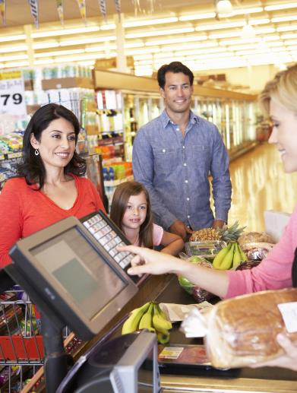
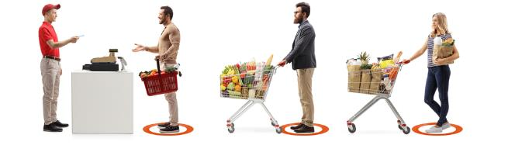
6. Queuing to pay for food

Slide 35
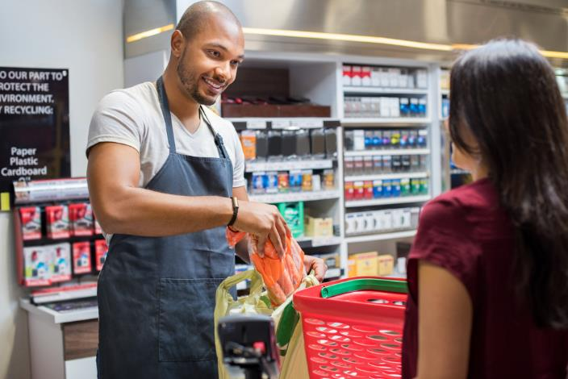
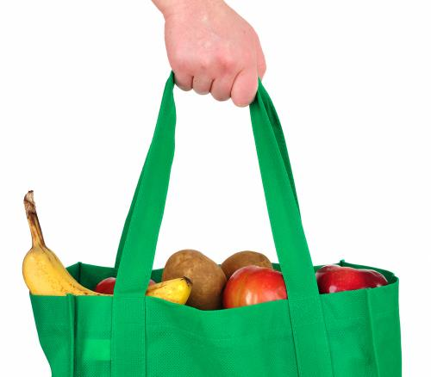
7. Packing food

Slide 36
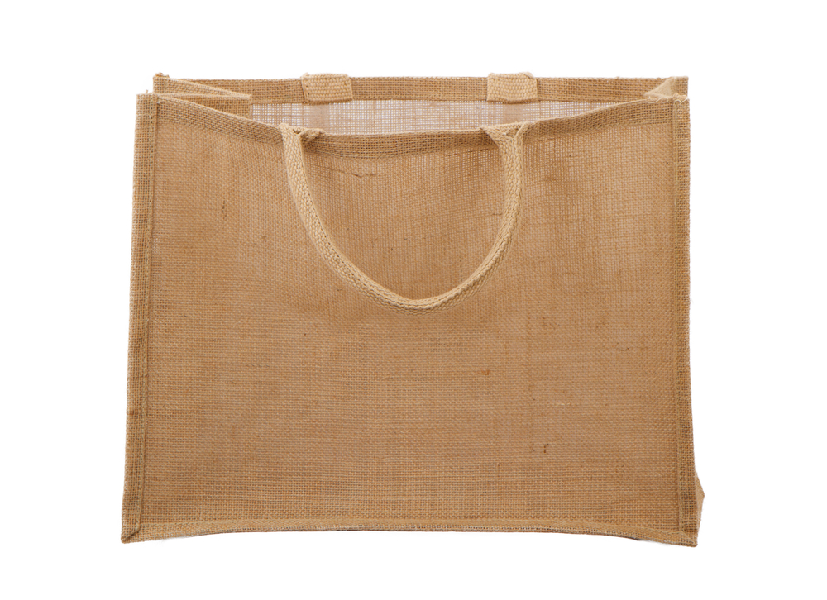

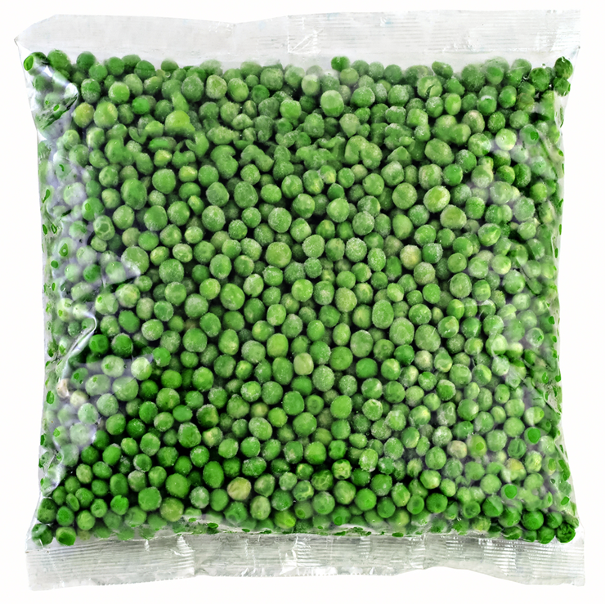
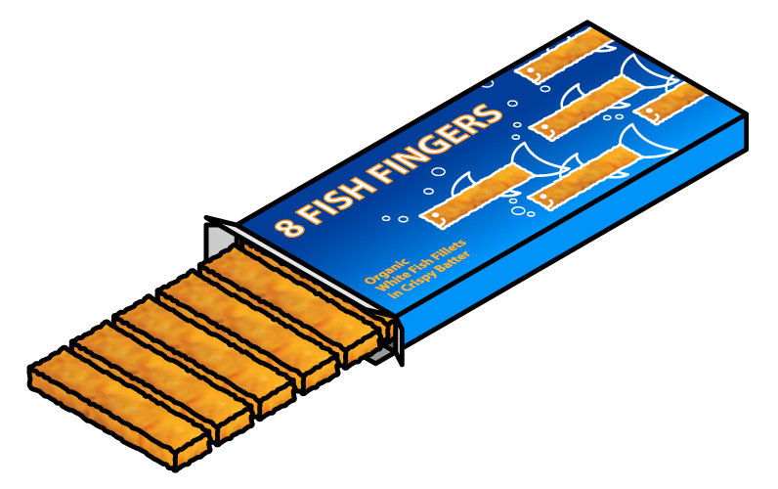
7. Packing food
Frozen food together

Slide 37
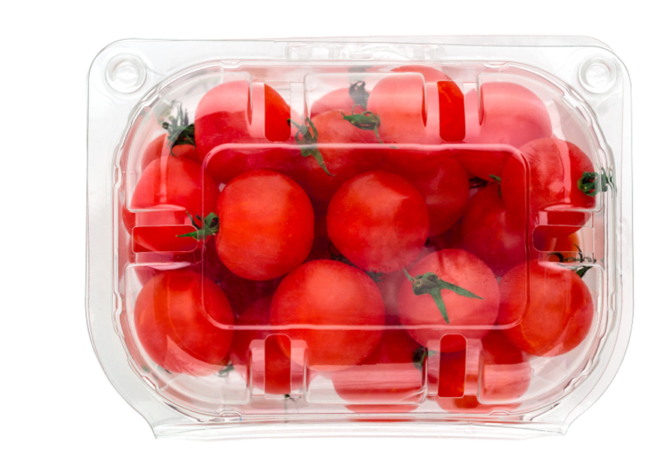
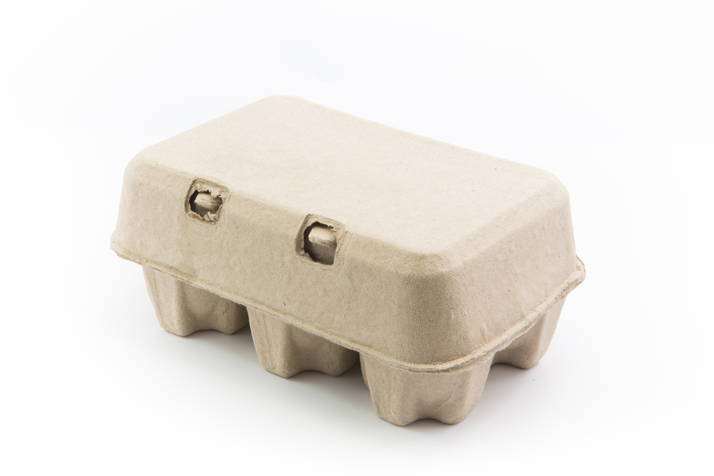
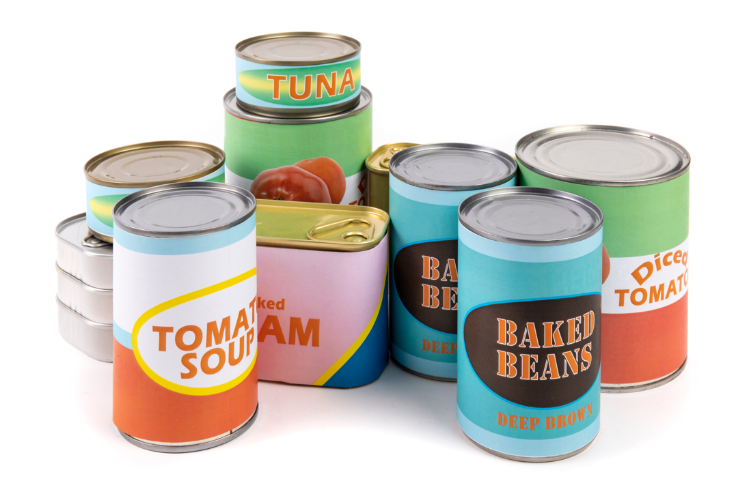
7. Packing food
Heavy food at the bottom

Slide 38
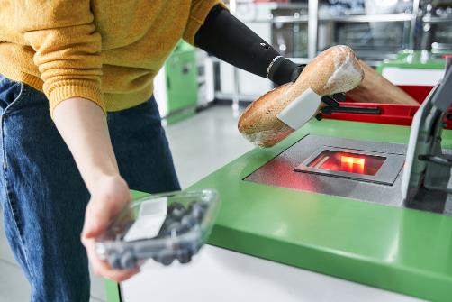
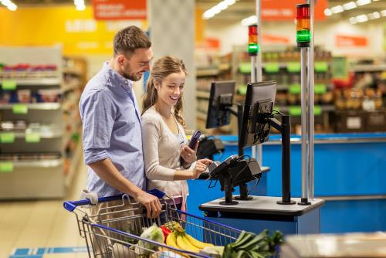
6. Paying
Self service

Slide 39
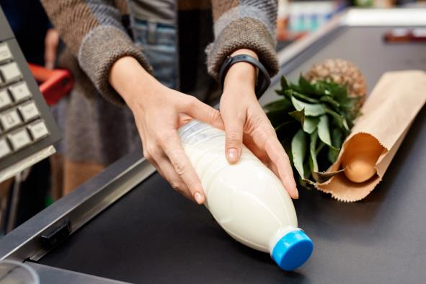
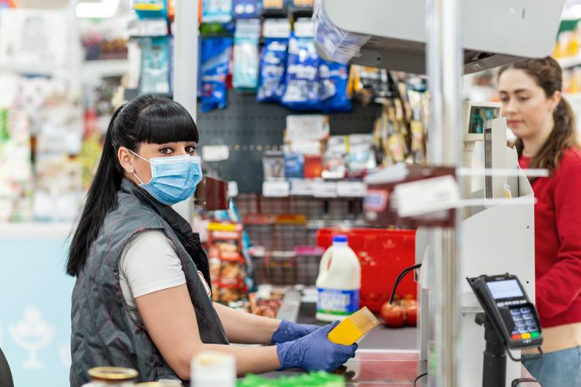
6. Paying

Slide 40



6. Paying
Cash – notes and coins

Slide 41

6. Paying
Card

Slide 42

6. Paying
Mobile phone

Slide 43


7. Going home

Slide 44

Other ways to buy food
On the internet

Slide 45

Other ways to buy food
Mobile phone

Slide 46
This did this social story cover?
Leaving home – what do you need?
Going to the shop – where are you going?
Getting there
Arriving at the shop and different types of shop
Choosing food
Queuing to pay
Packing food
Paying for your shopping
Going home
Other ways to buy food

Slide 47


The story continues – let’s cook!

Slide 48
Shopping social story
For further information, go to:
www.foodafactoflife.org.uk
This resource meets the Guidelines for producers and users of school education resources about food.

