Slide 1
Functions of colloidal systems in food products

Slide 2
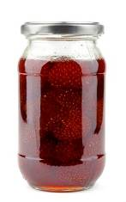
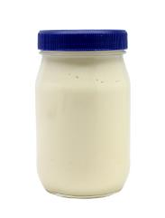
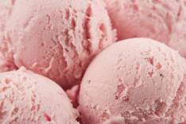
What are colloidal systems?
Colloidal systems give structure, texture and mouthfeel to many different products. For example:
The functions of colloidal systems can be used in a variety of ways in order to produce food products.
jam
ice cream
mayonnaise

Slide 3
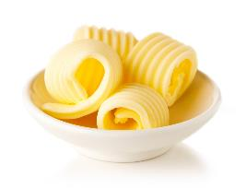
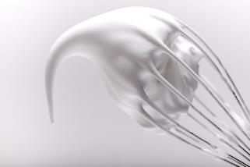
What are colloidal systems?
Colloids are formed when one substance is dispersed through another, but does not form a solution. There are many types of colloidal systems, depending on the state of the two substances mixed together.
Gels, sols, foams (e.g. egg white foam) and emulsions (e.g. butter) are all types of colloids.
The substance which is dispersed is known as the disperse phase and it is suspended in the continuous phase.
Egg white foam is an example of this. Air bubbles (disperse phase) are trapped in the egg white (continuous phase), resulting in a foam.

Slide 4
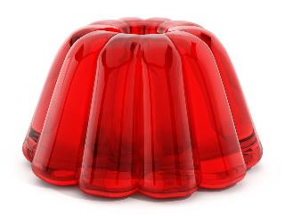
Functions of colloidal systems in food products
Most colloids are stable, but the two phases may separate over time because of an increase in temperature or through physical force.
They may also become unstable when frozen or heated, especially if they contain an emulsion of fat and water.

Slide 5
Main types of colloidal system
System | Disperse phase | Continuous phase | Product
Sol | Solid | Liquid | Uncooked custard, unset jelly
Gel | Liquid | Solid | Jelly, jam, blancmange
Emulsion | Liquid | Liquid | Mayonnaise, milk
Solid emulsion | Liquid | Solid | Butter, baking fat/block
Foam | Gas | Liquid | Whipped cream, whisked egg white
Solid foam | Gas | Solid | Meringue, bread, cake, ice cream

Slide 6
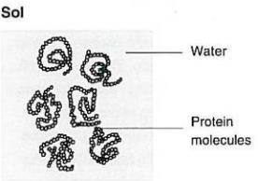
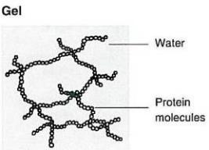
Sols and gels
A sol is a colloid in which solid particles are dispersed through a liquid continuous phase. Sometimes the mixture needs to be heated and stirred to disperse the solid particles evenly. When this solution cools, the sol may form a gel, in which the solid particles form a network (continuous phase), trapping the liquid (disperse phase). Both proteins and starches are capable of this. On this page, you can see an illustration of how a protein (e.g. gelatine) can form a gel from a sol upon cooling.

Slide 7
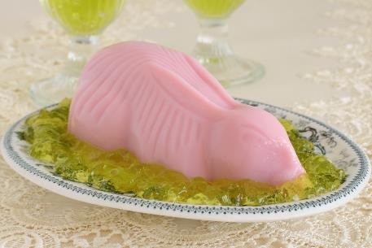
Sols and gels
When a jelly is made, gelatine is dispersed into a liquid and heated to form a sol. As the sol cools, protein molecules unwind, forming a network that traps water and forms a gel.
If cornflour is mixed with water and heated, the starch granules absorb water until they rupture. The starch disperses in the water and the mixture becomes more viscous and forms a gel on cooling.

Slide 8
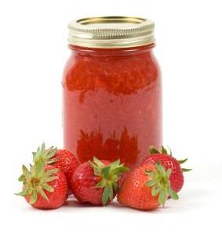
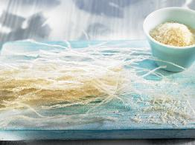
Other types of gel
Other types of gel may be formed with pectin or agar.
Pectin, a carbohydrate found in fruits, is used in the production of jam to help it set. However, for it to gel there must be at least 50% sugar and conditions should be acidic. Agar is a polysaccharide (complex carbohydrate), extracted from seaweed, which can form gels.
If a gel is allowed to stand for a time, it can start to ‘weep’.
This loss of liquid is known as syneresis.

Slide 9
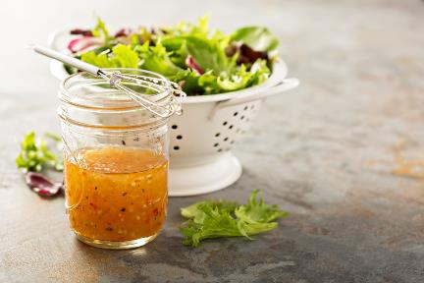
Emulsions
When water and oil are shaken together, they form an emulsion. This emulsion is unstable. If left to stand, the oil will form a separate layer on top of the water (e.g. traditional French dressing).
The two liquids are immiscible (they will not mix together). A stable emulsion is formed when two immiscible liquids are held stable by a third substance, called an emulsifier.

Slide 10
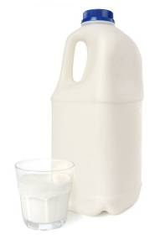
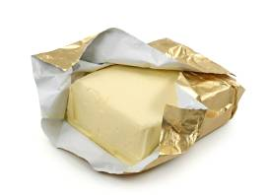
Emulsions
An emulsion may be oil-in-water (o/w) in which case small oil droplets are dispersed through water (e.g. milk) or water-in-oil (w/o) in which case small water droplets are dispersed through oil (e.g. butter).

Slide 11
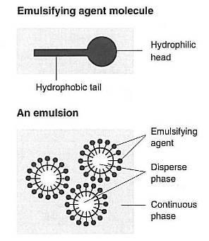
Emulsions
An emulsifier is a molecule with two distinct parts, known as the ‘head’ and ‘tail’. The head is hydrophilic (water loving) and the tail is hydrophobic (water hating). This means that the tail will sit within the oil and the head will sit within the water. This keeps the small bubbles of oil or water from coalescing (joining together). The emulsifier holds the disperse phase within the continuous phase. This results in the emulsion becoming stable.

Slide 12
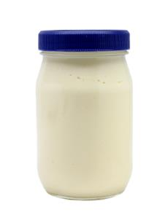
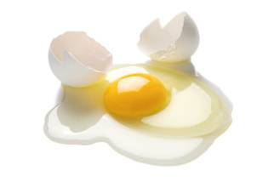
Emulsions
Mayonnaise is an example of a stable emulsion of oil and vinegar, when egg yolk (lecithin) may be used as an emulsifier. Sometimes mustard is also used which contains another emulsifier (mucilage). Stabilisers are often added to help improve the stability of the emulsion, as over time the emulsion may separate. Stabilisers also increase shelf life (e.g. E461 methylcellulose, used in low fat spreads).

Slide 13
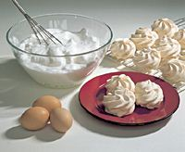
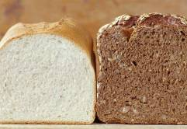
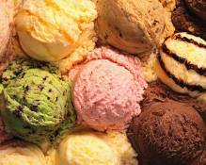
Foams
Foams are composed of small bubbles of gas (usually air) dispersed in a liquid, e.g. egg white foam. As liquid egg white is whisked, air bubbles are incorporated.
The mechanical action causes proteins in the egg white to unfold and form a network, trapping the air.
If an egg white foam is heated, proteins coagulate, and moisture is driven off. This forms a solid foam, e.g. a meringue.
Ice cream, bread and cakes are other examples of solid foams.

Slide 14
Functions of colloidal systems in food products
For further information, go to:
www.foodafactoflife.org.uk
This resource meets the Guidelines for producers and users of school education resources about food.

