Slide 1
Dutch apple cake
Complexity: medium - high

Slide 2
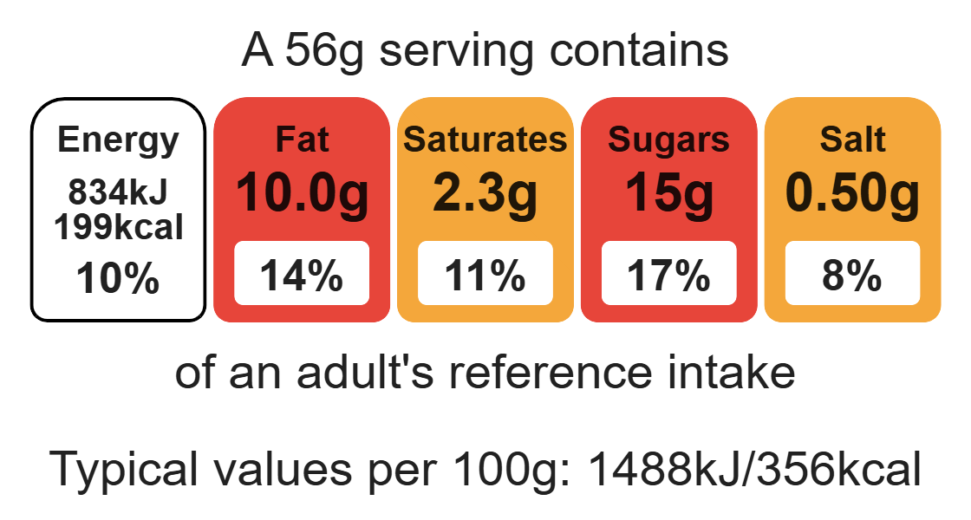
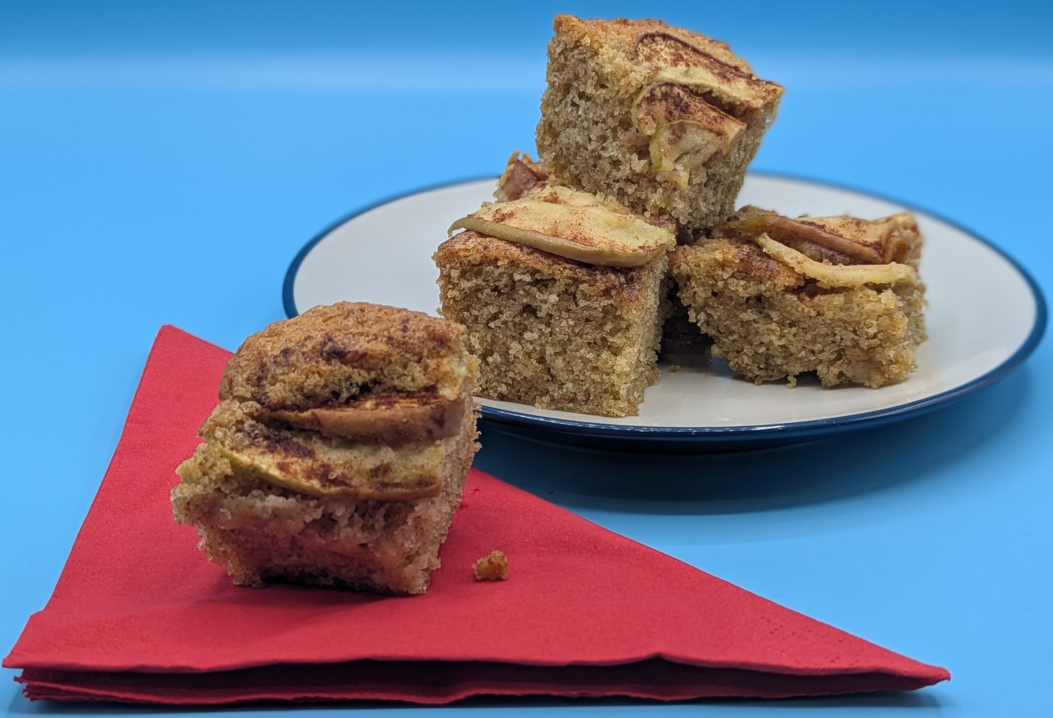
Nutritional analysis
Makes 8

Slide 3
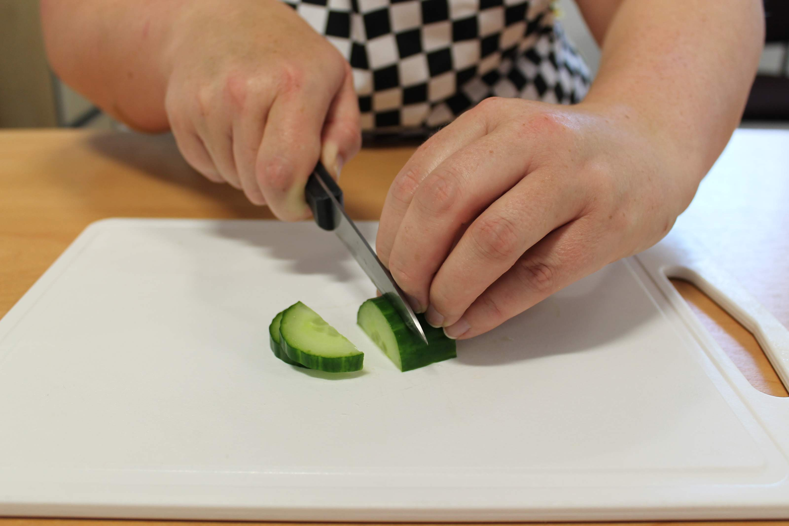
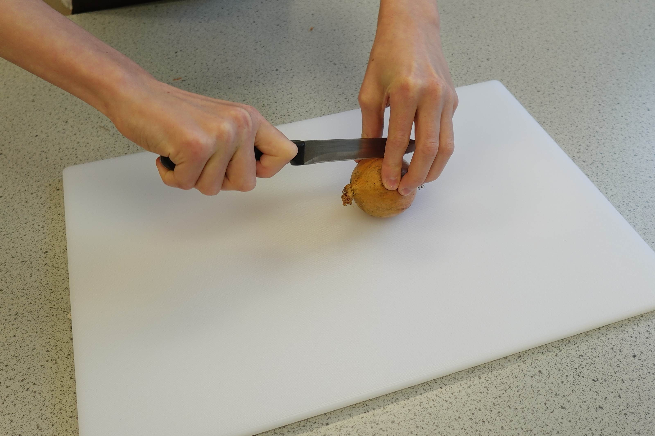
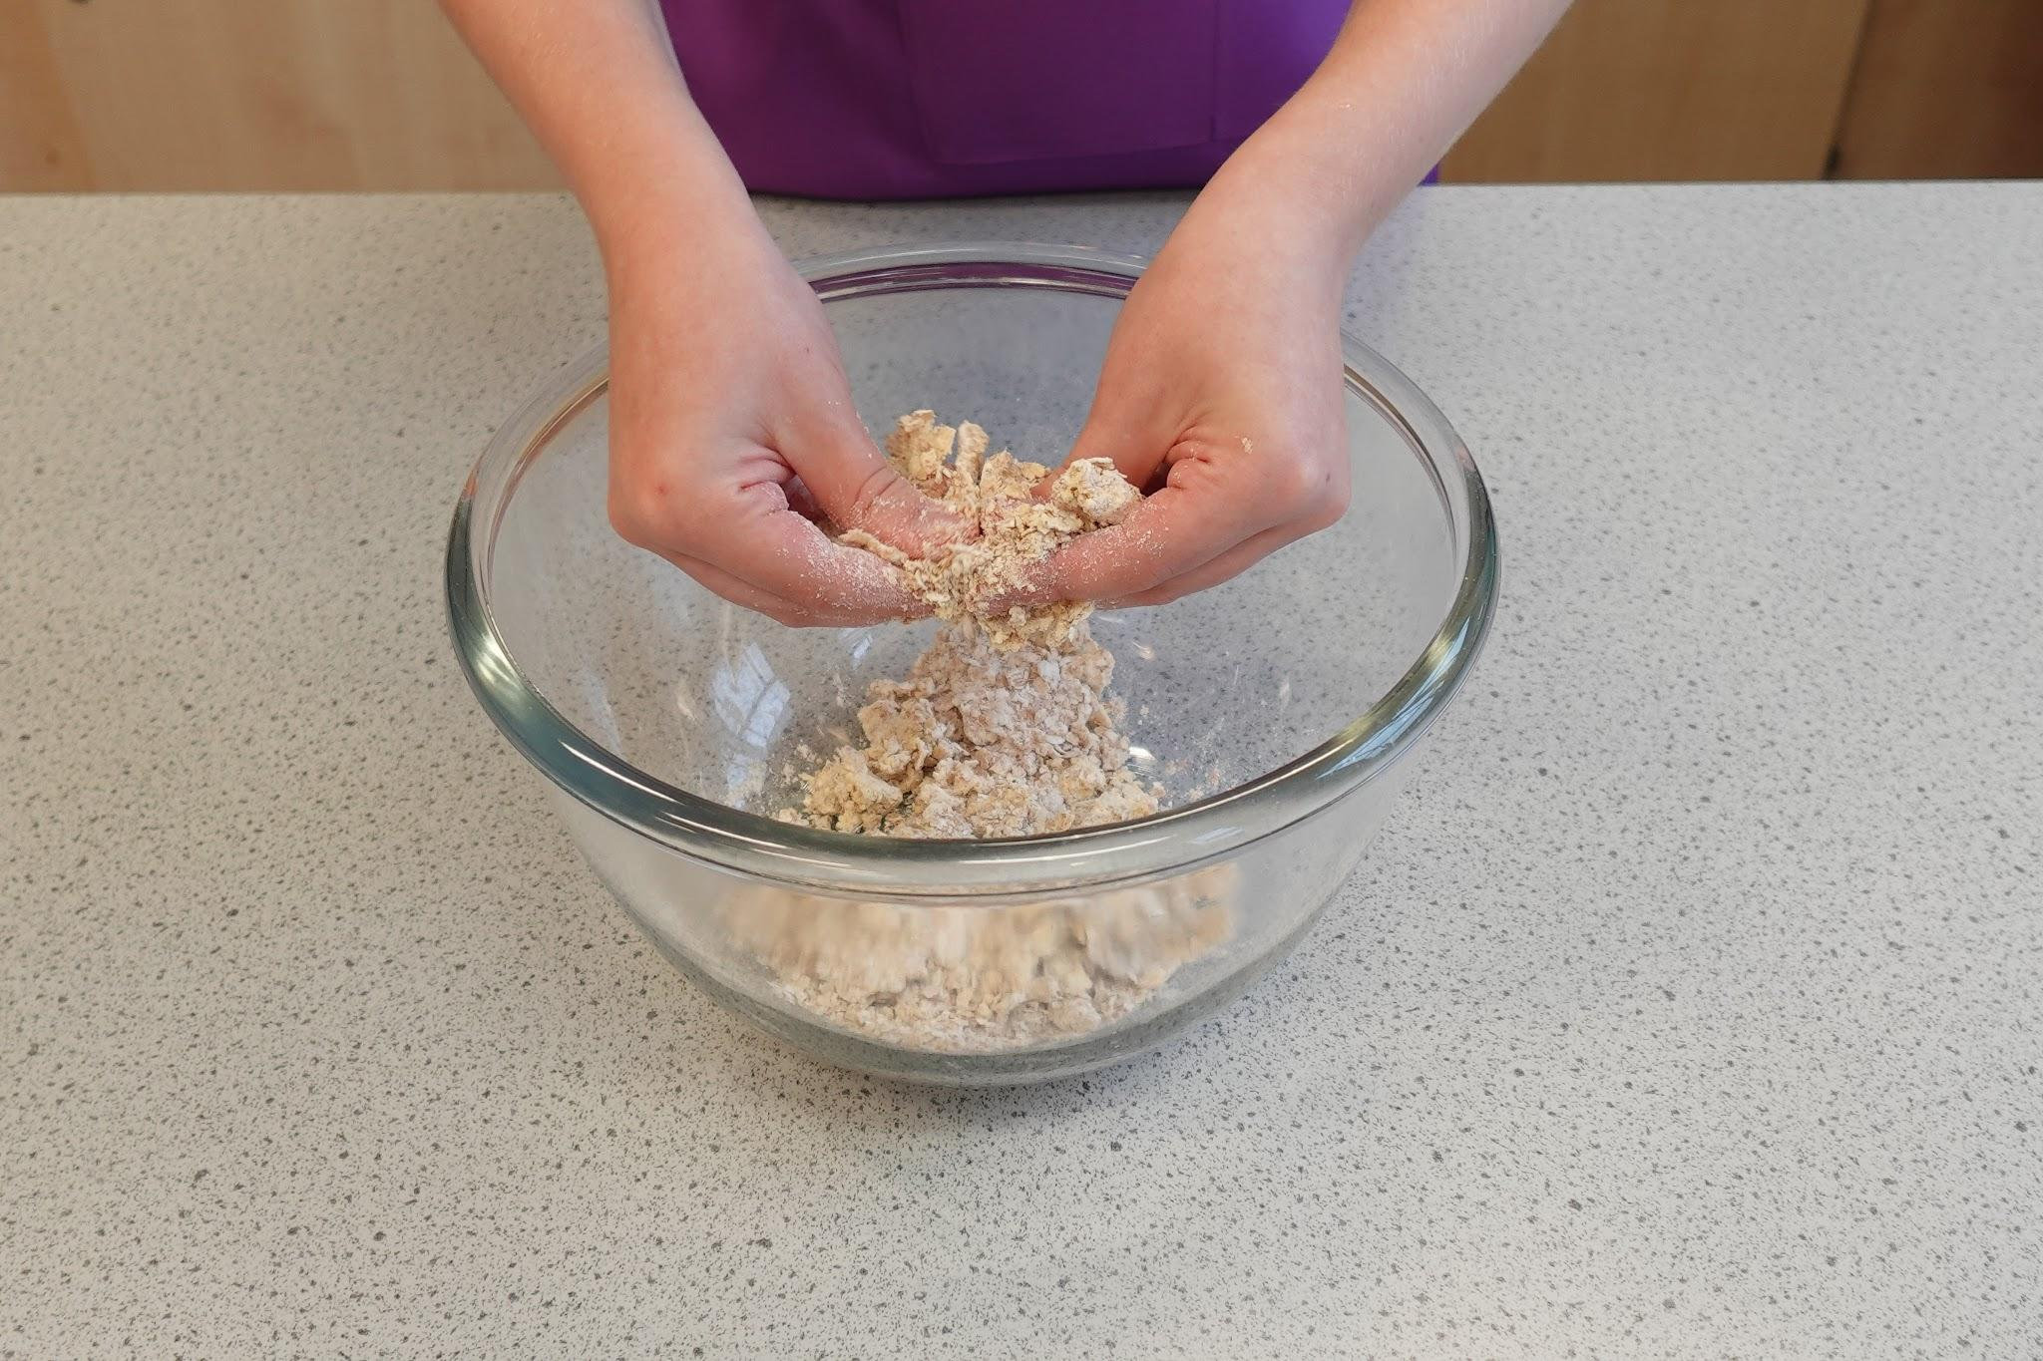
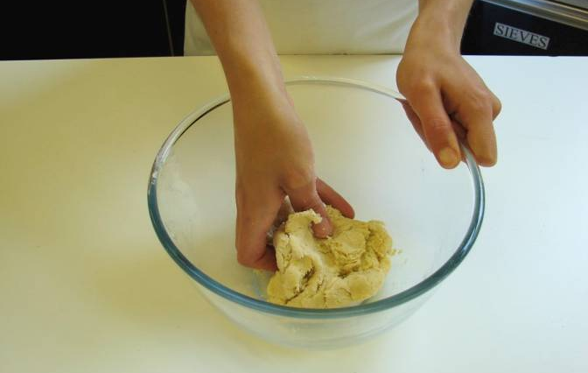
Starter activity
Which skills do these images show?

Slide 4
Example responses
Which skills do these images show?
Claw grip
Bridge hold
Forming a dough
Rubbing-in

Slide 5
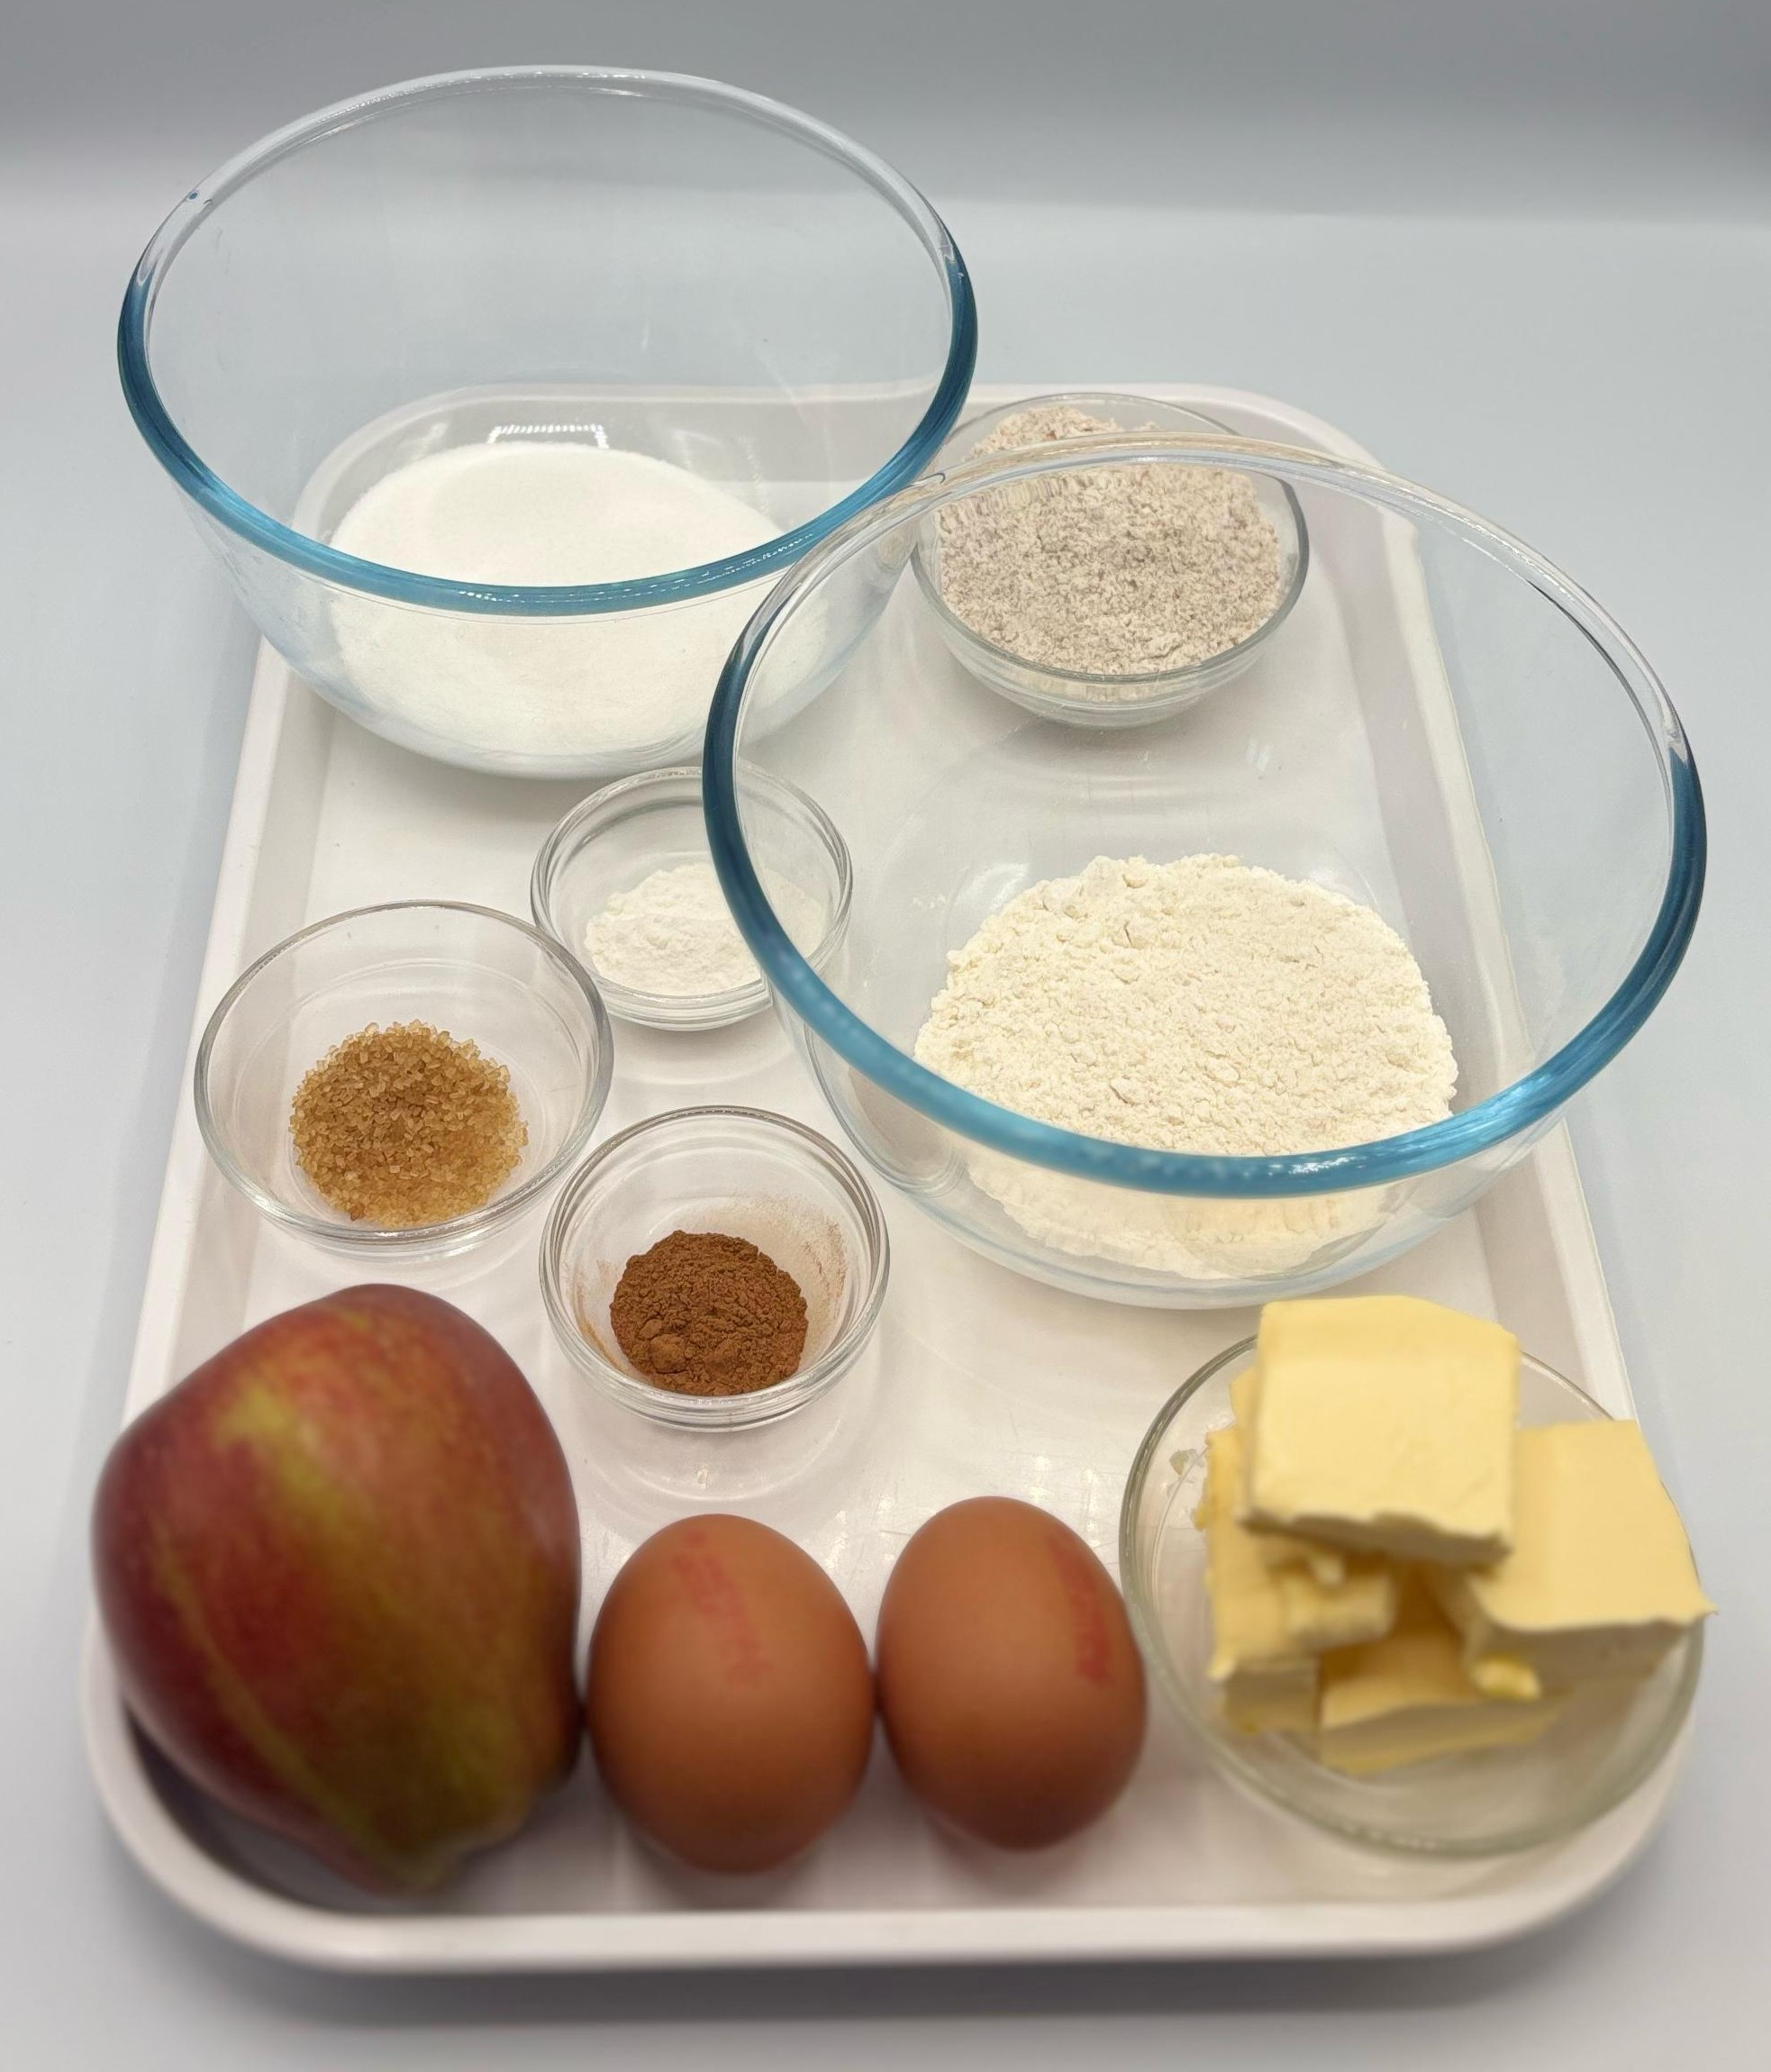

Ingredients (makes 8)
100g caster sugar
100g reduced-fat spread
2 eggs
50g self-raising white flour
50g self-raising wholemeal flour
1 x 5ml spoon baking powder
1 eating apple
½ x 5ml spoon cinnamon
1 x 5ml spoon demerara sugar
Check for any food allergy, intolerance, special dietary requirement or religious/cultural reasons for not handling or eating the ingredients in this recipe.

Slide 6
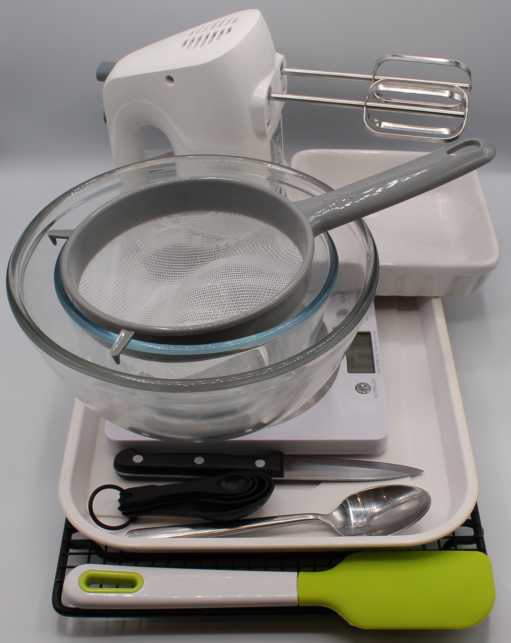
Equipment
Weighing scales
Baking tin (20cm square) or foil trays
Electric hand whisk
Mixing bowl
Small bowl
Sieve
Metal spoon
Sharp knife
Chopping board
Spatula
Measuring spoons
Cooling rack

Slide 7
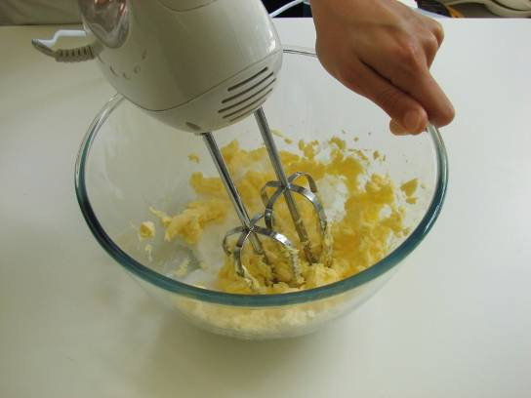
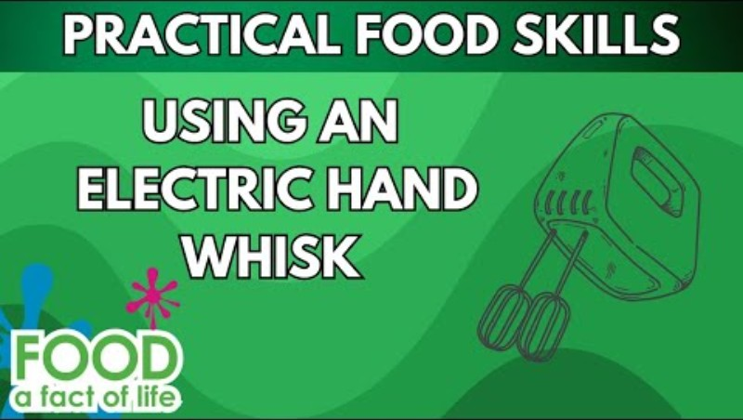
Food skills
Slice
Bake
Weigh
Measure
Cream
Beat
Sift
Mix
Stir and combine
Fold
Core
Cut
Click below to see how to use the electric hand whisk safely

Slide 8
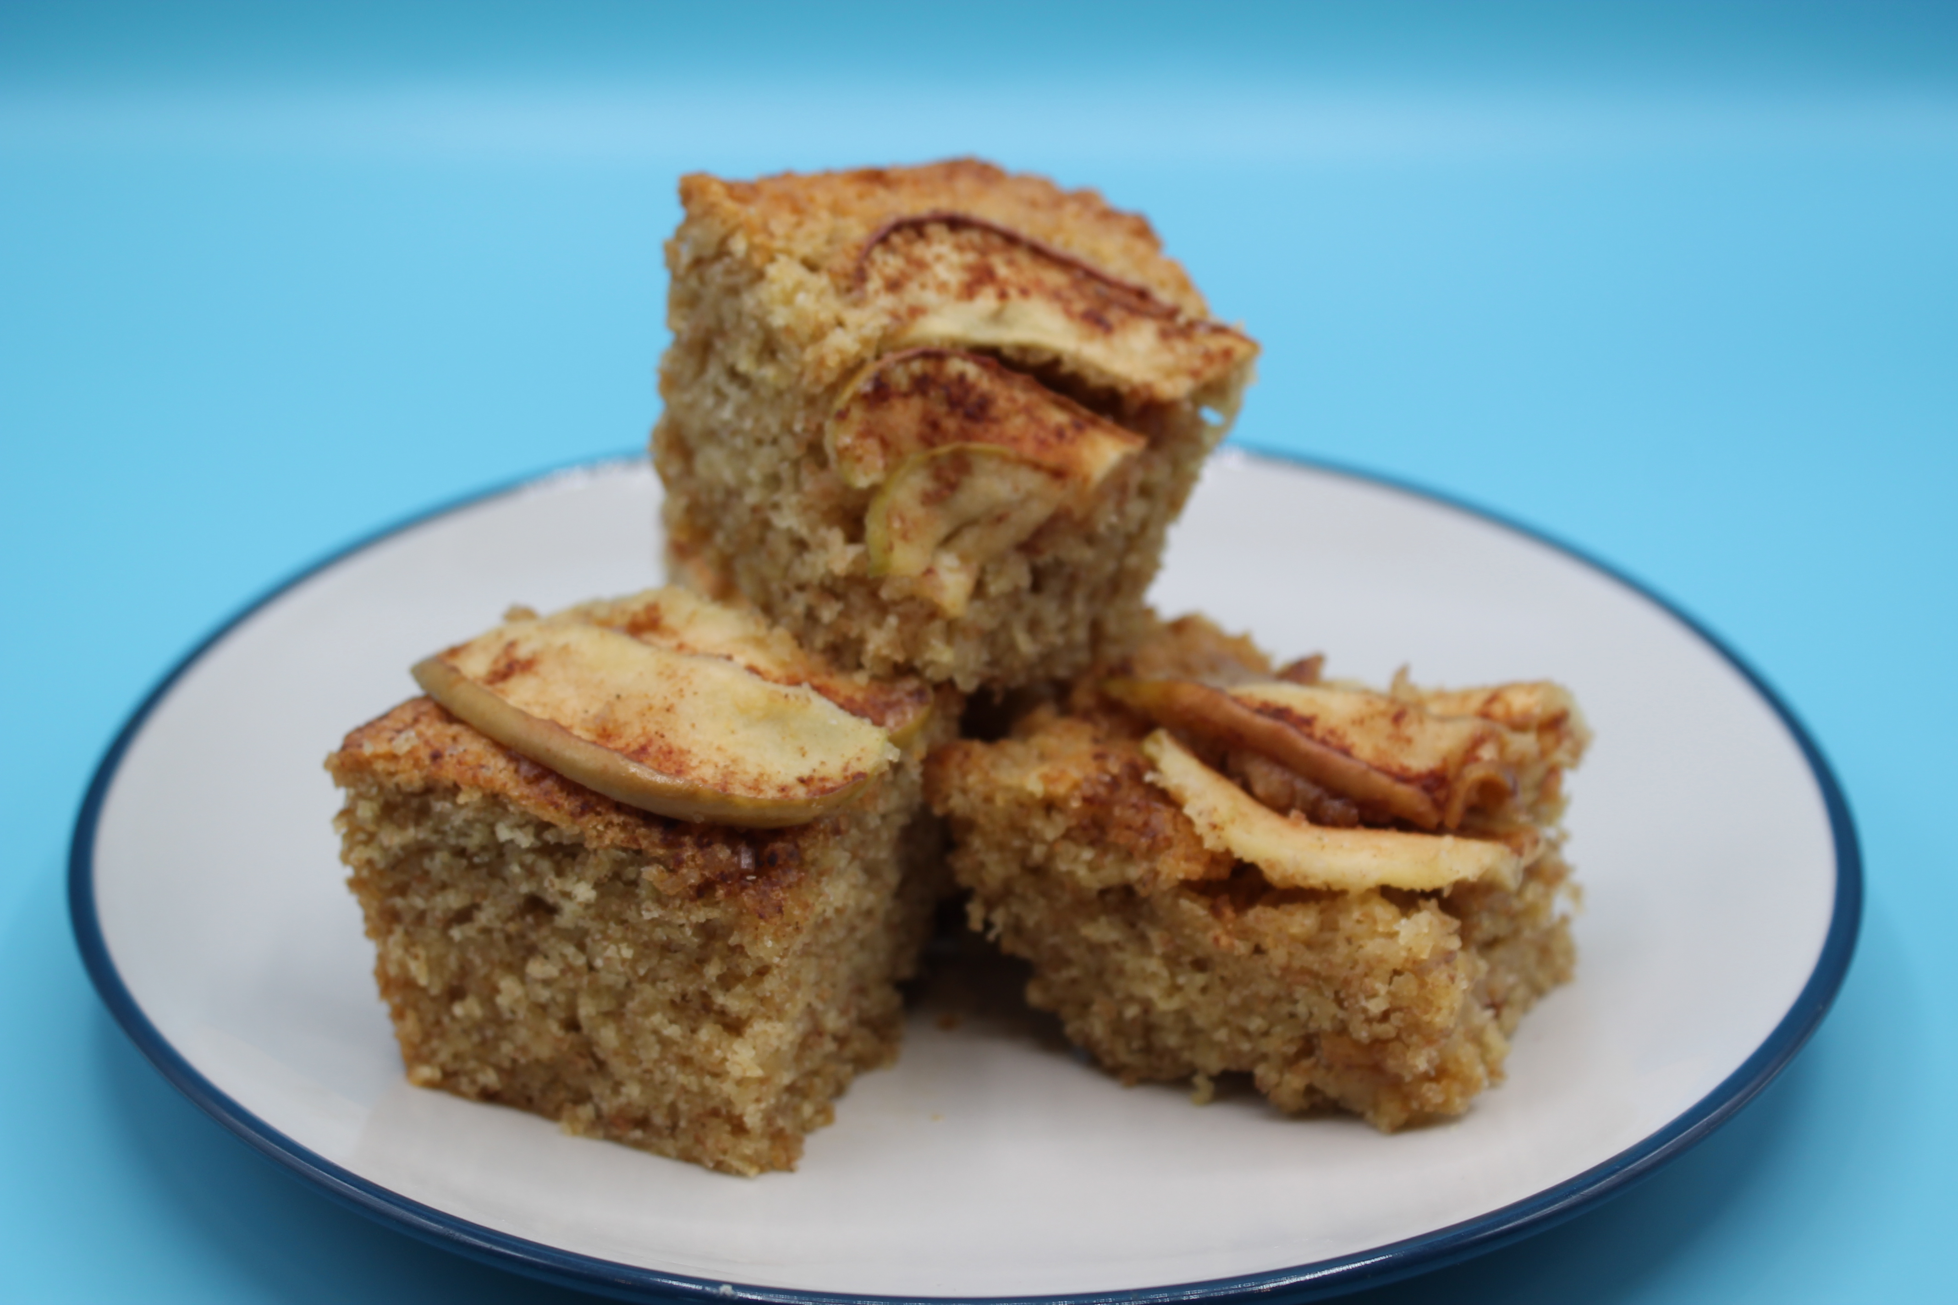
Method
Preheat the oven to 180ºC or gas mark 4.
Grease or line the baking tin or foil trays.
Cream the caster sugar and fat together, ideally using an electric hand whisk, until light and fluffy.
In a small bowl, crack and beat the eggs with a fork.
Add the beaten egg, a little at a time, to the fat and sugar.
Sift the flour and baking powder into a bowl, or onto a plate or piece of greaseproof paper.
Fold the flour and baking powder into the mixture, a spoonful at a time.
Spread the mixture in the cake tin.
Core the apple on a clean chopping board and slice thinly.
Arrange the apple slices over the cake mix, then sprinkle the cinnamon and demerara sugar on top.
Place in the oven and bake for around 20 minutes, until golden brown and springy to the touch.
Remove from the oven and allow to cool.

Slide 9
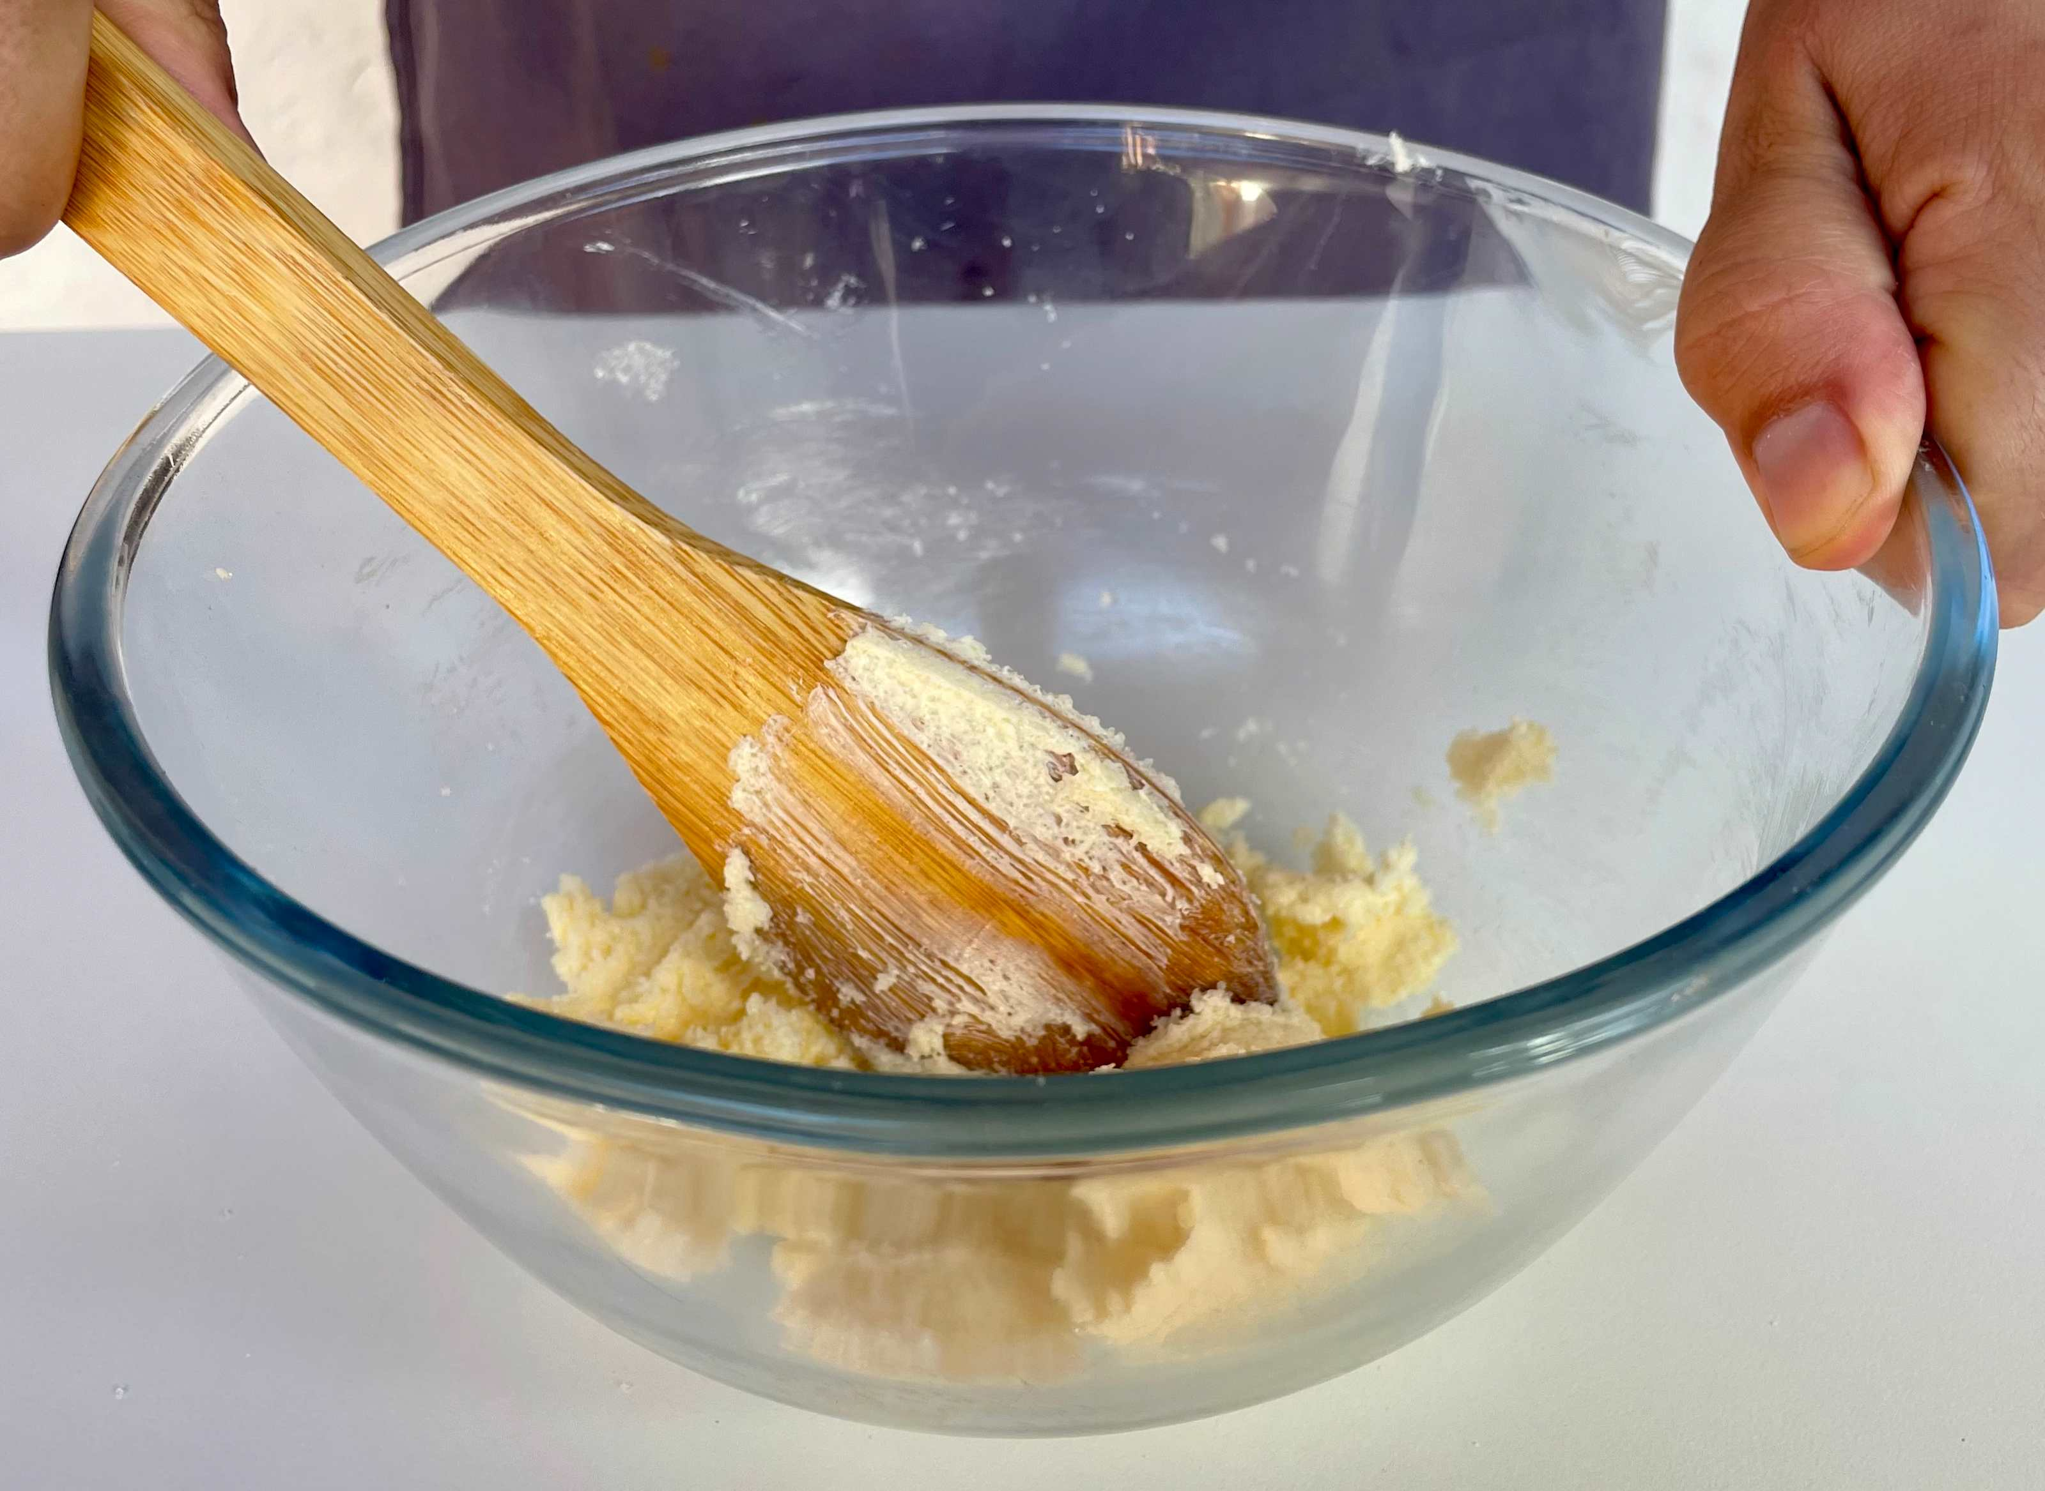
Food science
Aeration
Products such as creamed cakes need air incorporated into the mixture to give a well-risen texture. This is achieved by creaming a fat, such as butter or baking spread, with caster sugar.
Small bubbles of air are incorporated and form a stable foam.

Slide 10
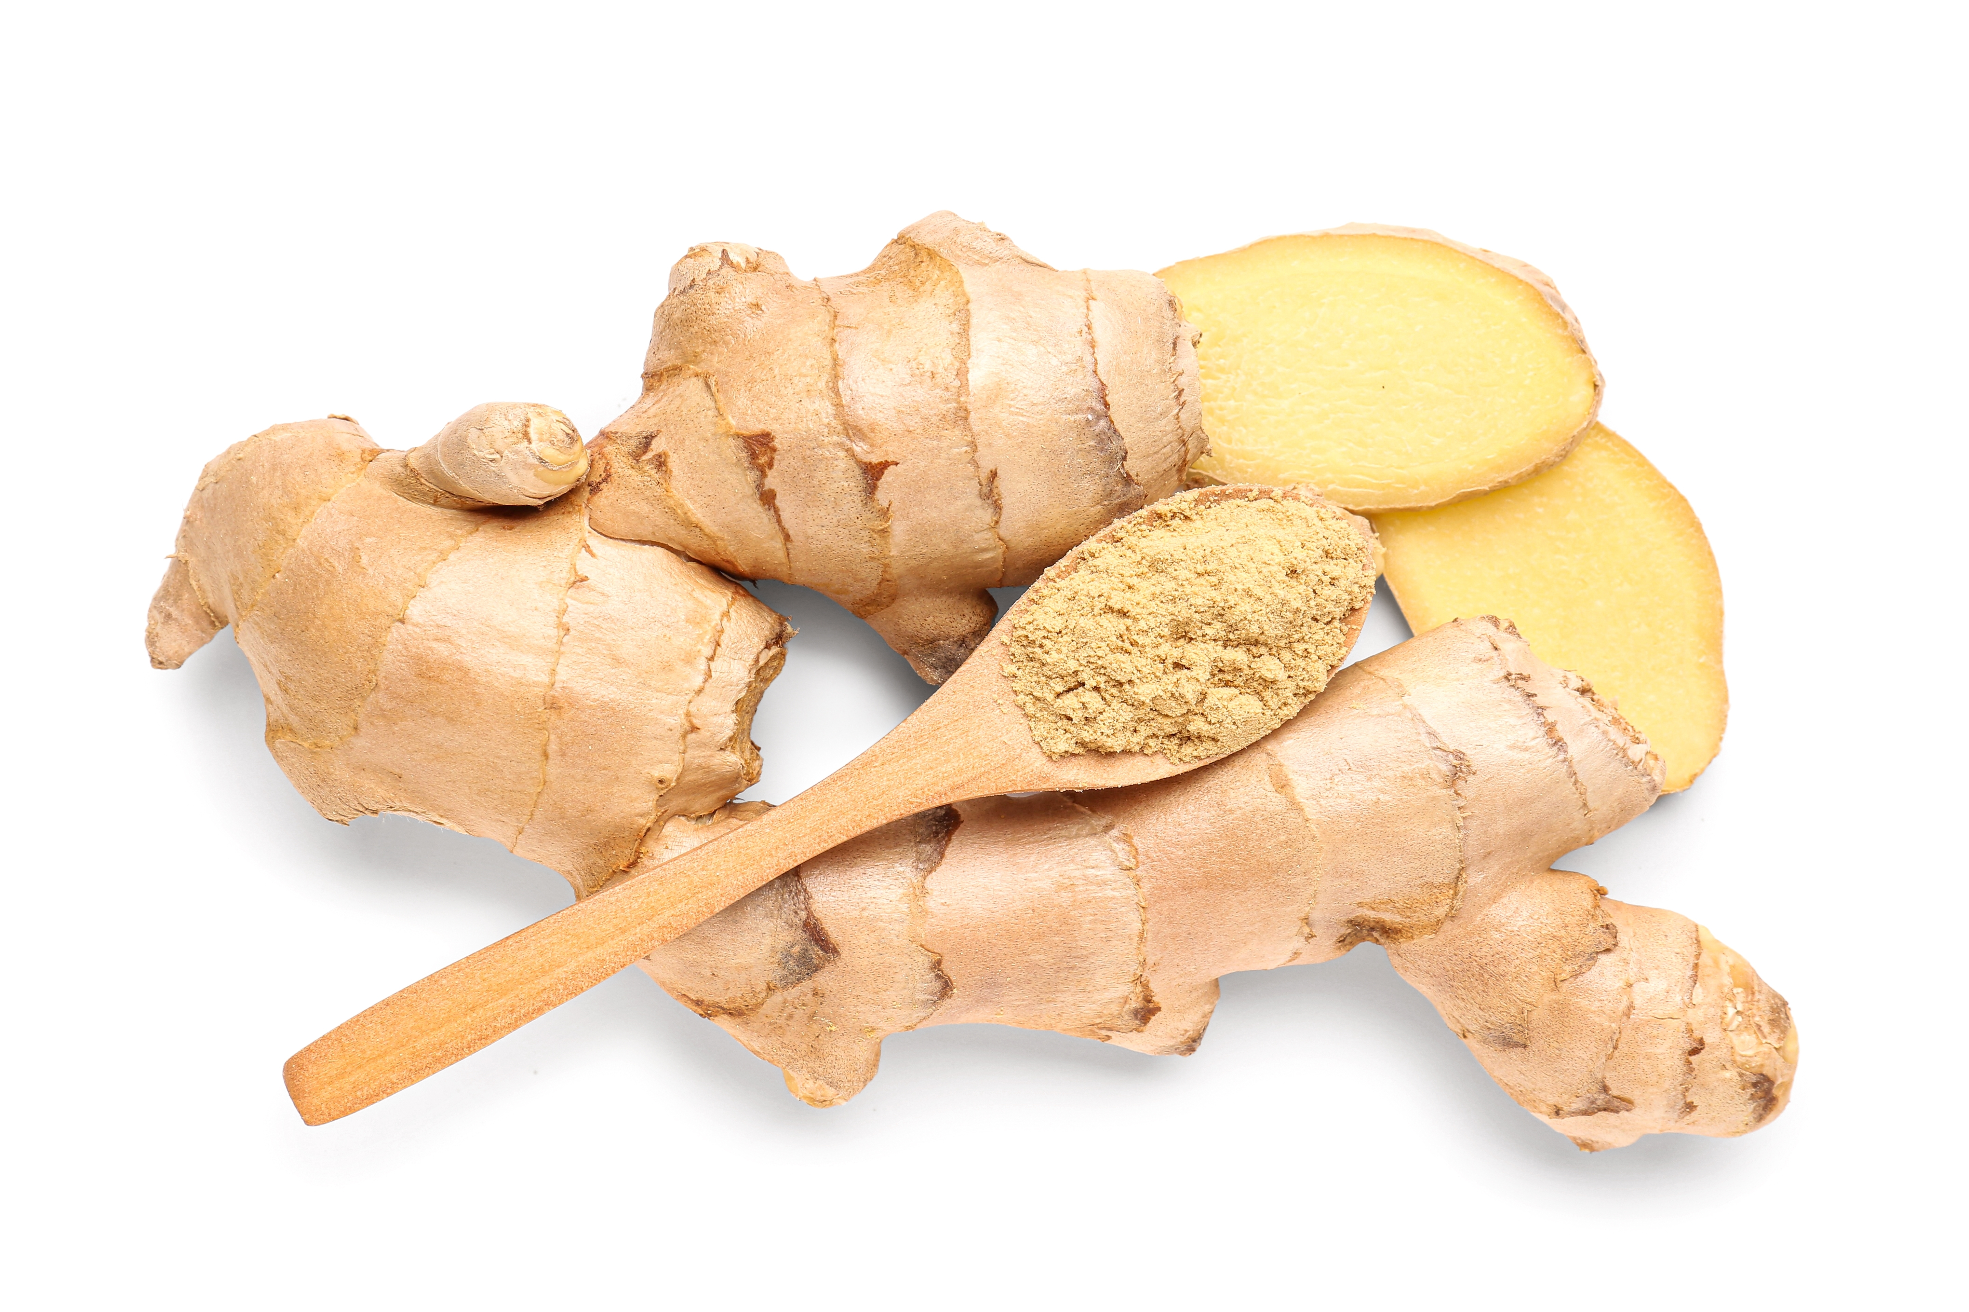
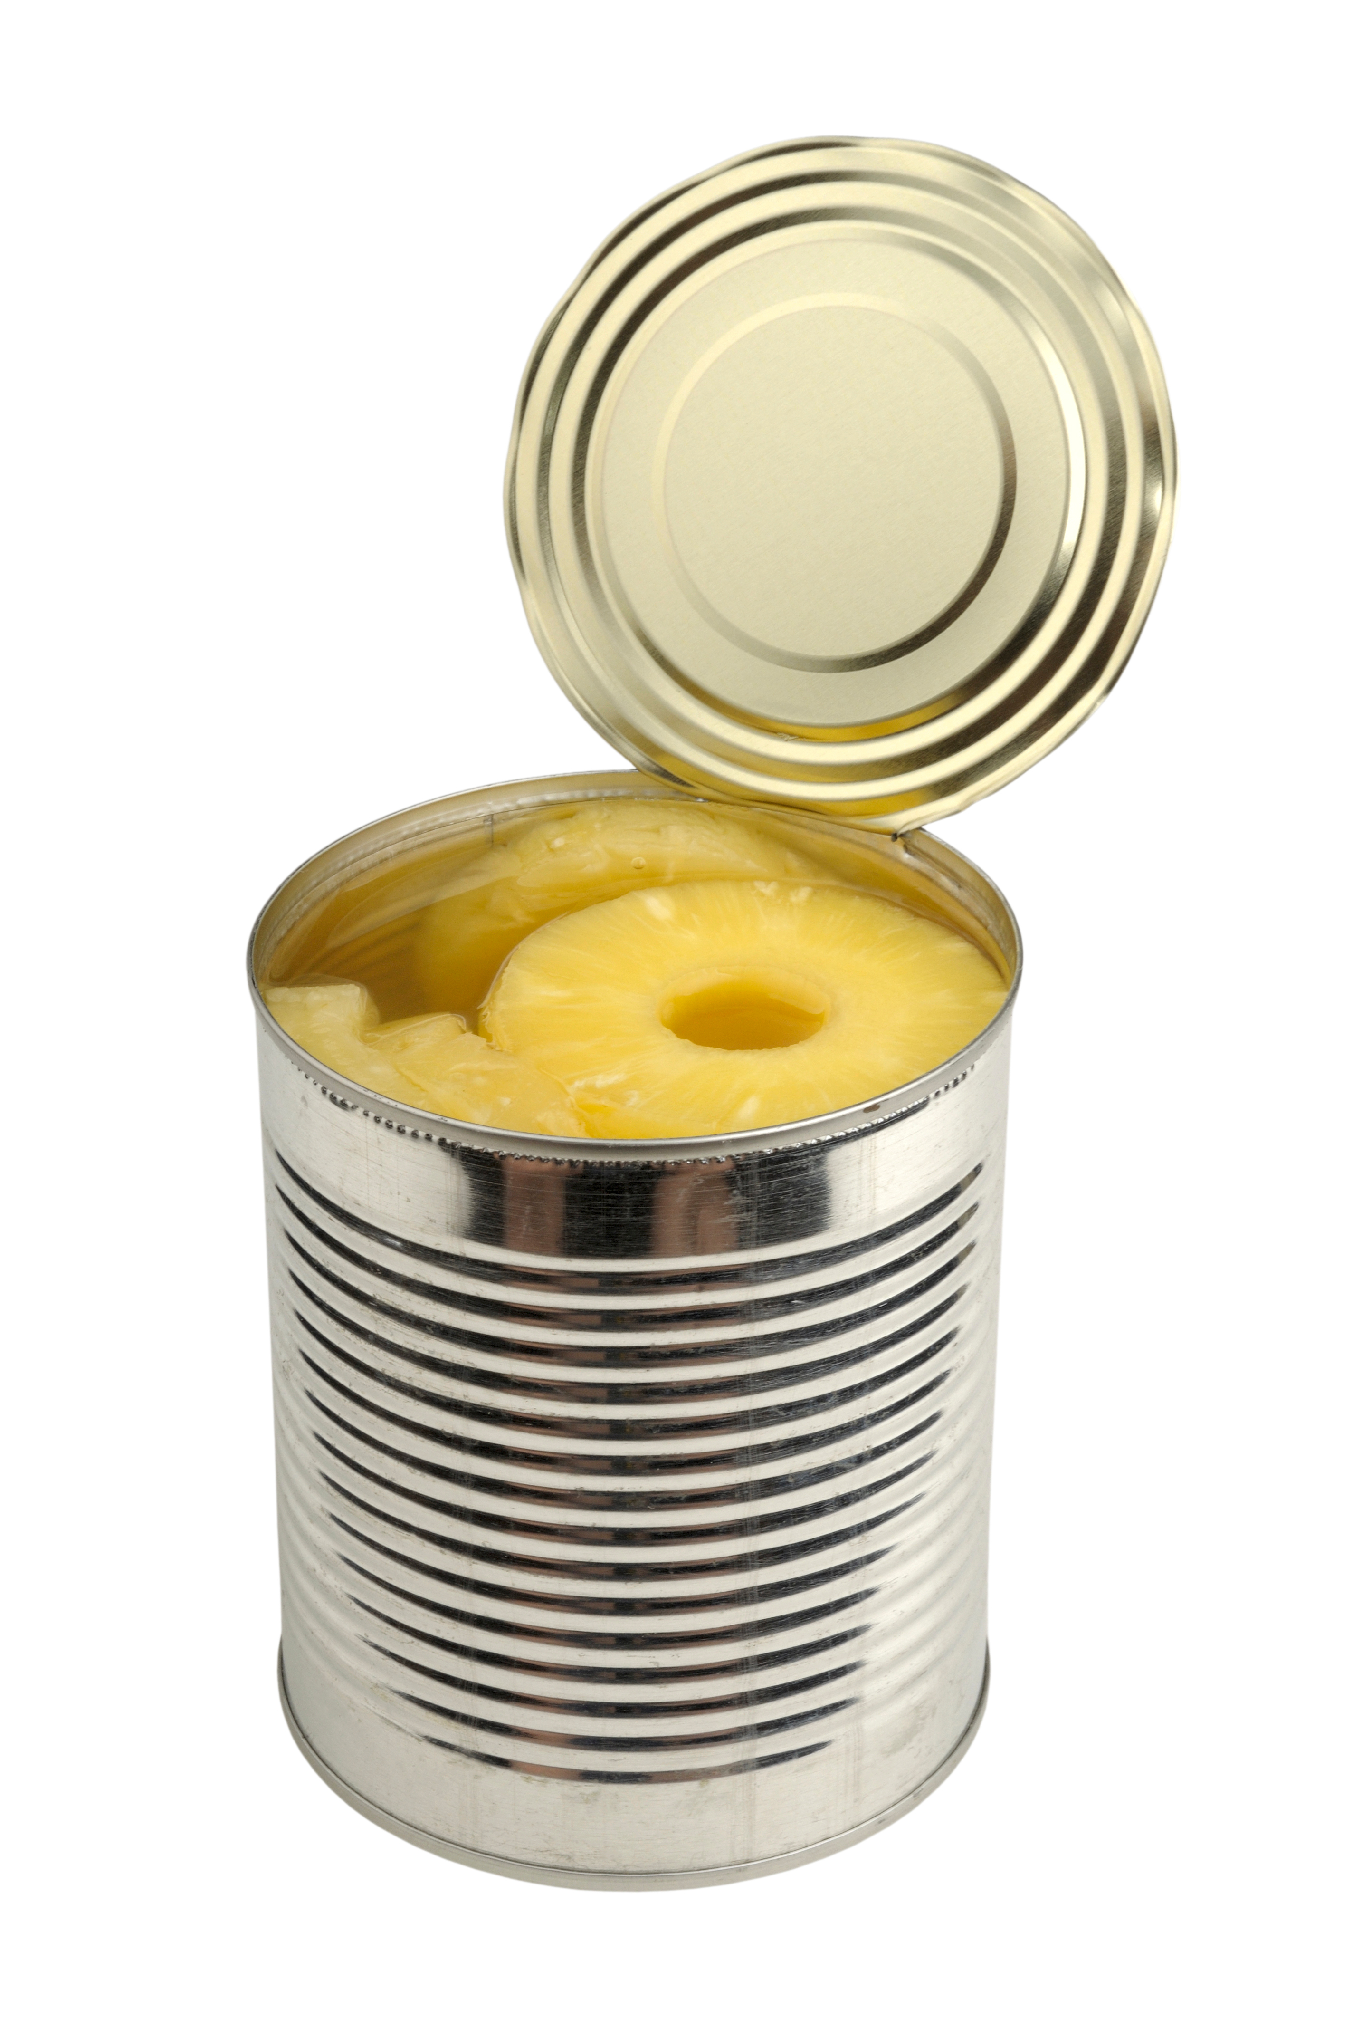
Top tips
Turn up the flavour: For a tasty alternative try pear and ginger.
Reduce food waste: Use up any leftover fruit in your cake.
When lining the baking tin, it is only necessary to line the bottom of the tin. The sides can be greased with oil.

Slide 11
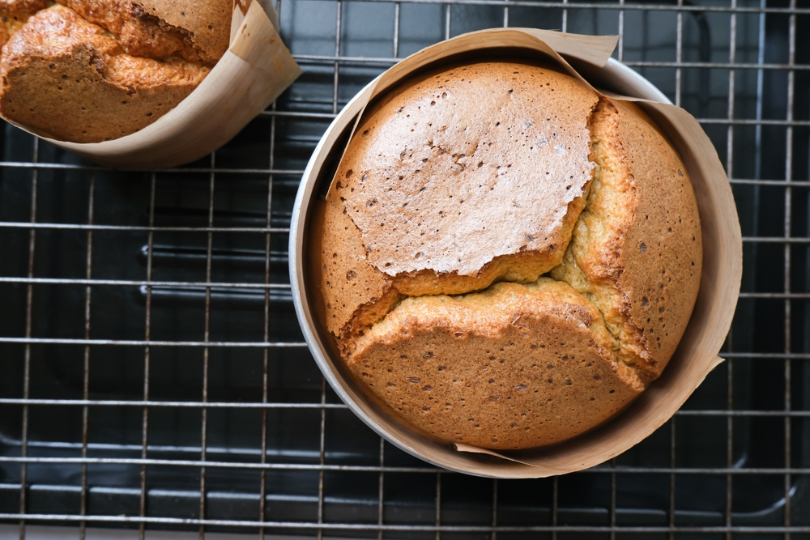
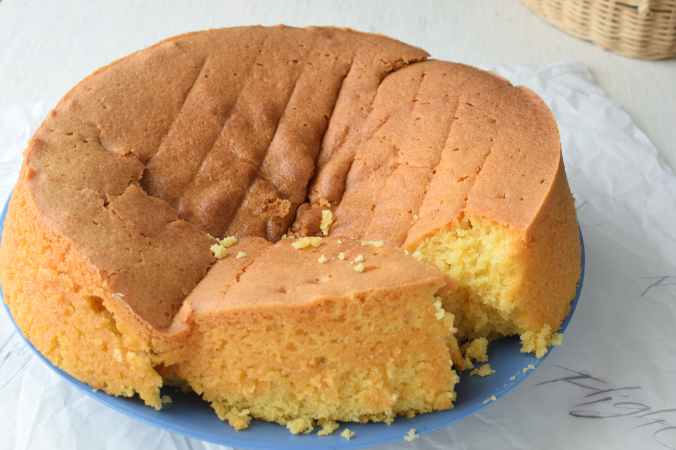
Plenary: what went wrong?
The Dutch apple cake is cracked with peaks on top.
The cake sank when baked.
The top of the cake was speckled.
The cake was very dense.

Slide 12
Example responses
The Dutch apple cake is cracked with peaks on top.
Too much raising agent added, cake tin was over-filled or too small, cake may have cooked too quickly (oven too hot, too near the top of oven).
2. The cake sank when baked.
Too much raising agent, over-creamed fat and sugar, over-beaten mixture after adding the egg, under-baked or the oven on too low a temperature.
3. The top of the cake was speckled.
Too much sugar used, or granulated sugar instead of caster sugar.
4. The cake is very dense.
Not enough air beaten into the mixture, eggs added too quickly causing curdling, not enough raising agent.

Slide 13
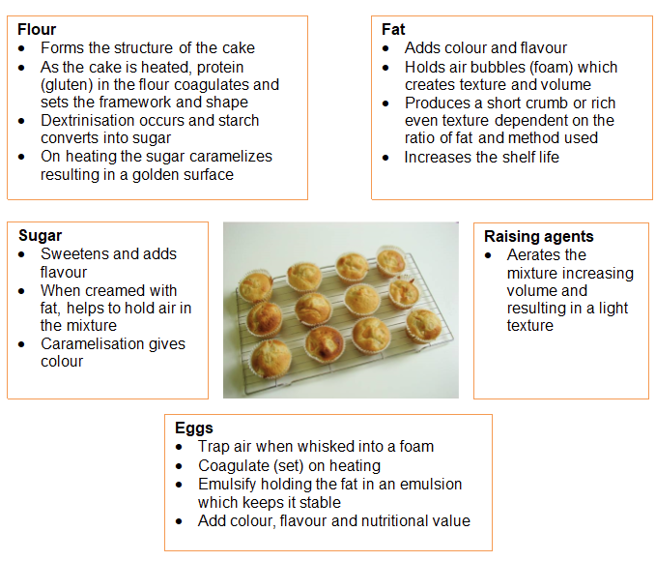
Looking for more…
Use our function of ingredients worksheet to teach your pupils the value of each ingredient in cake making. It also covers common errors which can occur when baking cakes.
For a different cake making method, why not try the Mini carrot cakes in this lesson from the Food – a fact of life Schemes of Work?

Slide 14
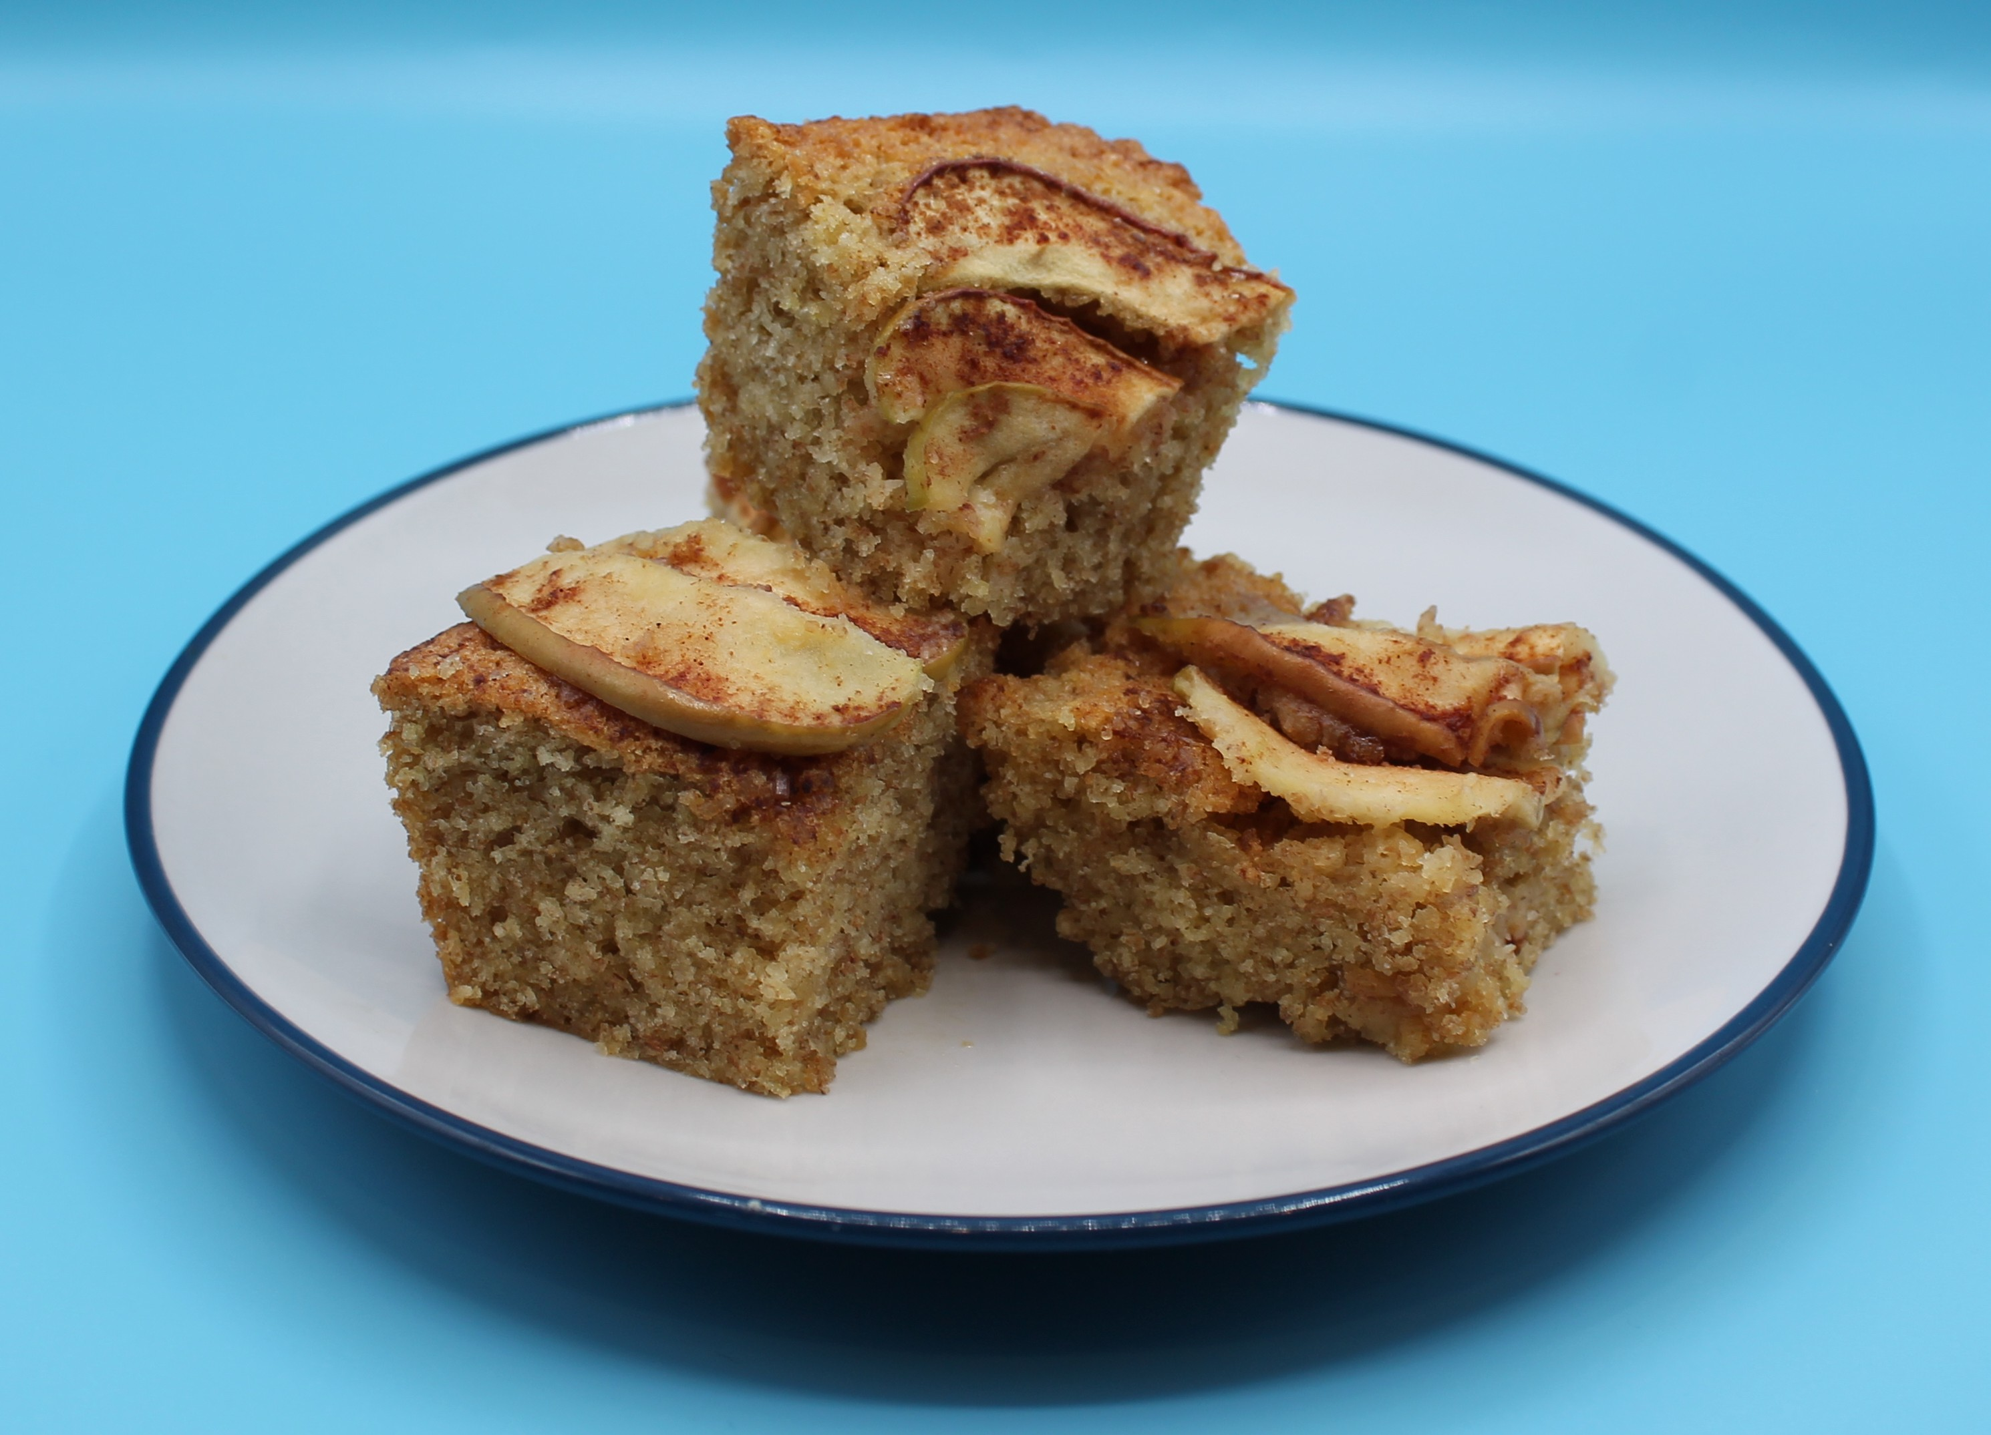
Dutch apple cake
For further information, go to:
www.foodafactoflife.org.uk
This resource meets the Guidelines for producers and users of school education resources about food.

