Slide 1
Food certification and assurance schemes

Slide 2
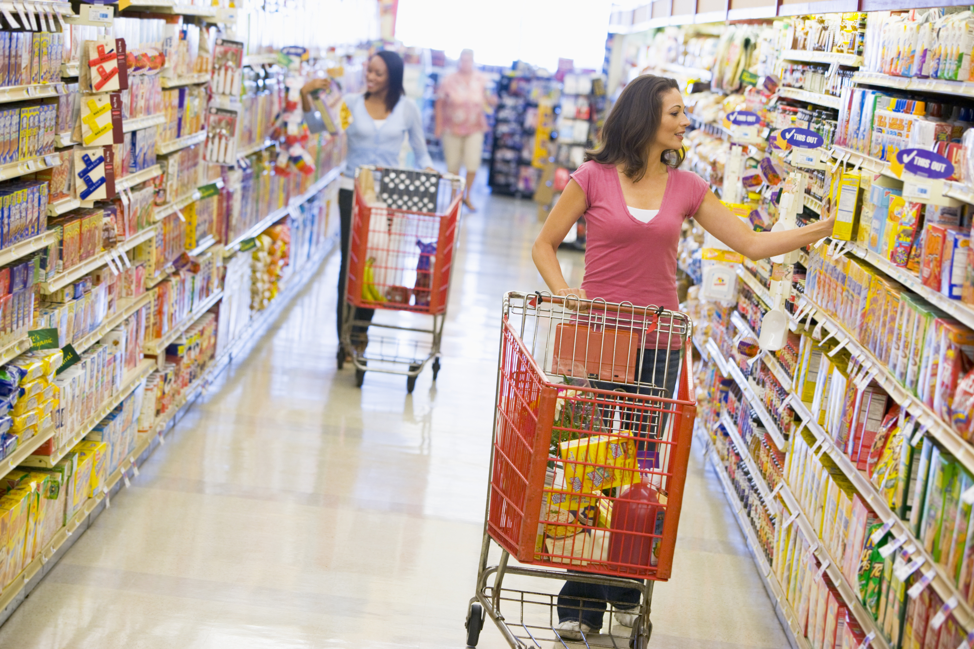
Food assurance schemes
Food assurance schemes are run as product certification schemes.
These schemes use regular independent inspections to check that members are meeting specific standards.
They often use logos on products, websites and/or literature to indicate they have fulfilled all the requirements.

Slide 3
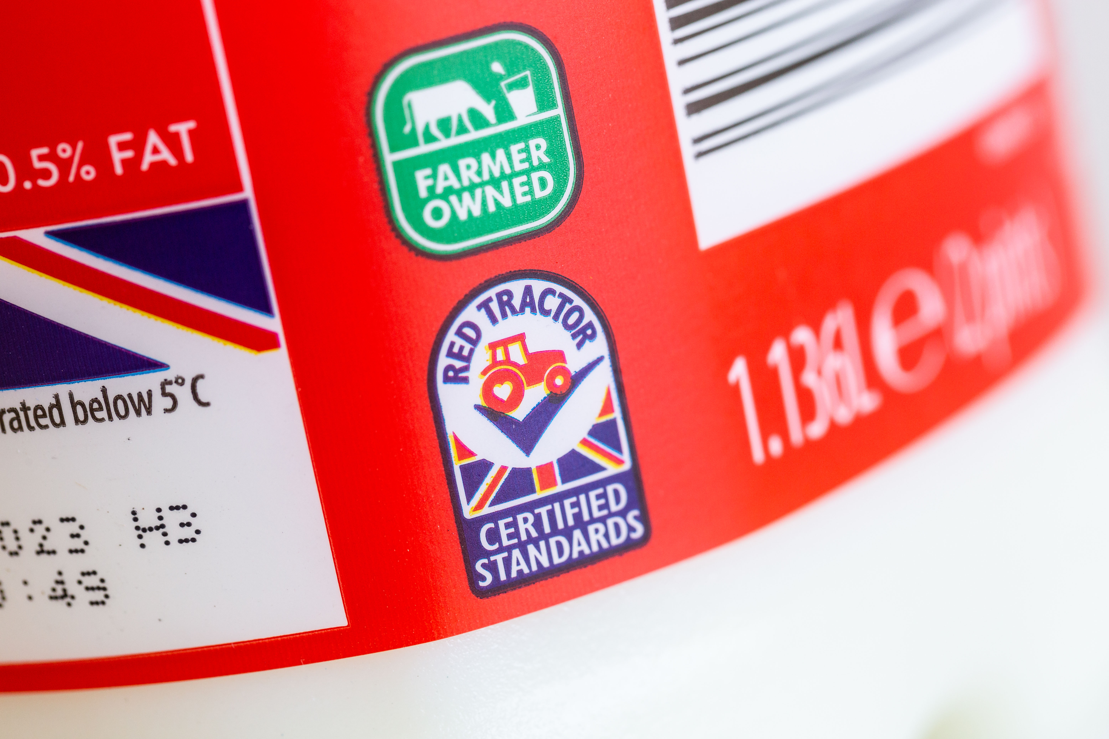
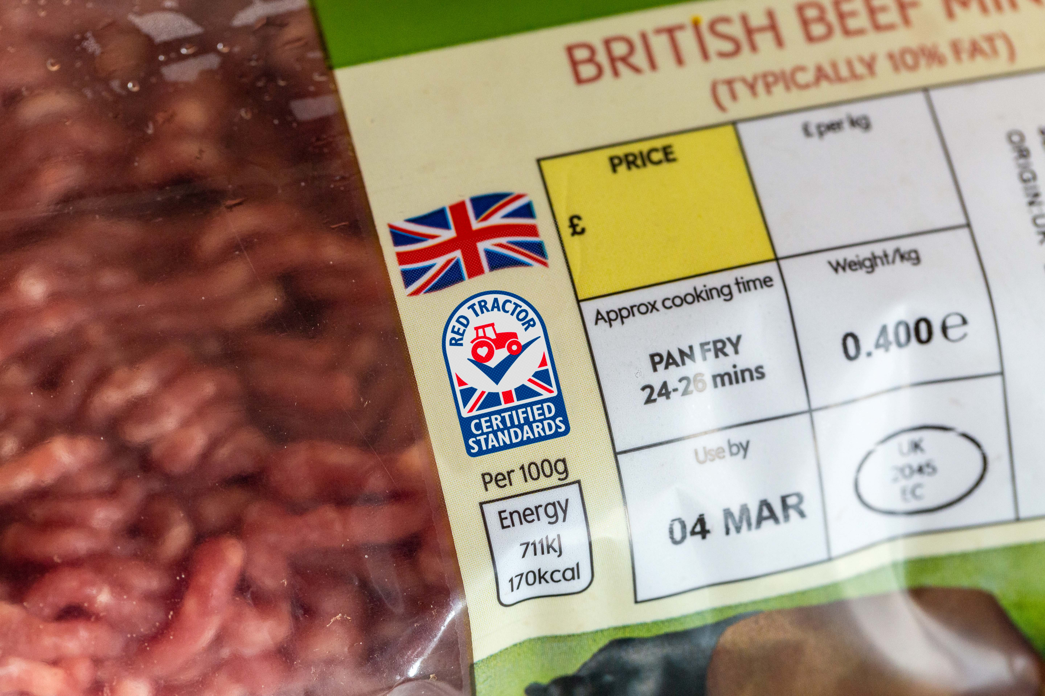
Food assurance schemes
The leading food assurance schemes aim to define the standards that most producers in the sector should meet.
Over time, these schemes intend to raise standards to improve the overall standard of the entire sector.

Slide 4

Red Tractor
Red Tractor is an independent UK whole chain food assurance scheme which assures high standards of food safety, animal welfare and environmental protection from farm to pack.

Slide 5
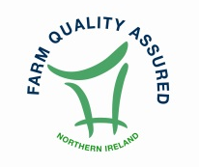
Northern Ireland Beef and Lamb Farm Quality
Assurance
The Northern Ireland Beef & Lamb Farm Quality Assurance Scheme was developed to give consumers assurances about the farm end of the production chain of their food.
It is about farm quality – the quality of the production methods used, the quality of care for animals which is practiced, the quality of the farm environment, and above all the quality of concern for the customer in producing beef and lamb which is wholesome, safe and free from unnatural substances.

Slide 6
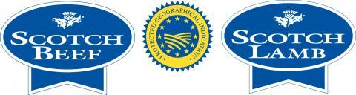


Assurance schemes
Protected Geographical Indication (PGI)
PGI emphasises the relationship between the specific geographic region and the name of the product, where a particular quality, reputation or other characteristic is essentially attributable to its geographical origin. For most products, at least one of the stages of production, processing or preparation takes place in the region.
EU quality schemes
UK registered protected name products

Slide 7


Assurance schemes
Traditional Speciality Guaranteed (TSG)
Traditional speciality guaranteed (TSG) highlights the traditional aspects such as the way the product is made or its composition, without being linked to a specific geographical area. The name of a product being registered as a TSG protects it against falsification and misuse.
Protected Designation of Origin (PDO)
Product names registered as PDO are those that have the strongest links to the place in which they are made. Every part of the production, processing and preparation process must take place in the specific region.

Slide 8
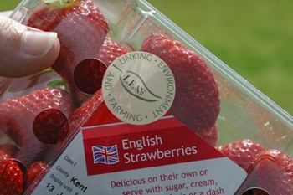
LEAF Marque
LEAF Marque is an environmental assurance system recognising sustainably farmed products. The Standards cover:
soil and water management;
pollution control;
crop health;
animal welfare;
community engagement;
energy efficiency;
landscape and nature conservation.

Slide 9
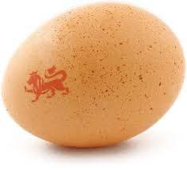
The British Lion mark
A quality code of practice that ensures eggs have been produced to the highest standards of food safety.
The code covers the entire production chain and ensures strict food safety controls including the guarantee that all hens are vaccinated against Salmonella and a ‘passport’ system ensuring that all hens, eggs and feed are fully traceable.

Slide 10

RSPCA Assured
The RSPCA Welfare Standards cover every aspect of animal’s lives whether they are farmed indoors or outdoors, free range or organic.
The RSPCA Assured label can be found on a wide variety of commodities, or food products made from them:
beef, lamb and pork;
chicken, duck and turkey;
eggs;
dairy;
salmon and trout.

Slide 11
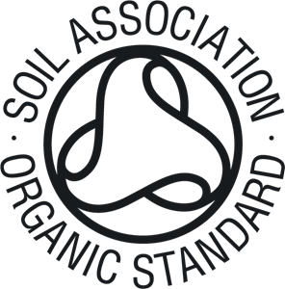
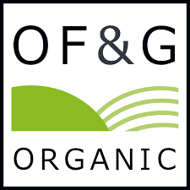
Organic certification
The Soil Association certified scheme sets high standards for how an organic product must be grown, farmed or made.
Certification covers:
farming;
food and drink;
beauty and well being;
textiles.
Organic Farmers and Growers also offers an organic certification scheme. OF&G certify over 1400 farmers, who farm more than half of the UK’s organic land, as well as companies ranging from small, independent processors to major multinationals.

Slide 12

Marine Stewardship Council
The MSC is used to assess if a fishery is well managed and sustainable.
The Standard has three core principles:
sustainable fish stocks;
minimising environmental impact;
effective fisheries management.
The standard also covers fishing types, e.g. line caught or pole and line.
The MSC logo can be used on fresh fish counters, packaged fish products and restaurant menus.

Slide 13
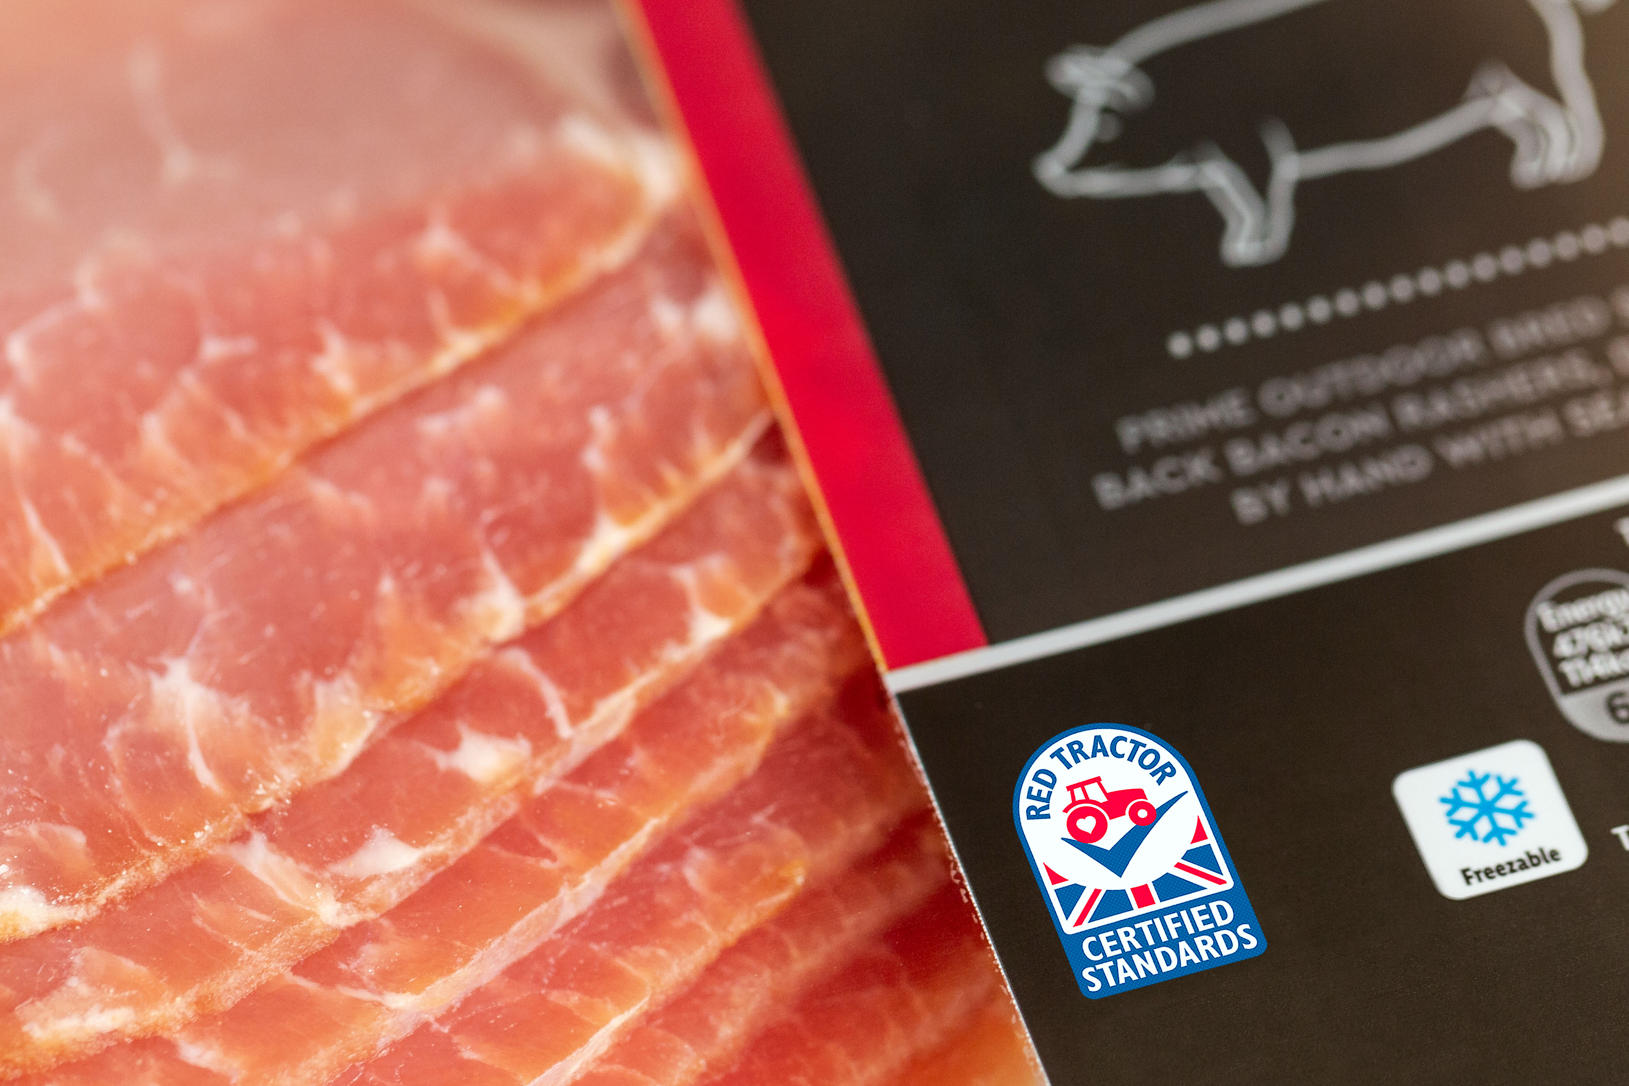
Case study: Red Tractor
Red Tractor producers are overseen by Assured Food Standards (AFS) who carry out independent inspections to confirm that businesses are meeting certain standards.
These include food safety, animal welfare, the environment and traceability.
The Red Tractor logo covers many food groups, which have all been grown, processed and packed in Britain. This is shown by the Union flag.

Slide 14
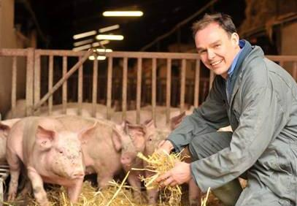
Red Tractor products
The Red Tractor logo tells the consumer that the food has been checked every step of the way - from farm to pack - and can be traced back to the farm source.
The Red Tractor logo appears on these products:
meat - beef, lamb, pork, chicken, turkey;
dairy - milk, cheese, cream;
cereals and flour;
fruit, vegetables and salads;
sugar.

Slide 15
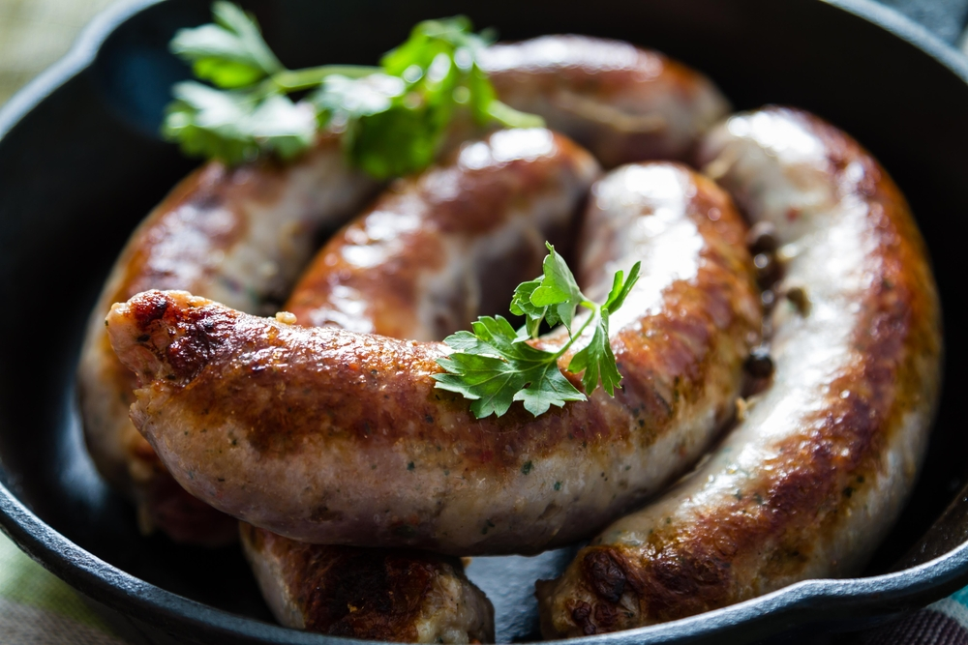
Red Tractor products
The logo can also be used to highlight that the main ingredient of a food when more than one ingredient is assured, such as pork in a sausage.
For a mixed ingredient food to be able to display the logo the main ingredient must:
be named;
come from the usual assured chain;
be at least 65% of the total product.

Slide 16
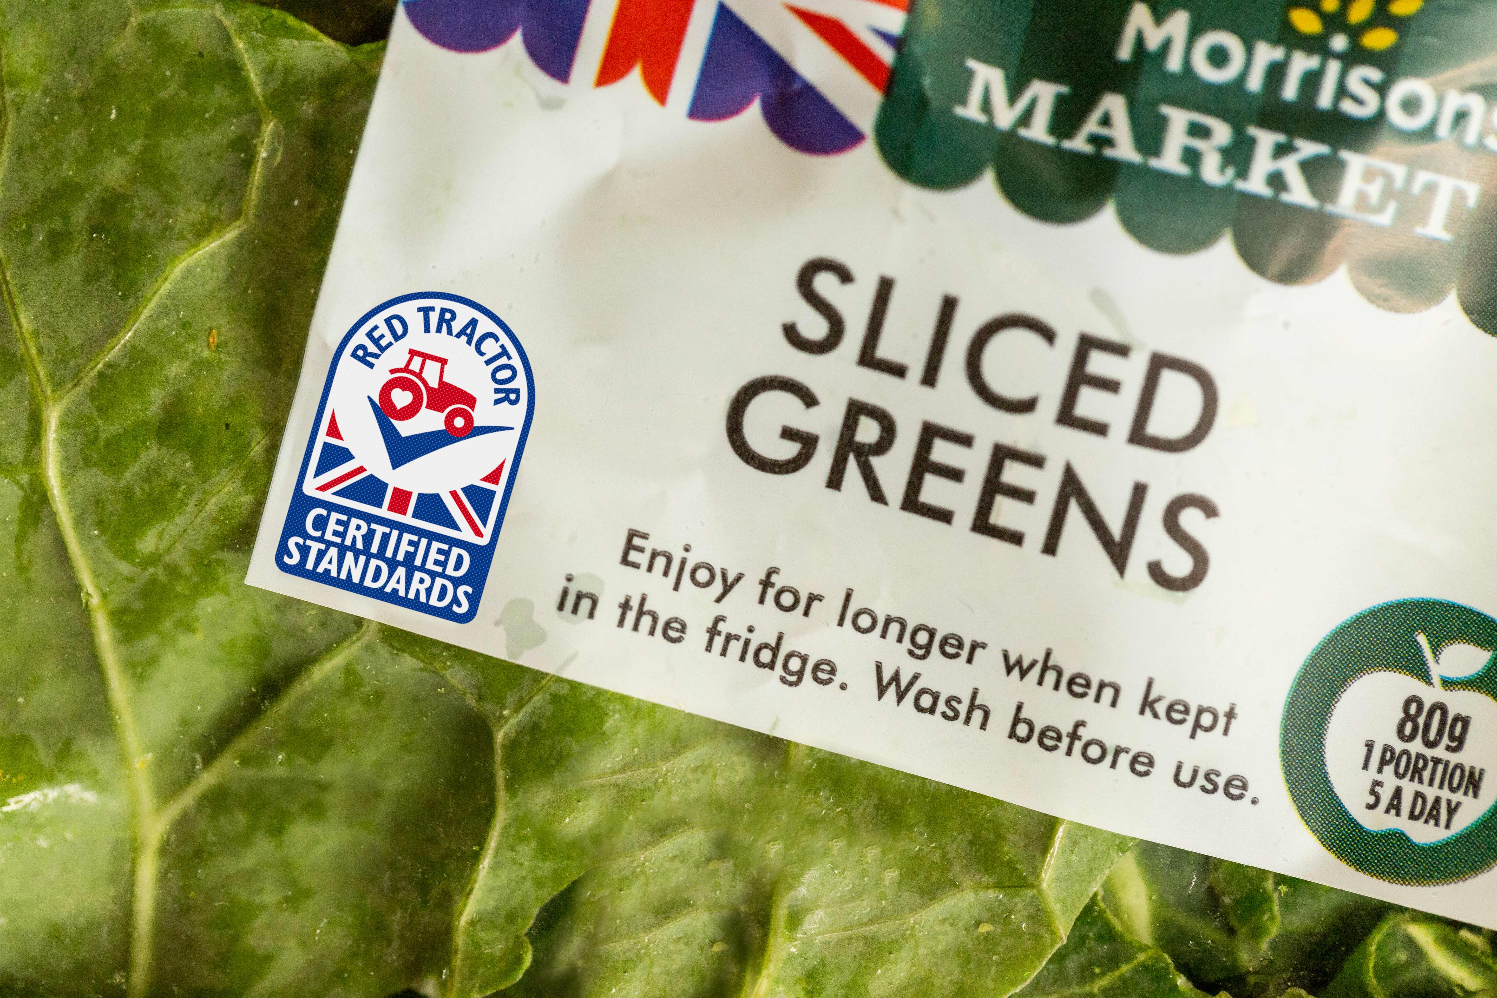
Did you know….
There are 78,000 Red Tractor farmers in the UK.
Assured Food Standards was established in the spring of 2000, and the Red Tractor was launched in the summer of the same year.
There are over 450 inspectors working on the Red Tractor scheme and they conduct over 60,000 inspections a year.
Red Tractor food is available from all the major supermarkets and restaurant chains.

Slide 17
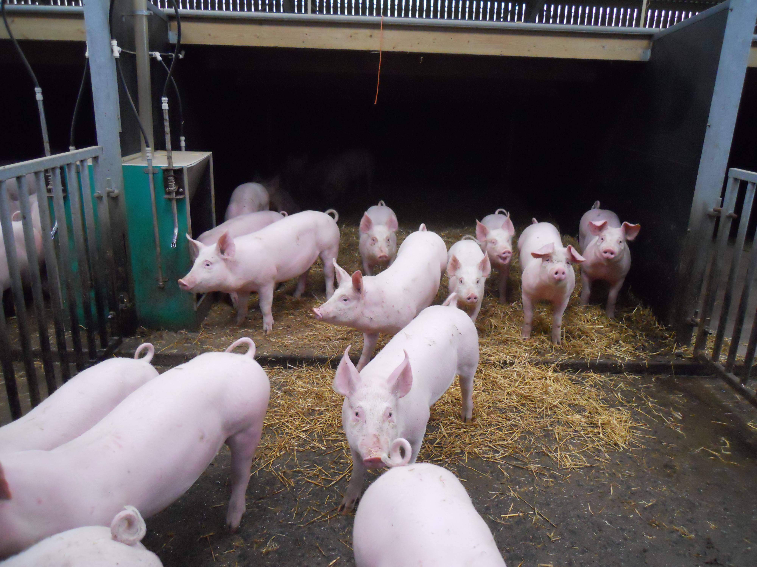
Red Tractor standards
Food safety
Everyone involved – from farmer to caterer – are experts in their field, trained to handle food safely and responsibly.
Animal welfare
Ensures animals have everything they need for a good quality of life and are treated with compassion by farmers who know what they are doing.

Slide 18
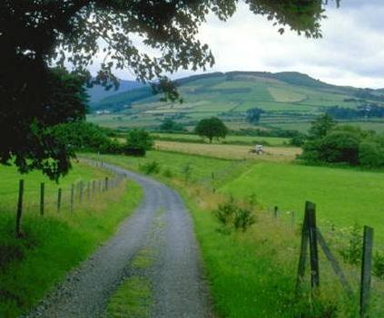
Red Tractor standards
Environment
Makes sure farmers protect the countryside by preventing pollution of watercourses, soil, air and wildlife habitats.
Traceability
Every part of the food supply chain is inspected to ensure food carrying the logo is accounted for and can be traced back to UK farms.

Slide 19
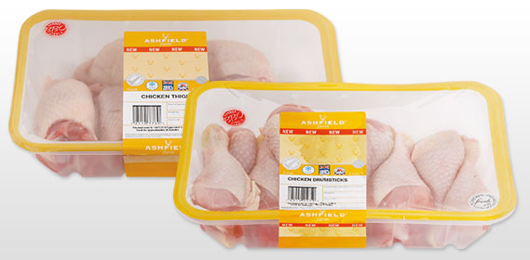
Traceability – an example
Assured feed
Assured hatchery
Assured breeding flocks
Assured farms
Assured livestock transport
Assured processing plants
Licenced packer

Slide 20
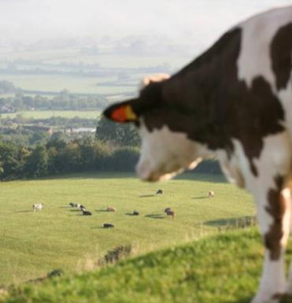
Animal welfare and traceability
The Red Tractor standards require that animals are:
handled with care and compassion and checked regularly;
regularly checked by a vet. Antibiotics are only given on prescription by a vet when an animal is ill;
are fed on safe assured feeds and transported in assured trailers to minimise stress and risk of hurting the animals;
are kept in clean and safe housing with animals of a similar size/age and have access to fresh, clean water at all times;
Farmers keep traceability records so we know where animals have come from and where they go.
If an animal is raised on an organic farm, its product must not be sold as organic whilst the animal is on antibiotics.

Slide 21
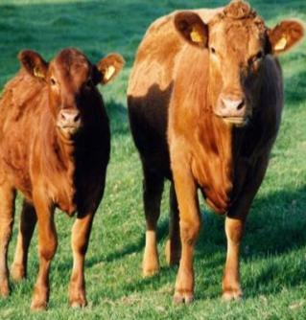
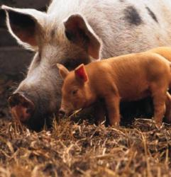
Did you know….
Every beef cow has its own passport (detailing where it was born, parents, and breed), a traceability tag and digital record.
All Red Tractor pig farms are inspected 4 times a year by vets and independently inspected by Red Tractor once a year.

Slide 22
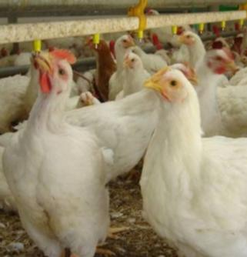
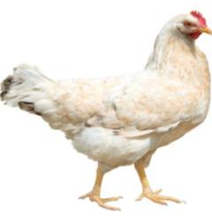
Poultry
The Red Tractor standards require that birds are:
kept in large houses on straw/shavings or litter bedding where they have space to preen, flap their wings and dust bathe;
birds are handled with care and compassion by farmers and transported in safe, clean vehicles to minimise discomfort or distress;

Slide 23
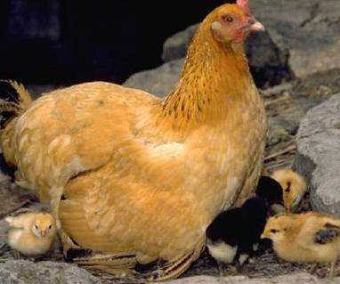
Poultry
The Red Tractor standards require that birds are:
birds are fed with safe animal feed that is from certified sources and have access to fresh, clean drinking water at all times;
birds are inspected twice daily and have strict procedures in place to prevent spread of disease.

Slide 24
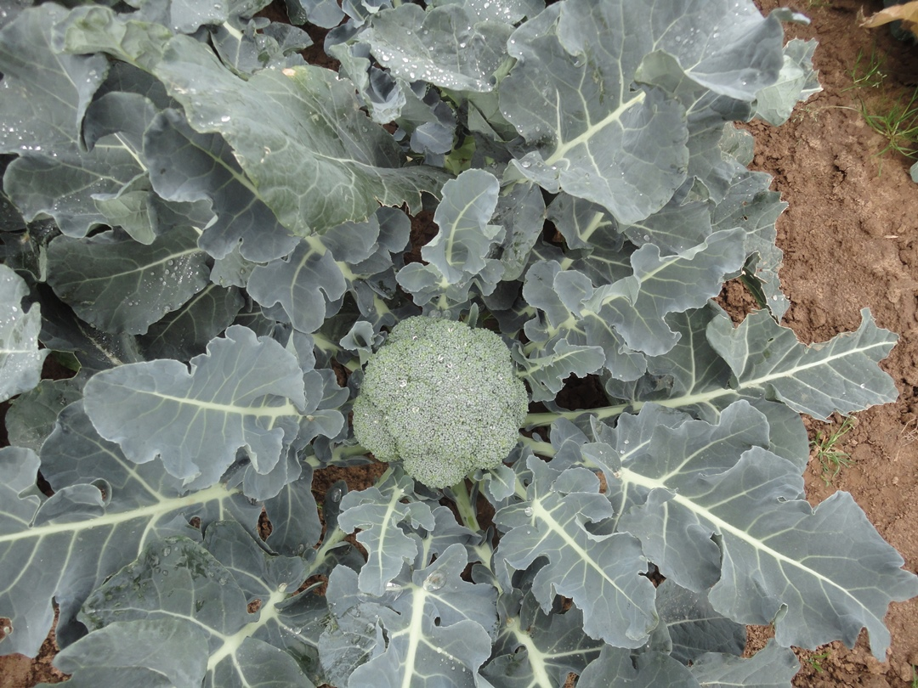
Fresh produce
The Red Tractor standards require that:
farmers do everything they can to avoid using pesticides, and only use as a last resort;
farms are tested annually for pesticide residue to guarantee produce recently treated does not enter the food chain;

Slide 25
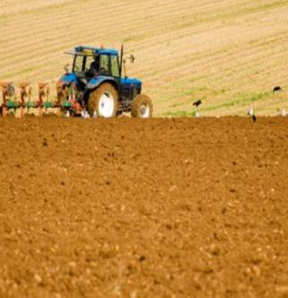
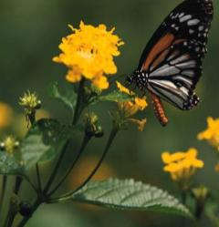
Fresh produce
The Red Tractor standards require that:
farmers take care of the countryside by protecting habitats, encouraging wildlife and improving biodiversity wherever possible;
farmers limit their environmental impact by safely storing, applying and disposing fertilisers and pesticides so they do not contaminate streams and rivers or wildlife habitats.

Slide 26
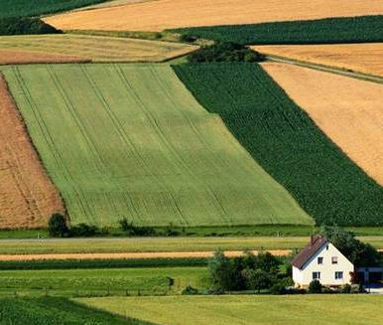
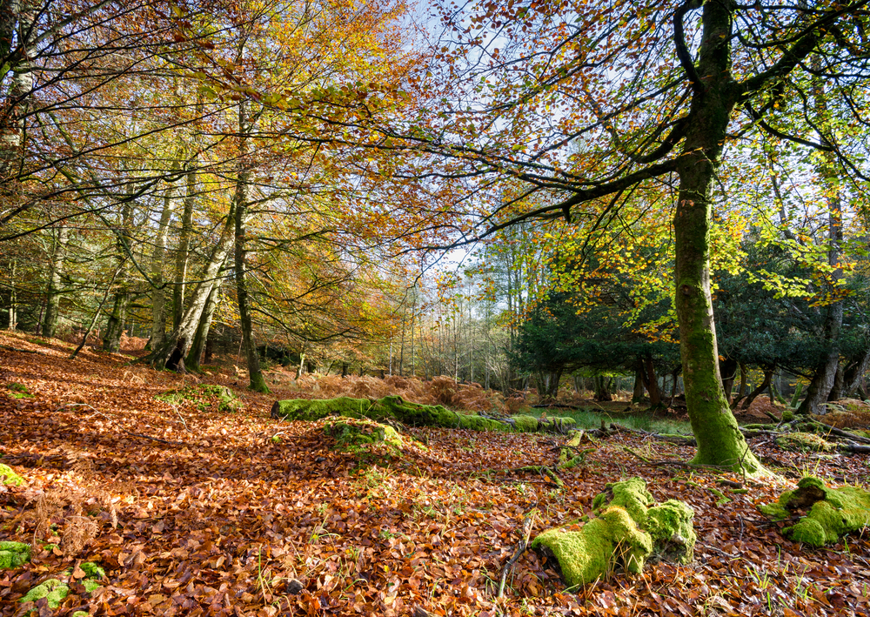
Did you know….
Farmers can help to:
reinstate native chalkland;
create environments where endangered insects flourish;
protect ancient woodland and regeneration of hedgerows;
establish wildlife sanctuaries around reservoirs and wildflower meadows.

Slide 27

Food assurance schemes
This resource meets the Guidelines for producers and users of school education resources about food.

