Slide 1
Mini carrot cakes
Complexity: medium

Slide 2
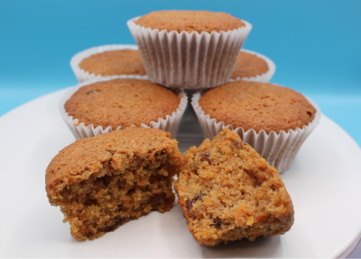
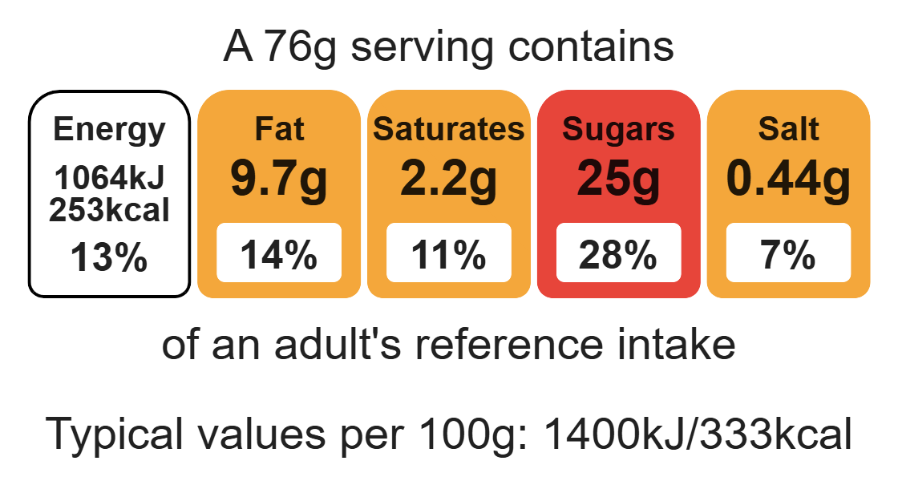
Nutritional analysis
Serves 12

Slide 3
Starter activity
Focused questions
What temperature does the oven need preheating to?
What skills are used to prep the carrot?
What type of mixture is the carrot cake?
True/False: The fat and sugar are creamed together?
How long do the carrot cakes take to bake?
How can you tell when they are ready?
Preheat oven to 200°C or gas mark 6.
Place the muffin cases in the muffin tin.
Melt the fat in the microwave or in a small saucepan.
Peel, top and tail, and grate the carrots.
Combine the grated carrots, sugar and melted fat in the mixing bowl.
Sift in the flour, cinnamon and baking powder.
Beat the eggs in a small bowl and then add to the mixture.
Mix in the sultanas and nuts (optional).
Mix all the ingredients together to form a smooth batter.
Divide the mixture equally between the muffin cases using 2 spoons.
Bake for 20 minutes, until golden.
Allow to cool on a cooling rack.

Slide 4
Example responses
Preheat oven to 200°C or gas mark 6.
Place the muffin cases in the muffin tin.
Melt the fat in the microwave or in a small saucepan.
Peel, top and tail, and grate the carrots.
Combine the grated carrots, sugar and melted fat in the mixing bowl.
Sift in the flour, cinnamon and baking powder.
Beat the eggs in a small bowl and then add to the mixture.
Mix in the sultanas and nuts (optional).
Mix all the ingredients together to form a smooth batter.
Divide the mixture equally between the muffin cases using 2 spoons.
Bake for 20 minutes, until golden.
Allow to cool on a cooling rack.
What temperature does the oven need preheating to? 200°C or Gas 6.
What skills are used to prep the carrot? Peel, top, tail, grate.
What type of mixture is the carrot cake? Batter.
True/False: The fat and sugar are creamed together? False, the fat is melted.
How long do the carrot cakes take to bake? 20 mins.
How can you tell when they are ready? Well risen and golden.

Slide 5
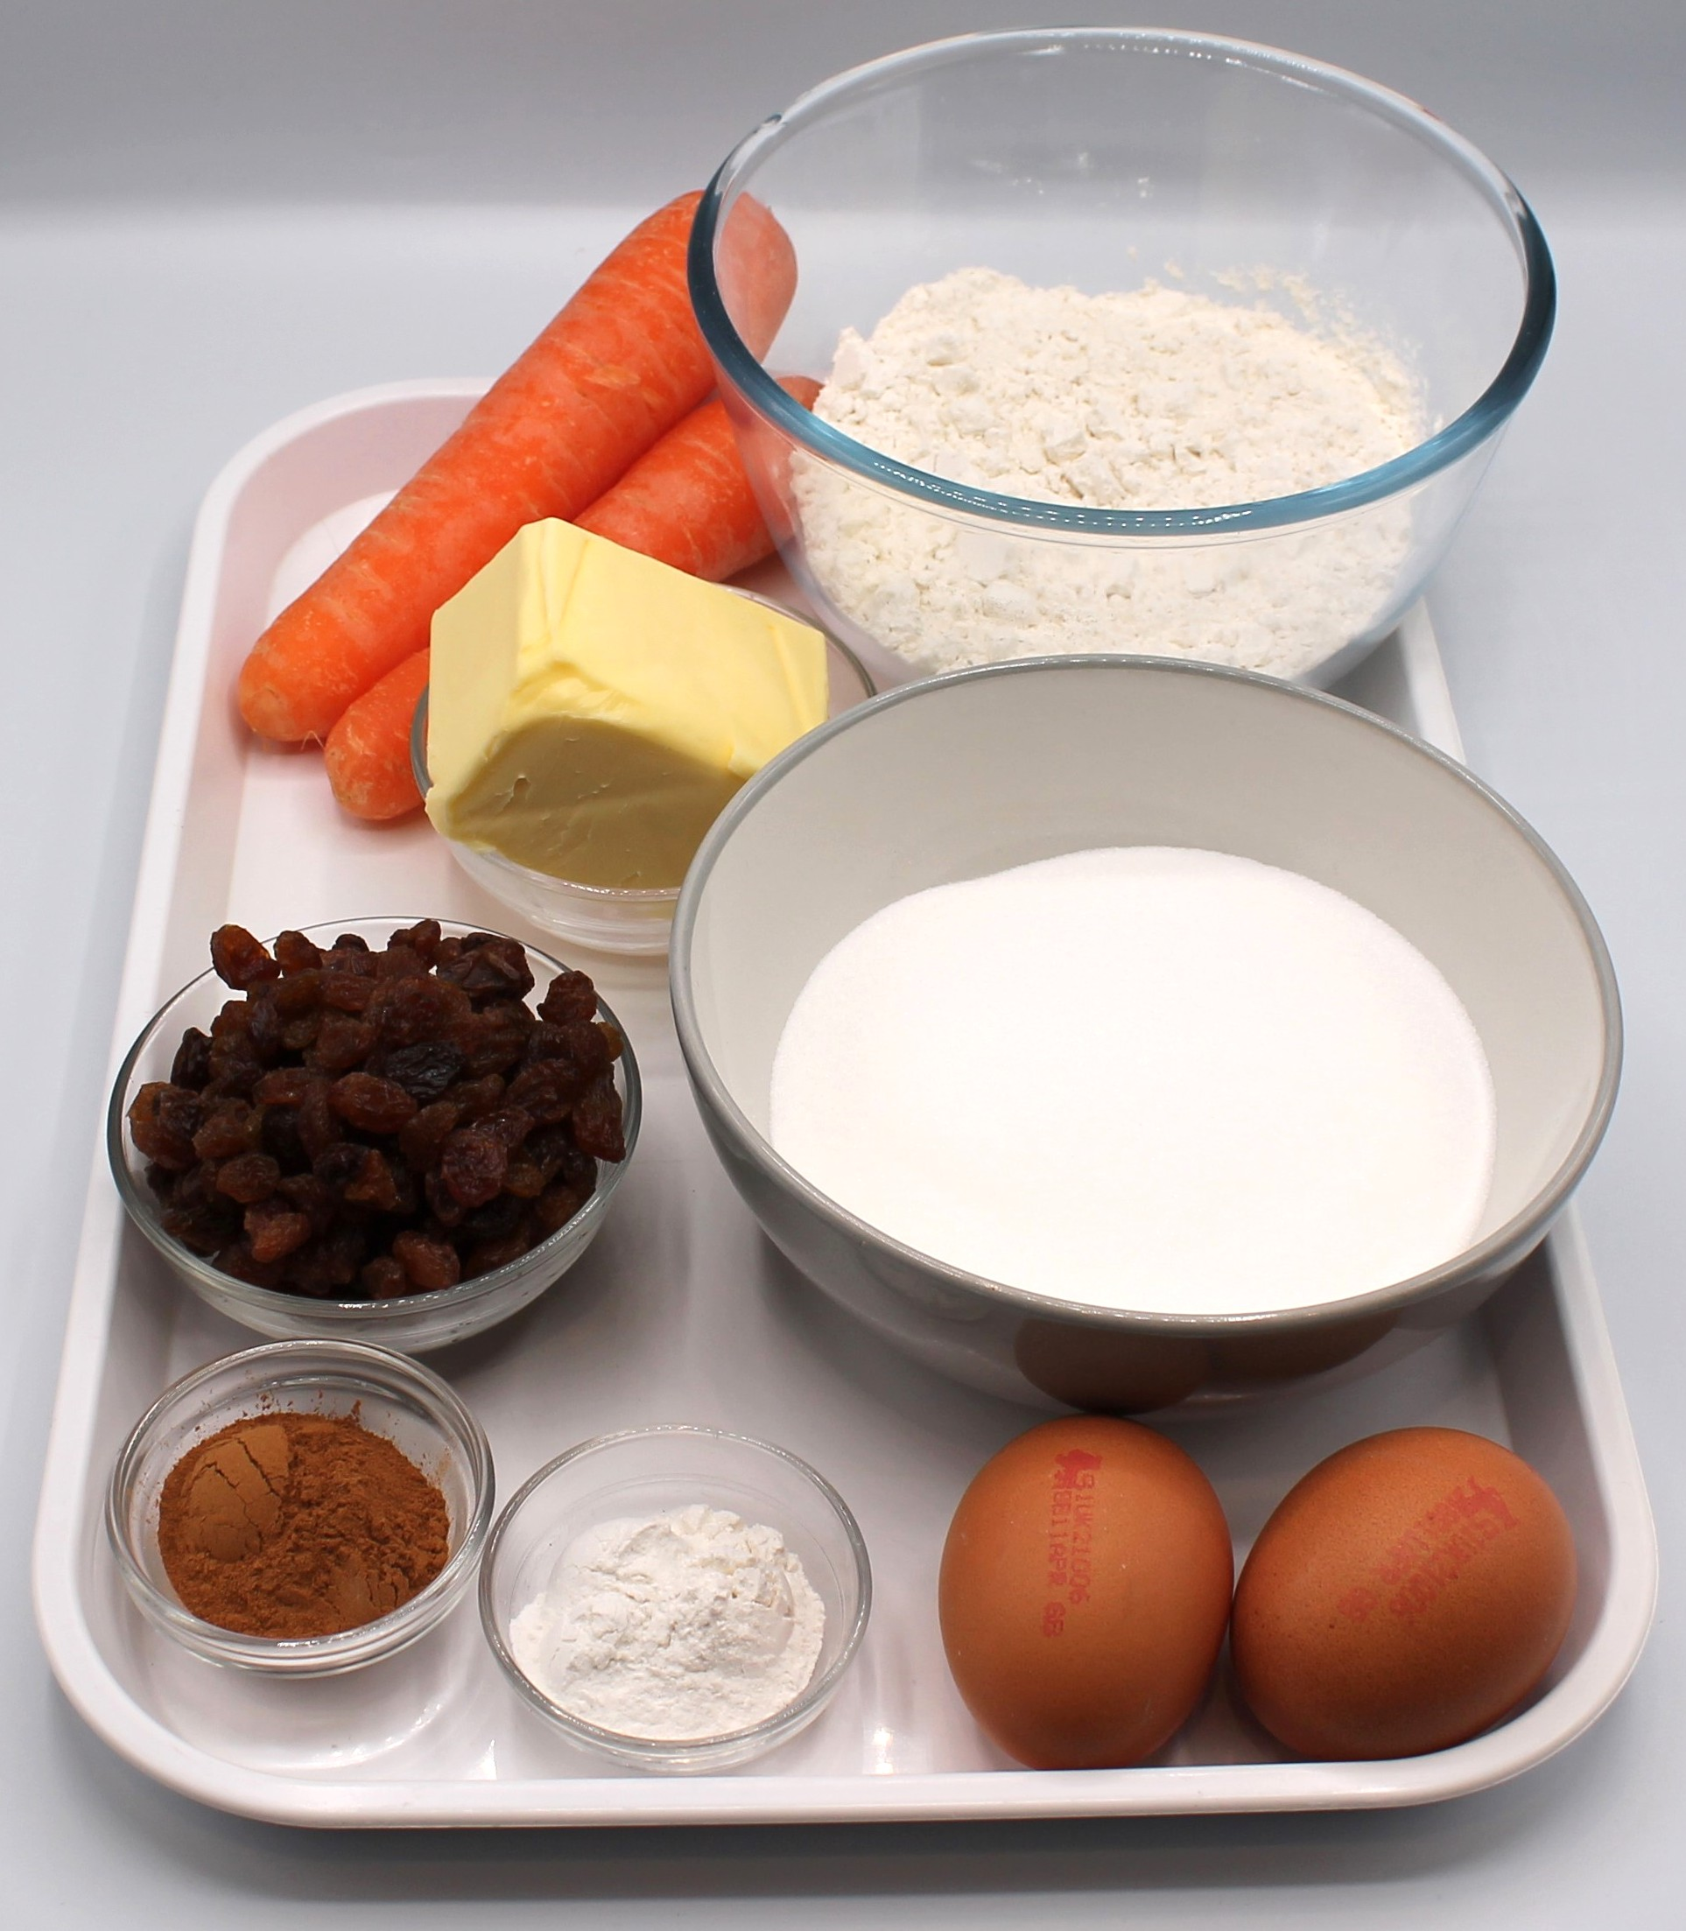

Ingredients (makes 12)
150g reduced-fat spread
250g carrots
200g caster sugar
100g plain white flour
100g plain wholemeal flour
2 x 5ml spoons cinnamon
2 x 5ml spoon baking powder
2 eggs
125g sultanas
50g nuts (optional)
Check for any food allergy, intolerance, special dietary requirement or religious/cultural reasons for not handling or eating the ingredients in this recipe.

Slide 6
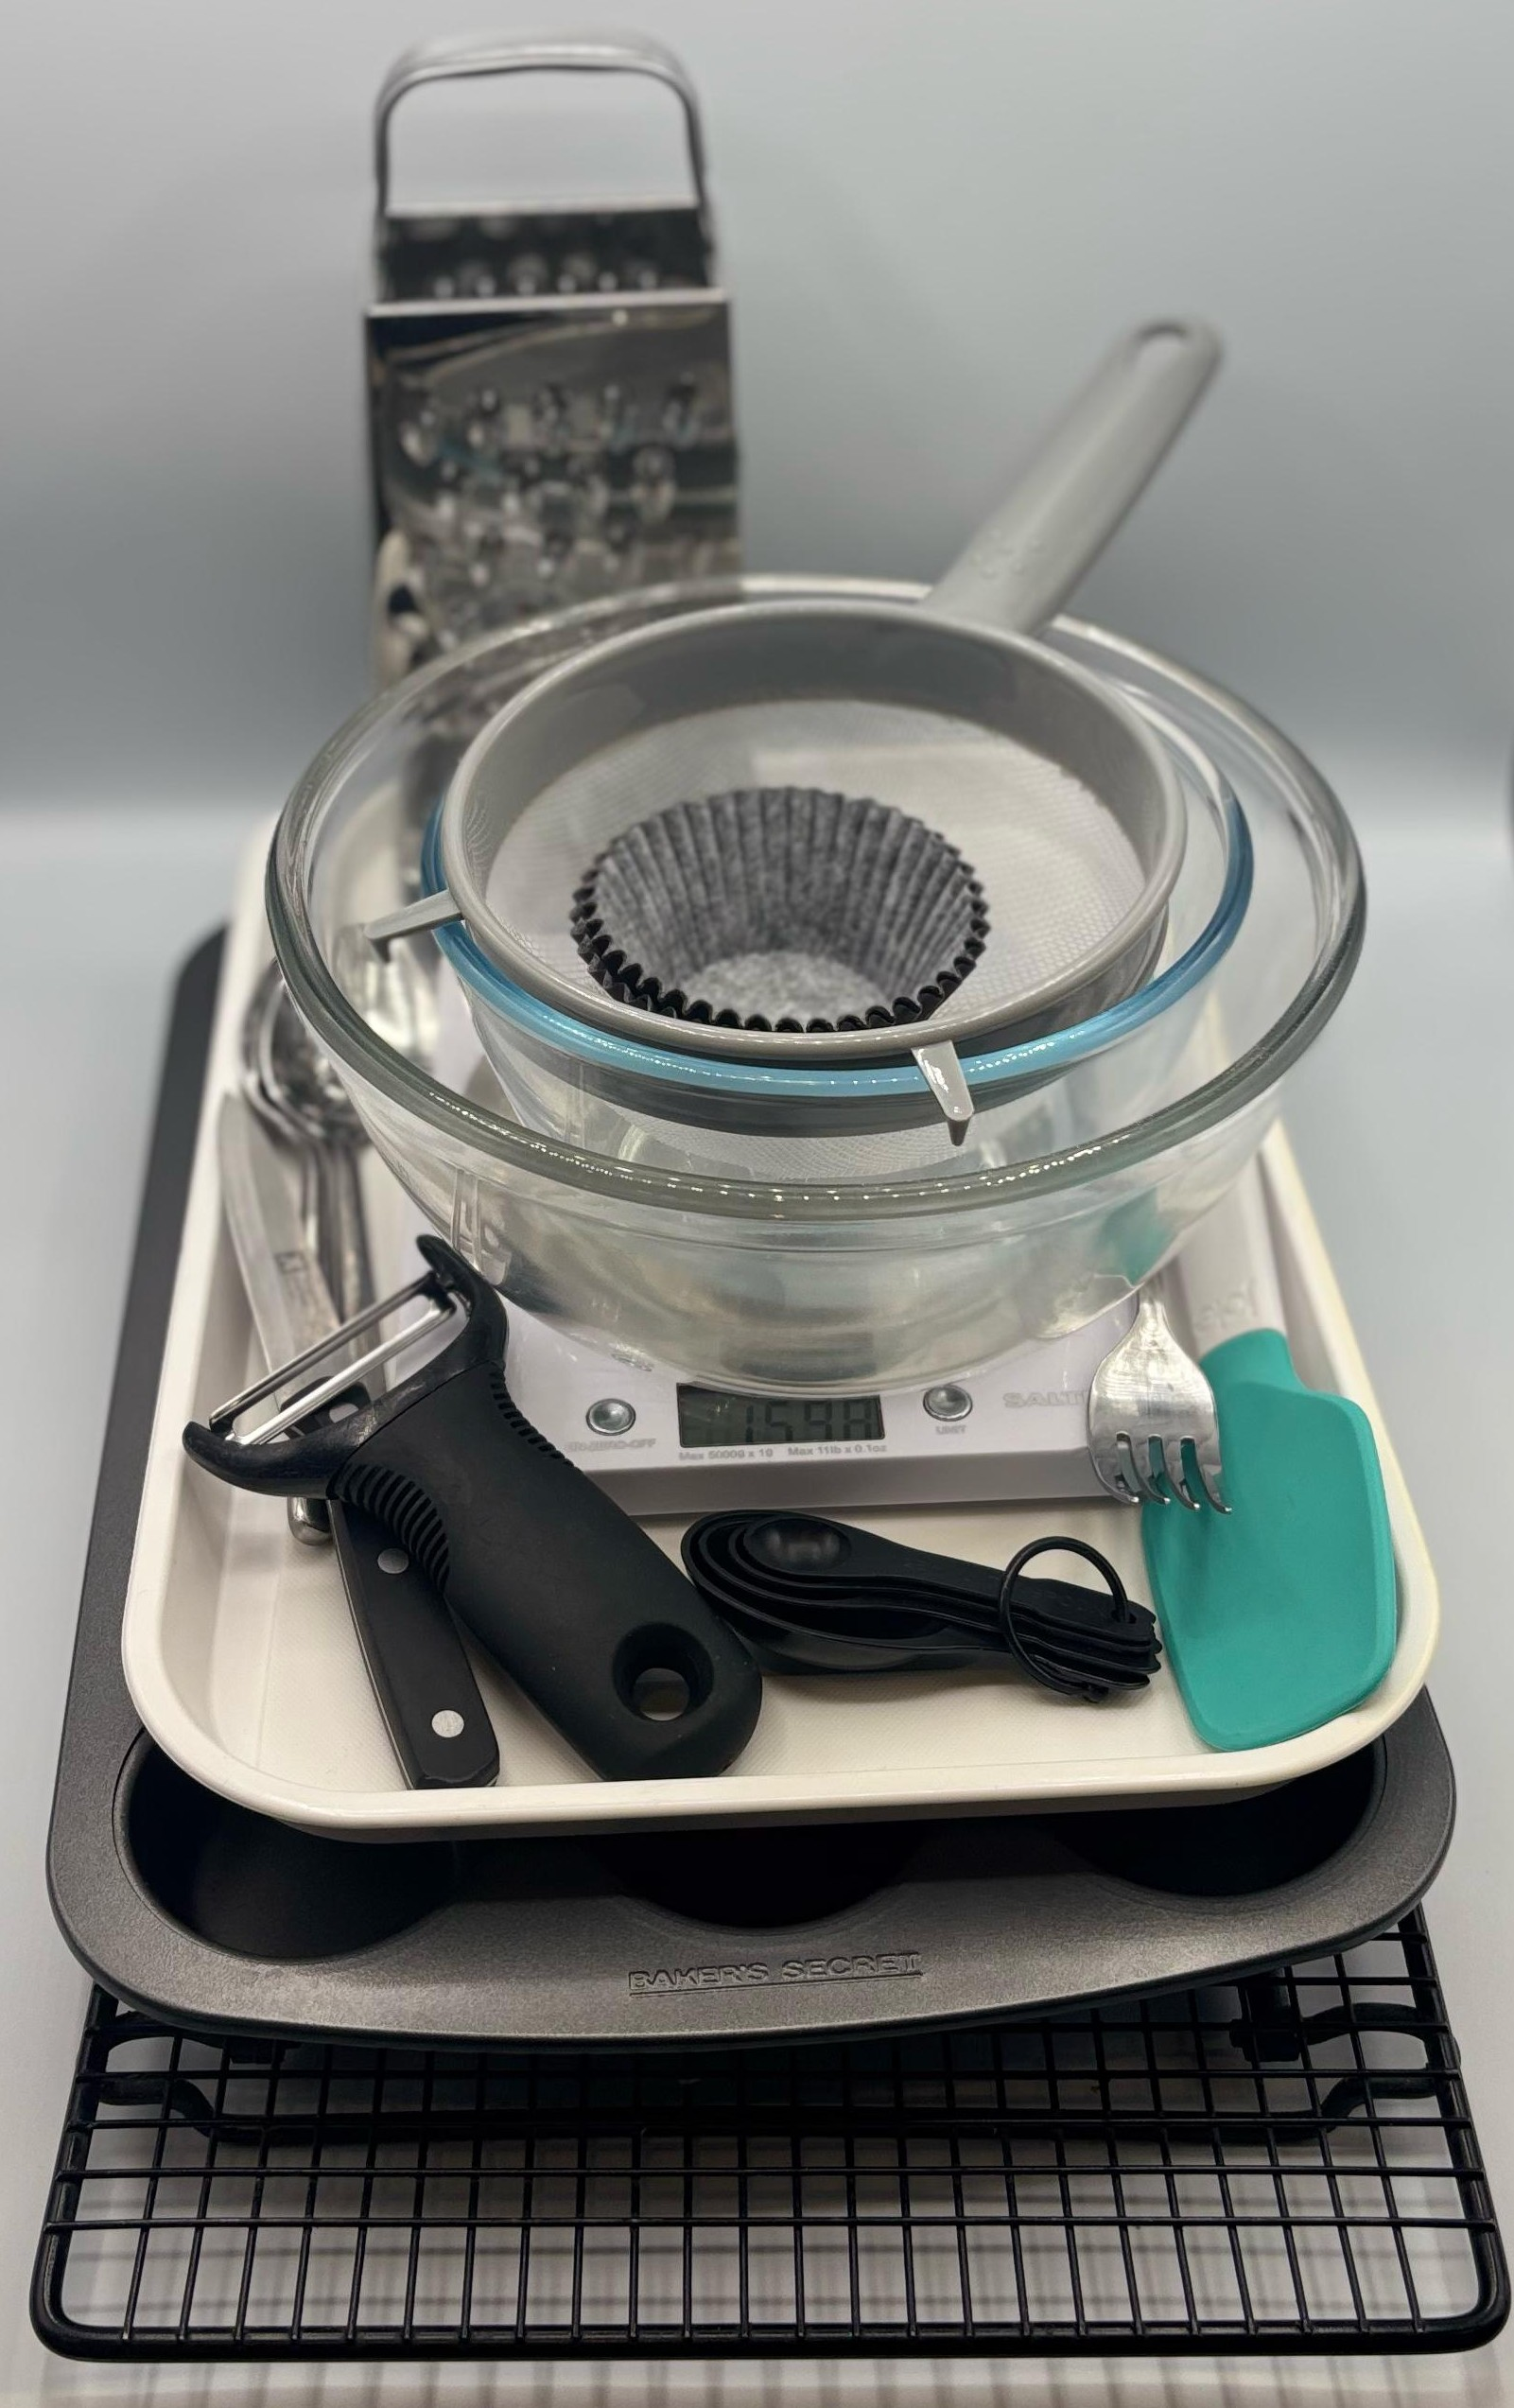
Equipment
Muffin tray
12 muffin cases
Weighing scales
Chopping board
Vegetable peeler
Sharp knife
Grater
Measuring spoons
Small bowl
Mixing bowl
Mixing spoon
Sieve
2 metal spoons
Fork
Cooling rack

Slide 7
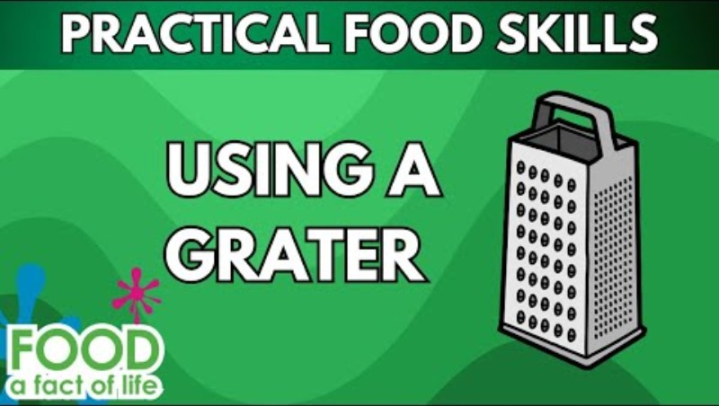
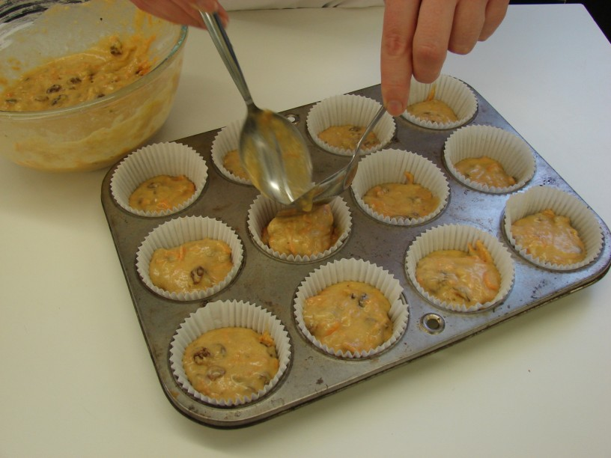
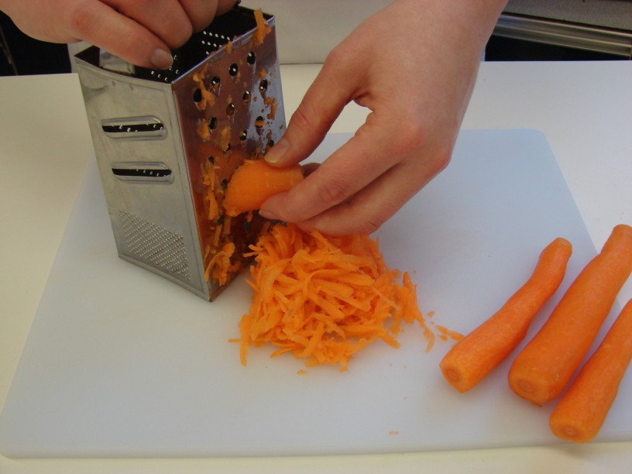
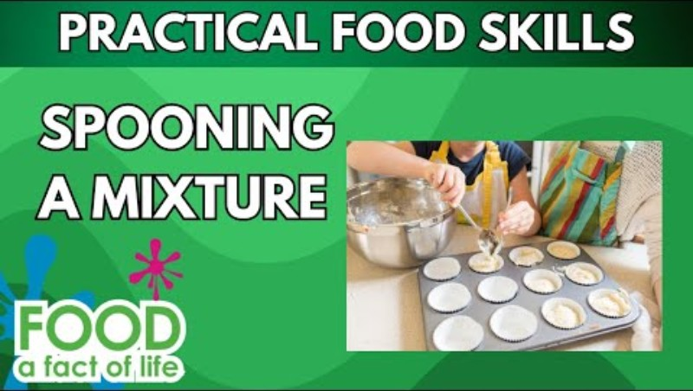
Food skills
Click below to see how to use a grater safely
Mix
Stir and combine
Sift
Portion/divide
Bake
Weigh
Measure
Melt
Peel
Cut
Dice and trim
Grate
Click below to see how to spoon a mixture

Slide 8
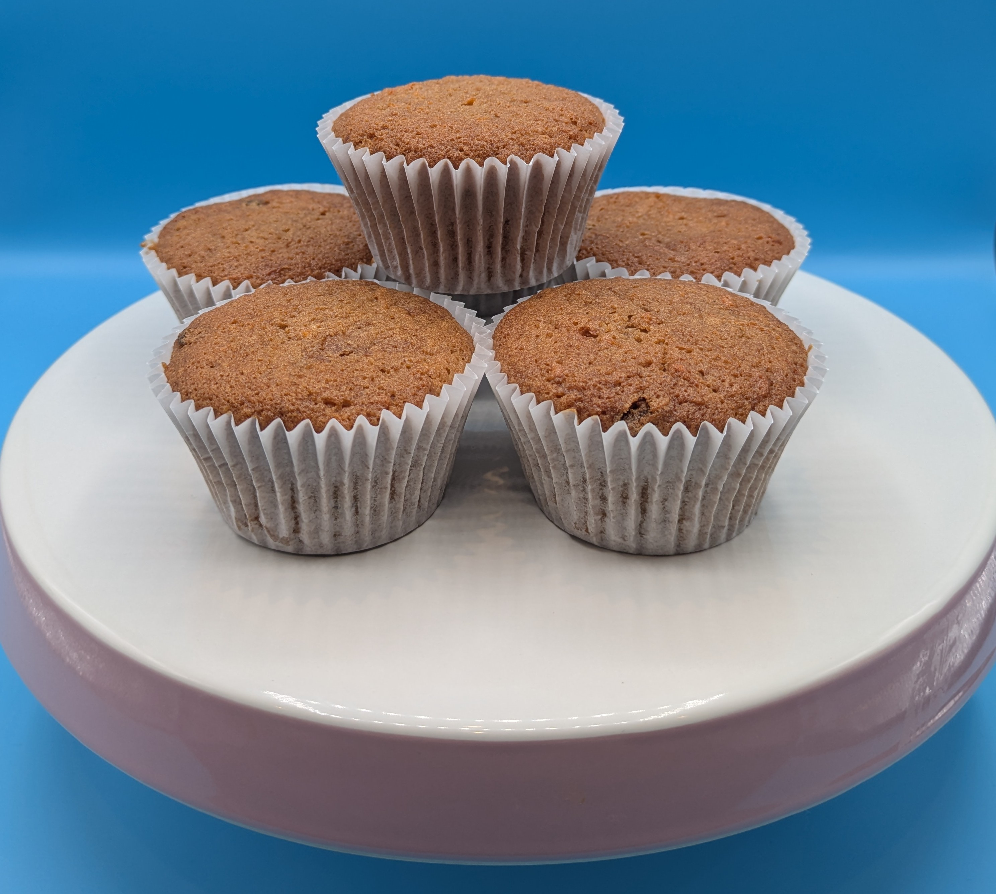
Method
Preheat oven to 200°C or gas mark 6.
Place the muffin cases in the muffin tin.
Melt the fat in the microwave or in a small saucepan.
Peel, top and tail, and grate the carrots.
Combine the grated carrots, sugar and melted fat in the mixing bowl.
Sift in the flour, cinnamon and baking powder.
Beat the eggs in a small bowl and then add to the mixture.
Mix in the sultanas and nuts (optional).
Mix all the ingredients together to form a smooth batter.
Divide the mixture equally between the muffin cases using 2 spoons.
Bake for 20 minutes, until golden.
Allow to cool on a cooling rack.

Slide 9
Food science
Dextrinisation
When the starch turns to dextrin under the application of dry heat and causes the cake to golden brown.
Coagulation
When the eggs (protein) coagulate and set forming the structure of the traybake.

Slide 10
Top tips
Focus on fibre: Replace the white flour with 100g wholemeal flour.
Reduce food waste: Add leftover canned pineapple or grated apple.
Serving suggestion: Combine 50g reduced-fat cream cheese and 25g of icing sugar for a cream cheese topping. Place on top of the mini carrot cakes once they have cooled.

Slide 11
Plenary
Explain why it is important to thoroughly wash and dry hands after touching raw egg.
Explain why the egg is cracked into a separate bowl.
Name five different ingredients that could be added to the cake mixture.
Identify the main functions of the ingredients used.
Name the ingredient that made the cakes rise.

Slide 12
Example responses
Explain why the egg is cracked into a separate bowl.
To make sure no egg shell gets into the mixture, also to make sure the egg is fresh.
Identify the main functions of the ingredients used.
Egg: structure.
Flour: structure, colour.
Baking powder: raising agent.
Sugar: flavour, colour.
Fat: flavour, colour, improve keeping quality.
Carrots: flavour, texture, colour, add moisture.
Name the ingredient that made the cakes rise
Baking powder.

Slide 13
Example response
Explain why it is important to thoroughly wash and dry hands after touching raw egg.
To remove any bacteria and prevent cross-contamination.
Name five different ingredients that could be added to the cake mixture.
Coconut, grated apple, pineapple, nuts (be allergy aware), dried fruit.

Slide 14
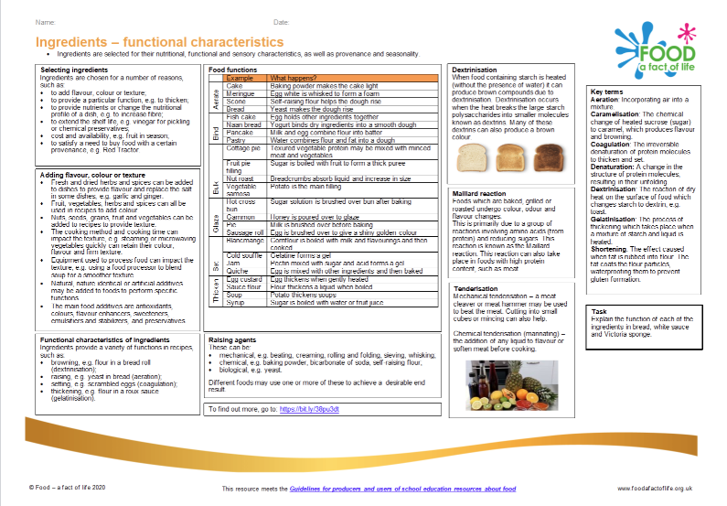
Looking for more…
Use this recipe as an opportunity to extend your pupils learning with our ingredients- functional characteristics knowledge organiser.
For a different cake making method, why not try the Dutch apple cake in this lesson from the Food – a fact of life Schemes of Work?

Slide 15
Mini carrot cakes
For further information, go to:
www.foodafactoflife.org.uk
This resource meets the Guidelines for producers and users of school education resources about food.

