Slide 1
World food

Slide 2
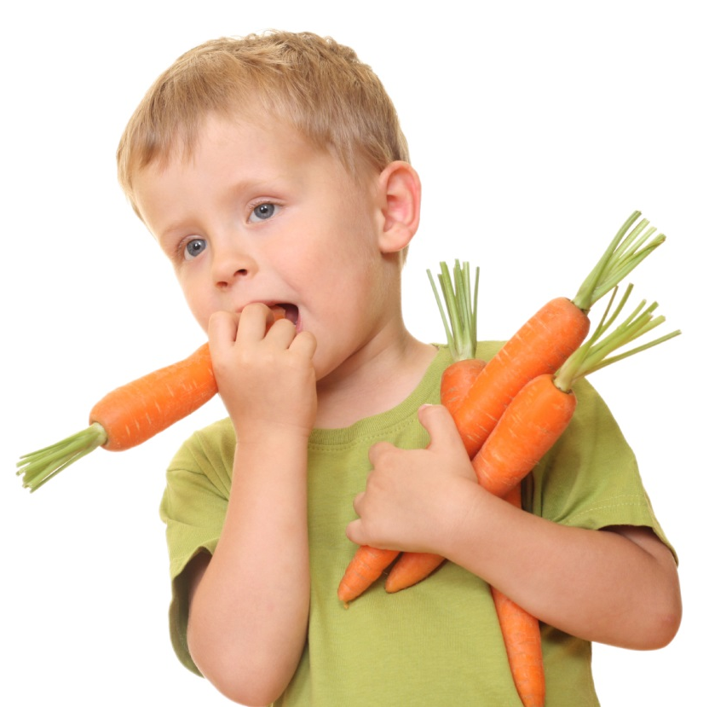
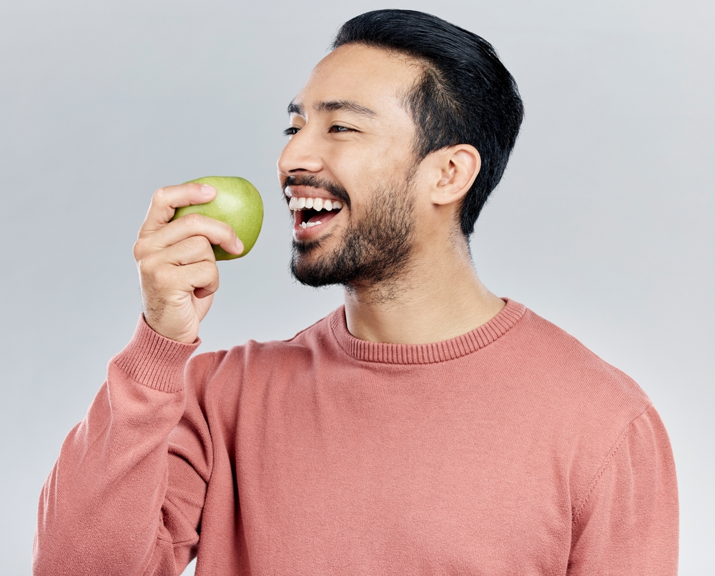
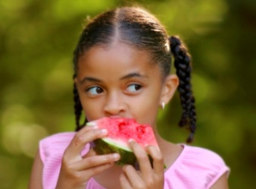
People eat and drink food in lots of different ways. Sometimes we eat with our hands:

Slide 3
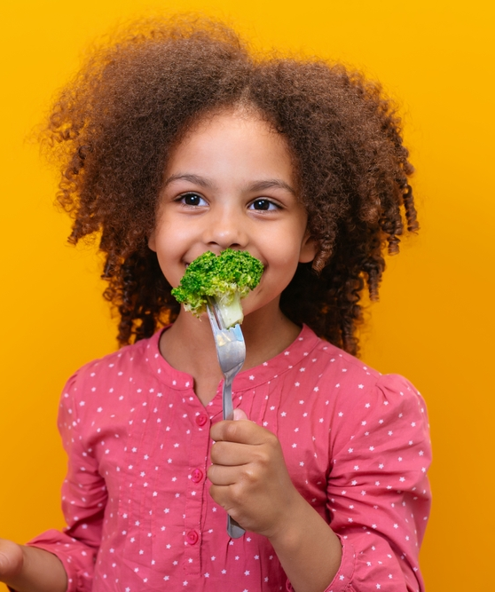
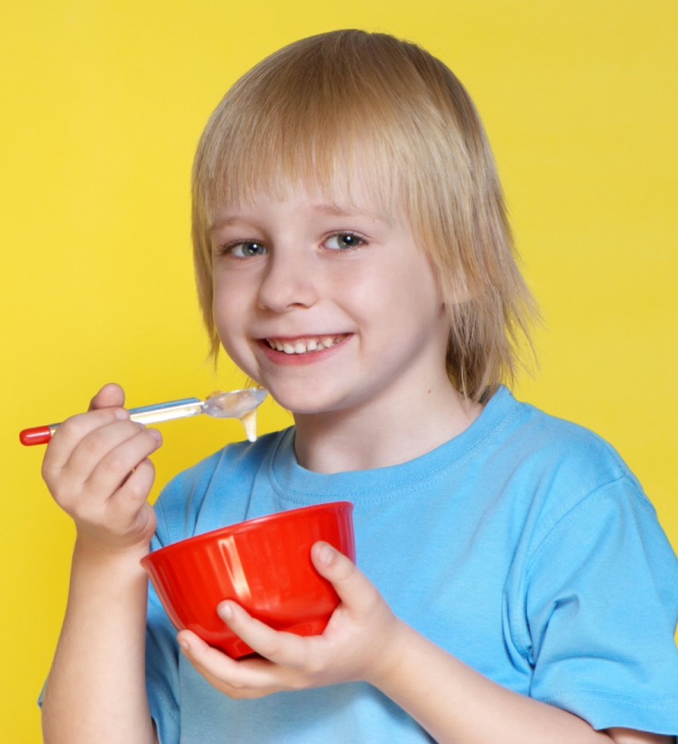
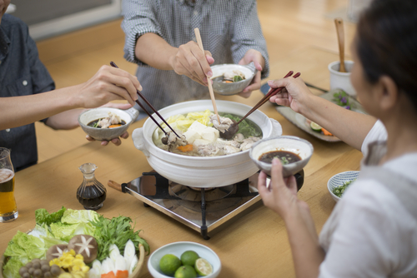
Sometimes we eat with cutlery or chopsticks:

Slide 4
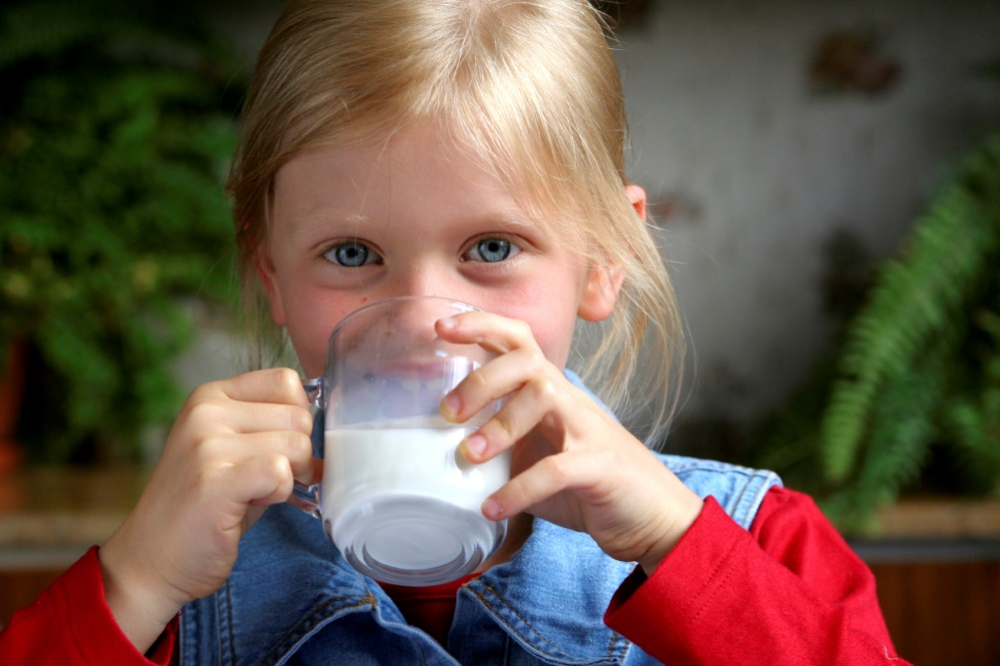
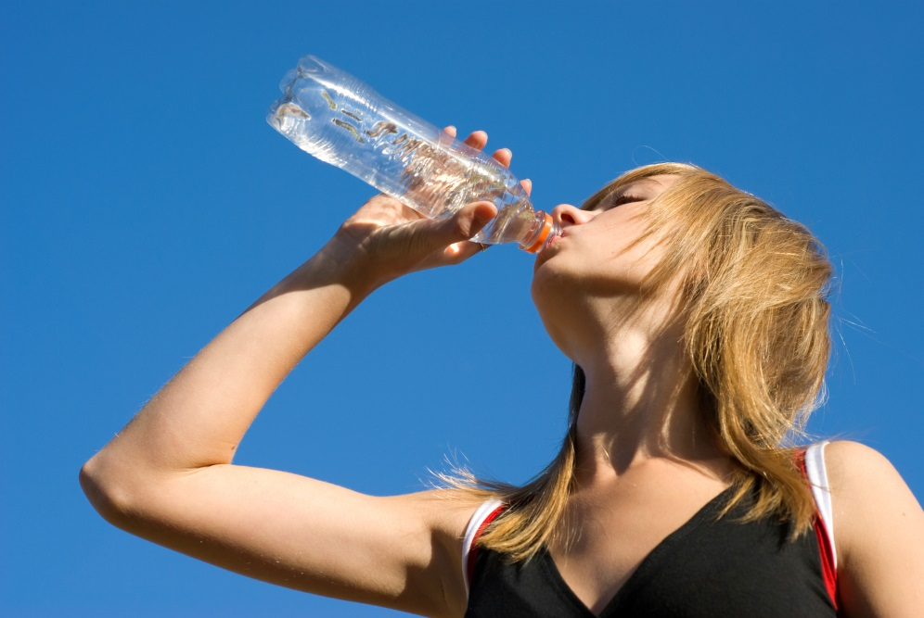
Sometimes we drink in different ways:

Slide 5
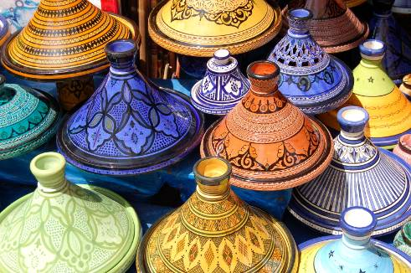
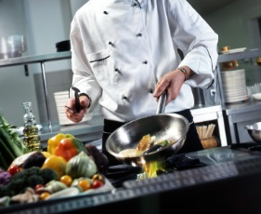
Around the world, food is prepared and cooked in lots of different ways, using different equipment.

Slide 6
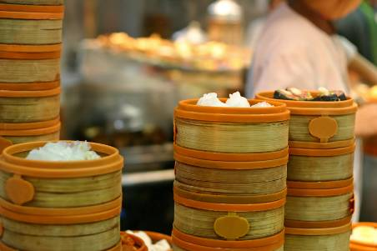
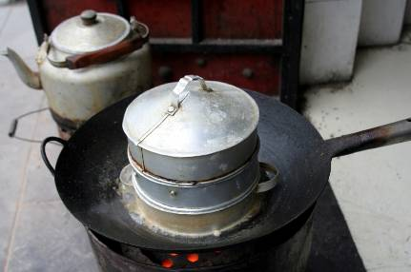
Food can be steamed …
dim sum
vegetables
fish
potatoes

Slide 7
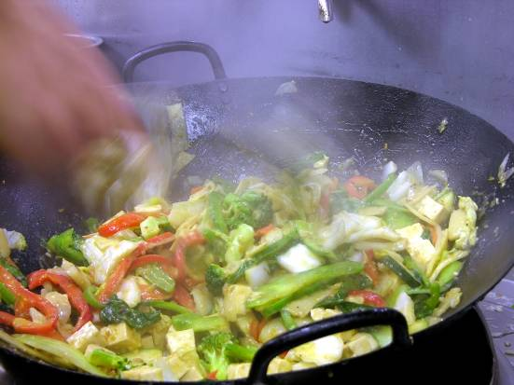
Food can be stir-fried …
vegetables
noodles
rice
prawns
meat

Slide 8
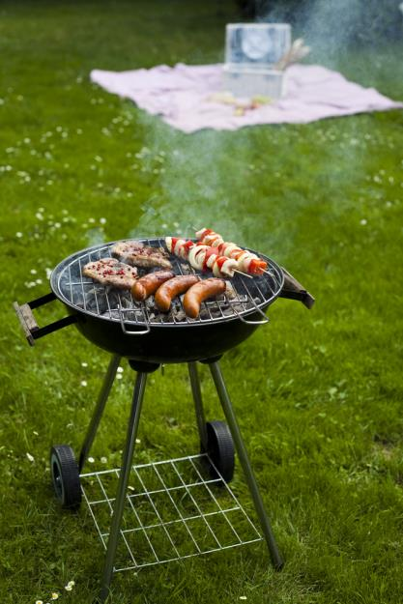
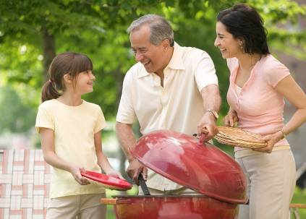
Food can be barbequed …
sweetcorn
fish
meat
vegetables

Slide 9
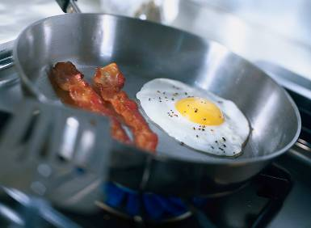
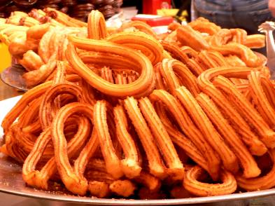
Food can be fried …
chips
chourros
eggs
tempura

Slide 10
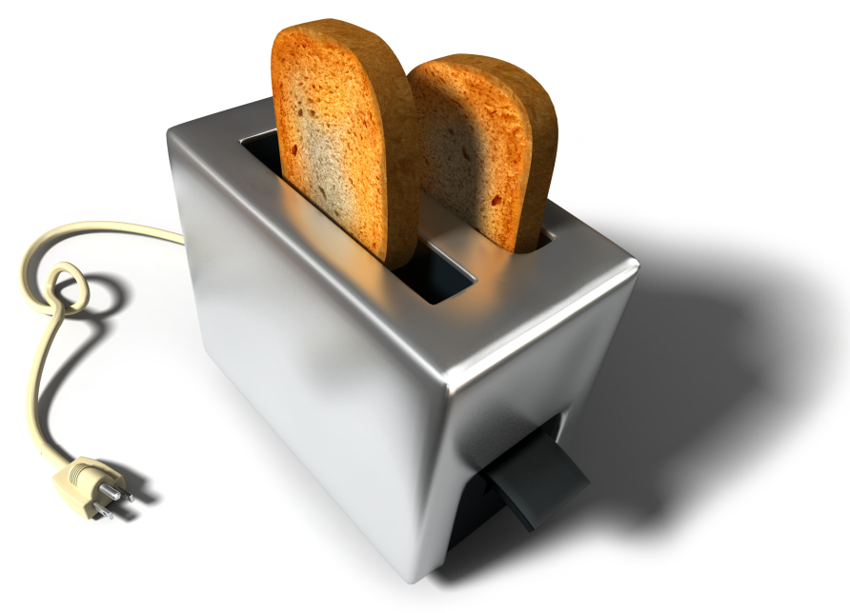
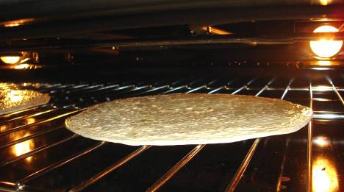
Food can be grilled …
bacon
bread
fish
tomatoes

Slide 11
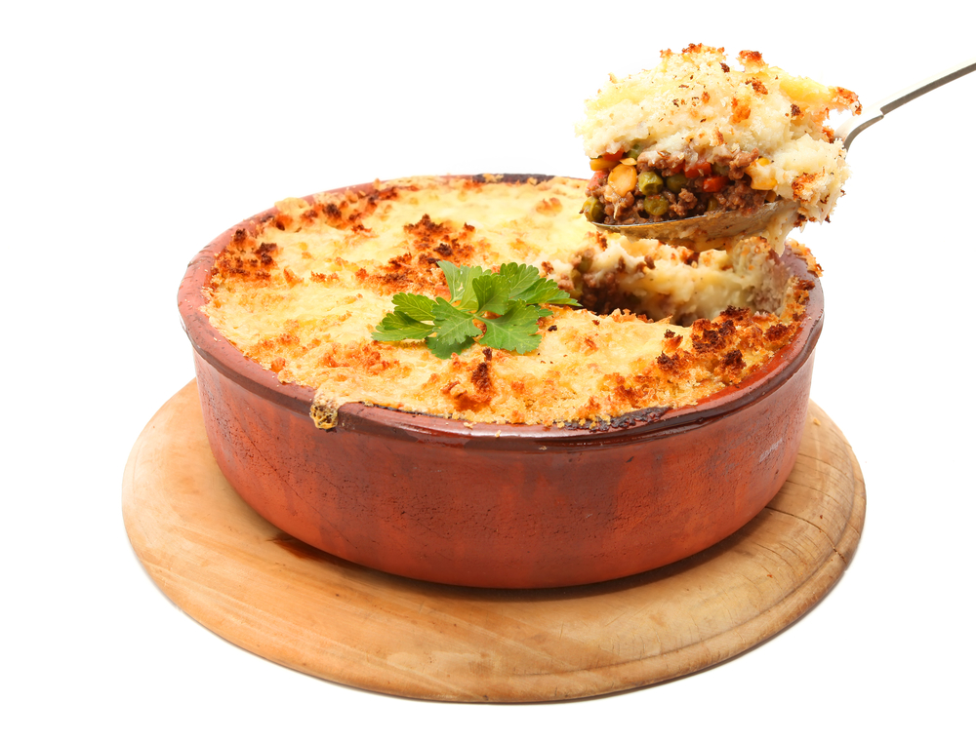
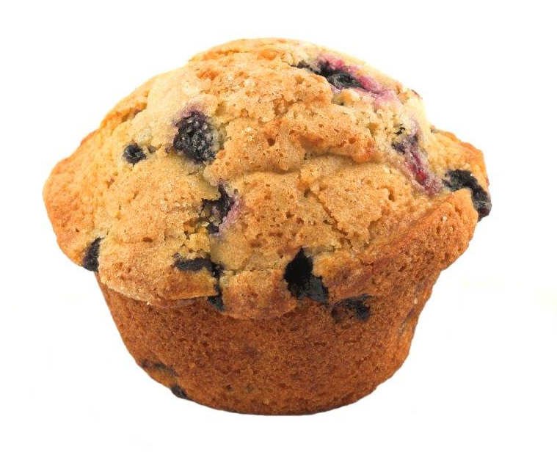
Food can be baked …
cake / muffin
pie
tandoori chicken
fish cakes

Slide 12
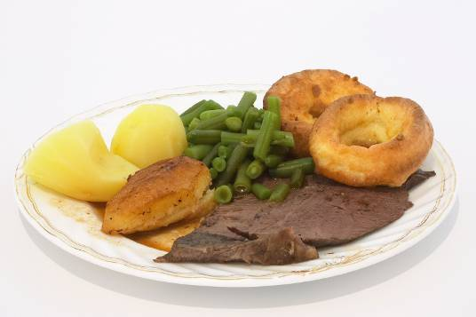
Food can be roasted …
beef
Yorkshire pudding
potatoes
vegetables

Slide 13
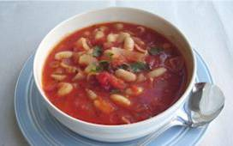
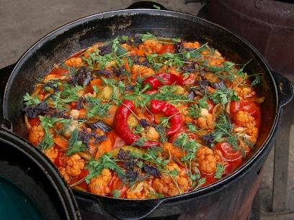
Food can be simmered …
soup
casserole
dumplings
curry

Slide 14
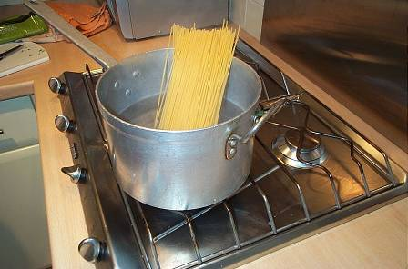
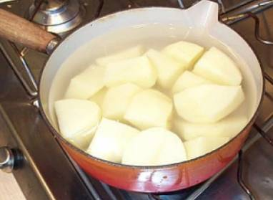
Food can be boiled …
pasta
rice
potatoes
cassava

Slide 15
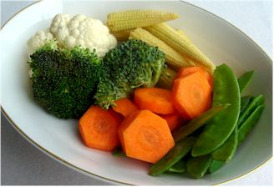
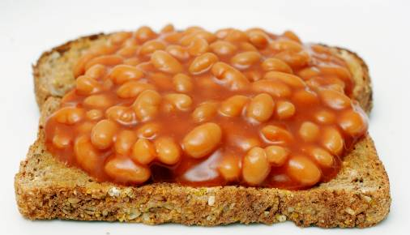
Food can be microwaved …
baked beans
vegetables
fish
potatoes

Slide 16
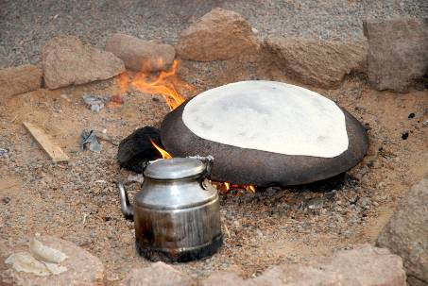
Food can be cooked by …
a hot stone (flat bread)

Slide 17
World food
For further information, go to:
www.foodafactoflife.org.uk
This resource meets the Guidelines for producers and users of school education resources about food.

