Slide 1
Practical food skills and recipes masterclass – cheese making
15/09/2021

Slide 2
Covered in today’s webinar
Traditional cheese making at Quicke’s farm in Devon.
Each of the stages of making cheese.
The factors that are important and influence the taste of the finished cheese.
Simple steps to making soft cheese in the classroom.
Links to Food – a fact of life.
Suggestions for sources of information.

Slide 3
Video
You will find videos on cheese making in the dairy and a demonstration of making mozzarella in the classroom here:
https://www.foodafactoflife.org.uk/professional-development/teaching-and-learning/teacher-knowledge-and-skills/food-science-and-cooking/

Slide 4
Cheese making in the classroom - mozzarella
Ingredients
2.5g citric acid
60ml warm water
1litre unhomogenised milk
1.25g rennet
15g salt
Leave the milk to stand off the heat for 5-10 minutes. The curds will separate from the whey.
Carefully scoop the curds from the pan using a slotted spoon and place them in a sieve over a bowl. Leave the whey in the pan.
Add salt to the whey and heat to 80C.
Put the gloves on. Divide the curds into three balls then dip one ball into the hot whey on a slotted spoon until it is warmed through, then gently stretch the ball or fold it back on itself. Keep doing this until it becomes stretchy and glossy. Don’t overwork it.
Mould and reshape the cheese into a ball.
Repeat for the remaining mozzarella.
Store in a bowl of chilled whey, refrigerate and use within 2 days.
Equipment
Measuring spoons, measuring jug, 1 x small mixing bowl, large saucepan, mixing spoon, temperature probe, slotted spoon, large bowl, sieve, thick rubber gloves.
Method
Dissolve 2.5g citric acid in 60ml warm water.
Pour milk into saucepan, heat gently to about 13°C.
Add the dissolved citric acid to the warm milk increasing heat to 30°C, stirring gently - it will start to curdle. Remove from the heat.
Add 1.25g rennet to the milk. Stir for 30 seconds - no more.

Slide 5
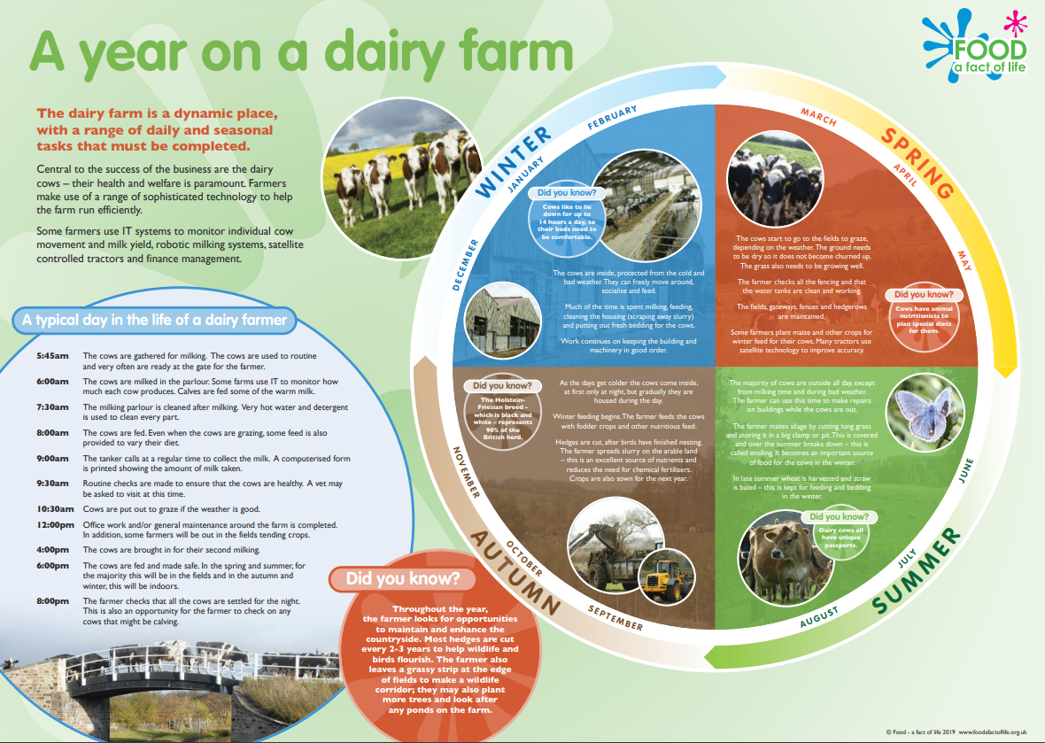
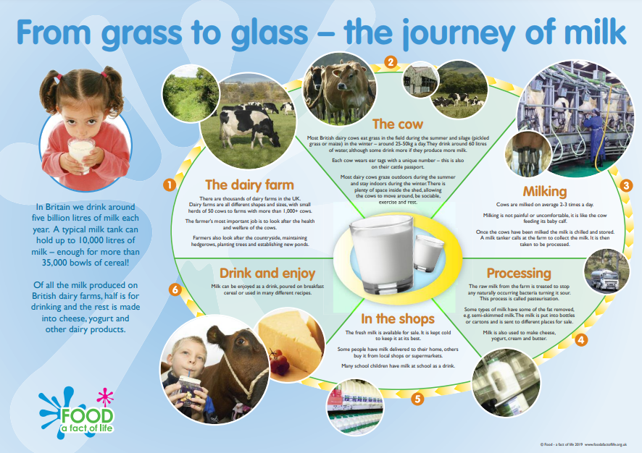
Resources
11-14 and 14-16 dairy resources
Milk processing presentation, worksheet and answers
Milk journey cards
Cheese production presentation, worksheet and answers
Nutritional composition of milk, cheese and yogurt
Cheese tasting worksheet
Cheese making video
Dairy posters
Rank cheese in order of fat per 100g activity

Slide 6
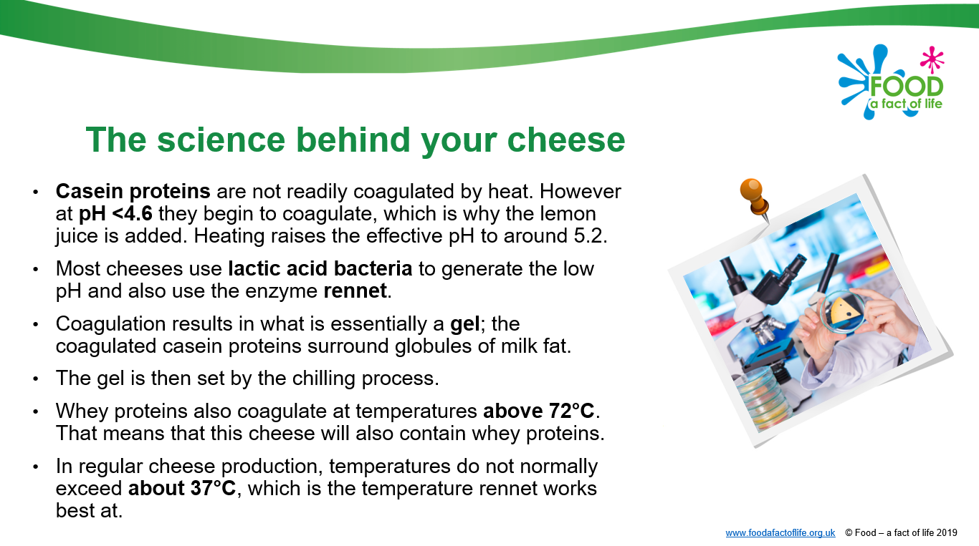
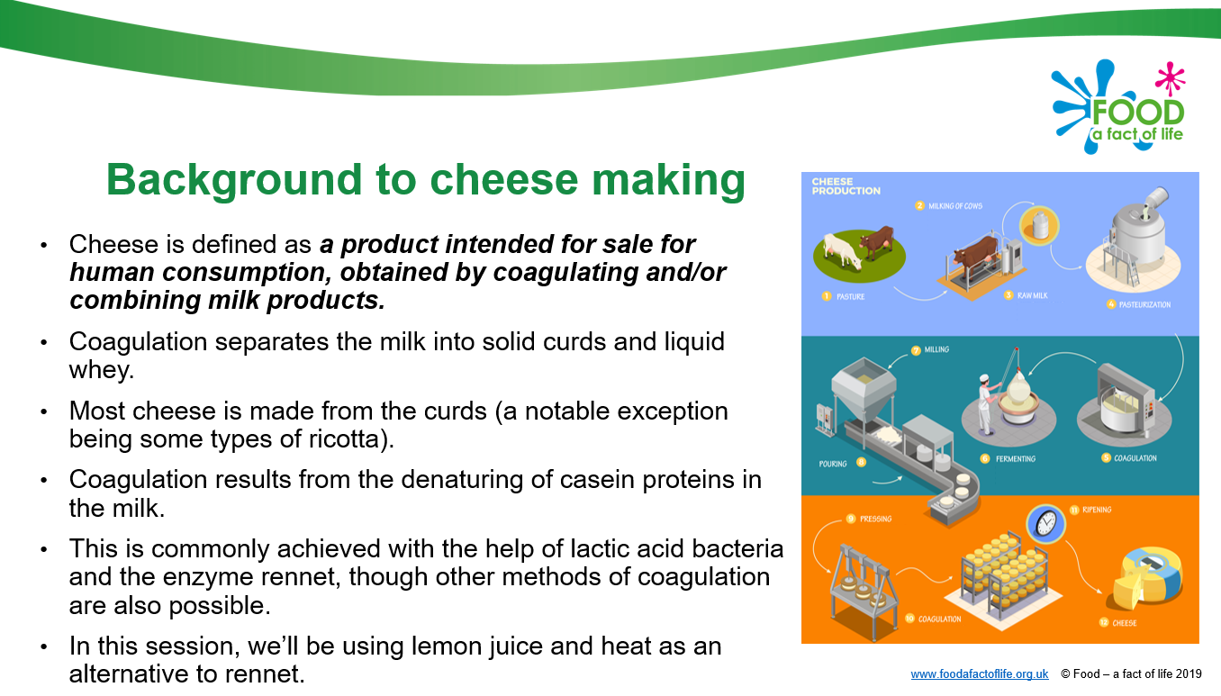
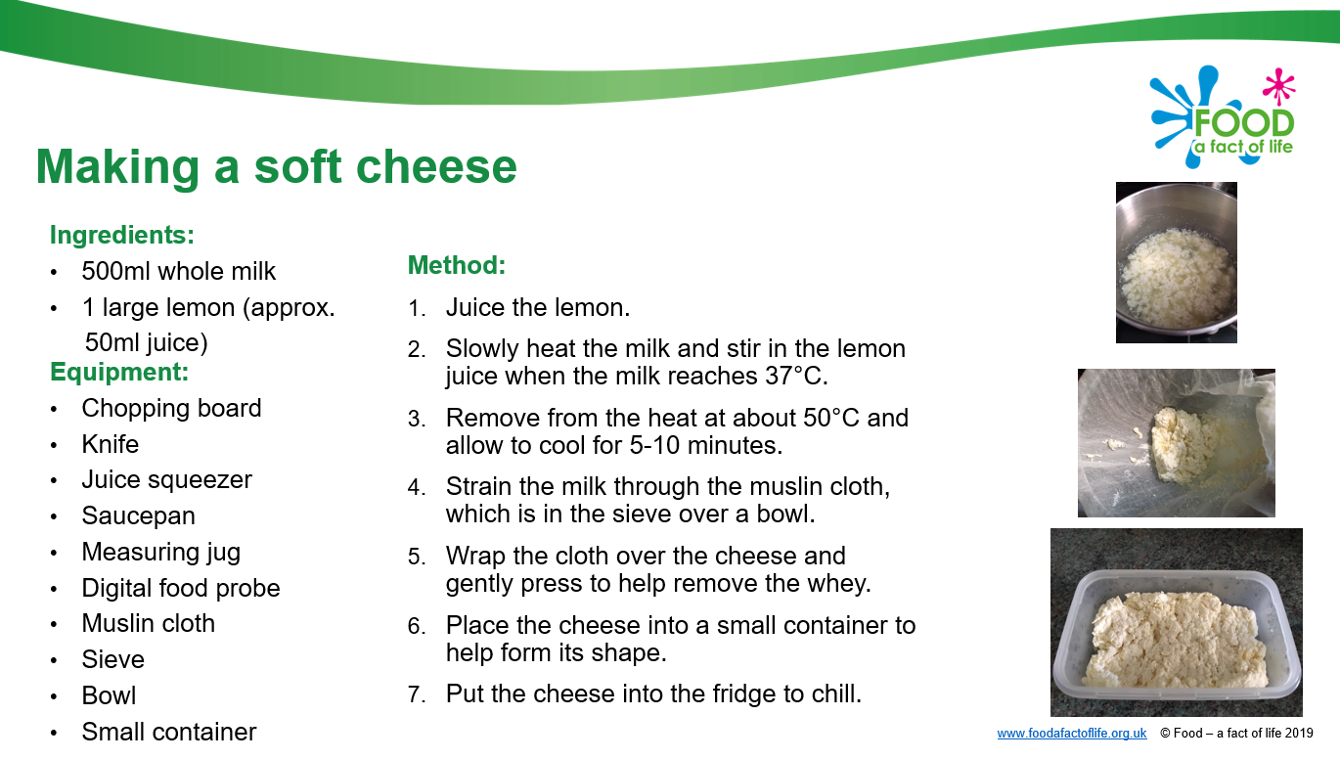
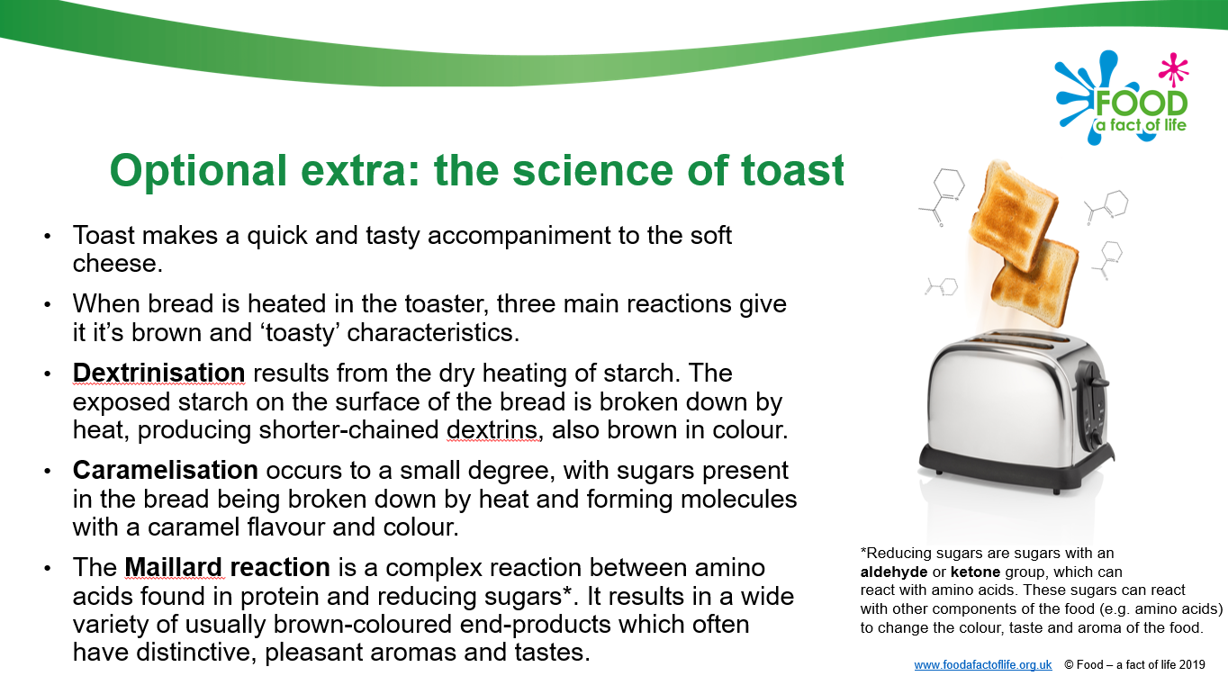
Resources – cheese making in the classroom
Cheese making presentation

Slide 7
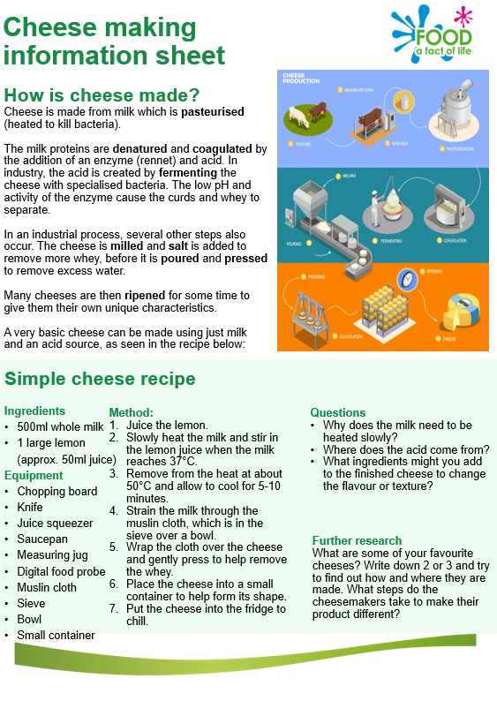
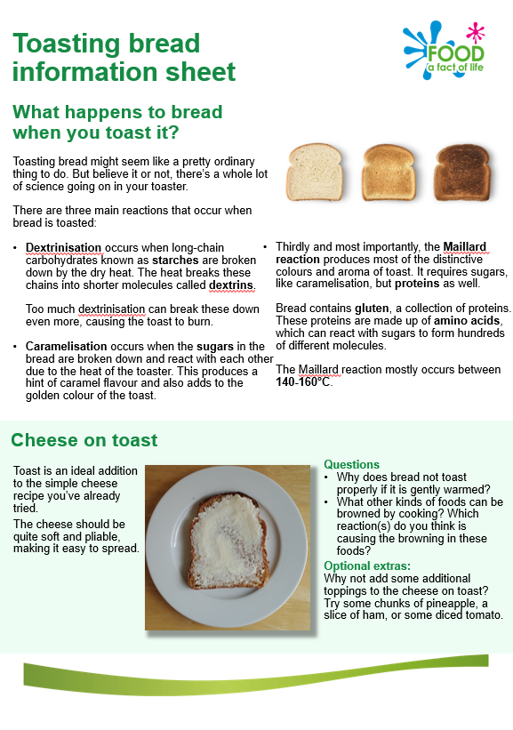
Resources – cheese making in the classroom
Cheese making information sheet

Slide 8
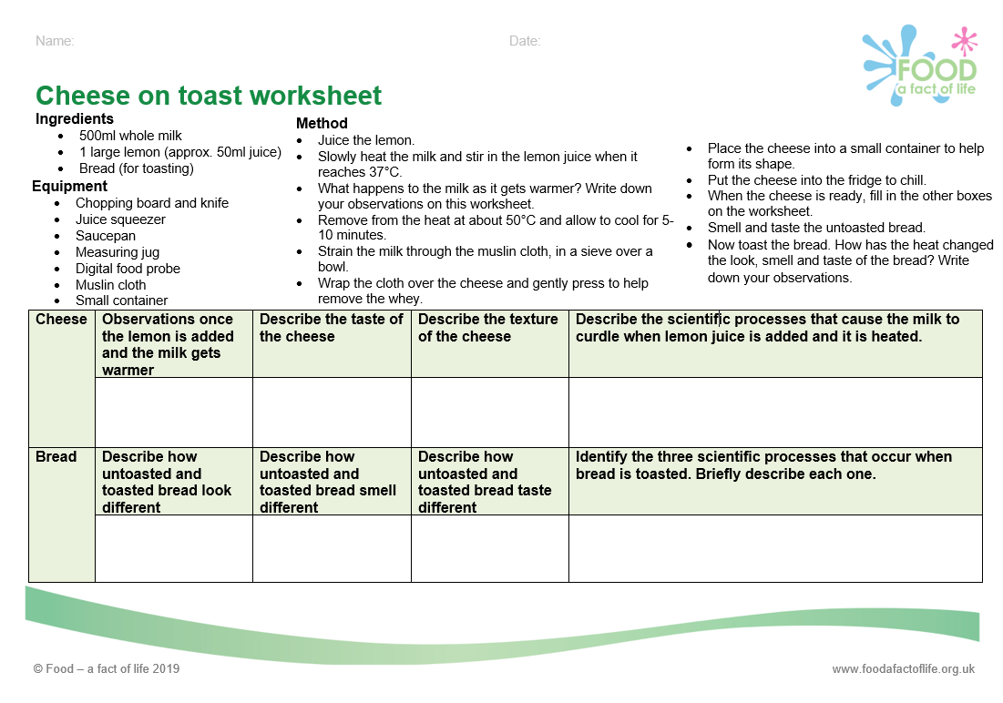
Resources – cheese making in the classroom
Cheese on toast worksheet

Slide 9
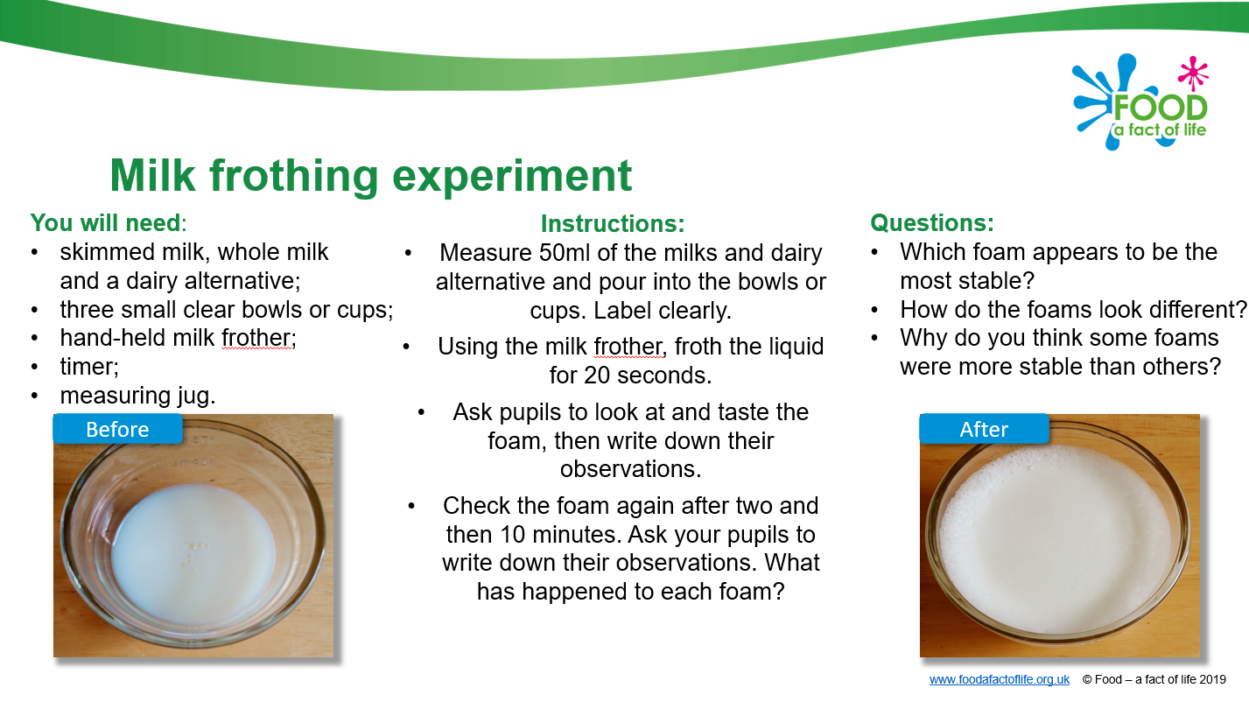
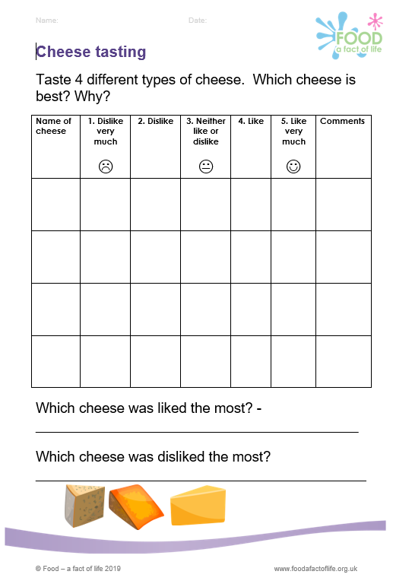
Other resources and sources of information
Simple food investigation
Milk frothing
Recipes
Recipes using cheese
Support for primary colleagues
5-7 and 7-11 dairy resources
Cheese tasting worksheet
Cheese tasting worksheet – using your senses
Further information
AHDB Dairy
Dairy UK

Slide 10
Practical food skills and recipes masterclass – cheese making
For further information, go to:
www.foodafactoflife.org.uk

