Slide 1
Freezing and dehydration

Slide 2
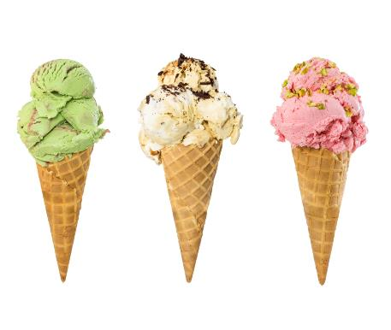
Freezing
There are different methods of commercial freezing available, but they are all based on two principles.
1) Very low temperatures inhibit growth of micro-organisms and limit enzyme and chemical activity.
2) The formation of ice crystals draws available water from the food, also preventing growth of micro-organisms.
Other products also acquire desirable characteristics when frozen, and are made to be eaten straight from the freezer (e.g. ice cream).

Slide 3
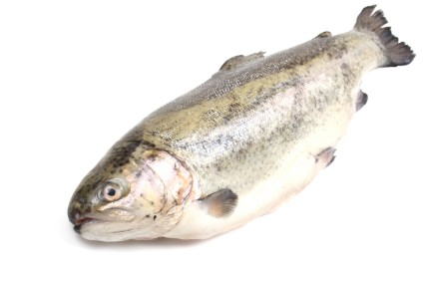
Immersion freezing
Traditionally food was immersed in solutions of salt and ice for several hours, e.g. brine, freezing of fish at sea.
However, modern methods of freezing have meant that this process is rarely used in industry. Refrigerants are now sprayed directly onto the food.

Slide 4
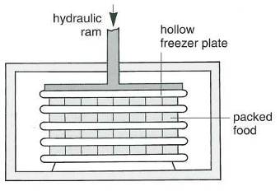
Plate freezing
The food is prepared as normal, then packed between flat, hollow, cold metal plates.
These are adjusted to press tightly on the food and reduce any air gaps. The plates may be horizontal or vertical, the latter being used for many bulky products, such as blocks of fish for fish fingers.
This system is ideal for freezing large blocks of product, but cannot easily freeze irregular shaped items.

Slide 5
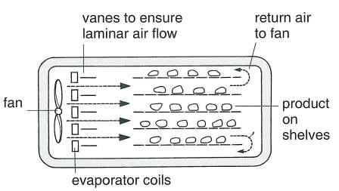
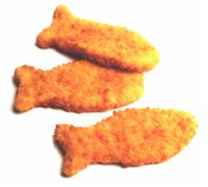
Blast freezing
Batches of food are subjected to a constant, steady stream of cold air (-40ºC or lower) in a tunnel or large cabinet.
This process can freeze irregular shaped foods, including those which have already been packaged, e.g. battered fish pieces.

Slide 6
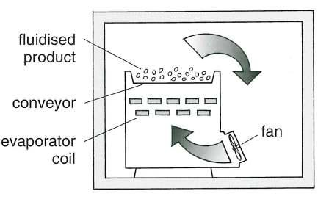
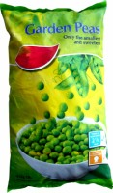
Fluidised bed freezing
Vertical jets of refrigerated air are blown up through the product, causing it to float and remain separated. This is a continuous process which takes up to 10 minutes. The product, e.g. peas, beans, chopped vegetables or prawns, move along a conveyor belt.

Slide 7
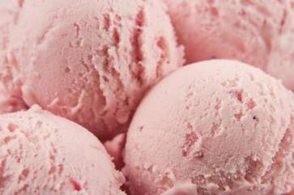
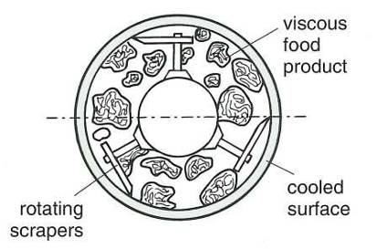
Scraped heat exchangers
Products are frozen using this method in order to stir and freeze simultaneously, such as ice cream. It reduces large ice crystal formation, producing a smooth end product.

Slide 8
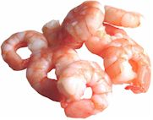
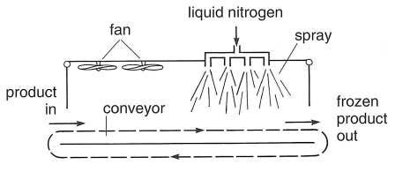
Cryogenic freezing
Liquid nitrogen or carbon dioxide is sprayed directly onto small food items such as soft fruit and prawns. Due to the liquids’ extremely low temperatures (nitrogen -196ºC, carbon dioxide -78ºC) freezing is almost instant. The nitrogen gas produced is removed by fans. Carbon dioxide is used for larger products. The carbon dioxide system is more economical and the gas can be recycled into the system.

Slide 9
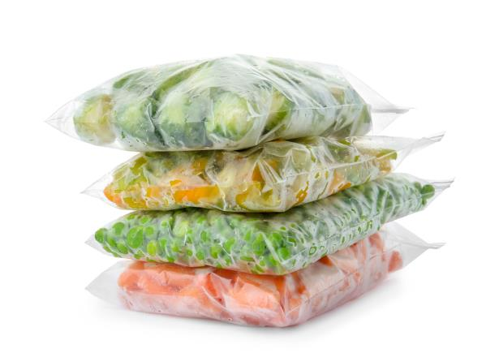
Benefits of rapid freezing
Rapid freezing produces small ice crystals which reduce the amount of ‘drip’ on thawing, as smaller ice crystals cause less damage to the structure of the food.

Slide 10
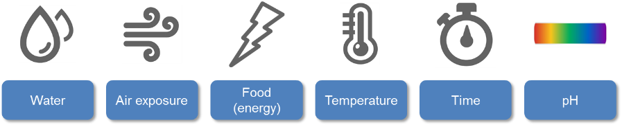
Dehydration
Microorganisms need water in order to grow and reproduce.
When moisture is removed from food, it does not kill the microbes but it can limit their growth.
Dehydration reduces the water activity level, weight and bulk of the food and helps to preserve the product.
Water is one of the key conditions microorganisms need to grow.

Slide 11
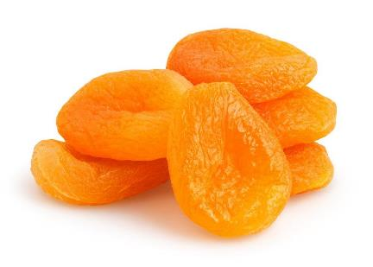
Dehydration
There are six main dehydration techniques, each method being suitable for a different range of foods. The main principle behind each method is the same – the removal of moisture to prevent microbial activity.
Many products such as vegetables are diced before drying, to increase their surface area and make water loss much more rapid.
Blanching may be necessary to inactivate enzymes which cause browning.

Slide 12
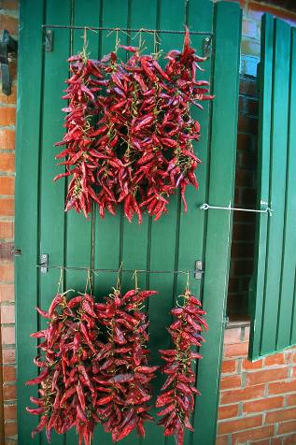
Sun drying
This is a traditional method of drying. It is slow and only practical in hot, dry climates. However, it is still used today e.g. sun dried chillies, raisins or tomatoes.
Sun-dried food is also vulnerable to contamination through pollution and vermin (e.g. rodents and flies), particularly foods like fish.

Slide 13
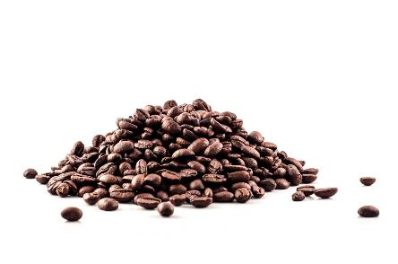
Spray drying
This method is suitable for producing products such as dried milk and coffee powder. A fine spray of liquid is injected into a blast of hot air in a chamber.
Water evaporates within seconds, leaving the solid part of the product behind in powdered form. Usually this powder is too fine to disperse in water, so a little moisture is added to make it ‘clump’ together into larger particles.
This improves the wettability of the product and helps it dissolve more fully when added to water. Fluidised bed drying is used to granulate these powders.

Slide 14
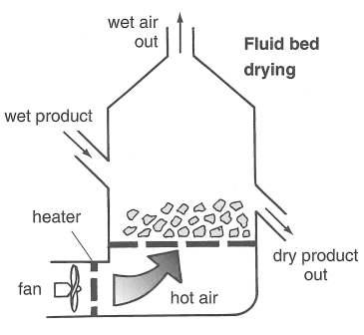
Fluidised bed drying
Warm air is blown upwards directly underneath the food, causing it to flow and remain separated. This procedure is suitable for small items such as peas and coffee beans.

Slide 15
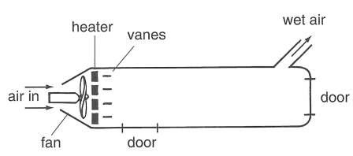
Tunnel drying
Hot air is blown over the product (e.g. vegetables). The concurrent system (air blown the same way as the product moves) dries the food rapidly with little shrinkage, but leaves a relatively high moisture content.
The counter-current system (air blown in the opposite direction to the product’s movement) is slower, but produces a product with a low moisture level.
A disadvantage of this process is that the product tends to shrink and is less easy to rehydrate.

Slide 16
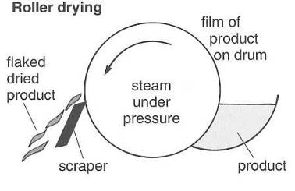
Roller drying
The food product, in a liquid or paste form, is uniformly spread over heated rollers or drums which rotate slowly.
The heat causes the moisture to evaporate, leaving a dried product behind.
A scraper then removes this for use. This method is suitable for instant mashed potato and baby foods.

Slide 17
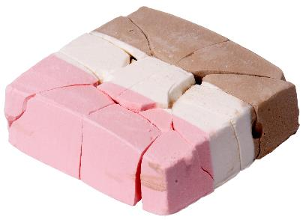
Accelerated freeze drying
This method produces an excellent quality dried product, but is both expensive and time consuming. It is often used for luxury items, such as coffee and certain fruits.
First, the product is frozen. Then the temperature is increased under a strong vacuum.
This makes the frozen water sublime (turn from a solid to a gas instantly). This process involves little or no heating, so there is little shrinkage or flavour change and the product rehydrates well. The product, however, is very fragile and crumbles easily.
Freeze-dried ice cream was originally designed for astronauts to take to space as it does not require cold storage.

Slide 18
Freezing and dehydration
For further information, go to:
www.foodafactoflife.org.uk
This resource meets the Guidelines for producers and users of school education resources about food.

